Slide 1
FUNDAMENTALS OF PYTHON
Day-2 Concepts

Slide 2



Data Structures & Functions
Dictionary
Functions & Types
Types of Arguments
Key-value pairs; mutable, keys unique.
Reusable code blocks: built-in, user-defined, with/without args or return values.
Positional, keyword, default, and *args (variable-length).
student = {"name": "Rakshitha", "age": 22}
def add(a, b):
return a + b
def greet(name="Guest"):
print("Hello", name)

Slide 3





Built-in & Functional Tools
Common Built-in Functions
Lambda
Filter
Small anonymous function.
Keeps elements matching a condition.
print() — display output
input() — read user input
len() — length of a sequence
type() — data type of a value
int() / float() / str() — convert types
max() / min() / sum() — aggregate values
square = lambda x: x*x
filter(fn, iterable)
Map
Reduce
Applies a function to every element.
Reduces a list to a single value.
map(fn, iterable)
reduce(fn, iterable)

Slide 4



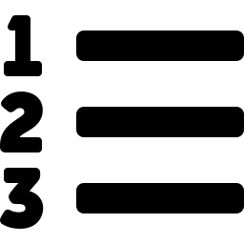
Advanced Function Concepts
Recursion
A function calls itself until a base condition is met.
factorial(5) → 120
Generators
Return values one at a time using yield instead of return.
yield 1; yield 2; yield 3
Decorators
Add extra behavior to a function without changing its code.
@decorator
Iterators
Access elements one by one using iter() and next().
it = iter([10,20,30])

Slide 5





Python Foundations
PEP 8 & LEGB
Modules
OOP Concepts
Style guide + variable lookup order: Local→Enclosing→Global→Built-in.
Reusable .py files; built-ins like math, random, os, sys, datetime.
Class, Object, Encapsulation, Inheritance, Polymorphism, Abstraction.
File Handling
PVM
Algorithms
open(), read(), write(), append(), close() manage files.
Python Virtual Machine executes compiled bytecode (.pyc).
Brute force, divide & conquer, greedy, dynamic programming, recursive.

