Slide 1
Structure-Based Docking and Active Site Analysis of EstB with Ester Substrates
Market Relevance
Pharmaceuticals: Esterases like EstB are used in prodrug activation and metabolic profiling.
Biotechnology: Enzyme engineering for industrial catalysis and biosensors.
Computational Biology: AI-driven tools like AlphaFold and AutoDock Vina are transforming protein-ligand interaction studies.

Slide 2
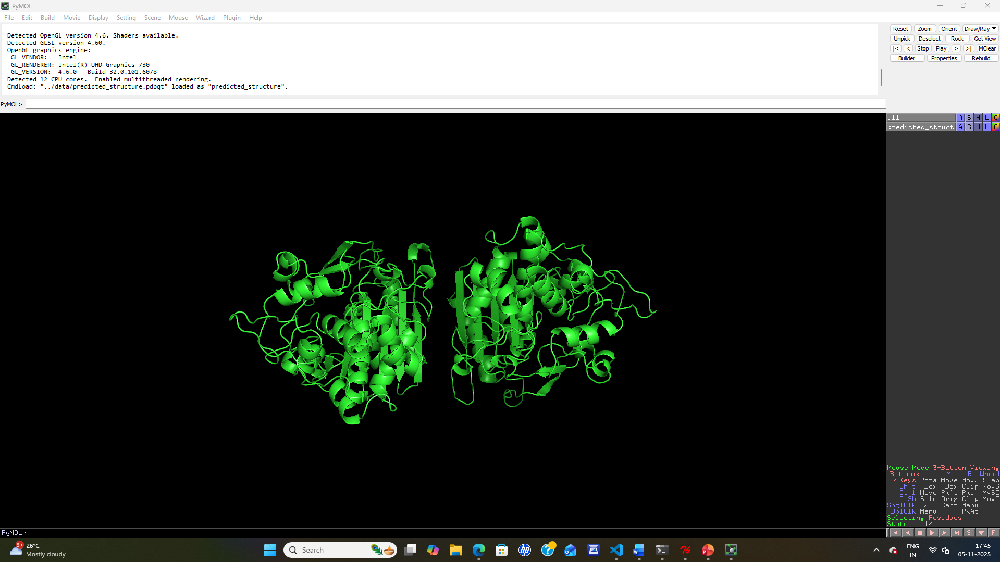
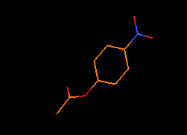
Esterase EstB and 4-Nitrophenyl Acetate

Slide 3
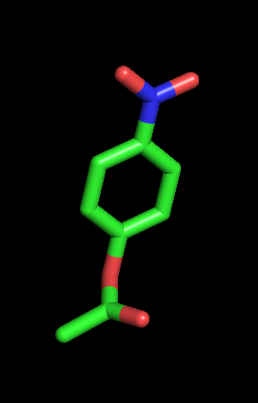
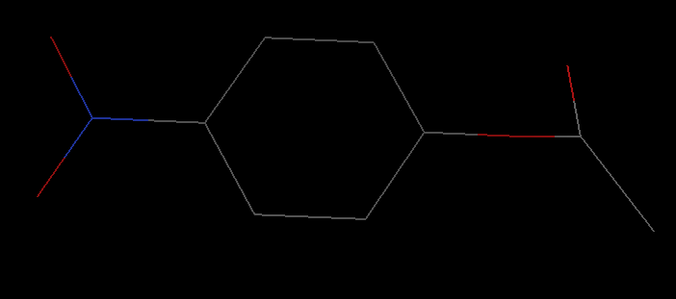
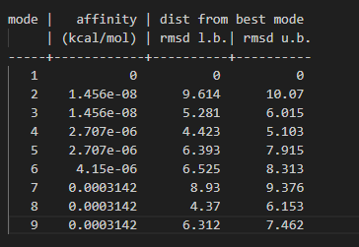
Output

