Slide 1

Fraudshield AI
Your Digital Call Guardian.
Presented By chandan and Team

Slide 2
Problem Statement
The Challenge: Individuals and organizations are increasingly targeted by sophisticated voice-based scams, including spam calls, phishing attempts, and alarming "digital arrest" threats. These calls often aim to extract sensitive personal information (bank details, OTPs, ID numbers) or coerce victims into transferring money.
The Difficulty: Scammers use convincing tactics, impersonate authorities (police, banks, government), and leverage urgency, making it difficult for people, especially vulnerable individuals, to distinguish legitimate calls from fraudulent ones.
The Impact: This leads to significant financial losses, emotional distress, and a general erosion of trust in voice communication.
The Need: A system is required to automatically analyze call audio, reliably classify potential threats (Spam, Fraud/Digital Arrest), and empower users to take appropriate action, thereby mitigating the risks associated with voice scams.

Slide 3
AGENDA
Problem Statement: The Rise of Voice Scams
FraudShield AI: Solution Overview & Diagram
Our Approach: Leveraging AI for Call Analysis
Technology Stack Used
LLM Implementation: Gemini 1.5 Flash & The 5-Step Framework
Challenges Encountered
Team Contributions
Impact & Benefits of FraudShield AI
Future Enhancements & Outlook
Q&A

Slide 4
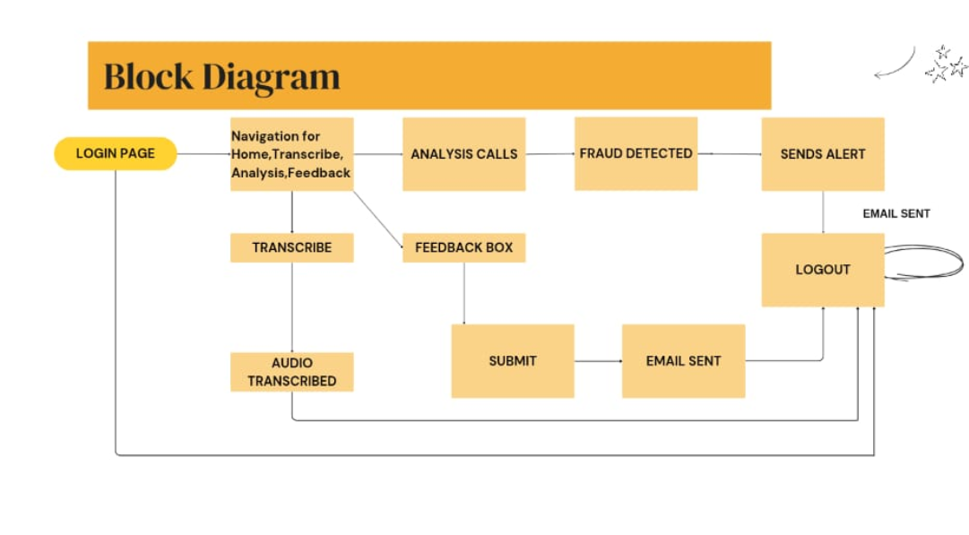
SOLUTION OVERVIEW
FraudShield AI is a system that detects phone call scams using Google Gemini AI. It listens to call recordings, analyzes the audio, and classifies them as Normal, Spam, or Fraudulent.

Slide 5
Solution
Explanation of Diagram:
User: Interacts with the Streamlit UI.
Streamlit UI: Handles authentication (Login/Register), file uploads, and displays results/buttons.
Auth Module: Interacts with the SQLite database to verify or add users.
File Uploader: Gets the audio file from the user.
Audio Processor (Pydub): Takes the raw audio bytes, crops it to the first 60 seconds, and potentially converts format (e.g., to WAV for compatibility).
Gemini 1.5 Pro API Call: Sends the cropped audio data to the Gemini API for analysis. This is the core LLM component, leveraging its native audio understanding capabilities (which implicitly include speech-to-text and semantic analysis).
Result Processing: Takes the "Fraud" / "Not Fraud" text response from Gemini, interprets it, stores the original audio and the result in the database.
Result Display: Shows the analysis outcome (Fraud/Not Fraud/Uncertain) to the user on the Streamlit UI. Includes the "Report Fraud" button if fraud is detected.
Email Module (smtplib): Sends an email notification when the user clicks "Report Fraud".
SQLite3 Database: Stores user credentials (hashed passwords) and audio file metadata/data (including the fraud flag and report status).
Support Team Inbox: Receives the fraud report email.

Slide 6
Approach taken to arrive at the solution
UI-Centric Design: The primary request was for a "very fancy" UI. The approach prioritized creating a visually appealing interface within Streamlit's limitations by:
Injecting custom CSS for background images/gradients, button styling, input field appearance, container styling (auth box), and custom radio buttons.
Using st.session_state extensively to manage the application flow (login status, analysis results, report status) smoothly across page reruns, essential for a good UX in Streamlit.
Leveraging Native Audio LLM: Instead of a separate Speech-to-Text model followed by a text-based LLM, the approach directly utilized Google Gemini 1.5 Pro's native multi-modal capability to process audio. This simplifies the pipeline.
Innovation: Using the Gemini File API (genai.upload_file) specifically for audio analysis within a Streamlit context is a relatively modern approach leveraging the latest model capabilities.
Simplified Backend:
Database: Chose sqlite3 for its simplicity, ease of integration (built-in Python library), and suitability for single-instance applications without requiring a separate database server setup.
Email: Employed Python's smtplib with a Gmail App Password for direct email sending, which is straightforward for this specific use case compared to setting up more complex email services (though less scalable/robust for production).
Audio Handling: Used the pydub library for easy audio loading and cropping, ensuring only the first 60 seconds are processed as per the requirement. Included format conversion (to WAV) for broader compatibility with the analysis API.
Clear User Feedback: Implemented spinners (st.spinner), success/error/warning messages (st.success, st.error, st.warning), and status updates (e.g., "Report Sent") to keep the user informed.
Security (Basic): Implemented password hashing (hashlib) for user credentials, although API keys were hardcoded as requested (which is not a secure practice for deployment).

Slide 7
Programming Language: Python 3
Web Framework: Streamlit
Database: SQLite 3 (via Python's sqlite3 module)
LLM / AI Service: Google Gemini 1.5 Pro (via google-generativeai library)
Audio Processing Library: Pydub
Email Library: Python's smtplib, email.mime.text
Styling: HTML, CSS (injected via st.markdown)
Other Libraries: hashlib (password hashing), io, os, time, base64
Tech Stack

Slide 8
5 step Framework of LLM
NLP can detect phishing emails and other social engineering attacks by analyzing the content and identifying suspicious patterns.
Which LLM was used?
The LLM used was Google Gemini 1.5 Pro.
It was selected primarily for its advanced native multi-modal capabilities, specifically its ability to directly process and understand audio input without requiring a separate Speech-to-Text pre-processing step. This simplifies the architecture and leverages the latest model features for potentially more nuanced audio understanding.

Slide 9
5 step Framework of LLM
Task:
Definition: The core task was clearly defined: Analyze the first 60 seconds of a user-uploaded audio file to detect signs of potential fraud, scams, or coercive situations (like digital arrest threats). The output needed to be a simple classification usable within the application flow.
Framework Help: Defining the task explicitly helped scope the interaction with the LLM. It clarified what needed to be achieved (fraud detection), what input was relevant (first 60s audio), and what output was desired (a clear flag).
Context:
Definition: This involved providing the LLM with the necessary background and instructions to perform the task correctly. The primary context provided was:
The cropped audio data itself (uploaded via the Gemini File API).
A specific prompt instructing the LLM to:
Analyze the provided audio.
Focus on identifying fraud, scams, coercion, digital arrest, etc.
Strictly limit the response to only the words "Fraud" or "Not Fraud".
Framework Help: Thinking about "Context" forced clarity on exactly what information and instructions the LLM needed. The prompt became the crucial piece of context shaping the LLM's behavior for this specific task, especially guiding the output format.

Slide 10
5 step Framework of LLM
References:
Definition: This refers to the data or examples the LLM uses to understand and execute the task. In this implementation:
The main "reference" was Gemini 1.5 Pro's vast pre-training data, which includes enormous amounts of text, speech, and audio, allowing it to understand patterns associated with normal conversation versus potentially fraudulent or manipulative language/tone within audio.
We did not provide explicit few-shot examples (specific reference audio clips labeled as fraud/not fraud) within the prompt itself in this iteration. The approach relied on the model's zero-shot/general capabilities guided by the prompt's context.
Framework Help: Recognizing that the model relies heavily on its internal "references" (training data) highlights the importance of selecting a capable model (like Gemini 1.5 Pro) trained on relevant modalities (audio). It also flags that for more nuanced or specific fraud types, providing explicit reference examples (few-shot prompting) could be a future iteration.

Slide 11
5 step Framework of LLM
Evaluate:
Definition: Assessing the LLM's output for correctness and suitability. Evaluation in this development context was primarily functional:
Format Compliance: Did the LLM output strictly adhere to "Fraud" or "Not Fraud"? Code was added to .strip() and .title() the output to handle minor variations, but the core check was for these exact strings.
Error Handling: How were non-compliant or unexpected outputs handled? The code defaults to an "Uncertain" state if the response isn't clearly "Fraud" or "Not Fraud".
(Implicit) Plausibility: While not quantitatively measured, the expectation was that the classification would be reasonably plausible for common scam types.
Framework Help: This step highlighted the need for robust output parsing. It drove the implementation of checks for the specific expected outputs and the inclusion of logic to handle cases where the LLM might deviate, ensuring the application doesn't break and provides some feedback (even if uncertain).

Slide 12
5 step Framework of LLM
Iterate:
Definition: Refining the process based on evaluation. Iteration occurred mainly in:
Prompt Engineering: If initial testing showed the LLM wasn't consistently giving the desired output format, the prompt was tweaked (e.g., adding stronger constraints like "ONLY respond with...", "Do not add explanation.").
Output Handling: Adding the .strip().title() logic was an iterative refinement based on observing potential minor variations in LLM responses.
Error Management: Refining error messages or handling for API failures or audio decoding issues is an iterative process based on testing.
API Usage: Shifting to the File API for audio was an iteration based on best practices for handling larger data inputs with Gemini 1.5 Pro. Ensuring file cleanup (delete_file) was added iteratively for resource management.
Framework Help: This emphasizes that getting the LLM interaction right often requires refinement. It justified adjustments to the prompt and surrounding code based on observed performance during development, aiming for more reliable and consistent results.

Slide 13
Challenges Faced

Slide 14
Individual Contributions

Slide 15
Impact of the Solution proposed
User Empowerment: Provides an accessible tool for individuals to quickly get an AI-powered assessment of potentially fraudulent audio calls or recordings.
Potential Fraud Prevention: By identifying scam calls (like digital arrest threats) early, it can help users avoid falling victim.
Streamlined Reporting: Creates a simple, direct mechanism for users to report detected fraud attempts to a designated support team, enabling faster investigation or tracking.
Awareness: Simply using the tool can raise user awareness about the prevalence and types of audio-based fraud.
Data Collection: Storing the audio (even if anonymized later) and the AI's assessment provides valuable data for the support team to analyze trends and potentially improve detection methods.

Slide 16
Future outlook
Enhanced Fraud Categories: Train or prompt Gemini to identify specific types of fraud (e.g., tech support scam, bank impersonation, digital arrest, fake job offer) instead of just a binary classification.
Audio Waveform Visualization: Implement the suggested feature using librosa and matplotlib to display a waveform of the analyzed audio segment, enhancing the UI.
User Dashboard: Allow logged-in users to see a history of their uploaded audio files and their analysis results.
Admin Panel: A separate interface for the support team to review reported cases, listen to the full audio stored in the database, mark cases as resolved, and potentially view basic analytics.
Real-time Analysis (Advanced): Explore possibilities for analyzing audio streams in near real-time (would require a different architecture, likely involving websockets and potentially faster/streaming STT/LLM models).
Confidence Scores: Modify the interaction with Gemini (if possible via API or prompting) to get a confidence score along with the "Fraud" / "Not Fraud" label.
Extended Analysis: Allow analysis of longer audio segments, perhaps summarizing key points or identifying multiple potentially fraudulent sections.

Slide 17
THANK YOU !!

