Slide 1
IBM University Engagement Project Submission
“Exploring the Power of Agentic AI with IBM Granite and LangFlow”

Slide 2

Project Tile – [AI Agent for Smart Farming Advice ]
Domain of Project – [ Agriculture ]
Student Name | Recent Passport Photo | Email ID | Mobile number [WhatsApp]
Rakshitha K N
shivakripa2819@gmail.com
7411342930

Slide 3
Problem Statement -
Problem Statement : AI Agent for Smart Farming Advice
The Challenge
Small-scale farmers often struggle to access reliable and timely agricultural information related to weather forecasts, soil health, crop selection, pest management, irrigation schedules, fertilizer usage, and market prices. Information is usually scattered across multiple sources and may not be available in local languages.
Without real-time and location-specific guidance, farmers face risks such as crop failure, pest outbreaks, poor yield, and reduced profits.
.
The Objective
Build an AI-powered Smart Farming Agent that provides personalized and real-time agricultural guidance using Retrieval-Augmented Generation (RAG).
The solution should:
• Recommend suitable crops based on season, soil type, and location.
• Provide weather forecasts and rainfall predictions.
• Retrieve mandi (market) prices for agricultural commodities.
• Offer pest and disease control recommendations.
• Suggest irrigation schedules and fertilizer usage.
• Support multilingual farmer interactions.
• Use trusted agricultural databases and government sources.
• Deliver intelligent responses through IBM Llama models.
Multi-Agent System
Crop Recommendation Agent
Weather Intelligence Agent
Soil Health Agent
Pest Control Agent
Market Price Agent
Farming Knowledge Agent (RAG)

Slide 4
Technology Used
Approach Used:
Replicate with LangChain + RAG + IBM Granite Models
Technology Stack:
• IBM watsonx.ai • IBM Granite Models • LangChain • Chroma Vector Database • Hugging Face Embeddings • Flask Web Application • Python • RAG Pipeline • Government Agriculture APIs • Weather APIs

Slide 5
Proposed Solution -
Proposed Solution: AI-Powered Smart Farming Agent
The proposed solution is a multi-agent AI-powered Smart Farming Agent built using IBM watsonx.ai, Granite/Llama Models, LangChain, and RAG (Retrieval-Augmented Generation) to provide personalized, real-time agricultural guidance for farmers. The system addresses challenges in crop selection, soil management, pest control, irrigation planning, and market awareness through an intelligent and modular architecture.
At its core, the solution uses a RAG pipeline to retrieve accurate agricultural information from trusted farming knowledge sources. The data is embedded and stored in a Chroma Vector Database, enabling the system to fetch relevant information and generate context-aware responses using IBM Granite/Llama models.
The system consists of five key agents:
Weather Intelligence Agent retrieves weather forecasts and rainfall information to support farming decisions.
Crop Recommendation Agent suggests suitable crops based on season, soil type, and regional conditions.
Soil Health Agent provides soil-based crop recommendations and fertilizer guidance.
Pest Management Agent offers pest and disease prevention measures, including organic and chemical control methods.
Market Intelligence Agent retrieves current mandi prices and market insights to help farmers maximize profits.
The solution supports multilingual interactions, allowing farmers to ask questions in their local language and receive accurate responses. A user-friendly Flask-based web interface enables easy access to weather updates, crop recommendations, soil insights, pest control guidance, and mandi prices.
LangChain orchestrates the RAG workflow, while IBM watsonx.ai provides scalable AI model deployment. Granite/Llama models power reasoning, summarization, and personalized agricultural recommendations.
Overall, this solution delivers an end-to-end intelligent farming assistant that helps farmers make data-driven decisions, improve crop productivity, reduce risks, and increase income through real-time agricultural insights.

Slide 6
IBM Cloud component Used -
Chat Input The farmer submits a query related to crops, weather, soil, pest control, irrigation, or market prices through the web interface.
Translation Module The system translates multilingual queries into English to ensure accurate processing and understanding.
Intent Detection The AI identifies the user's intent and determines the appropriate domain such as weather, soil, crop recommendation, or mandi prices.
Data Retrieval Relevant information is collected from external APIs, the agricultural knowledge base, and the RAG system.
ChromaDB Vector Search The RAG module retrieves the most relevant agricultural knowledge using semantic similarity search.
IBM watsonx.ai (Llama Model) The AI model analyzes the retrieved information and generates context-aware farming recommendations.
Response Generation The system prepares a clear, concise, and farmer-friendly response based on the available data.
Chat Output The final personalized recommendation is provided to help farmers make informed agricultural decisions.

Slide 7
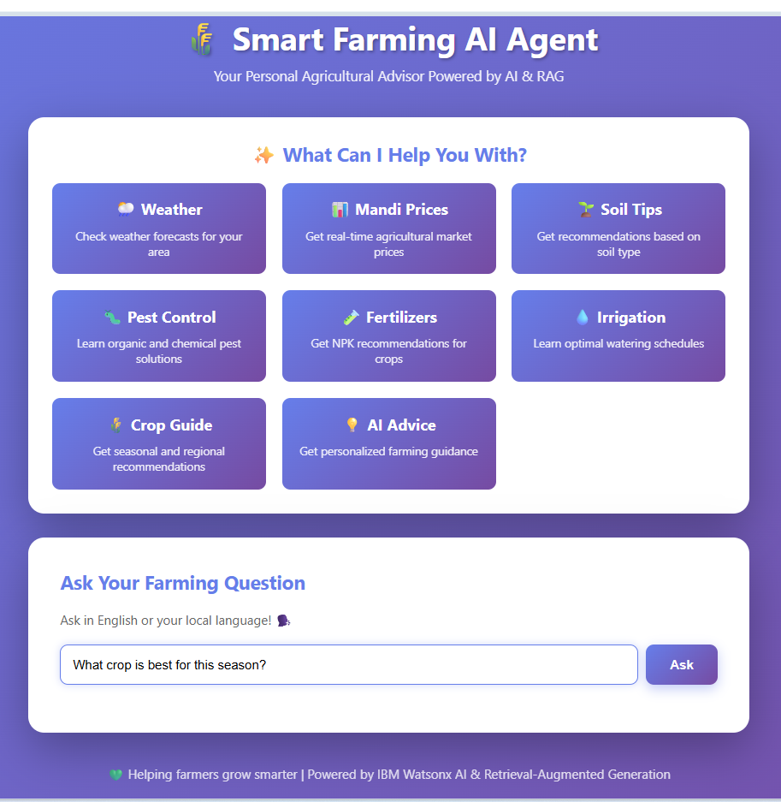
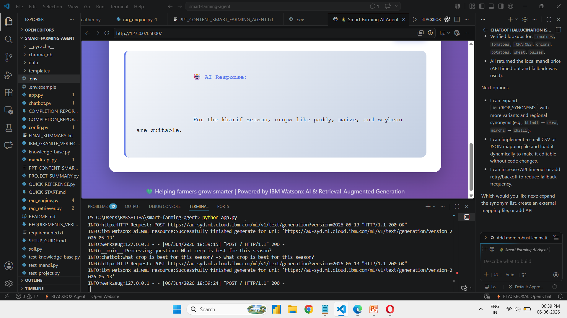

Slide 8
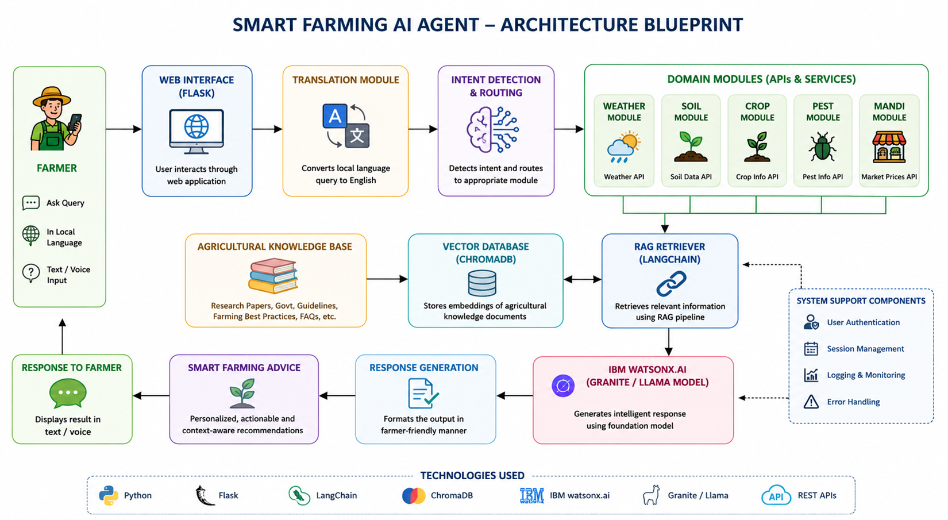
Architecture blueprint

Slide 9

Role of Agentic AI in the solution
Intent-Based Decision Making – The AI agent analyzes the farmer's query and identifies whether it is related to weather, soil, crop selection, pest control, irrigation, fertilizer usage, or market prices.
Tool Orchestration – The agent automatically selects and invokes the appropriate modules such as Weather API, Mandi Price API, Soil Analysis, or RAG Retrieval based on the user's request.
Knowledge-Grounded Responses – Before generating an answer, the agent retrieves relevant agricultural information from the knowledge base and vector database using RAG, ensuring accurate and reliable recommendations.
Context-Aware Assistance – The agent considers factors such as season, crop type, soil conditions, and user query context to provide personalized farming advice.
Multilingual Support – The agent translates farmer queries into English for processing and generates meaningful responses, making the system accessible to users in different languages.
Reliable and Adaptive System – The agent uses fallback mechanisms for AI models and external APIs, ensuring continuous and dependable assistance even when some services are unavailable.
Outcome: Agentic AI enables the Smart Farming AI Agent to act as an intelligent agricultural advisor that autonomously retrieves information, reasons over it, and delivers actionable recommendations to farmers.

Slide 10
Technology Used
IBM Cloud – Provides a secure and scalable cloud environment for deploying and managing the Smart Farming AI Agent.
IBM watsonx.ai – Used for foundation model inference and AI-powered response generation, providing intelligent and context-aware farming recommendations.
IBM Llama Models – Used for natural language understanding, reasoning, and generating personalized agricultural guidance based on user queries. meta-llama/llama-3-3-70b-instruct
LangChain – Used to build and manage the RAG pipeline, document processing, embeddings, and information retrieval workflows.
Chroma Vector Database – Stores agricultural knowledge embeddings and enables fast similarity search for retrieving relevant farming information.
RAG (Retrieval-Augmented Generation) – Retrieves relevant agricultural knowledge from the vector database before generating responses, improving accuracy and reducing hallucinations.

Slide 11
Technology Used
HuggingFace Embeddings – Converts agricultural documents into vector representations for efficient semantic search and retrieval.
OpenWeatherMap API – Provides real-time weather forecasts and climate information to support farming decisions.
AgMarket/Data.gov API – Retrieves mandi and commodity prices, helping farmers make informed marketing and selling decisions.
Flask Framework – Used to develop the web application and API endpoints, enabling farmers to interact with the AI assistant through a simple interface.
Deep Translator – Enables multilingual support by translating farmer queries into English for consistent processing by the AI system.

Slide 12
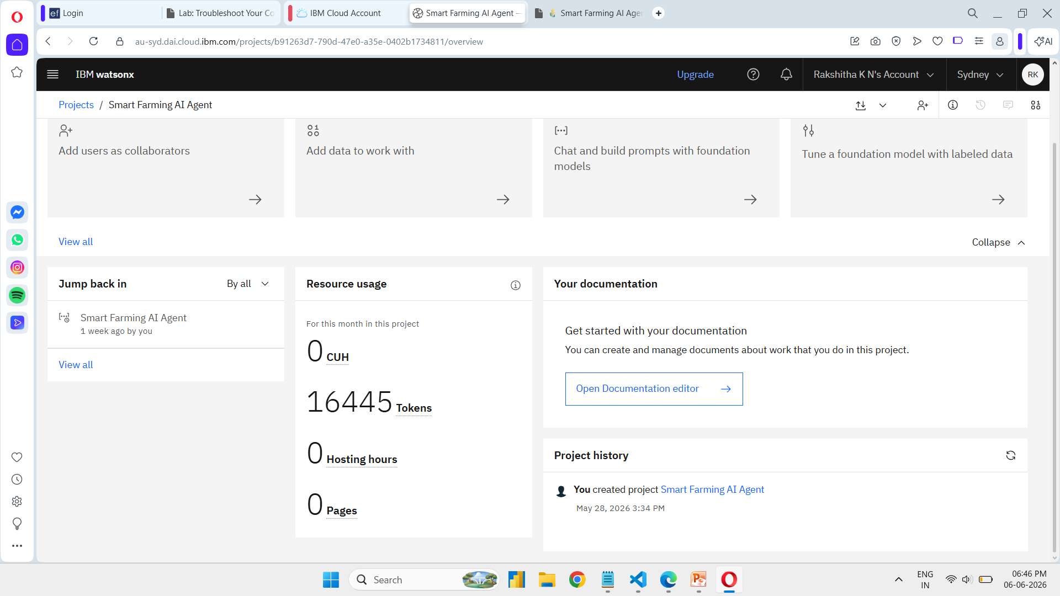
Token Usage
16,445 tokens are used

Slide 13
Novelty and Uniqueness
Combines weather forecasting, mandi prices, soil analysis, crop recommendations, and pest management in a single AI platform.
Uses RAG (Retrieval-Augmented Generation) to provide accurate and knowledge-based farming advice.
Supports multilingual interaction, making it accessible to farmers in regional languages.
Provides seasonal and location-specific recommendations for better decision-making.
Integrates IBM watsonx.ai and Granite/Llama models for intelligent and context-aware responses.
Includes fallback mechanisms for AI models and external APIs, ensuring reliable service.
Unique Feature: A single AI-powered assistant that delivers personalized, real-time, and data-driven agricultural guidance to farmers.

Slide 14
Git Hub Link
https://github.com/Rakshitha6851/Smart_Farming_agent.git
·
·
·

Slide 15
Future Scope
1. Smart Automation
Integrate IoT sensors for real-time soil monitoring, smart irrigation, and yield prediction.
2. Crop Monitoring
Use satellite, drone, and image-based analysis for crop health monitoring and disease detection.
3. Farmer Support
Develop a mobile app, voice assistant in regional languages, and integrate market prices and government schemes.
Conclusion: These enhancements will make the Smart Farming AI Agent more intelligent, accessible, and beneficial for farmers.
·
·
·

Slide 16


