Slide 1
Data Science Foundation Project
Facebook Data Set

Slide 2
Personal Information:
Name : Rakshitha Anna Manohar
Email id : raks.amr@gmail.com
Contact No. : +918951603679
My Experience : 3 years 8months
Current Working Domain : Automation Testing of front and back end applications using different tools like selenium, UFT
Currently working @ Tech Mahindra Ltd
Location : Bangalore, Karnataka

Slide 3
Introduction to Facebook dataset:
Facebook is a social website where people interacts with each other virtually through their posts and updates on it
It allows an user to make friends with any other existing user , play games , like , share and comments to any of their friend’s posts and lot more
The given dataset allows us to know more about the users details like their DOB, count of friends, no. of likes they have made to the posts etc
Assumptions
The given dataset as original dataset provided by Facebook company.
Column "Tenure" as no. of days that the individual's account is active
Pre-Conditions
Importing required packages - Numpy, Pandas, Matplotlib, Seaborn, Scipy,PandasProfiling(if required)
Read all the contents of the file

Slide 4
Business questions Identified :
1. Which age group people are using facebook most?
2. Which age group is using facebook from long period of time?
3. Which age group people have maximum no. of friends?
4. In the most used facebook age group,is it male or female used most?
5. Overall, which gender has the highest no. of facebook accounts?
6. Which is most preferred platform, either Mobile or Website?
7. Which age group prefers mobile platform the most?
8. which gender uses which platform most?

Slide 5
Importing Packages : import numpy as np import pandas as pd
Importing Dataset file :
myPath="..." #Stored local path into this variable
#Code :
dataset = pd.read_csv(myPath+"pseudo_facebook.tsv",sep="\t")
#Read all the contents of the dataset file to a variable "dataset" and separated distinct variables or columns in the dataset with separator "\t“
Foremost command used for brief analysis of overall dataset : “Pandas Profiling”
!pip install pandas-profiling #to install pip package of Pandas Profiling
import pandas_profiling as pp #Required package as pre-condition
pp.ProfileReport(dataset) #Provides Overview of Dataset

Slide 6
Overview of Dataset : Size and shape of dataset: (99003,15) rows - 99003 columns – 15 Missing values – 0 Variables : Numeric - 14 Categorical - 1 (Gender)
Highly Correlated Variables :
"mobile_likes_received" with "likes_received"
"www_likes_received" with "likes_received"
*My Analysis : As the sum of "mobile_likes_received" and "www_likes_received" variables will gain the variable "likes_received".
Hence both are highly correlated with "likes_received" variable

Slide 7
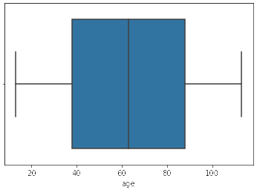
Age alias DOB analysis :
Dataset contains 101 distinct values i.e. 101 different aged group pupil uses Facebook.
Minimum age - 13
Maximum age - 113
#Code :
data_age1 = dataset.groupby('age').mean() #groups the entire dataset by mean of age values
data_age1.reset_index(inplace=True) # to reset the index column from age to default values
data_age1.head() #Displays the first 5 row contents of the dataset
#Importing Additional packages for Data Visualization :
from scipy import stats, integrate
import matplotlib.pyplot as plt
import seaborn as sns
%matplotlib inline #provides the plots or graphs to be
displayed on notebook itself.
sns.boxplot(data_age1.age) # BoxPlotOfAge
From Figure, 50% of the age groups of facebook users fall between
40 and 90

Slide 8
#Code
dataset['age'].value_counts().head() #Provides the count of each value of age
Output :
18 5196
23 4404
19 4391
20 3769
21 3671
Name: age, dtype: int64
INFERENCE : From the above output, its observed that
18 years age group have highest no. of facebook users with 5196 people
[Note : This is also provided with the command "Pandas-Profiling"]

Slide 9
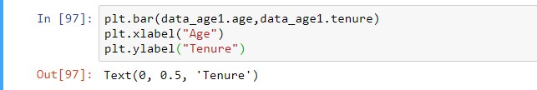
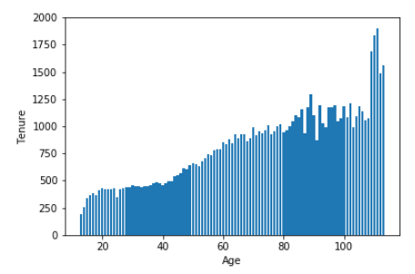
Tenure Analysis :
Figure represents Age Vs Tenure analysis.
From bar graph, it can be inferred that as the older the people more the no. of days the face book is active
More analysis is made to check whether the graphs represents right analysis.

Slide 10
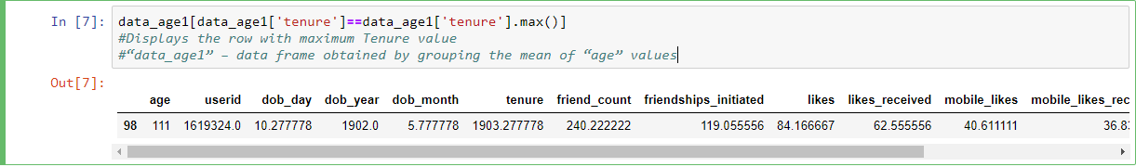
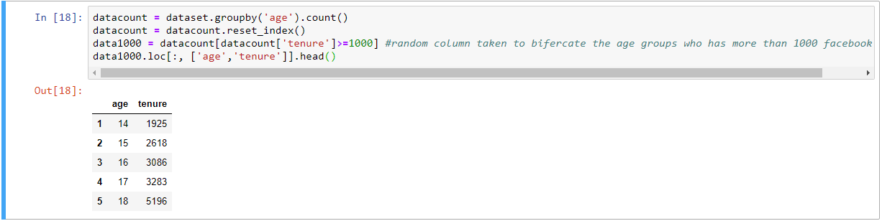
From above observation, 111 aged group are using face book from longer period but this age group entries are only 18
Hence some more analysis is to be made to get better value

Slide 11
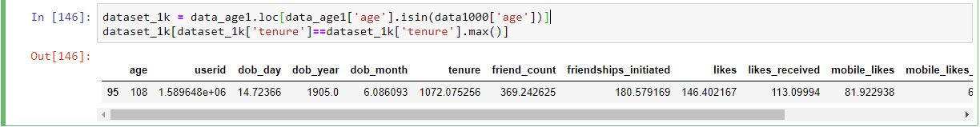
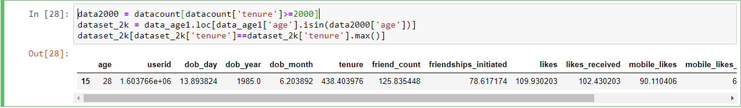
Now we form a data frame "dataset_1k" having only common age values both in dataset "data_age1" and "data1000" to fetch the age group who is using from longer period and has more than 1000 face book users
From above observation, if we consider 1000+ users in each age group, we may conclude, 108 aged group people are using face book from long period of time
But practically,108 age group people existence is quiet rare. Hence analysis on 2000+ users in each age group is made to get a better value.
INFERENCE : From above observation, 2000+ users in each group reveals that,28 aged group people are using facebook from long duration of time

Slide 12
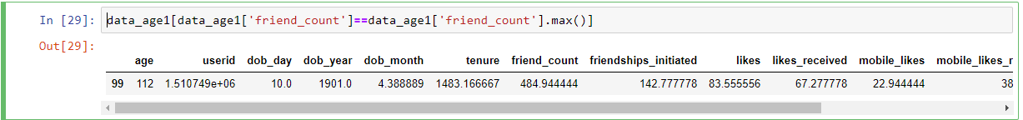
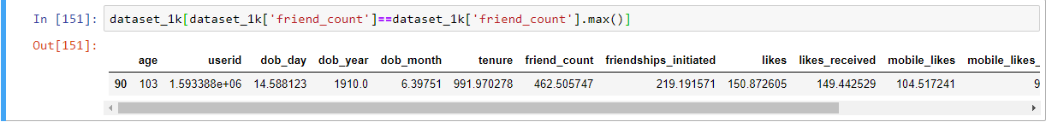
Friend Count Analysis :
Let's find out which age group pupil has maximum no. of friends in Facebook
Age group 112 has only 18 people, hence more analysis is to be made by considering age group having minimum of 1000 or 2000 people
Considering formed two data frames "dataset_1k" and "dataset_2k“ during “Tenure analysis”

Slide 13
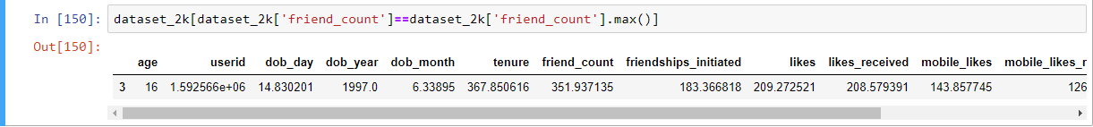
INFERENCE : From above two observations, 103 aged group people has 1044 users with average friends 462
where as 16 aged group people has 3086 users with average friends 351.
Out of two observations, considering more no. of users in each age group, 16 aged group of people have highest no. of friends in facebook
Gender Analysis :
Forming each data frame for each gender

Slide 14
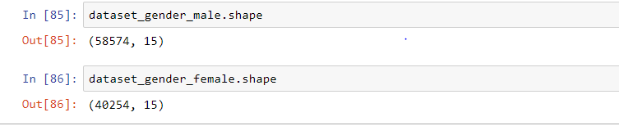
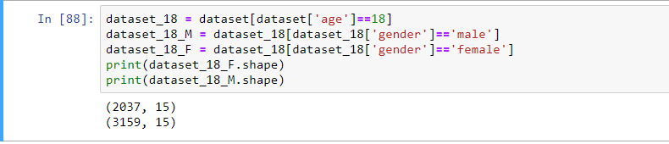
INFERENCE : From above analysis, out of 99003 facebook users, 58574 are male users who are than 40254 female users.
We know that, from DOB analysis, 18 age group have highest no. of facebook users.
Hence analysis is made on this age to know which gender have highest facebook users
INFERENCE : Male count is 3159 and female count is 2037. Therefore, in highest facebook users age group also male users are more.

Slide 15
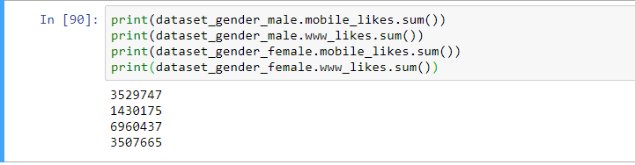
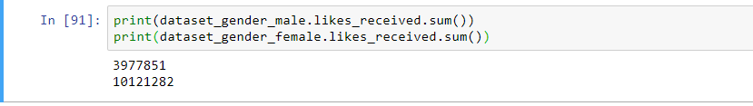
INFERENCE : From above analysis, we infer female prefers "mobile platform" than "web platform“ and also uses facebook more than male.
Similarly, one more analysis can be done based on gender as below :
INFERENCE : Female received likes almost 3 times more than male for their posts and updates

Slide 16
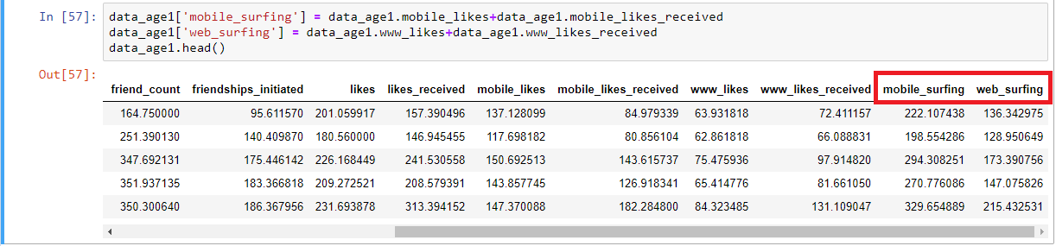
Mobile and Web Surfing Analysis :
Adding two more columns "mobile_surfing" and "web_surfing" to the dataset "data_age1"
# “data_age1” – data frame formed by taking mean of age values and grouping it

Slide 17
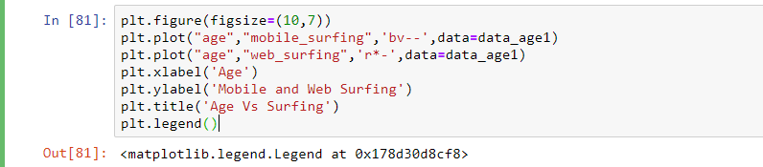
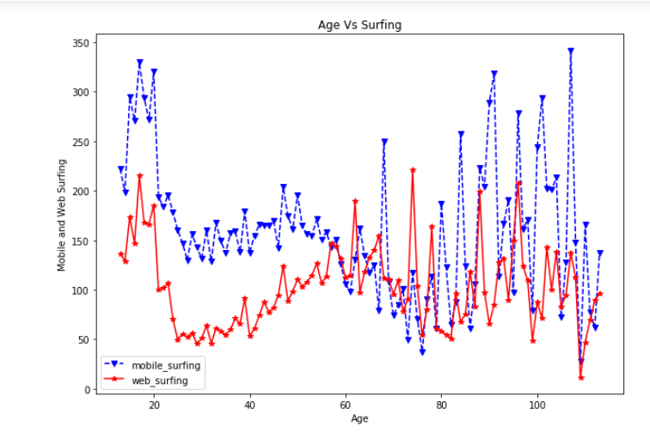
From the figure, People up to age 60, uses mobile platform more than web, but beyond 60 aged people uses both web and mobile near to equal ratio. Overall mobile platform users are more than web.
More analysis is made to get a approximate value of both the platform users

Slide 18

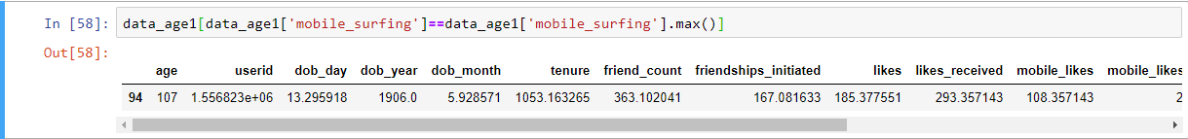
INFERENCE : out of 101 different age groups, 78 groups prefers mobile surfing than web surfing.
107 age group people uses mobile as preferred platform but this age group has only 98 users which may contain outliers. Hence lets consider the age group who has 2000+ users.
Adding two more columns "mobile_surfing" and "web_surfing" to the dataset "dataset_2k"

Slide 19
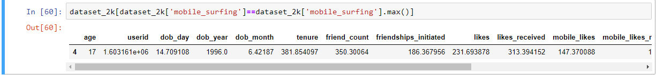
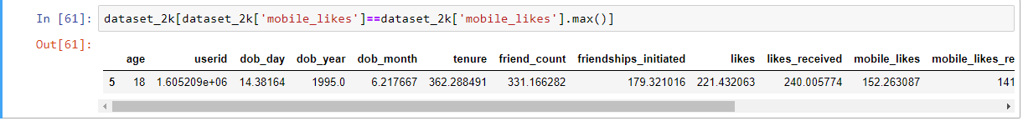
INFERENCE : In age groups who has 2000+ users, 17 age group surfs facebook more in Mobile.
INFERENCE : In real time secanrio, likes recieved will include different age people liking their posts apart from their own age group liking it.
Hence we exclude "mobile_likes_received" column, we find that 18 age group people prefers mobile more than web.
Out of so many observations, we can generalise that Teenage group prefers mobile platform than web platform

Slide 20
Data Frames formed during analysis :
“dataset” – #Code : dataset = pd.read_csv(myPath+"pseudo_facebook.tsv",sep="\t")
Contents of given dataset is read into this variable from csv file
“data_age1” – #Code : data_age1 = dataset.groupby('age').mean()
Formed by grouping the mean of “Age” column
“datacount” – #Code : datacount = dataset.groupby('age').count()
Formed by grouping the count of “Age” column
“data1000” – #Code : datacount[datacount['tenure']>=1000]
Age groups having value_count() more than 1000 formed from “datacount” dataframe
“data2000” - #Code : datacount[datacount['tenure’]>=2000]
Age groups having value_count() more than 2000 formed from “datacount” dataframe

Slide 21
“dataset_1k” – #Code : data_age1.loc[data_age1['age'].isin(data1000['age’])]
Formed by taking loc of “data_age1” data frame and has common age groups with “data1000”
“dataset_2k” – #Code : data_age1.loc[data_age1['age'].isin(data2000['age’])]
Formed by taking loc of “data_age1” data frame having common age groups with “data2000”
“dataset_gender_male” - #Code : dataset[dataset['gender']=='male’]
Formed by taking all the values with gender as male
“dataset_gender_female” - #Code : dataset[dataset['gender']=='female’]
Formed by taking all the values with gender as female
“dataset_18” - #Code : dataset[dataset['age']==18]
Formed by taking all the values with ageis equal to 18
“dataset_18_M” - #Code : dataset_18[dataset_18['gender']=='male’]
Formed by taking all the values with gender as male in dataframe “dataset_18”
“dataset_18_F” - #Code : dataset_18[dataset_18['gender']=='female’]
Formed by taking all the values with gender as female in dataframe “dataset_18”

Slide 22
Overview of Business questions identified and its analysis :
1. Which age group people are using facebook most?
Analysis : Age 18 group people are most facebook users
2. Which age group is using facebook from long period of time?
Analysis : Considering age groups having 2000+ user, 28 aged group people are using facebook from long period of time
3. Which age group people have maximum no. of friends?
Analysis : 103 aged group people has 1044 users with average friends 462
where as 16 aged group people has 3086 users with average friends 351.
Out of two observations, considering more no. of users in each age group, 16 aged group of people have highest no. of friends in facebook
4. In the most used facebook age group,is it male or female used most?
Analysis : 18 age group people are most facebook users, in which male count is 3159 and female count is 2037.
Therefore, in highest facebook users age group also male users are more.
5. Overall, which gender has the highest no. of facebook accounts?
Analysis : If we consider overall users of facebook also, male users are more than female

Slide 23
6. Which is most preferred platform, either Mobile or Website?
Analysis : People up to age 60 uses mobile platform more than web, but beyond 60 aged people uses both web and mobile near to equal ratio. Overall mobile platform users are more than web.
7. Which age group prefers mobile platform the most?
Analysis : In real time scenario, likes received will include different age people liking their posts apart from their own age group liking it. Hence if we exclude "mobile_likes_received" column, we find that 18 age group people prefers mobile more than web.
8. which gender uses which platform most?
Analysis : Women uses mobile platform more than men.
we see female uses both mobile and web platforms more than men even though female users are less than male users

