Slide 1
Vehicle Insights Dashboard
Interactive Power BI Dashboard for Business Analysis
RAKSHITHA L

Slide 2
OBJECTIVE
To provide stakeholders with key insights into vehicle brands, conditions, and seller trends using an interactive Power BI dashboard.

Slide 3
Dataset Overview
Source: Kaggle - Car Prices Dataset
Key Columns - Brand, Model, Year, Seller, Price, Condition, Color etc.,

Slide 4
KPIs Tracked
Top vehicle brands by volume
Distribution by model, body type, and color
Vehicle condition trends
Seller patterns by model
Year-based filtering for trend analysis

Slide 5
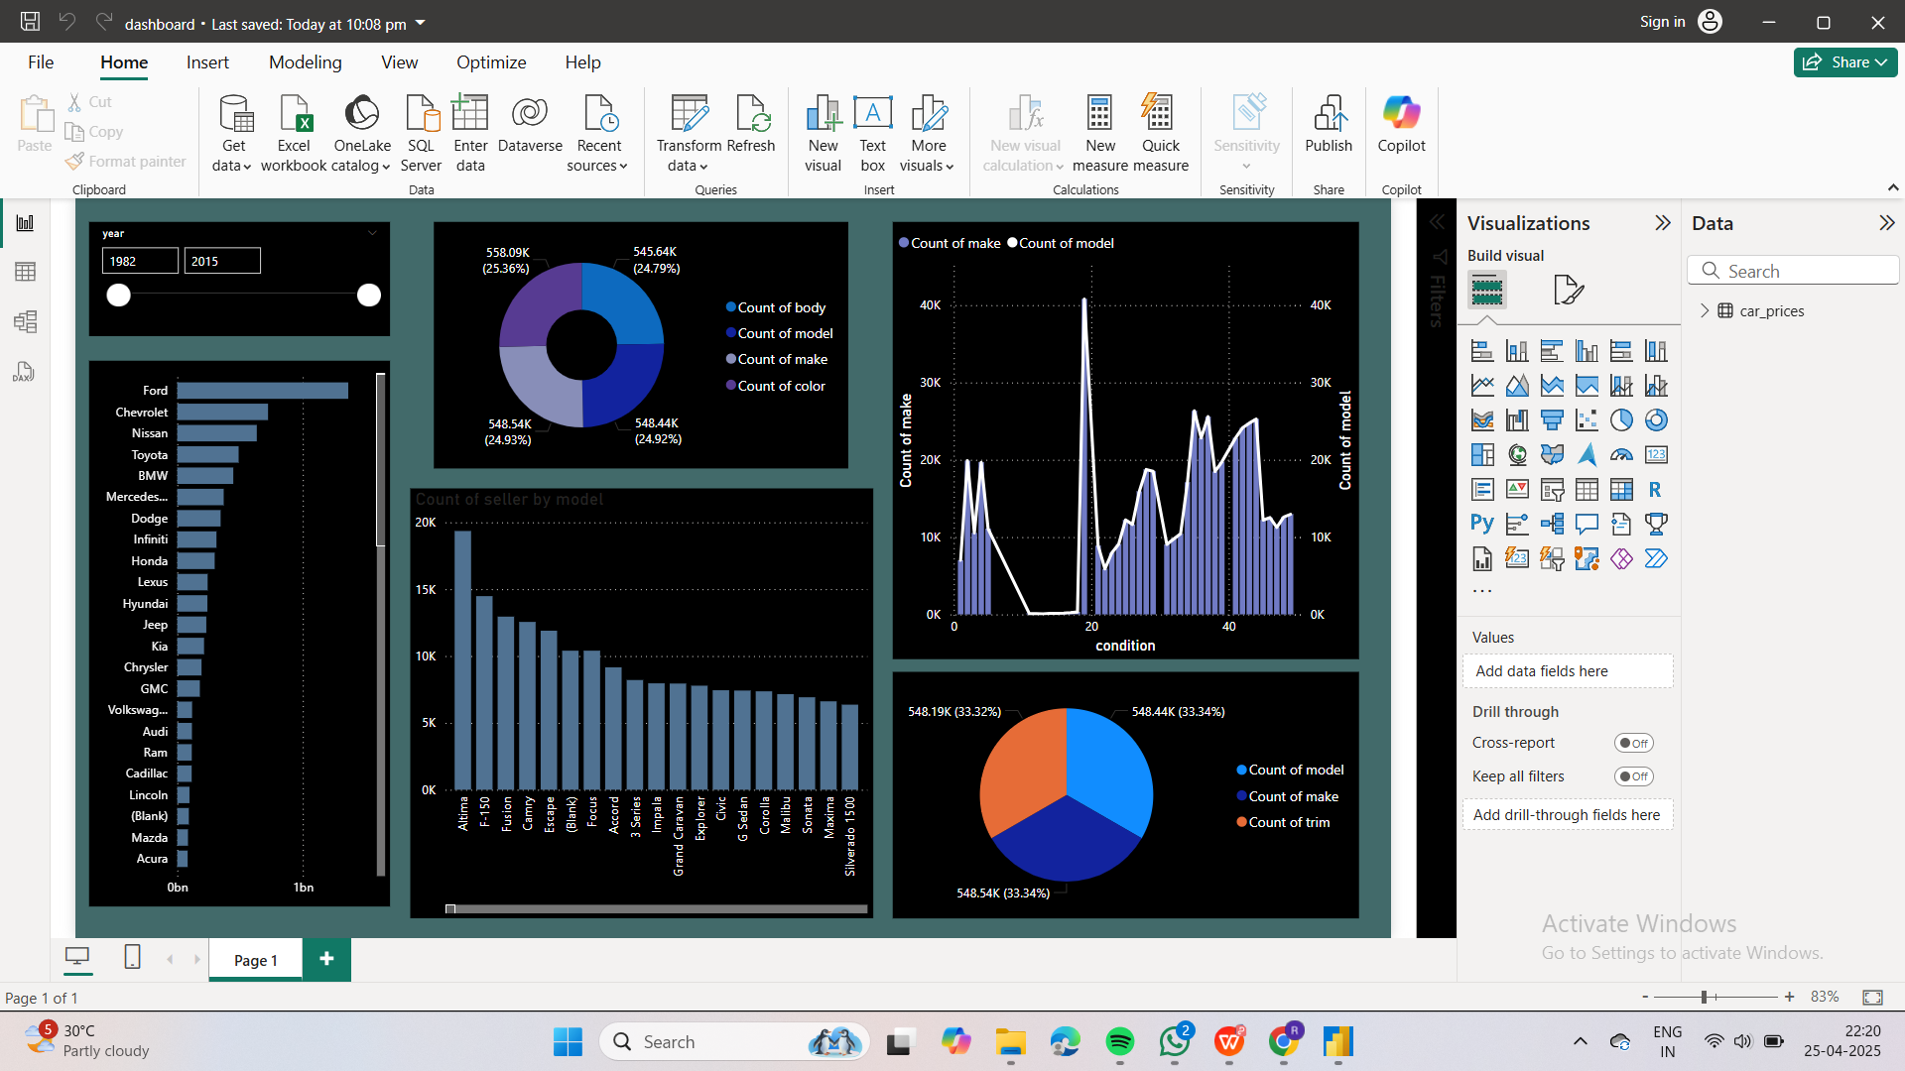
Dashboard Preview

Slide 6
Key Insights
Ford leads the market by listing volume, followed by Chevy and Nissan.
Most vehicles sit in the mid-to-high condition range, ideal for resale.
A handful of sellers dominate listings for popular models.
Body type and color are evenly distributed across listings.

Slide 7
THANK YOU

