Slide 1
CULTURE BASED TOURISM DEVELOPMENT PORTAL
CSE7101- Capstone Project
Review-2
Roll Number | Student Name
20221CSG0114 | Rakshitha D P
20221CSG0116 | Vishal Gowda H
20221CSG0124 | Sai Siri Naidu O
Under the Supervision of,
Dr. Chandrasekar V
Professor
School of Computer Science and Engineering
Presidency University
Name of the Program: Computer science and technology
Name of the HoD: Dr. Anandaraj S.P
Name of the Program Project Coordinator: Dr. Sharmasth Vali
Name of the School Project Coordinators: Dr. Sampath A K , Dr. Geetha A

Slide 2
Content (continuation)..
Problem Statement : A solution/idea that can boost the current situation of the tourism industries including hotels, travel and others by indulging travelers with a touch of cultural experience across various destinations.
Objectives : This project aims to preserve cultural heritage, empower local communities, and enhance tourism development by shifting the focus from conventional sightseeing to authentic cultural engagement. By integrating technology with culture, the portal supports sustainable tourism, cultural preservation, and economic upliftment of local communities.
Innovation / Novel Contributions :
Unlike existing tourism portals, our system highlights culture as the primary driver.
Integration of festivals, folklore, cuisine, and art into destination guides.
Recommendation engine to personalize suggestions based on cultural preferences.
Support for local community engagement (event organizers, artisans, guides).

Slide 3
Content
Background & Related Work :
Existing portals like TripAdvisor, MakeMyTrip provide travel services but lack a strong focus on cultural immersion.
Research shows tourists increasingly seek authentic experiences beyond sightseeing.
Prior academic works on culture-based tourism systems highlight the importance of culture and personalization.
Our project bridges this gap by combining web technology, cultural knowledge, and interactive user experience.

Slide 4
Analysis of Problem Statement
Technology Stack Components:
Frontend: HTML5, CSS3, Bootstrap
Backend: Python Flask
Database: SQLite via SQLAlchemy
Templates: Jinja2-based HTML templates
Version Control: Git
Hosting : Local Flask server

Slide 5
References
Virtual Attributes for Cultural Learning (VR) – Yin et al., 2024.
“A Hybrid Recommender System for Cultural Points of Interest”- Chalkiadakis et al. ,2023.
“Intelligent Digital Platform for Community-Based Tourism in Peru”- Maquera et al. ,2022.
M. Richards, “Cultural tourism: A review of recent research and trends,” Journal of Hospitality and Tourism Management, vol. 36, pp. 12–21, 2018.
A. Smith and L. Robinson, “Cultural tourism in a digital world,” Tourism Review, vol. 74, no. 3, pp. 482–496, 2019.
P. Urry and J. Larsen, The Tourist Gaze 3.0, Sage Publications, 2011.
B. Tussyadiah, “Technology and behavioral design in tourism experience,” Information Technology & Tourism, vol. 19, pp. 1–2, 2018.

Slide 6
Existing Methods and Drawbacks:
Methods:
Machine Learning – Applied to improve adaptive VR experiences (e.g., adjusting recommendations or visuals based on user interaction).
Data Processing – Used cultural heritage datasets (artifacts, monuments, traditions) to create 3D/VR content.
Immersive System Architecture – Designed VR modules with interactive UI, enabling 360° viewing, cultural storytelling, and guided navigation.
User Study/Experiments – Tested VR attributes with participants to measure how well these tools improved cultural learning.
Drawbacks:
Data Bias – Cultural datasets used may exclude smaller or minority heritage sites, focusing mostly on popular attractions.
High Device Dependency – Requires VR headsets or high-end devices, limiting accessibility for budget-conscious or rural users.
User Error – Some users, especially non-tech-savvy tourists, may find navigating VR interfaces confusing.
Privacy Concerns – VR applications can collect sensitive behavioral or biometric data, which raises security issues.

Slide 7
Solution :
In this project, our focus is not only on technology but primarily on activity-based, culture-driven tourism that highlights on-site experiences such as festivals, traditional art workshops, local cuisine, and folklore activities.
While we integrate digital features like recommendations, 360° virtual previews these are only supportive tools.
The main emphasis lies in promoting cultural ideologies, heritage preservation, and community participation, rather than on building advanced technical systems alone.

Slide 8
ABSTRACT:
The Culture-Oriented Tourism Development Portal is a full-stack web platform designed to promote cultural heritage and community-based tourism. The system connects tourists, local cultural communities, guides, and tourism boards to create a sustainable and engaging travel ecosystem.
The platform will allow tourists to explore destinations through a cultural lens—including local festivals, cuisines, handicrafts, art forms, historical monuments, and folklore. Features include virtual tours of heritage sites, personalized itineraries based on cultural interests, booking local homestays, connecting with certified guides, cultural event listings, and e-commerce integration for handicrafts and souvenirs.
Local communities and artisans can use the portal to showcase their traditions and services, while government/tourism boards can manage content, approvals, and promotions. The system leverages geolocation and multimedia storytelling.
This project aims to digitally preserve cultural heritage, empower local communities, and enhance tourism development by shifting the focus from conventional sightseeing to authentic cultural engagement. By integrating technology with culture, the portal supports sustainable tourism, cultural preservation, and economic upliftment of local communities.

Slide 9
Proposed System
Cultural information system listing important places
Each place includes:
Title
Description
Image
Services connected to the place:
Hotels
Transport
Booking system for tourists
Admin dashboard for content management
Fully responsive UI using Bootstrap

Slide 10
Detailed Functionality
Homepage (index.html): Displays all cultural places
Place Detail Page (place_detail.html):
Full description
Image
Available services
Book Services (book_services.html): Hotel/transport options
Booking Form: User fills details
Admin Panels:
Add place
Add hotel
Add transport
Manage bookings

Slide 11
Testing & Validation
Tested user module — navigation, booking, form submissions
Tested admin operations — add/edit/delete
Database integrated testing
Responsive UI testing
Verified booking flow from start → success
No major bugs found after debugging

Slide 12
Challenges Faced
Template linking issues
Routing & URL handling
Database relationship handling
Handling multiple services per place
UI alignment adjustments
Flask environment setup

Slide 13
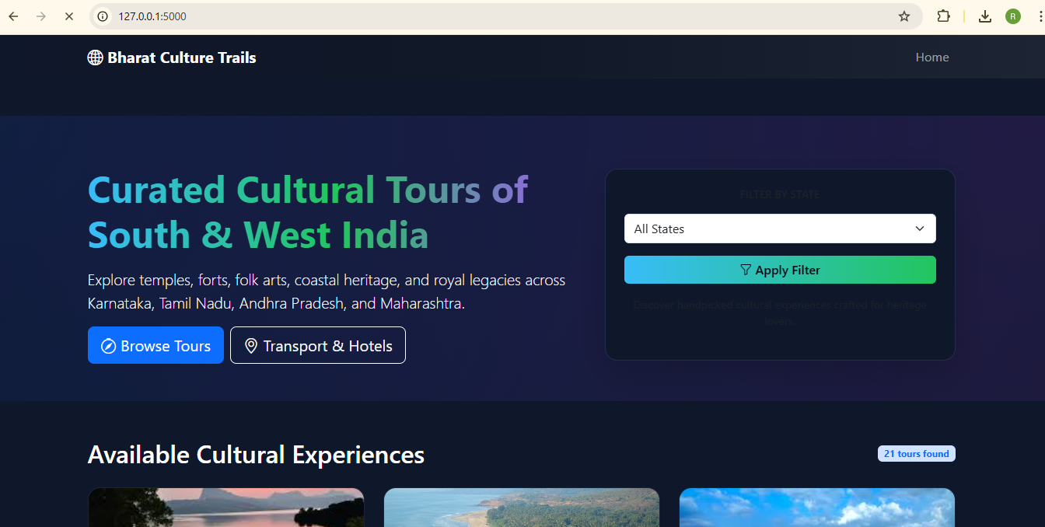
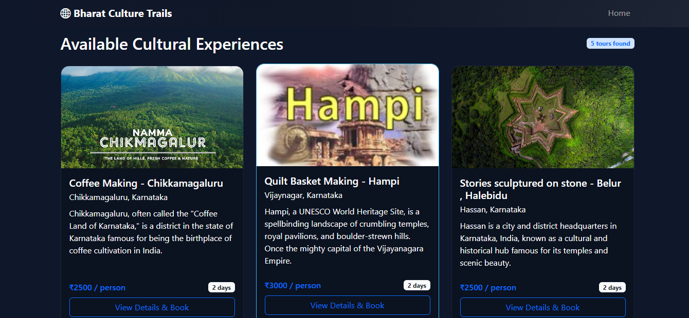
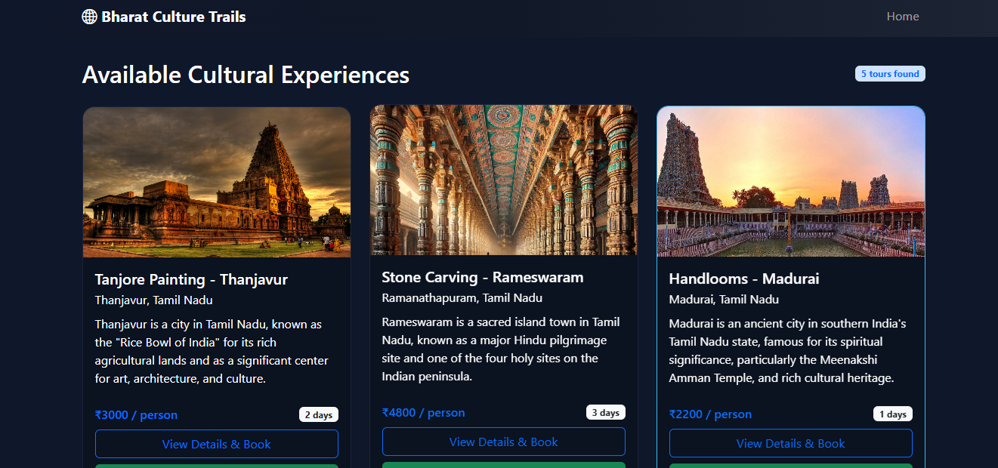
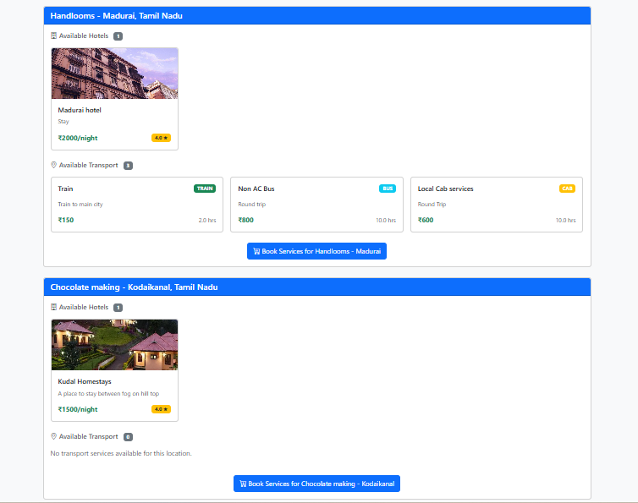
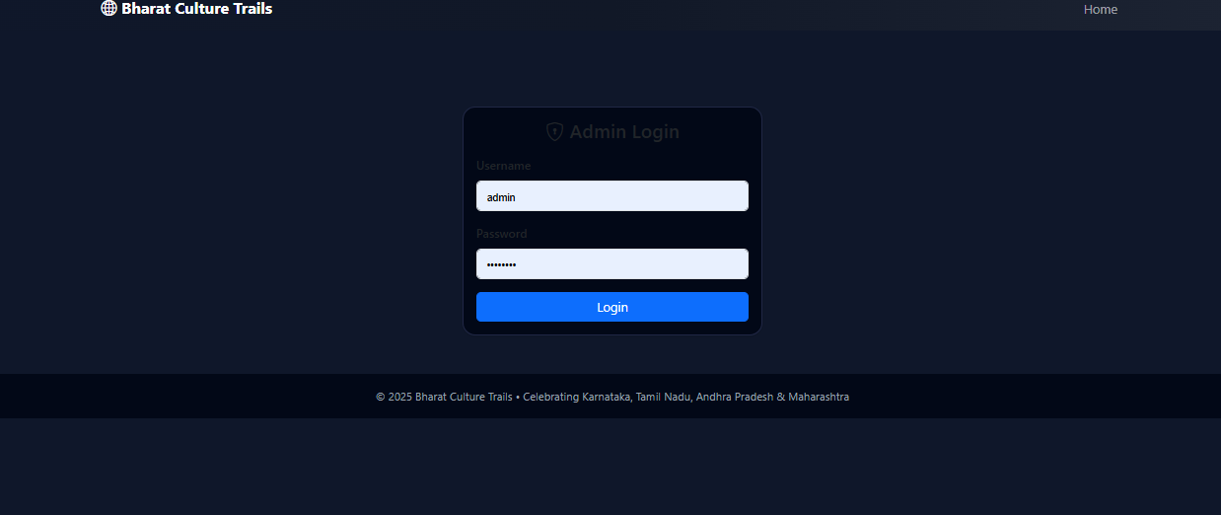
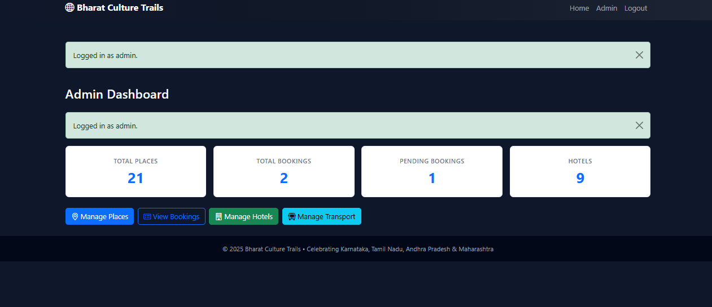
Project Screenshots

Slide 14
Results
Fully functional tourism portal
Seamless booking experience
Clean admin interface
Useful for cultural tourism promotion
Simplified management of services & places
Ready for deployment with minor enhancements

Slide 15
Conclusion
Successfully developed a cultural tourism portal
Helps users explore and book cultural experiences
Strengthens cultural tourism awareness
Provides admin tools for data management
Scalable and can be extended further

Slide 16
Future Enhancements
Virtual Reality (VR) Based Cultural Heritage Tours
  360° walkthroughs of temples, palaces, heritage streets
  VR storytelling about local traditions and rituals
  Simulated cultural festivals, dances, and workshops
AI Recommendation Engine
Use AI to recommend places, events, food, and itineraries based on user interests and travel behavior.
Multi-Language Support
Offer content in multiple regional and international languages to make the portal accessible to global users.
Dynamic Festival & Event Calendar
Integrate real-time cultural event updates so tourists can plan visits during festivals and special occasions.
AI Chatbot Support
Add a smart chatbot to instantly answer tourist queries and assist with bookings and recommendations.
Social Media Sharing
Allow users to share cultural experiences, photos, and visited locations directly to social media platforms.

Slide 17
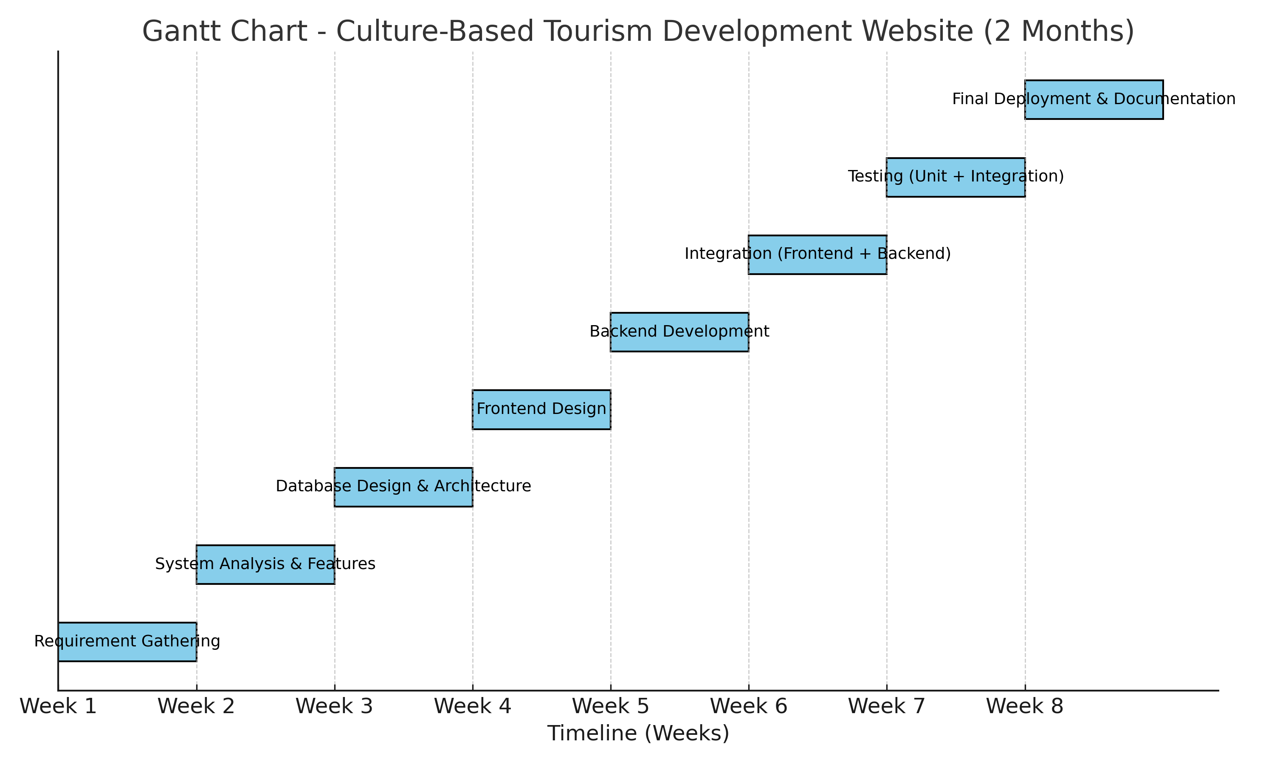
Timeline of the Project (Gantt Chart)

Slide 18


