Slide 1


Research on Improving the Quality of Online Customer Support Using Artificial Intelligence
Rakshitha Shyamanur Revanaradhya, ISIfmu24
(e-mail: rakshitha.shyamanur-revanaradhya@stud.vilniustech.lt )
Supervisor: Assoc. prof. Urtė Radvilaitė
18-06-2025

Slide 2

Research Goal
Tasks of the Thesis
Scientific Value
Novelty of the Research
Literature Review Results
Proposed Methodology
Feasibility analysis of the proposed methodology
Conclusion
Future works

Slide 3
Research Goal
To develop an NLP-based system for automating customer query classification and response generation across multi-channel support platforms. It aims to enhance response accuracy, customer satisfaction, and operational efficiency through advanced AI techniques.

Slide 4

Tasks of the Thesis
To analyze the limitations of existing customer support systems by identifying core challenges like delayed responses, lack of personalization, and scalability issues—laying the groundwork for targeted AI solutions.
To explore the applicability of AI technologies (e.g., NLP, chatbots, ML) in customer support by mapping their strengths and limitations to real-world service pain points.
To design and test AI-driven support solutions in practical environments, measuring improvements in response accuracy, personalization, and user satisfaction for scalable deployment.

Slide 5
Scientific Value of the Thesis
Provides a structured analysis of existing customer support limitations to define research goals and design parameters.
Integrates interdisciplinary AI technologies to develop a tailored taxonomy for customer service applications.
Validates AI prototypes through empirical testing, contributing measurable performance data to applied AI research.
Develops a scalable, modular framework adaptable to various industries, enhancing the applicability of the research.

Slide 6
Novelty of the Research
Sentiment-Aware Dynamic Responses: Unlike traditional support bots, the SSA adapts its tone and content based on real-time sentiment analysis, enabling emotionally intelligent and empathetic communication.
Contextual Retrieval with Vector Search: Leverages vector similarity search to fetch highly relevant, context-specific information from multiple data sources (FAQs, CRM, prior chats), enhancing response accuracy and relevance.
Human-in-the-Loop Escalation Mechanism: Seamlessly integrates automated processing with intelligent human fallback for complex or sensitive queries, ensuring both scalability and trust in support interactions.

Slide 7
Literature Review Results
Key Insights | Details | References
Automating Customer Service using LangChain | The dynamics of customer service are evolving, driven by technological advancements and the integration of Large Language Models (LLMs). | (Pandya & Mahavidyalaya, 2023)
Predicting the Use of Chatbots for Consumer Channel Selection in Multichannel Environments | Managing digital complexity with the help of artificial intelligence and supporting decisions in a multichannel context | (Oncioiu, 2023)
The Application of Chatbot for Customer Service in E-Commerce | We are able to manipulate the ability of chatbot to impersonate how humans interact with each other and will enable it to play a role as to handle the customer service in e-commerce websites or applications | (Wibowo et al., 2020)

Slide 8
Proposed Methodology
AI-Powered Smart Support Assistant (SSA): Utilizes NLP, sentiment analysis, and contextual knowledge retrieval to handle multilingual, unstructured customer queries across channels like chat, email, and social media.
Modular Pipeline: Comprises five key stages—data preprocessing, intent/sentiment detection, contextual knowledge retrieval, intelligent response generation, and performance evaluation.
Hybrid Intelligence Approach: Combines adaptive ML models with rule-based mechanisms to ensure reliability and flexibility, especially for complex or critical queries.
Continuous Improvement: Uses feedback loops and retraining to enhance accuracy, customer satisfaction, and efficiency over time, delivering scalable, cost-effective support.

Slide 9
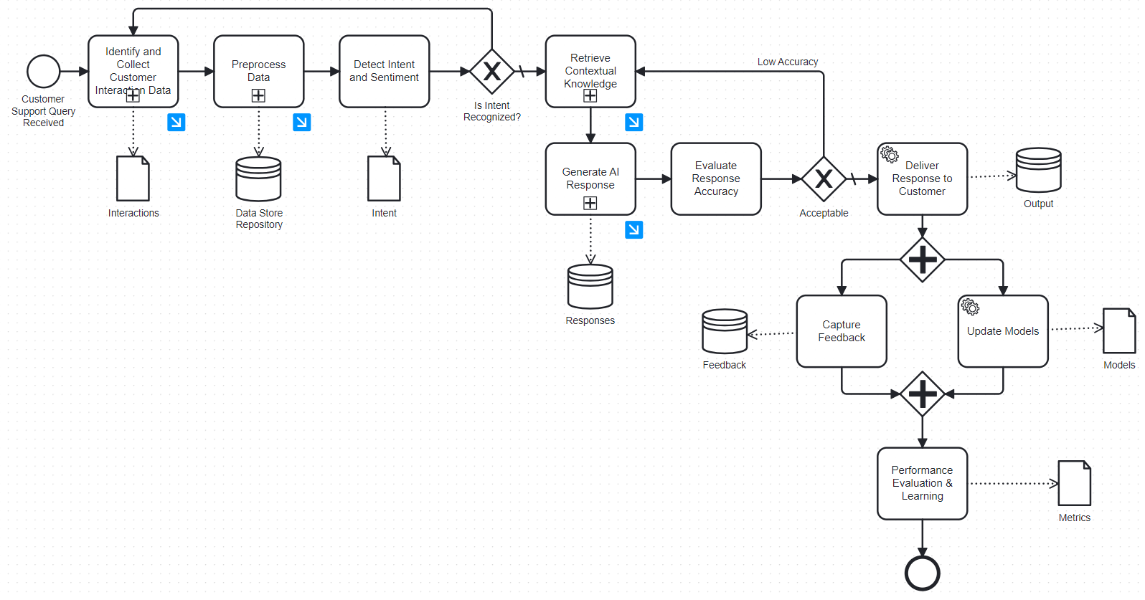
Proposed Methodology Contd…
BPMN Diagram for Proposed Methodology Main Process
The diagram illustrates the end-to-end workflow of an AI-powered customer support system. It covers query intake, intent detection, contextual response generation, evaluation, feedback capture, and continuous learning for model improvement.

Slide 10
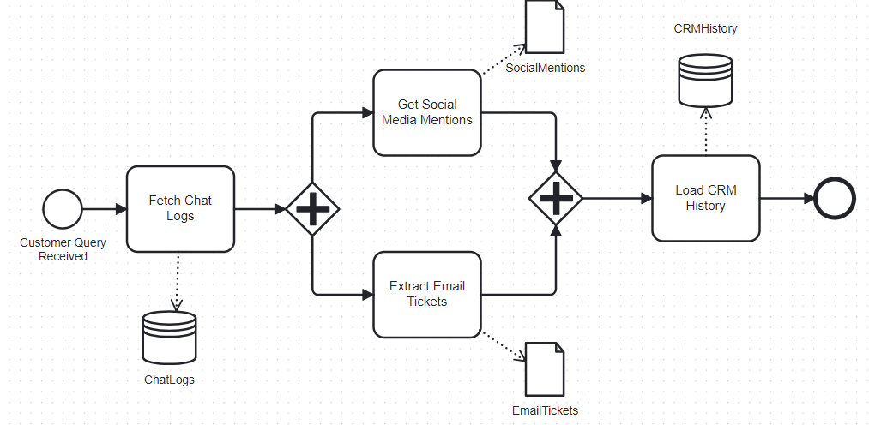
Proposed Methodology Contd…
BPMN for Identify and Collect Customer interaction data Sub-process
This diagram displays functions related to customer relationship management (CRM) and social media monitoring, including "CRM History," "Social Mentions," "Fetch Chat," and "Email Tickets."

Slide 11
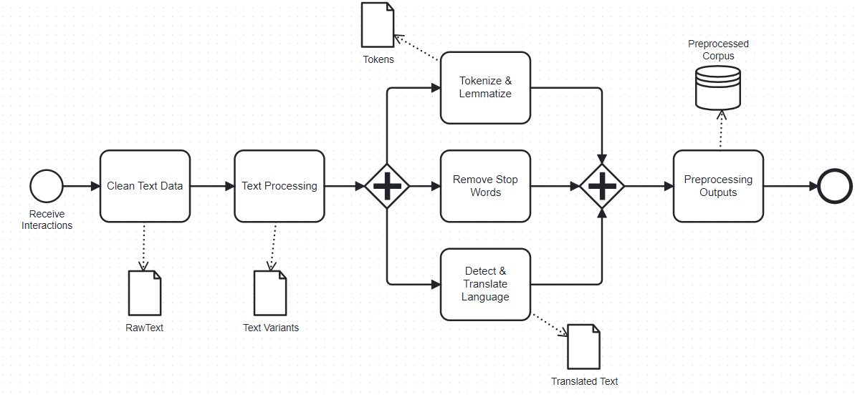
Proposed Methodology Contd…
BPMN for Pre-processed data Sub-process
The image shows a workflow or menu of text preprocessing tasks, including tokenization, lemmatization, stop word removal, language detection, and translation, with labels like "RawText," "Clean Text Data," and "Preprocessed Corpus."

Slide 12
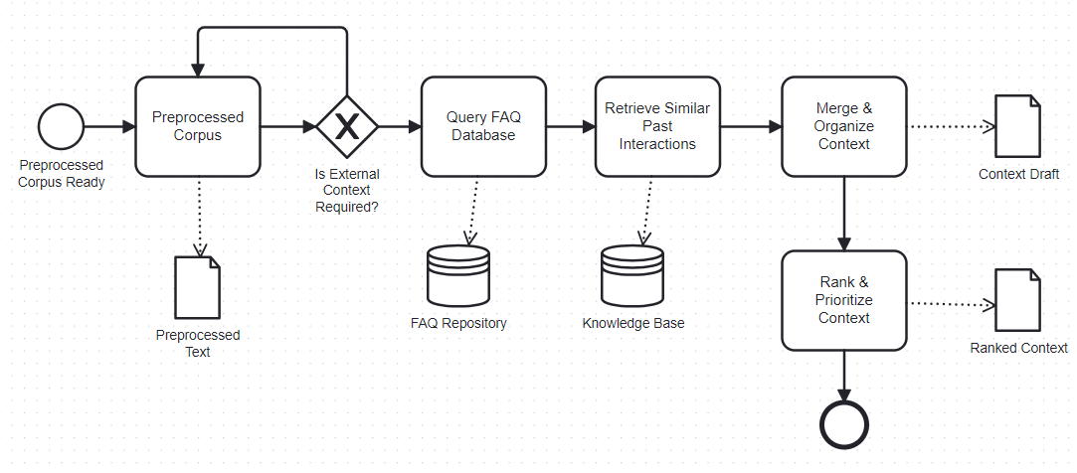
Proposed Methodology Contd…
BPMN for Retrieve Contextual Knowledge Sub-process
The image displays a structured workflow for processing a preprocessed corpus, including FAQ database queries, retrieval of past interactions, context ranking, and options for modifying changes, culminating in a context draft.

Slide 13
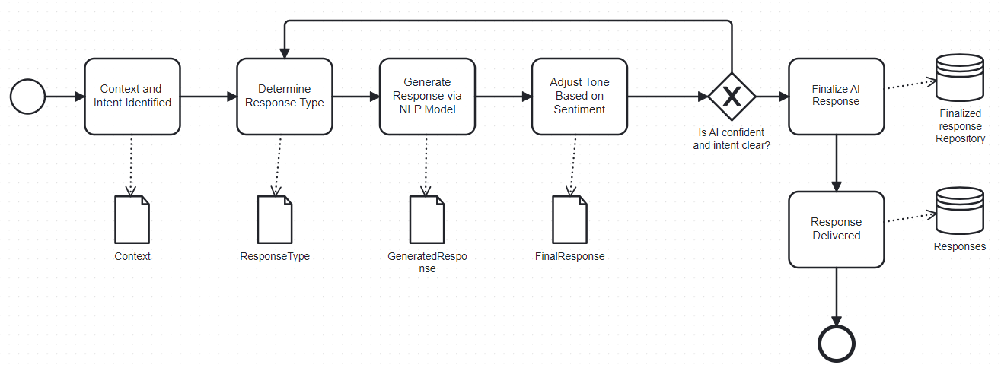
Proposed Methodology Contd…
BPMN for Generate AI response Sub-process
The image shows an AI response generation workflow, from context analysis and intent identification through NLP-based response creation, tone adjustment, and final delivery, with quality checks for confidence and clarity.

Slide 14
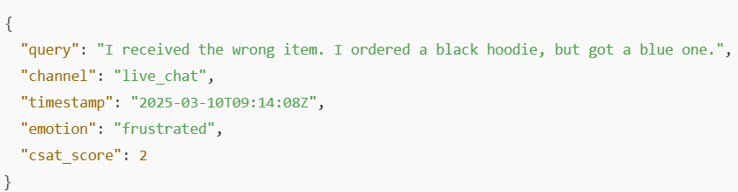
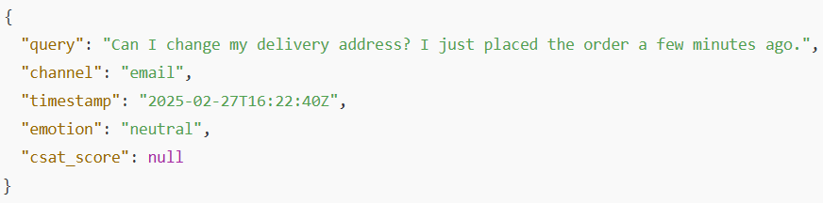
Feasibility analysis of the proposed methodology
Data Collection
Gathered customer support data from multiple e-commerce channels: 5,000 live chat transcripts, 2,000 email tickets, and 3,500 social media inquiries.
Included metadata such as timestamp, communication channel, and customer sentiment (when available).
Focused on real customer-agent interactions to ensure data relevance and quality.
Removed all personally identifiable information (PII) to comply with privacy and data protection standards.

Slide 15
Feasibility analysis of the proposed methodology contd..
Data Pre-processing
Applied text preprocessing techniques: cleaning, normalization, tokenization, lemmatization, stop word removal, and language detection using Python, spaCy, and NLTK.
Used a fine-tuned BERT model for intent classification (e.g., refund request, order inquiry).
Performed sentiment analysis with VADER and TextBlob to detect emotional tone (e.g., angry, happy, neutral).
Implemented a Retrieval-Augmented Generation (RAG) approach with vector databases for contextual response enrichment using relevant past interactions and FAQs.

Slide 16
Feasibility analysis of the proposed methodology contd..
Conducted initial experiments using a labeled multi-channel dataset; applied NLP preprocessing and classified queries into five key intent categories using a fine-tuned BERT model.
Achieved strong performance with an average F1-score of 0.86, with highest accuracy in identifying technical issues.
Slightly lower performance in the "Other" category highlights the complexity of handling broad, ambiguous queries.
Category | Precision | Recall
Login Issues | 0.91 | 0.88
Payment | 0.87 | 0.85
Technical Errors | 0.89 | 0.90
Account Information | 0.86 | 0.84
Other | 0.78 | 0.82
Macro Average | 0.86 | 0.86

Slide 17
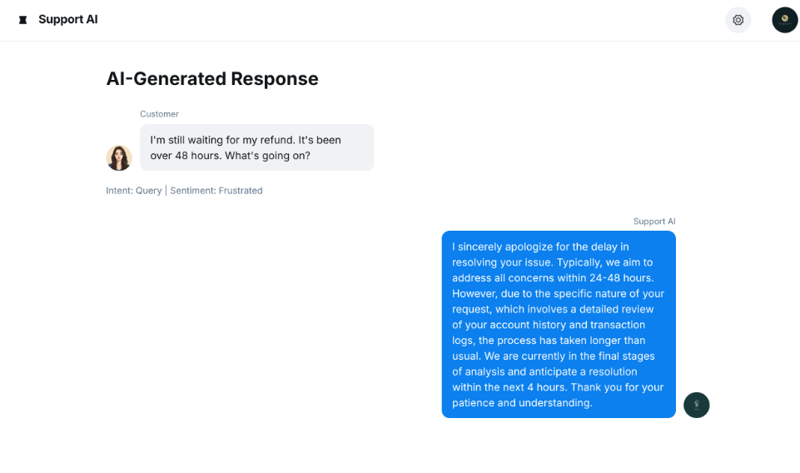
Feasibility analysis of the proposed methodology contd..
Demonstrated end-to-end AI response generation using Rasa, accurately detecting intent and sentiment to deliver empathetic, context-aware replies.
Utilizes mature NLP and ML tools with a modular, cloud-scalable architecture for seamless CRM integration.
Leverages diverse multi-channel customer data to train robust, generalizable models.
Achieves strong performance with an average F1-score of 0.86 across key intent categories.
Designed for adaptability—supports easy retraining, new languages, and additional communication channels.

Slide 18
Conclusion
Utilized Rasa, spaCy, and BERT for intent recognition, sentiment analysis, and response generation, achieving an average F1-score of 0.86.
Supports multi-channel data (chat, email, social media) with a scalable cloud-based architecture for real-world deployment.
Modular and flexible pipeline allows retraining with new data and integration with existing CRM systems.
Demonstrated improved response accuracy and operational efficiency, with future scope for multilingual and voice-based support.

Slide 19
Future work Plans
Advanced Capabilities: Integrate multimodal inputs (e.g., voice, images, code) and multilingual support to handle complex, diverse queries.
1
Enhanced Personalization: Use behavioral data, interaction history, and adaptive models to deliver more context-aware and user-specific responses.
2
AI-Human Collaboration: Improve agent interfaces with smart suggestions, real-time analytics, and collaborative tools to boost support efficiency and transparency.
3

Slide 20


THANK YOU FOR LISTENING
QUESTIONS ??

