Slide 1

Progress Presentation
Explainable and Actionable Machine Learning for Robust Student Performance Prediction Across Courses
Presented by
Supervised by
MARIA FARDUS MITA
(0692230005101003)
ISTIAK ALAM
(0692230005101005)
SYEDA NAZME RAHMAN
(0692230005101011)
BATCH : CSE20
Md. Khorshed Alam
Lecturer,
Department of CSE
Notre Dame University Bangladesh
February 3, 2026
1

Slide 2
Contents
Introduction
Motivation
Related works/Literature review
Objectives
Tools
Dataset and Methodology
Implementation/Proposed Algorithm
Future work
Conclusion
Progress Presentation
*
Department of CSE, NDUB
2

Slide 3
Introduction
Student performance prediction is widely used in education.
Most models are black-box and focus only on accuracy. Lack of explainability limits trust and real-world use.
This work applies Explainable ML for transparent student outcome prediction.
Progress Presentation
Department of CSE, NDUB
3

Slide 4
Motivation
Accuracy alone is not sufficient for educational decisions.
Educators need explanations they can trust and act upon.
Existing studies rarely provide:
Early-warning prediction
Generalization across courses
Actionable feedback
This research aims to address these gaps.
Progress Presentation
Department of CSE, NDUB
4

Slide 5
Related Works
Progress Presentation
Department of CSE, NDUB
5

Slide 6
Related works | Limitations
Contribution
Unified pipeline combining performance, fairness, and explainability
Uses open-access data → reproducible research
Strong use of SHAP + adversarial debiasing
Dataset limited to Portuguese secondary schools
Heavy reliance on G1 and G2 grades
SMOTE may introduce synthetic bias artifacts
No deep learning or longitudinal modeling explored
Beyond Performance: Explaining and Ensuring Fairness in Student Academic Performance Prediction with Machine Learning [1]
Using Data Mining to Predict Secondary School Student Performance [2]
Used decision trees and regression
No fairness and explainability
A Comparison of Machine Learning Techniques for the Prediction of the Student’s Academic Performance [3]
Compared multiple ML models
No bias analysis
Ignored demographic bias
Department of CSE, NDUB
6

Slide 7
Related works | Limitations | Contribution
 |  | Added SHAP + fairness
 |  | Semi-supervised learning
 |  | High accuracy
An explainable AI-based approach for predicting undergraduate students academic performance. [4]
Does not analyze intersectional bias deeply.
Limited socioeconomic analysis
An Ensemble-Based Semi-Supervised Approach for Predicting Students’ Performance. [5]
Lack of interpretability.
No fairness & interpretable
Supporting academic decision making at higher educational institutions using machine learning-based algorithms. [6]
Hard to justify to educators
Limited socioeconomic analysis
Progress Presentation
Department of CSE, NDUB
7

Slide 8
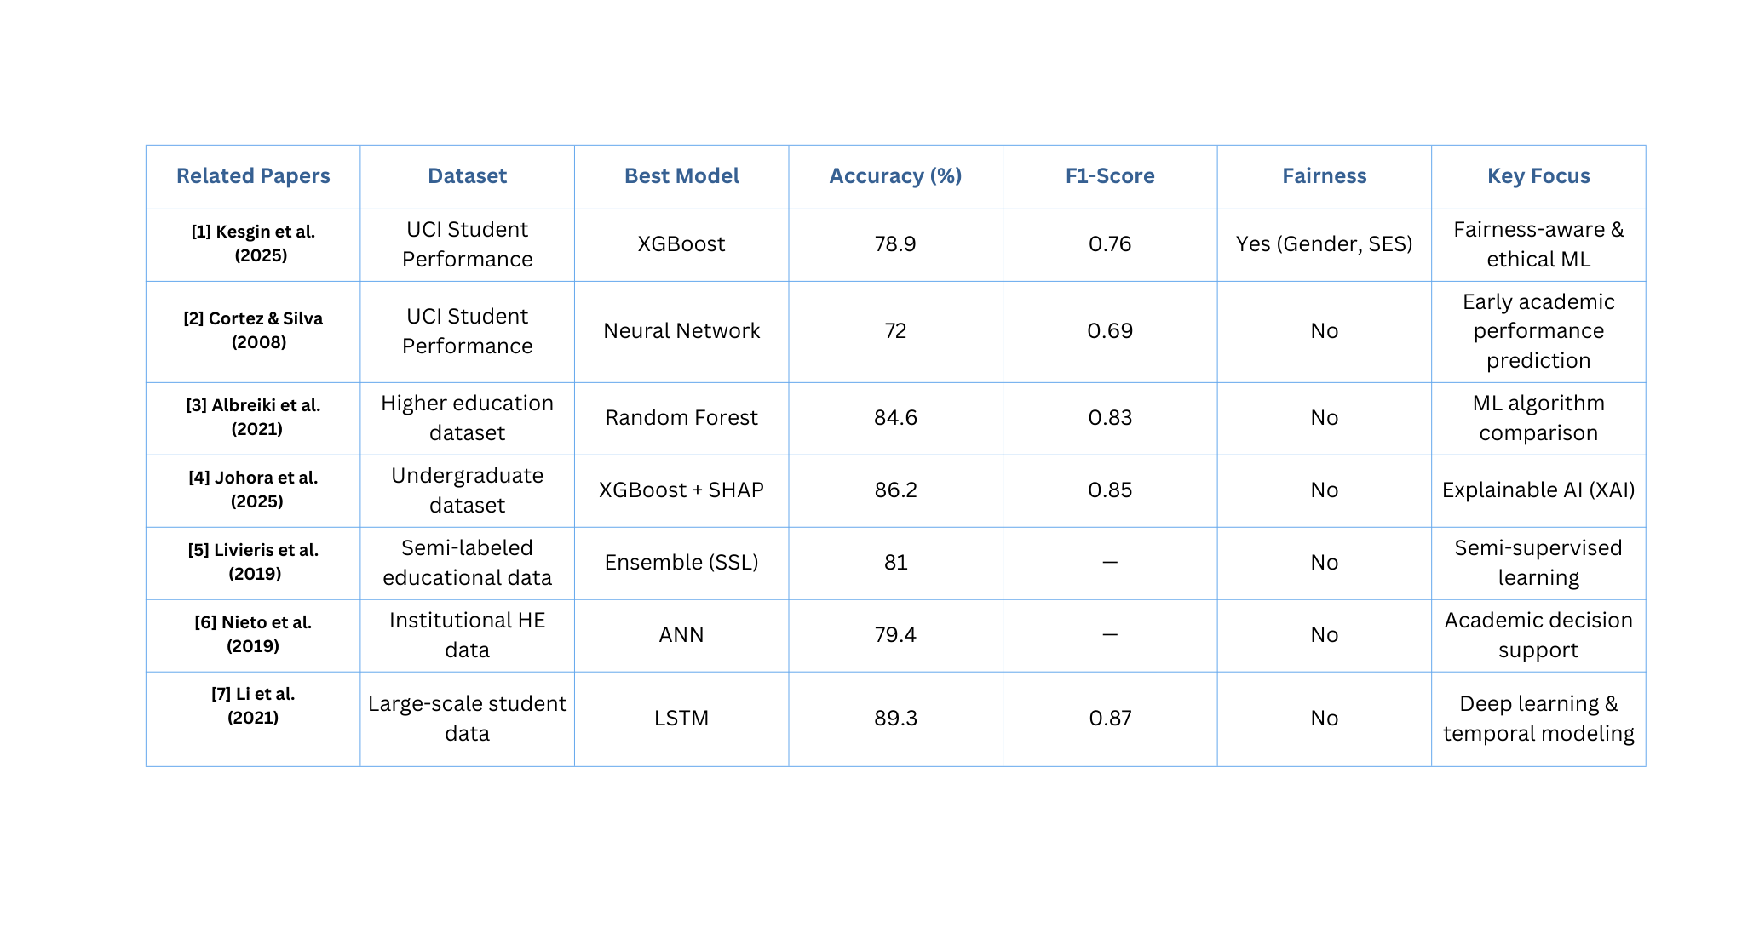
Comparison
Progress Presentation
Department of CSE, NDUB
8

Slide 9
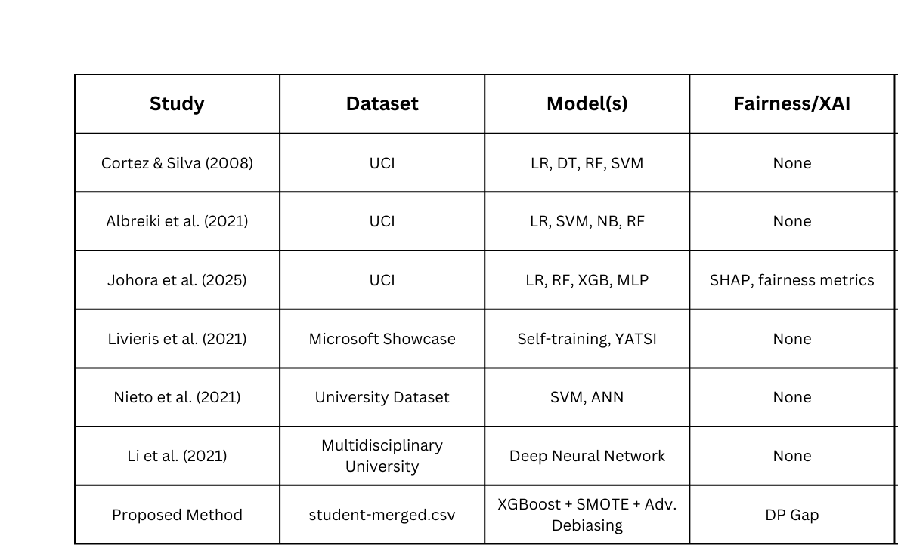
Research Gap Identified
Progress Presentation
Department of CSE, NDUB
9

Slide 10
Objectives
To address limitations of black-box models
To improve predictive performance over baseline methods
To ensure fairness and bias awareness
To integrate Human-in-the-Loop validation
To design a deployment-ready decision support framework
Progress Presentation
Department of CSE, NDUB
10

Slide 11
Dataset used
Name: Student Performance Dataset
Source: UCI Machine Learning Repository
Domain: Education
Objective: Analyze and predict student academic performance
Index Range: 1044 entries, 0 to 1043
Features: 30 input attributes
Files:
student-mat.csv (Mathematics)
student-por.csv (Portuguese)
Data Types
Categorical (e.g., sex, school)
Ordinal/Integer (e.g., study time, grades)
Binary (yes/no features)
No missing values
Clean and well-structured dataset
Progress Presentation
Department of CSE, NDUB
11

Slide 12
Dataset cont.
Types of Variables
Input Features
Demographic info: school, sex, age, address, family size, parents’ cohabitation.
Parental background: parents’ education, parents’ job.
School & behavioral: travel time, study time, failures, extra support, family support, paid classes.
Lifestyle & activity: free time, going out with friends, alcohol consumption (workday/weekend).
Attendance: absences.
Target Variable
G3: Final grade (numeric 0-20)
Can be used for regression or converted to categories (e.g., pass/fail) for classification.
Progress Presentation
Department of CSE, NDUB
12

Slide 13



Tools
Programming Language: Python 3.10
Libraries:
Scikit-learn (ML & evaluation)
XGBoost (boosting model)
Imbalanced-learn (SMOTE-NC)
SHAP & LIME (explainability)
Human in the Loop (validation)
Platform: Google Colab, Jypyterlab
Progress Presentation
Department of CSE, NDUB
13

Slide 14
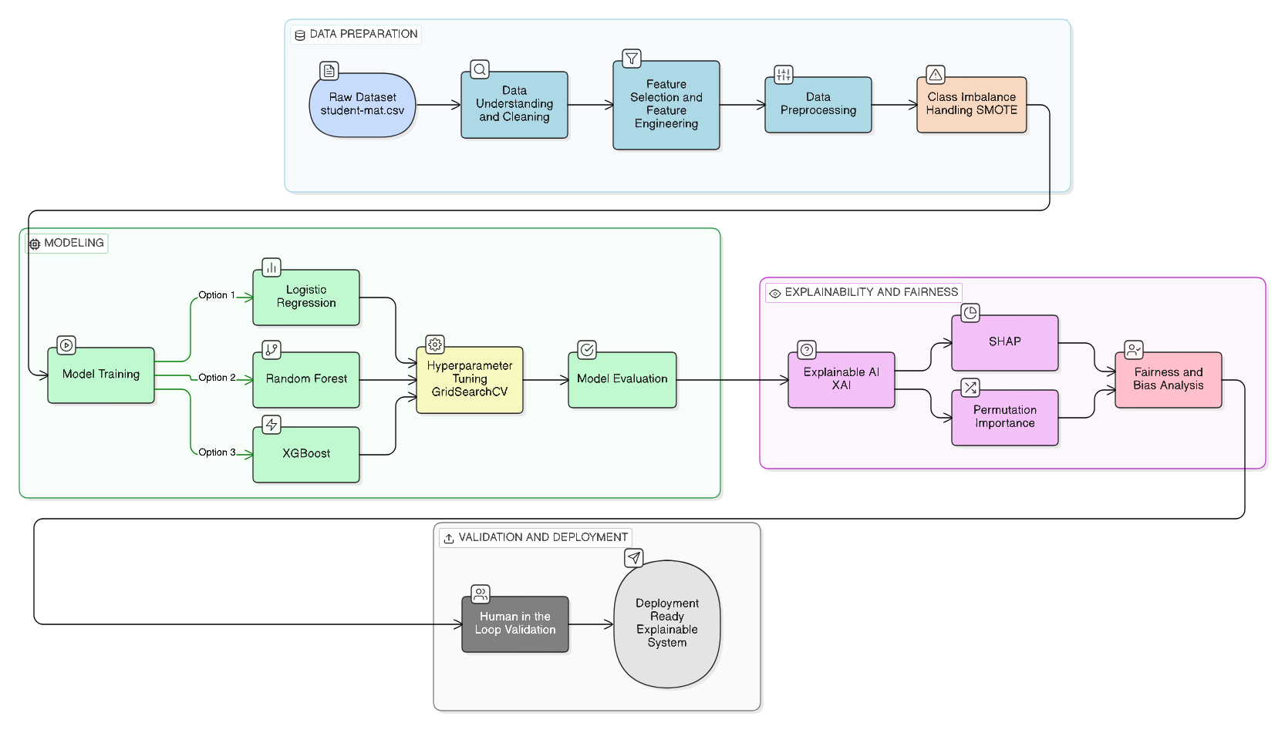
Methodology
Progress Presentation
Department of CSE, NDUB
14

Slide 15
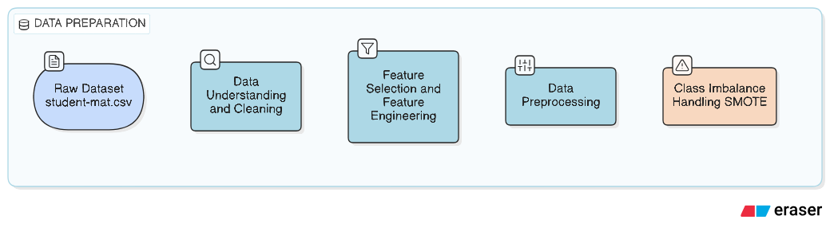
Methodology
Dataset Attributes
Feature Attributes
School
Sex
age
address
famsize
Pstatus
Medu
Fedu
Mjob
Fjob
reason
guardian
traveltime
studytime
failures
relationshipState
schoolsup
famsup
paidcls
activities
nursery
higher
internet
famrel
freetime
goout
Dalc
Walc
health
absences
G1
G2
School
Sex
age
address
famsize
Pstatus
Medu
Fedu
failures
absences
G1 (1st period Grade)
G2 (2nd Period Grade)
Target Attributes
G3 (Final Grade)
Progress Presentation
Department of CSE, NDUB
15

Slide 16
Methodology
Class Imbalance Handling (SMOTE)
Impact
Improved recall and F1-score for at-risk students
Reduced bias toward majority class
Reliable and ethical predictions
Problem: Imbalanced Classes
Dataset contains significantly more “Pass” cases than “Fail” cases
This imbalance biases models toward predicting the majority class
Solution: SMOTE (Synthetic Minority Over-sampling Technique)
Generates synthetic samples for the minority class
Creates new data points
Prevents overfitting
Progress Presentation
Department of CSE, NDUB
16

Slide 17
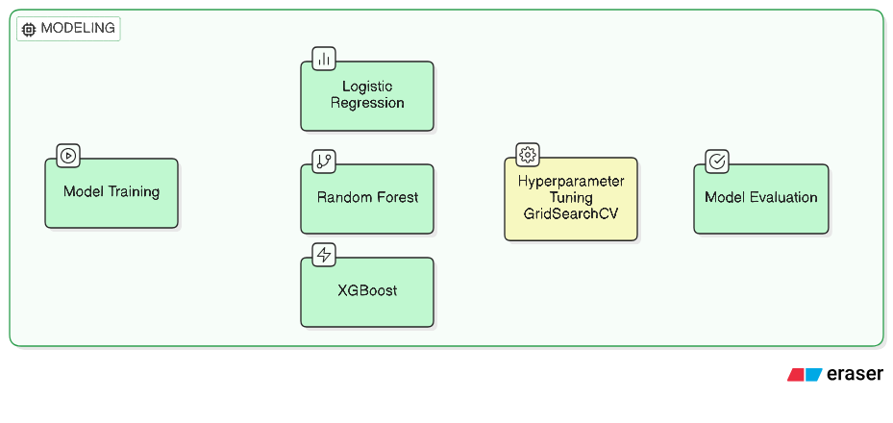
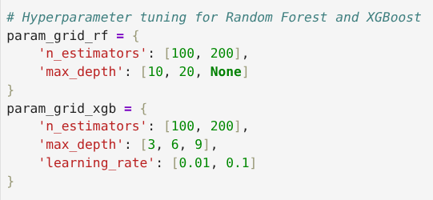
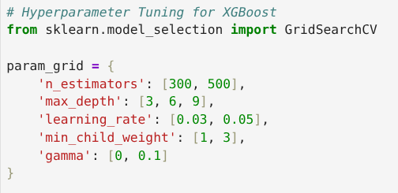
Methodology
Previous Tuning
Our Test Tuning
Progress Presentation
Department of CSE, NDUB
17

Slide 18
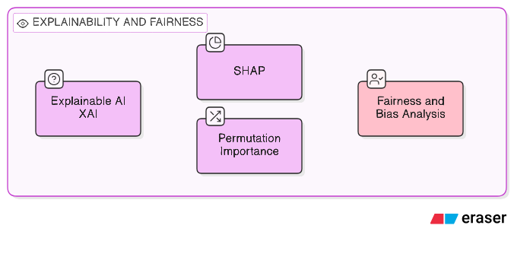
Methodology
Progress Presentation
Department of CSE, NDUB
18

Slide 19
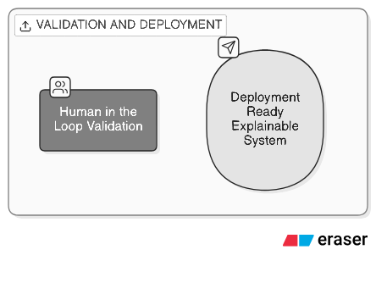
Methodology
Human in The Loop
Human-in-the-Loop validation integrates expert human judgment into model evaluation and decision-making to improve reliability, trust, and accountability.
class=1(P>0.5)
Probabilistic Predictions
Confidence=P(pass∣x)
Shap Confidence using the Prediction
Progress Presentation
Department of CSE, NDUB
19

Slide 20
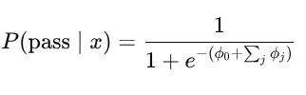
Methodology
Human in The Loop Cont.
SHAP does not compute probability itself.
It explains why the model produced that probability.
ϕ0​ = baseline prediction (average output across training data)
ϕj = contribution of feature j to this prediction
High | sum of ϕj ​|
→ strong influence
→ prediction is stable/confident
Low | sum of ϕj ​|
→ weak influence
→ prediction is uncertain
→ human review
Progress Presentation
Department of CSE, NDUB
20

Slide 21
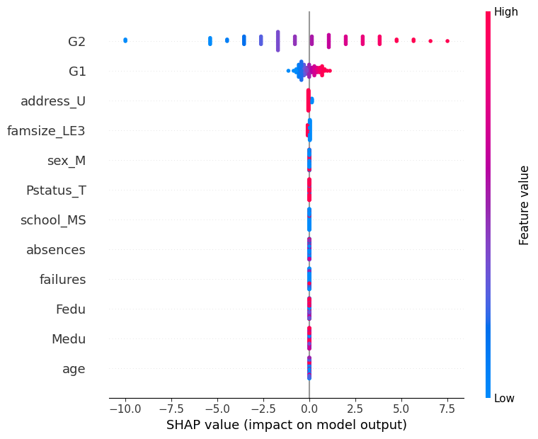
Result
SHAP for Logistic Regression (Linear model)
SHAP values quantify linear contributions of features to pass/fail prediction.
G2 and G1 are the most influential predictors, confirming academic relevance.
Socio-demographic features show minimal impact, supporting fairness.
The narrow SHAP distribution reflects the linear nature of Logistic Regression.
This model serves as a transparent baseline for comparison with complex learners.
Progress Presentation
Department of CSE, NDUB
21

Slide 22
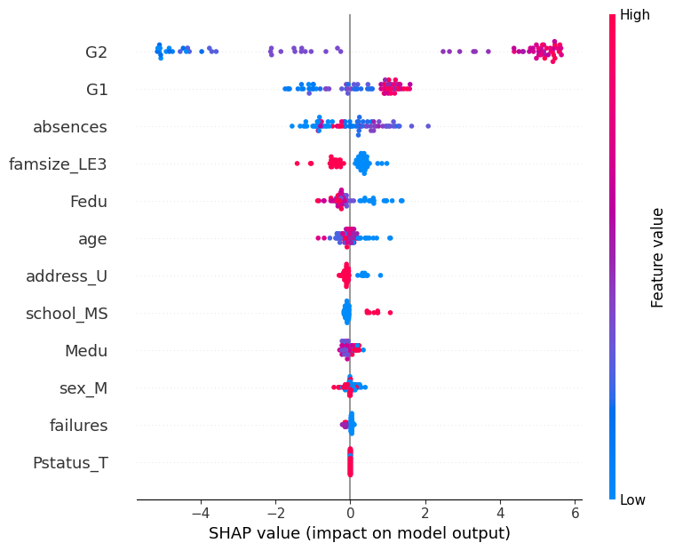
Result Cont.
SHAP-Based Explainability of XGBoost Model
The SHAP summary plot illustrates the global importance and directional influence of features.
Academic performance indicators (G2, G1) are the strongest contributors to student success.
Behavioral factors such as absences negatively impact predictions.
Socio-demographic attributes have limited influence, indicating reduced model bias.
This explainability enhances trust, transparency, and ethical deployment.
Progress Presentation
Department of CSE, NDUB
22

Slide 23
Result Cont.
SHAP-Based Explainability of XGBoost Model
The SHAP summary plot illustrates the global importance and directional influence of features.
Academic performance indicators (G2, G1) are the strongest contributors to student success.
Behavioral factors such as absences negatively impact predictions.
Socio-demographic attributes have limited influence, indicating reduced model bias.
This explainability enhances trust, transparency, and ethical deployment.
Progress Presentation
Department of CSE, NDUB
23

Slide 24
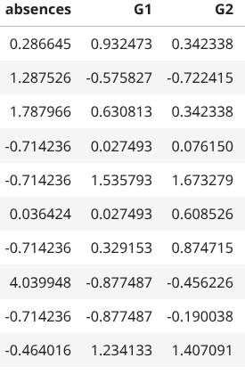
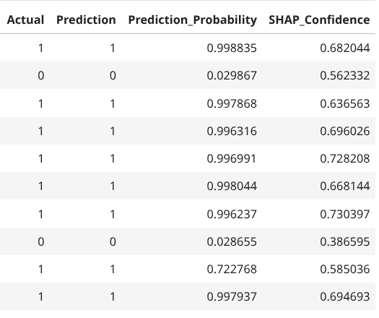
Result Cont.
Human in the loop Validation using Shap confidence
Progress Presentation
Department of CSE, NDUB
24

Slide 25
Comparing Result using dataset
Model | Accuracy | Recall | Precision | F1-Scrore
Random Forest | 0.934 | 0.9245 | 0.960 | 0.9423
XGBoost | 0.90 | 0.886 | 0.959 | 0.9215
Logistic Regression | 0.835 | 0.7735 | 0.976 | 0.9631
Our
Contribution
Random Forest | 0.789 | -- | -- | 0.868
XGBoost | 0.780 | -- | -- | 0.876
Logistic Regression | 0.775 | -- | -- | 0.867
Previous Works form
[1] K. Kesgin, S. Kiraz,
Progress Presentation
Department of CSE, NDUB
25

Slide 26
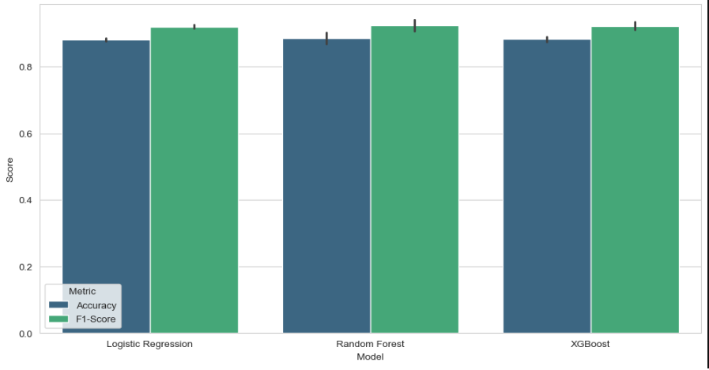
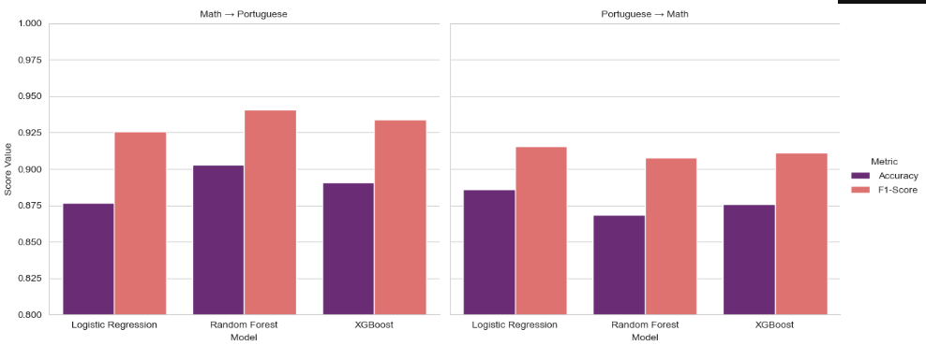
Result of cross-course generalization
Model | Train Dataset | Test Dataset | Accuracy | F1-Score
Logistic Regression | Math | Portuguese | 0.8767 | 0.9257
Random Forest | Math | Portuguese | 0.9029 | 0.9408
XGBoost | Math | Portuguese | 0.8906 | 0.934
Logistic Regression | Portuguese | Math | 0.8861 | 0.9156
Random Forest | Portuguese | Math | 0.8684 | 0.9078
XGBoost | Portuguese | Math | 0.8759 | 0.9111
Progress Presentation
Department of CSE, NDUB
26

Slide 27
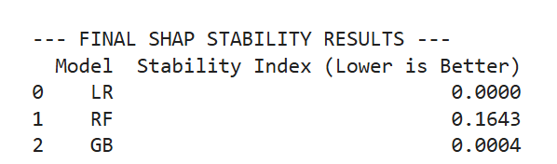
Evaluation of trustworthiness of SHAP explanation
Progress Presentation
Department of CSE, NDUB
27

Slide 28
Future works
Develop an early-warning ML system to identify at-risk students before final exams.
Generate actionable counterfactuals that suggest minimal changes for academic success.
Implement Premutation importance.
Deployment ready explainable System.
Progress Presentation
Department of CSE, NDUB
28

Slide 29
Conclusion
Implemented baseline ML models and SHAP explanations.
Designed experiments for early-warning and generalization.
Work is progressing toward a trustworthy and actionable AI system.
Progress Presentation
Department of CSE, NDUB
29

Slide 30
References
[1] K. Kesgin, S. Kiraz, S. Kosunalp, and B. Stoycheva, “Beyond Performance: Explaining and Ensuring Fairness in Student Academic Performance Prediction with Machine Learning,” Appl. Sci., vol. 15, no. 15, art. no. 8409, 2025, doi: 10.3390/app15158409
[2] P. Cortez and A. M. G. Silva, “Using data mining to predict secondary school student performance,” in Proc. EUROSIS Conf., 2008, pp. 5–12. [Online]. Available: https://archive.ics.uci.edu/ml/datasets/Student+Performance. Accessed: Jul. 11, 2025
[3] B. Albreiki, M. Zohdy, and H. Lutfiyya, “A comparison of machine learning algorithms for predicting student academic performance in higher education,” Int. J. Emerg. Technol. Learn., vol. 16, pp. 76–90, 2021.
Progress Presentation
Department of CSE, NDUB
30

Slide 31
References
[4] F. T. Johora, M. N. Hasan, and A. Rajbongshi, “An explainable AI-based approach for predicting undergraduate students’ academic performance,” Array, vol. 26, Art. no. 100384, 2025.
[5] I. E. Livieris, K. Drakopoulou, T. A. Mikropoulos, V. Tampakas, and P. Pintelas, “An ensemble-based semi-supervised approach for predicting student performance,” Int. J. Artif. Intell. Educ., vol. 29, pp. 405–428, 2019.
[6] Y. Nieto, V. García-Díaz, C. Montenegro, and R. G. Crespo, “Supporting academic decision making at higher educational institutions using machine learning-based algorithms,” Soft Comput., vol. 23, pp. 4145–4159, 2019.
[7] Z. Li, S. C. H. Hoi, W. Wang, L. Liu, and L. Wang, “Deep learning approaches for student performance prediction,” IEEE Trans. Learn. Technol., vol. 14, pp. 189–202, 2021.
Progress Presentation
Department of CSE, NDUB
31

Slide 32
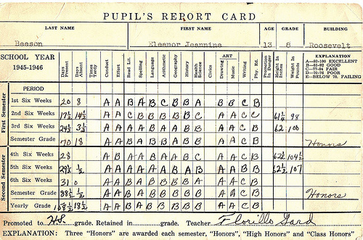
Thank You
Any queries?!!
Progress Presentation
Department of CSE, NDUB
32

