Slide 1
Graphics Hardware: Display Technology

Slide 2
Display Technology
A display is a computer output surface and projecting mechanism that shows text and often graphics image to the computer user, using a Cathode Ray Tube (CRT), Liquid Crystal Display (LCD), Light Emitting Diode (LED), Gas Plasma or other image projection technology.
Display can be characterized as:
Color capability
Sharpness and viewability
Size of the screen
Projection technology

Slide 3
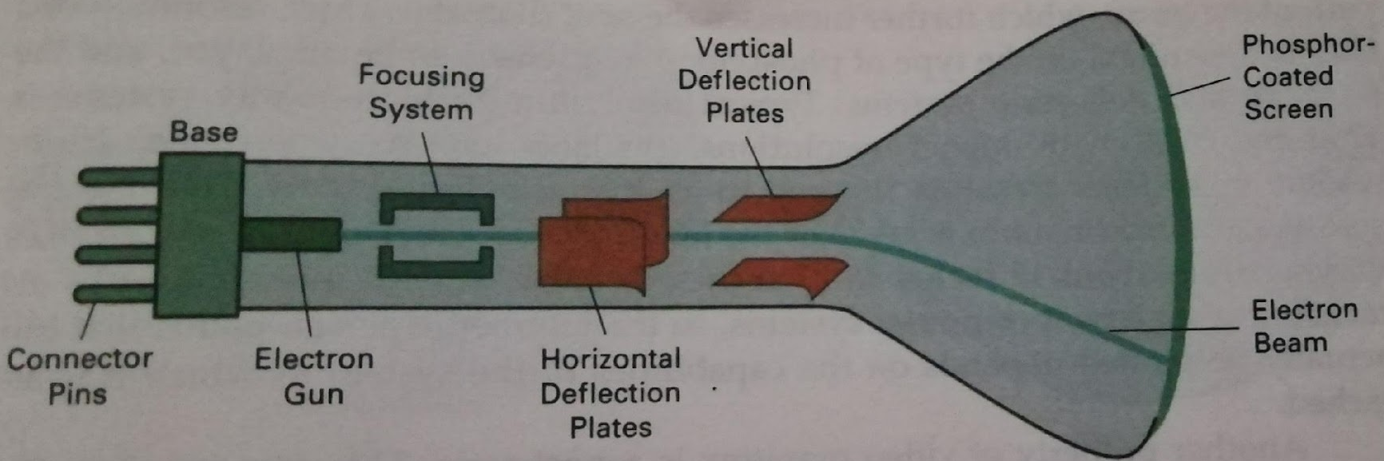
Cathode Ray Tube(CRT)
A CRT is a specialized vacuum tube in which images are produced when an electron beam strikes a phosphorescent surface. It modulates, accelerates and deflects electron beam onto the screen to create the images.
Most desktop computer displays make use of CRTs.
The CRT in a computer display is similar to the picture tube in a television receiver.

Slide 4
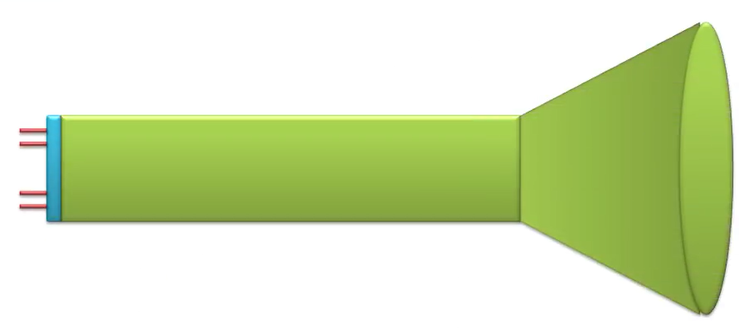
Cathode Ray Tube(CRT)
Basic component of CRT:
Tube pin (connectors): A CRT typically has a set of connector pins at the back of the tube, to control the tube. Types of tube pin are:
Heater pins: There are two heater pins, for power connections. They power the filament which generates the CRT’s electrons.

Slide 5
Cathode Ray Tube(CRT)
Deflection pin: It is not mounted at the back of the tube. In tubes which donot include these pins as part of the regular pinout, you should find the pins upon the neck of the tube, mounted upon the actual yoke. There are four yoke control pins total, 2 for horizontal positions and two for vertical position. Changing the voltage across these pins changes the vertical or horizontal position of the electron beam on the screen.

Slide 6
Cathode Ray Tube(CRT)
Basic component of CRT:
Grid pins: Control the level of voltage in CRT’s grids.
Cathode pin: In monochrome CRT there is only one cathode pin but in colour CRT there are three, one for each of the light’s primary color). These pins are basically used as digital inputs rather than analog. They are turned on when that particular cathode is meant to shine and turned off when it is not meant to. They are used in conjunction with the deflection control pins to control what colors are placed on the screen and where.

Slide 7
Cathode Ray Tube(CRT)
Basic component of CRT:
Cathode: It is negatively charged electrode that attracts +ve charge. It produce electron i.e. cathode is the source of electron.
Electron: Electron is a subatomic particle whose electric charge is –ve.
Heating filament
Cathode

Slide 8
Cathode Ray Tube(CRT)
Electron beam: Stream of electrons generated by heat. The electron in vacuum can be accelerated and their orbits controlled by electric or magnetic fields. A electron beam carry high kinetic energy.
Anode: It is positively charged electrode that attracts –ve charge.
Heating filament
Cathode

Slide 9
Cathode Ray Tube(CRT)
Basic component of CRT:
Grid: There important anodes between the heater and the rest of the CRT assembly. These anodes are commonly called the grids.
The first grid is the control grid, second grid is the screen grid and the third grid is the focus grid.
Heating filament
Cathode

Slide 10
Cathode Ray Tube(CRT)
Control grid control the brightness of the CRT. It is placed directly on the top of the cathode. If there is no voltage on control grid, the electrons can flow freely from the cathode. If there is some negative voltage, the electrons from the cathode are repelled and the screen appears darker. The more the voltage on control Grid, the darker the screen becomes.
Heating filament
Cathode
Control Grid

Slide 11
Cathode Ray Tube(CRT)
Focusing grid also called focusing anode controls the focus of the electron beam. This required to make the beam create a small sharp point on the screen.
The screen grid known as accelerating anodes or cutoff serves to push the electrons so that electrons travel more quickly toward the screen. This anode may be referred to as the accelerating anodes. The screen anode actually uses a positive voltage to pull the electrons.
Focusing anode
Heating filament
Cathode
Control Grid
Accelerating anode

Slide 12
Cathode Ray Tube(CRT)
Basic component of CRT:
Deflection system: Deflection system consists of two sets of electromagnets, one for vertical positioning, one for horizontal. Sometimes coils are used and sometimes plates are used. These serves to control where the electron beam is targeted. The electrons in the beam are sensitive to magnetism and can be moved. The vertical plates control the vertical position of the electron beam and the horizontal plates control the horizontal position of the electron beam.
Focusing anode
Horizontal deflection plates
Heating filament
Cathode
Control Grid
Accelerating anode
Vertical deflection plates

Slide 13
Cathode Ray Tube(CRT)
Basic component of CRT:
Screen: It is a plate of glass, coated by phosphor. When a part of this coating is struck with the electron beam, the phosphor become excited and they produce light. The chemical composition of the phosphor determines what color of light it will produce. The electron beam must strike each phosphor individually. The strength of the electron beam determines how brightly the phosphor will glow.
Focusing anode
Horizontal deflection plates
Heating filament
Cathode
Control Grid
Accelerating anode
Vertical deflection plates

Slide 14
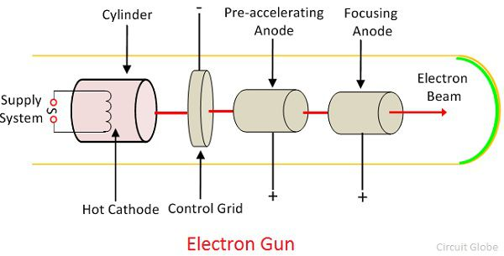
Cathode Ray Tube(CRT)
Basic component of CRT:
So what is electron gun?
The assembly of cathode and control grid is called the electron gun.

Slide 15
Cathode Ray Tube(CRT)
Persistence:
Time it takes the emitted light from the screen to decay to one tenth of its original intensity.
Lower the persistence phosphors requires higher refresh rates to maintain a picture on a screen without flicker.
A phosphor with low persistence is useful for animation whereas high persistence phosphor is useful for displaying highly complex, static pictures.
Graphics monitors are usually constructed with a persistence in the range from 10 to 60 microseconds.

Slide 16
Raster Scan Display
In this technology, electron beam is swept across the screen, one row at a time from top to bottom, during this beam intensity is turned on or off to create a pattern of illuminated spots.
Framebuffer is a memory area which holds the set of intensity values for all screen points.
Intensity values are then retrieved from refresh buffer and painted on the screen one row (scan line) at a time.
Each screen point is referred to as pixel or pel (picture element).
The capability of raster scan system to store intensity information for each screen point makes it well suited for realistic display of scenes containing dedicated shading and color patterns.
Intensity range for pixel position depends on the capability of the raster system. For example: in black and white system, each screen point is either on or off. Therefore only one bit per pixel is needed to control the intensity of screen positions.
A bit value of 1 indicate that electron beam is turned on at that position and 0 indicates beam intensity is to be off.
Additional bits are needed when color and variations can be displayed.

Slide 17
Raster Scan Display
A system with 24 bits per pixel, and screen resolution of 1024×1024 requires 3 MB of storage for the frame buffer.
Bitmap: Frame buffer on a black and white system with one bit per pixel
Pixmap: The frame buffer of a system with multiple bits per pixel.
Refreshing on a raster scan displays is carried out at the rate of 60 to 80 frames per second.
A refresh rate of 60 frames per second is termed as 60 Hz.
Horizonatal retrace: At the end of each scan line, the electron beam returns to the left side of the screen to begin displaying the next scan line. The return to the left of the screen after refreshing each scan line is horizontal retrace.
Vertical retrace: At the end of each frame the electron beam returns to the top left corner of the screen to begin the next frame.

Slide 18
Raster Scan Display
Interlaced refresh procedure: On some raster scan systems each frame is displayed in two passes using an interlaced refresh procedure. At higher resolutions, the frame is sometimes scanned in interlaced fashion: first the odd numbered lines and then the even numbered lines. This allows for a lower refresh rate without producing flicker. Although it is best suited for text and fixed graphics display but not suitable for animated graphics.
Interlacing is primarly used with slower refreshing rates. For example: with a raster scan display with 30 frames per second, noninterlaced display, some flicker is noticed.
But with interlacing each of the two passes can be accomplished in 1/60th of a second which brings the refresh rate nearer to 60 frames per second and can avoid flicker.

Slide 19
Random Scan Display
In random scan display unit, a CRT has the electron beam directed only to the parts of the screen where a picture to be drawn.
Random scan monitors draw a picture one line at a time and for this reason are also referred to as vector or stroke writing or calligraphic displays).
Refresh rate on a random-scan system depends on the number of lines to be displayed.
In this picture definition stored as a set of line drawing commands in an area of memory referred to as the refresh display file or display list, display program or refresh buffer.
To display a specified picture, the system cycles through the set of commands in the display file drawing each component line in turn.
After all line drawing commands are processed the system cycles back to the first line command in the list.

Slide 20
Random Scan Display
Random scan displays are designed to draw all the component lines of a picture 30 to 60 times each second.
Random scan display are designed for line drawing applications and cannot display realistic shaded scenes.
Picture definition is stored as a set of vector displays generally have higher resolution than raster systems.
It help to produce the smooth line drawings because the CRT beam directly follows the line path.

Slide 21
Color CRT montiros
A CRT monitor displays color pictures by using a combination of phosphors that emit different colored light.
By combining the emitted light from the different phosphors, a range of colors can be generated.
Technique for producing color displays with CRT:
Beam Penetration
Shadow masking

Slide 22
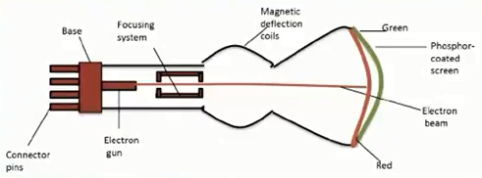
Color CRT montiros
Beam Penetration:
It used random scan monitors for displaying color pictures.
It has two layer of phosphor, usually red and green, coated onto the inside of the CRT screen and the displayed color depends on how far the electron beam penetrates into the phosphor layers.
A slow electron excites only the outer red layer.
A beam of very fast electrons penetrates through red layer and excites the inner green layer.
Beam speeds and combination of red and green light are emitted to show two additional colors, orange and yellow. The speed of electron and screen color at any point is controlled by the beam acceleration voltage.

Slide 23
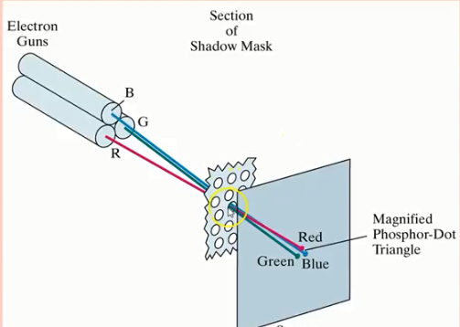
Color CRT montiros
Shadow mask method:
Shadow mask method normally used in raster scan system as it can produce a wide range of colors than beam penetration method.
It has 3 phosphor color dots at each pixel position.
One phosphor dot emits a red light, another emits a green light and the third emits a blue light.

Slide 24
Color CRT montiros
Shadow mask method:
It has three electron gun one for each color dot.
Shadow mask grid just behind phosphor coated screen is placed which consist of a holes where a single hole is equal to pixel.
The three electron beams are deflected and focused as a group into the shadow mask which contains a series of holes aligned with the phosphor dot patterned. When three beam passes through a hole in the shadow mask they activate a triad (a dot triangle).
The phosphor dots in the triangles are arranged so that each electron beam can activate only its corresponding color dot when it passes through the shadow mask.

Slide 25
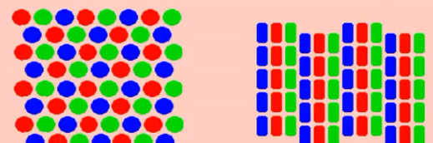
Color CRT montiros
Shadow mask method:
Triangular (Delta)
Inline (High resolution color CRT)

Slide 26
Color CRT montiros
Shadow mask method:
The inline arrangement in three electron guns help the three electron guns and the corresponding RGB color dots on the screen.
The inline arrangement of electron gun is easier to keep alignment and normally used for high resolution color CRTs.
We obtain color variations in a shadow mask CRT by varying the intensity levels of the three electron beam.
The color we see depends on the amount of excitation of the red, green and blue phosphors.
High quality raster graphics systems have 24 bits per pixel in the frame buffer which allow 256 voltage settings for each electron gun with nearly 17 million color choices for each pixel.
An RGB color systems with 24 bits of storage per pixel is generally referred to as full color or true color system.

Slide 27
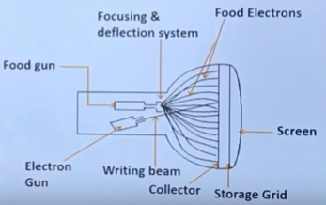
Direct View Storage tube
It stores the picture information inside the CRT instead of refreshing the screen.
DVST stores the picture information as a charge distribution just behind the phosphor coated screen.
Two electron guns are used in DVST: Primary gun and flood gun.
Primary gun or writing gun used to store picture pattern as a +ve charge on storage grid whereas flood fun maintains the picture display.
It doesnot required refreshing so complex pictures can be displayed at very high resolution without flicker. However it donot display color and selected parts of a picture cannot be erased. To erase certain part of the picture entire screen must be erased and modified picture must be redrawn which is time consuming for complex picture.

Slide 28
Direct View Storage tube
It stores the picture information inside the CRT instead of refreshing the screen.
DVST stores the picture information as a charge distribution just behind the phosphor coated screen.
Two electron guns are used in DVST: Primary gun and flood gun.
Primary gun or writing gun used to store picture pattern as a +ve charge on storage grid whereas flood fun (collector)maintains the picture display which has lesser energy.
Electrons passes through collector at low speed and are attracted by +vely charged picture pattern on storage grid and are repelled by the rest. The attracted electrons by positive picture pattern pass right through it and strike on phosphor making it visible screen.

Slide 29
Flat panel display
It is a class of video devices that have reduced volume, weight and power requirements compared to a CRT.
Example: Small TV monitors, calculators, pocket video games, laptop computer, etc.
Types of flat panel display:
Emissive displays
Non emissive displays

Slide 30
Flat panel display
Emissive display:
It is a device which convert electrical energy into light
Example: Plasma panels, thin film electroluminescent display, LED,etc.
Non emissive display:
It is a device which convert sunlight or light from other source into graphics patterns. Example: LCD.

Slide 31
Plasma Panel
It is called as gas discharge display are constructed by filling the region between two glass plates with a mixture of gases that usually includes neon.
It consists of two ribbon, Horizontal and vertical ribbons on two glass panel.
Firing voltages applied to a pair of horizontal and vertical conductors cause the gat the intersection of the two conductors to break down into a glowing plasma of electron and ions.
Picture definition is stored in refresh buffer and the firing voltages are applied to refresh the pixel positions (intersecting the conductors) 60 times per second.
For brighter display it use alternating current method.
Separation between pixels is provided by the electric field of the conductors.
Mostly it is used in monochromatic system but system have been developed for displaying color and grayscale using plasma panel.

Slide 32
Thin film electroluminescent displays:
It is similar to plasma panel expect that the region between the glass plates is filled with a phosphor such as zinc sulfide doped with manganese rather than gas.
When sufficiently high voltage is applied to a pair of crossing electrodes the phosphor becomes a conductor in an area of the intersection of the two electrodes.
Electrical energy is then absorbed by the manganese atoms which then release energy as a spot of light similar to the flowing plasma effect in a plasma panel.

Slide 33
LED (Light Emitting Diode)
It is a emissive device where a matrix of diodes is arranged to form the pixel positions in the display and picture definition is stored in refresh buffer.
As in scan line refreshing of a CRT, information is read from refresh buffer and converted to voltage levels that are applied to the diodes to produce the light patterns in the display.

Slide 34
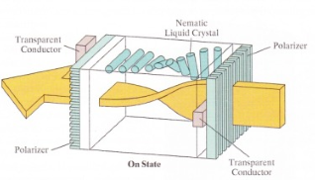
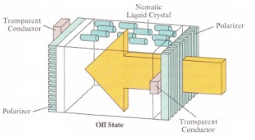
LCD (Liquid Crystal Display)
It is non-emissive devices which produce a picture by passing polarized light from the surroundings or from an internal light source through a liquid crystal materials that are aligned to either block or transmit the light fully or partially.
It has a crystalline arrangement of molecules, which flow like a liquid.

Slide 35
LCD (Liquid Crystal Display)
A flat panel display commonly use nematic liquid crystal compound that tend to keep the long axes of the rod shaped molecules aligned.
Two glass plates each containing a light polarizer at right angles to the other plate, sandwich the liquid crystal material.
Rows of horizontal transparent conductors are built into one glass plate and columns of vertical conductors are put into the other plate.
The intersection of two conductors defines a pixel position.

Slide 36
LCD (Liquid Crystal Display)
Passive matrix LCD:
Polarized light passing through the material is twisted so that it will pass through the opposite polarizer. The light is then reflected back to the viewer. To turn off the pixel, we apply a voltage to the two intersecting conductors to align the molecules so that the light is not twisted. This type of flat-panel device is referred to as a passive-matrix LCD.
Picture definitions are stored in a refresh buffer, and the screen is refreshed at the rate of 60 frames per second, as in the emissive devices. Back lighting is also commonly applied using solid-state electronic devices, so that the system is not completely dependent on outside light sources. Colors can be displayed by using different materials or dyes and by placing triad of color pixels at each screen location.

Slide 37
LCD (Liquid Crystal Display)
Active matrix LCD:
Transistor is palced at each pixel location using thin flim transistor technology. The transistors are used to control the voltage at pixel locations and to prevent charge from gradually leaking out of the liquid crystal cells. These devices are called active matrix displays.

Slide 38
Software Standards
With standard graphics functions software can be moved easily from one hardware system to another and used in different implementations and applications.
If we do not have standard programs for graphics, designed for one hardware system often cannot be transferred to another system without extensive rewriting of the programs.
Types of software standards for graphics:
GKS (Graphical Kernel System)
PHIGS (Programmer’s Hierarchical

Slide 39
Software Standards
GKS (Graphical Kernel System):
This was the first graphics software standard developed by ISO, ANSI and various national standards organizations.
GKS was originally designed for 2D graphics package and later on 3D GKS extension was subsequently developed.
PHIGS (Programmer’s Hierarchical Interactive Graphics Standard):
It is an extension of GKS with increased capabilities for object modeling, color specifications, surface rendering and picture manipulation.
The extension of PHIGS called PHIGS+ was developed to provide 3D surface shading capabilities which was not available in PHIGS.
Standard graphics functions are defined as a set of specifications that is independent of any programming language.

Slide 40
Software Standards
PHIGS (Programmer’s Hierarchical Interactive Graphics Standard):
A language binding is then defined for a particular high level programming language which allow for accessing various standard graphics functions from this language.
For example: the general form of the PHIGS and GKS function for specifying a sequence of n-1 connected 2D straight line segment is : polyline(n,x,y). In FORTRAN this procedure is implemented as a subroutine with the name GPL.
In C the procedure would be invoked with ppolyline(n,pts) where pts is the list of coordinate endpoint positions.
PHIGS only provide a specification for basic graphics functions, it doesnot provide a standard methology for a graphics interface to output devices.
Computer Graphics Interface (CGI) is a standardization for device interface methods.
Computer Graphics Metafile (CGM) system specifies standards for archiving and transporting pictures.

Slide 41
Software Standards
PHIGS Workstations:
The term workstation refers to a computer system with a combination of input and output devices that is designated for a single user.
PHIGS and GKS workstation is used to identify various combinations of graphics hardware and software.
A PHIGS workstation can be a single output device, a single input device, a combination of input and output devices, a file or even a window displayed on a video monitor.

Slide 42
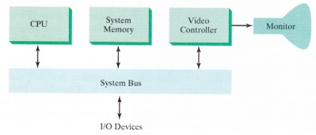
Raster Scan Systems
Video Controller
A special purpose processor called video controller or display controller is used to control the operation of the display device.
In addition to the video controller most sophisticated raster system employ other processors as coprocessors and accelerators to implement various graphics operations.

Slide 43
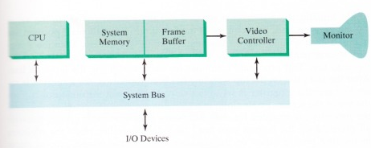
Raster Scan Systems
Video Controller
In a raster system, a fixed area of the system memory is reserved for the frame buffer and the video controller is given direct access to the frame buffer memory. Frame buffer locations and screen positions are referenced in Cartesian coordinates.
In most of the graphics monitors the coordinates origin from lower left screen corner. The screen surface is then represented at the first quadrant of 2D system with +ve x values increasing to the right and positive y values increasing from bottom to top.
Scan line are labelled from y_{max} at the top to 0 at the bottom, each scan line screen pixel positions are labelled from 0 to x_{max}.

Slide 44
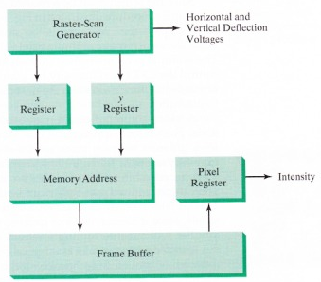
Raster Scan Systems
Video Controller
In video controller, two registers (x register and y register) are used to store the coordinates of the screen pixels where initially, x register is set to 0 and y register is set to y_{max}.
The value stored in the frame buffer for this pixel position is then retrieved and used to set the intensity of the CRT beam. Then the x-register is incremented by 1 and the process repeated for the next pixel position on the top of the scan line.

Slide 45
Raster Scan Systems
Video Controller
After the last pixel on the top of the scan line has been processed, the x-register is reset to 0 and the register y is decremented by 1. After cycling through all pixels along last scan line (y=0) the video controller resets the registers to the first pixel position on the top scan line and the refresh process start over.
To speed up the pixel processing, video controller can retrieve multiple pixel values from the refresh buffer on each pass and multiple intensities values are stored in separate register and used to control the CRT beam intensity for a group of adjacent pixels. When that group of pixels has been processed the next block of pixel values is retrieved from the frame buffer.

Slide 46
Raster Scan Systems
Video Controller
In high quality systems, two buffers are often used, one for refreshing and other to fill the intensity values where the two buffers can switch the roles.
This is used to provide fast mechanism for generating real-time animations, since different views of moving objects can be successively loaded into the refresh buffer and also some transformations can be accomplished by the video controller.

Slide 47
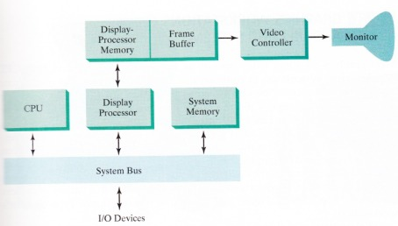
Raster Scan Systems
Raster Scan Display Processor:
It is also referred to as graphics controller or display coprocessor. It’s main task is to free the CPU from the graphics routine rasks.
It’s major task is to digitizing a picture definition given in an application program into a set of pixel intensity values for storage in the frame buffer. The digitization process is called scan conversion.
It can also be used for generating various lines sytles (dashed, dotted, solid), displaying color areas and performing certain transformations and manipulations on displayed objects. As well as to interface with interactive input devices such as a mouse.

Slide 48
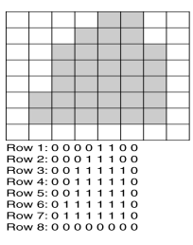
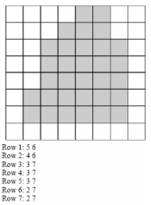
Raster Scan Systems
Raster Scan Display Processor:
There are three common methods for storing raster data:
Cell encoding
Run-length encoding
Quad tree

Slide 49
Raster Scan Systems
Raster Scan Display Processor:
To reduce the memory requirements in raster system, frame buffer has been organized in linked list and encoding the intensity information. For this, one way is to store each scan line as a set of integer pairs, where one number repesents the intensity value and the second number represents the number of adjacent pixels on the scan line that are to have that intensity. This method is called run length encoding. This method help to save the storage space if a picture is to be constructed with long runs of a single color each.
Another method is cell encoding which encode the raster as a set of rectangular areas i.e. raster is stored as a matrix and its cell values are written into a file by row and column.
The disadvantages of encoding runs are :
Intensity changes are difficult to make and storage requirements actually increase as the length of the runs decreases.
It is difficult for display controller to process the raster when many short runs are involved.

Slide 50
Random Scan Systems
In this system, an application program is input and stored in the system memory along with a graphics package. Graphics commands in the application program are translated by the graphics package into a display file stored in the system memory.
This display file is then accessed by the display processor to refresh the screen.
The display processor cycles through each command in the display file program once during every refresh cycle.
Graphics patterns drawn on this system by directing electron bema along the component lines of the pictures.
Lines are defined by the values of their coordinate endpoints and these input coordinate values are converted to x and y deflection voltage.
A scene is then drawn one line at a time by positioning the beam to fill in the line between specified endpoints.

