Slide 1
Unit-2
Hardware and software Concept

Slide 2
Introduction
In computer graphics objects are represented as a collection of discrete element called pixels (smallest screen element of an image).
Users can edit graphic objects with the help of keyboard, mouse, touch sensitive panels on the screen So we can say Graphic devices are combination of input and output (display) devices.

Slide 3
Input Devices
Keyboard:
This device is mandatory peripheral for any computer. Its alphanumeric keys derived from traditional typewriter and are used to enter text strings, while additional keys such as arrow and function keys, performs special actions.
Mouse:
This is an example of pointing devices which input spatial data to the computer. As mouse is moved by user’s hand on a flat surface, a mechanical ball or optical sensor at its base signals the amount of movement to the computer which correspondingly moves a cursor on the screen. The user determines the location of the cursor. Mouse is more than just a pointing device, it has buttons each of which can be clicked to give binary input.

Slide 4
Input Devices
3. Touchpad:
Another 2D point device, particularly common on portable computers, the touchpad is a small rectangular area embedded with electronic sensors to determine the position of a touching finger or stylus. Movement of the finger or stylus is echoed by movement of cursor.
Pointing stick:
It is another 2D pointing device common on portable computers, the pointing stick is typically a rubber peg located between ‘G’, ‘H’ and ‘B’ keys, which moves the cursor in response to pressure applied with a finger.
Trackball
This is essentially an upside down mouse with a socket containing a ball which the user manipulates with his hand to make the cursor move.

Slide 5
Input Devices
6. Spaceball:
This is a pointing device with six degrees of freedom versus the two of an ordinary mouse. It is used in special applications such as manipulating a camera in a 3D scene: not only is the camera moved but also rotated, affording it multiple degrees of freedom, each of which the user controls. The spaceball itself consists of a pressure sensitive ball which can distinguish different kinds of forces, including backward/forward, lateral and twist, responding by moving and orienting the selected object.
7. Tablet:
This is a digitizing device which has a surface embedded with sensors to pick up the successive coordinates of a stylus head or fingertip as it travels over the surface (in effect converting physical motion into digital data). The user can write or draw on a tablet, just as on paper with pen, the output being displayed on the monitor. The monitor is usually separate but on devices like tablet PC, the display and sensing surface are the same.

Slide 6
Input Devices
8. Haptic device:
This is a pointing device which gives physical feedback to the user based on the location of the cursor or possibly, that of an object being moved along with the cursor. The functioning of heptic device is like a mouse with a mechanical ball which is programmed to lock and stop rolling when cursor reaches the side of the screen. The reaction of user then has is of that cursor running into physical obstacles at the edge of the screen. The three link arm swiveling on a ball gives it six degree of freedom. Haptics can be used on teleoperation of robots and simulated surgery training in medicine
9. Joystick
This is an input device popular in video games and applications such as flight simulators. A joystick pivots around a fixed base, gaining thus two degrees of freedom. Usually it has buttons which can provide additional input. In a game or simulator setting joystick is typically used to control object traveling through space.

Slide 7
Input Devices
10. Wheel:
This is also a input device for games and simulators obviously derived from car steering wheel and provides rotational input in an exactly similar manner generally to virtual automobile. Haptic feedback to give the user a sense of vehicle’s response and even of the terrain over which it is traveling, is becoming increasingly popular.
9. Camera:
This is a input device to capture images from surroundings. It also provided software to recognize faces, gestures and expressions.
Data gloves
Touchscreen
Gamepad

Slide 8
Input Devices
10. Wheel:
This is also a input device for games and simulators obviously derived from car steering wheel and provides rotational input in an exactly similar manner generally to virtual automobile. Haptic feedback to give the user a sense of vehicle’s response and even of the terrain over which it is traveling, is becoming increasingly popular.
9. Camera:
This is a input device to capture images from surroundings. It also provided software to recognize faces, gestures and expressions.
Data gloves
Touchscreen
Gamepad

Slide 9
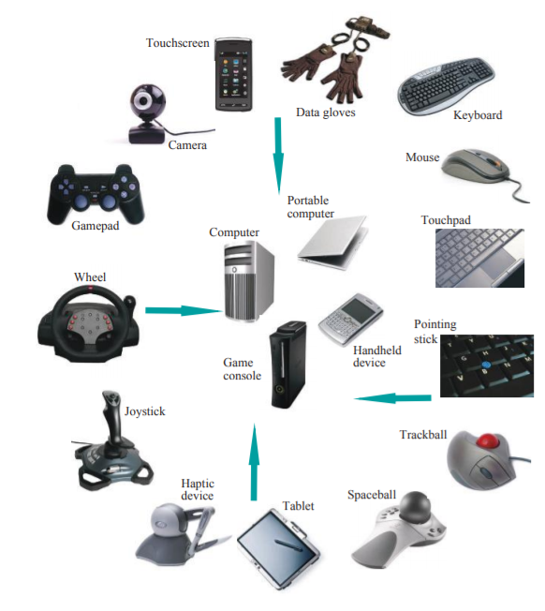
Input Devices

Slide 10
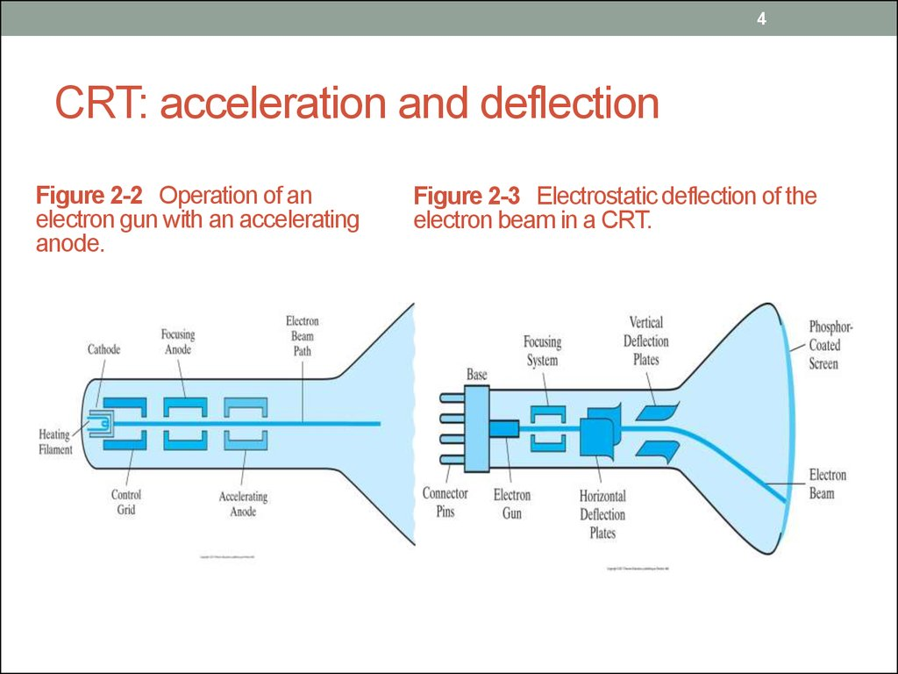

Slide 11
Output Devices
CRT (Cathode Ray Tube):
CRT is a device which convert electrical signal (voltage, current) into visual signal
CRT (Cathode Ray Tube) is a specialized vacuum tube in which images are produced when electron beam strikes a pahosphorescent surface. The CRT in a computer display is similar to the picture tube in a television receiver.
Heat is supplied to the cathode by passing current through heater element. The cathode is a cylindrical metallic structure that is rich in electrons.
A beam of electrons (Cathode rays) emitted by electron gun, passes through focusing and deflection systems that direct the beam toward specified positions on the phosphor-coated screen.
Then phosphor emits a small spot of light at each position contracted by electron beam.
As light emitted by phosphor fades very rapidly, so to keep phosphor glowing is to redraw the picture repeatedly by quickly directing the electron beam back over the same points. This type of display is called refresh CRT.

Slide 12
Output Devices
CRT (Cathode Ray Tube):
The primary components of an electron gun in CRT are heated metal cathode and a control grid.
Heat is supplied to the cathode by directing a current through a coil of wire, called filament, inside cylindrical cathode structures. Due to this heat, electrons boiled off and then free negatively charged electrons are accelerated towards the phosphor coating by a high positive voltage. The intensity of the electron beam is controlled by setting voltage levels on the control grid, which is a metal cylinder that fits over the cathode.
A high negative voltage applied to the control grid shuts off the beam by repelling electrons and stopping them from passing through the small hole at the end of the control grid structure. A smaller negative voltage on the control grid simply decreases the number of electrons passing through the cathode. Therefore we can control the brightness of display by varying the voltage on the control grid.

Slide 13
Output Devices
CRT (Cathode Ray Tube):
Focusing and deflection coils are together needed to force the electron beam to converge into a small spot as it strikes the screen otherwise electrons would repel each other, and the beam would spread out as it approaches the screen.
Focusing is accomplished either by electric or magnetic field.
Electrostatic focusing is generally used in television and computer graphics monitors.
Deflecting coils produce extremely low frequency electromagnetic field that allows for constant adjustment of the direction of the electron beam.
There are two sets of deflecting coils: horizontal and vertical.
Horizontal deflection plates controls the vertical deflection and vertical deflection plates control the horizontal deflection.

Slide 14
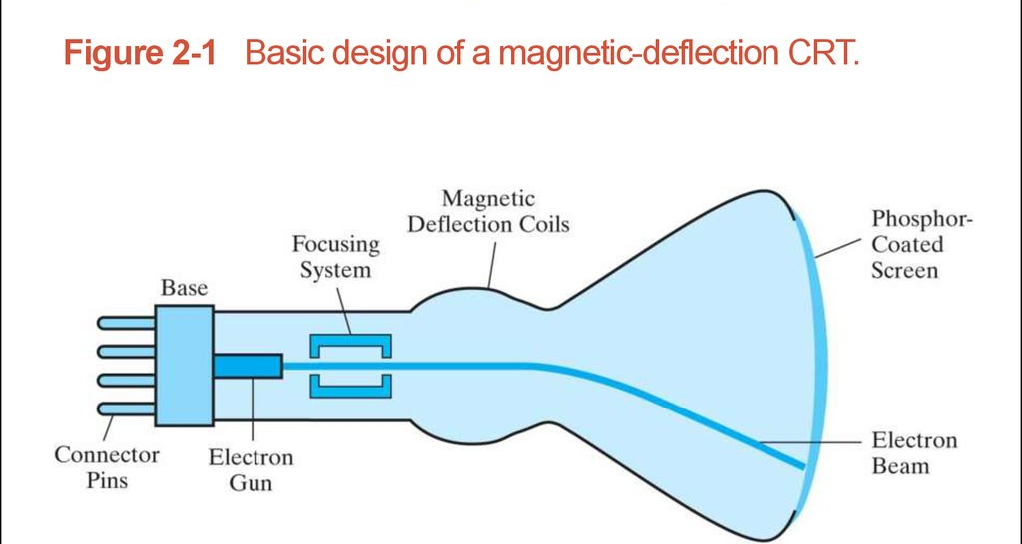
Output Devices
CRT (Cathode Ray Tube):
When the electrons in the beam collide with phosphor coating they are stopped and their kinetic energy is absorbed by phosphor. Then part of beam energy s converted to light and heat and resulting in screen display.

Slide 15
Output Devices
CRT (Cathode Ray Tube):

Slide 16

Output Devices
Factors affecting on CRT
Pixel or Pel or Picture Element: It is a smallest addressable screen element.
Resolution: Number of pixels per inch that can be drawn horizontally and vertically. It is nothing but clarity and sharpness of the picture. High quality resolution is 1280x1024.
Persistence: The time taken to emit light from the screen to decay to 1/10th of its original intensity.
Aspect ratio: It gives the ratio between vertical and horizontal points necessary to produce equal lines in both directions on the screen. The standard aspect ratio is 4:3 or 5:4.
Addressability: It is a measure of spacing between centers of vertical and horizontal lines.

Slide 17
Output Devices
Factors affecting on CRT
Refresh rate:Due to phosphorescence property of phosphor atom, the phosphor glows when electron beam strikes the certain part of the screen. After some time, the intensity of the glowing phosphor starts to reduce. In such, it is necessary to maintain the stable image, for this the electron beam must move horizontally and vertically and then return to redraw it a number of times per second. If the electron beam takes too long to refresh, it becomes visible as a flicker in the image. So refresh rate is the number of times per second the display is able to draw a new image. This is measured in Hz.

Slide 18
Two types of Refresh CRT’s
Raster Scan:
Raster scan display is the most common method of drawing images on a CRT screen. In this, horizontal and vertical deflection signals are generated to move a beam all over the screen in a pattern for displaying an image.
In this, the electron beam is swept across the screen one row at a time from top to bottom.
The electron beam sweeps back and forth from left to right across the screen. The beam is on while it moves from left to right. The beam is off when it moves back from right to left. This process is called horizontal retrace.
As soon as beam reaches the bottom of the screen, it turned off and rapid move back to the top left to start again. This process is called vertical retrace.
In raster scan display, it maintains the steady image on the screen by repeating scanning of the same image. This process is called refreshing of a screen. The refreshing on rsater scan is carried out at the rate of 60 to 80 frames per second

Slide 19
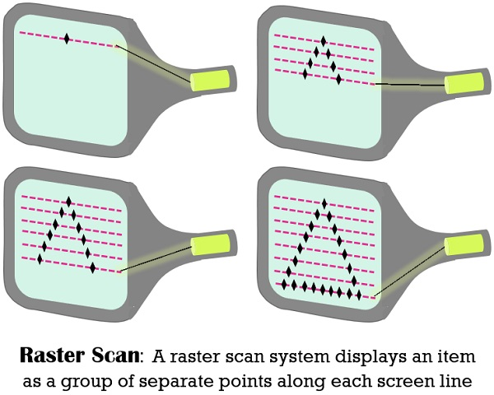
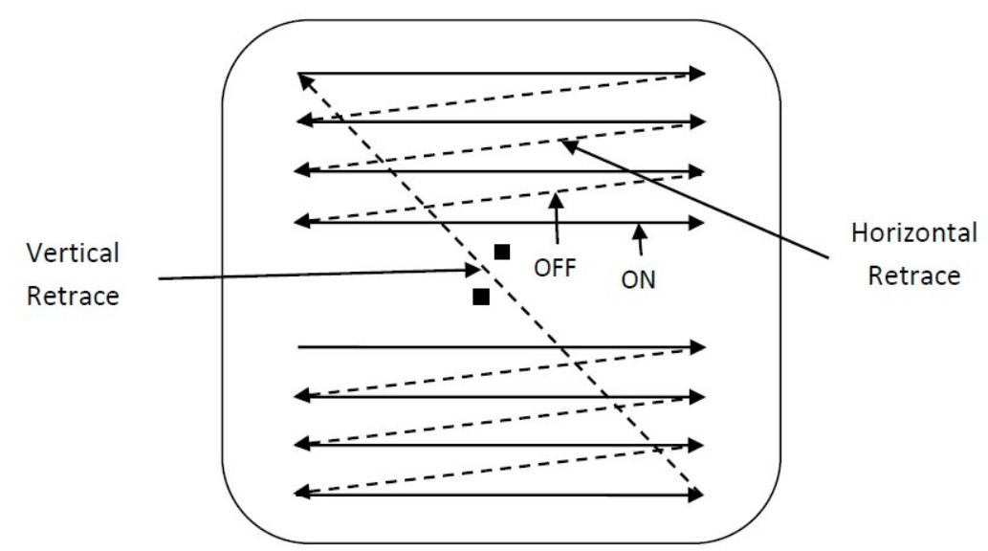

Slide 20
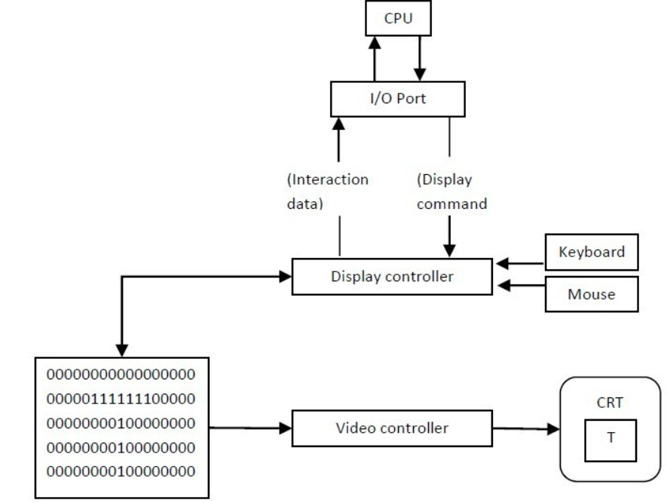
The architecture of Raster display. It consists of a display controller, CPU, video controller, refreshes buffer, keyboard, mouse, and CRT.
The display image is stored in the form of 1’s and 0’s in the refresh buffer.
The video controller reads this refresh buffer and produces the actual image on screen.
It will scan one line at a time from top to bottom & then back to the top.
The screen image is maintained by repeatedly scanning the same image. This process is known as Refreshing of Screen.
In raster scan displays a special area of memory is dedicated to graphics This memory is called Frame Buffer.
Frame buffer holds set of intensity values for all the screen points
That intensity is retrieved from frame buffer and display on screen one row at a time.

Slide 21
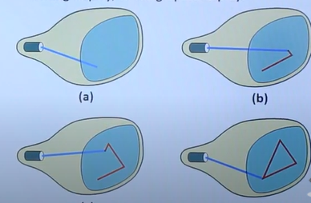
Two types of Refresh CRT’s
Random Scan (Vector Scan):
A CRT as a random scan display unit, has an electron beam directed only to the part of the screen where a picture is to be drawn rather than scanning from left to right and top to bottom as in raster scan. Random scan monitors draw a picture one line at a time.
These are also referred to as vector display or stroke writing or calligraphic displays.
Each line segments is drawn on the screen by directing the beam to move from one point on the screen to the next, where its x and y coordinates defines each point.

Slide 22
Two types of Refresh CRT’s
Random Scan (Vector Scan):
Picture definition is stored as a set of line drawing commands in an area of memory referred to as refresh display file.
To display a specified picture, the system cycles through the set of commands in display file, drawing each component line in turn.
After all line drawing commands are process, the system cycles back to the first line command in the first.
Random scan displays are designed to draw all the component lines of picture 30 to 60 times each second.

Slide 23
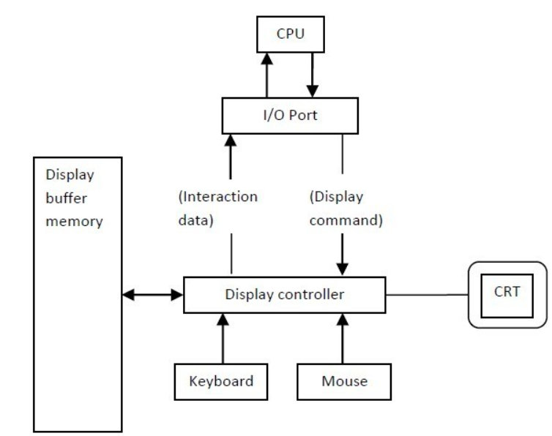
Two types of Refresh CRT’s
Random Scan (Vector Scan):
Image shows the architecture of vector display. It consists of display controller, CPU, display buffer memory and CRT.
Display controller is connected as an I/O peripheral to the CPU.
Display buffer stores computer produced display list or display program.
The Program contains point & line plotting commands with end point co-ordinates as well as character plotting commands.
Display controller interprets command and sends digital and point co-ordinates to a vector generator.
Vector generator then converts the digital co-ordinate value to analog voltages for beam deflection circuits that displace an electron beam which points on the CRT’s screen.
In this technique beam is deflected from end point to end point hence this techniques is also called random scan.

Slide 24
Two types of Refresh CRT’s
Random Scan (Vector Scan):
We know as beam strikes phosphors coated screen it emits light but that light decays after few milliseconds and therefore it is necessary to repeat through the display list to refresh the screen at least 30 times per second to avoid flicker.

Slide 25
Difference between Raster scan and Random scan display
Raster scan | Random scan
It draws the image by scanning one row at a time. | It draws the image by directing the electron beam directly to the part of the screen, where image is to be drawn.
They generally have resolution limited to pixel size | They have higher resolution than raster scan display
Lines are jiggered, and curves are less smooth | Linen plots are straight and curves are smooth
They are more suited to geometric area drawing applications eg. Monitors, TV, etc | They are more suited to line drawing application eg. CRO and pen plotter.

Slide 26
Difference between Raster scan and Random scan display
Raster scan | Random scan
Refresh rate is 60 to 80 frame per seconds | Refresh rate is 30 to 60 frame per seconds
Screen points/pixel are used to draw an image | Mathematical functions are used to draw an image.

Slide 27
Color CRT monitor
Color CRT monitor generates a range of colors by combining the emitted light from multilayered phosphor coated color CRT.
There are two basic techniques used to produce color display:
Beam penetration technique
Shadow mask technique
Beam penetration technique is used with Random scan display where CRT is coated with 2 layer of phosphor i.e. red and green.
The outer layer is coated with red phosphor and inner layer is coated with green phosphor.
The color depends how far electron beam penetrates into phosphor layers. When the speed of electron beam is low then electron beam strike only red phosphor and thus produce red traces on screen.
When the speed of electron beam is high then electron beam penetrates into green phosphor and produce green traces.
When the speed of electron beam is medium it produce the color of combination of red and green like orange and yellow.
The advantages of beam penetration is that it is cost effective.
The disadvantages is that only four color can be generated so the quality is not good.

Slide 28
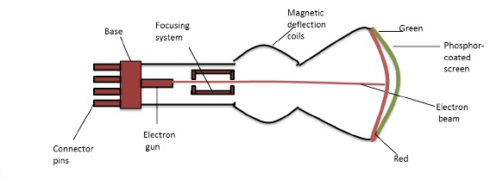
Color CRT monitor
Beam Penetration Technique

Slide 29
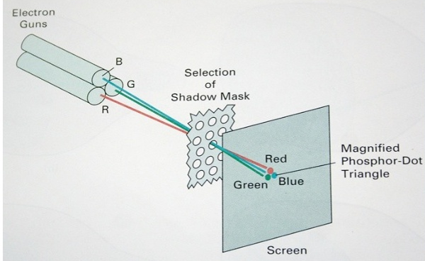
Color CRT monitor
Shadow mask technique: It is used with Raster scan display where CRT can produce a wide range of colors.
Three phosphor color (red, green, blue) dots are usedat each pixel position and there is three electron gun are used one for each color dot.
A shadow mask grid used just behind the phosphor coated screen.
The color dot pattern can be arranged in two mays one is triangular (delta) and other is in-line (high resolution color CRT).

Slide 30
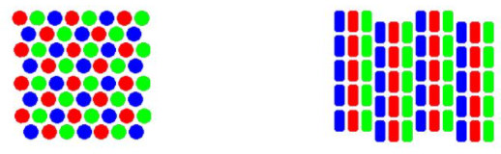
Color CRT monitor
Shadow mask technique:
In older version of CRT monitor delta method is used. It can have 8 color maximum as for one electron gun we give 1 bit range then we have 3 bit, so we can set 8 color.
We can enhance the color range. For this, we use 8 bit for each electron gun. Then for three electron gun we have total 24 bit. So 2²⁴ means we can generate millions of colors.
So, in enhance color range, 24 bits per pixel are used in the frame buffer and nearly 17 million color choice for each pixel.
Delta Electron
Gun arrangement
In-line Electron
gun arrangement

Slide 31
Direct View Storage Tube (DVST)
It is CRT with a long persistence phosphor.
It is the advance version of random scan system with high resolution.
It uses the storage grid which stores the screen information as a charge distribution just behind the phosphor coated screen.
It has two types of electron guns:
Primary gun or writing : It stores the picture pattern. It stores the picture from refresh buffer to the storage grid.
Flood gun: It maintain the picture display. It generates low speed electrons.
The primary gun produce high speed electrons which strike on the storage grid also called mesh grid to draw the picture pattern. It contains the +ve charge particles which contains the picture information. When electron strikes on the storage grid then picture information is displayed on the screen.
We also have collector which controls the acceleration speed of the electrons. Collector has negative charge particles so it helps to repel the electron which slow down the speed of the electron. After this electron beam strike the storage grid and picture is displayed in the screen.
The low speed electrons then penetrate storage grid and strike the phosphor coating without affecting eh positive charge pattern on the storage grid.

Slide 32
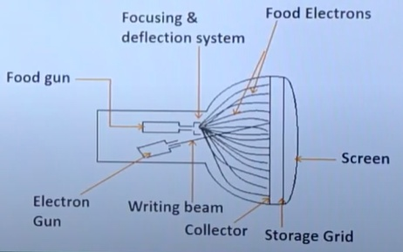
Direct View Storage Tube (DVST)

Slide 33
Color model
A color model is a specification of a 3D color coordinate system and a visible subset in the coordinate system within which all colors in a particular color gamut lie. For example, RGB color model is the unit cube subset of 3D cartesian coordinate system.
Color gamut is the full range of colors visible to the human eye. We usually use three colors called primary colors, to produce a range of colors called color gamut.
Color model is an abstract mathematical model, describing the ways colors can be represented.
In other word color model is a method for explaining the properties or behavior of color within some particular context.
No single model can explain all aspects of color, so we make use of different models to help describe the different perceived characteristics of color.

Slide 34
Color model
There are different color models: RGB which is hardware oriented color models used with color CRT monitors, YIQ for the broadcast TV color system, CMY (Cyan, Magenta, Yellow) for some color printing devices. All these color models are hardware oriented so they are not easy to use.

Slide 35
Properties of light
What we perceive as light or different colors is a narrow frequency band within the electromagnetic spectrum.
Each frequency value within the visible band corresponds to a distinct color. At low frequency end is a red color (4.3×10¹⁴ hertz) and highest frequency we can see is a violet color (7.5 × 10¹⁴ hertz).
Spectral color range from red through orange and yellow at the low frequency end to greens, blues and violet at the high end.
As light is an electromagnetic wave we can describee various colors in terms of frequency f or wavelength λ of the wave.
Light at the red end of the spectrum has a wavlength of approximately 700 nanometers (nm) or millimicron. And wavelength of the violet light at the other end of spectrum is about 400 nm.
When the light is incident on a surface, some wavelengths are absorbed and others are reflected. This give us the perception of color of an object. If low frequencies are predominant in the reflected light, the object is described as red.
In this case, we say the perceived light has a dominant frequency or dominant wavelength at the red end of the spectrum.
The dominant frequency is also called the hue or color of the light.
We can combine light from two or more sources with different intensities to produce a range of colors.

Slide 36
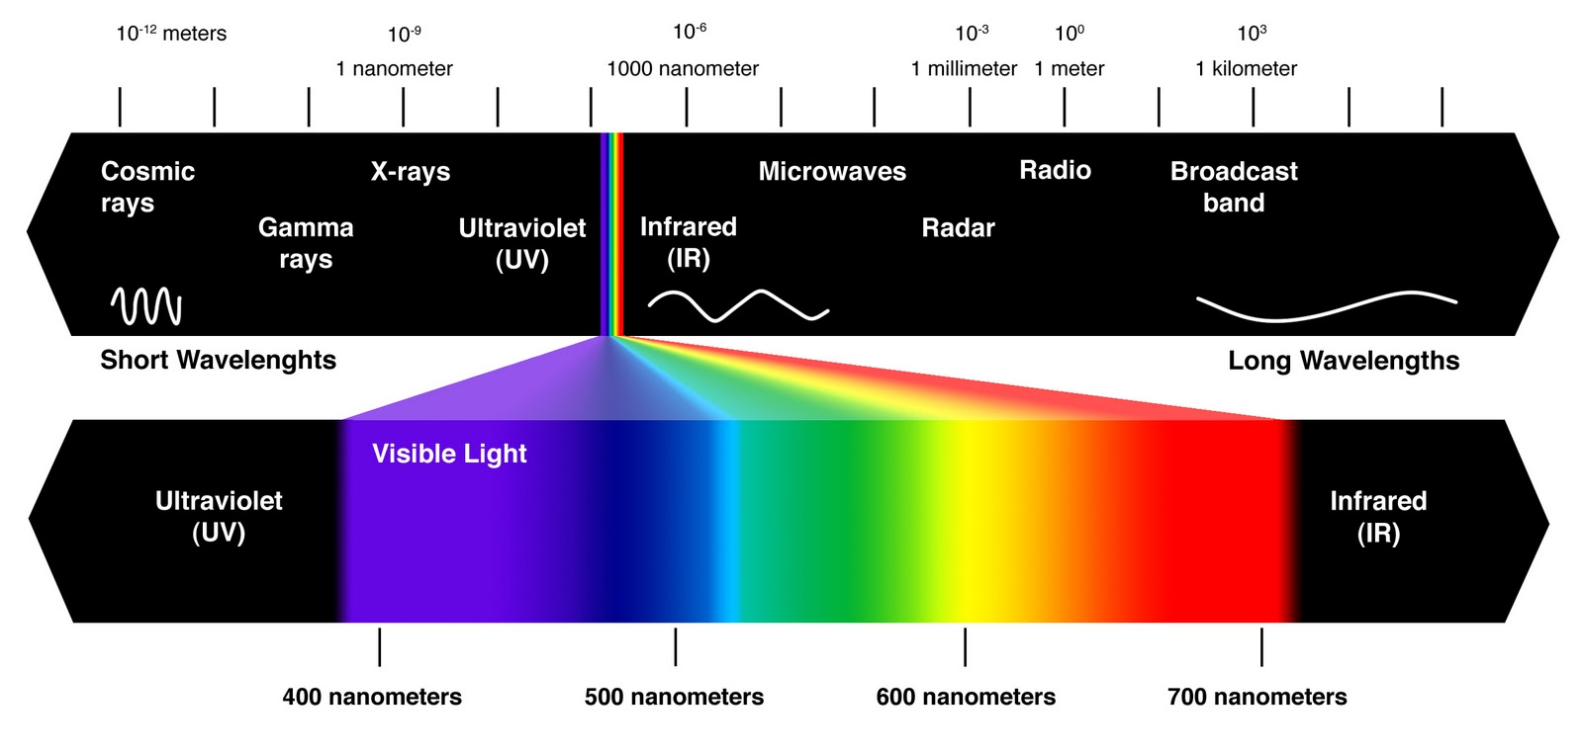
Properties of light

Slide 37
Color model : RGB color model
The red, green, blue (RGB) color model is used in color CRT monitors and raster graphics employs a Cartesian coordinate system. This model is the best for setting the electron guns for a CRT.
This model is an additive color model in which red, green and blue light are added together in various ways to reproduce a broad array of colors. It uses light.
The name of the model comes from initials of the three additive primary colors: red, green and blue.
The main purpose of RGB color model is for sensing, representation and display of images in electronic systems, such as televisions and computers as well as conventional photography.
This is an additive model since the phosphors are emitting light.
The subtractive model would be the one in which color is the reflected light and it uses ink.

Slide 38
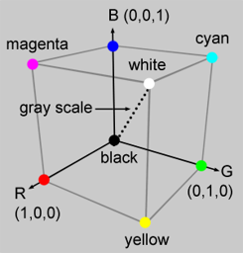
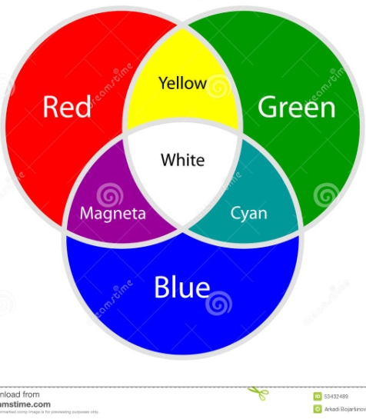
Color model : RGB color model
We can represent this model, with the unit cube defined on R, G and B axes.
The origin represents black and the vertex with coordinates (1,1,1) is white. Vertices of the cube on the axes represent the primary colors and the remaining vertices represent the complementary color for each of the primary colors.
The magenta vertex is obtained by adding red and blue to produce the triple (1,0,1).
Shades of gray are represented along the main diagonal of the cube from the origin (black) to the white vertex.

Slide 39
Color model : HSV color model
HSV (Hue, Saturation, Value) also called HSB (Hue, Saturation, Brightness) model, defines a color space in terms of three constituent components: hue, saturation and value.
HSV model is more intuitive than RGB color model. The user specifies a color (hue) and then adds white or black.
Changing the saturation parameter corresponds to adding or subtracting white and changing the value parameter corresponds to adding or subtracting black.
A 3D representation of HSV model is derived from RGB mode cube. If we look at RGB, the cube along the gray diagonal, we can see a hexagon that is HSV hexcone.
Hue is represented as an angle about the vertical axis, ranging from 0⁰ at red through 360⁰. Hue is given by an angle about the vertical axis with red at 0⁰, yellow at 60⁰, green at 120⁰, cyan at 180⁰, blue at 240⁰, and magenta at 300⁰,

Slide 40
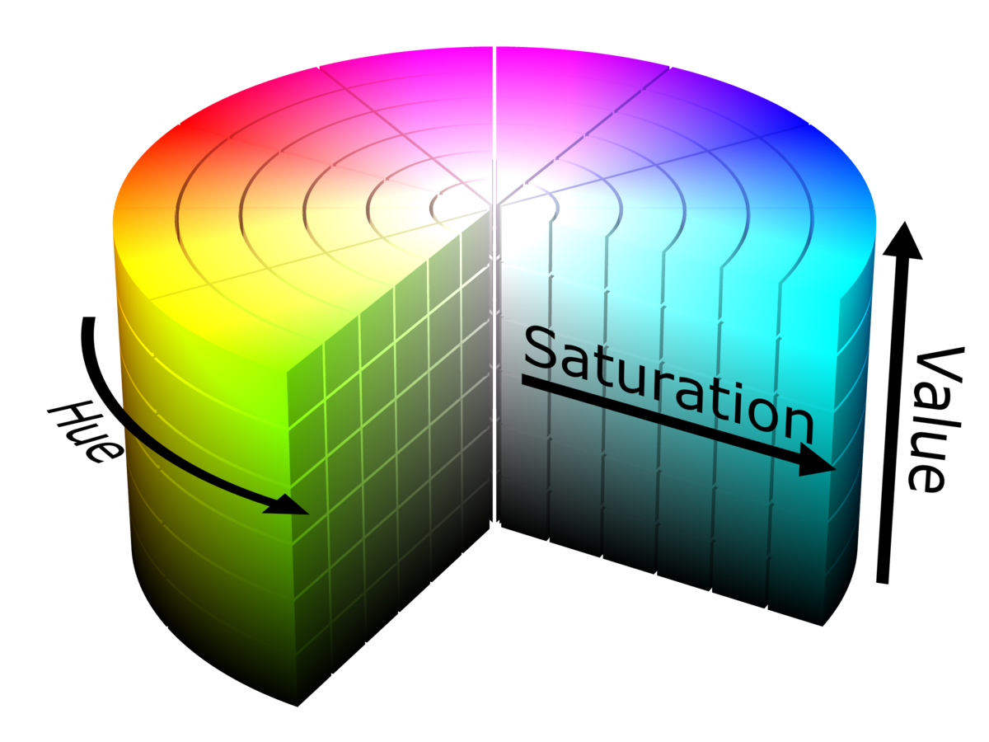
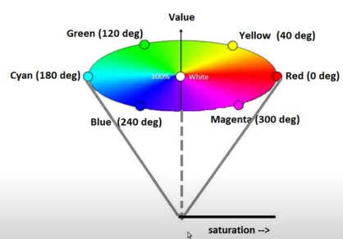
Color model : HSV or HSB color model
Saturation of the color rages from 0 to 100%. It is also sometimes called as purity. The lower the saturation of a color the more grayness is present and the more faded the color will appear. If 100%, it signifies the intense color presence.
Value, also called as brightness of color ranges from 0 to 100%. It is a nonlinear transformation of RGB color space. 0 represents black and 100 represent the brightest.

Slide 41
Assignment
Describe flat panel display (LED, LCD) and Plasma technology.

Slide 42
Software Standards
Software Standards
The primary goal of standardized graphics software is portability. When packages are designed with standard graphics functions, software can be moved easily from one hardware system to another and used in different implementations and applications. Without standards, programs designation for one hardware system often cannot be transferred to another system without extensive rewriting of the programs. So, software standards helps in portability and machine independency.
International and national standards planning organizations in many countries have cooperated in an effort to develop a generally accepted standard for computer graphics. After considerable effort, this work on standards led to the development of the Graphical Kernel System (GKS). This system was adopted as the first graphics software standard by the International Standards Organization (ISO) and by various; national standards organizations, including the American National Standards Institute (ANSI).

Slide 43
Software Standards
Although GKS was originally designed as a two-dimensional graphics package, a three-dimensional GKS extension was subsequently developed. The second software standard to be developed and proved by the standards organizations was PHIGS (Programmer's Hierarchical Interactive Graphics standard), which is an extension of GKS having increased capabilities for object modeling, color specifications, surface rendering, and picture manipulations are provided in PHIGS. Subsequently, an extension of PHIGS, called PHIGS+ , was developed to provide three-dimensional surface-shading capabilities not available in PHIGS.

Slide 44
Software Standards
Standard graphics functions are defined as a set of specifications that is Independent of any programming language. A language binding is then defined for a particular high-level programming language. This binding gives the syntax tor accessing the various standard graphics functions from this language. For example, the general form of the PHIGS (and GKS) function for specifying a sequence of n - 1 connected two-dimensional straight Line segments is:
polyline (n, x, y)
In FORTRAN, this procedure is implemented as a subroutine with the name GPL. A graphics programmer, using FORTRAN, would invoke this procedure with the subroutine call statement CRLL GPL (N, X, Y), where X and Y are one dimensional arrays of coordinate values for the line endpoints. In C, the procedure would be invoked with ppclyline( n , pts ) , where points is the list of coordinate endpoint positions. Each language binding is defined to make best use of the corresponding language capabilities and to handle various syntax issues, such as data types, parameter passing, and errors.
Although PHIGS presents a specification for basic graphics functions, it does not provide a standard methodology for a graphics interface to output d e vices. Nor does it specify methods for storing and transmitting pictures. Separate standards have been developed for these areas. Standardization for device interface methods is given in the Computer Graphics Interface (CGI) system. And the Computer Graphics Metafile (CGM) system specifies standards for archiving and transporting pictures.

Slide 45
Software Standards
Although PHIGS presents a specification for basic graphics functions, it does not provide a standard methodology for a graphics interface to output d e vices. Nor does it specify methods for storing and transmitting pictures. Separate standards have been developed for these areas. Standardization for device interface methods is given in the Computer Graphics Interface (CGI) system. And the Computer Graphics Metafile (CGM) system specifies standards for archiving and transporting pictures.

