Slide 1
Scanline Conversion Algorithm
And
Output primitives

Slide 2
Introduction
All graphics terminals have distinct graphical output, which presents rapidly variable graphical effect as seen in real life.
Any display can be either raster scan or random scan.
The only real implementation constraint is that all geometric objects eventually need to be represented by a collection of points in 2D grid (a raster).
A image can be imagined as a collection of points, lines, curve and polygons. These are the collection of visual points called pixel.
Raster is a rectangular grid or an array off pixel positions which have X, Y coordinates. Usually Y points down.
Scan conversion is a general term for drawing method, which create (digitize) raster images according to given picture primitives. The term is mainly used for drawing methods for 2D picture elements or primitives like lines, polygon and text.

Slide 3
Introduction
The raster scan graphics display requires special procedures for displaying graphics elements like lines, curves, circles. For this it is important to determine which pixel to be painted on the screen coordinates and with what intensity.
The process by which a primitive is converted to a two dimensional image is called rasterization and when such procedure is combined with picture generation using scan line it is called scan line conversion.

Slide 4
Scan conversion of a point
A point is a geometric element that has a position but no extension. A point is defined by it coordinates.
Mathematically, a point in space has coordinates x and y represented by P(x,y).
A point coordinates have integral value in order to display it on the screen coordinates, as a display system requires no floating point coordinates.
If one generates such coordinates then it must be converted to its nearest integer part. For example point with coordinates P(1.3,4.2) has to be converted to P(1,4) for display using suitable functions in any programming environment.

Slide 5
Scan Conversion of a line: DDA Algorithm
It stands for Digital Differential Analyzer
A line connects two points. It is the basic element in graphics.
To draw a line, you need two points between which you can draw a line.
Line is the collection of points in a common path. The path can be defined by using line equation. The common line equation is y=mx+c where m is the slope of the line and c is intercepting point in y-axis, x and y are the coordinates of the points that satisfy the function and so lie on the straight line.
When you have slope and y-intercept then you can compute any point in the line.
DDA algorithm is an incremental method of scan conversion of line. In this method, calculation is performed at each step but by using results of previous steps.

Slide 6
Scan Conversion of a line: DDA Algorithm
Step-1: Get the input of two end points (X₀,Y₀) and (X₁,Y₁)
Step-2:Calculate the difference between two end points
dx=X₁-X₀, dy=Y₁-Y₀
Step-3: If (abs(dx)>abs(dy))
steps=abs(dx);
else
step=abs(dy);
Step-4: Calculate the increment factor in X and Y coordinate
Xincrement=dx/(float)steps;
Yincrement=dy/(float)steps;
Step-5: x=X₀, y=Y₀
Step-6: Put the pixel by successfully incrementing x and y coordinates accordingly and draw a line.
for(int i=0;i<steps;i++)
{
putpixel(Round(x),Round(y));
x=x+Xincrement;
y=y+Yincrement;
}

Slide 7
DDA line drawing Algorithm
Draw a line using DDA line drawing algorithm or incremental method whose end points are (5,6) and (10,12).
Draw a line using DDA line drawing algorithm whose end points are (20,10) and (12,15).

Slide 8
Bresenham’s Line Drawing Algorithm
This algorithm is used for scan converting a line. It was developed by Elton Bresenham in 1962. It is also called as midpoint line drawing algorithm
In DDA line drawing algorithm, it uses float data type for calculation which makes it complex and time consuming.
But bresenham line drawing algorithm is an efficient method as it involves only integer addition, subtractions and multiplication operations. So, line generation will be faster in comparison to DDA line drawing algorithm.

Slide 9
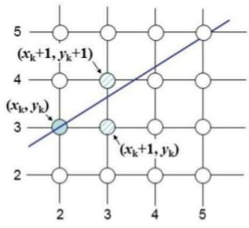
Bresenham’s Line Drawing Algorithm
In this algorithm, we select the next pixel position in order to plot a point based on the nearest pixel position the path of the line.
For this, we use decision parameter.
While drawing a line we have three cases:
Case1: slope(m)<1
Case2: slope(m)>1
Case3: slope(m)=1

Slide 10
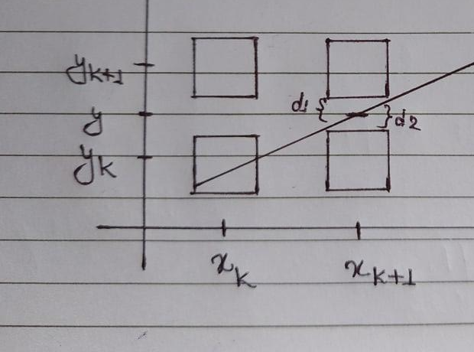

Bresenham’s Line Drawing Algorithm: Derivation
Let us consider the scan conversion process for lines with a positive slope less than 1. Then we will increment X variable by 1 unit at each step and for Y-direction we will plot the pixel that is closet to the line path.
Suppose we have just plotted the pixel at (X_{k}, Y_{k}), now we have to decide which pixel to plot next. Then out choices are the pixels at position (X_{k}+1,Y_{k}) and (X_{k}+1,Y_{k}+1)
The equation for a line is
y=mx+c
y=m(x_{k}+1)+c
Now,
d1=y – Y_{k}= m(X_{k}+1)+c – Y_{K}
d2=Y_{k}+1-y=Y_{k}+1- m(X_{k}+1) - c
Subtract d1-d2
d1-d2=[m(X_{k}+1)+c – Y_{K}]–[Yk+1 - m(Xk+1) – c]
= m(X_{k}+1)+c – Y_{K}]–Yk – 1 + m(Xk+1) + c
= 2m(Xk+1) – 2Yk + 2c – 1
Multiply both side by Δx
=

Slide 11
Bresenham’s Line Drawing Algorithm: Derivation
P_{k} = 2ΔyX_{k} - 2ΔxY_{k} + 2Δy+ 2Δxc - Δx
P_{k}= Δx(d1-d2) = 2ΔyX_{k} - 2ΔxY_{k}
P_{next}= P_{k+1}= 2ΔyX_{next} - 2ΔxY_{next}
Now subtract P_{k} from P_{next}
P_{next} – P_{k}= [2ΔyX_{next} - 2ΔxY_{next}] – [2ΔyX_{k} - 2ΔxY_{k}]
= 2Δy[(X_{next} – X_{k}] - 2Δx(Y_{next} – Y_{k})
if (P_{next} – P_{k} <0)
P_{next}=P_{k}+ 2Δy[X_{k}+1 – X_{k}] - 2Δx [ Y_{k} – Y_{k}]
if (P_{next} – P_{k} >=0)
P_{next}=P_{k}+ 2Δy[X_{k}+1 – X_{k}] - 2Δx [ Y_{k} + 1– Y_{k}]
=Pk+2 ΔyXk+2 Δy - 2 ΔyXk – 2 ΔxYk+2 Δx +2 ΔxYk
=Pk+2 Δy+2 Δx
Initial decision parameter
P₀=2 ΔyXk -2 ΔxYk+2 Δy+2 Δxc - Δx
=2 ΔyXk-2 ΔxYk+2 Δy+2 Δx(y₀- Δy/ Δx *x1)- Δx
=2 Δy - Δx

Slide 12
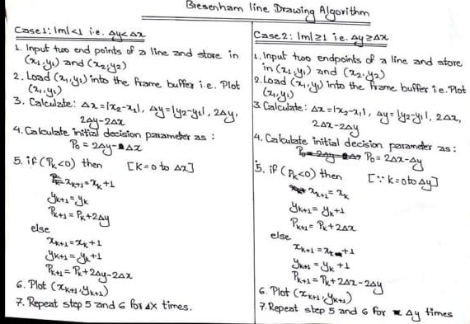
Bresenham’s Line Drawing Algorithm: Derivation

Slide 13
Circle drawing algorithm
Properties of circle
A circle is a set of points that are all at a given distance r from the center position (Xc,Yc). The general equation for circle is :
(x-xc)² + (y-yc)² = r
We can generate circle by two method: polynomial method and trignometric or polar coordinate method. In polynomial method we can generate circle by calculating the corresponding value at each position as:
y=yc ±
However this method is not suitable for generating a circle as we have to perform a lot of computation at each step. And space between plotted pixel positions is not uniform.
Another method is to eliminate the unequal spacing is to calculate the points along circular boundary using polar coordinates r and θ. While expressing circle equation for parametric polar form yields the pair of equals:
x=xc+rcosθ
y=yc+rsinθ
In this method, circle with equally spaced points along the circumference is plotted. However we can reduced the computation by considering the symmetry of circles.

Slide 14
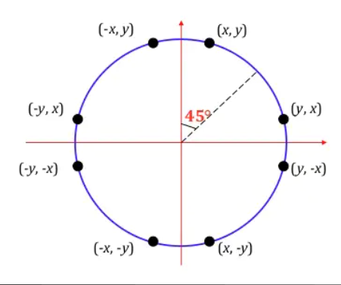
Circle drawing algorithm
Properties of circle
Symmetry in quadrants: The shape of the circle is similar in each quadrant. So we can calculate points in one quadrant we can calculate points in other three quadrants.
Symmetry in octants: The shape of the circle is similar in each octant. So by calculating points in one octant we can calculate points in other seven octants. If the point (X,Y) is on the circle, we can trivially compute seven other points on the circle. So we have to compute only 45⁰ segment to determine circle.

Slide 15
Circle drawing algorithm: Midpoint circle drawing algorithm
In midpoint circle drawing algorithm, we can divide a circle into eight different octants. For the symmetry if we draw only one octant we can easily draw points on other seven octants using reflection procedure.
Here we have to finds points for the first octant, when x≥y then it indicates the end of the octant 1.
The first coordinate point is (0,r) to draw a circle, the x increasing as unit interval, the y decreasing along the values of x.
The next point be either (x_{k}+1, y_{k}-1) or (x_{k}+1,y_{k}) so the mid point of these two points is (x_{m},y_{m}), where
x_{m}=(x_{k}+1+x_{k}+1)/2
y_{m}=(y_{k}-1+y_{k})/2
(x_{m},y_{m})=(x_{k}+1,y_{k}-1/2)
As we know the equation of circle is x²+y²=r², putting (x_{m}, y_{m}) in circle equation we get,
decision parameter (P_{k})=(x_{k}+1)²+(y_{k}-1/2)² – r² and
P_{k+1}=(x_{k+1}+1)²+(y_{k+1}-1/2)² – r²
So, P_{k+1} - P_{k}=(x_{k+1}+1)²+(y_{k+1}-1/2)² – r² – [(x_{k}+1)²+(y_{k}-1/2)² – r²]

Slide 16
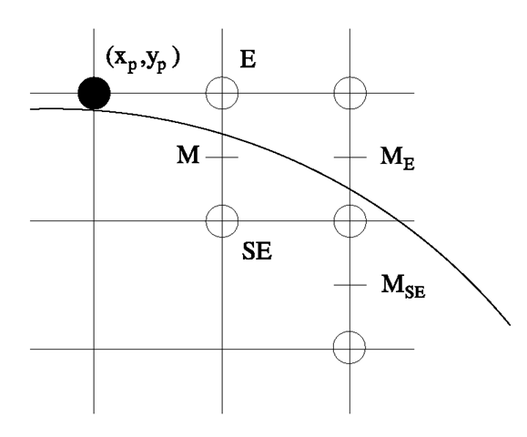
Circle drawing algorithm: Midpoint circle drawing algorithm
So, P_{k+1} - P_{k}=(x_{k+1}+1)²+(y_{k+1}-1/2)² – r² – (x_{k}+1)² - (y_{k}-1/2)² + r²
P_{k+1} - P_{k}=(x_{k}+1)+1)2+(y_{k+1}-1/2)² – [(x_{k}+1)² – (y_{k}-1/2)²
P_{k+1} = P_{k} + 2(x_{k}+1)+{(y_{k+1}² – y_{k}²} – (y_{k+1} – y_{k})+1
Now, the starting point is (0,r), so x_{k}=0 and y_{k}=r, for the initial decision paramter P₀.
p₀=(0+1)²+(r – 1/2)² – r²
=1+r²+1/4 – r – r²
=5/4 – r
P₀=1-r [approximate to avoid fractional part]
now, if P_{k}≥0 then,
y_{k+1}=y_{k} – 1
else
y_{k+1}=y_{k}

Slide 17
Line attributes in computer graphics
Line Type:
Type of Line: Solid lines, dashed lines, dotted line and dash dotted lines are the four line types. To generate such lines, we alter a line drawing algorithm by adjusting the length and spacing of displayed solid sections along the line path.
An inter dash spacing equal to the length of the solid sections could be used to display a dashed line. The inter dash spacing and the length of the dashes are frequently specified as user options. To create a dotted line, create very short dashes with spacing equal to or greater than the dash size. Similar techniques are employed.
To set line type attribute in PHIGS application:
setLineType(lt) can be used where lt can be : 1, 2, 3, 4

Slide 18
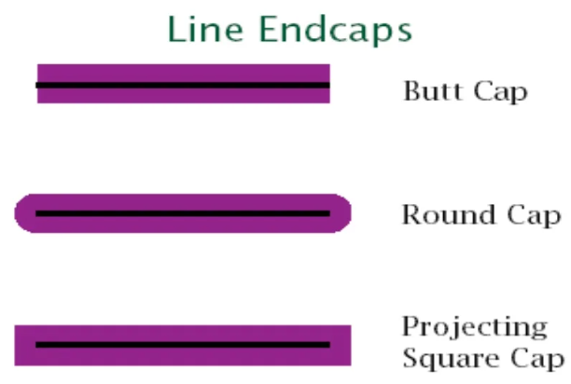
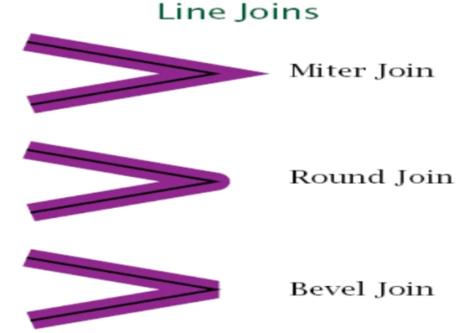
Line attributes in computer graphics
Line Width:
We use the command to set the line-width attribute:
A positive number is assigned to the line-width parameter or to indicate the relative width of the line to be displayed.
Thicker line can be produced by:
Adding extra pixel veritcally when |m|<1.
Adding extra pixel horizontally when |m|>1
We can set the width of a line using setLineWidthScaleFactors(lw);
where lw is assigned to a positive number.
Issues related to Line Width:
Line have different thickness on the slope.
So, problem with end of the line (use line caps)
problem with the two lines (polygon)

Slide 19
Line attributes in computer graphics
Line Color:
When a system offers color (or intensity) options, a parameter indicating the current setting is included.
The color index is one of the system-attribute values. A polyline routine displays a line in the current color by using the setpixel procedure to set the current color value in the framebuffer at pixel locations along the line path.
The number of color options is determined by the number of bits per pixel available in the frame buffer. In PHIGS, we use the function to set the line color value.
Set the PolylineColorIndex(lc).
Pen and Brush options
The selected pen and brush determine the way a line will be drawn. Pens and brushes have size, shape, color and pattern attribute. Pixel mask is applied in both of them.

Slide 20
Curve attributes in computer graphics
CURVE ATTRIBUTES:
Curve attributes have the same set of parameters as line segments. Curves can be displayed in a variety of colors, widths, dot dash patterns, and pen or brush options.
Thicker curves can be produced by :
1. Plotting additional pixel
2. Filling the space between two concentric circles
3. Using thicker pen or brush

Slide 21
Text attributes in computer graphics
There are many text options that can be made available to graphics programmers.
There is the choice of font (or typeface) which is a set of characters with particular design style like Courier, Helvetica, Times new roman, Arial, etc.
The width only of text can be set with function :
setCharacterExpansionFactor(cw)
Where cw (character-width) parameter is set to a positive real value that scales the body width of characters.
Text height is unaffected by this attribute settings.
Spacing between characters is controlled by seprarately with:
setCharacterSpacing(cs)
where cs (character-spacing) parameter can be assigned any real value. The value assigned to cs determines spacing between character bodies along print lines.
Negative values of cs overlap character bodies; positive values insert space to spread out the displayed characters. Assigning value 0 to cs causes text to be displayed with no space between character bodies.

Slide 22
Area filling
There are two basic approaches of area filling on raster system
Interior defined: An interior defined region is a collection or patch of same color contiguous pixels. Pixel exterior to the region have different colors. Flood fill algorithm are used to fill interior.
Boundary defined: For boundary defined region pixels that mark the boundary or outline of the region have a unique color that is not same as the color of interior pixels. Boundary fill algorithm are used to fill boundary.

Slide 23
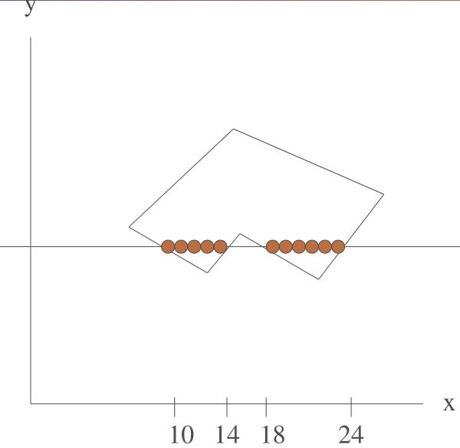
Area filling : Scan line polygon filling algorithm
Then these intersection points are sorted from left to right and corresponding frame buffer positions between each intersection pair are set to the specified fill color.
In the given figure, four pixel intersections positions with polygon boundaries define two stretches of interior pixels to X=10 to Y=14 and X=18 to X=24.
Scan line fill algorithm of a region is performed as follows:
Scan line polygon filling algorithm is used for solid color filling in polygons.
It involves the horizontal scanning of the polygon from its leftmost to its rightmost vertex.
For each scan line crossing a polygon, the area fill algorithm locates the intersection points of the scan line with the polygon edges.
Determine the intersection of the scan line with the edges of the polygon.
Sort the intersections by increasing X-coordinate value.
The fill colors are applied to each section of a scan line that lies within the interior of the fill region using odd-parity rule to determine that a point is inside the polygon or not.
So, in this algorithm each scan line intersection point with a polygon boundary is obtained by solving a pair of simultaneous linear equations where equation for scan line is simply y=constant.

Slide 24
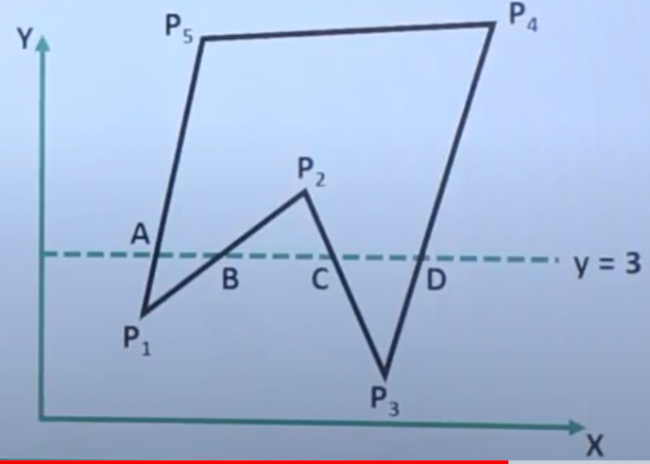
Area filling : Scanline polygon filling algorithm
In this polygon we have the vertex: P1, P2, P3, P4, P5 and edge list are (P1,P2), (P2,P3), (P3,P4), (P4,P5) and (P5,P1) then intersection of the scan line y=3 at edges are in order B(x=3), C(x=4), D(x=6 and A(x=1) and after sorting these intersections the sequence is A,B,C,D.
Now we start with default parity 0 (even) and for each intersection we inverts the parity.As a result the routine produces filled interior spans AB and CD and skips BC which lies outside the polygon.
In the second first scan line, the scan line is intersecting with 3 different edges i.e. odd number and also passing through a vertex/endpoint. So, in this case we need to do some extra processing i.e. we need to check if 2 edges at the endpoint through which scan line is passing are they on opposite sides or on the same sides?

Slide 25
Area filling : Inside outside test
A test used in computer graphics to determine if a point is inside or outside of a polygon while filling an object. For this we have got two methods:
Even Odd rule or odd parity rule
Non-zero winding rule.
It is also known as crossing number and ray casting algorithm. The algorithm follows a basic observation that if a ray coming from infinity crosses through border of polygon, then it goes from outside to inside and outside to inside alternately. For every two crossings, point lies outside of polygon.
In even odd rule we draw a line from any position P to a distinct point outside the coordinate extents of the object and count the number of edges crossings along the line. If the number of edges crossed by the line is odd then the point p is interior otherwise P is an exterior point.

Slide 26
Area filling : Inside outside test
Non-zero winding rule.
Alternative algorithm to perform test is Winding Number algorithm. A winding Number is calculated for given point with respect to polygon. If winding number is non-zero, then point lies inside the polygon. Else, it lies outside of polygon.
So to apply non-zero winding rule we follow the steps given below:
Initialize the winding number to 0
Then imagine a point, draw a line from point to outside the polygon which doesnot pass through any vertex.
Add 1 to the winding number every time, when a line intersect a polygon edge that crosses the line from right to left and subtract 1 every, when a line interesect an edge that crosses from left to right.
Interior points are that have a non-zero value for winding number.
Exterior points are those whose value of the winding number is zero.

Slide 27
Area filling : Boundary fill algorithm
In this algorithm, we start by selecting a point inside a region which is also called as seed pixel and paint the interior outward the boundary. If boundary is specified in a single color the fill algorithm proceeds outward pixel by pixel until the boundary color is reached. This algorithm checks if the adjacent pixel is already filled or if it is border color, if so it does no thing otherwise it fill the interior color to that pixel. After filling the color, it goes for its neighbor pixels. The process continues until all pixels interior to the polygon has been tested.
We can implement boundary fill algorithm by two method.
- Four connected method
- Eight connected method

Slide 28
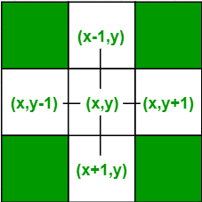
Area filling : Boundary fill algorithm
Four connected method:
After painting a pixel, then it goes for selecting four neighboring pixels on its left, right, top and bottom.
void boundaryFill4(int x, int y, int fill_color,int boundary_color)
{
if(getpixel(x, y) != boundary_color && getpixel(x, y) != fill_color)
{
putpixel(x, y, fill_color);
boundaryFill4(x + 1, y, fill_color, boundary_color);
boundaryFill4(x, y + 1, fill_color, boundary_color);
boundaryFill4(x - 1, y, fill_color, boundary_color);
boundaryFill4(x, y - 1, fill_color, boundary_color);
}
}

Slide 29
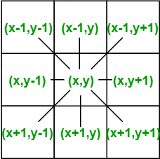
Area filling : Boundary fill algorithm
Eight connected method:
When we try to fill the color interior to the complex polygon it may failed, so to overcome this problem we can use eight connected method. The pixels to be tested are the neighbors of current pixel that comes on it left, right, top, bottom, top-left, top-right, bottom-left, bottom-right.

Slide 30
Area filling : Boundary fill algorithm
Eight connected method:
void boundaryFill4(int x, int y, int fill_color,int boundary_color)
{
if(getpixel(x, y) != boundary_color && getpixel(x, y) != fill_color)
{
putpixel(x, y, fill_color);
boundaryFill4(x + 1, y, fill_color, boundary_color);
boundaryFill4(x, y + 1, fill_color, boundary_color);
boundaryFill4(x + 1, y + 1, fill_color, boundary_color);
boundaryFill4(x - 1, y - 1, fill_color, boundary_color);
boundaryFill4(x - 1, y, fill_color, boundary_color);
boundaryFill4(x, y - 1, fill_color, boundary_color);
boundaryFill4(x - 1, y + 1, fill_color, boundary_color);
boundaryFill4(x +1, y - 1, fill_color, boundary_color);
}
}

