Slide 1
Light source
Light source means an object that is emitting radian energy for example sun, light bulb, etc.
When we view an opaque nonluminous object, it reflect light from the surfaces of the object.
The total light is the sum of the contribution from light sources and other reflecting surfaces in the scene. Thus the object that is not directly exposed to the light source may still be visible if nearby object are illuminated.
Some times, light sources are referred to as light emitting source or reflecting surface.
A luminous object can be both light source and light reflector.
For example: a plastic globe with a light bulb inside both emits and reflects light from the surface of the globe. Emitted light from the globe may then illuminated other object in the vicinity.
The amount of a light reflect depend on the type of the material. Shiny materials reflect more of the incident light, and dull surface absorbed more of the incident light.

Slide 2
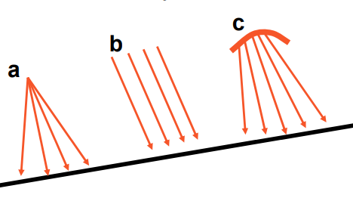
Light Source Models
Point Source(a): Point sources emit light from a single point in all directions, with the intensity of the light decreasing with distance. An example of a point source is a standalone light bulb All light rays originate at a point and radially diverge. A reasonable approximation for sources whose dimensions are small compared to the object size
Parallel source(b) : Light rays are all parallel. May be modeled as a point source at infinite distance (the sun)
Distributed source(c) : All light rays originate at a finite area in space. It models a nearby source, such as a fluorescent light. The surface of light source is greater than the surface of an object.

Slide 3
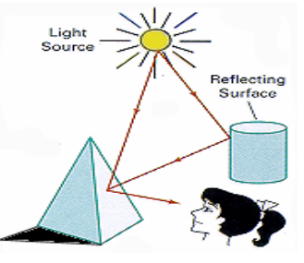
An illumination/lighting model/shading model is used to calculate the intensity of the light that is reflected at a given point on a surface
A rendering method uses intensity calculations from the illumination model to determine the light intensity at all pixels in the image.
Illumination model can be expressed by an illumination equation in variables associated with point on the object being shaded. The illumination equation that expresses this simple model is
I=k_{i}
where I is the resulting intensity and the coefficient
K_{i} is the object’s intrinsic intensity.
The process of evaluating the illumination equation at one or more points on an object is often termed as lighting to the object.

Slide 4
illumination/lighting model ……
Lighting effects are described with models that consider the interaction of light sources with object surfaces.
The factors determining the lighting effects are: –
The light source parameters:
• Positions
• Electromagnetic Spectrum
• Shape
The surface parameters
• Position
• Reflectance properties
• Position of nearby surfaces
The eye (camera) parameters
• Position
• Sensor spectrum sensitivities

Slide 5
Diffuse illumination
We must also have a clear concept of diffuse illumination.
Diffuse illumination is the light reflected from the surface. It is also termed as ambient light. If ambient light disperse equally on all surfaces from all directions then our illumination equation becomes
I_{adiff} =I_{a}K_{a}
I_{a} is intensity of ambient light, assumed to be constant for all objects. Ka is ambient reflection coefficient also called as coefficient of reflection or reflexivity ranges from 0 to 1.
Ka can be computed by
Ka=I_{R}/I_{S}
where I_{S} is the light source and I_{R} is the intensity of ambient light.

Slide 6
Illumination Models
Diffuse model
Ambient Illumination
Specular Reflection

Slide 7
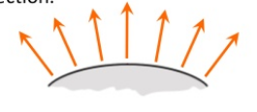
1.Diffuse Reflection
Diffuse (Lambertian) surfaces are rough or grainy, like clay, soil, fabric tend to reflect light in all direction.
Surface that reflect incident light with equal intensity in all direction called perfect diffusion reflection.
The surface appears equally bright from all viewing directions
The brightness at each point is proportional to cos( θ )

Slide 8
1.Diffuse Reflection ….
Brightness is proportional to cos( θ) because a surface perpendicular to the light direction is more illuminated than a surface at an oblique angle.
The reflected intensity I_{diff} of a point on the surface is:
L_{diff}=K_{d}l_{p}cos(θ)=K_{d}l_{p}(N⋅ L )
I_{p} - the point light intensity. May appear as attenuated source f_{att}(r)I_{P}
K_{d} ∈ [0,1] - the surface diffuse reflectivity
N - the surface normal
L - the light direction
NOTE: If N and L have unitary length: cos( θ) = N ⋅ L

Slide 9
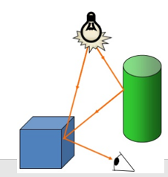
2.Ambient light
A surface that is not exposed to direct light may still be lit up by reflections from other nearby objects ambient light/ background light.
It has no spatial or directional characteristics.
The amount of ambient light incident on each object is a constant for all surface and over all direction.
But the intensity of reflected light for each surface depend on the optical properties of the surface i.e. how much of the incident energy is to be reflected and how much absorbed.

Slide 10
2.Ambient light….
The reflected intensity I_{amb} of any point on the surface is:
l_{amb}=K_{a}l_{a}
I_{a} - ambient light intensity
K_{a} ∈ [0,1] - surface ambient reflectivity
In principle I _{a} and K_{a} are functions of color, so we have I^{R} _{amb}, I^{G} _{amb} and I^{B}_{amb}

Slide 11
3.Specular reflection
In Specular reflection it may possible that some portion of surface generated more light or may produce bright spot. This is called specular reflection.
Example
Metal surfaces
Mirror
Shiny plastic
Gold and silver coated surfaces
Shiny apple surface

Slide 12
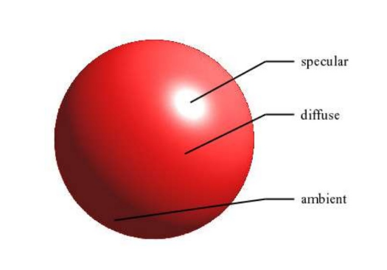

Slide 13
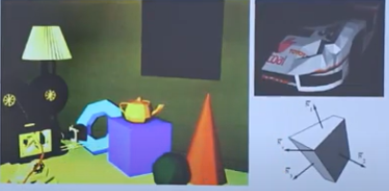
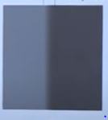
Flat shading
It is also called as constant shading or faceted shading.
It is most simple and fast method to color for an object.
This model compute the single intensity for each polycolor at the middle of polygon surface. Then all pixels in the same polygon are colored by the same intensity value.
It is suitable for objects really made of flat faces.
It is useful for quick display of curved surface. It is suitable for planar object not for round object.
It suffers from Mach band effect (discontinuity of colors can be observed in different faces of surface.
Mach Band Effect

Slide 14
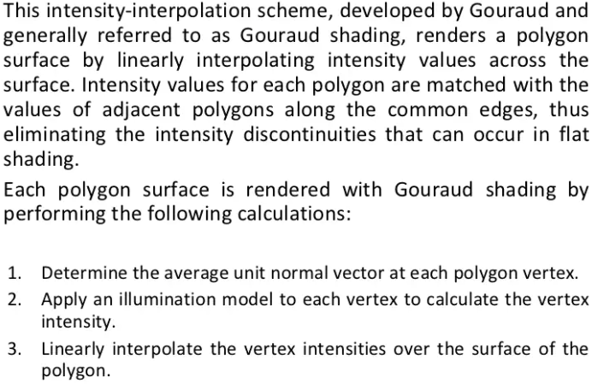
Gouroud shading

Slide 15
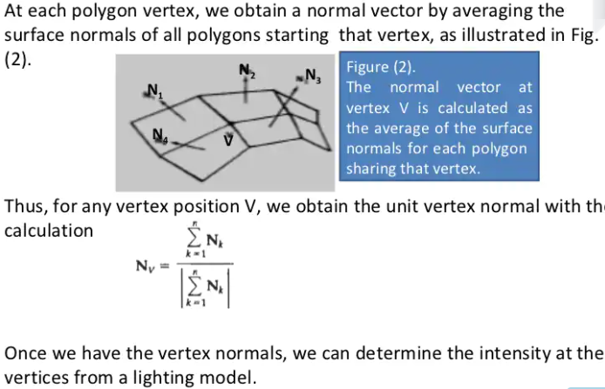
Gouroud shading

Slide 16
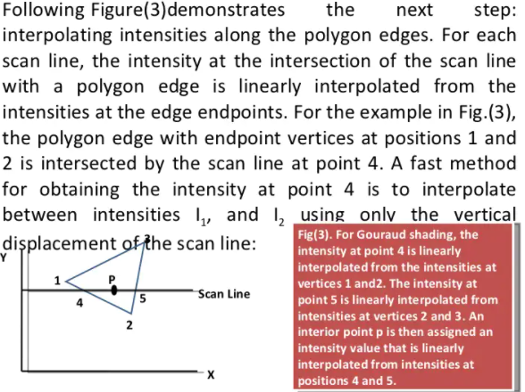
Gouroud shading

Slide 17
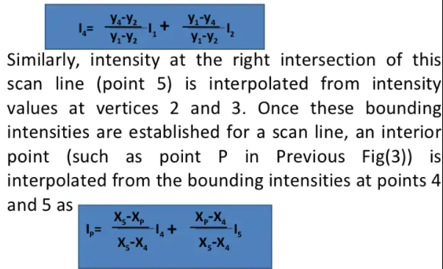
Gouroud shading

Slide 18
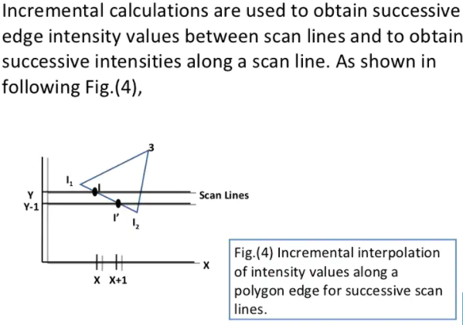
Gouroud shading

Slide 19
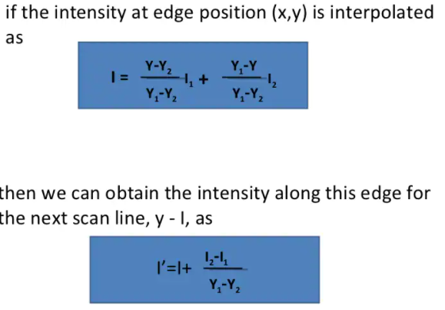
Gouroud shading

Slide 20
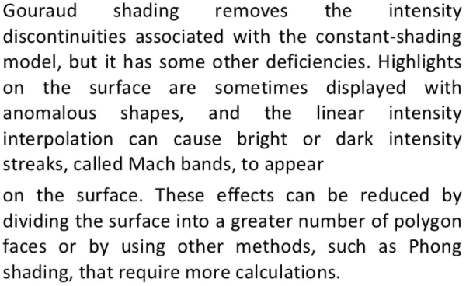
Gouroud shading

Slide 21
Phong shading
It is a more accurate method for rendering a polygon surface is to interpolate normal vectors and then apply the illumination model to each surface point.
It is developed by Phong Bui Tuong.
It is also called as normal vector interpolation shading.
It helps to displays more realistic highlights on a surface and greatly reduces the mach band effect.
Steps:
Determine the average unit normal vector at each polygon vertex
Linearly interpolate the vertex normals over the surface of the polygon
Apply illumination model along each scan line to calculate projected pixel intensities for the surface points.

Slide 22
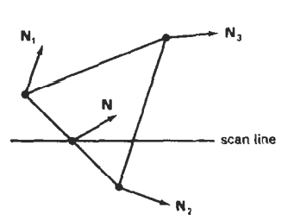

Phong shading
Interpolation of surface normals for the scan line intersection point along the edge between vertices can be obtained by vertically interpolating between edge endpoint normals.
Incremental methods are used to evaluate normals between scan lines and along each individual scan line.
Intensity calculations using an approximated normal vector at each point along the scan line produce more accurate results than the direct interpolation of intensities as in Gouraud shading.
However it requires more calculations.

Slide 23
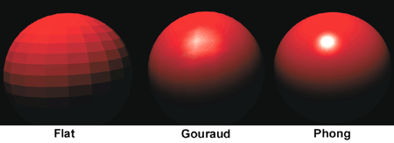
Phong shading

Slide 24
Transparency
Transparent surfaces reflect a part of light but object behind them can also be seen.
A transparent surface, produce both reflected light as well as transmitted light.
How much light will be reflected and how much will be transmitted is decided by the transparency level of the surface.
Shadow
Shadow helps to create realism. Without it, a cup for example on a table may look as if the cup is floating in the air above the table.
By applying hidden surface methods with pretending that the position of a light source is the viewing postion, we can find which surface sections cannot be “seen” from the light source i.e. shadow areas.
We usually display shadow areas with ambient light intensity only.
A shadowed object is one where light is blocked from reaching i.e. the object which is hidden with respect to light source.
However shadowed are seen only when observer’s position is not coincident with the light source.
The shadow areas are not visible from the light source position but are visible from observer’s position.

Slide 25
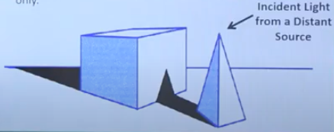
Shadow
There are two types of shadow:
Shelf shadow: Shelf shadow are created on some of the object planes when the object itself obstructs light from illuminating those planes.
Projected shadow: Projected shadows results on a surface when an intervening object blocks light from reaching the surface.

