Slide 1
Unit-3
2D transformation

Slide 2
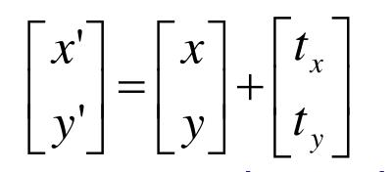
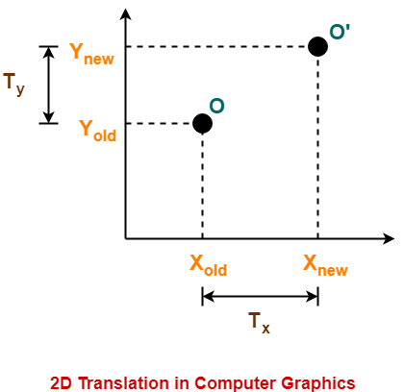
2D Translation
2D translation is the process of shifting the position of the graphical object along a straight line path from one coordinate location to another.
It is a rigid body transformation that moves object without deformation i.e. every point on the object is translated by same amount.
We translate the 2D point by adding the translation distance tx and ty to the original coordinate position (x,y) to move the point to a new position (x’,y’)
x’=x+tx
y’=y+ty
The translation distance pair (tx,ty) is called a translation vector or shift vector.
We can also express translation equation in matrix form.
P’
P
T
P’=P+T

Slide 3
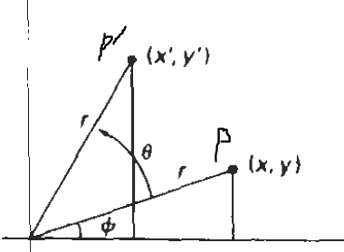
2D Rotation
2D rotation is applied to an object by repositioning it along a circular path in xy plane.
Rotation is also a rigid body transformation that move the objects without deformation. Every point in an object is rotated through the same angle
To generate a rotation, we must have a rotation angle θ and position (x_{r},y_{r}) of the rotation point (or pivot point) about which object is to be rotated. Here r is the distance of the point from the origin. It remains same after rotation.
Positive value for rotation angle define counter clockwise rotation about pivot point and negative values rotate object in clockwise direction.
Here, in the figure, the original point O is at P(x,y) at distance r from origin. The angle of point P from origin is φ and θ is the rotation angle. Then we can say that angle of P’ from origin is (φ+θ).

Slide 4



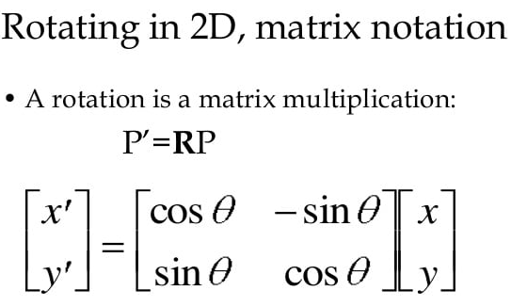

2D Rotation
We can represent 2D rotation in matrix form.

Slide 5
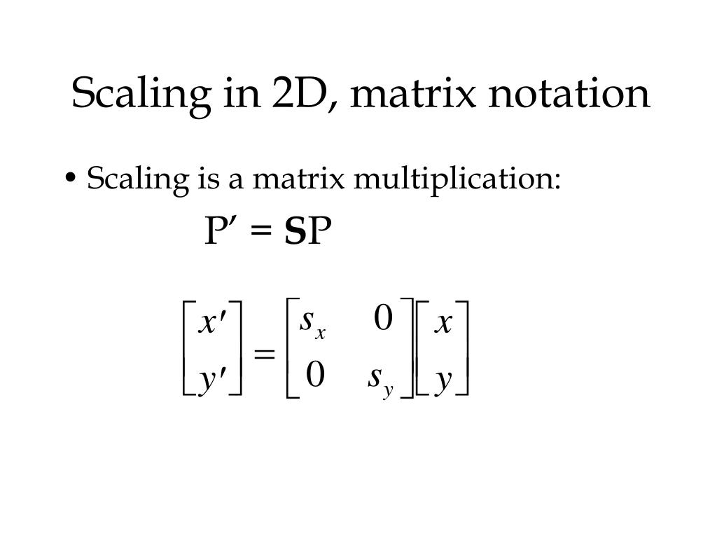
2D Scaling
A scaling transformation alters the size of an object. This operation can be carried out for polygons by multiplying the coordinate values (x,y) of each vertex by scaling factors Sx and Sy to produce the transformed coordinates (x’,y’).
Scaling factor Sx scales the object in x direction whereas Sy scales in y direction.
Scaling equation is:
x’=x . Sx
y’=y . Sy
i.e.
This can be represented in matrix form as:

Slide 6
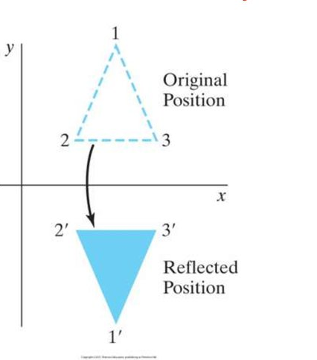
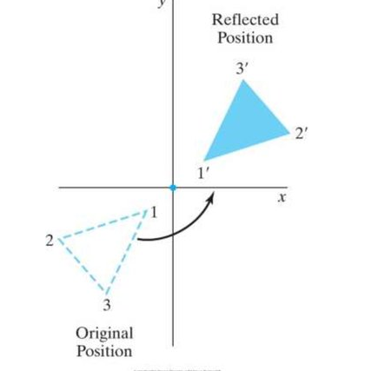
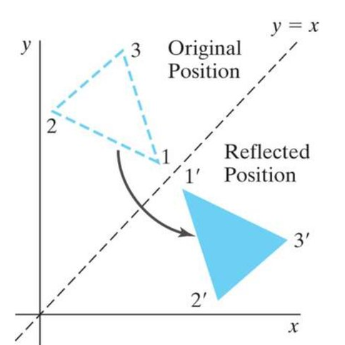
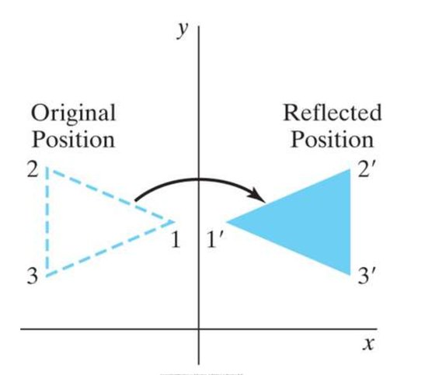
2D Reflection
Reflection is a transformation that produces a mirror image of an object.
A 2D reflection is generated relative to an axis of reflection by rotating the object 180⁰ about the reflection axis.
Reflection is rigid body transformation i.e. no change in shape and size.
We can reflect object by following ways:
Reflection about x-axis
Reflection about y-axis
Reflection about plane perpendicular to xy plane
Reflection about line y=x
a
b
c
d

Slide 7
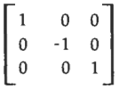

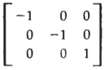

2D Reflection
Reflection about x-axis is accomplished with transformation matrix:
Reflection about y-axis is accomplished with transformation matrix:
Reflection of an object relative to an axis perpendicular to xy plane passing through origin is accomplished with transformation matrix:
Reflection of an object with respect to the line y=x is accomplished with transformation matrix:
This transformation keeps x values the same but flips the y values of coordinate position.
This transformation keeps y values the same but flips the x values of coordinate position.
This transformation flips both x and y values of coordinate position.
This transformation interchange both x and y values in coordinate position.

Slide 8


2D Shearing
Transformation that distorts (slant or tilt) the shape of an object is called shearing.
Two common shearing transformations are those that shift coordinate x values and those that shift y values.
An x-direction shear relative to x axis is produced with the transformation matrix:
Which transforms coordinate positions as:
x’=x+sh_{x}.y y’=y
An y-direction shear relative to y-axis is produced with the transformation matrix:
Which transforms coordinate position as:
x’=x y’=y+sh_{y}.x

Slide 9
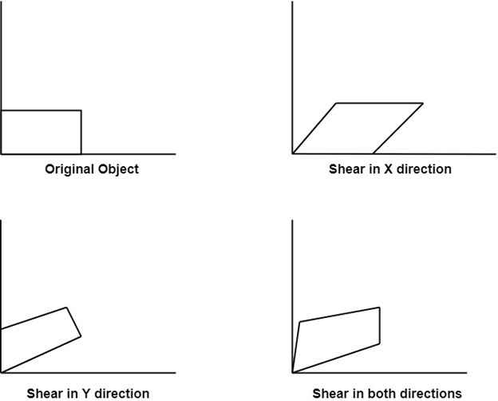
2D Shearing

Slide 10
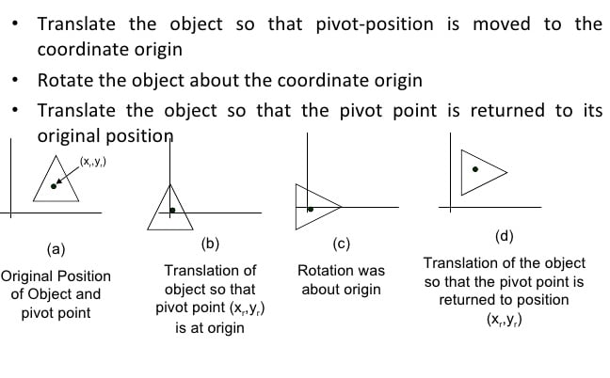
General Pivot Point rotation

Slide 11
Homogeneous Coordinate and Matrix representation of 2D transformation
The matrix representation for translation, scaling and rotation are respectively:
P’=P+T
P’=P.S
P’=P.R
So, translation is treated differently (as an addition) from scaling and rotation (as multiplications). We cannot perform all these transformation at once. In order to do so, we have to use homogeneous coordinate. For a 2D space 3D vector are used. The three components are called homogeneous coordinates.
In homogeneous coordinates, we add a third coordinate to a point.
In homogeneous coordinates all three transformation can be treated as multiplication as we can represent translation as matrix multiplication.
With the help of homogeneous coordinate it is possible to perform composite transformation.

Slide 12
Window to viewport Transformation
When we model an image in world coordinate system, we are not interested in the entire world but only a portion of it. So, we define the portion of interest that is a polygonal area generally rectangle specified in world coordinate system called window..
This window enclose the object for display.
The user may want to create images on different parts off the screen so we define a viewport inn normalized device coordinates.

Slide 13
Window to viewport Transformation
A world coordinate area selected for display is called a window.
In CG, window is a graphical control element.
Window defines a rectangular area in world coordinates.
An area on a display device to which a window is mapped is called viewport.
Viewport is a polygon viewing region in computer graphics.
Window defines what is to be viewed and viewport defines where it is to be displayed.
While window selects a part of the scene, viewport display the selected part at desired location on the display area.
Mapping of a part of world coordinate scene to device coordinates is referred to as a viewing transformation also know as window-to-viewport transformation or windowing transformation.

Slide 14
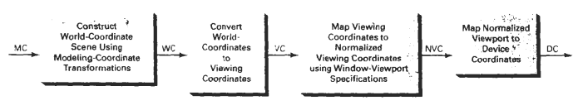
Window to viewport Transformation
While mapping mages from model coordinate to device coordinate we have to follow the following steps:
Construct a world coordinate scene using model coordinate transformation.
Convert world coordinates to viewing cooridnates (clipping window)
Transform viewing coordinates to normalized coordinates
Map normalized coordinates to device coordinates.
Using normalized device coordinate allows for output device independence.

Slide 15
Window to viewport Transformation
Mapping clipping window into normalized coordinates involves the following steps:
Viewport is defined with normalized coordinate values between 0 and 1
Object descriptions are transferred to this normalized spacce.
The transformation used maintain the same relative placement of a point in the viewport as in clipping window.
Relative proportions are only mainted if the aspect ratio of viewport is same as clipping window.

Slide 16
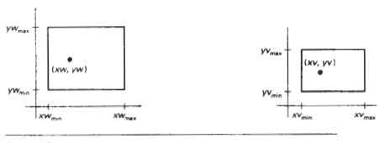
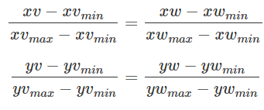
Window to viewport Transformation
To maintain the same relative placement of the image in clipping window in the viewport as in the window, the ratio must be same.

Slide 17


Window to viewport Transformation
Solving the above expression for viewport position (xv,yv), we have
Where the scaling factors are
Relative proportions of object are maintained if the scaling factors are same (sx=sy) otherwise world objects will be stretched or contracted in either x or y direction when displayed on the output device.

Slide 18
Clipping
Any procedure that identifies those portions of a picture that are either inside or outside of a specified region of space is referred to as a clipping algorithm or clipping.
The region against which an object is clipped is called a clip window.
There primitive types of clipping algorithm, they are:
Point clipping
Line clipping
Area clipping
Curve clipping
Text clipping
Polygon clipping

Slide 19
Point Clipping
A point clipping algorithm finds all the points that are interior to a clipping window. Any point (x,y) is said to be interior to clipping window if it satisfies the point visibility test given by
x≥x_{left}, x≤x_{right}
y≥y_{bottom}, y≤y_{top}

Slide 20
Line Clipping
Line clipping is the process of removing lines or portions of lines outside of an area of interest.
Line that intersect the clipping window at some portion have some portion of them in the clipping window, while lines which do not intersect the clipping window are either totally inside the window or totally outside the clipping window.
Any line that is outside the viewing area is removed.
Most common algorithms used for line clipping are:
- Cohen sutherland line clipping algorithm
- Liang-Barsky line clipping algorithm

Slide 21
Line Clipping: Cohen Sutherland line clipping algorithm
This is conventional line clipping procedure.
Cohen sutherland line clipping algorithm quickly detects and dispenses with two common and trivial cases.
To clip a line, we need to consider only its endpoints. If both endpoints of a line lie inside it, the entire line is inside the clipping window. It is trivially accepted and needs no clipping.
If both endpoints of a line lie outside it, the entire line is outside the clipping window. It is trivially rejected and needs to be neither clipped or displayed.
This algorithm divides a plane in nine regions by four straight lines.
The bounded middle region is a rectangular window with each point in the plane.
The algorithm extended window boundaries into nine region: top-left, top-center, top-right, center-left, center-right, center, bottom-left bottom-center, bottom-right.

Slide 22
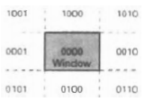
Line Clipping: Cohen Sutherland line clipping algorithm
Every line endpoint in a picture is assigned a four digit binary code, called region code, that identifies the location of the point relative to boundaries of clipping rectangle, where, each bit position for (from right to left)
bit1: left
bit2: right
bit3: below
bit4: above
The code’s bits are set according to following conditions:
If 1st bit is set 1: Point P lies to the left of window (x<x_{left})
If 2nd bit is set 1: Point P lies to the right of window (x>x_{right})
If 3rd bit is set 1: Point P lies to the bottom of the window (y<y_{bottom})
If 4th bit is set 1: Point P lies to the top of window (y>y_{top})

Slide 23
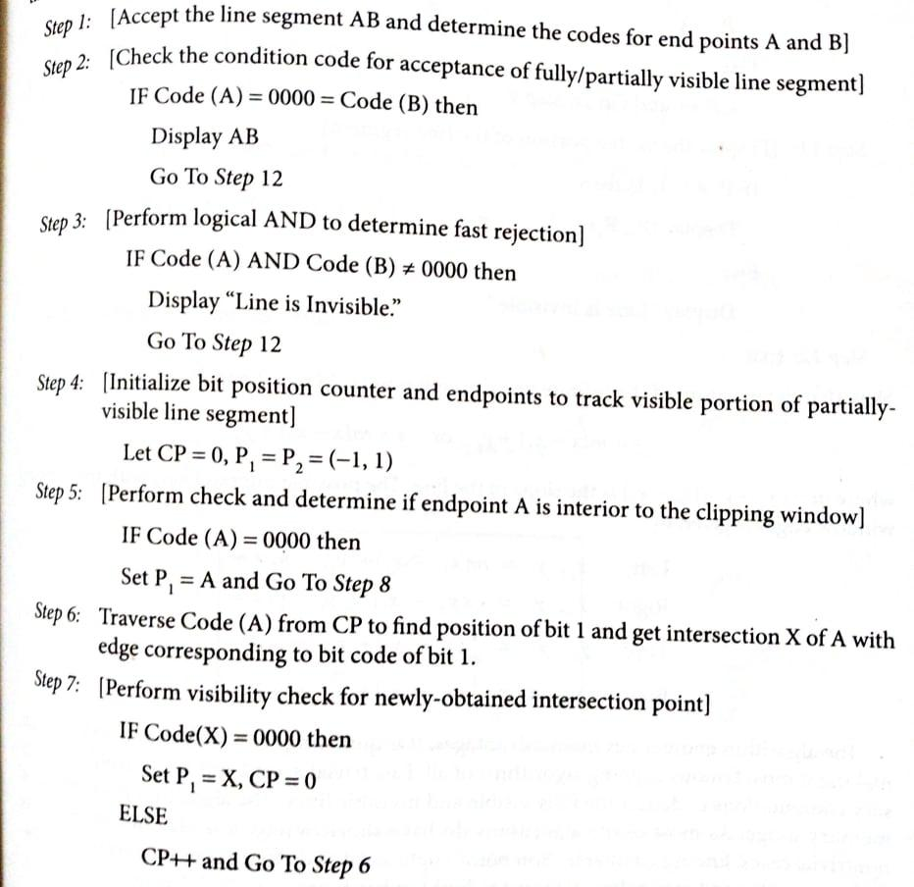
Line Clipping: Cohen Sutherland line clipping algorithm

Slide 24
Line Clipping: Cohen Sutherland line clipping algorithm

Slide 25
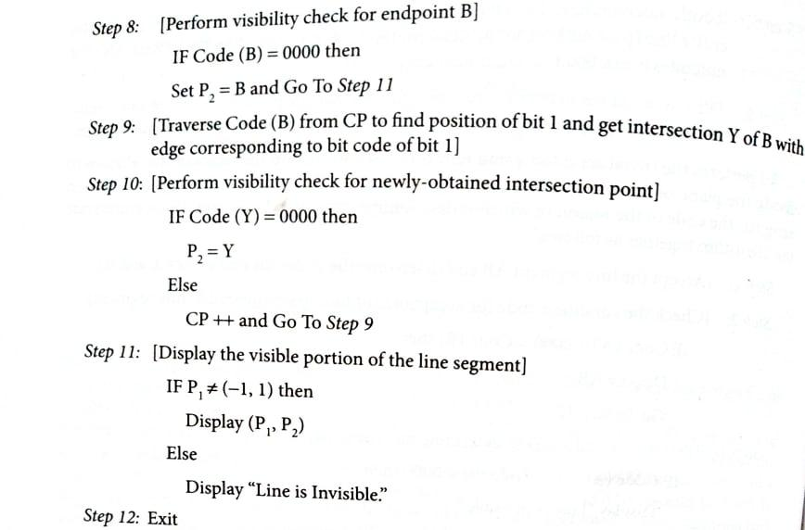
Line Clipping: Cohen Sutherland line clipping algorithm

Slide 26
Polygon Clipping
Polygon is a closed figure bounded by straight line with minimum three sides.
There are different polygon clipping algorithm each having its strength and weaknesses. The conventional one is Sutherland-Hodgeman algorithm.
This algorithm processes the polygon as a whole against each window edge.
It begins with initial set of polygon vertices and clip against left window edge to produce new set of vertices. The new set of veritces now clipped against the bottom, right and top edge respectively.
Sutherland Hodgeman uses divide and conquer strategy. It first clips the polygon against the right clipping boundary. The resulting (partly-clipping) polygon is then clipped against the top boundary and then the process is repeated for two remaining boundary. Any way we can do it in any order.

Slide 27
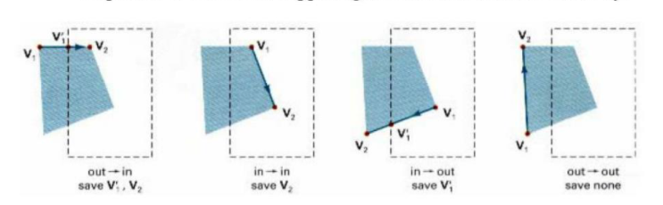
Polygon Clipping
Possible cases for the vertices to be clipped are as follow:
Case-1: If the starting (previous) vertex is outside the window boundary and end (current) vertex is inside the window boundary then both the intersection point with the window edge and the current vertex are added to the new vertex list.
Case-2: If both vertices are inside the window then only current vertex will be added to the list.
Case-3: If the previous vertex is inside the window boundary and current vertex is outside the window boundary then only the intersection point with window edge added to list.
Case-4: If both the vertices are outside the window boundary then the intersection points are tested for visibility and then added to the vertex list.

Slide 28
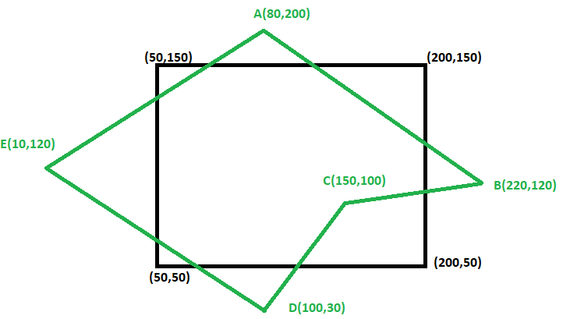
Polygon Clipping
Clip polygon ABCD against window PQRS. The Coordinates of the polygon are A(80,200), B(220,120), C(150,100), D(100,30), E(100,120). Coordinates of the window are P(200,50), Q(200,150), R(50,150), S(50,50).
Solution,
First of all plot the points and draw a polygon based on this points.

Slide 29
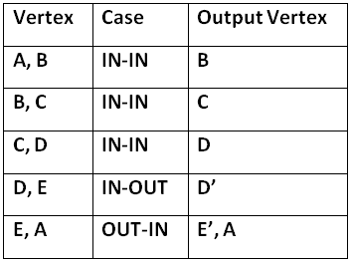
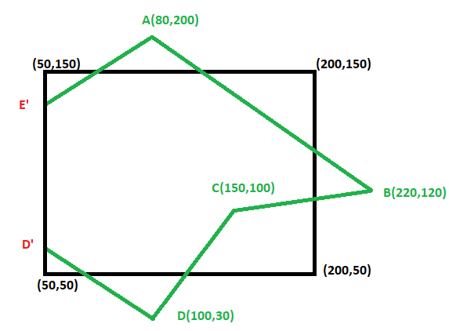
Polygon Clipping
OUT
IN
Clip against left edge of the window
(Left Clipping)
After Left Clipping

Slide 30
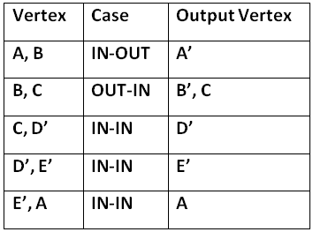
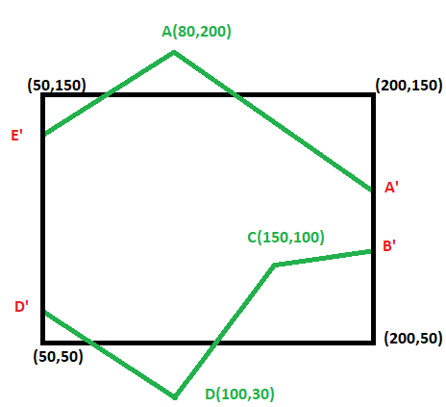
Polygon Clipping
IN
OUT
Clip against right edge of the window
(Right Clipping)
After Right Clipping

Slide 31
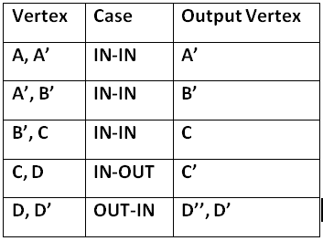
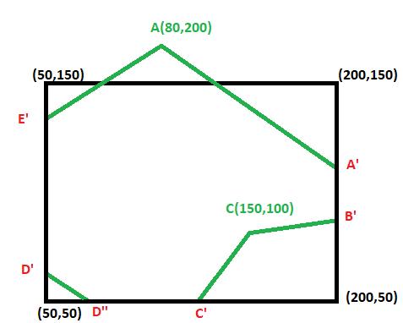
Polygon Clipping
Clip against bottom edge of the window
(Bottom Clipping)
After Bottom Clipping
IN
OUT

Slide 32
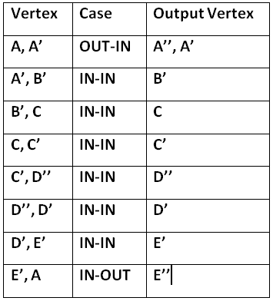
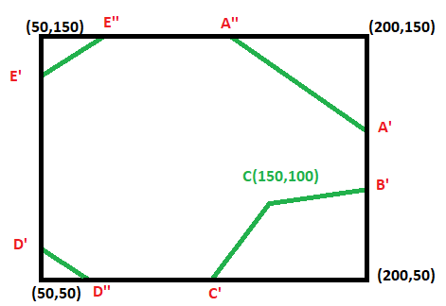
Polygon Clipping
Clip against top edge of the window
(Top Clipping)
After Top Clipping
IN
OUT

Slide 33
3D Transformation

Slide 34
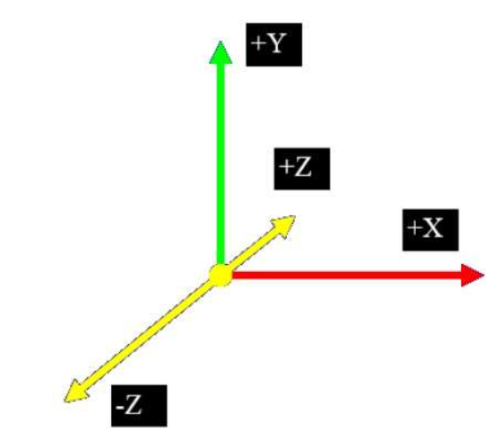
3D Transformation
In 2D system, we use only two coordinates X and Y but in 3D an extra coordinate Z is added.
When the transformation takes place on a 3D plane, then it is called 3D transformation.
The translation, scaling and rotation transformation used for 2D can be extended to 3D.
In 3D, each transformation is represented by 4x4 matrix.
Matrix representation of 3D transformation
Just as 2D transformation can be represented by 3x3 matrices using homogeneous coordinates, so 3D transformation can be represented by 4x4 matrices.
Instead of representing point as (X, Y, Z) we represent it as (X, Y, Z, W).

Slide 35
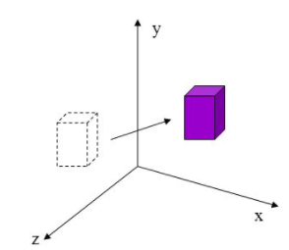
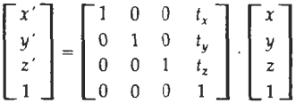
3D Transformation: Translation
Translation in 3D is similar to translation in the 2D except that there is one more direction parallel to z-axis.
If tx, ty, tz are used to represent translation vectors, then translation of position P(x,y,z) into point P’(x’y’,z’) can be represented as:
x’=x+tx
y’=y+ty
z’=z+tz
In 3D homogeneous coordinate representation, a point is translated from position P=(x, y, z) to position P’ = (x’, y’, z’) with the matrix operation.
Or,
P’ = T.P
Here, tx, ty, tz specify translation distances from coordinate directions x, y and z

Slide 36
3D Rotation
Rotation is a movement of an object in a circular motion.
It is a transformation in a plane or in space that describes the motion of rigid body around a fixed point.
3D rotation is more complicated than a 2D rotation as we must specify an axis of rotation. In 2D axis of rotation is always perpendicular to xy plane i.e. the z-axis. But in 3D the axis of ration can have any spatial orientation.
In 2D a rotation is prescribed by an angle of rotation θ and the center of rotation P, while in 3D rotation requires an angle of rotation and an axis of rotation.

Slide 37
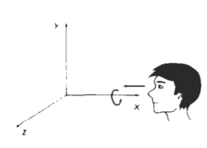
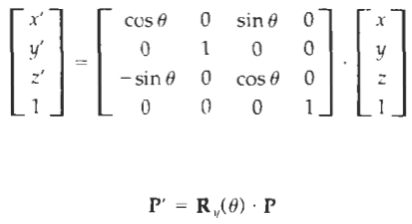
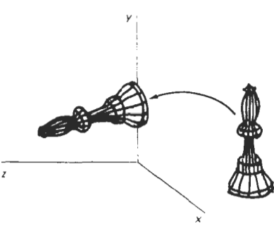
3D Rotation: On X-axis
If [x, y, z] is original coordinates of a point P then for positive rotation by angle φ about x-axis, x is preserved. Therefore for rotated point P with coordinates (x’, y’, z’) we have the relation
X’= x
Y’=ycosφ - zsinφ
Z’=ysinφ+zcosφ
Representing the above in homogeneous coordinate we get

Slide 38
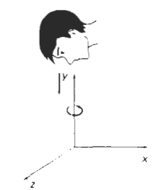
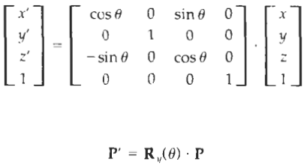
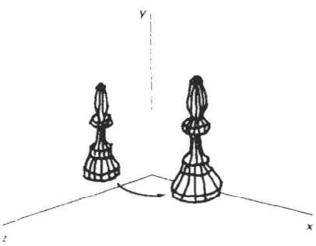
3D Rotation: On Y-axis
If [x, y, z] is original coordinates of a point P then for positive rotation by angle φ about y-axis, y is preserved. Therefore for rotated point P with coordinates (x’, y’, z’) we have the relation.
X’= zsinφ+xcosφ
Y’=y
Z’=zcosφ - xsinφ
Representing the above in homogeneous coordinate we get

Slide 39
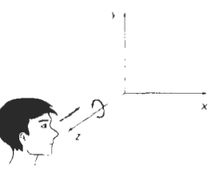
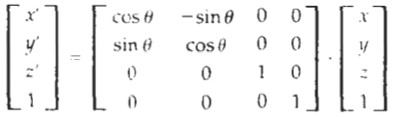
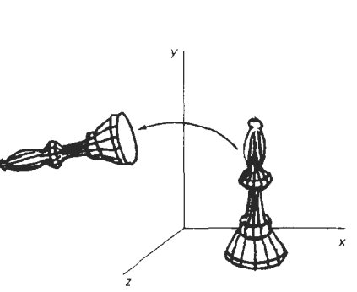

3D Rotation: On Z-axis
If [x, y, z] is original coordinates of a point P then for positive rotation by angle φ about z-axis, z is preserved. Therefore for rotated point P with coordinates (x’, y’, z’) we have the relation.
X’=xcosφ - ysinφ
Y’= xsinφ+ycosφ
Z’=z
Representing the above in homogeneous coordinate we get

Slide 40
3D Rotation: On Z-axis
If [x, y, z] is original coordinates of a point P then for positive rotation by angle φ about z-axis, z is preserved. Therefore for rotated point P with coordinates (x’, y’, z’) we have the relation.
X’=xcosφ - ysinφ
Y’= xsinφ+ycosφ
Z’=z
Representing the above in homogeneous coordinate we get

Slide 41
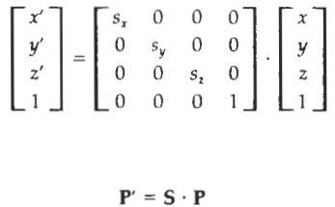
3D Scaling
A scaling transformation alters the size of an object. This operation can be carried out for polygons by multiplying the coordinate values (x,y,z) of each vertex by scaling factors Sx, Sy and Sz to produce the transformed coordinates (x’,y’, z’).
When the scaling factor is same in all directions it is called homothety.
Scaling factor Sx scales the object in x direction whereas Sy scales in y direction.
Coordinate transformation for scaling relative to origin are:
x’=x . Sx
y’=y . Sy
z’=z.Sz
Representing above in homogeneous coordinate:

Slide 42
3D Scaling
Scaling an object with transformation changes the size of the object and reposition the object relative to the coordinate origin. If transformation parameters are not equal relative dimension in the object are changed.
Uniform scaling: We preserve the original shape of an object with a uniform scaling factor (Sx=Sy=Sz)
Differential scaling: We do not preserve the original shape of an object with a differential scaling (Sx≠Sy≠Sz)
Scaling with respect to a selected fixed position: This can be represented with the transformation sequence:
Translate fixed point to origin
Scale the object relative to the coordinate origin
Translate the fixed point back to its original position
For these we can have composite transformation matrix by multiplying three matrices into one. [Please visit next slide for Matrix representation.]

Slide 43
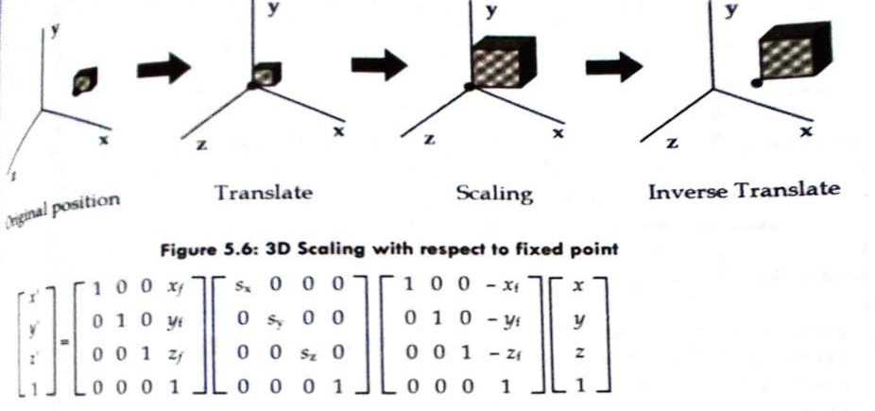
3D Scaling

Slide 44
2D Reflection
Reflection is a transformation that produces a mirror image of an object.
Reflection is a kind of rotation where rotation angle is 180 degree.
Reflections with respect to a plane are equivalent to 180⁰ rotations in 4D space.
The size of the reflected object is same as the size of original object.
Reflection is rigid body transformation i.e. no change in shape and size.
In 3D, there are 3 possible types of reflection:
- Reflection relative to XY plane
- Reflection relative to YZ plane
- Reflection relative to XZ plane

Slide 45
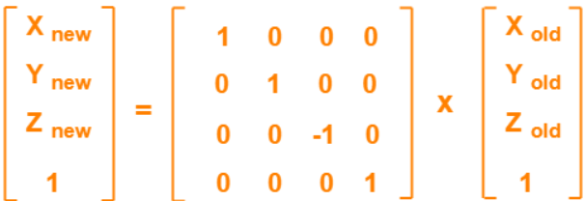
2D Reflection
Reflection relative to XY plane
This reflection is achieved by using the following reflection equations:
x’=x
y’=y
z’=-z
Representing above equation in matrix form
P’=R_{xy}.P

Slide 46
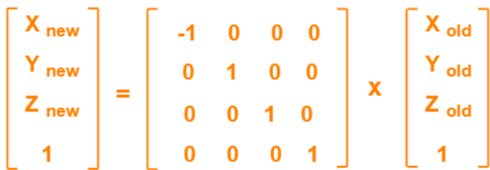
2D Reflection
Reflection relative to YZ plane
This reflection is achieved by using the following reflection equations:
x’=-x
y’=y
z’=z
Representing above equation in matrix form
P’=R_{yz}.P

Slide 47
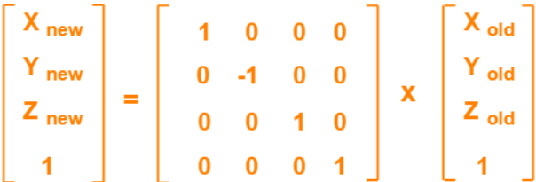
3D Reflection
Reflection relative to XZ plane
This reflection is achieved by using the following reflection equations:
x’=x
y’=-y
z’=z
Representing above equation in matrix form
P’=R_{xz}.P

Slide 48
3D Shearing
Transformation that distorts (slant or tilt) the shape of an object is called shearing.
3D shearing is an technique to change the shape of an existing object in 3D plane.
There are three types of shearing:
- Shearing in X axis
- Shearing in Y axis
- Shearing in Z axis

Slide 49
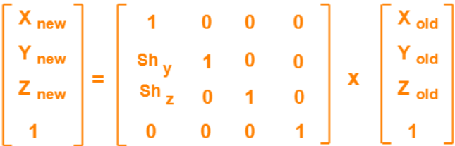
3D Shearing
Shearing in X axis:
Shearing in X axis is achieved by using the following equations:
x’=x
y’=y+sh_{y} . x
z’=z+sh_{z} . x
Representing above equation in matrix form:

Slide 50
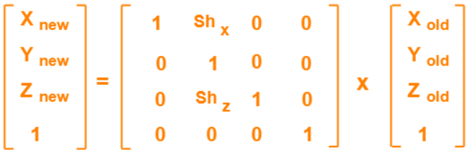
3D Shearing
Shearing in Y axis:
Shearing in Y axis is achieved by using the following equations:
x’=x+sh_{x} . y
y’=y
z’=z+sh_{z} . y
Representing above equation in matrix form:

Slide 51
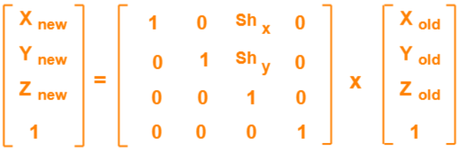
3D Shearing
Shearing in Z axis:
Shearing in Y axis is achieved by using the following equations:
x’=x+sh_{x} . z
y’=y+sh_{y} . z
z’=z
Representing above equation in matrix form:

