Slide 1
Computer Graphics
Unit-1

Slide 2
Introduction
The word graphics is made up of two words: graphs and pics. Here, graphs is a mathematical figures like circle, lines, ellipse, etc and pics represent the images.
So, computer graphics is an art of drawing pictures, lines, chart, etc using computer with the help of program and software.
Computer graphics refers to the creation, storage and manipulation of pictures and drawings using digital computer.
Computer graphics is a field of computer science that is concerned with digitally synthesizing and manipulating visual contents.
Also, we can say that it is the science and technology of creating, storing, displaying and manipulating images and objects.
Computer graphics is a branch of computer science that deals representation, manipulation and storage of images with the help of computer.
In CG, objects are presented as a collection of discrete picture element (pixel).

Slide 3
Introduction
The term “Computer Graphics” deals with:
Representation (How it will be displayed) and manipulation (change or edit) of pictorial data by a computer.
Different technologies used to create and manipulate such pictorial data.
Images so produced and stored
Study of methods for digitally synthesizing and manipulating the visual content.

Slide 4
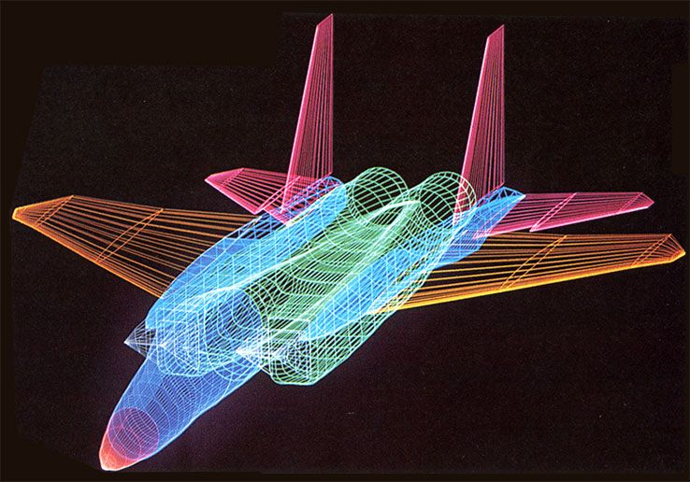
Application of Computer Graphics
Computer-Aided Design (CAD): In CAD, interactive graphics is used to design components and system of mechanical, electrical, electromechanical and electronic devices including structures like buildings, automobile bodies, airplane, VLSI chips, telephone and computer networks. CAD uses wireframe outline form. Real time animation using wireframe display on video monitor are useful for testing performance of vechicles or system. Some of CAD softwares are: QCAD, NX, CATIA v5, etc

Slide 5
Application of Computer Graphics
Simulation and animation for scientific visualization and entertainment: Computer produced animated movies and displays of the time varying behavior of real and simulated objects are becoming increasingly popular for scientific and engineering visualization. We can use CG to study abstract mathematical entities as well as mathematical models of such phenomena like chemical reactions, physiological system, organ function and deformation of mechanical structures under various kinds of loads.
Another advanced technology area is interactive cartooning. Cartoon characters will increasingly be modeled in the computer as 3D shape descriptions whose movements are controlled by computer commands rather than by figures being drawn manually by cartoonists. It is also used in TV commercials featurings flying logos and more exotic visual with elegant special effects in movies.

Slide 6
Application of Computer Graphics
User Interface: Most applications that run on personal computers and workstations have user interfaces that rely on desktop window systems to manage multiple simultaneous activities and on point and click facilities to allow users to select menu, icons and objects on the screen. With the advancement of CG, typing is necessary only to input text to be stored and manipulated.
Cartography: Computer graphics is used to produce both accurate and schematic representations of geographical and other natural phenomena from measurement data. For example, geographic maps, relief maps, exploration maps for drilling and minning, oceanographic charts, weather maps, population density maps,etc.

Slide 7
Application of Computer Graphics
Process control: Flight simulators or arcade games let users interact with a simulation of real or artificial world many other applications enable people to interact with some aspect of real world itself. Status displays in refineries, power plants and computer networks show data values from sensors attached to critical system components so that operators can respond to problematic conditions. For example, military commanders view field data, numbers and position of vechicles, weapons lunched, troop movements, casulties on command and control displays to revise their tactics as needed.
Others:
Art and commerce
Medical
Education and training
Desktop publication and many more.

