Slide 1
Unit-4
3D Graph

Slide 2
Introduction
Solid objects can be broadly divided into two categories:
- Boundary Representation
- Space partitioning representation
Boundary representation describes 3D objecct as a set of surfaces that separates the object interior from the environment. Example: polygon facets and spline patches.
Space partitioning representation describes the interior properties by partitioning the spatial region containing an object into a set of small, non-overlapping, contigous solid (usually cubes). Example of this is octree representation.

Slide 3
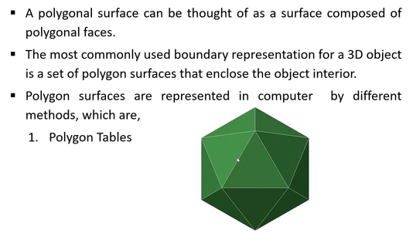
Polygon surfaces
Plane equation
Polygon Mess

Slide 4
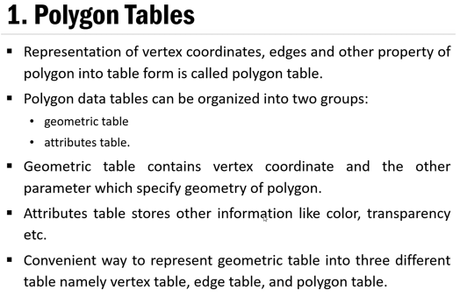

Slide 5
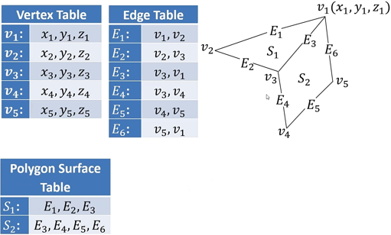

Slide 6
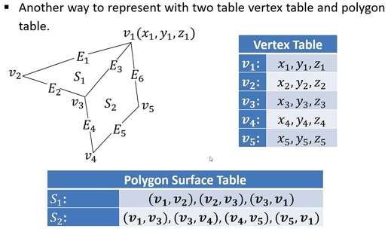

Slide 7
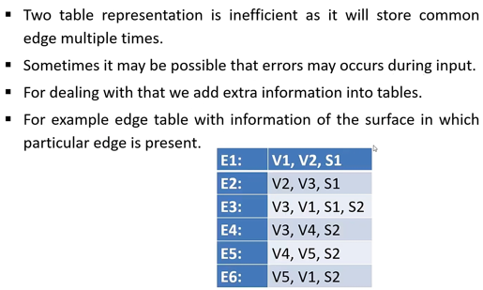

Slide 8
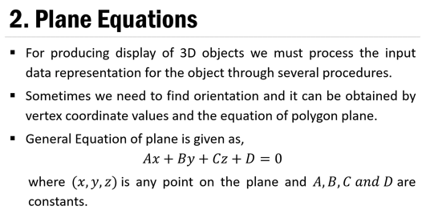

Slide 9
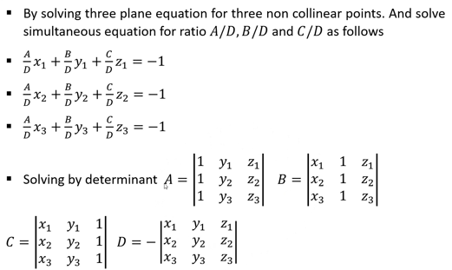

Slide 10
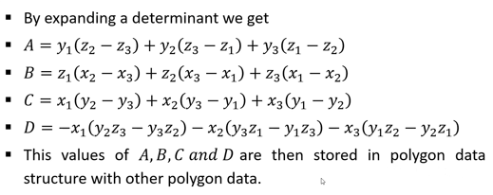

Slide 11
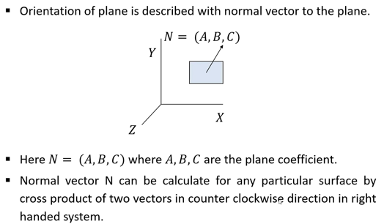

Slide 12
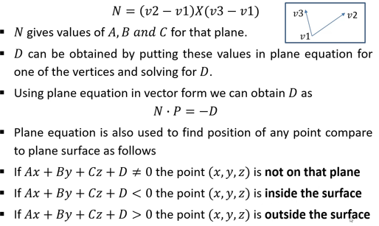

Slide 13
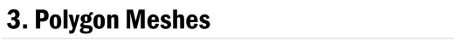
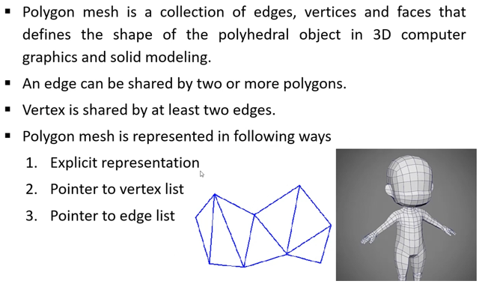

Slide 14
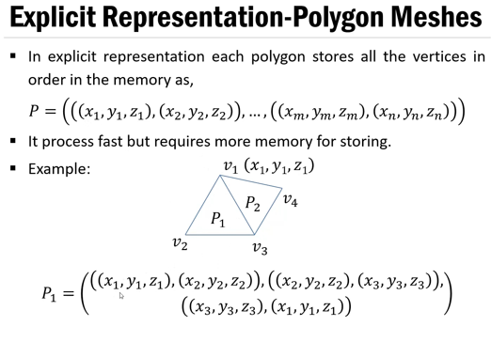

Slide 15
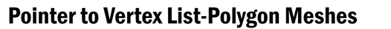
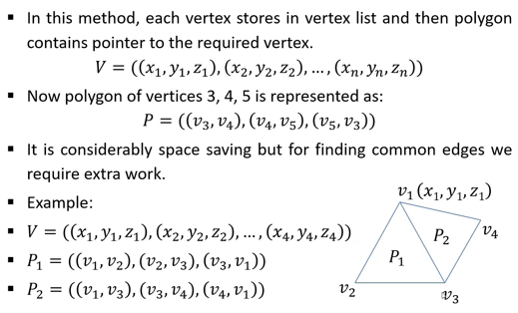

Slide 16
