Slide 1
Unit-4
Visible Surface Determination and Computer Graphics Algorithm

Slide 2
Visible Surface Determination
It is the process used to determine which surfaces and part of surfaces are not visible from the certain viewpoint. It is also termed as hidden surface removal.
The process of hidden surface determination is called hiding and such an algorithm is called a hider.
When we view a picture containing non-transparent objects and surfaces, then we cannot see those objects from views which are behind from objects closer to eye.
We have to remove these hidden surfaces to get a realistic screen image. So the identification and removal of these surfaces is called Hidden-Surface problem.
We can implement two method for removing hidden surface problems:
- Object space method
- Image space method

Slide 3
Object Space method
Object space method also known as object precision algorithms is implemented in physical coordinate system.
For visibility, object space method compares objects and parts of objects to each other within the scene definition to determine which surfaces are visible .
Geometric calculation is precise i.e. done on floating point so, it is easy to implement but slow than other methods.
Some of the popular method for object space are: Back face Removal, Area subdivision algorithm (quadtree and octree) method, binary space partitioning method.
It is used in line display algorithm.
Basic procedure:
Begin
Determine those parts of the object whose view is unobstructed by other parts of it or any other objects with respect to the viewing specifications.
Draw those parts in the object color
End

Slide 4
Object Space method
Calculation are performed at the resolution in which objects are defined. Process is unrelated to display resolution or individual pixel in the image and result of process is applicable to various display resolutions.
Complexity of this method is O(n²) for n number of objects.

Slide 5
Image Space method
Image space works in screen coordinate system or device coordinate system.
In image space method, visibility is decided point by point in each pixel position in view plane. It is used in line/surface display algorithm in computer graphics.
Accuracy of calculation is bounded by display resolution. And change in display resolution requires re-calculation.
Complexity of this method is O(n^{N}) where n is the number of object in the scene and N is the number of pixel.
The most popular methods for image space method are depth buffer (z-buffer), scan line, depth sorting (painter algorithm).
Basic procedure:
Begin
- Determine the object closet to that pixel
- Draw the pixel in object color
End

Slide 6
Back Face Detection (Plane Equation Method)
Back-face detection, also known as plane equation method is an object space method in which objects and parts of objects are compared to find out the visible surfaces.
In a solid object, there are surfaces which are facing the viewer (front faces) and there are surfaces which are opposite to the viewer (back faces).
These back faces contribute to approximately half of the total number of surfaces.
There are three methods for back face detection, although all these three methods have the same concept.

Slide 7
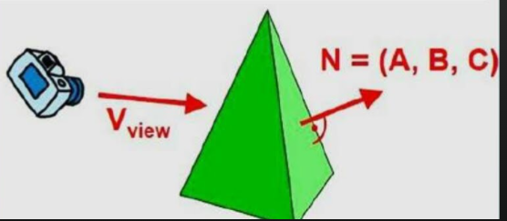
Back Face Detection (Plane Equation Method): First method
A point (x, y, z) is inside a polygon surface with plane parameters A, B, C and D if:
Ax+By+Cz+D<0
Then, if the point is inside the polygon surface we have to determine if it is back face or front face.
If inside point is along the line of sight to the surface, the polygon must be a back face.

Slide 8
Back Face Detection (Plane Equation Method): Second method
We can simplify first method test by considering the Normal vector N to a polygon surface which has Cartesian components (A, B, C).
If V is the vector in viewing direction from the center of projection then this polygon is a back face if:
V.N>0
V.N=|V|.|N|cosθ
Here if, 0≤θ≤90 then point is back face.

Slide 9
Back Face Detection (Plane Equation Method): Third method
If object description have been converted to projection coordinates and our viewing direction is parallel to the viewing Z_{v} axis then V=(0,0,V_{z})
V.N= V_{z}.C
Here sign of C decides whether the point is back face or front face.
If we are viewing along negative Z axis i.e if we are viewing from z-axis seeing towards negative z-axis the C ≤ 0 then point is back face otherwise point is front face.
Drawback of this algorithm is:
Back-face detection can identify all the hidden surfaces in a scene that contain non-overlapping convex polyhedra but cannot used for concave polyhedra.
A polygon surface with plane parameter C<0 in a right handed viewing coordinate syste is identified as a back face when viewing direction is along negative z-axis.

Slide 10
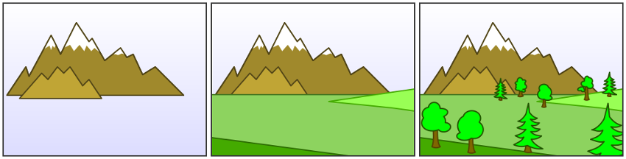
Painter’s algorithm (Depth sort algorithm)
Painter’s algorithm also called as priority fill algorithm uses both object space method and image space method.
So, depth sorting method performs two basic functions:
First the surfaces are sorted in order of descending depth i.e. z-value.
Second, the surfaces are scan converted in order, starting with the surface of greatest depth.
The name painter’s algorithm refers to a simple minded painter who paints the distant parts of a scene first then covers them by those parts that are nearer.
The painter’s algorithm sorts all the polygons in a scene by their depth and paints them in this order. It will over-paints the parts that are normally not visible.

Slide 11
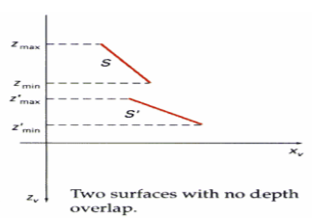
Painter’s algorithm (Depth sort algorithm)
Painting polygon surfaces into the frame buffer according to depth is carried out in several steps. Let us assume we are viewing along z-direction, surfaces are ordered on the first pass according to the smallest z-value on each surface. There are five test in painter’s algorithm.
Test 0:
The surface s at the end of the list (having greatest depth) is then compared to the other surfaces in the list to determine whether there are any depth overlaps. If no overlaps occurs, S is the most distant surface and it is scan converted.
This process is repeated for next surface in the list. If no overlaps occur, each surface is processed in depth order until all have been scan converted (in order S→S’)
If a depth overlap is detected at any point in the list, we need to make some additional comparisons to determine whether any of the surface should be reordered.

Slide 12
Painter’s algorithm (Depth sort algorithm)
For surface that has depth overlap with S. If any one of the test is true, no reordering is necessary for S otherwise reordering is necessary. The tests performed are:
The bounding rectangles in xy direction for two surfaces do not overlap
Surface S is completely behind the overlapping surface relative to the viewing position.
The overlapping surface is completely in front of S relative to the viewing position.
The boundary edge projections of the two surfaces onto the view plane do not overlap.

Slide 13
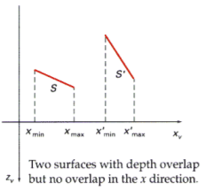
Painter’s algorithm (Depth sort algorithm)
Test 1:The bounding rectangles in xy direction for two surfaces do not overlap
Test 1 is performed in two parts.
We first check for overlap in x-direction, then we check for overlap in y direction. If either of these direction show no overlap, the planes cannot obscure one other.
If the test is passes no overlap in both x-direction and y-direction, then ordering is not necessary i.e. S→S’ otherwise we have to move to second and third test.

Slide 14
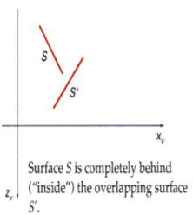
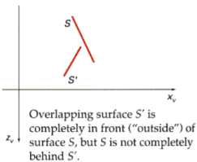
Painter’s algorithm (Depth sort algorithm)
Test 2: Surface S is completely behind the overlapping surface relative to the viewing position.
Test3: The overlapping surface is completely in front of S relative to the viewing position.
We perform test2 and 3 with an inside-outside polygon test with an equation:
For test-2, we substitute the coordinates for all vertices of S into the plane equation for the overlapping surface S’ and check the sign of the result. If Ax+By+Cz+D<0, surface S is behind (inside) the S’.
Test-2 will failed, if S is not completely behind the S then we will move to test 4.
For test-3, we substitue the coordinates for all vertices of S’ into the plane equation for the overlapping surface S and check the sign of the result.If we get Ax+By+Cz+D>0, then test is pass otherwise we will perform test 4.
Inside outside polygon test:
Ax+By+Cz+D<0 (point is inside)
Ax+By+Cz+D≥0 (point is outside)

Slide 15
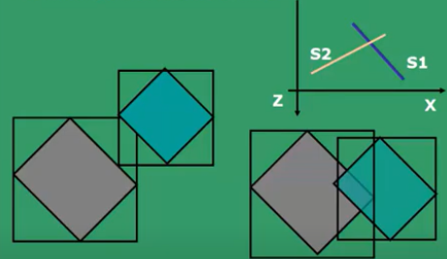
Painter’s algorithm (Depth sort algorithm)
Test 4: The boundary edge projections of the two surfaces onto the view plane do not overlap.
If test 1 through 4 have all failed, we perform test 4 to determine whether the two surface projections overlap.
If overlaps, test 4 is failed, the we have to reorder i.e. S’→S

Slide 16
Z buffer/depth buffer
The drawback of Back face detection is that it cannot work on partially hidden surfaces and it works only with non-overlapping (separate) objects.
To remove this problem Z-buffer algorithm comes into existence.
The basic idea is to test Z-depth of each surface to determine the closest (visible) surface.
It is an image object method to eliminate hidden surfaces.
Z buffer compares surface depth at each pixel position on the projection plane. The object depth is usually measured from the view plane along the z-axis of a viewing system.

Slide 17
Z buffer/depth buffer
Each surface of a scene is processed separately, one point at time across the surface.
It uses two buffer: z-buffer and refresh buffer. Z-buffer stores the z-value in (x,y) position and refresh buffer stores intensity value in (x,y) position.
With object descriptions converted to projection coordinates each (x,y,z) position on a polygon surface corresponds to orthographic projection point (x,y) on the view plane. So each pixel position (x,y) can be compared by comparing the z values.
We can implement depth buffer algorithm in normalized coordinates so the z value range from 0 to 1.

Slide 18
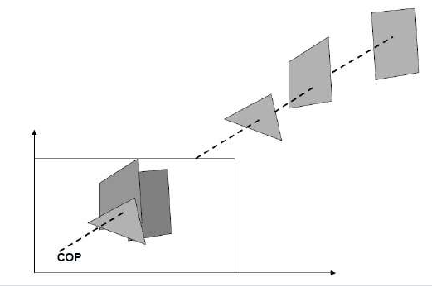
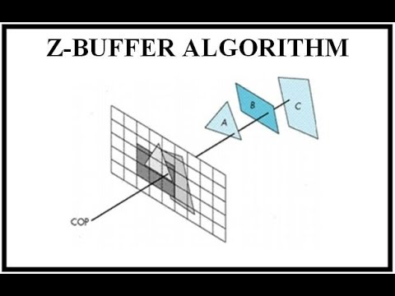

Slide 19
Z buffer/depth buffer
There are two cases that depends on where we are sitting and looking in which direction.
Case 1: Sitting +Z and looking origin –Z
Larger Z value, closer the surface and smaller Z value farther the surface
Initialize depth buffer and refresh buffer
D(x,y)=0
R(x,y)=I_{background}
If (Z_{new}>D(x,y)
D(x,y)=Z_{new} and R(x,y)=I_{new}

Slide 20
Z buffer/depth buffer
Case 2: Sitting –Z and Looing origin +Z
Smaller Z value, closer the sruface and larger Z value farther the surface
D(x,y)=Z_{max} (∞)
R(x,y)=I_{Background}
If (Z_{new}<D(x,y)
D(x,y)-Z_{ne} and R(x,y)=I_{new}

Slide 21

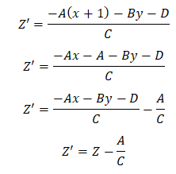
Z buffer/depth buffer
We use surface equation to ..........
Ax+By+Cz+D=0, solving this, we get,
For (x+1),
Z’ can be calculated using previous Z value as is constant. This reduces calculation time.
But this algorithm can be used only when there are opaque surfaces.

Slide 22
A-Buffer
A-Buffer method in computer graphics is a general hidden face detection mechanism.
This method is also known as anti-aliased or area-averaged or accumulation buffer. It is developed for implementing in surface rendering system called REYES (Render Everyting You Ever Saw).
This method extends the algorithm of depth-buffer (or Z Buffer) method.
As the depth buffer method can only be used for opaque object but not for transparent object, the A-buffer method provides advantage in this scenario.
Although the A buffer method requires more memory, but different surface colors can be correctly composed using it.

Slide 23
Being a descendent of the Z-buffer algorithm, each position in the buffer can reference a linked list of surfaces.
The key data structure in the A buffer is the accumulation buffer.
A buffer method is slightly costly than Z-buffer method because it requires more memory in comparison to the Z-buffer method. It proceeds just like the depth buffer algorithm. Here, the depth and opacity are used to determine the final color of the pixel. As shown in the figure below, the A buffer method can be used to show the transparent objects.
Each position in the A buffer has 2 fields : 1) Depth field 2) Surface data field or Intensity field

Slide 24
The surface buffer in the A buffer method includes :
Depth
Surface Identifier
Opacity Parameter
Percent of area coverage
RGB intensity components
Pointer to the next surface
Other surface rendering parameter

Slide 25
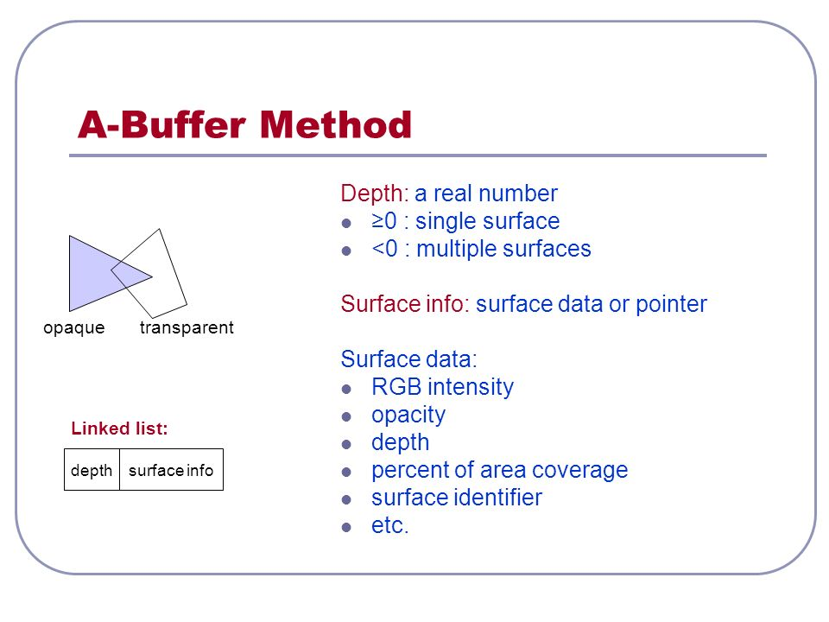
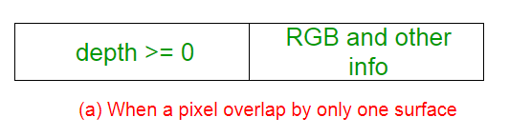
A depth field stores a positive or negative real number. A surface data field can stores surface intensity information or a pointer to a linked list of surfaces that contribute to that pixel position
.
When a pixel overlap by only one surface
As shown in the above figure, if the value of depth is >= 0, the number stored at that position is the depth of single surface overlapping the corresponding pixel area. The 2nd field, i.e, the intensity field then stores the RGB components of the surface color at that point and the percent of pixel coverage.

Slide 26
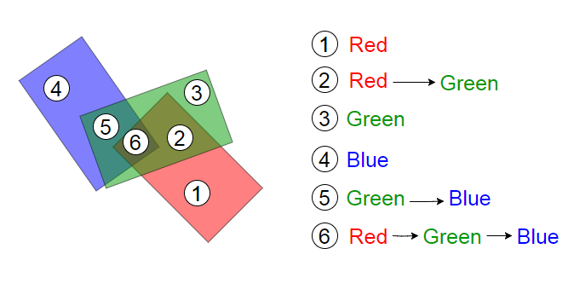
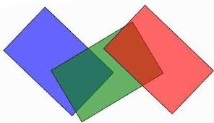
The one of advantage of A buffer method is that it provides anti-aliasing (process to remove jaggy or staircase effect in the picture) in addition to what Z-buffer does.
In A-buffer method, each pixel is made up of a group of sub-pixels. The final color of a pixel is computed by summing up all of its sub-pixels. Due to this accumulation taking place at sub-pixel level, A-buffer method gets the name accumulation buffer.

Slide 27
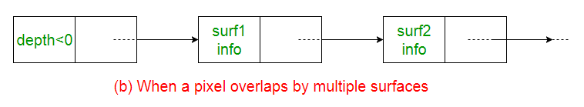
When a pixel overlap by multiple surfaces
As shown in the above figure, multiple-surface contributions to the pixel intensity is indicated by depth < 0. The 2nd field, i.e, the intensity field then stores a pointer to a linked list of surface data.

Slide 28

Scan line method for Visible Surface Detection
It is image space method for removing hidden surfaces. It is an extension of scan line algorithm for filling polygons interiors.
When we use Z-buffer we can process only one surface at a time. But by scan line method we can process more than one surfaces at a time.
In this method, for all polygons intersecting a scan line, the faces are processed from left to right.
And if there are overlapping faces, we should determine the depth so that the nearest face to the view plane is identified and the intensity of that face is entered into the refresh buffer.
The first step of this method is to create an edge table for all non-horizontal edges of all pol]ygons projected on the view plane. Horizontal edges are ignored. Each entry in edge table contains:
- x coordinate of the end with smaller y coordinate
- y coordinate of the edge’s other end
- x increment Δx, used in stepping from one scan line to the next ( Δx is the inverse slope of edge)
- Polygon identification number indicating the polygon to which edge belongs.
Edge Table:

Slide 29

Scan line method for Visible Surface Detection
Polygon table fields contains:
- Polygon ID
- Coefficient of plane equation
- Shading or color information for polygon
- In-Out Boolean flag, initiated to false and used during scan line processing.
To facilitate the search for surfaces crossing a given scan line an active list of edges is formed for each scan line as it is processed.
The active list stores only those edges that cross the scan line in an increasing order from x.
Also a flag is set for each surface to indicate whether the position along a scan line is either inside or outside the surface
Polygon Table:

Slide 30
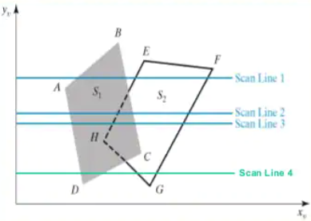
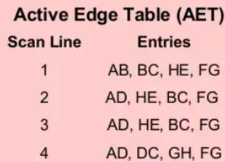
Scan line method for Visible Surface Detection
Example:
Sorted edges are: AD, CD, GH, FG, HE, BC, AB and EF
Polygon table has entries: ABCD for surface S1 and EFGH for surface s2.
Prepare active edge table (AET)

