Slide 1

TRANSIT
SECURE
SYSTEM

Slide 2
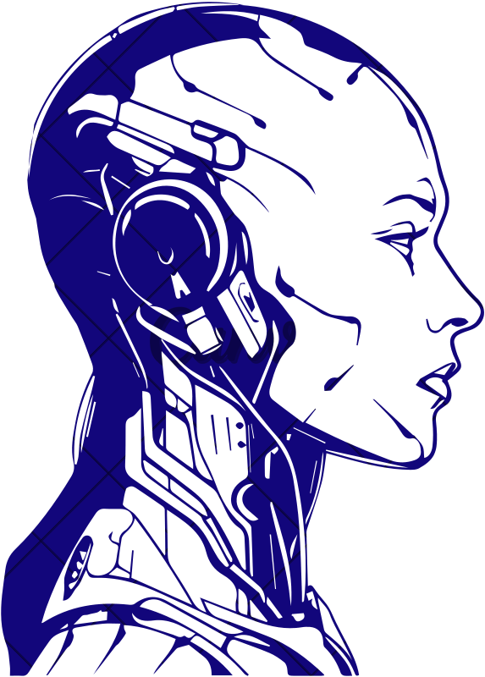

TECHNOCRATS
VAAGEDVI ENGINEERING COLLEGE
IEEE VEC STUDENT BRANCH
V. RAKSHITH
V.RAKESH
syed SHARIQ SHARIeF
DAVID RAJU

Slide 3
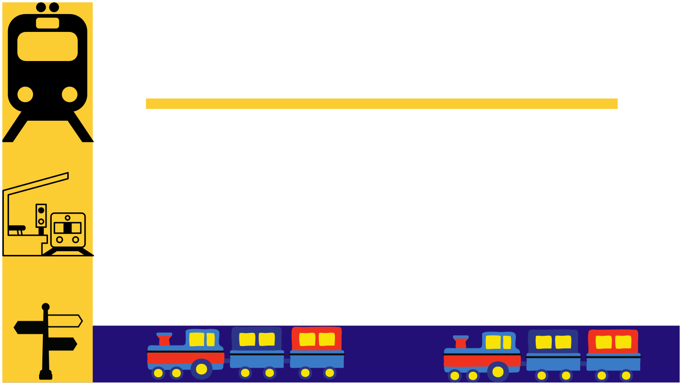
PROBLEM STATEMENT
To Eradicate Human Error Accidents While Crossing
The Track from the Platform , While the train is
passing with a great speed through the Station

Slide 4
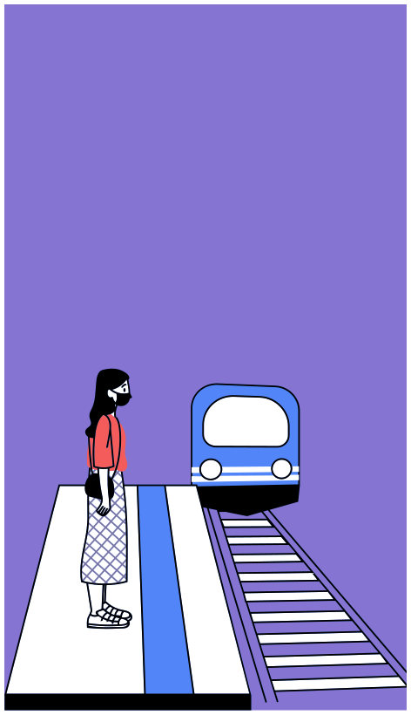
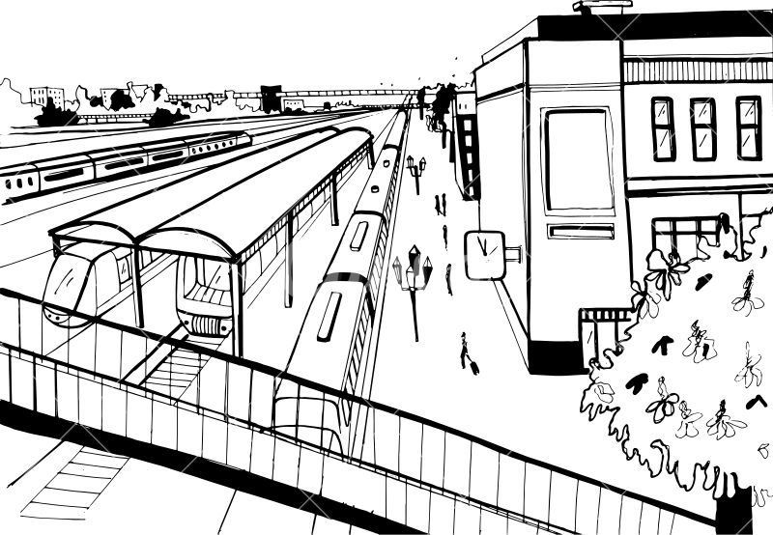
Introduction
Generally , A Train passes over A Railway Station with a High speed. Usually people who are late to Their Train will Try To avoid the Pedestrain Bridge , and reach the platform over the Tracks.
Most of the Vendors often do the same to catch up the trains very soon . As a Result if a train Accidently Hits them it leads to Human loss certainly Most of them will die due to collison.
TO eradicate such Accidents & Human loss we coined a solution

Slide 5

CAUSE
For Accidents
1.DUE TO LACK OF CAUTIOUSNESS
2.LACK OF AWARENESS AMONG PASSENGERS
3.IMPROPER ALERTING & SECURITY SYSTEMS

Slide 6



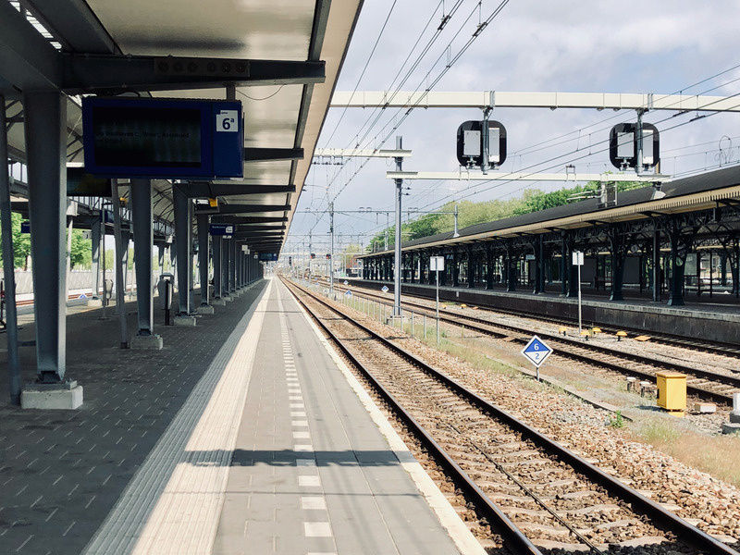

SOLUTION
TO Eradicate Such Human loss & Accidents We
Came Up Within Solution
By this Project will be Able to Eradicate the
Human Error’s and Accidents.

Slide 7
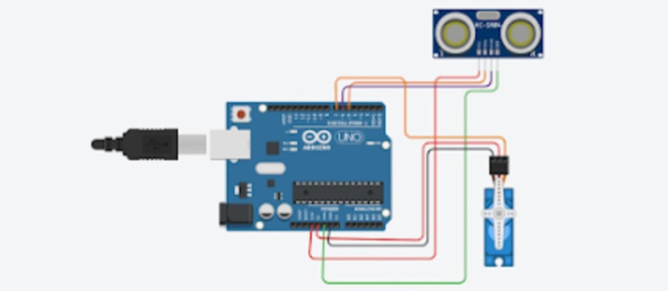

Requirements:
Arduino UNO
Ultrasonic sensor
Servo 9v
A battery -9V
Jumper cables

Slide 8

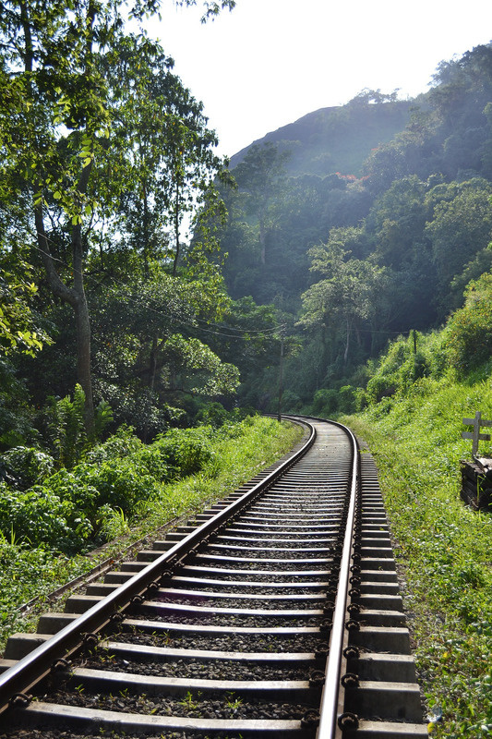
Arrangement
THE CODE IS UPLOADED IN ARDUNIO .
CHIPSET SUCH THAT OUR APPARATUS FOR THE NEED
IS SERVED.
A GATE IS SET TO THE FLOOR OF PLATFORM SUCH
THAT IT OPENS AND CLOSES HORIZONTALLY.
THROUGH AUTOMATION SENSORS THE GATE OPENS AND CLOSES AUTOMATICALLY WITHOUT THIRD-PARTY MANUAL INTERFEARENCE.
SUCH THAT IT RESTRICTS THE MOVEMENT OF PASSENGERS TO CROSS TRACK

Slide 9

Conclusion
THROUGH THIS TECHNOLOGY WE WILL BE ABLE TO
ERADICATE HUMAN ERROR CAUSED ACCIDENTS ON RAILWAY TRACKS

Slide 10
THANK YOU
Thank you

