Slide 1
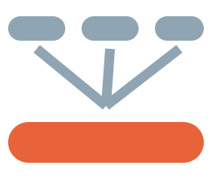
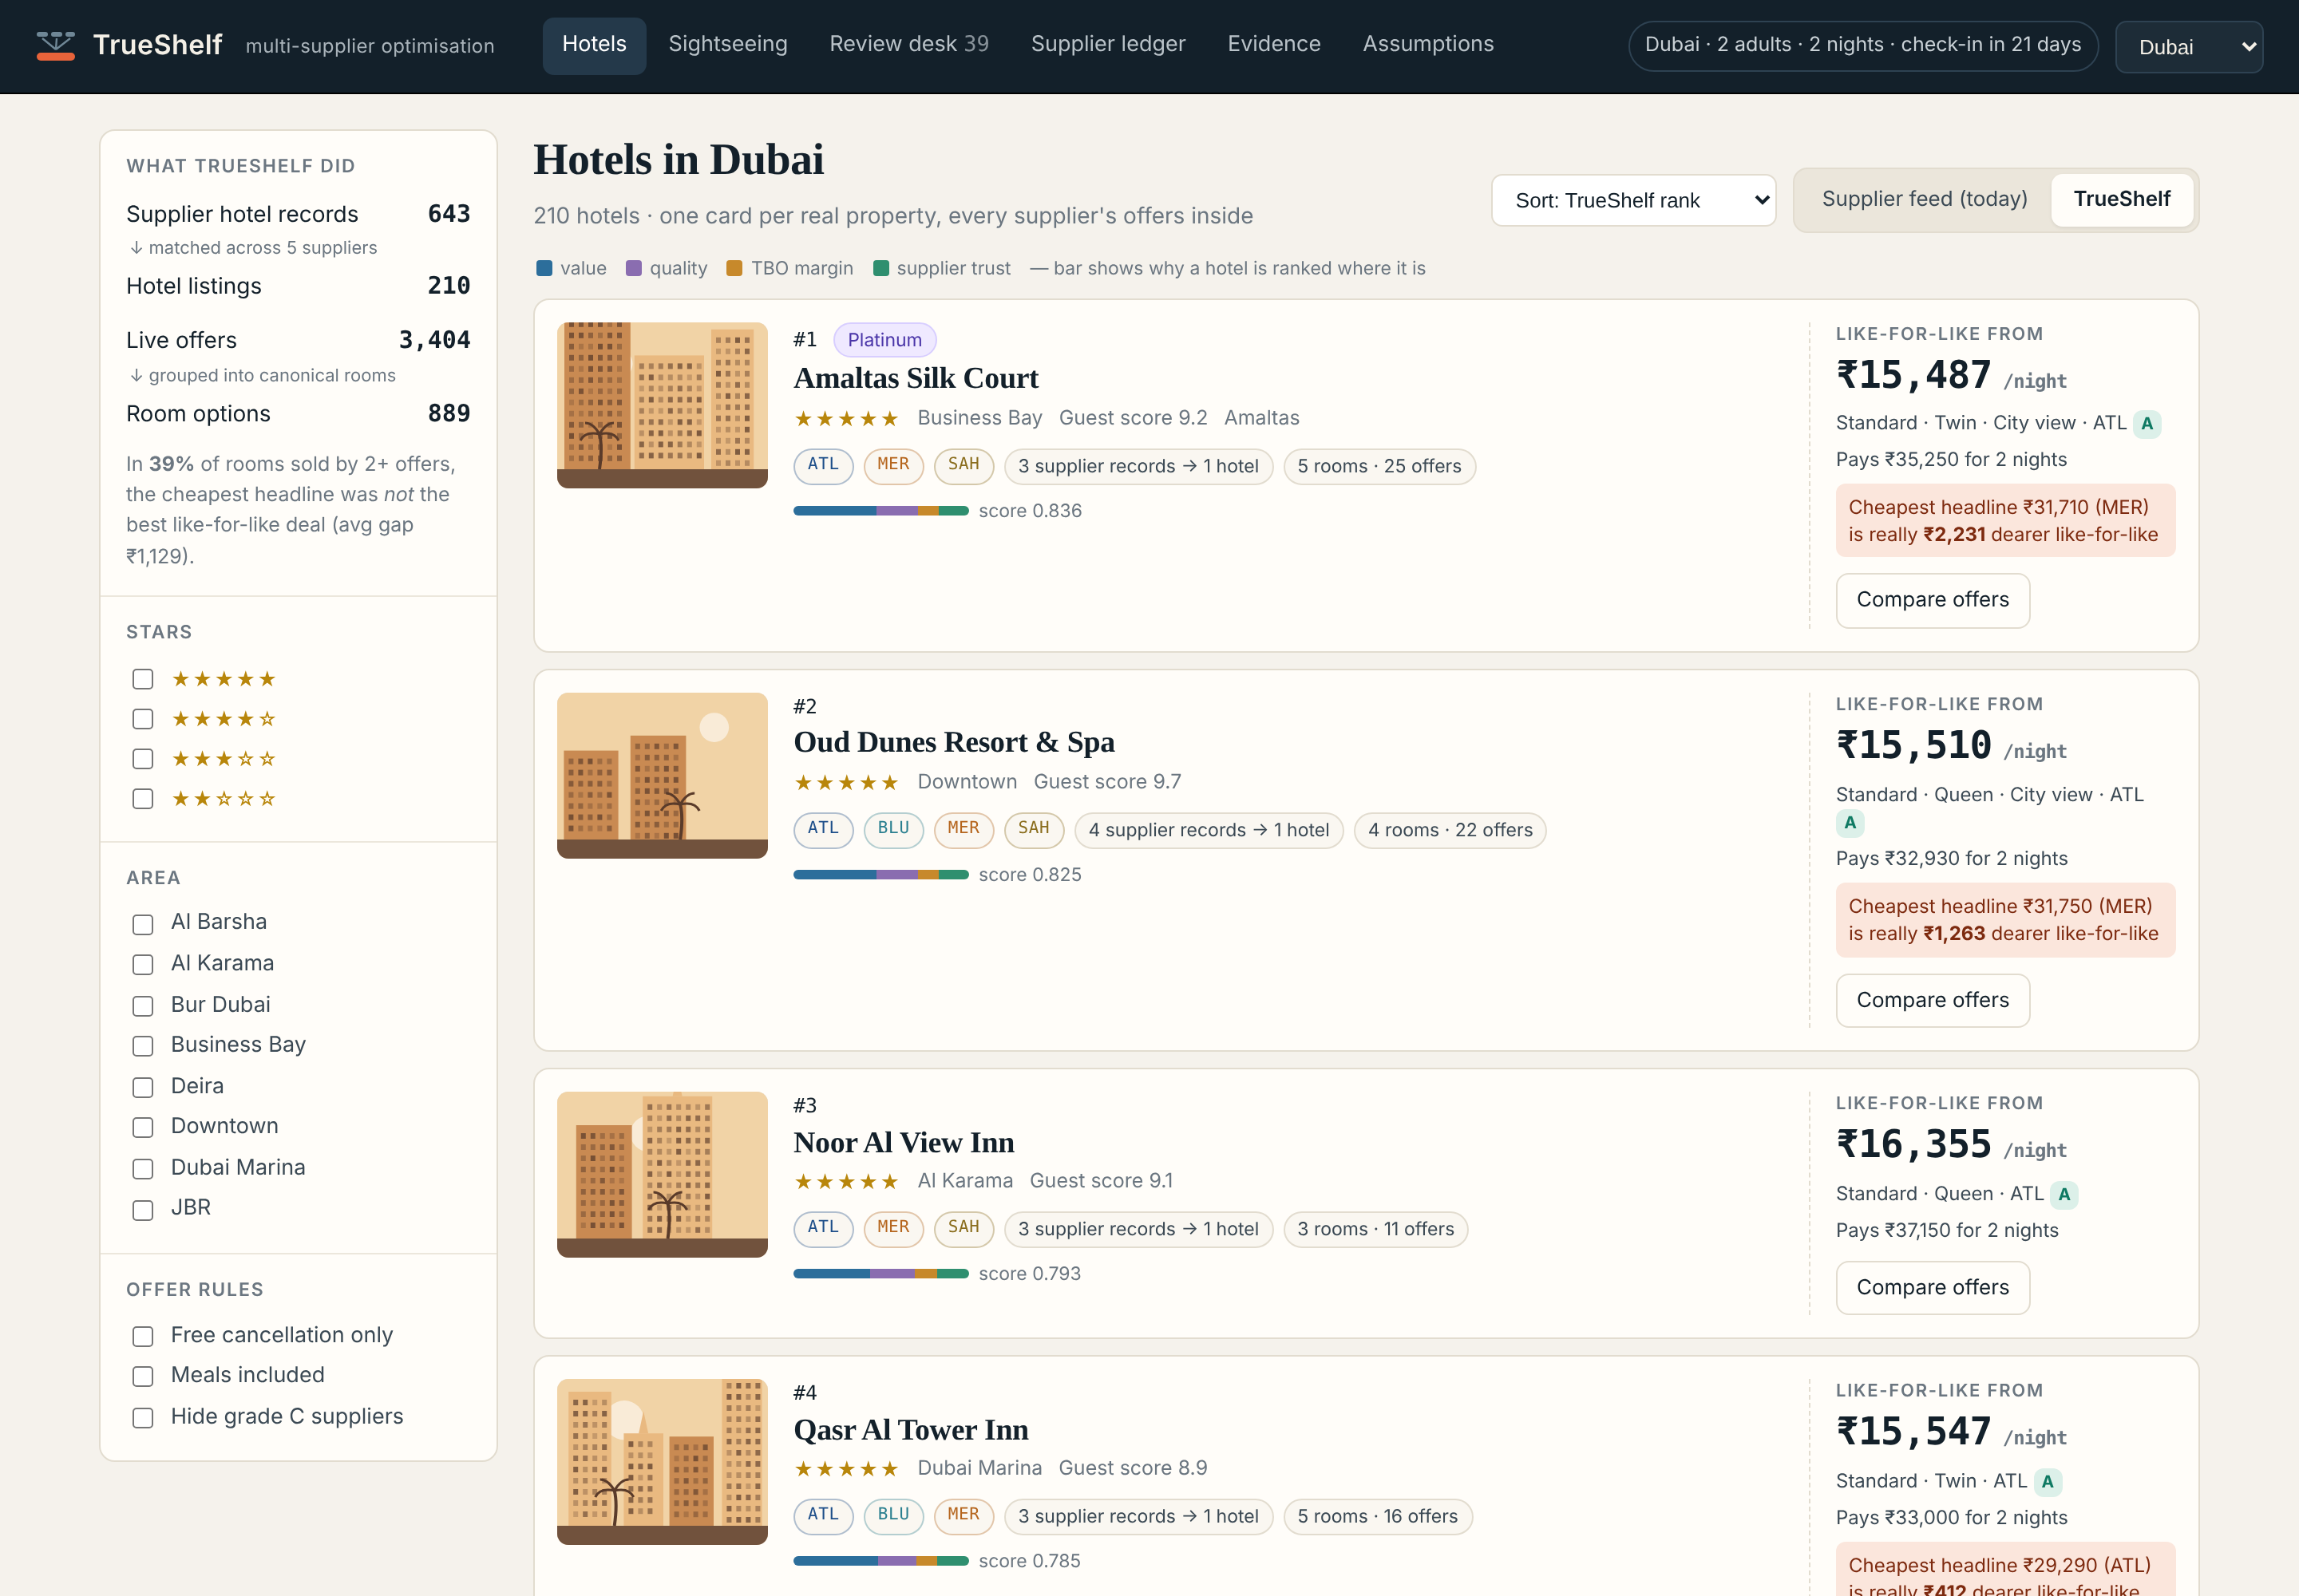
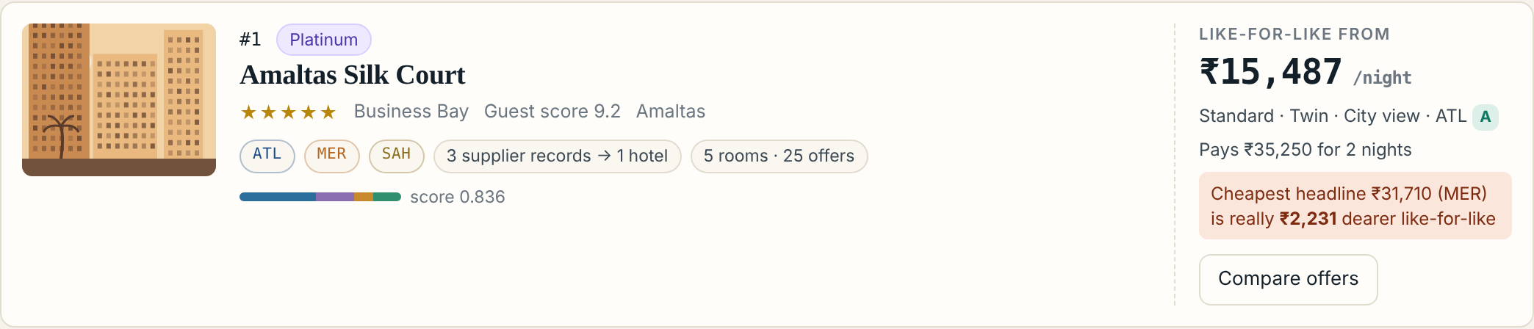

TBO VOYAGEHACK 4.0 · IDEA SUBMISSION
TrueShelf
Every supplier's version of the same hotel, room or experience: on one shelf, at its true price.
Track: Multi-Supplier Optimization (Hotels + Sightseeing)
Team vortexxx
Raktim Chandra (lead) · Nipun Dewangan · Pronov Mazumdar
SRM Institute of Science and Technology, Chennai
One card per real hotel. Every supplier's offers inside. Like-for-like price up front.
Scan: live prototype, 5-min walkthrough, all 36 tests, and our evaluation re-run in your own browser.

Slide 2
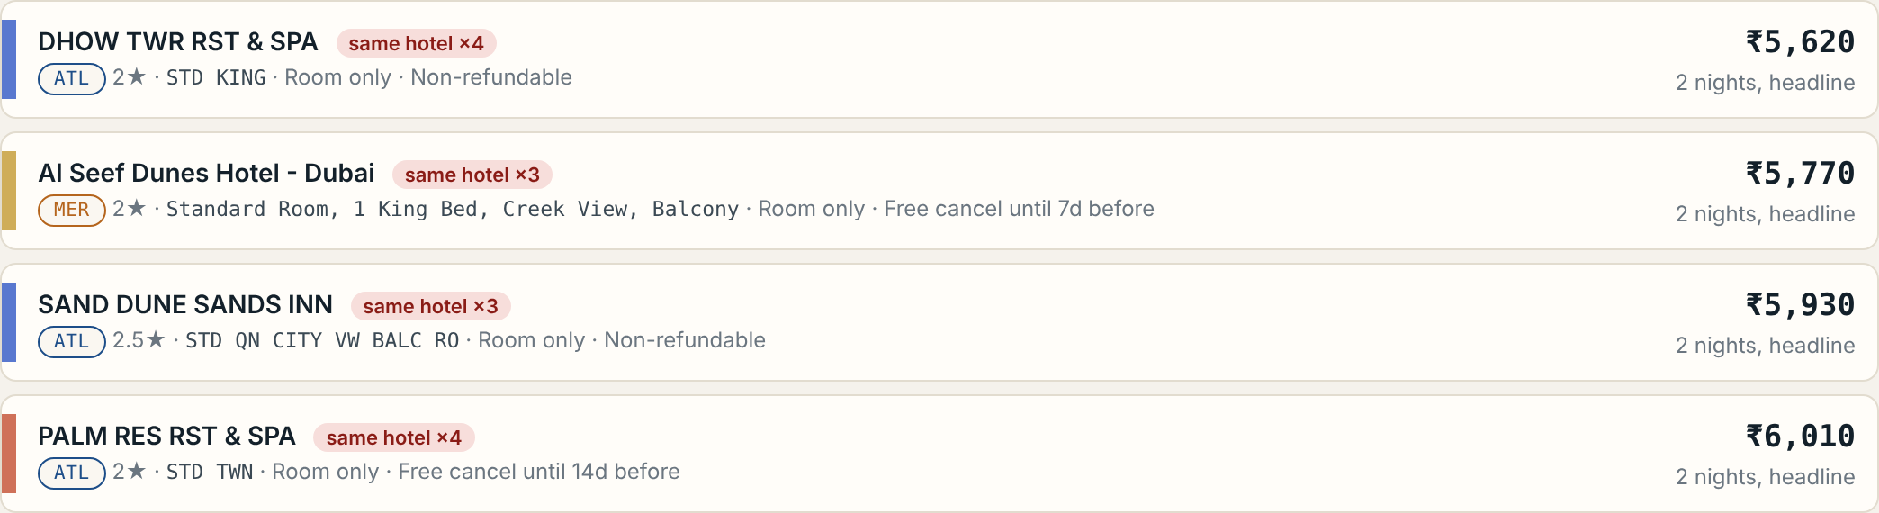
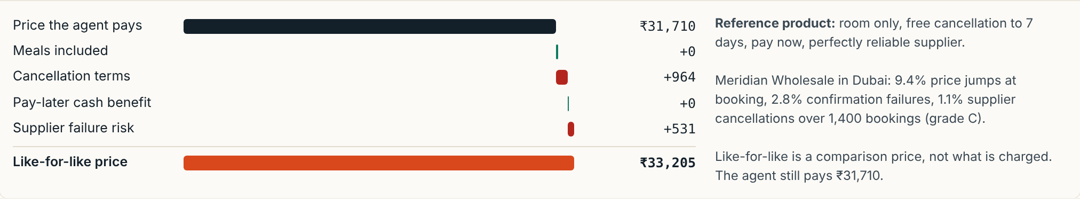
The cheapest headline is often not the cheapest deal
TBO buys the same hotel, room and ticket from many suppliers. Each names, prices and packages it differently, and agents pay for the confusion.
1 · PROBLEM TODAY
2 · TRUESHELF: FOUR LAYERS
3 · INNOVATION
1
Same place?
Cleans names (Qasr/Kasr, HTL/Hotel), blocks by geo + rare words, scores 23 signals with a calibrated model. Sister properties 150 m apart stay separate.
Today's feed: the same hotel up to 5×, sorted by a price that hides breakfast, cancellation terms and supplier risk.
2
Same product?
Room grammar reads class, bed, view; strips “Breakfast Included” leaked into names. Sightseeing split into atoms: access, transfer, meal, guide, cancellation.
87%
of TBO gross profit comes from hotels + ancillaries (Q2 FY26). Listing quality is a profit lever.
Offer-level, not just hotel-level. Hotel mapping can be bought. Comparing offers like-for-like, from TBO's own booking outcomes, cannot.
A price with receipts. Agents still pay the real price; L4L only reorders choices and explains why, in rupees.
Fails safe. Unreadable room names are never merged; a wrong merge sells the wrong bed.
No chatbot. Rules where rules work, small calibrated models where they don't. Cheap to run, easy to audit.
3
Like-for-Like Price
Turns meals, cancellation terms, pay-later and supplier failure risk into rupees. Every rupee shown, every assumption editable.
2.9×
supplier records per real hotel in our test world: 1,657 records collapse into 574 hotels.
25–65%
of rooms sold by 2+ offers, where the cheapest headline loses like-for-like (avg ₹1.1–1.4k).
4
ShelfRank
Orders hotels by deal value, quality, expected TBO margin and supplier trust. No clone-stacking; Platinum lift capped and visible.
Synthetic data, held-out evaluation; see slide 3.
Plus: a Review Desk (people see only the 0.04% of uncertain pairs, ordered by booking value at risk) and a Supplier Reliability Ledger (Bayesian failure rates per supplier × city).
Notes:
Problem, solution and innovation. Numbers are from the working prototype on synthetic data with leave-one-city-out evaluation.

Slide 3
Measured, explainable, and safe to switch on
Every number below comes from the running prototype. Hotel matching is held-out: each city is scored by a model trained only on the other two.
POTENTIAL IMPACT
IMPLEMENTATION & TECHNICAL FEASIBILITY
ADOPTION RISK & HOW WE DE-RISK IT
0.996 vs 0.795
Supplier feeds
→
Clean
→
Block
→
Score
A wrong merge sells the wrong room
Merge only at p ≥ 0.90; 0.30–0.90 goes to a person. Unreadable names never merge.
Hotel matching F1, held-out, no human, vs the usual “similar name + within 300 m” rule (precision 99.86%).
Cluster
→
Rooms
→
L4L
→
Rank
0.996 vs 0.21
Agents distrust a “made-up” price
 | Records | F1 | Rule F1
Dubai | 651 | 0.999 | 0.806
Bangkok | 605 | 0.993 | 0.755
Paris | 401 | 0.996 | 0.824
They still see and pay the real price. L4L is a labelled comparison with every rupee itemised.
Room mapping F1 vs fuzzy room-name matching; sightseeing product matching F1 0.996.
Commercial deals bend ranking
Agents: one card per hotel instead of up to five; the real best deal is visible in seconds.
TBO margin: ranking weighs expected gross profit and booking success, not headline price alone.
Fewer failed bookings: supplier risk is priced in before the agent books.
Supply team: per-supplier data-quality report (e.g. 30% of one feed's room names carry rate-plan words).
Platinum lift is a setting, capped at 3 places and shown on the card.
Offline: mapping re-runs per city when a feed changes (blocking never crosses cities, so it shards by destination).
Online: at search time it is a table join plus arithmetic. Booking still uses the supplier's own codes.
Built: Python, scikit-learn, RapidFuzz, FastAPI, plain-JS UI; 36 tests, including a check that browser and engine agree to the rupee. Full pipeline in 15 s on one CPU.
Assumptions may be wrong
All are versioned config with live what-if sliders, then replaced by values from TBO's booking data.
Synthetic data ≠ real feeds
Round 2: shadow-mode pilot on one city's real feed, then A/B on conversion.
Notes:
Impact, feasibility and adoption risk. Rollout path: shadow mode, then an A/B test in one city, then expand.

Slide 4
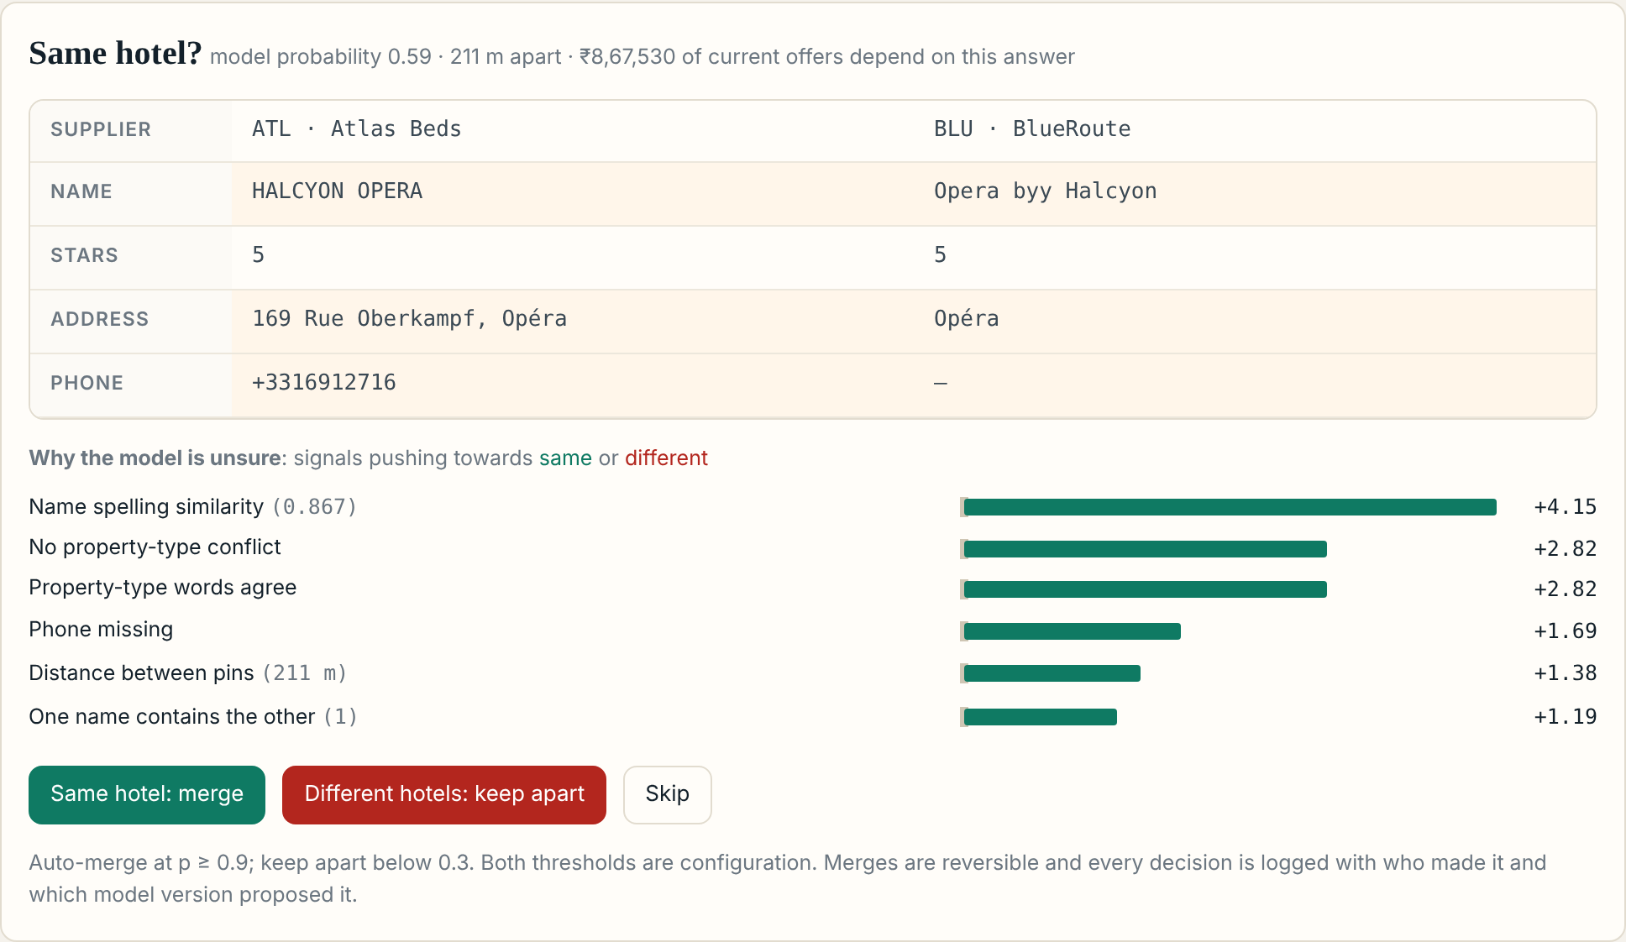
Thank you
One hotel, one card, the true price, with the evidence attached.
Already built for Round 2
Six-screen working prototype: hotel shelves, sightseeing, review desk, supplier ledger, evidence, live assumptions
REST API: search, match, like-for-like, review decisions
Held-out evaluation, an unseen-supplier stress test and 36 automated tests
A proof page that re-runs our evaluation in the judge's own browser
Review desk: a person sees only the pairs the model is unsure about, with the reasons.
Don't trust the slides. Run them.
Scan to open the proof page. It re-runs our Paris held-out evaluation inside your browser: no server, nothing precomputed. Plus the live prototype, the video and all 36 tests.
Team vortexxx · Raktim Chandra · raktimchandra26@gmail.com · +91 98322 88101

