Slide 1

WEB DEVELOPMENT
CSS Animations
and Keyframes
Nothing on a good webpage teleports. Everything moves.
By the end of today you will have built a spinner, a moving box, and a bouncing ball.

Slide 2


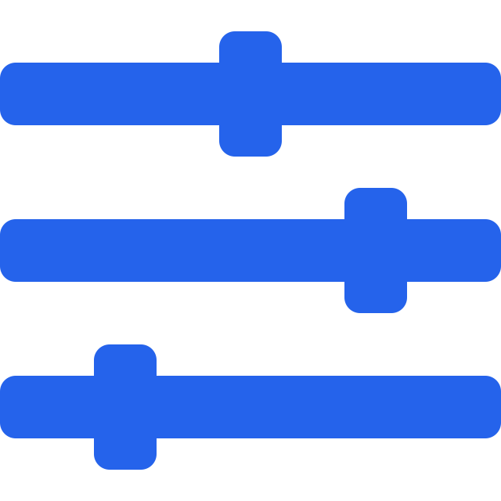

AGENDA
What we cover today
1
2
3
4
CSS Animations
Keyframes
Animation properties
Building real things
What they are, and why a ball rolls instead of teleporting.
from and to, then percentage stages for multi-step motion.
duration, delay, iteration, direction, timing, fill-mode, play-state.
A loader, a moving box, and a bouncing ball.
Slides can only show frames. Everything here is worth running live so the room sees it actually move.
1

Slide 3
01
SECTION 1
CSS Animations
Moving smoothly from one style to another.

Slide 4
CONCEPT
What is a CSS animation?
Moving or changing an element smoothly from one style to another.
THINK OF IT AS
A ball rolling across a room
A button changing colour slowly
A box moving from left to right
A loader rotating continuously
An element appearing and disappearing
An image bouncing on the screen
It does not jump to the far wall. It passes through every point in between, and that is exactly what an animation does.
2

Slide 5
LIVE CODE - SWITCH TO VS CODE
Your first animation
index.html
SAY THIS WHILE YOU TYPE
.box {
width: 100px;
height: 100px;
background-color: red;
animation-name: moveBox;
animation-duration: 2s;
}
@keyframes moveBox {
from { transform: translateX(0); }
to { transform: translateX(300px); }
}
Two pieces: the element, and the keyframes block.
animation-name links the box to the animation by name.
animation-duration says how long the trip takes.
The keyframes describe the start and the end.
Save and refresh. The box slides 300px to the right.
CSS Animations and Keyframes
3

Slide 6
OUTPUT
What two seconds looks like
A slide can only show frames. In the browser these blend into one continuous slide across the screen.
index.html
translateX(0) to translateX(300px)
0s
0.5s
1s
1.5s
2s
animation-name picks the animation. animation-duration decides how long it takes. Those two alone are enough to move something.
4

Slide 7
QUIZ 1
What are CSS animations primarily used for?
To smoothly change styles over time
To only change font sizes
A
B
To create HTML elements
To connect CSS with JavaScript
C
D
Hands up for A, B, C, D. Then ask someone to name an animation they have seen on a site this week.
CSS Animations and Keyframes
5

Slide 8

02
SECTION 2
Keyframes
The stages of the journey, not just the destination.

Slide 9
CONCEPT
@keyframes: from and to
styles.css
red to blue over 3 seconds
@keyframes changeColor {
from { background-color: red; }
to { background-color: blue; }
}
from
to
.box {
animation-name: changeColor;
animation-duration: 3s;
}
from is the starting point of the animation
to is the ending point
the browser fills in every frame in between
6

Slide 10
DRY RUN
Percentage keyframes: more than two stops
from and to give you a start and an end. Percentages let you script everything in between.
three stages
five stages
0%
50%
100%
0%
25%
50%
75%
100%
0% is the start, 100% is the end
@keyframes colorChange {
0% { background-color: red; }
50% { background-color: yellow; }
100% { background-color: green; }
}
Anything in between is a stop you get to design. Add as many as the animation needs: 25, 40, 60, 80. This is what makes complex motion possible.
7

Slide 11
QUIZ 2
What does @keyframes define in CSS?
Different stages of an animation
The size of an HTML element
A
B
The structure of a webpage
The position of a JavaScript function
C
D
Chorus answer on three. Then ask: how many stages did our five-colour example have?
CSS Animations and Keyframes
8

Slide 12

ANIMATIONS AND KEYFRAMES COVERED
5 minute break
Stand up. Water. Rest your eyes. We resume on the dot.
Next up: the properties that control them

Slide 13

03
SECTION 3
Animation properties
Eight dials that shape how the motion feels.

Slide 14
OVERVIEW
The eight properties
animation-name
animation-duration
which @keyframes block to use
how long one run takes
animation-delay
animation-iteration-count
how long to wait before starting
how many times it runs
animation-direction
animation-timing-function
forwards, backwards, or alternating
the speed pattern of the motion
animation-fill-mode
animation-play-state
what styles remain after it ends
running or paused
9

Slide 15
DRY RUN
duration, delay and iteration-count
animation-delay: 2s animation-duration: 3s
waiting (2s)
animating (3s)
done
0s
2s
5s
1000ms = 1 second, so 500ms is half a second.
animation-iteration-count: 3
animation-iteration-count: infinite
run 1
run 2
run 3
run 1
run 2
run 3
...
runs three times, then stops
never stops, which is what a loader needs
10

Slide 16
DRY RUN
animation-direction
Which way the playhead travels through your keyframes, and what happens on the next run.
normal
reverse
alternate
alternate-reverse
run 1
run 1
run 1
run 1
S
E
E
S
S
E
E
S
run 2
run 2
run 2
run 2
S
E
E
S
E
S
S
E
start to end, every time
end to start, every time
forward, then backward
backward, then forward
S is the start of your keyframes, E is the end. alternate is what makes a bouncing ball look natural instead of snapping back.
11

Slide 17
DRY RUN
animation-timing-function
Same distance, same duration, different feel. The curve shows progress over time.
linear
ease
ease-in
ease-out
ease-in-out
progress
same speed throughout
slow, fast, slow (default)
starts slowly
ends slowly
slow at both ends
time
A steep part of the curve means the element is moving fast at that moment. A flat part means it is barely moving.
12

Slide 18
LIVE CODE - SWITCH TO VS CODE
Race five boxes to see the difference
styles.css
SAY THIS WHILE YOU TYPE
.box {
animation-name: moveBox;
animation-duration: 4s;
}
.linear { animation-timing-function: linear; }
.ease { animation-timing-function: ease; }
.ease-in { animation-timing-function: ease-in; }
.ease-out { animation-timing-function: ease-out; }
.ease-in-out { animation-timing-function: ease-in-out; }
@keyframes moveBox {
from { transform: translateX(0); }
to { transform: translateX(500px); }
}
Five boxes, same distance, same four seconds.
They all start and finish together. Only the middle differs.
Watch linear: it is the only one at a constant speed.
ease-in crawls off the line, ease-out coasts into the wall.
Ask the room which one feels most natural. Usually ease.
CSS Animations and Keyframes
13

Slide 19
QUIZ 3
Which property makes an animation repeat forever?
animation-repeat: infinite
animation-iteration-count: infinite
A
B
animation-duration: infinite
animation-loop: infinite
C
D
Vote first. Three of these four are not real CSS properties at all. Which three?
CSS Animations and Keyframes
14

Slide 20
SHORTCUT
The animation shorthand
the long way
the short way
.box {
animation-name: moveBox;
animation-duration: 3s;
animation-timing-function: ease-in-out;
animation-delay: 1s;
animation-iteration-count: infinite;
animation-direction: alternate;
}
.box {
animation:
moveBox 3s ease-in-out
1s infinite alternate;
}
moveBox
3s
ease-in-out
1s
infinite
alternate
name
duration
timing-function
delay
iteration-count
direction
the order matters: name, duration, timing-function, delay, iteration-count, direction
15

Slide 21
ALL EIGHT PROPERTIES COVERED
5 minute break
Stand up. Water. Rest your eyes. We resume on the dot.
Next up: building a loader and a moving box

Slide 22

04
SECTION 4
Building real things
A moving box, a spinner, and a bouncing ball.

Slide 23
DRY RUN
A box that travels in a square
styles.css
.box {
animation: moveBox 5s infinite;
}
@keyframes moveBox {
0% { transform: translate(0, 0); }
25% { transform: translate(300px, 0); }
50% { transform: translate(300px, 300px); }
75% { transform: translate(0, 300px); }
100% { transform: translate(0, 0); }
}
1
2
0% / 100%
25%
4
3
75%
50%
right, down, left, back up: one continuous loop
16

Slide 24
LIVE CODE - SWITCH TO VS CODE
Build a spinner from one div
styles.css
SAY THIS WHILE YOU TYPE
.loader {
width: 50px;
height: 50px;
border: 5px solid lightgray;
border-top: 5px solid blue;
border-radius: 50%;
animation: rotateLoader 1s linear infinite;
}
@keyframes rotateLoader {
from { transform: rotate(0deg); }
to { transform: rotate(360deg); }
}
Start with a square, then border-radius: 50% makes it a circle.
A grey border all round, and one blue edge on top.
That single blue edge is the only thing you can see spinning.
linear matters here: a spinner must not speed up or slow down.
infinite keeps it going until the page is ready.
CSS Animations and Keyframes
17

Slide 25
OUTPUT
One rotation, frame by frame
Only the top border is coloured, so a full 360 degree turn reads as a spinning arc.
0deg
90deg
180deg
270deg
360deg
from
to
0deg and 360deg look identical, which is exactly why the loop is seamless. There is no visible jump when it restarts.
18

Slide 26


COMPARISON
Transitions vs animations
CSS Transition
CSS Animation
button { transition: background-color 1s; }
button:hover { background-color: red; }
.box { animation: moveBox 3s infinite; }
usually needs a state change
can start on its own
one start state, one end state
as many stages as you like
uses transition properties
uses @keyframes
good for simple effects
good for complex effects
19

Slide 27
QUIZ 4
Which CSS feature lets us create multiple stages of movement?
CSS Borders
CSS Transitions
A
B
CSS Keyframes
CSS Display
C
D
Rows of four, one scribe. Agree on an answer, and be ready to say why the runner-up is wrong.
CSS Animations and Keyframes
20

Slide 28
TWO FINISHING TOUCHES
fill-mode and play-state
animation-fill-mode: forwards
animation-play-state
By default an element snaps back to its original styles when the animation ends. forwards tells it to keep the final frame.
Pause an animation and resume it, without removing it.
without forwards
.box {
animation: moveBox 3s infinite alternate;
}
.box:hover {
animation-play-state: paused;
}
snaps home
with forwards
stays put
running
paused
the box holds its final position
hover to pause, move away to resume
21

Slide 29

CLASS ACTIVITY
Rows of four, one scribe
Your turn: build a bouncing ball
Time: 8 min
PROMPT Make a circle bounce up and down, forever, with a natural ease at each end.
1
Start from a 100px square with border-radius: 50% and a tomato background
2
Write a keyframes block called bounce using translateY
3
Duration 1s, iteration-count infinite, direction alternate, timing ease-in-out
4
Rows of four: compare whose ball looks most natural and why
CSS Animations and Keyframes
22

Slide 30
WALKTHROUGH
Bouncing ball: the solution
styles.css
translateY(0)
.ball {
width: 100px;
height: 100px;
background-color: tomato;
border-radius: 50%;
animation: bounce 1s ease-in-out
infinite alternate;
}
@keyframes bounce {
from { transform: translateY(0); }
to { transform: translateY(300px); }
}
translateY(300px)
alternate sends it back up, ease-in-out softens both ends
23

Slide 31
QUIZ 5
Which animation property controls whether the animation runs forward, backward, or alternates?
animation-duration
animation-direction
A
B
animation-delay
animation-fill-mode
C
D
Last vote of the day. Then ask which value we used to make the ball come back down.
CSS Animations and Keyframes
24

Slide 32





RECAP
The whole picture
@keyframes
duration and delay
from and to, or percentages for multiple stages
how long it runs, and how long it waits first
iteration-count
direction
a number, or infinite for loaders
normal, reverse, alternate, alternate-reverse
timing-function
shorthand
linear, ease, ease-in, ease-out, ease-in-out
name duration timing delay count direction
25

Slide 33

Questions and doubts
Practice: add a loader to your portfolio, and animate one section as it appears.
Rule of thumb animation should guide the eye, not fight it
26

