Slide 1

CLASS 6 - WEB DEVELOPMENT
Responsive Layout
and CSS Grid
Flexbox gave us a line. Grid gives us rows and columns at the same time.
Two dimensions, one property set. This is how real page layouts get built.

Slide 2
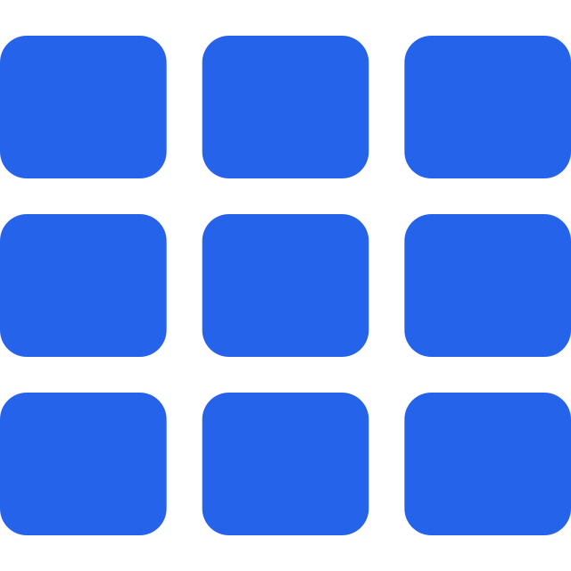
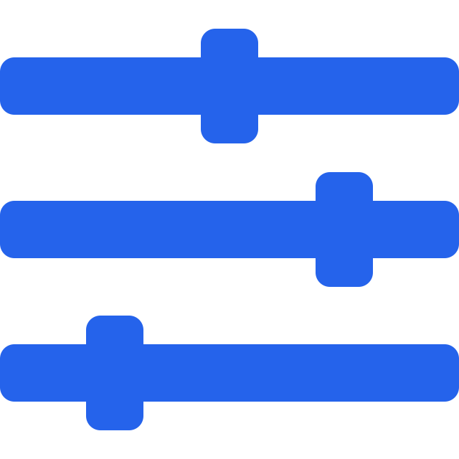

AGENDA
What we cover today
1
2
3
What is a Grid layout
Grid properties
Flexbox vs Grid
The two-dimensional layout model, and when reaching for it beats Flexbox.
Template columns and rows, fr units, gaps, repeat, spans, and named areas.
One dimension against two, and how to pick the right one for the job.
Keep practising Flexbox at flexboxfroggy.com. Grid builds directly on what you learned last class.
1

Slide 3
01
SECTION 1
What is Grid
Rows and columns together, not one after the other.

Slide 4
CONCEPT
You already know what a grid is
FLEXBOX - one dimension
GRID - two dimensions
Think of the squared notebooks from school. Rows across, columns down, every cell the same size.
1
2
3
1
2
3
4
CSS Grid is a layout model that builds exactly that structure on a page. You define the rows and the columns, and elements drop into the cells.
4
5
6
a line of items
rows and columns at once
Flexbox lays items along one axis and lets the other fall where it may. Grid controls both at the same time, which is why it handles page-level layout so much better.
Reach for Grid when the layout is complex enough that a single line will not describe it.
2

Slide 5
SETUP
Our nine-item playground
index.html
index.html
* { padding: 0; margin: 0; }
.container {
width: 1200px;
margin: 100px auto;
padding: 10px;
display: grid;
}
.item {
background-color: dodgerblue;
color: white;
padding: 20px;
border: 1px solid lightblue;
}
<div class="container">
<div class="item">Item 1</div>
... nine of these ...
</div>
Item 1
Item 2
Item 3
Item 4
Item 5
Item 6
Item 7
Item 8
Item 9
display: grid on its own stacks them. Nothing looks different yet.
3

Slide 6
LIVE CODE - SWITCH TO VS CODE
Turn the container into a grid
styles.css
SAY THIS WHILE YOU TYPE
.container {
width: 1200px;
margin: 100px auto;
padding: 10px;
display: grid; /* <-- grid container */
}
Ask the room first: what would display: flex do here?
Right, it would put all nine items in one row.
Now switch it to grid. Save. Nothing visibly changes.
Open inspect. See the grid badge next to the container?
That badge means every grid property is now available to us.
Responsive Layout and CSS Grid
4

Slide 7
DRY RUN
grid-template-columns
styles.css
THE PROBLEM
.container {
grid-template-columns: 100px 100px 100px;
border: 2px solid black;
}
1
2
3
900px of wasted space
4
5
6
Three tracks of 100px each. The nine items now flow into three columns and three rows.
7
8
9
But the container is 1200px wide. The items use 300px and the other 900px sits empty.
300px
container: 1200px
5

Slide 8
THE FIX
fr: the fraction unit
One fr means one share of whatever space is available. Add the fractions up, then split the width in that ratio.
grid-template-columns: 1fr 1fr 1fr
WORKED EXAMPLE
1fr
1fr
1fr
container = 120px
1fr 1fr 1fr
total = 1 + 1 + 1 = 3
equal thirds, and the full width is used
grid-template-columns: 1fr 2fr 1fr
each = 120 / 3
1fr = 300px
2fr = 600px
1fr = 300px
each = 40px
middle track takes a double share of the same 1200px
6

Slide 9
DRY RUN
Breathing room: the gap properties
column-gap: 20px
row-gap: 20px
gap: 20px
space between columns only
space between rows only
both at once, one property
.container { gap: 20px; }
7

Slide 10
LIVE CODE - SWITCH TO VS CODE
Rows, and the repeat shortcut
styles.css
SAY THIS WHILE YOU TYPE
.container {
display: grid;
grid-template-columns: 1fr 2fr 1fr;
grid-template-rows: 1fr 2fr 1fr;
gap: 20px;
}
/* same three equal columns, less typing */
.container {
grid-template-columns: repeat(3, 1fr);
}
Rows work exactly like columns, just vertically.
1fr 2fr 1fr makes the middle row twice as tall.
Now imagine twelve equal columns. That is a lot of typing.
repeat(3, 1fr) means: this track, three times.
Inspect the items and read out the computed sizes.
Responsive Layout and CSS Grid
8

Slide 11
MORE CONTROL
Implicit rows and alignment
grid-auto-rows: 200px
Flexbox properties still work
When content spills past the rows you defined, Grid creates rows automatically. This sets the height of those implicit rows so the layout stays even instead of growing with the content.
align-items, justify-content, align-self and the rest all apply to Grid too. Everything you learned last class carries over.
align-items: end
1
2
3
4
5
6
1
2
3
green rows were created implicitly, all 200px tall
items sit at the bottom of their cells
9

Slide 12
QUIZ 1
What property is used to define the size of columns and rows in a CSS Grid?
grid-gap
grid-size
A
B
grid-template
grid-column
C
D
Hands up for A, B, C, D. Ask one learner to say which of the four they have actually typed today.
Responsive Layout and CSS Grid
10

Slide 13

CONTAINER-LEVEL GRID DONE
5 minute break
Stand up. Water. Rest your eyes. We resume on the dot.
Next up: controlling individual items

Slide 14

02
SECTION 2
Item-level control
Target one cell, and let items span across tracks.

Slide 15
PSEUDO-SELECTOR
Target one item without a new class
styles.css
index.html
.item:nth-of-type(2) {
width: 100px;
height: 100px;
align-self: center;
justify-self: center;
}
1
3
2
4
5
6
7
8
9
align-self centres it vertically in its cell, justify-self centres it horizontally. Only item 2 is affected.
11

Slide 16
DRY RUN
Grid lines are numbered
The confusion with 1/3 goes away once you count the lines, not the cells. Three columns have four lines.
column lines
1
2
3
4
styles.css
1
.item:nth-of-type(1) {
grid-row: 1 / 3;
}
1
2
3
2
4
5
6
1
2
3
3
4
5
7
8
9
4
6
7
8
item 1 stretches from row line 1 to row line 3, so it covers two rows
12

Slide 17
SHORTHAND
span: the easier way to say it
grid-column: 1 / 3
grid-column: span 2
1
2
1
2
3
4
5
=
3
4
5
6
7
8
6
7
8
counting lines: start at 1, stop at 3
just say how many tracks to cover
Same result. span is easier to read and does not break when you add a column later.
13

Slide 18
QUIZ 2
Which CSS property creates a gap between columns and rows in a CSS Grid?
grid-gap
grid-space
A
B
grid-margin
grid-padding
C
D
Chorus answer on three. Then ask which two of these four are not real CSS properties at all.
Responsive Layout and CSS Grid
14

Slide 19
ITEM-LEVEL CONTROL DONE
5 minute break
Stand up. Water. Rest your eyes. We resume on the dot.
Next up: building a full page layout with grid areas

Slide 20

03
SECTION 3
Grid areas
Name the regions, then draw the layout as a map.

Slide 21
THE GOAL
The layout we are building
Top-down is the right approach. Name the regions first, then size them.
header
SEMANTIC TAGS FIRST
nav
main content
aside
sidebar 2
<header>
<nav>
<main>
<aside>
<div>
footer
<footer>
Each region gets a real tag, not a pile of divs.
15

Slide 22
LIVE CODE - SWITCH TO VS CODE
Draw the layout with grid-template-areas
styles.css
SAY THIS WHILE YOU TYPE
body {
height: 100vh;
display: grid;
grid-template-areas:
'top top top top'
'nav content sidebar sidebar2'
'nav footer footer footer';
}
header { grid-area: top; }
nav { grid-area: nav; }
main { grid-area: content; }
aside { grid-area: sidebar; }
div { grid-area: sidebar2; }
footer { grid-area: footer; }
Look at the strings. That is literally a picture of the page.
Each quoted line is one row, each word is one column.
Repeat a name and it stretches across those cells.
nav appears on two lines, so it spans two rows.
Then every element just claims its name with grid-area.
Responsive Layout and CSS Grid
16

Slide 23
DRY RUN
The string map is the layout
top
top
top
top
top
nav
content
sidebar
sidebar2
nav
content
sidebar
sidebar2
nav
footer
footer
footer
three quoted rows, four names each
footer
the final sizing pass
grid-template-columns: 1fr 4fr 1fr 1fr; grid-template-rows: 80px 1fr 70px;
17

Slide 24
QUIZ 3
Which CSS property places an item into a specific named cell of a CSS Grid?
grid-position
grid-row
A
B
grid-cell
grid-area
C
D
Rows of four, one scribe. Two of these are real properties. Decide which, and what the other one actually does.
Responsive Layout and CSS Grid
18

Slide 25

04
SECTION 4
Flexbox vs Grid
Not a rivalry. Two tools for two different shapes of problem.

Slide 26

COMPARISON
One dimension or two
Flexbox
Grid
One dimension. Content first.
Two dimensions. Layout first.
Lay items along a row or a column, not both
Best when the number or size of items is unknown
Navigation bars, headers, footers, toolbars
Centering one thing inside another
display: flex, flex-direction, justify-content, align-items, flex-wrap
Rows and columns controlled at the same time
Best when you already know the shape of the layout
Whole page layouts, dashboards, photo galleries
Named areas make complex structures readable
display: grid, grid-template-rows / columns, gap, grid-template-areas
19

Slide 27




RECAP
The whole picture
display: grid
grid-template-columns / rows
makes a two-dimensional grid container
define the tracks, in px or fr
fr and repeat()
gap
share out free space, and stop repeating yourself
row-gap, column-gap, or both in one property
grid-row / grid-column / span
grid-template-areas
let one item cover several tracks
name the regions and draw the layout as a map
20

Slide 28

Questions and doubts
Practice: rebuild today's page layout from memory using only grid-template-areas.
Try also cssgridgarden.com for practice
21

