Slide 1
CloudThat
Deloitte Experiential Learning

Slide 2

Task: Perform Uber Trip Cost Analytics
Week 2 – Case Study - 2
Project - Big Data Analytics and Visualization
Group-3 Members
Raktim
Vijay
Sanjeeva
Kavin
Ujjwal

Slide 3
Introduction
Uber is a technology company whose mission is to reimagine the way the world moves for the better. The technology at Uber helps to develop and maintain multisided platforms that match consumers looking for rides and independent providers of ride services, as well as with other forms of transportation, including public transit, bikes, and scooters.
Uber also connect consumers and restaurants, grocers, and other merchants so they can buy and sell meals, groceries, and other items, then these are matched with independent delivery service providers. Plus, Uber connects shippers and carriers in the freight industry.
The technology at Uber helps people connect and move in over 70 countries and 10,000 cities around the world.

Slide 4
Business Requirement
To capture, manage and store the real time data which is generated continuously since the company is providing the services to millions of people all over the world.
To design an efficient algorithm using machine learning model which will predict the fare to be charged for a passenger for the future transactional cases
The fare prices should be estimated accurately

Slide 5
Objectives
To capture, manage and store the real time data which is generated continuously since the company is providing the services to millions of people.
To Generate logs Continuously using the AWS Services.
To design an efficient algorithm using machine learning model which will predict the fare to be charged.
To visualize the Analyzed & Cleaned data to gain insights.

Slide 6
Dataset
Since the data is generated in real time, the columns of the data to be received are as follows:
Customer ID
Gender
Current Date – The date at which the ride is booked
Current Time – The time at which the ride is booked
Pickup Address – The address for pickup
Pickup Time – The time at which the pickup is expected
Drop Time – Expected drop time
Drop Location – The destination address
Cost – The fare for the trip

Slide 7
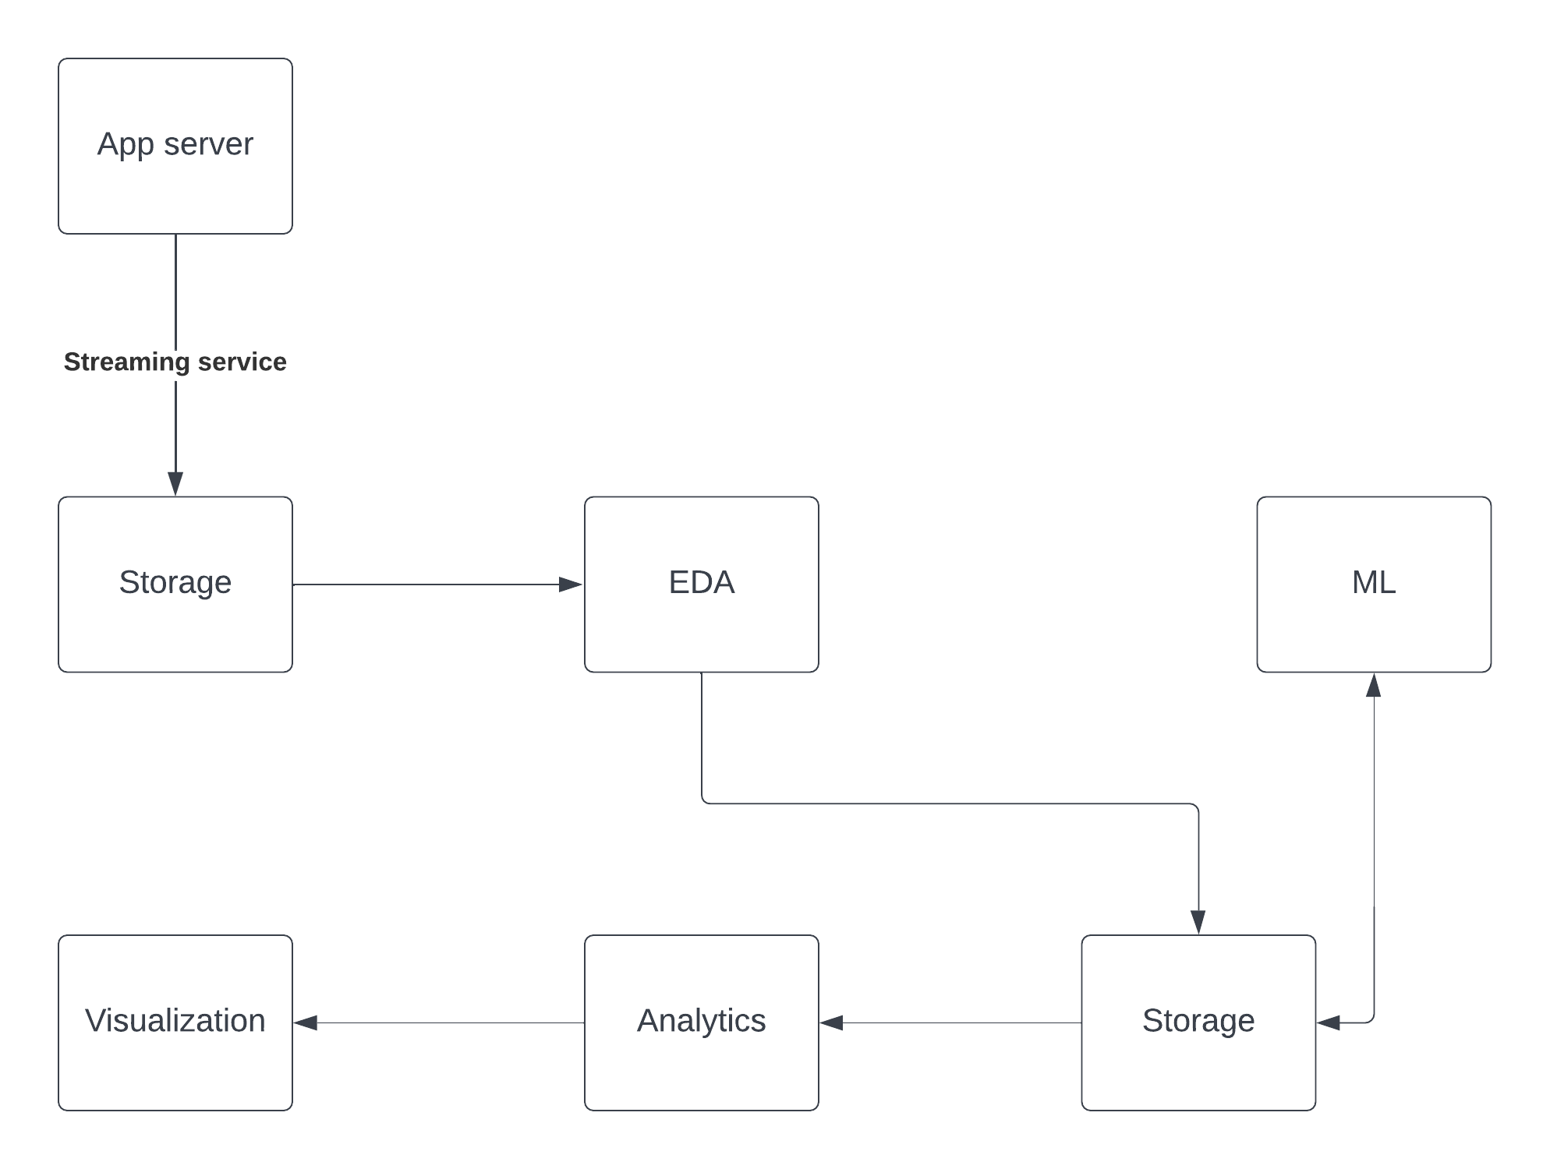
Block Diagram

Slide 8
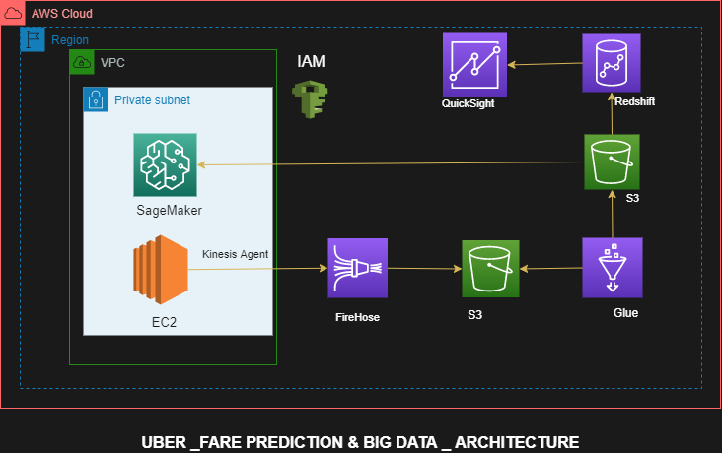
AWS Architecture

Slide 9
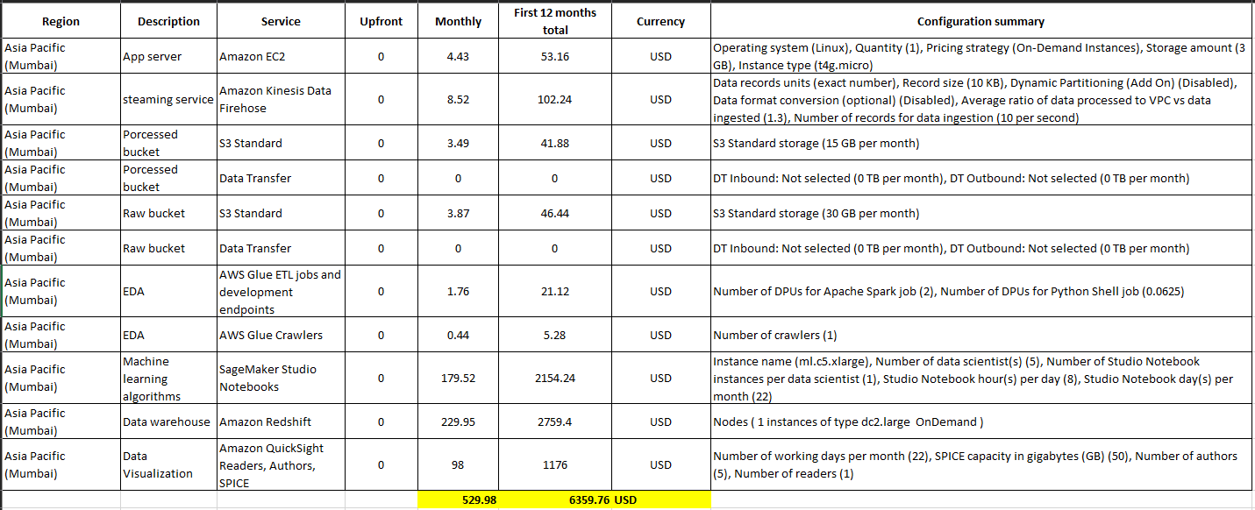
Cost Estimate
Price estimate link:
https://calculator.aws/#/estimate?id=208c1cfd99101089238738ae4f57655d94bf7f3d

Slide 10
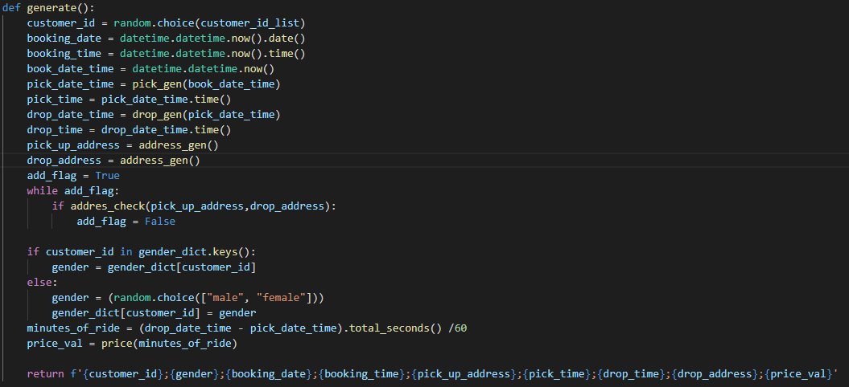
Code Snippet for log file generation

Slide 11
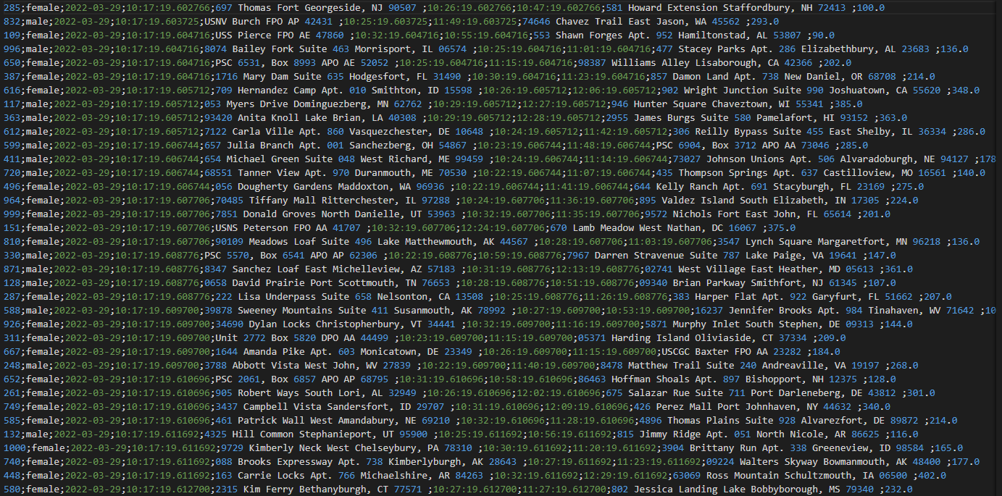
Log File (local)

Slide 12
Implementation flow
1. Move python script which is generating log files from S3 bucket to EC2 instance.
2. Install kinesis agent and then configure agent.json.
3. Attach necessary IAM roles with necessary permissions to EC2 (S3readOnly & FirehoseWriteOnly), Kinesis Firehose.
4. Execute python script on EC2 to generate log files continuously, simulating live data stream.
5. Generated log files transferred to S3 bucket from EC2 via Firehose with the help of kinesis agent.

Slide 13
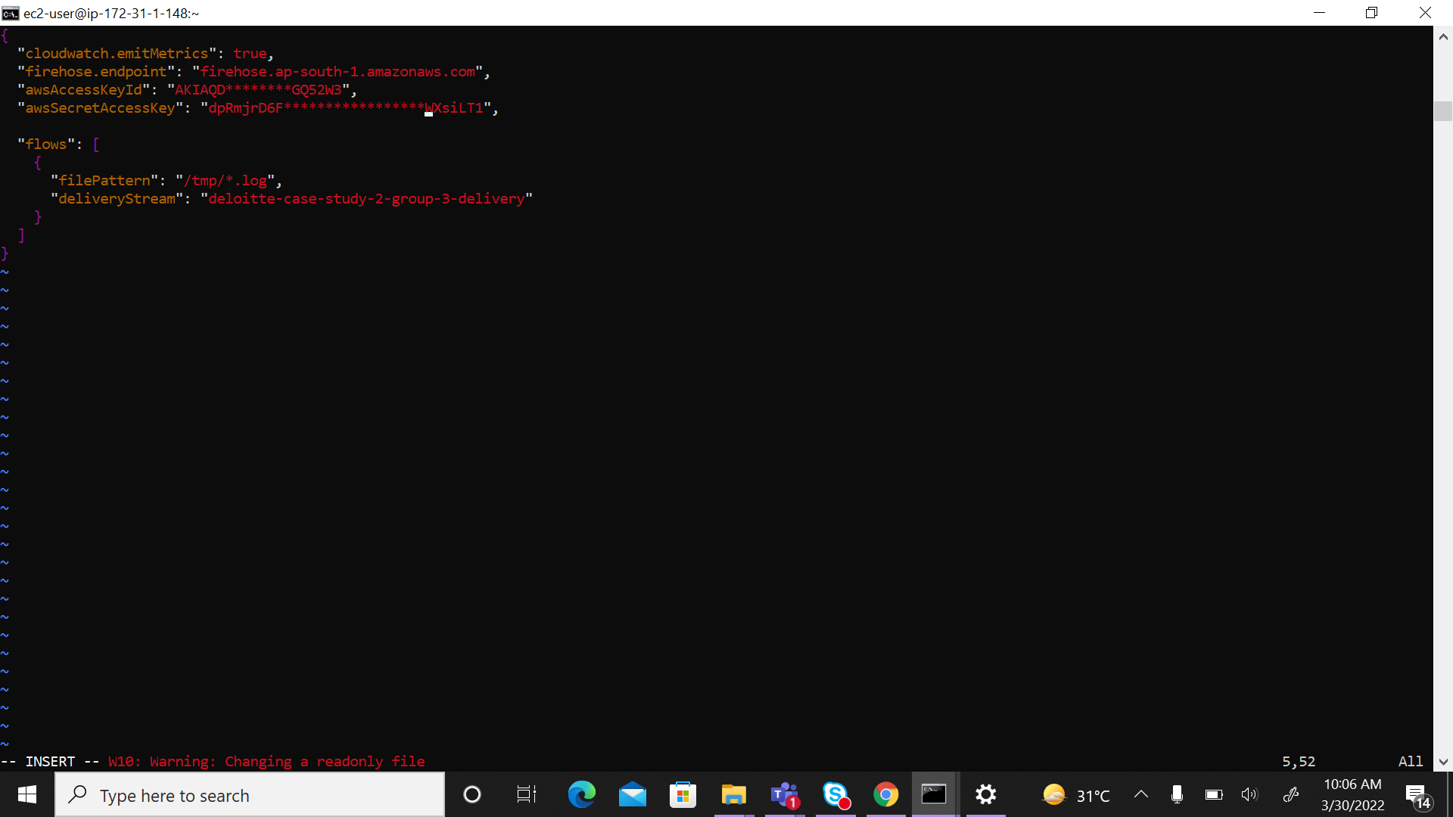
Agent.json

Slide 14
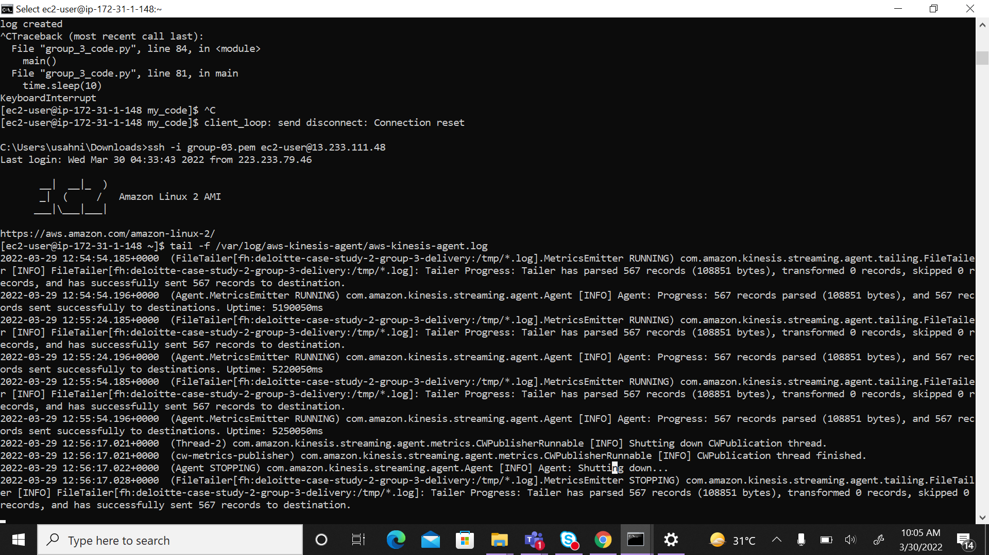
Agent logs

Slide 15
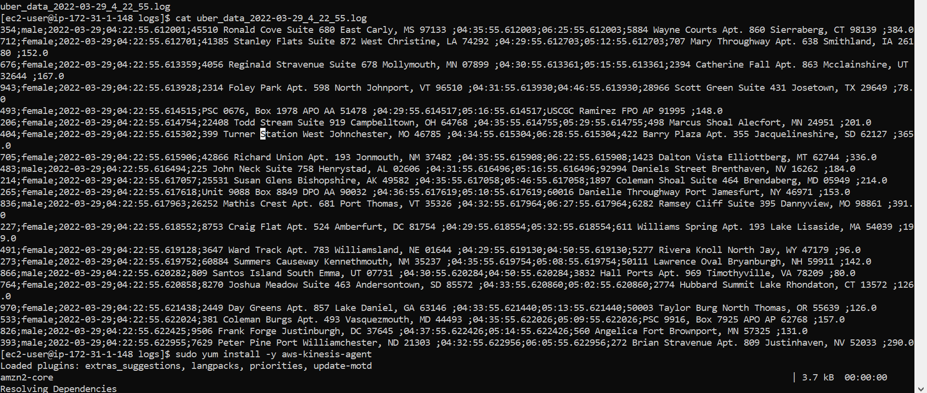
Log File (EC2)

Slide 16
Thank You !!

