Slide 1
CloudThat
Experiential Learning Approach for Deloitte

Slide 2

Domain: Banking & Financial Services Task: Perform Risk Analytics and Predict Credit Fraud
Week 1 – Case Study - 1
Project - Big Data Analytics and Visualization
Client - ABC bank

Slide 3
Introduction
ABC bank, a leading Banking firm based in the UK. Since past few years, we have seen a huge revenue growth year over year. In last couple of years, we have expanded to 12 countries in Europe, 7 in Asia, 1 in Latin America and 1 in Africa.

Slide 4
Problem Statement
Loan fraud increase with geographic expansion

Slide 5
Business requirements
>90% fraud detection even if some genuine customers are affected
Visualize Data

Slide 6
Dataset
1. 'previous_application.csv'
It contains information about the client’s previous loan data. It contains the data whether the previous application had been Approved, Cancelled, Refused or Unused offer.
2. 'application_data.csv'
It contains all the information of the client at the time of submitting the application.
3. 'columns_description.csv'
It is data dictionary which describes the meaning of the variables.

Slide 7
Possible important columns with justification

Slide 8
Business Objective
1. Predict probability of Fraud for an incoming loan application, 90% or more successful detection rate.
2. Minimize rejection of genuine customers.
3. Visualize the data

Slide 9
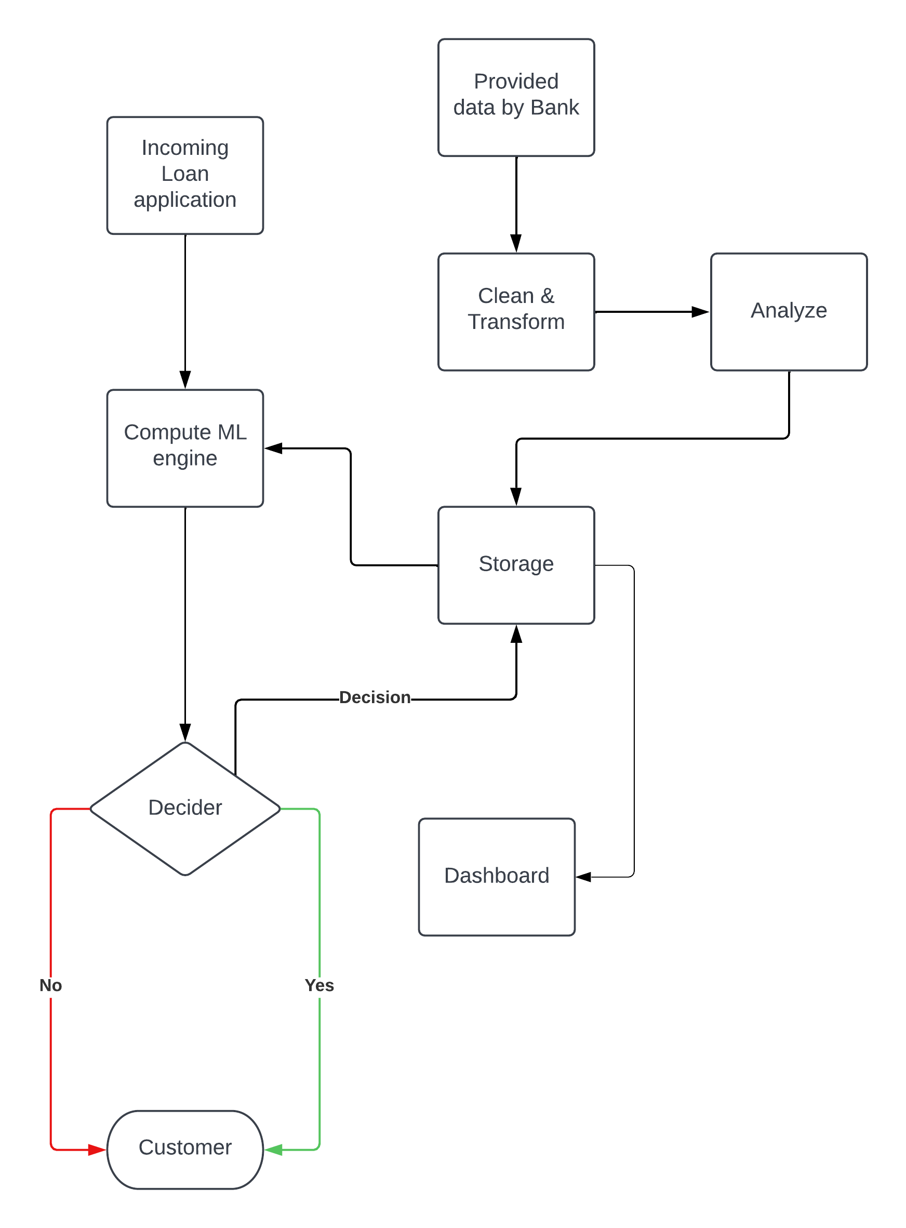
Solution Block Diagram

Slide 10
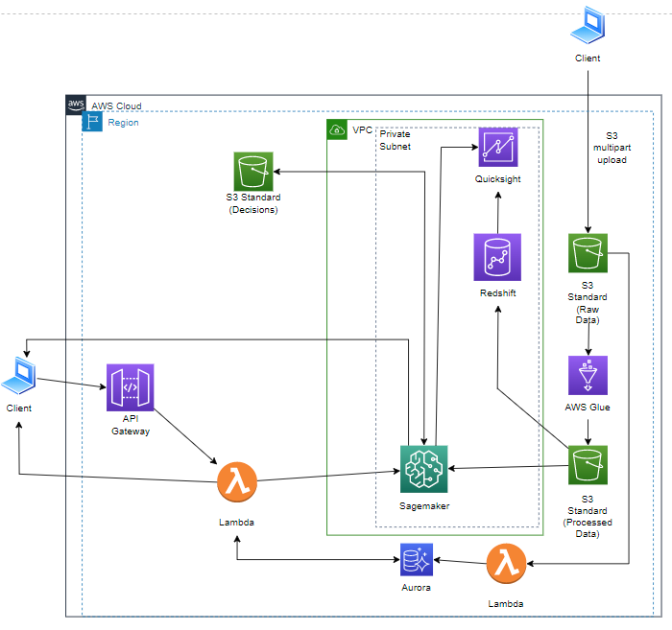
My AWS Architecture

Slide 11
Cost Estimate
https://calculator.aws/#/estimate?id=f123332f328ffdc9d5651b652a563a18b020d086

Slide 12
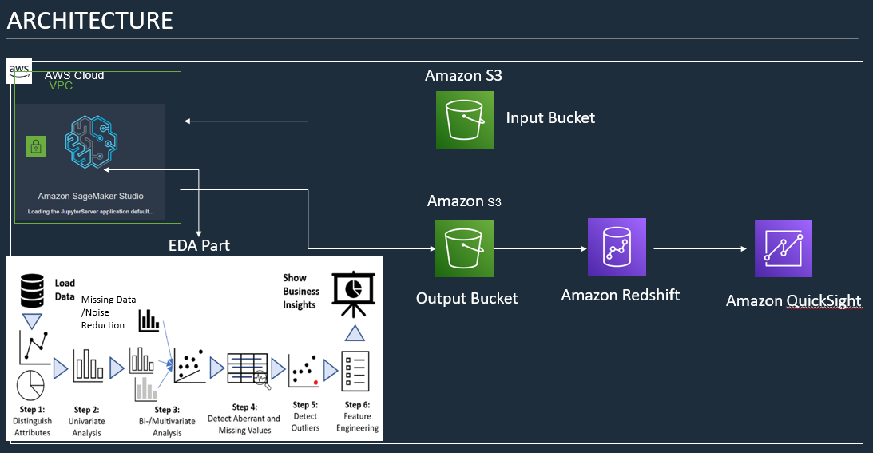
Suggested AWS architecture

Slide 13
Functional steps of program

Slide 14
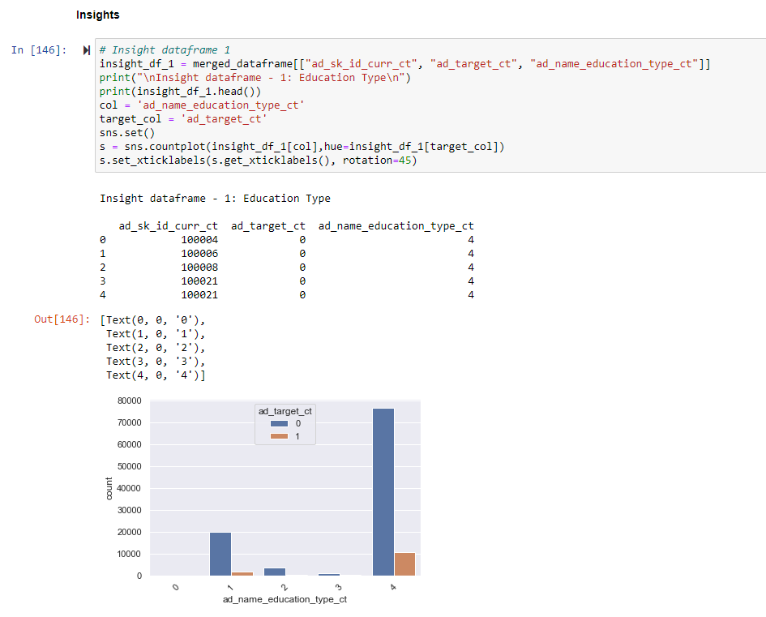
Insight tables

Slide 15
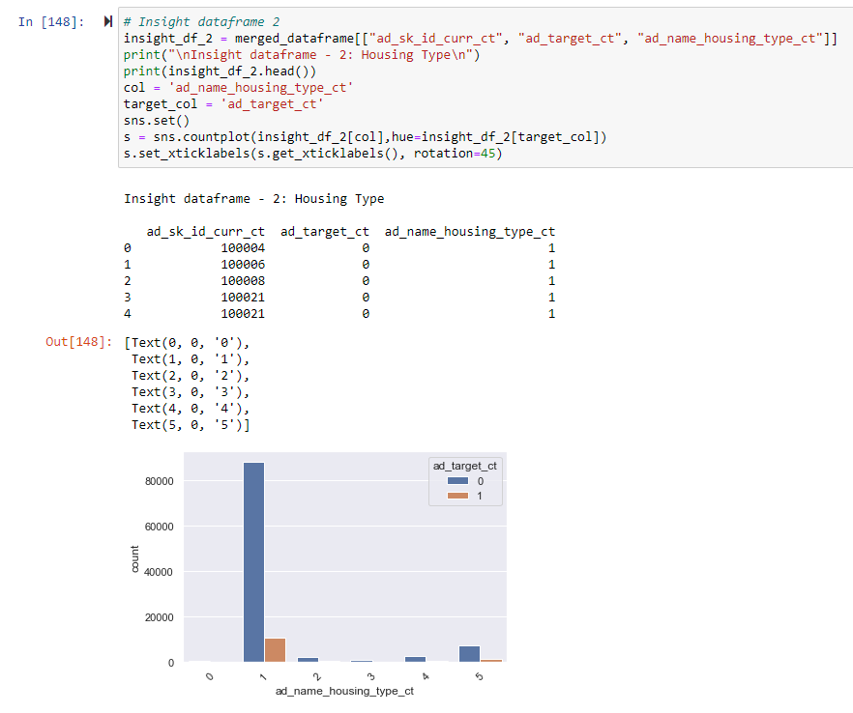
Insight continued

Slide 16
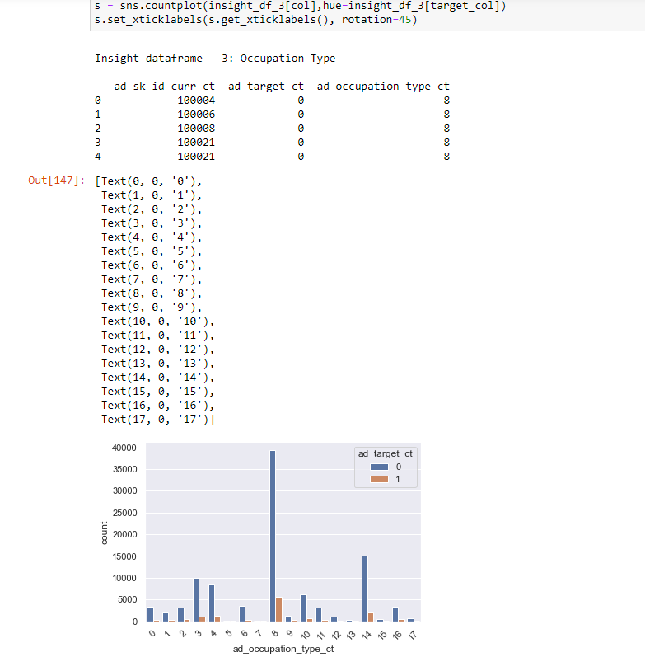
Insight final

Slide 17
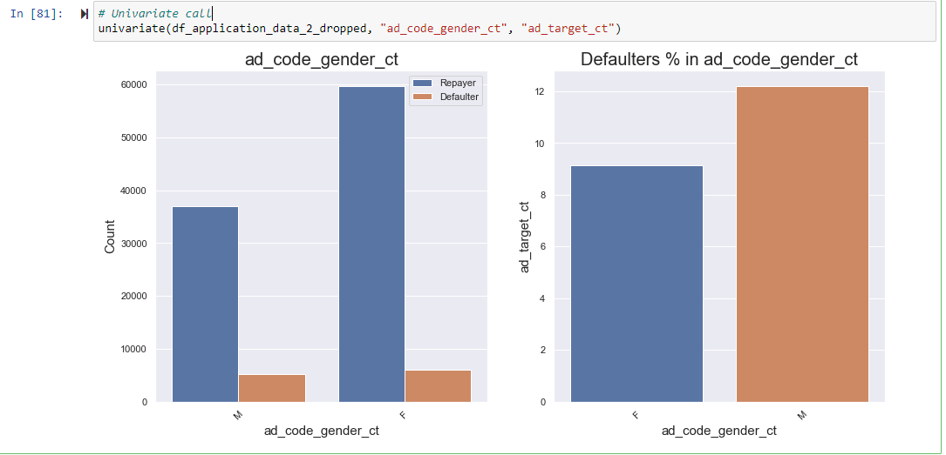
Univariate descriptive statistics

Slide 18
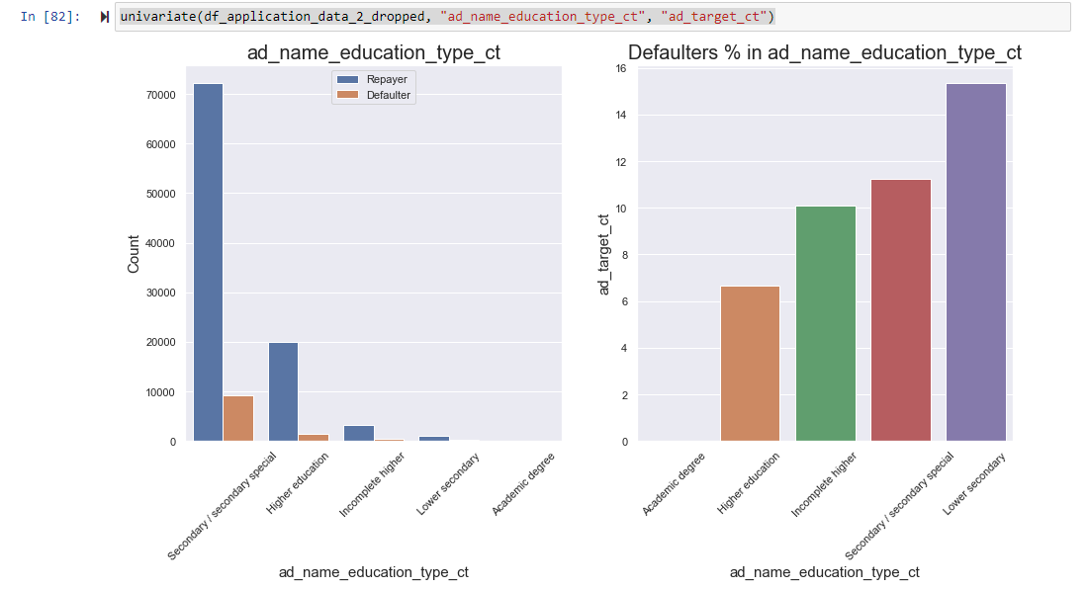
Univariate continued

Slide 19
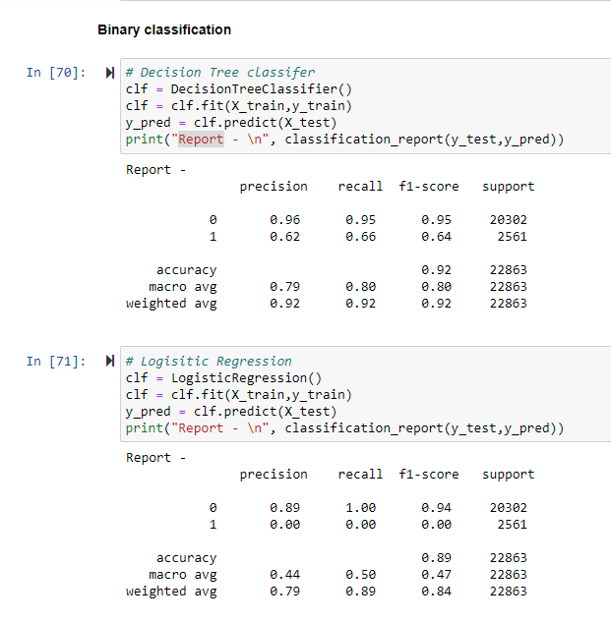
Machine learning accuracy

Slide 20
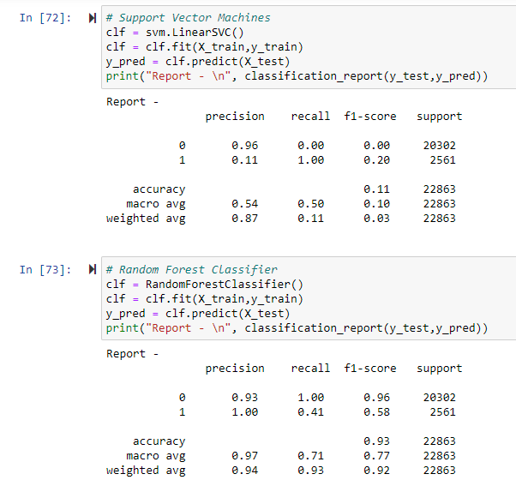
ML continued

Slide 21
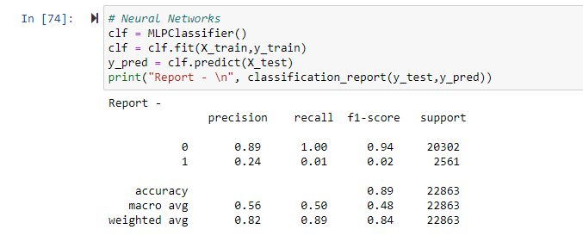
ML final

Slide 22
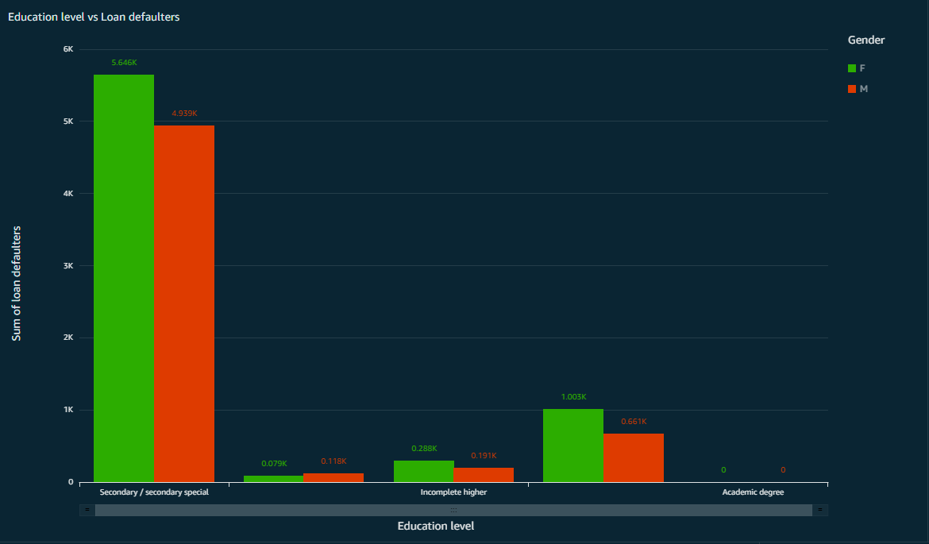
Quicksight visualization

Slide 23
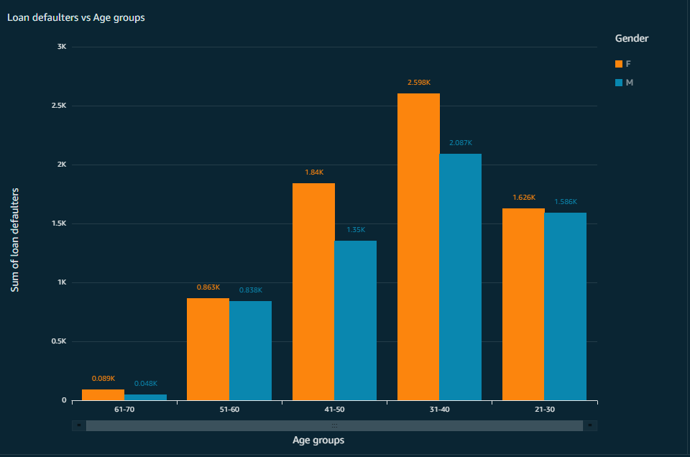
Quicksight continued

Slide 24
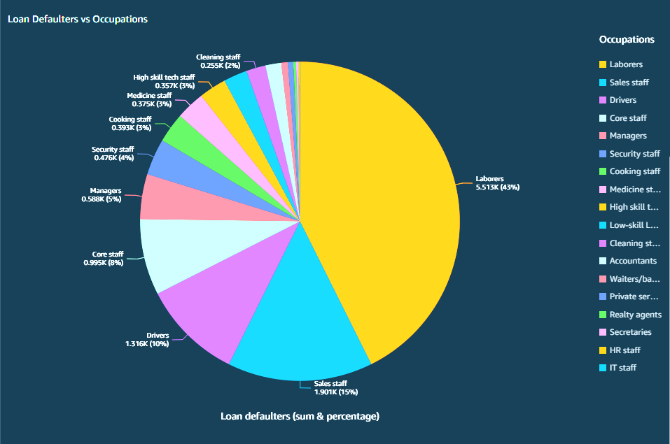
Quicksight Final

Slide 25
Thank You

