Slide 1

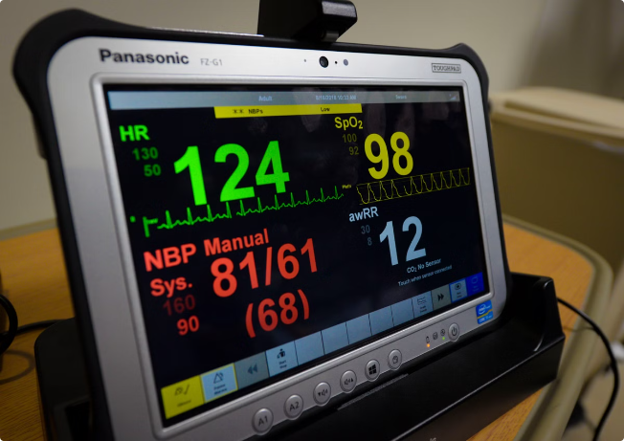
Innovative Monitoring System for TeleICU Patients Using Video Processing and Deep Learning
Intel Unnati Industrial Training Program
2024
TEAM : DEVATECH
TEAM MEMBER 1 : RAKTIM MAITY
TEAM MEMBER 2 : POOJA MAITY
TEAM MEMBER 3 : RISAV CHATTERJEE

Slide 2
Support Vector Machines for Classification
What are SVMs?
Training SVMs
Advantages of SVMs
Support Vector Machines (SVMs) are a class of supervised learning algorithms widely used for classification and regression tasks. SVMs work by finding the optimal hyperplane that separates different classes of data with the maximum margin. This helps the model generalize well to new, unseen data, making it a robust and powerful tool for a variety of applications.
The training process for SVMs involves optimizing the position and orientation of the separating hyperplane to ensure the largest possible margin between the classes. This is achieved by solving a convex optimization problem, which can be computationally intensive for large datasets. However, efficient algorithms and techniques have been developed to make SVM training scalable and practical.
SVMs are known for their ability to handle high-dimensional data, their robustness to noise and outliers, and their strong theoretical foundations. They have been successfully applied to a wide range of classification problems, including image recognition, text categorization, and bioinformatics.

Slide 3
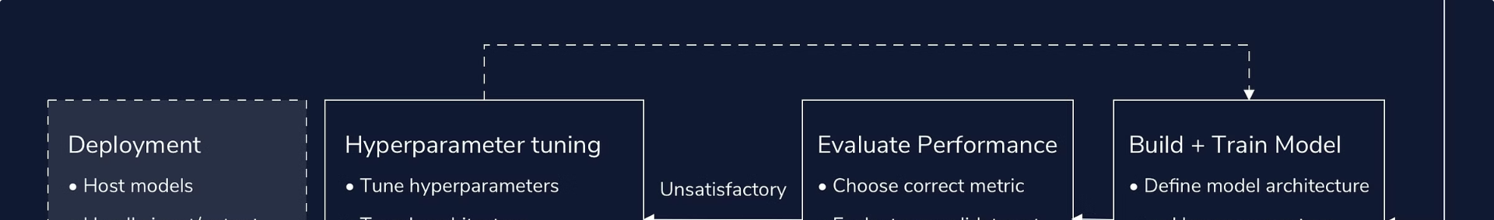
Measuring Model Accuracy
1
Accuracy Metrics
2
Cross-Validation
3
Evaluation Considerations
Evaluating the performance of a machine learning model is crucial for understanding its effectiveness and suitability for a given task. Common metrics used to measure the accuracy of classification models include accuracy, precision, recall, and F1-score. These metrics provide insights into the model's ability to correctly identify positive and negative instances.
To obtain a robust estimate of a model's performance, it is important to use techniques like cross-validation. Cross-validation involves partitioning the data into training and testing sets, and then evaluating the model's performance on the unseen test data. This helps ensure that the model's accuracy is not inflated by overfitting to the training data.
When evaluating a model's accuracy, it is essential to consider the specific requirements and constraints of the application. For example, in a medical application, false negatives (missed diagnoses) may be more critical than false positives. The choice of evaluation metrics and thresholds should be tailored to the problem at hand.

Slide 4

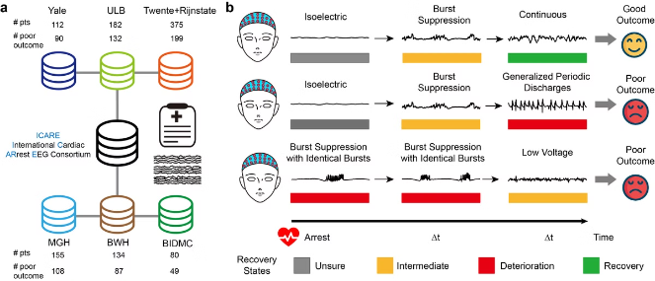
Deep Learning for Patient Monitoring
Computer Vision Techniques
Deep learning models, particularly convolutional neural networks (CNNs), have proven to be highly effective in processing and analyzing visual data, such as patient video footage. These models can be trained to detect and track patient movements, recognize facial expressions, and even measure physiological signals like heart rate and respiration rate.
Behavioral Analysis
By combining computer vision with behavioral analysis, the monitoring system can detect subtle changes in a patient's movements, posture, and other behaviors that may indicate changes in their clinical condition. This can help healthcare providers identify potential issues early and intervene proactively.
Continuous Monitoring
The automated nature of the deep learning-based monitoring system allows for continuous, real-time tracking of patient data, which is particularly valuable in the TeleICU setting where healthcare providers may not be physically present. This can help ensure timely detection of changes and facilitate prompt clinical decision-making.
Privacy Considerations
While the use of video monitoring raises important privacy concerns, the system can be designed with robust data privacy and security measures to protect patient information and comply with relevant regulations, ensuring the ethical and responsible use of this technology.

Slide 5

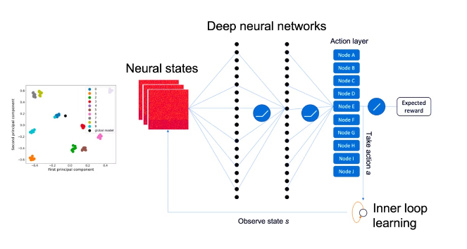
Integrating SVM and Deep Learning
1
Data Preprocessing
The first step in the monitoring system's workflow is to preprocess the video data, which may include tasks such as video stabilization, object detection, and feature extraction. These preprocessing steps help prepare the data for the subsequent machine learning models.
2
SVM Classification
The preprocessed data is then fed into a Support Vector Machine (SVM) classifier, which is trained to identify specific patient behaviors or physiological patterns. The SVM model's outputs can provide valuable insights into the patient's condition and serve as inputs to the deep learning-based monitoring system.
3
Deep Learning for Continuous Monitoring
The deep learning models, such as Convolutional Neural Networks (CNNs), are trained to continuously analyze the video feed and detect changes in the patient's status in real-time. These models leverage the features and insights provided by the SVM classifier to enhance their accuracy and responsiveness.

Slide 6


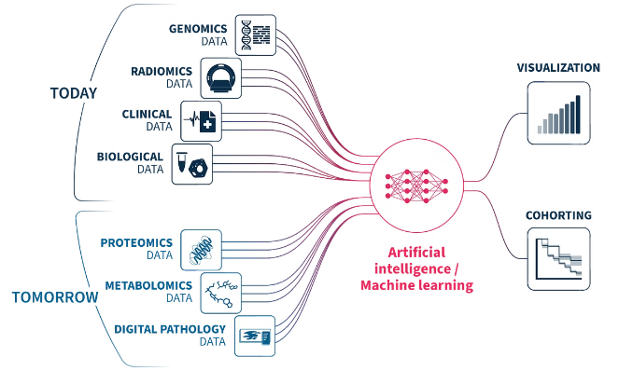



Leveraging Multimodal Data
Video Monitoring
The core of the monitoring system is the video data captured from the patient's room, which provides a rich source of information about the patient's movements, behaviors, and physical condition.
Wearable Sensors
In addition to video data, the system can integrate data from wearable sensors worn by the patient, such as heart rate monitors, activity trackers, and temperature sensors, to provide a more comprehensive view of the patient's physiological state.
Electronic Health Records
By linking the monitoring system with the patient's electronic health record (EHR), the healthcare team can access relevant medical history, medication information, and other clinical data to further enhance the accuracy and relevance of the system's insights.
Clinical Expertise
The monitoring system is designed to complement and empower healthcare professionals, providing them with timely data and insights to support their clinical decision-making and patient care strategies.

Slide 7


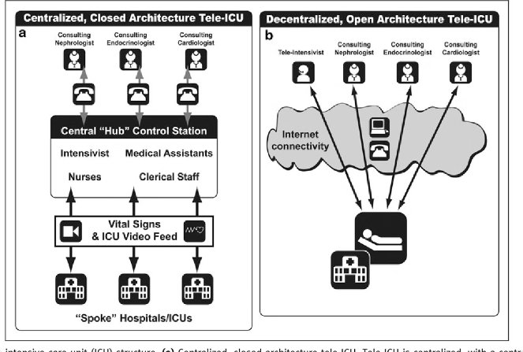



System Architecture and Deployment
Video Capture
High-quality video cameras are installed in the patient's room to capture real-time footage of the patient's activities and movements.
Edge Processing
An edge computing device, such as a GPU-enabled server or a specialized hardware module, is used to perform the initial video preprocessing and SVM classification tasks, reducing the computational load on the central monitoring system.
Cloud-based Analytics
The preprocessed data and SVM outputs are then sent to a cloud-based platform, where advanced deep learning models continuously monitor the patient's condition and generate real-time alerts and insights for the healthcare team.
Secure Communication
The system is designed with robust security measures, including end-to-end encryption and access controls, to ensure the confidentiality and integrity of the patient data during transmission and storage.

Slide 8

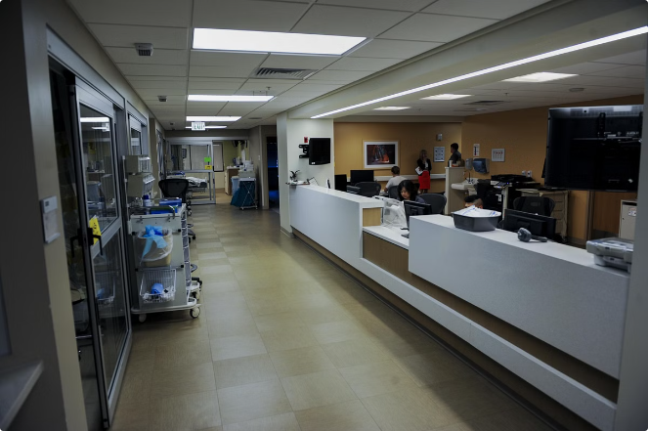
Impact and Future Developments
Improved Patient Outcomes
The early detection of changes in a patient's condition and the timely intervention enabled by the monitoring system can lead to better clinical outcomes and reduced complications.
Enhanced Clinical Workflow
By automating certain monitoring tasks, the system can help healthcare providers optimize their workflow, allowing them to focus more on direct patient care and clinical decision-making.
Cost Savings
The improved efficiency and reduced need for in-person monitoring can result in cost savings for healthcare organizations, making the system a valuable investment in the long run.
Future Developments
Ongoing research and development in areas such as multimodal data fusion, explainable AI, and edge computing will continue to enhance the capabilities and reliability of the monitoring system, paving the way for even more advanced telehealth solutions.

Slide 9


