Slide 1
IoT Paper Survey
202035303 고현철

Slide 2
1. Wi-Fi FTM protocol(국문)
GPS technology is widely used outdoors, but it is difficult to receive satellite signals indoors
Designed to estimate accurate location using devices built into mobile device
Wi-Fi is suitable for finding location by applying it to various location estimation companies as a large number of APs are already installed indoors.
Since measurement is based on received signals, it is disturbed by various factors and inaccurate distance estimates are made.
Initially, Microsoft proposed a fingerprinting location method.
Measure distance using received signal
Build a database by measuring received signal strength from adjacent Aps in numerous locations
It takes a lot of time and effort to build a database
If the location of the AP changes, the database must be built again!
So, 11mc in IEEE proposed a FTM(Fine Timing Measurement) using RTT
More precise position measurement is possible than existing methods!

Slide 3
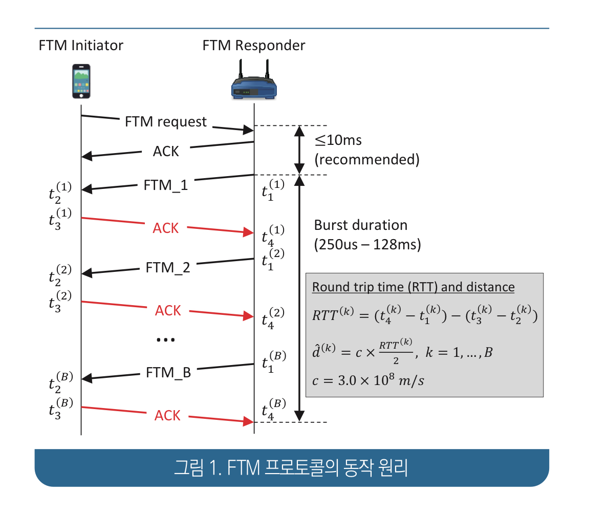
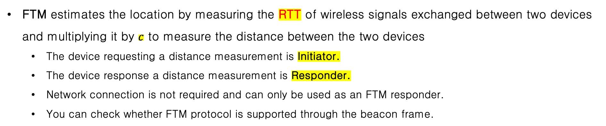
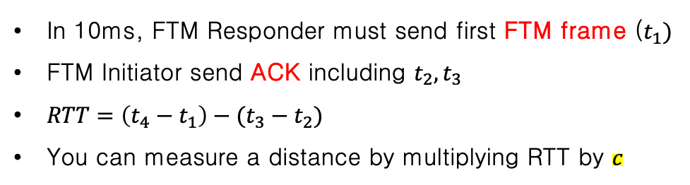
1. Wi-Fi FTM protocol(국문)
FTM estimates the location by measuring the RTT of wireless signals exchanged between two devices and multiplying it by $c$ to measure the distance between the two devices
The device requesting a distance measurement is Initiator.
The device response a distance measurement is Responder.
Network connection is not required and can only be used as an FTM responder.
You can check whether FTM protocol is supported through the beacon frame.
MAC Address | bandwidth | Carrier frequency
In 10ms, FTM Responder must send first FTM frame ($t_{1})$
FTM Initiator send ACK including $t_{2},t_{3}$
$RTT=\left(t_{4}−t_{1}\right)−(t_{3}−t_{2})$
You can measure a distance by multiplying RTT by $c$

Slide 4
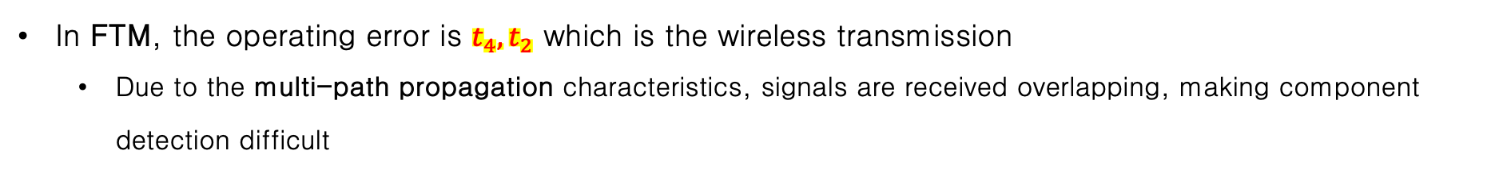
1. Wi-Fi FTM protocol(국문)
In FTM, the operating error is $t_{4},t_{2}$ which is the wireless transmission
Due to the multi-path propagation characteristics, signals are received overlapping, making component detection difficult
To solve this, a continuous distance estimation process called burst mode is performed.
By repeating the process, multiple estimated values can be obtained, and the estimated value is corrected by taking the average
Iteration process!!, More precise!!

Slide 5
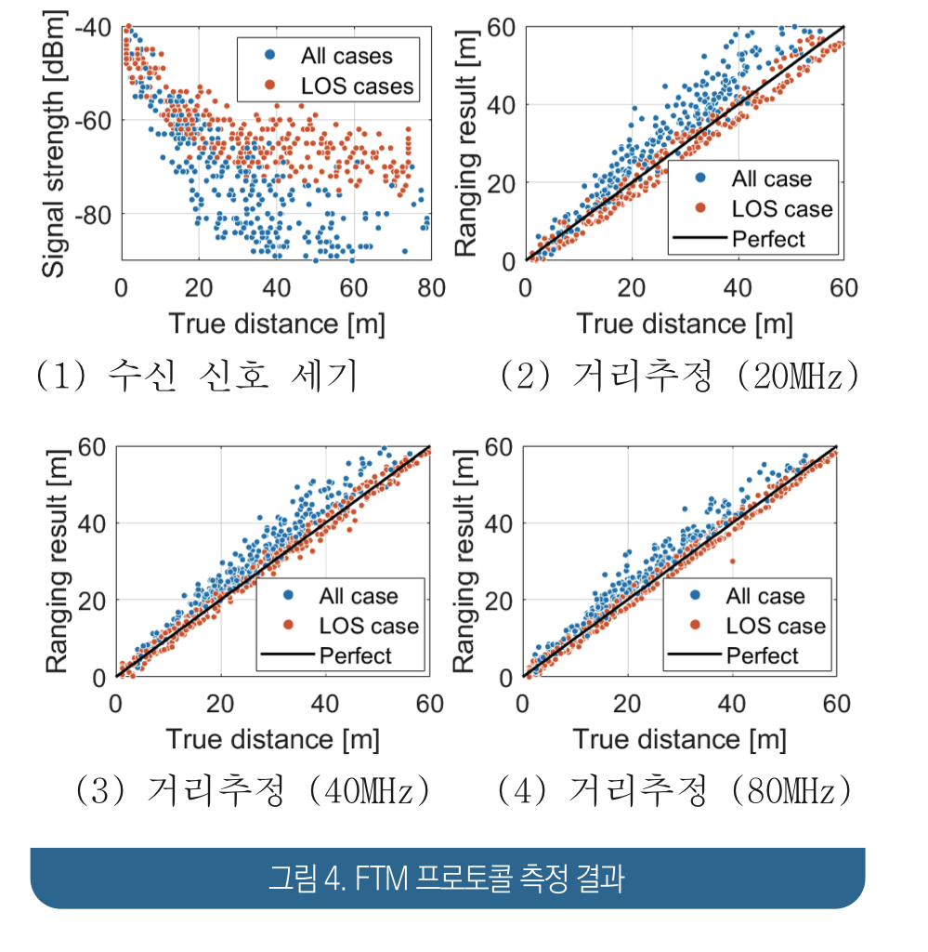
1. Wi-Fi FTM protocol(국문)
Received signal strength has the same pattern, with the signal decreasing with distance
At -70dBm, it cover a very wide area
Making accurate measurement difficult!!
In 4(2)-(4), distance estimation using FTM
The wider bandwidth, the more accurate estimates can be made!
Get closer to perfect result!!

Slide 6
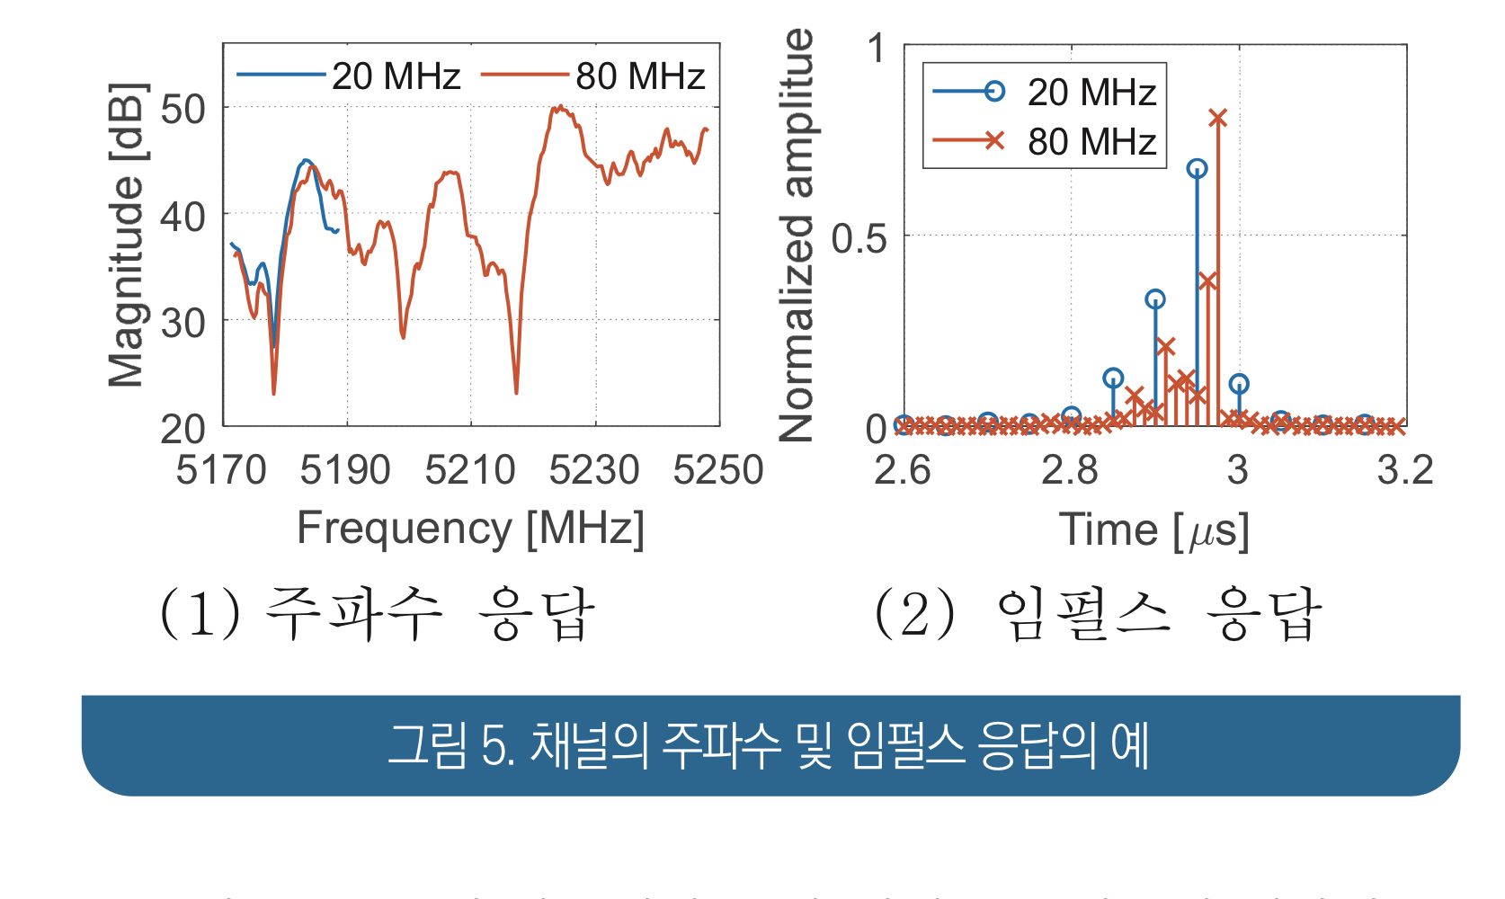
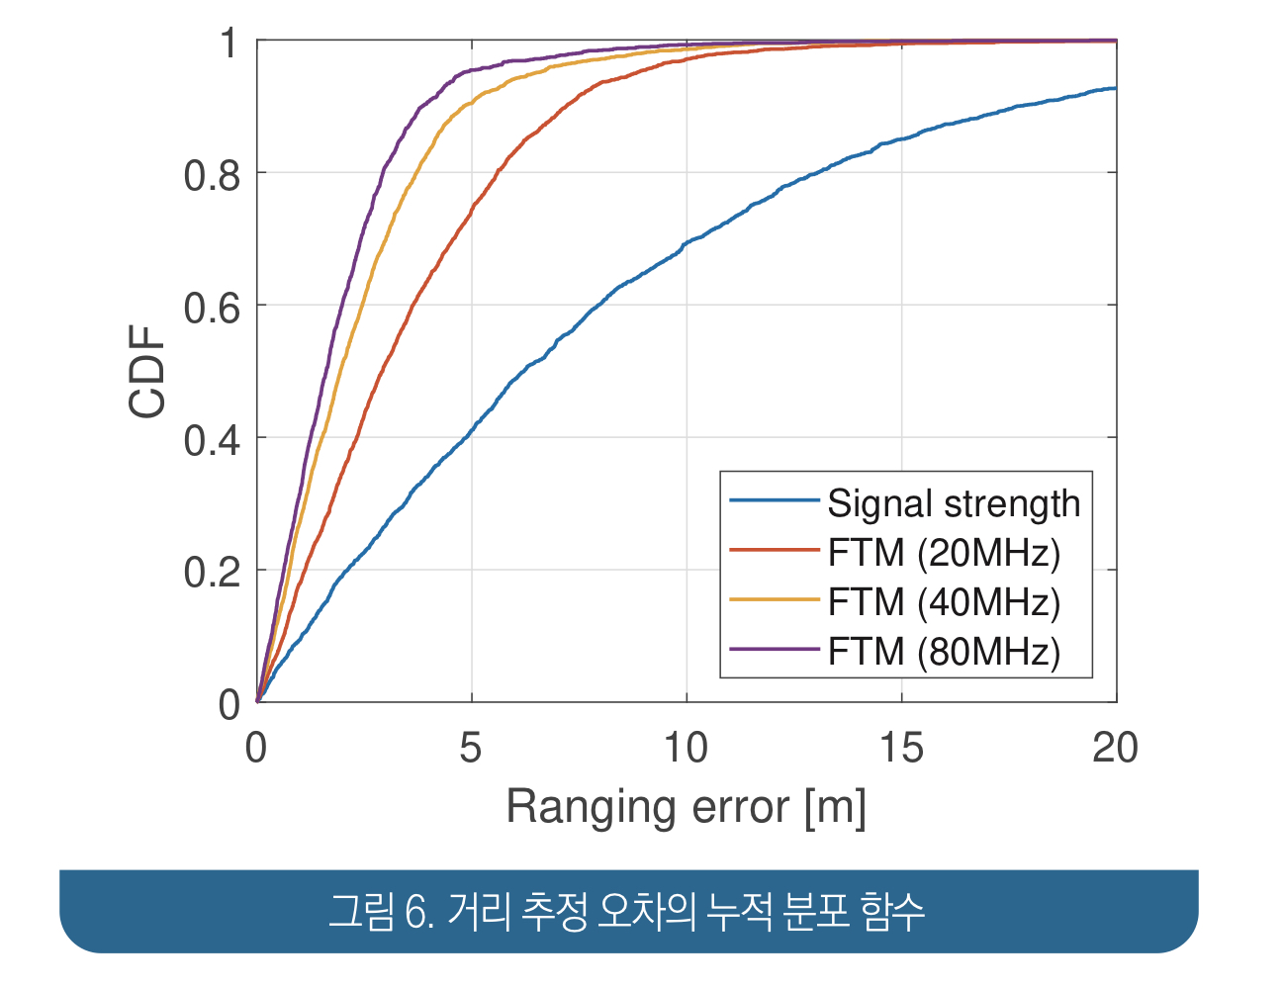
1. Wi-Fi FTM protocol(국문)
The accuracy of distance estimation varies depending on the radio wave environment.
Wi-Fi devices estimate the arrival time of the first arriving component using the CSI(Channel State Information) frequency response to measure the reception time of the transmitted signal
The wider the bandwidth used, the tighter the channel impulse response can be obtained in time domain
Ingredient detection performance is improved!!

Slide 7
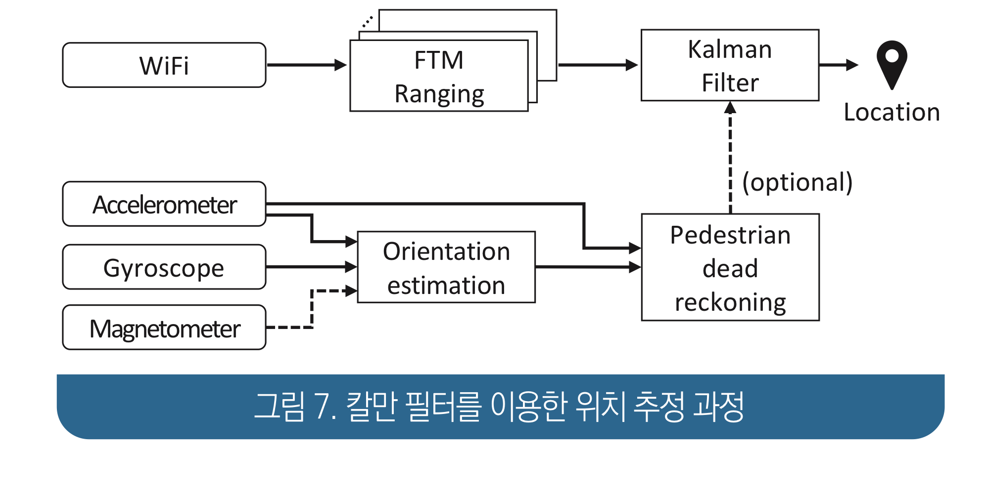
1. Wi-Fi FTM protocol(국문)
In real-time location measurement, the accuracy of location estimation can be improved by applying Bayesian filtering techniques such as Kielman filter
Accuracy can be further improved by using accelerometer, gyroscopes, and geomagnetic sensors mounted on mobile devices
Convert the location of the mobile device to be estimated into the state vector of the Kalman filter
Predict the device location at the current time form the device location estimated at the previous time
Final estimation using the distance estimate value obtained using FTM

Slide 8
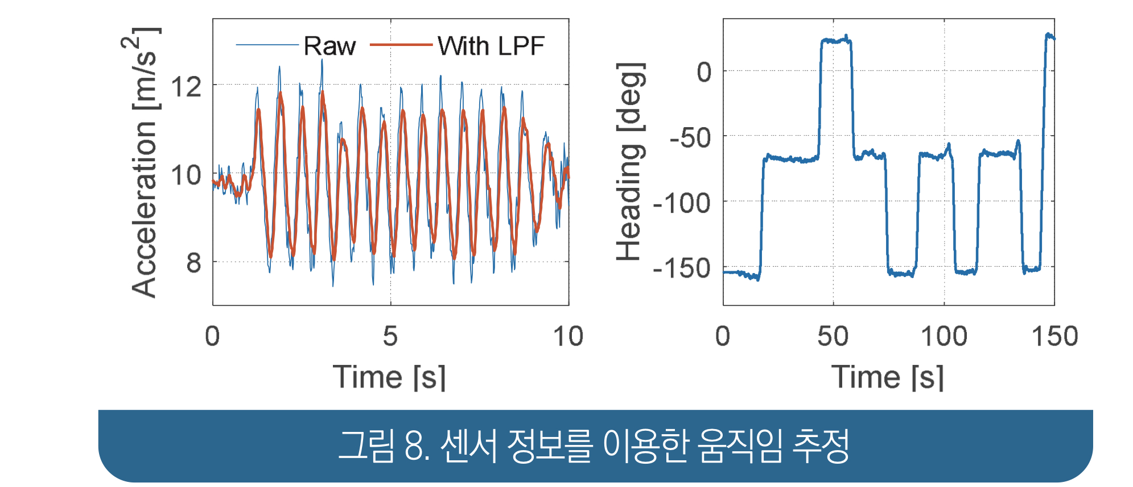
1. Wi-Fi FTM protocol(국문)
Sensor information is also used in the step of predicting the current location from the device’s location estimated at the previous time
Using sensor information, it is possible to obtain and predict the device’s movement path from the previous time to the current time.
PDR(Pedestrian Dead Reckoning)
Estimation of mobile device orientation with respect to reference coordinate system using accelerometer and gyroscope
Convert the acceleration value measured about the device’s internal coordinate axis to acceleration information about the reference coordinate system using direction
Get device’s motion information

Slide 9
2. WiNar(영문)
The indoor localization problem has been an active research area over the years
Indoor environments require more precise positioning to support various IoT-based and context aware applications
Several measurement techniques exist to measure the position
Fingerprinting technology obtains the features of physical signals at the offline stage through environmental surveys, and then measures them in real time at the online stage to estimate the user's location.
Distance-based positioning techniques use the propagation time of radio signals to estimate the distance between the transmitter and receiver.
Recently, the IEEE 802.11-2016 standard introduces the Fine Time Measurement (FTM) protocol to support round-trip time measurements.
However, localization in indoor settings still poses significant challenges!!
Multi-path propagation errors and the absence of visual communication propagation can lead to problems such as overestimation of distance estimation.
To address these challenges, WiNar uses RTT as a physical signal feature to combine the advantages of fingerprint and distance-based technologies

Slide 10
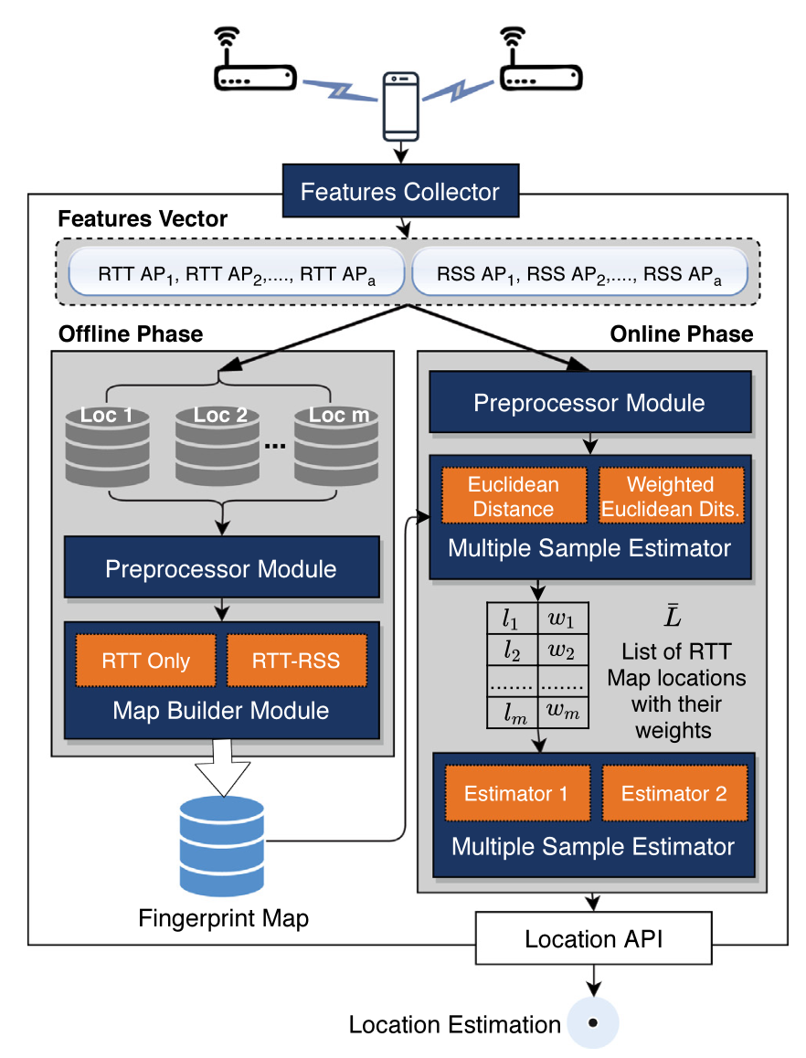
2. WiNar(영문)
WiNar works both offline and online.
In the offline phase, a combined RTT-RSS fingerprint map for discrete locations is collected within the building
In the online phase, the location is estimated based on the similarity between real-time detected RTT and RSS measurements and fingerprint map data collected in the offline phase.
WiNar uses a variety of modules used to handle RF noise, provide similarity weights at discrete grid locations, and place users in a continuous space

Slide 11
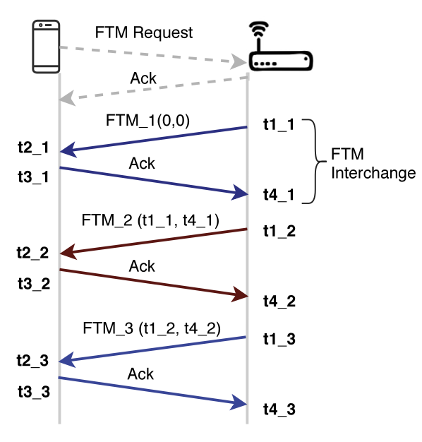
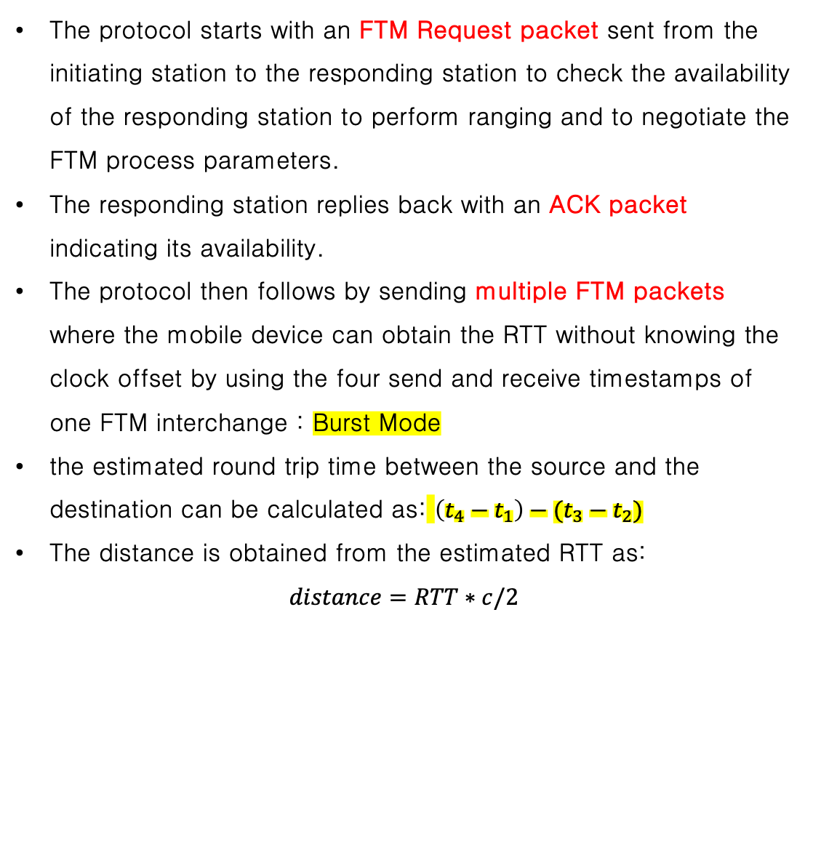
2. WiNar(영문)
FTM protocol background
FTM allows a station to accurately measure the round trip time (RTT) between it and another station.
The protocol starts with an FTM Request packet sent from the initiating station to the responding station to check the availability of the responding station to perform ranging and to negotiate the FTM process parameters.
The responding station replies back with an ACK packet indicating its availability.
The protocol then follows by sending multiple FTM packets where the mobile device can obtain the RTT without knowing the clock offset by using the four send and receive timestamps of one FTM interchange : Burst Mode
the estimated round trip time between the source and the destination can be calculated as: $\left(t_{4}−t_{1}\right)−(t_{3}−t_{2})$
The distance is obtained from the estimated RTT as:
$$distance=RTT∗c/2$$

Slide 12
2. WiNar(영문)
WiNar leverages the RTT and RSS values as a fingerprint profile and estimates the user location based on the similarity between the online and the offline profiles.
utilizes the FTM protocol, introduced by the IEEE802.11-2016 standard
recently supported by commercial off-the-shelf access points and the Android mobile phones
The WiNar system works in two phases:
The Offline Phase where it divides the area of interest into discrete grid locations and builds the fingerprint map.
the Online Phase, where it estimates the user location based on the measured round trip time values to the different access points and the generated RTT fingerprint map.

Slide 13
2. WiNar(영문)
The Features Collector module is used to scan for the APs and collect the associated RTT and RSS values at the different locations in the area of interest during both offline and online phases.
The Pre-processing module arranges the collected RTT and RSS values to construct the features vectors.
The Map Builder module constructs the fingerprint map from the collected RTT and RSS values of the various APs within vicinity in the area of interest.
The Single Sample Estimator module works during the online phase to calculate the similarity weight of each fingerprint location given the currently received features vector from different access points at the unknown user location.
The Multiple Samples Estimator module combines the number of estimates output by the Single Sample Estimator to get a more accurate location estimation in the continuous space.

Slide 14
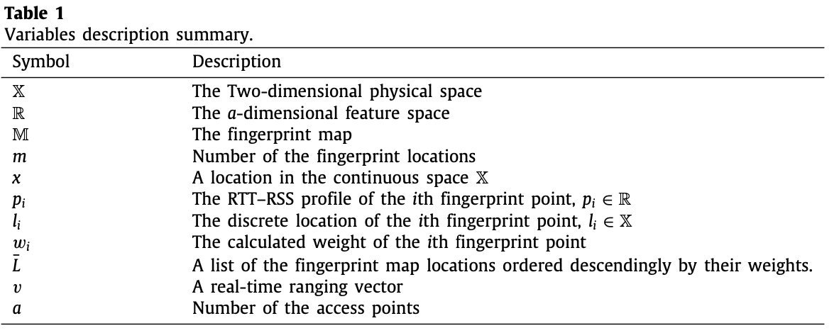
2. WiNar(영문)
System details
Without loss of generality let X be a two- dimensional physical space.
At each location x ∈ X we can obtain the round trip times (RTT) and the received signal strength (RSS) from a access points in the area of interest.
denote the a-dimensional feature space as R.
The fingerprint map M contains m entries, where the its entry contains the coordinates of a discrete location li ∈ X and a fingerprint profile pi ∈ R. Let v ∈ R be a sample feature vector that contains the round trip time and received signal strength to the a access points during the online phase.

Slide 15
2. WiNar(영문)
Pre-processing module
to convert the collected RTT and RSS values to a fixed length feature vector
we map each collected RTT and RSS value to its entry in this vector and normalizing them when necessary
this module assigns an RTT value of 2 × 10−4 milliseconds (which corresponds to 60 meters in the distance domain) and the RSS values of −100 dBm to the APs that are not heard in a specific scan.
since WiNar is a fingerprint-based technique, these negative values are implicitly handled as being part of the fingerprint of a particular location and hence do not affect our system’s accuracy.
The map-builder module
constructs the WiNar offline fingerprint.
Using only RTT features.
only leverages collected RTT values to construct the fingerprint map

Slide 16
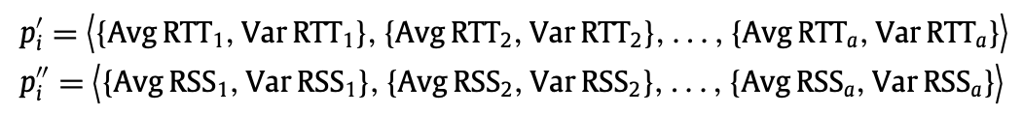
2. WiNar(영문)
The map-builder module
Using hybrid RTT–RSS features.
proposes a hybrid RSS–RTT Fingerprinting approach, that combines both received signal strength and round trip time information as an environment features to construct the fingerprint map.
Single sample estimator module
During the online phase, the goal of this module is to use the received RTT and RSS values at an unknown location to estimate the user location.
The module leverages a weighted K-nearest neighbor algorithm to calculate the location estimate.
Different distance measures can be used to judge the physical distance (which infers the similarity) between points.

Slide 17
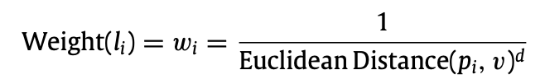
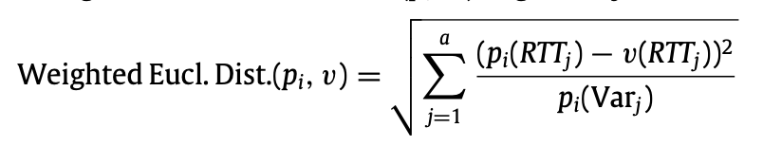
2. WiNar(영문)
Single sample estimator module
Unweighted euclidean distance.
Given a ranging sample vector v ∈ R, the Single Sample Estimator module returns a score for each fingerprint location.
This score represents the likelihood of the user being at that location based on the euclidean distance between the online ranging vector v and the fingerprint profile of the location li.
Weighting by RTT sample variance
The RTT offline measurements collected at the same fingerprint location and from the same access point can be affected differently by the environment dynamics
a new weighting approach that aims to overcome these challenges and improve accuracy by taking into consideration the fingerprint RTT sample quality, reflected by the sample variance of the fingerprint point
during the online localization phase, the Single Sample Estimator Module leverages the calculated fingerprint sample variances to weight the fingerprint locations differently.

Slide 18
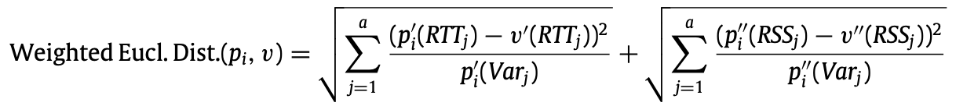
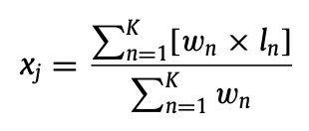
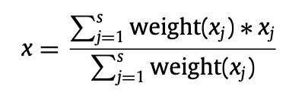
2. WiNar(영문)
Weighting by RTT–RSS sample variance.
explores the benefit of extending the previous RTT weighting approach by taking into consideration both the RTT and RSS offline samples variance.
During the online localization phase, the Single Sample Estimator Module receives a single RTT–RSS feature vector v at an unknown location and leverages the RTT–RSS fingerprint map M to calculate the similarity score for each fingerprint location using a weighted euclidean distance approach.
The multiple samples estimator module
To provide a more accurate user location estimation in the continuous space, the Multiple Samples Estimator Module processes a ranging sample vectors v ∈ R together, where s is a parameter to the system.
Technique 1
For each ranging sample vector vj ∈ R, 1 ≤ j ≤ s, an initial location estimate xj in the continuous space is first calculated by taking the weighted average of the K most probable fingerprint locations.

Slide 19
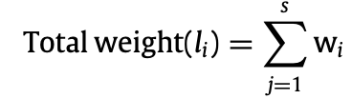
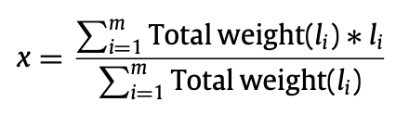
2. WiNar(영문)
Technique 2
Unlike the previous fusing technique that leverages each ranging sample vector individually to get an initial location estimation, this technique calculates a total weight vector by summing the weights of each ranging sample vector v over the s ranging samples as :
By leveraging multiple ranging samples and a weighted average approach to calculate the location estimation, this enables WiNar to be resilient to the environment dynamics by dominating the noisy weights, resulting from noisy ranging samples due to the environment dynamics or other hardware and software noises, by the weights that are calculated from the other accurate majority of the collected ranging samples.

