Slide 1
Raluca's FODMAP calculator

Slide 2
Coming up
Who needs this and why?
What are FODMAPs?
How does the application help?
What does the application use?
Any of your questions
What is done now?

Slide 3
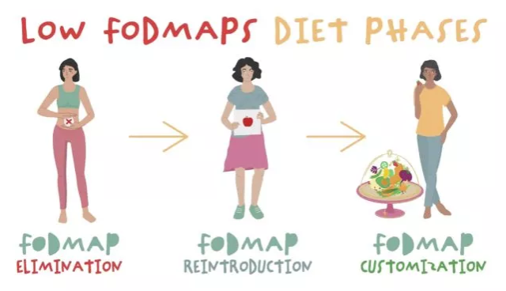
Who needs this and why
I do
Others with IBS
The FODMAP diet

Slide 4
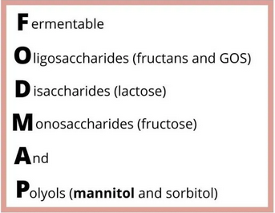
What are FODMAPs?

Slide 5


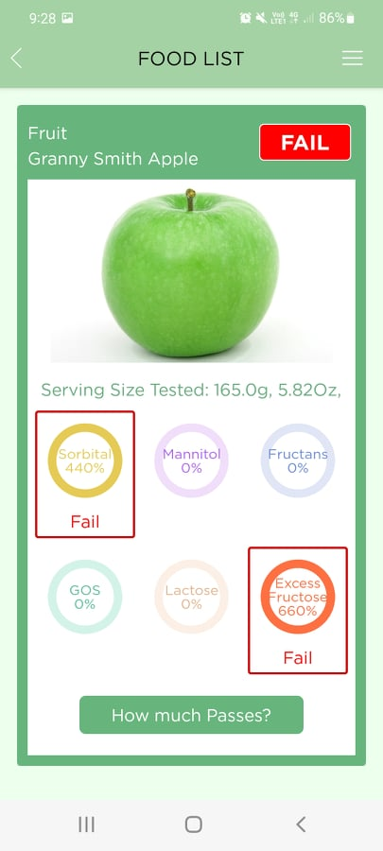
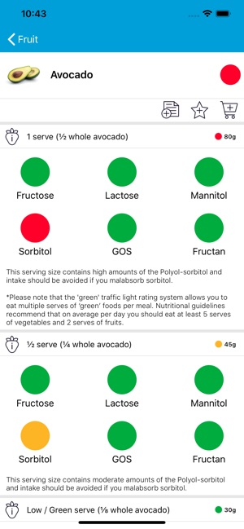
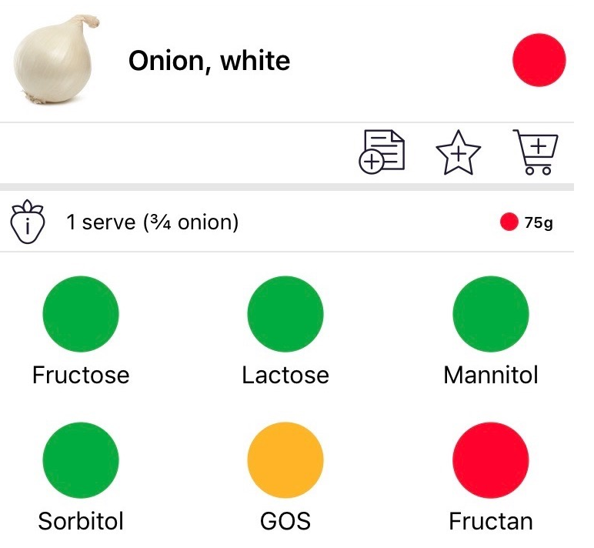
What is done now?

Slide 6
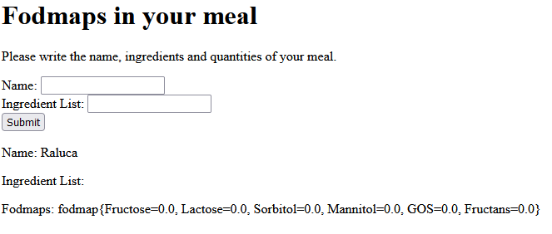
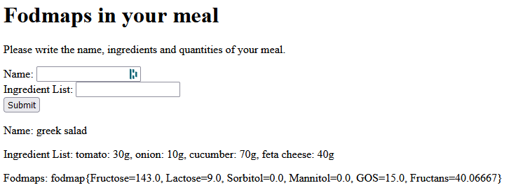

Slide 7
How does it do it?
Service Layer
Tomato: 30g, onion: 10g, cucumber: 70g, feta cheese 40g
Database
Tomato -> 30; onion -> 10 cucumber -> 70 feta cheese 40
Service layer
Tomato -> 90% fructose for 75 g
30 g used => 36% fructose
Greek salad -> 143.0% fructose
View
Fodmaps: fodmap{Fructose=143.0, Lactose=9.0, Sorbitol=0.0, Mannitol=0.0, GOS=15.0, Fructans=40.06667}

Slide 8
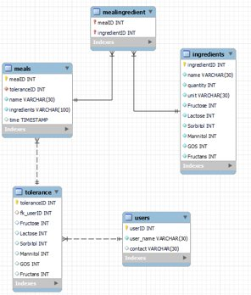
Database

Slide 9
Technologies used
JPA Repository​
JDBC template​
Spring Boot
Maven
Thymeleaf
JPA Repository​ JDBC template​ Spring Boot

Slide 10
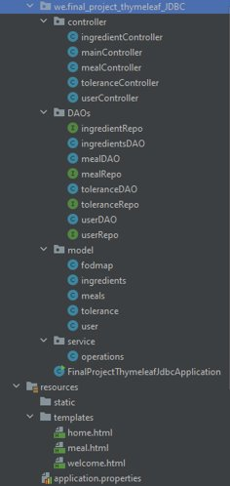
Project structure

Slide 11
Thank you for your time
Any questions?

