Slide 1
Presentation on Physics
By Ralenski Doucet
Date Created December 14, 2018

Slide 2
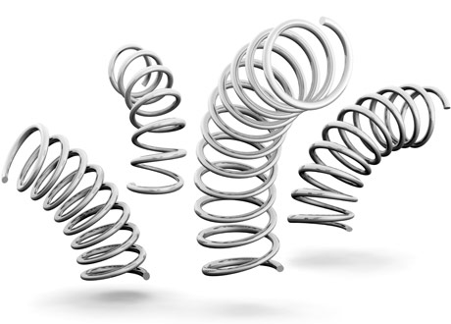
Springs

Slide 3
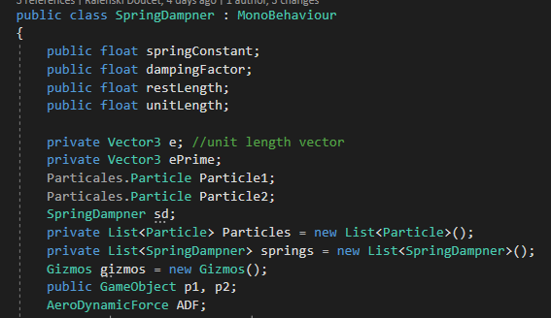
Explanation Of What You Should Know Before Making Springs
What Your class variables for your Spring Class should look like.
To Be able to make spring joints you need understand what a spring constant is , what a damping factor is, what rest length is, what e, e prime are, and what unit length is because all of these are variables you need. Spring constant is The value that specifies the stiffness of a spring. The damping factor is the amount of force that is applied to the force of the spring constant. The rest length is the length of the spring joint gravity is applied to the spring. E prime is equal to Particle 2’s position – Particle 1’s position. The Unit length is equal to e primes magnitude. E is equal to e prime normalized divided by the unit length. By understanding these variables and how they are used you now understand Hook's Law and how to implement Hook’s formula that you need to use to make a spring like mechanic.

Slide 4
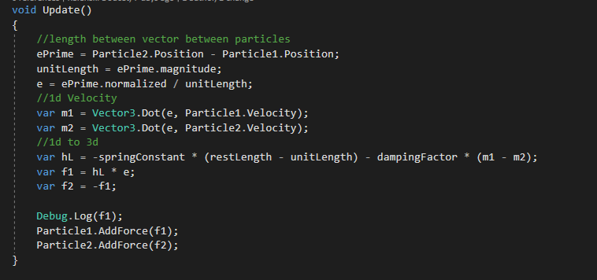
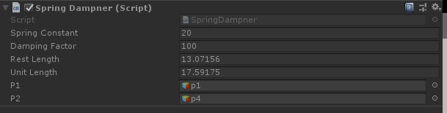
What Your Update function should look like.
After you have finished your spring damping class you should apply your script to an empty game object in unity that will use to other game objects that are particles the spring will connect to each other.
What your inspector for the spring game object you make should look like.

Slide 5
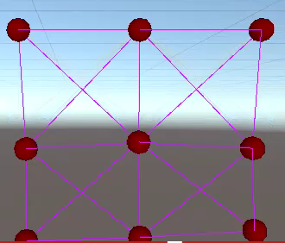
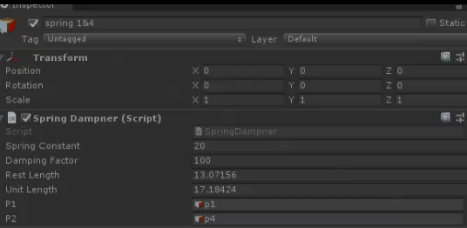
The Product in Action

Slide 6


Mesh

Slide 7
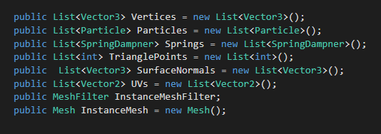
What Needs to be done to make mesh:
You need to create a variable of an Instance Mesh Filter. You will assign this variable’s name to be equal the game object that the script is attached to name. Then you need to create a list of ints for the triangle points of the mesh to be held in. You also want to make a list of vector3s that the vertices will be held in. You also want to create a list of vector3s that will be for the surface normal to be held in. the surface normal of a mesh or the vectors that point out perpendicular to the mesh at the position of the vertex associated with. You want to make the normal of the instance meshes equal to the normal of the surface normal. Create a list of Uvs. The uv will be used to project 2d objects to a 3d space .
These are the variables your mesh generator should have

Slide 8

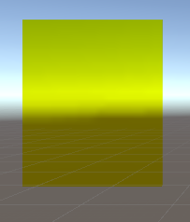
How the inspector should look
How the mesh looks when generated

Slide 9

Boids

Slide 10
Understanding the rules of boids:
Rule#1
Boid cohesion:
Is the act of boids being attracted towards each other. You can tell when boid cohesion is happening because you’ll be able to see the boids moving to each other. Of all the boids in the group one boid will be seen as the center of mass because all of the other boids will be gravitating towards each other. The pseudocode for boid cohesion looks something like this:
1st: c = (b₁.position + b₂.position + ... + b_{N} . position) / N
2nd: pc_{J} = (b₁.position + b₂.position + ... + b_{J-1}.position + b_{J+1}.position + ... + b_{N} . position) / (N-1)

Slide 11
Rule #2 Boid Dispersion
What this rule is for is to keep the boids a small distance from each other. You'll be able to tell when this rule is in use because the boids will always seem to stay a at least a certain distance from each other. To be able to implement this rule you need a variable in your code for the minimum distance that the boids will stay away form each other but you also need to make sure that you can still tell that the boids are in a group together . The pseudocode looks something like this:
FOR EACH BOID b
IF b != b.
THEN IF |b . position b . position| < 100 THEN c = c - (b . position b. position )

Slide 12
Rule #3 Flocking
For this rule the boids will try to match the speed of other near by boids. This rule is kind of similar to rule 1 but instead of averaging the positions of the boids you average the velocity of the boids instead. This rule actually came from a study of a flock of birds hence the name of the rule. The pseudocode would look something like this:
Vector pv_{J} FOR EACH BOID b IF b != b
THEN pv_{J} = pv_{J} + b.velocity pv_{J} = pv_{J} / N-1
RETURN (pv_{J} - b_{J}.velocity) / 8

