Slide 1

Book Club Management API
Computer Interface Programming
project

Slide 2
Creating books
ENDPOINT : http://localhost:8081/api/books/create
Json payload:
{
"title": "Makedonskite macenici",
"author": "Kristijan Ralevski"
}

Slide 3
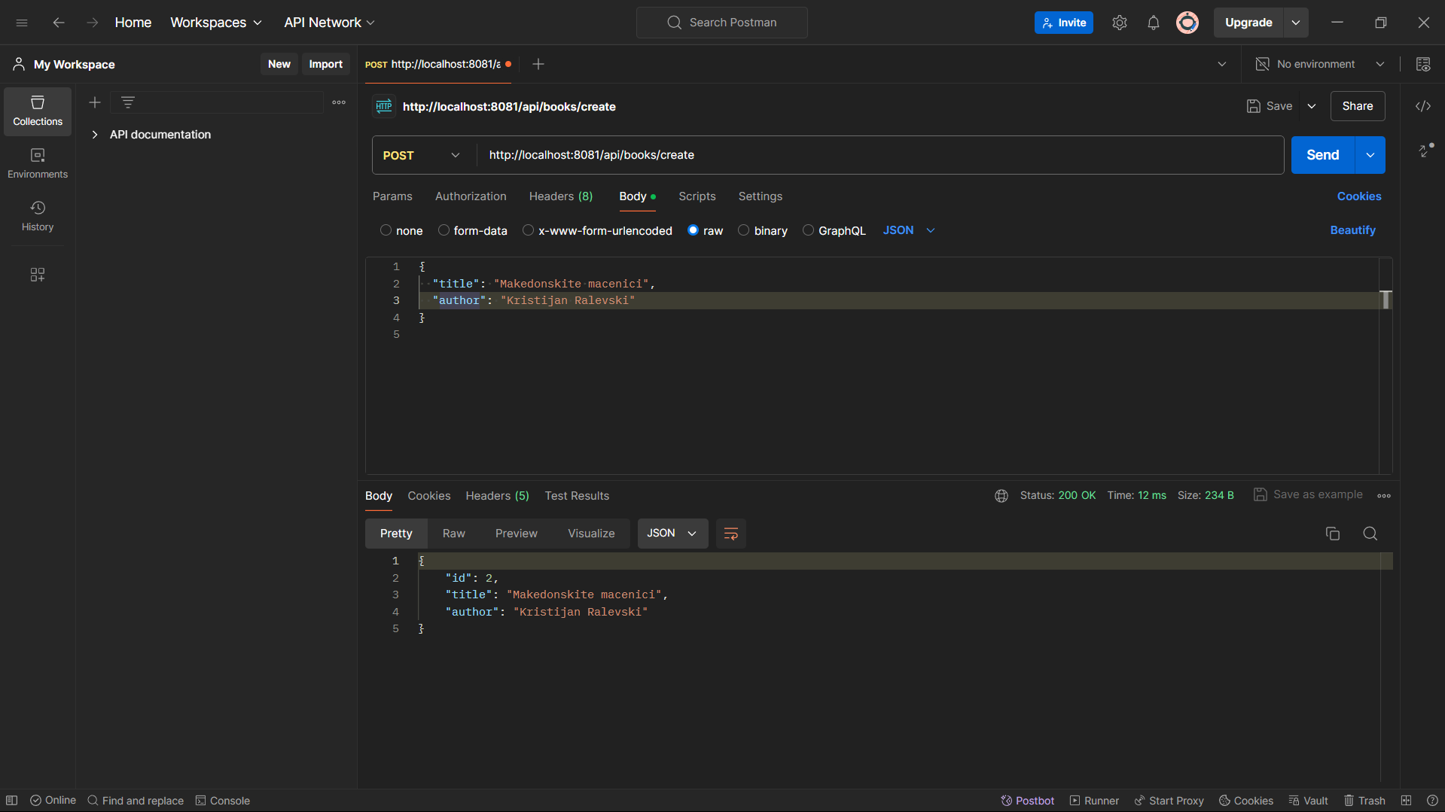
screenshot

Slide 4
LIST ALREADY INSERTED BOOKS
ENDPOINT :
http://localhost:8081/api/books
Json payload:
[
{
"id": 1,
"title": "1231",
"author": "1323"
},
{
"id": 2,
"title": "Makedonskite macenici",
"author": "Kristijan Ralevski"
}
]

Slide 5
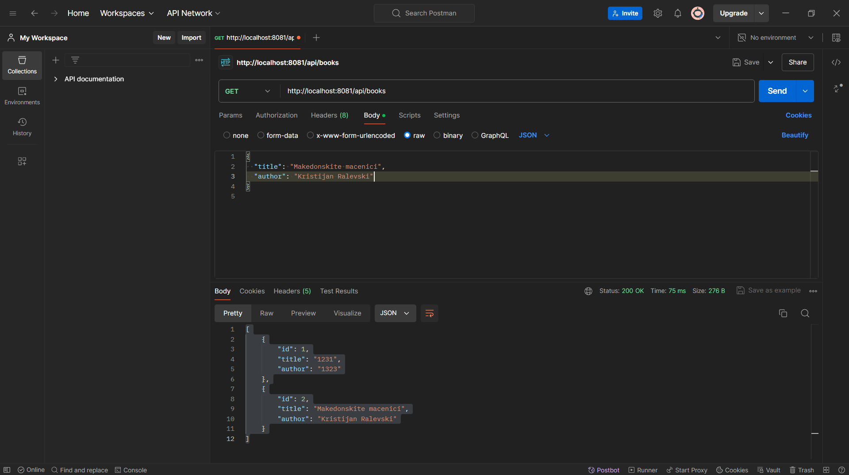
SCREENSHOT

Slide 6
UPDATE ALREADY INSERTED BOOK
ENDPOINT :
http://localhost:8081/api/books/2
Json payload:
{
"title": "Updated title of book",
"author": "Updated author NAME"
}

Slide 7
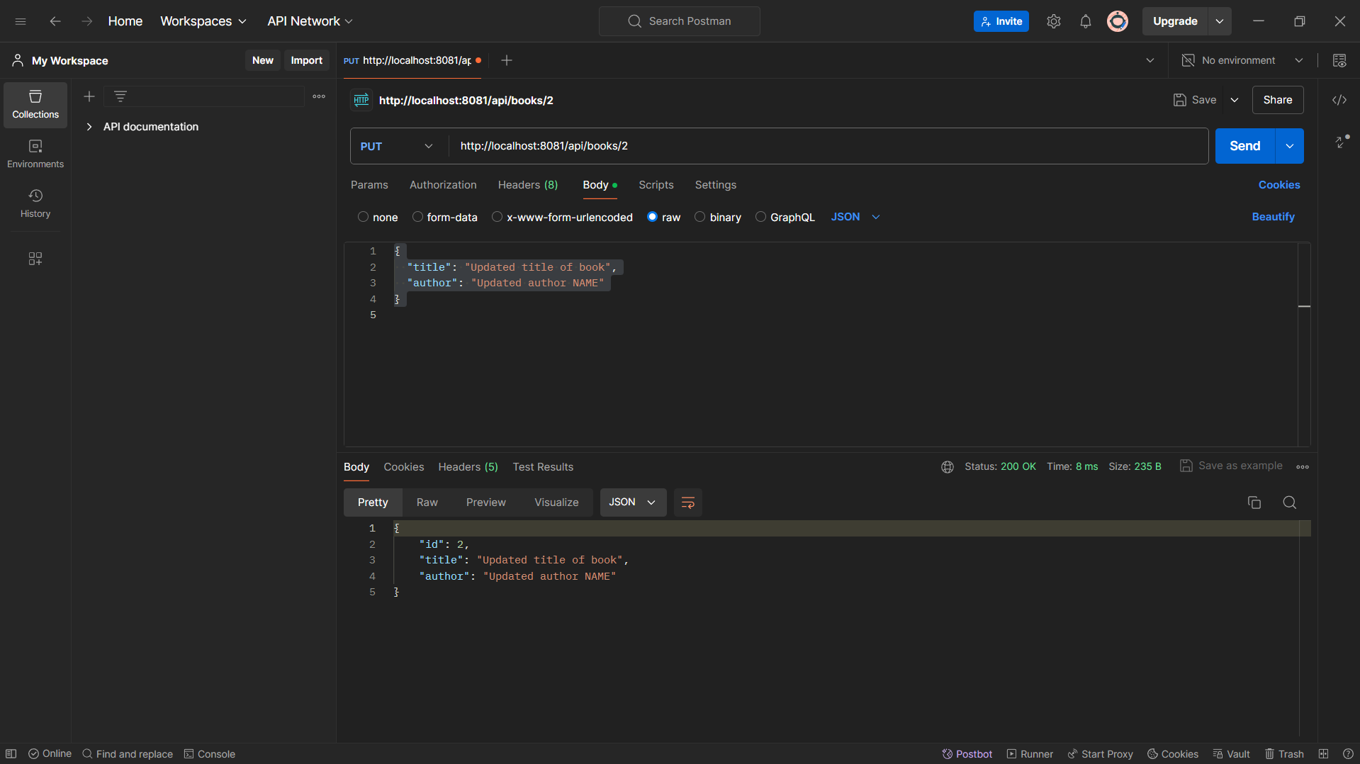
screenshot

Slide 8
Delete already inserted book
ENDPOINT :
http://localhost:8081/api/books/2
Json payload:
STATUS 200 OK

Slide 9
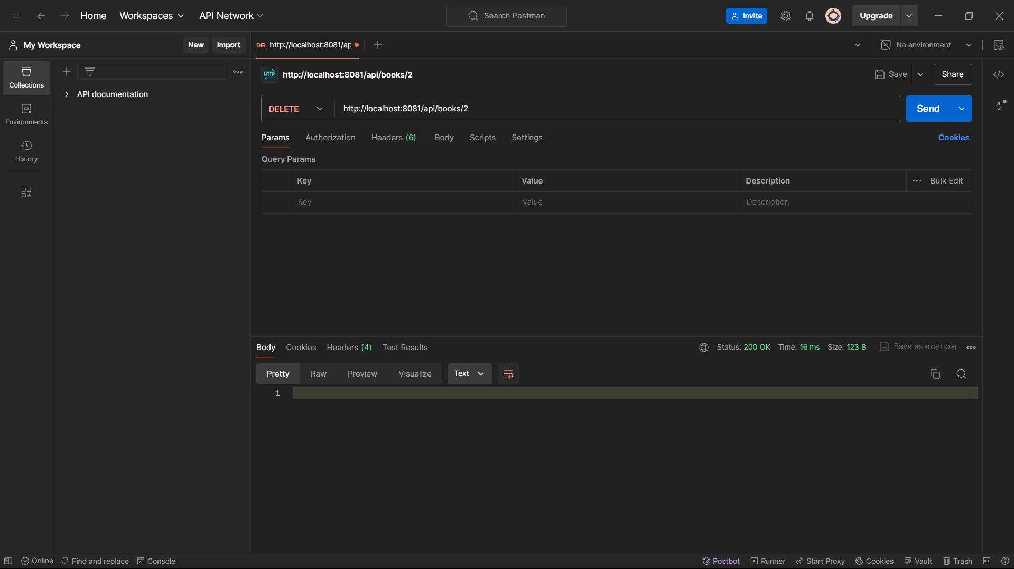
screenshot

Slide 10
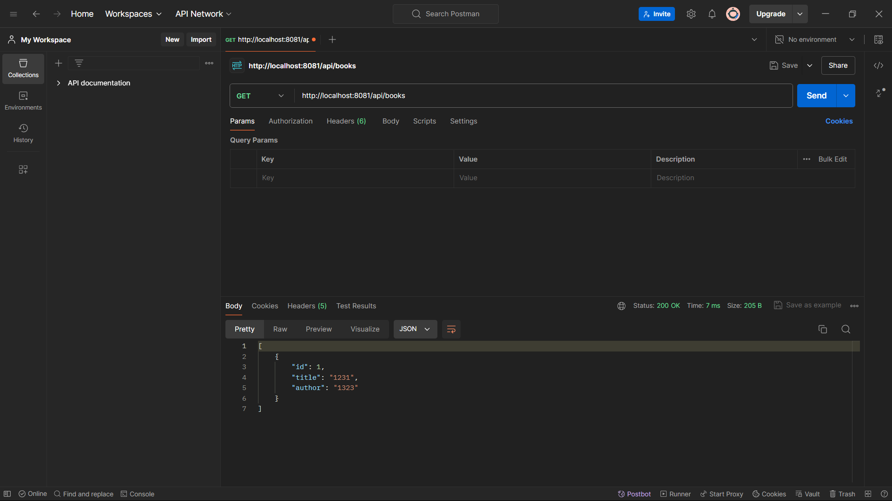
screenshot

Slide 11
CREATE A MEETING
ENDPOINT :
http://localhost:8081/api/meetings/create
Json payload:
{
"location": "Meeting Location",
"dateTime": "2024-06-01T10:00:00",
"bookId": 2
}

Slide 12
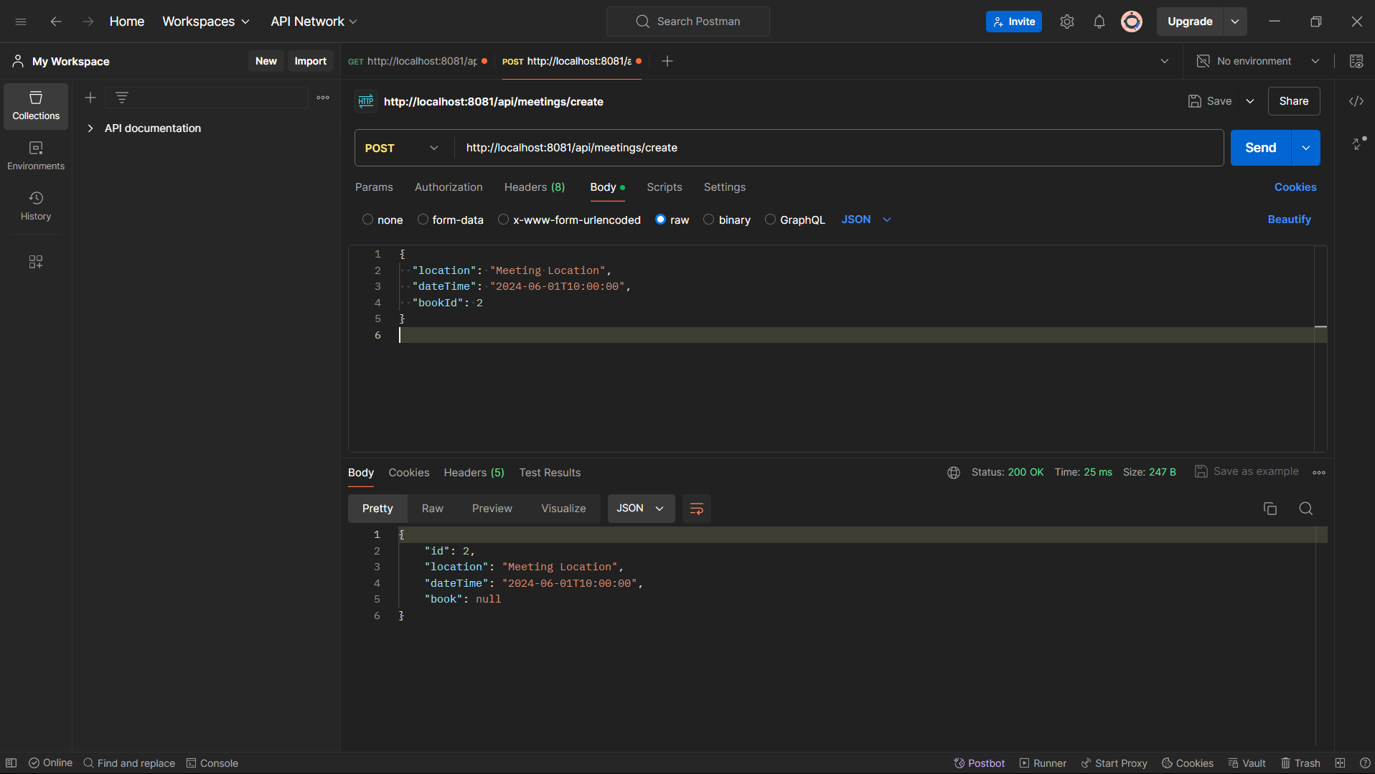
SCREENSHOT

Slide 13
get a list of all meetings
ENDPOINT :
http://localhost:8081/api/meetings
Json payload:
{
200 ok
}

Slide 14
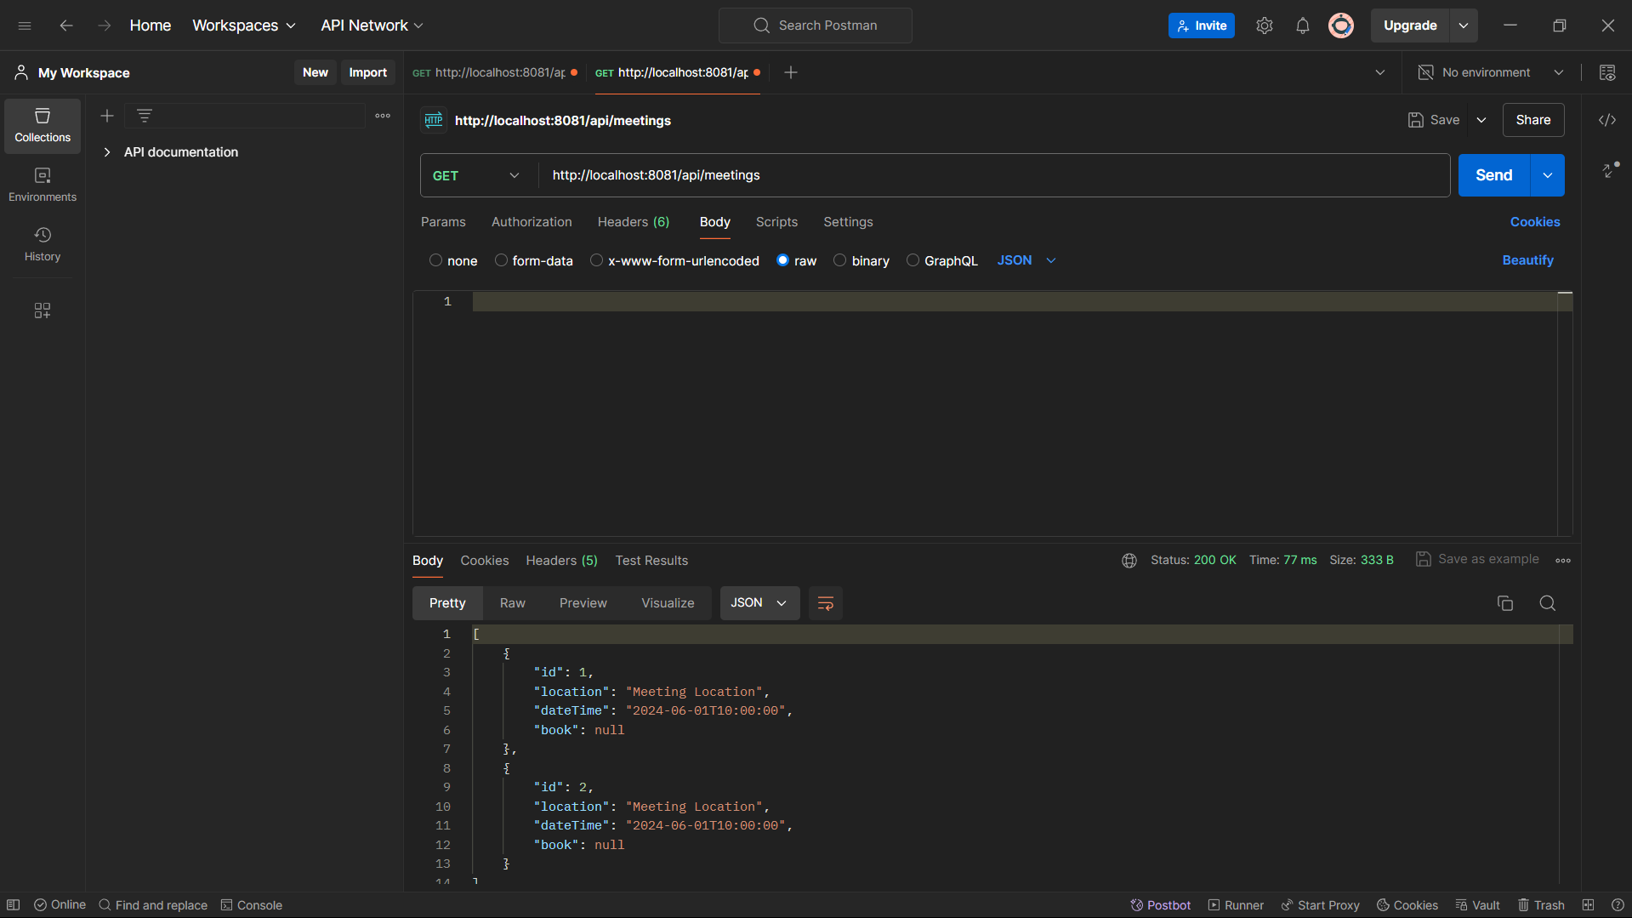
SCREENSHOT

Slide 15
UPDATE A MEETING
ENDPOINT :
http://localhost:8081/api/meetings/1
Json payload:
{
"id": 1,
"location": "Updated Location",
"dateTime": "2024-06-01T11:00:00",
"book": {
"id": 1,
"title": "Updated Book Title - UPDATED ONCE AGAIN",
"author": "Updated Author"
}
}

Slide 16
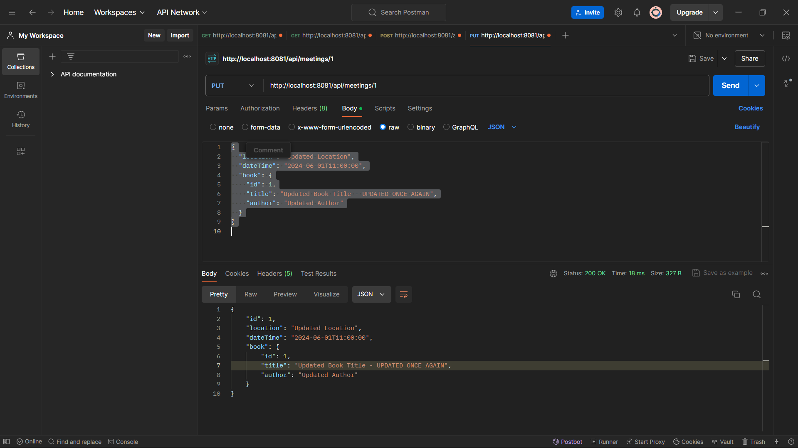
screenshot

Slide 17
DELETE A MEETING
ENDPOINT :
http://localhost:8081/api/meetings/1
Json payload:
{
200 ok
}

Slide 18
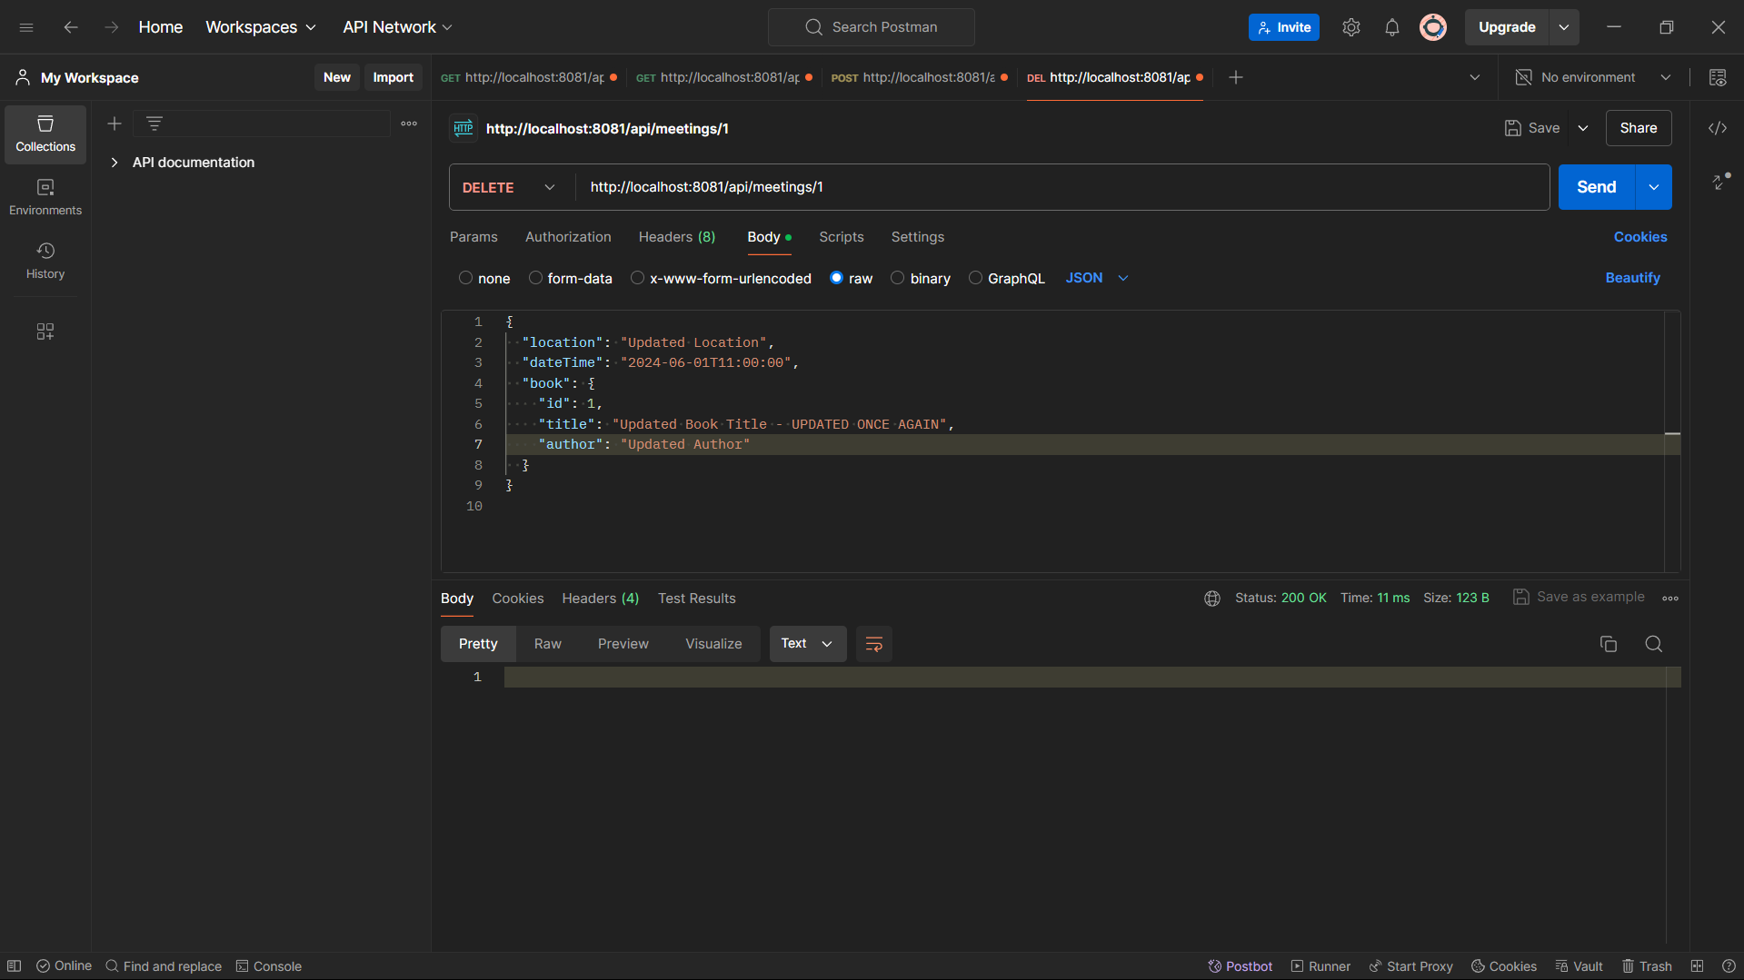
screenshot

Slide 19
Thanks for your attention !

