Slide 1
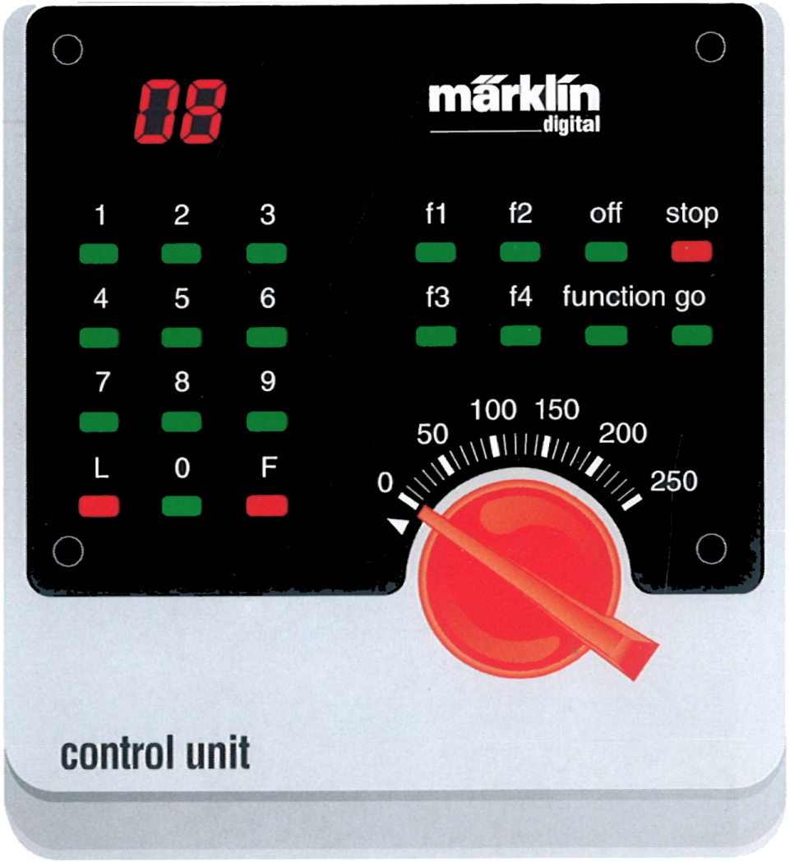

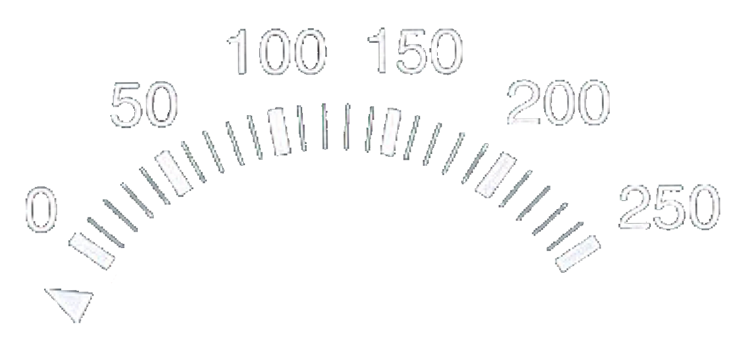
control unit

Slide 2
keyboard

Slide 3
memory

