Slide 1


Online Parking Calculator
    It is aimed toward both people and airports for fast access to the airport
    Improve the convenience of the airport travellers by estimating parking costs
    The customer can check several parking tariffs according to his period of stay
    An integrated program in the website of Gerald R. Ford International Airport
    and could be connected with any ticket system or other billing system

Slide 2
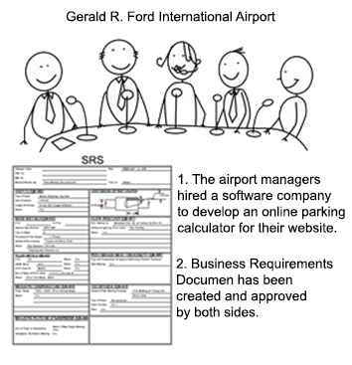
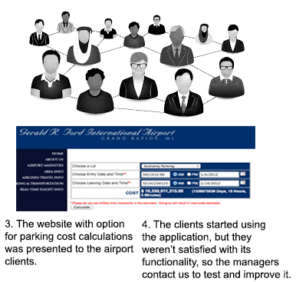
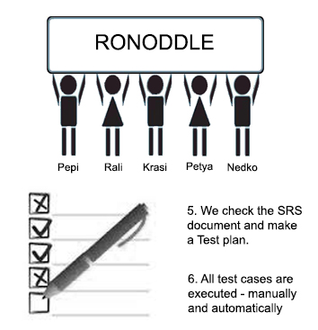
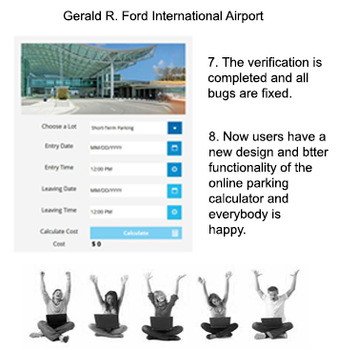
Software Development Lifecycle

