Slide 1
SUPERVISED LEARNING FOR GENRE CLASSIFICATION OF AUDIO TRACKS
Author: Angel Bergantiños Yeste
Director: Dr. Sergio Escalera Guerrero

Slide 2
Context and motivation

Slide 3
History

Slide 4
State of the art

Slide 5
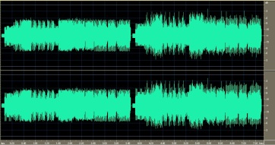
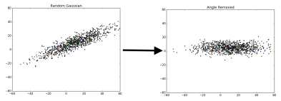
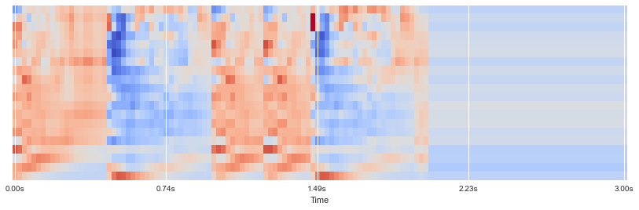
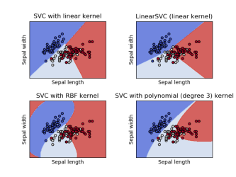

Method Whole overview
RAW SONG
MFCC
PCA
LEARNING
GENRE

Slide 6
Method: MFCC

Slide 7
Method: PCA and Feature representation

Slide 8
Method: PCA and Feature representation

Slide 9
Method: learning schemes

Slide 10
Results: Data

Slide 11
Results: Evaluation protocol and method parameters.

Slide 12
Results: Discussion

Slide 13
Results: Discussion

Slide 14
Results: Discussion

Slide 15
Conclussion and future work

Slide 16
Thanks for your attention!

