Slide 1
Github – Agile Central Integration Demo Hands-on
Kristy Corkan
Agile Central Technical Services
October 17, 2017

Slide 2
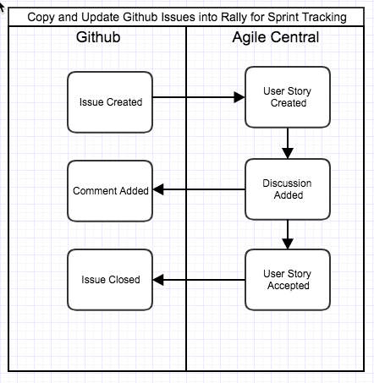
Github to Rally Integration
Our team plans and tracks work in Rally and our customers create issues against our repositories.
We would like to automatically create User Stories in Rally when an issue is submitted in Github so that we can plan the work into our iterations.
We would like to automatically update issues as the User Story is completed in Rally so that the customer can follow the progress of the Issue in Github.

Slide 3
Prerequisites: System Setup Github – Agile Central Integration Demo
Select a Rally Project to demo with (must be one that you can create test data in and have editor privileges to). Get the project reference from the project’s details page (e.g /project/12345)
Create an API Key in Rally with permissions to edit in the selected Rally Test Project (goto https://rally1.rallydev.com/login to create an API key) for authentication
Select a Github Repo to demo with that they have access to
Create your encoded username:password string to use for Basic authentication:
> echo –n username:secretpassword | base64
Note the key parts of the base address of your repo: https://github.com/organizationOrUser/repositoryName

Slide 4
Approaches
Webhook triggers are ideal for this scenario, since they are supported by both Github and Agile Central, though they may not be feasible for some customers running LAC on premise behind a firewall.
We will use the Timer feature to monitor changes in each system.

Slide 5
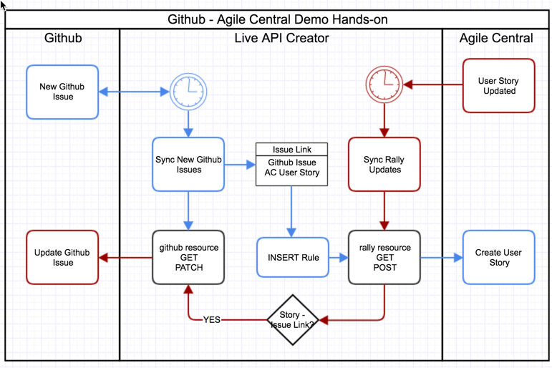
LAC Components and Flow “Stickies”

Slide 6
Build Steps
Enable moment.js in Libraries
Create Link Table with fields
ac_id (string),
github_id (string),
github_data (text)
Create & Test General Resources
Github GET/PATCH (Reference: https://developer.github.com/v3/issues/)
Rally GET/POST (Reference: https://rally1.rallydev.com/slm/doc/webservice/)

Slide 7
Build Steps (cont)
Create linkedObject Table resource
Create Request Event for linked Object
Create Github Sync “Controller”
Create INSERT Rule
Create Rally Sync ”Controller”
Create the timers

Slide 8
Challenges to consider
Logging and troubleshooting: how will a customer know/troubleshoot when a sync throws an exception?
Paging of data
Configuration: how to make the the demo/implementation easily configurable to change systems, update tokens and extend?
More complex value syncing, deletions
Each system in an integration flow must support all synced object types and relationship between those types.

