Slide 1
Two-Stage Instance Segmentation of Post-Harvest Surface Defects in Apple and Tomato Using YOLO26
Ralph Kevin G. Morales
Alexander Jann P. Espia
Deangelo James P. Largueza
Niel Francis M. Arligue
Adviser: Dr. Lysa V. Comia
AI2 AM3 | Mapúa University

Slide 2
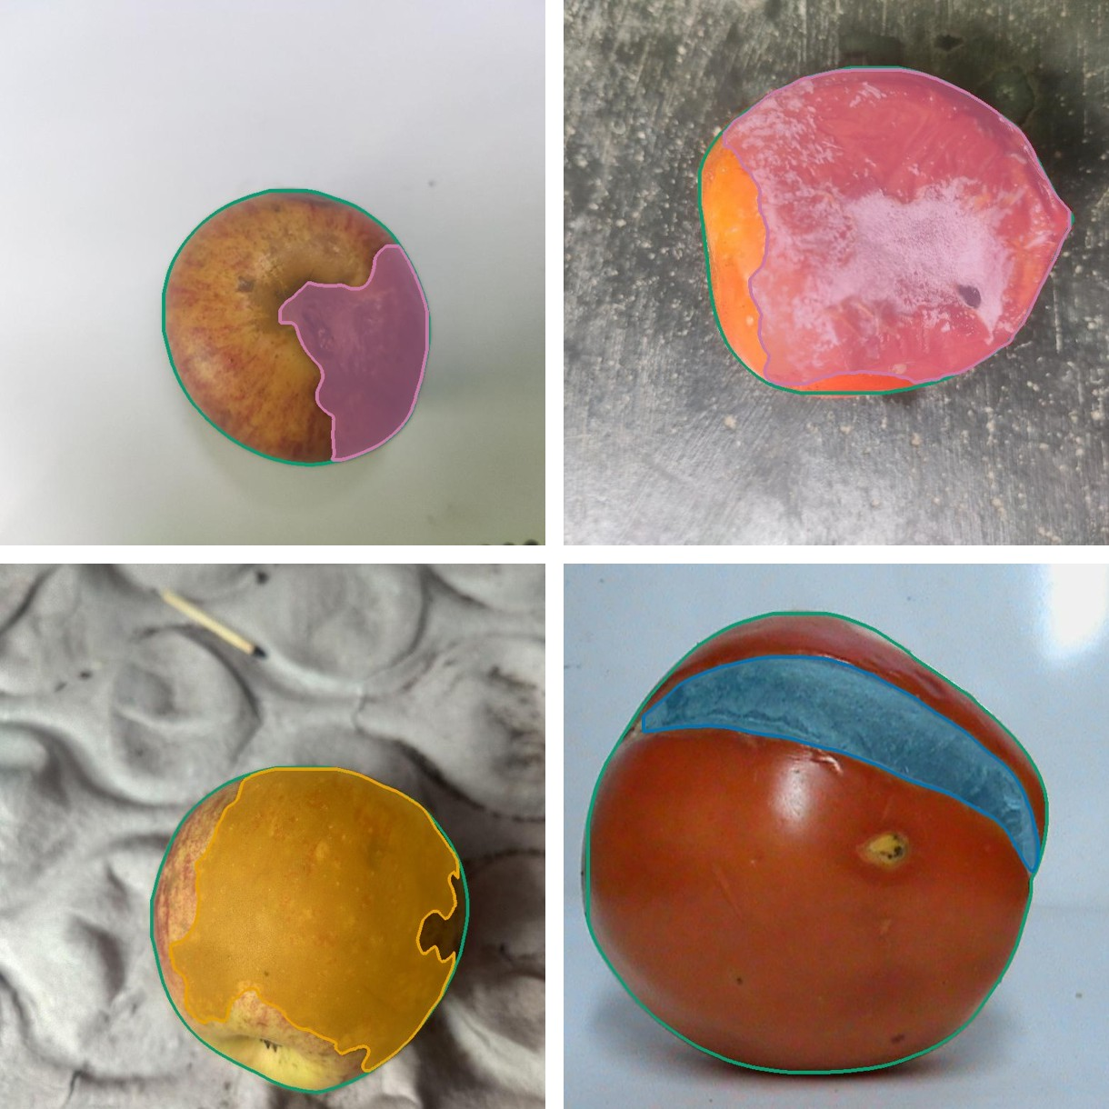
Background and Problem
Visible defects like bruises, rot and cuts decide the grade of fresh fruit
Manual inspection is slow and inconsistent
Public datasets such as AFruitDB give one grade per photo
A grade does not show where the defect is or how big it is
Instance segmentation outlines each defect so its size can be measured

Slide 3
Objectives
Develop a two-stage YOLO26 model that segments visible surface defects on apple and tomato
  Build team-reviewed pixel masks for three defect classes
  Train Stage 1 on the whole fruit, then Stage 2 on the defects
  Evaluate once on an untouched test set
  Compare separate per-fruit models with one combined model
  Deploy a web app that marks defects and reports the damaged share

Slide 4
Related Studies
Study | Target | Model | Fruit first | Reported score
Leiva et al. 2026 | Apple scab | YOLO11-seg | Yes | Lesion mAP50 0.75
Tan et al. 2025 | Blueberry bruise | YOLOv8 + YOLO11 | Yes | Bruise mAP50 0.940
Agarla et al. 2023 | Apple defects | U-shaped CNN | No | Pixel F-score 0.794
Knott et al. 2025 | Banana defects | MaskFormer | No | PQ about 78%
This study | Apple and tomato | YOLO26l-seg | Yes | Test mAP50 0.613 / 0.393

Slide 5
Dataset
Source | Train files
AFruitDB apple | 986
Lab2Wild apple rot (Kaggle) | 843
Team apple photos | 281
AFruitDB tomato | 1,313
All pixel masks drawn and reviewed by the team in Roboflow
AFruitDB grades were not used as targets
Split by capture group so copies of a photo stay together
Test set frozen before training and used once

Slide 6
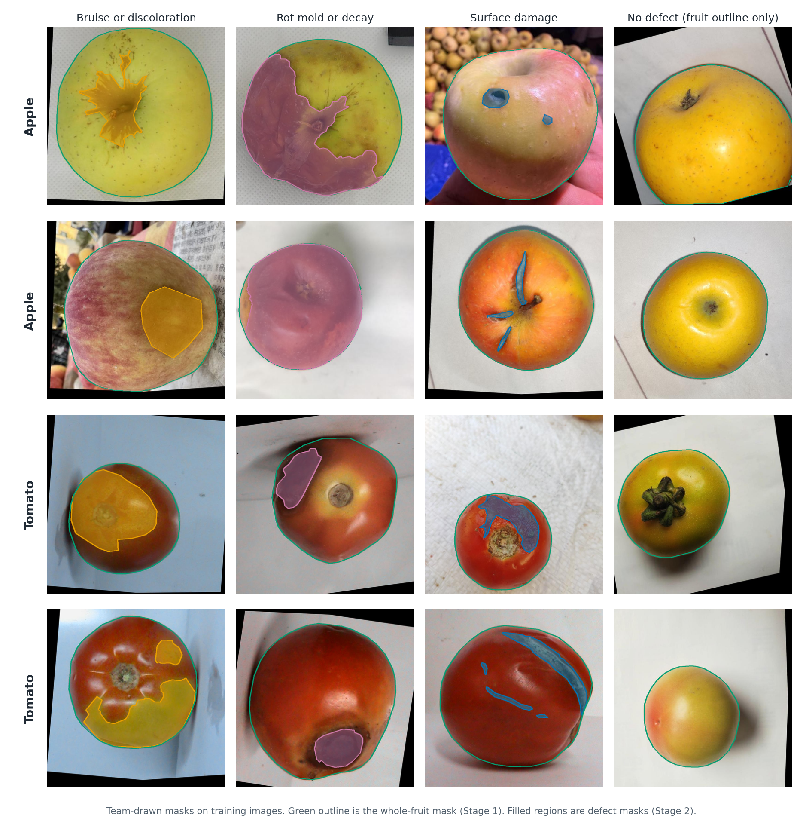
Defect Classes
Bruise or discoloration
  Smooth dark or discolored patch
Rot, mold or decay
  Soft collapsed or moldy tissue
Surface damage
  Cut, crack, scar or dry spot
Each class has more than 300 training images

Slide 7
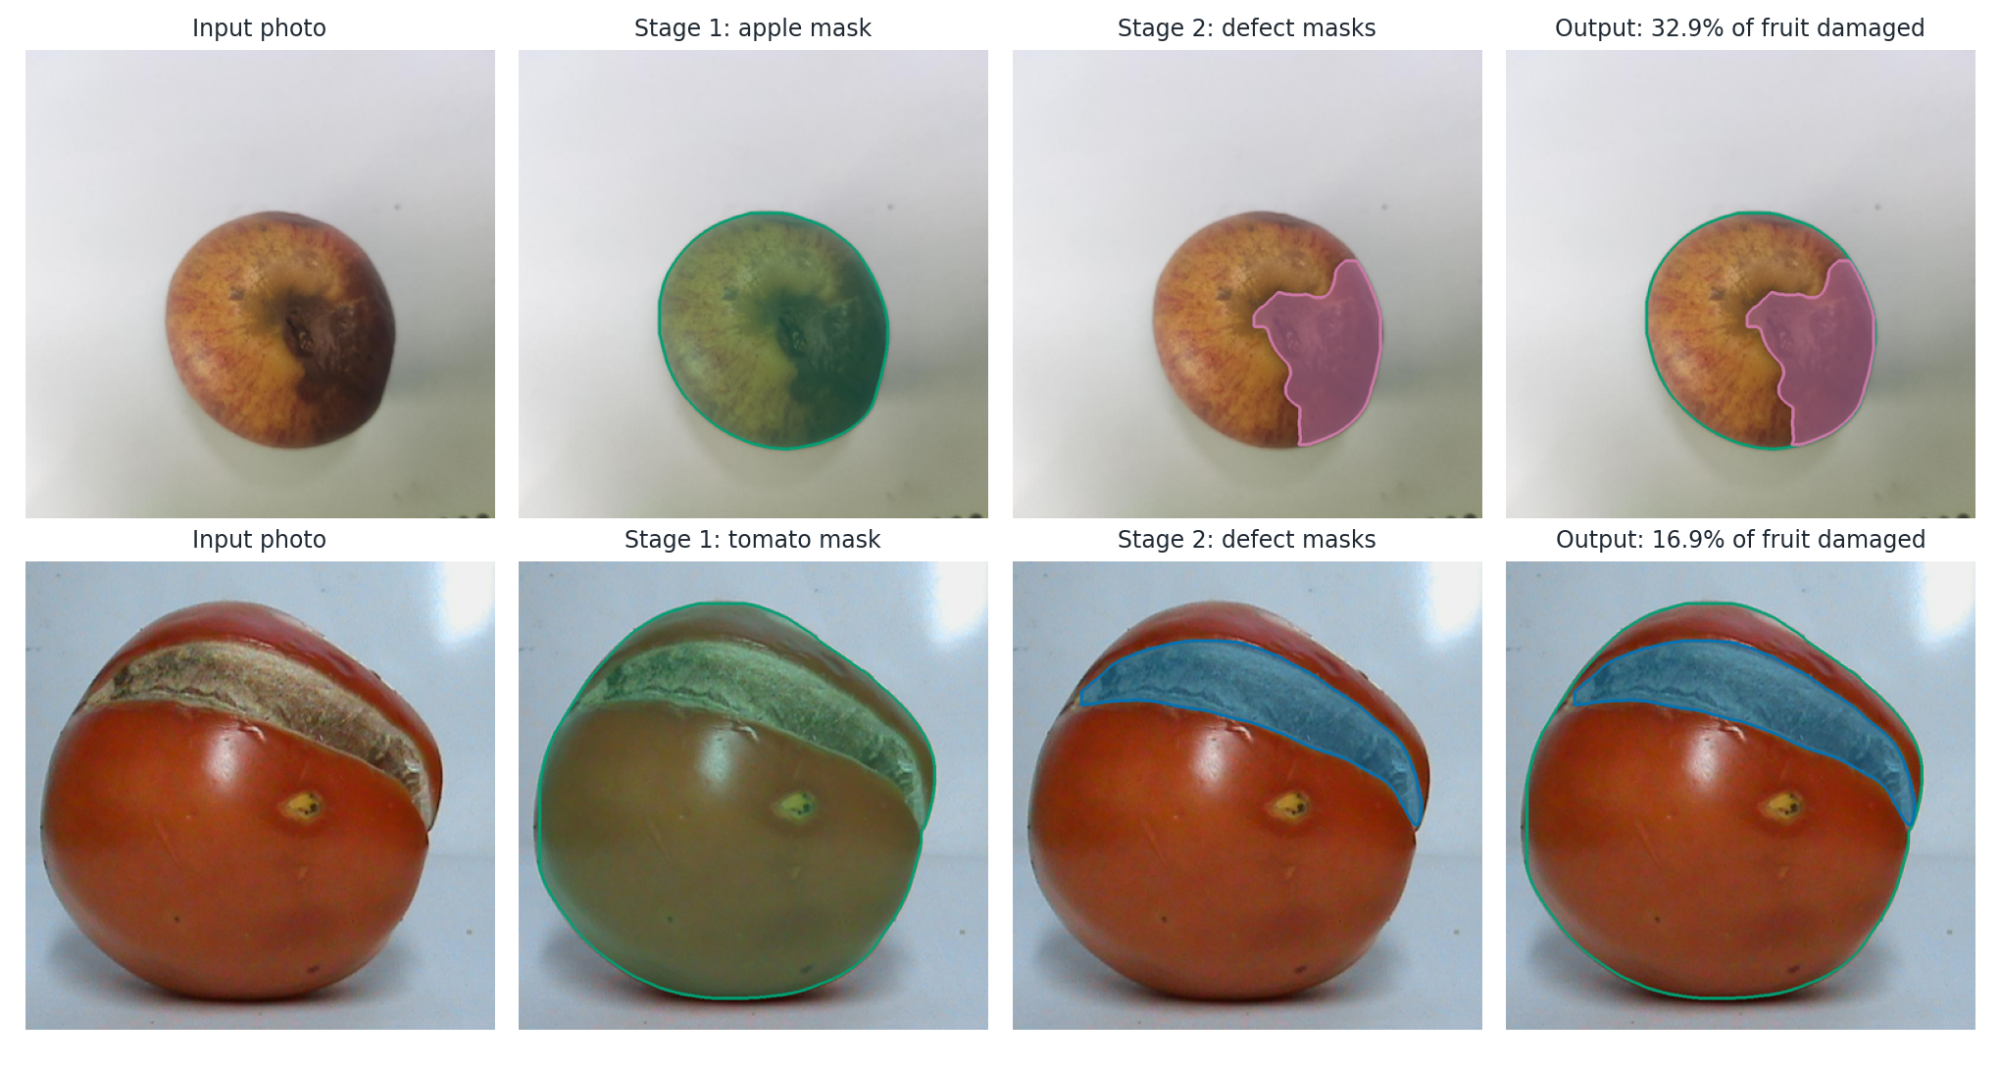
Two-Stage Method
Stage 1 segments the whole fruit. Stage 2 starts from the Stage 1 weights and segments the defects. Damaged share = defect pixels / fruit pixels.

Slide 8
Training Setup
Setting | Stage 1 | Stage 2
Start weights | yolo26l-seg | Stage 1 best
Classes | fruit | 3 defects
Optimizer / lr | SGD / 0.001 | AdamW / 0.0005
Epochs / patience | 100 / 10 | 300 / 30
Image size / batch | 864 / 56 | 864 / 56
Google Colab, NVIDIA A100
Ultralytics 8.4.126, seed 0
Flips, small rotation, scale and color augmentation
No Mosaic or MixUp so defect texture stays real
24 runs from first pilot to final model

Slide 9
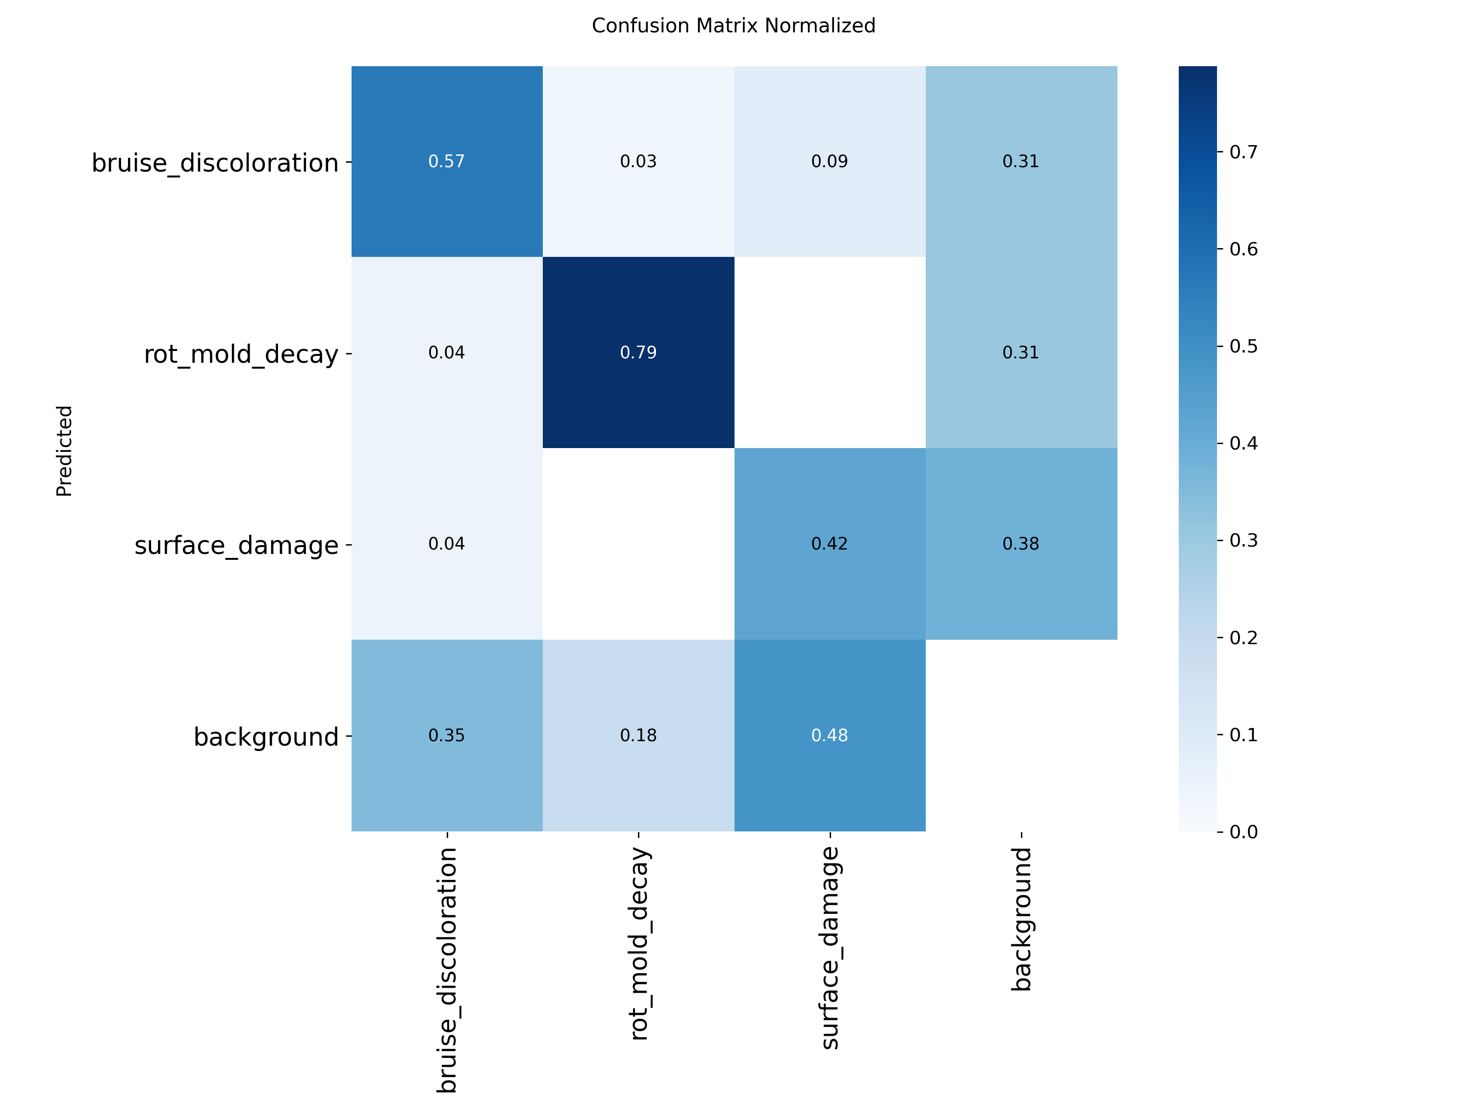
Results: Apple
Mask mAP50 | Validation | Test
Bruise | 0.777 | 0.594
Rot | 0.761 | 0.732
Surface damage | 0.527 | 0.511
All defects | 0.688 | 0.613
Precision | 0.809 | 0.718
Recall | 0.680 | 0.597
Stage 1 whole apple | 0.985 | -

Slide 10
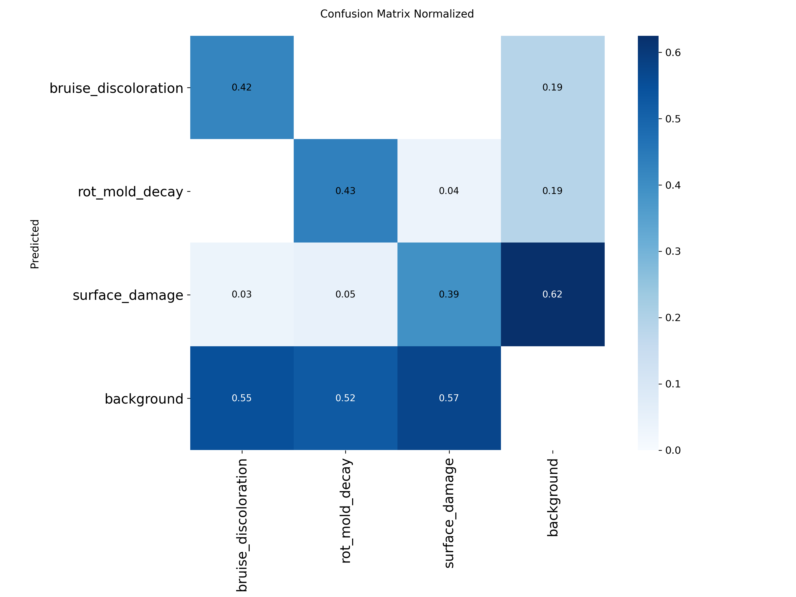
Results: Tomato
Mask mAP50 | Validation | Test
Bruise | 0.468 | 0.388
Rot | 0.533 | 0.477
Surface damage | 0.482 | 0.314
All defects | 0.494 | 0.393
Precision | 0.709 | 0.732
Recall | 0.473 | 0.375
Stage 1 whole tomato | 0.966 | -

Slide 11
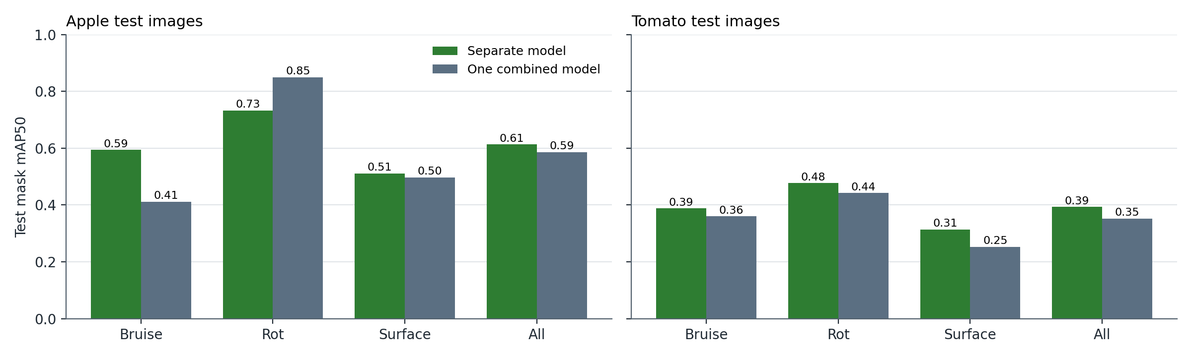
Separate vs Combined Model
Test mAP50 | Apple sep. | Apple comb. | Tomato sep. | Tomato comb.
Bruise | 0.594 | 0.411 | 0.388 | 0.360
Rot | 0.732 | 0.849 | 0.477 | 0.442
Surface | 0.511 | 0.497 | 0.314 | 0.253
All | 0.613 | 0.586 | 0.393 | 0.352

Slide 12
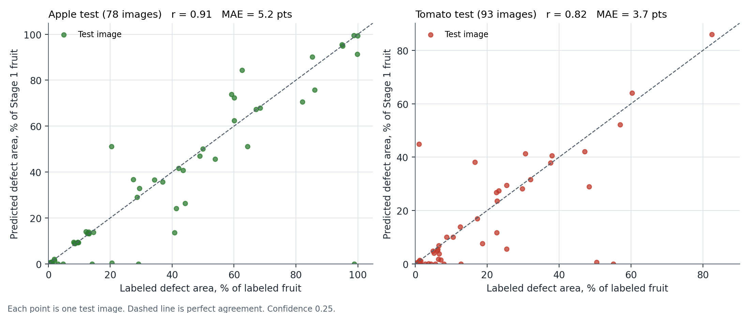
Damaged Share vs Team Labels
Correlation r = 0.91 on apple and 0.82 on tomato. Mean error 5.2 and 3.7 percentage points.

Slide 13
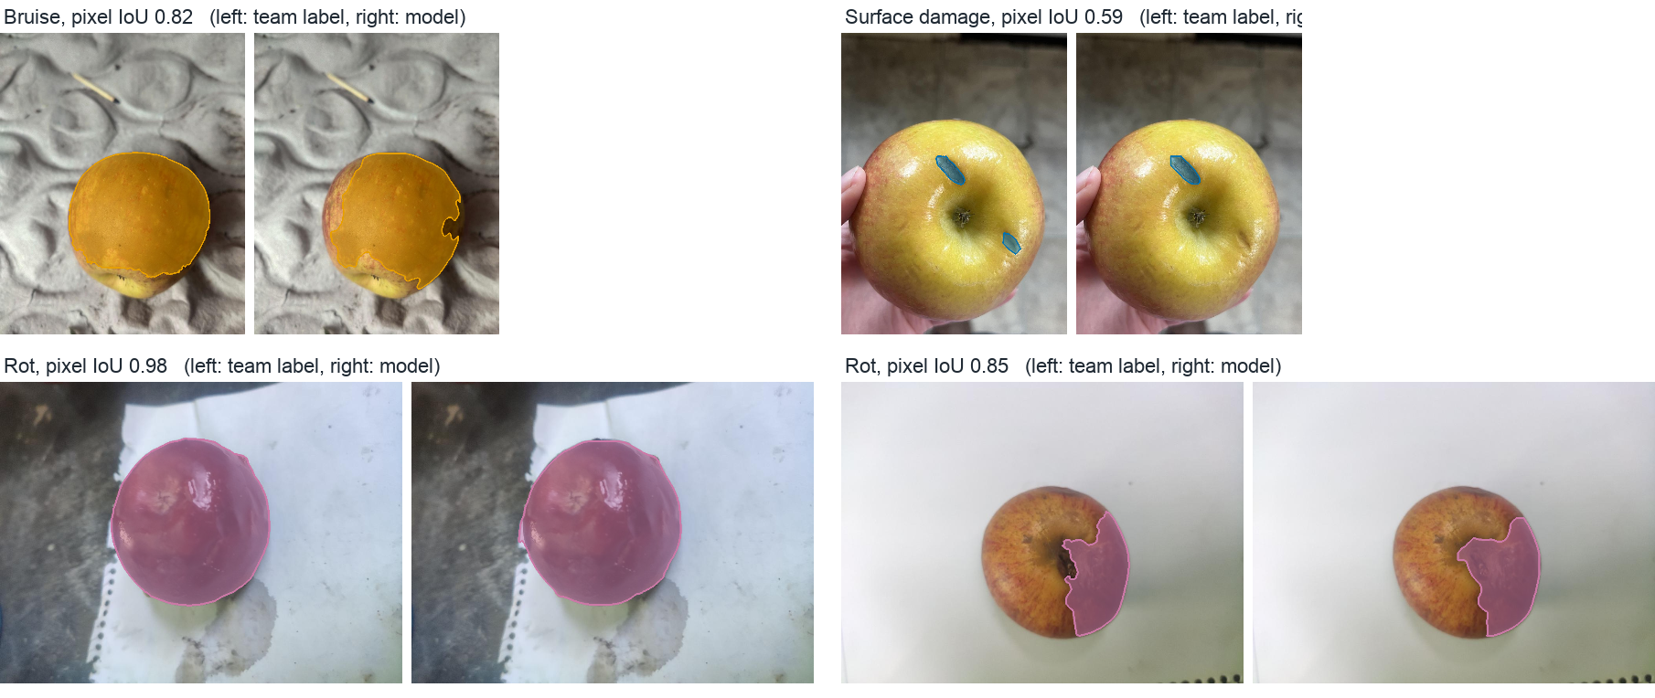
Predictions on Unseen Test Images

Slide 14
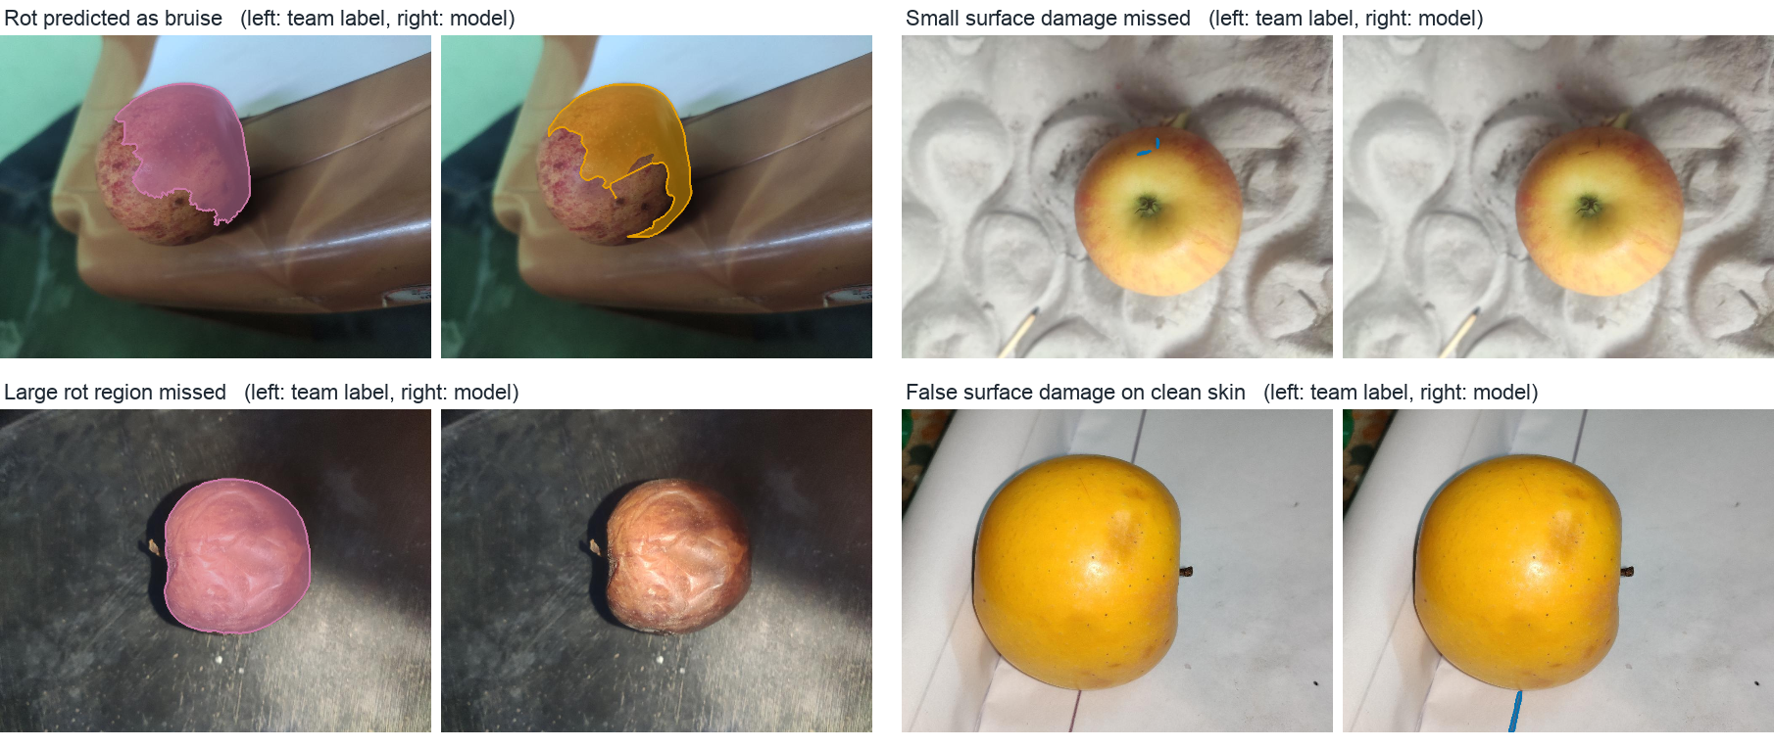
Failure Cases

Slide 15
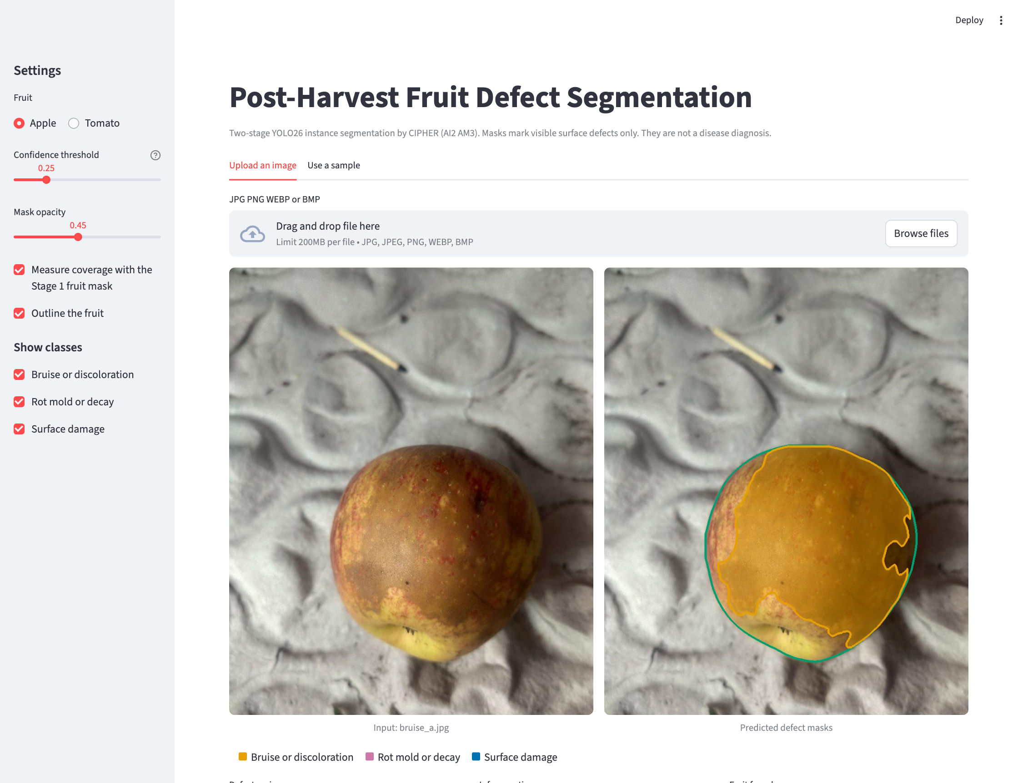
Web Application
Streamlit app
Choose apple, tomato or the combined model
Upload a photo or use a sample
Shows defect masks and damaged share
Live demo

Slide 16
Conclusion and Recommendations
Stage 1 segments the whole fruit almost perfectly (0.985 apple, 0.966 tomato)
Apple defects reach 0.613 test mAP50, tomato 0.393
Rot is the most stable class, surface damage the hardest
One combined model is close to two separate models
Damaged share closely follows the team labels
Collect more small-defect and tomato images
Run a single-stage baseline with identical settings
Test on new sources and lighting
Measure agreement between annotators

Slide 17
References
Mojumdar et al., AFruitDB, Data in Brief, 2025
Leiva et al., Apple scab with YOLO11, Plant Methods, 2026
Tan et al., Blueberry internal bruising, Front. Plant Sci., 2025
Agarla et al., Apple defect segmentation, Sensors, 2023
Knott et al., Panoptic segmentation for produce grading, CVPRW, 2025
Nesteruk, Apple rotting segmentation in the wild, Kaggle
Ultralytics, YOLO26 documentation, 2026

Slide 18
Thank You
Questions and live demo

