Slide 1
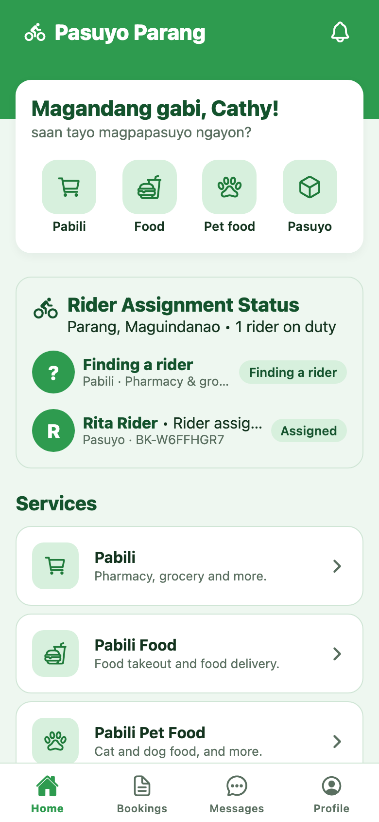

Pasuyo Parang
User Manual
Customer app · Rider app · Admin console
November 2026
Notes:
A guide for the three people who use Pasuyo Parang: customers who book, riders who deliver, and admins who run the service.

Slide 2







Three apps, one booking
Everyone uses the same web app. Each role signs in at its own page.
Customer
Rider
Admin
Book a Pabili or Pasuyo, track the rider on a map, and pay cash on delivery.
Go online, accept jobs near you, and move each job from pickup to delivered.
Watch bookings, assign riders, and manage riders, stores and fares.
Sign in at /login
Sign in at /rider/login
Sign in at /admin/login
The four services
Pabili
Pharmacy, grocery and more
Pabili Food
Food takeout and delivery
Pabili Pet Food
Cat and dog food, and more
Pasuyo
Pick up and drop off an item

Slide 3

How a booking moves
Every booking follows the same five steps. Customers, riders and admins all see the same status.
1
2
3
4
5
Finding a rider
Rider assigned
Heading to pickup
On the way
Delivered
The customer confirms the booking.
A rider accepts it, or an admin assigns one.
The rider is going to the store or pickup point.
Picked up. The rider is heading to the drop-off.
Handed over and paid in cash.
Customer
Rider or admin
Rider
Rider
Rider
Cancelled. A customer can cancel until the rider heads to pickup. An admin can cancel at any stage and must give a reason.

Slide 4
Customer app
For people booking a delivery. Works in the phone browser and can be added to the home screen.

Slide 5
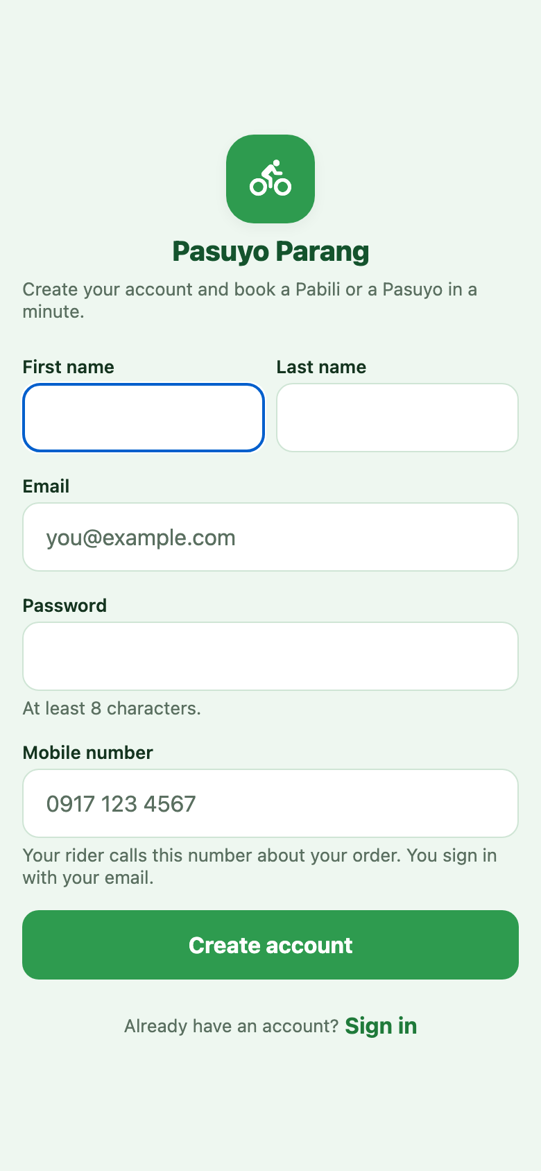
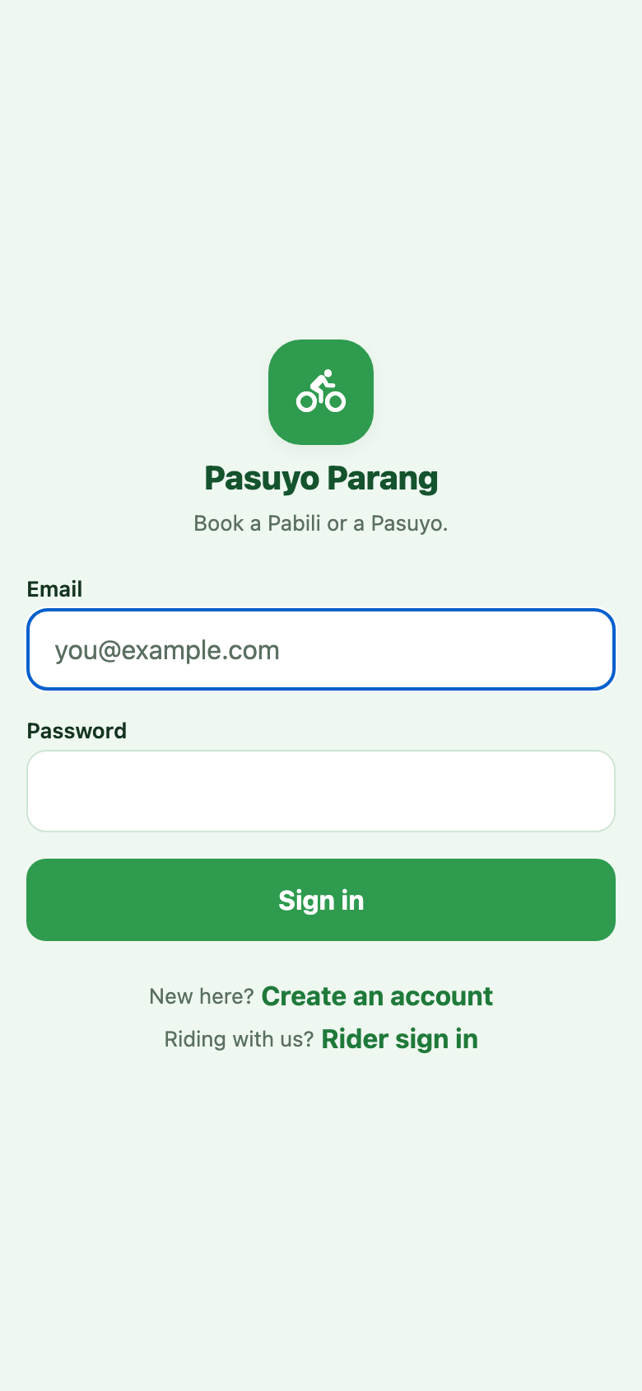
Create an account and sign in
New customers register once. After that, sign in with email and password.
1
Open the sign-up page
On the sign-in page, tap Create an account.
2
Enter your details
First and last name, email, a password of at least 8 characters, and your mobile number.
3
Tap Create account
You go straight to the Home screen. Your rider calls the mobile number you gave.
4
Sign in next time
Enter your email and password, then tap Sign in.
Tip On a phone, use the browser menu and tap Add to Home Screen to open the app like any other app.

Slide 6
The Home screen
Everything starts here: book a service, check your rider, and move between tabs.
1
Service tiles
Tap Pabili, Food, Pet food or Pasuyo in the greeting card to start a booking.
2
Rider Assignment Status
Your open bookings and their rider at a glance: finding a rider, assigned or on the way.
3
Services list
The same four services with a short description of each. Tap one to book.
4
Bottom tabs
Home, Bookings, Messages and Profile. The bell at the top opens your booking updates.

Slide 7
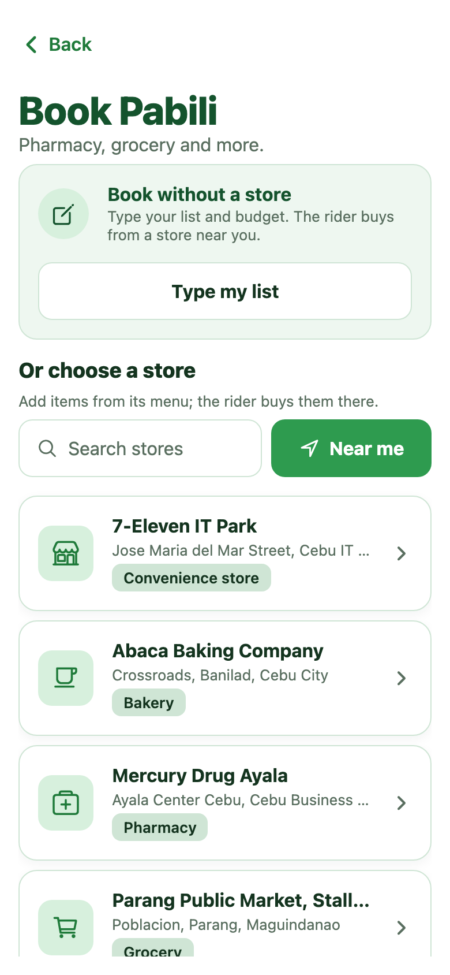
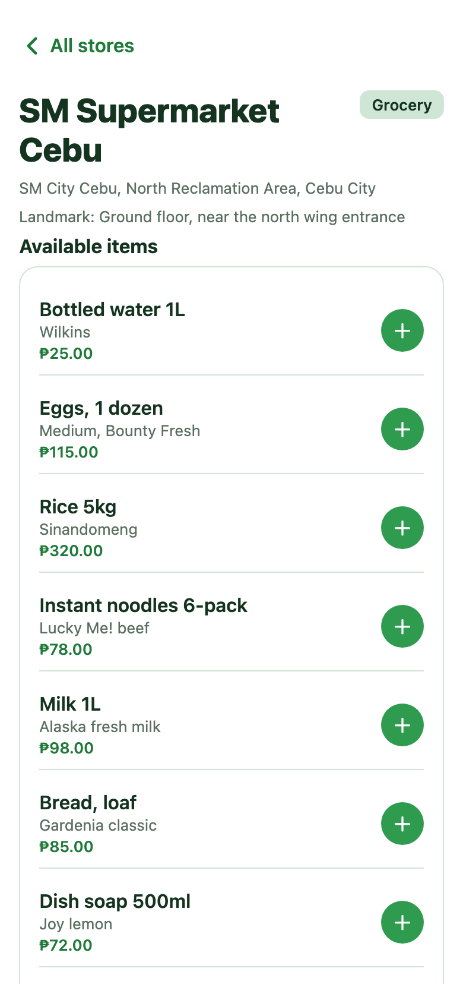
Book a Pabili from a store
Pabili means the rider buys for you. Pick a store and add items from its menu.
1
Choose Pabili, Food or Pet food
The store list shows stores for that service. Search by name or tap Near me.
2
Open a store
You see its available items with prices. Sold-out items are hidden.
3
Add items
Tap + on each item. A cart bar appears at the bottom; tap it to continue.
4
Finish the booking
Set the drop-off, check the purchase budget, then tap Review fare and Confirm booking.
Tip No store in the list? Tap Type my list and write what to buy. The rider buys it near you.

Slide 8
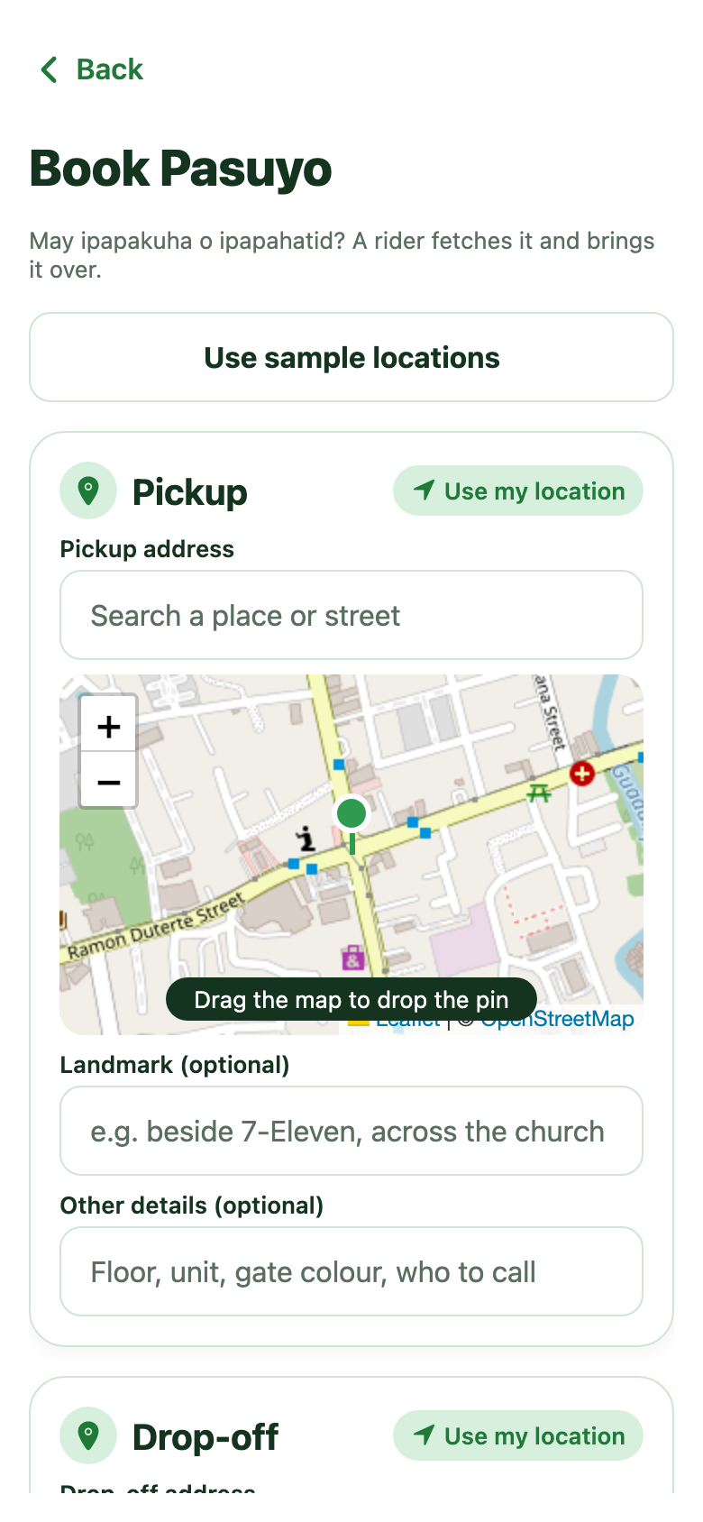
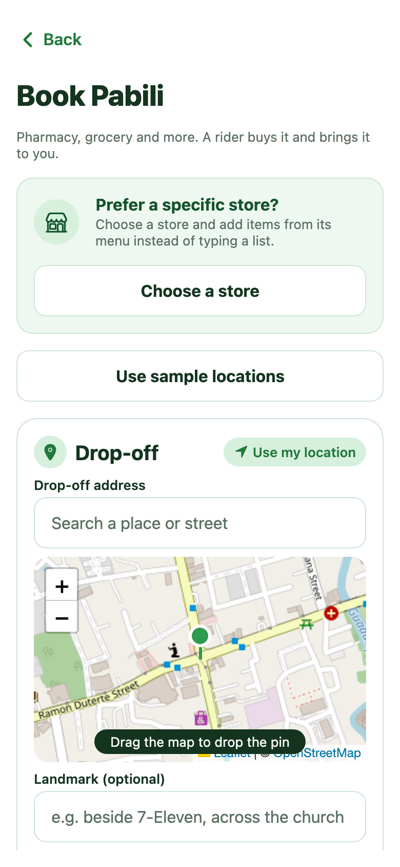
Book a Pasuyo or a typed list
Set the places on the map, add the details, and check the fare before you confirm.
1
Set the pickup
Search a place, tap Use my location, or drag the pin. Add a landmark to help the rider.
2
Set the drop-off
Same as pickup. Use Other details for floor, unit, gate colour or who to call.
3
Add the details
Pasuyo: what is being sent and the recipient. Pabili: your shopping list and purchase budget.
4
Review fare, then confirm
Tap Review fare to see the breakdown, then Confirm booking.
Good to know You pay the fare in cash to the rider on delivery. For Pabili, you also repay the items in cash.

Slide 9
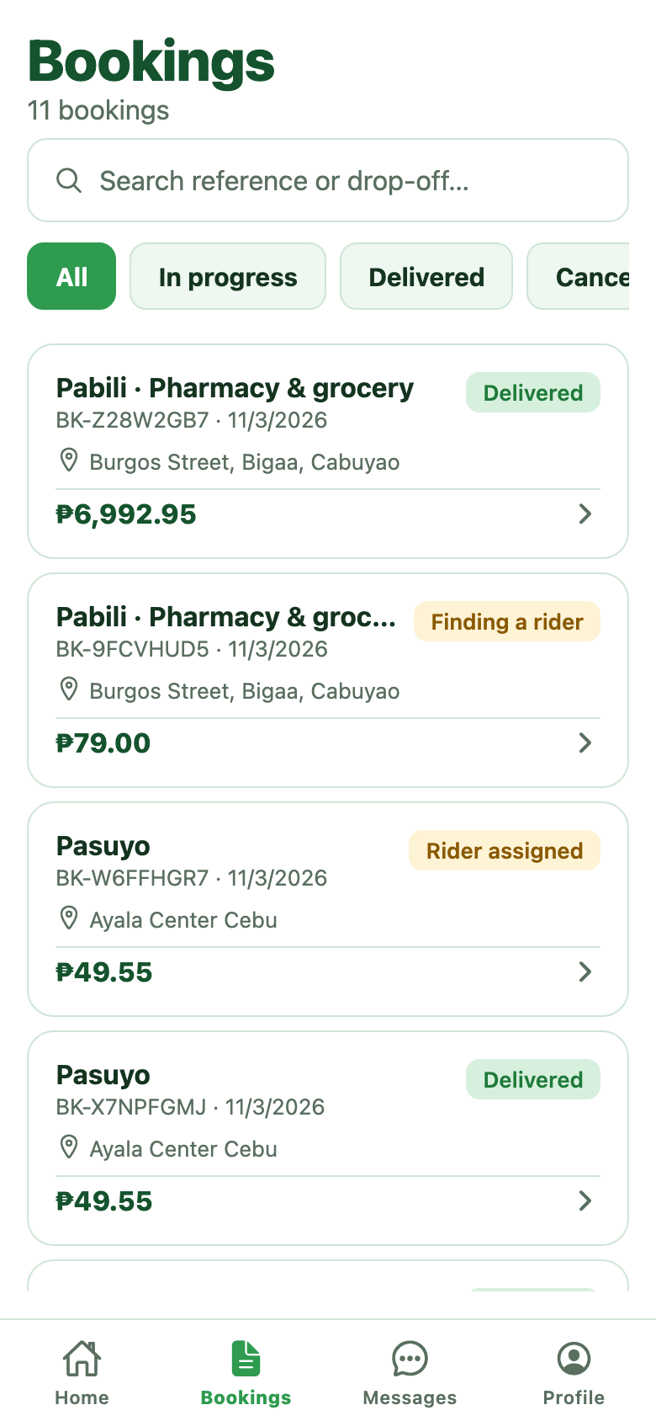
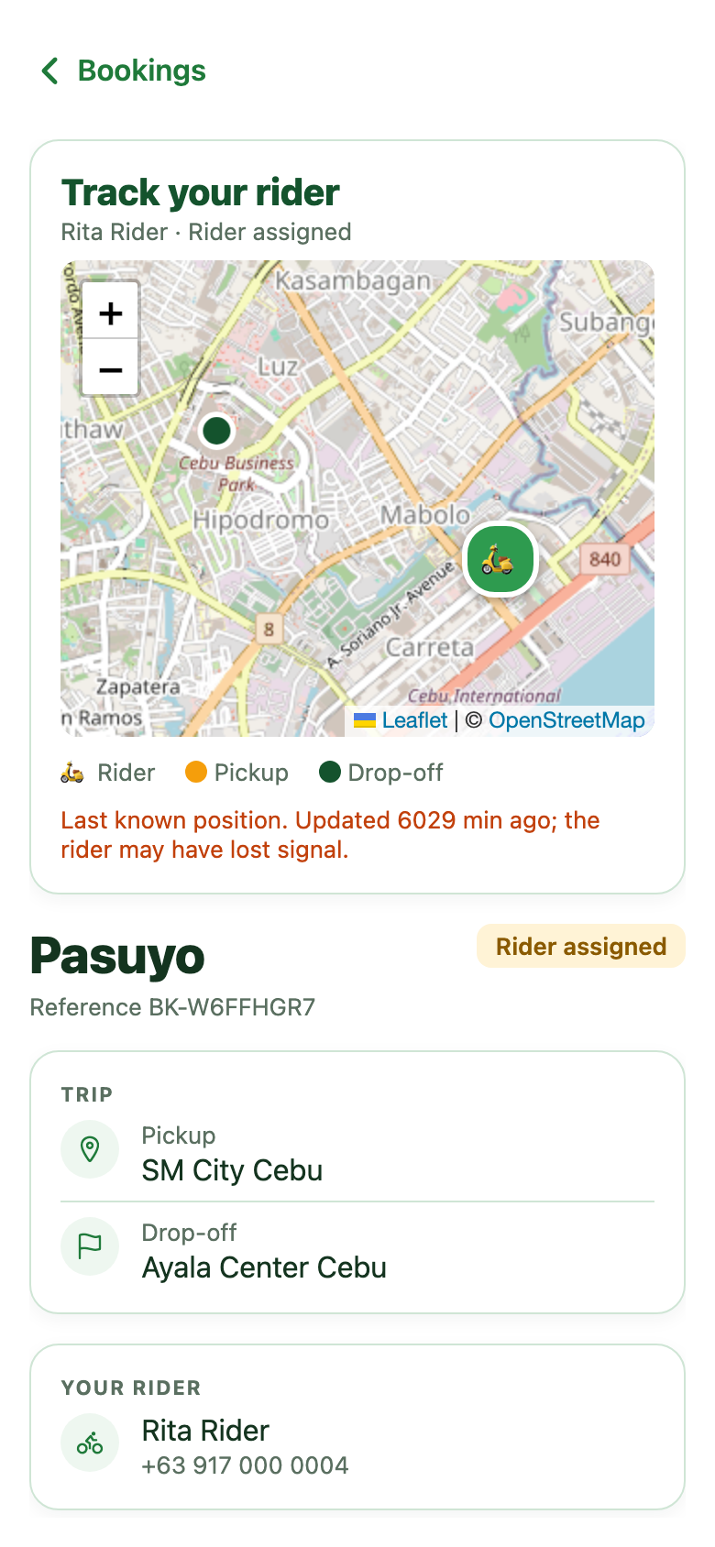
Track your bookings
Follow the rider live and see every booking you have made.
1
Open the Bookings tab
Filter by All, In progress, Delivered or Cancelled, or search by reference or drop-off.
2
Open a booking
Track your rider shows the rider, pickup and drop-off on a live map.
3
Call your rider
The rider’s name and mobile number appear under Your rider once one is assigned.
4
Cancel if you must
Cancel booking is shown until the rider heads to pickup.

Slide 10
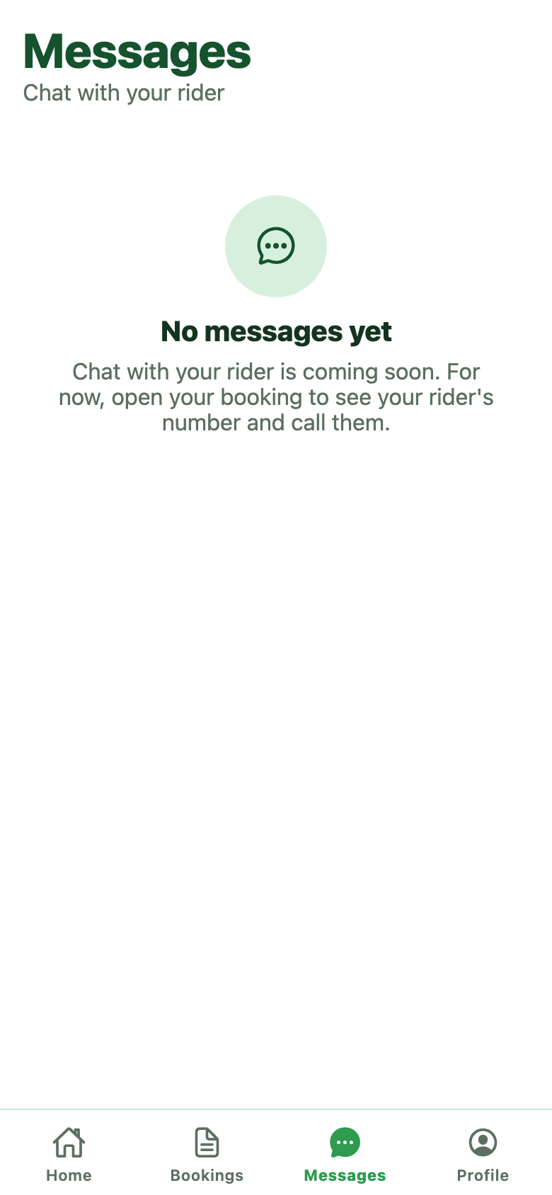
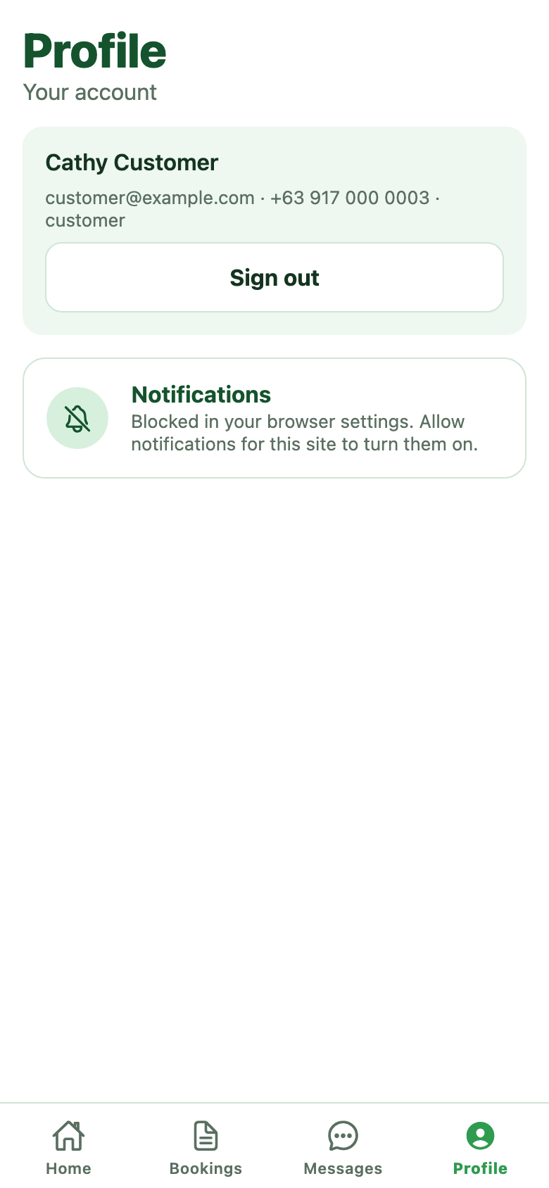
Messages and Profile
Chat is on the way. Profile holds your account, notifications and sign out.
1
Messages
Chat with your rider is coming soon. For now, call the number on the booking.
2
Your account
Profile shows your name, email and mobile number.
3
Notifications
Tap Turn on notifications to get booking updates even when the app is closed.
4
Sign out
Tap Sign out on the Profile tab.
Tip If notifications say Blocked, allow notifications for this site in your browser settings.

Slide 11
Rider app
For riders taking Pabili and Pasuyo jobs. Keep the app open while you work.

Slide 12
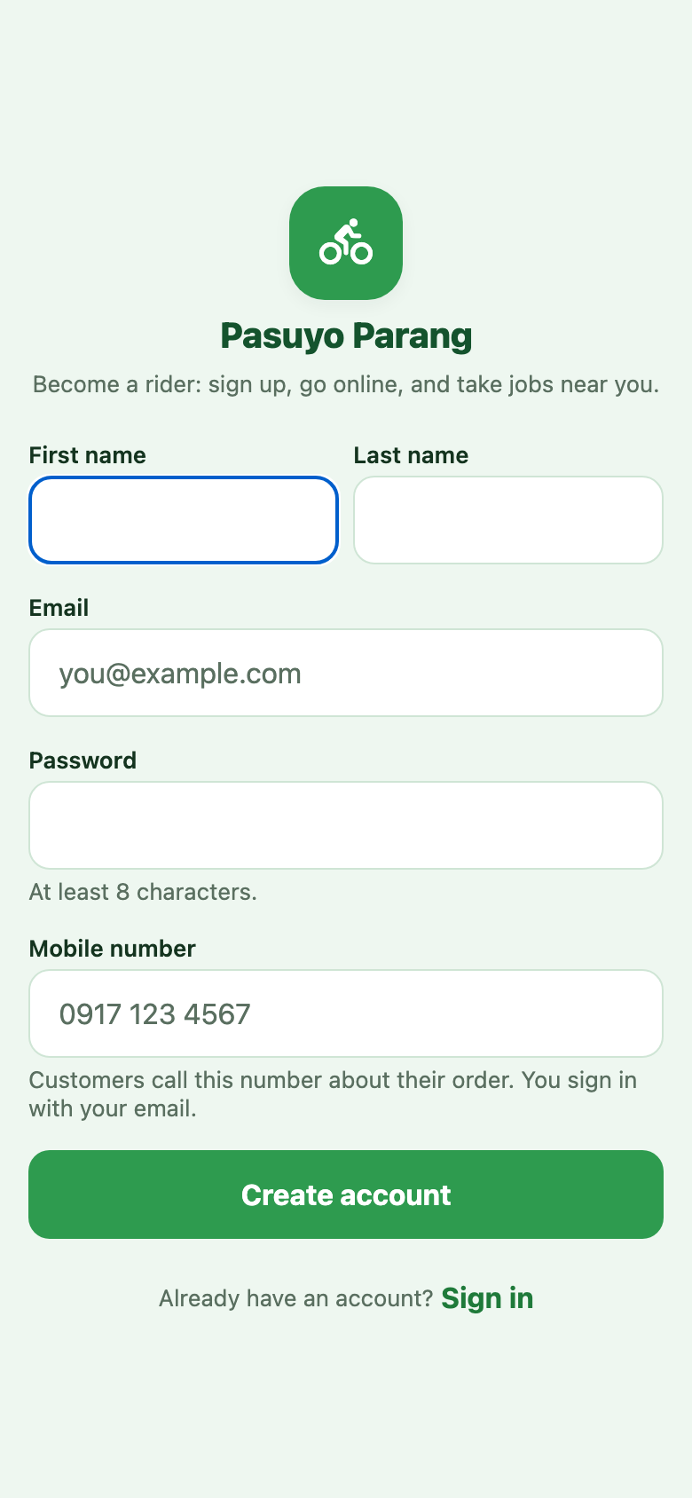
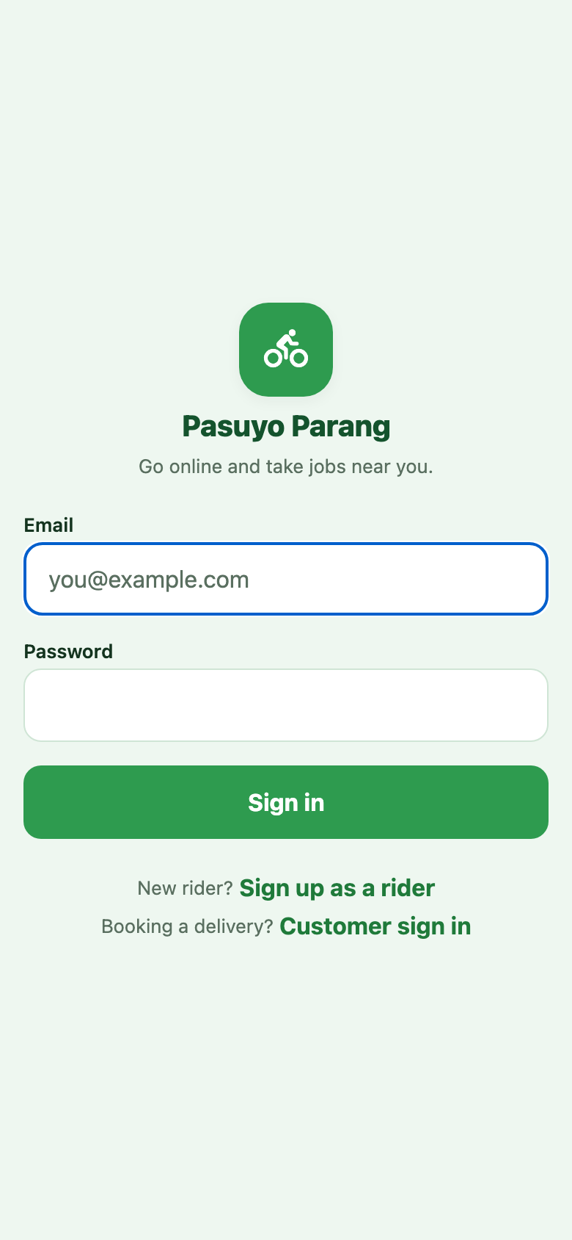
Sign up and sign in
Riders have their own sign-in page at /rider/login.
1
Sign up as a rider
On the rider sign-in page, tap Sign up as a rider.
2
Enter your details
Name, email, password and mobile number. Customers call this number about their order.
3
Or get an account from admin
An admin can create your account and give you your email and first password.
4
Sign in
Enter your email and password, then tap Sign in. You land on Jobs.

Slide 13
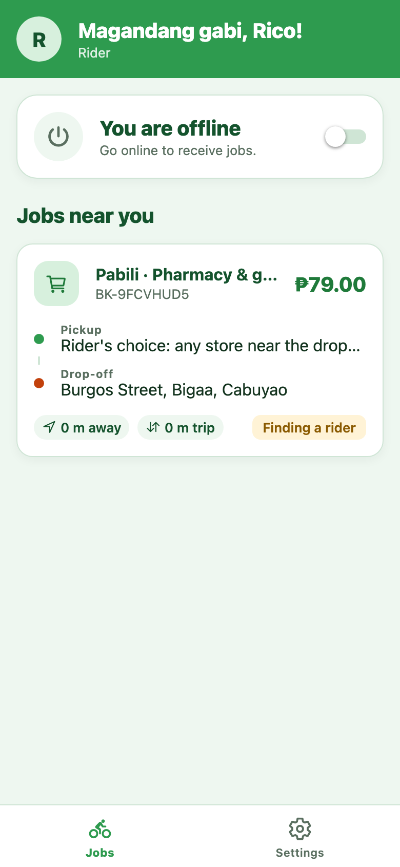
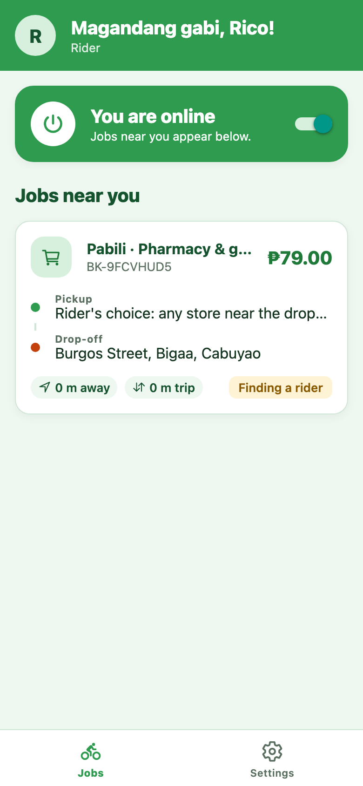
Go online and find jobs
The Jobs tab is your home: the online switch on top, open jobs below.
1
Flip the switch
You are offline turns into You are online, and the card turns green.
2
Keep the app open
You count as on duty only while the app is open and online.
3
Read the job card
Service, reference and fare on top; pickup and drop-off; distance away and trip length.
4
Refresh
The list refreshes on its own. Pull down to refresh it now.
Tip No jobs showing? Check that you are online, your location is shared, and you have no job in progress.

Slide 14
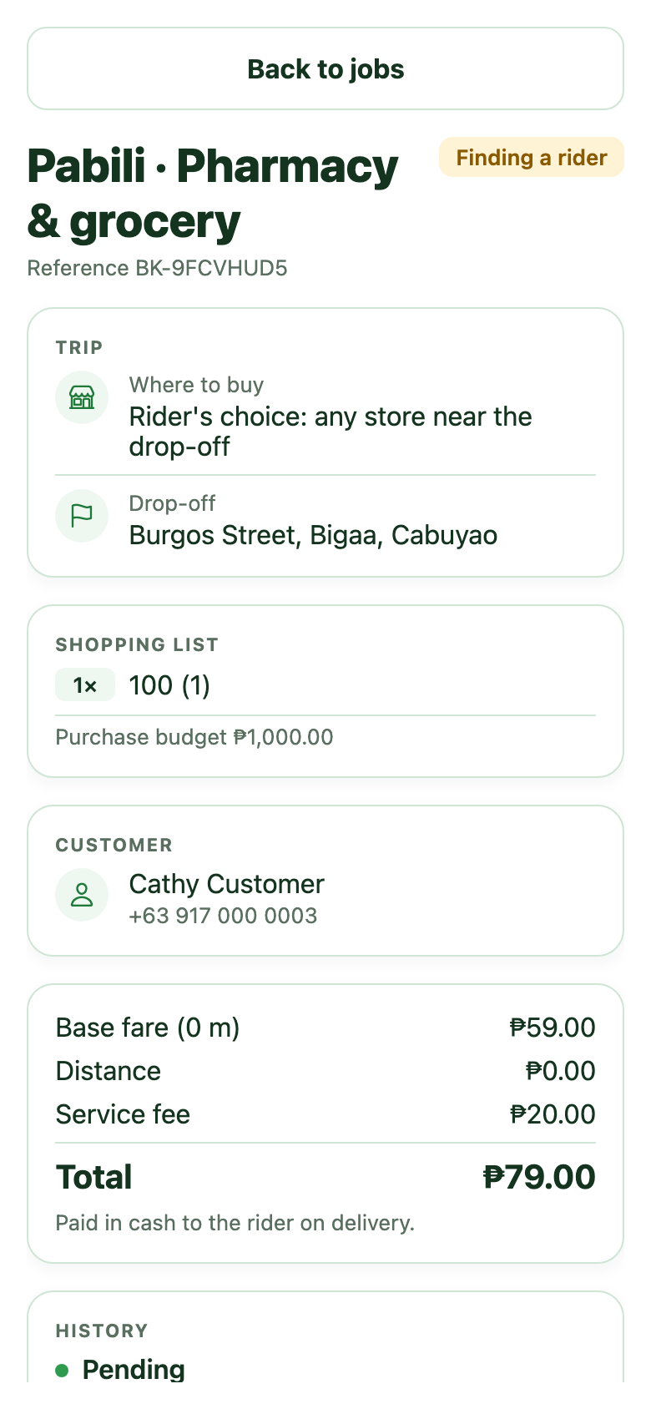
Take a job from start to finish
Tap a job card to see everything about it, then move it forward one step at a time.
1
Check the job
Trip, shopping list and purchase budget, customer name and number, and the fare.
2
Tap Accept job
The first rider to accept gets it. An admin can also assign a job to you directly.
3
Tap Heading to pickup
Then Picked up, on the way once you have the item.
4
Tap Delivered
Collect the fare in cash. For Pabili, also collect what you paid for the items.
Good to know While you have a job, your position is shared with the customer so they can track you.

Slide 15
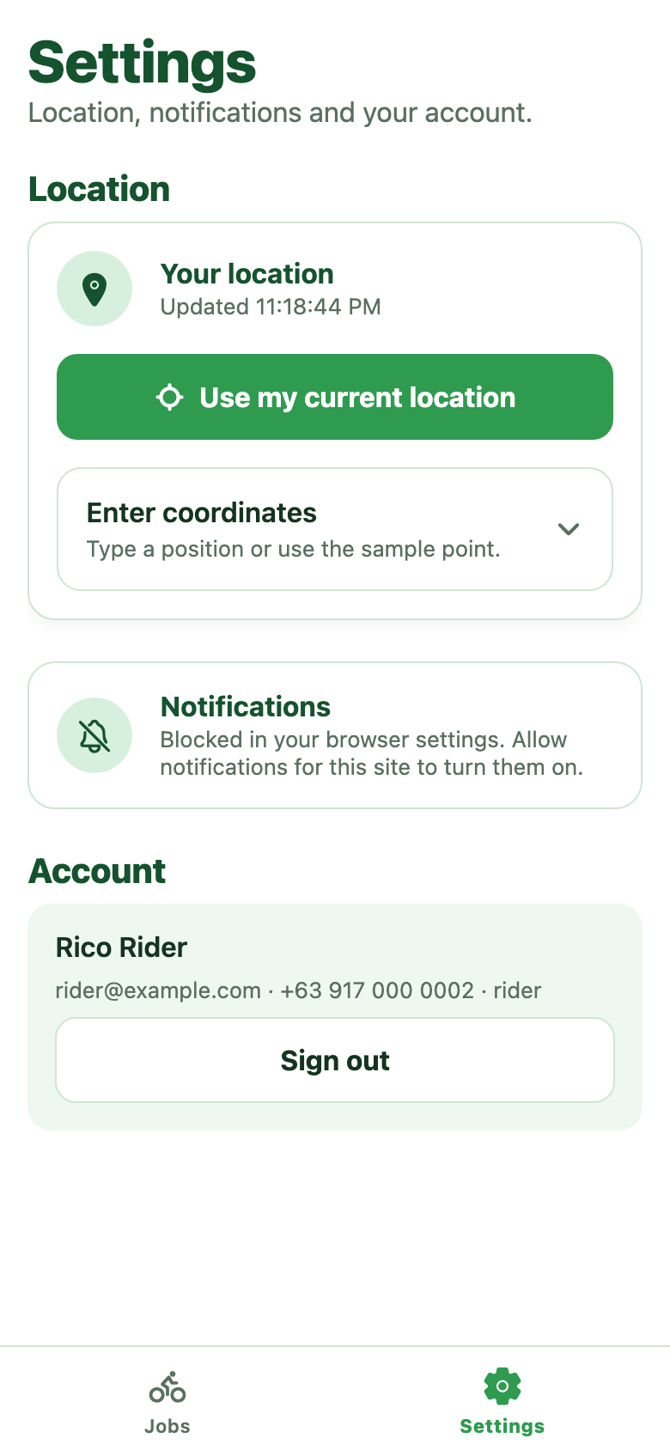
Settings
Your location, notifications and account, in one place.
1
Share your location
Tap Use my current location. Jobs are matched to where you are.
2
Enter coordinates
Open this only if your device location does not work, or for testing.
3
Turn on notifications
Get job updates on this device even when the app is closed.
4
Account and sign out
Your name, email and mobile, and the Sign out button.
Tip The wallet is switched off for now. You do not need a balance to accept jobs, and no commission is deducted.

Slide 16
Admin console
For staff running the service. Built for a desktop or laptop browser.

Slide 17
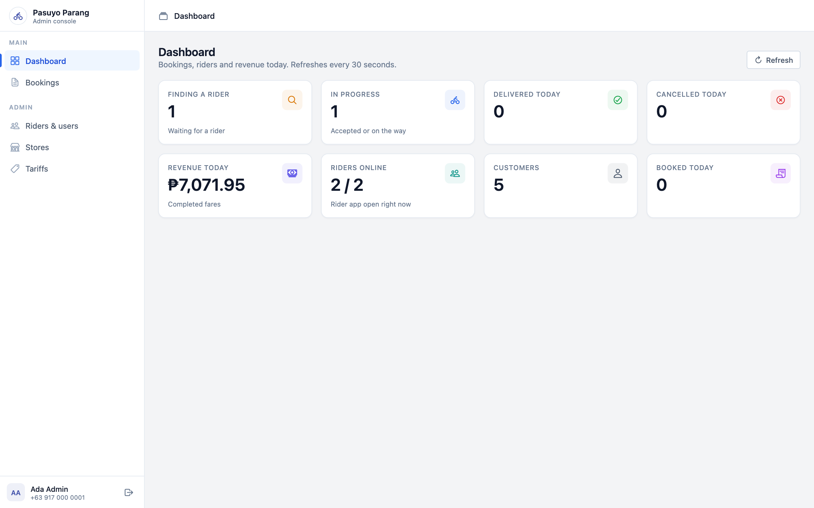



Sign in and the Dashboard
Sign in at /admin/login. The Dashboard is today’s picture and refreshes every 30 seconds.
Booking tiles
Finding a rider, In progress, Delivered today and Cancelled today.
Business tiles
Revenue today from completed fares, Customers, and Booked today.
Riders online
Riders with the app open right now, out of all riders.
Sidebar
Dashboard, Bookings, Riders & users, Stores and Tariffs. Sign out sits at the bottom.

Slide 18
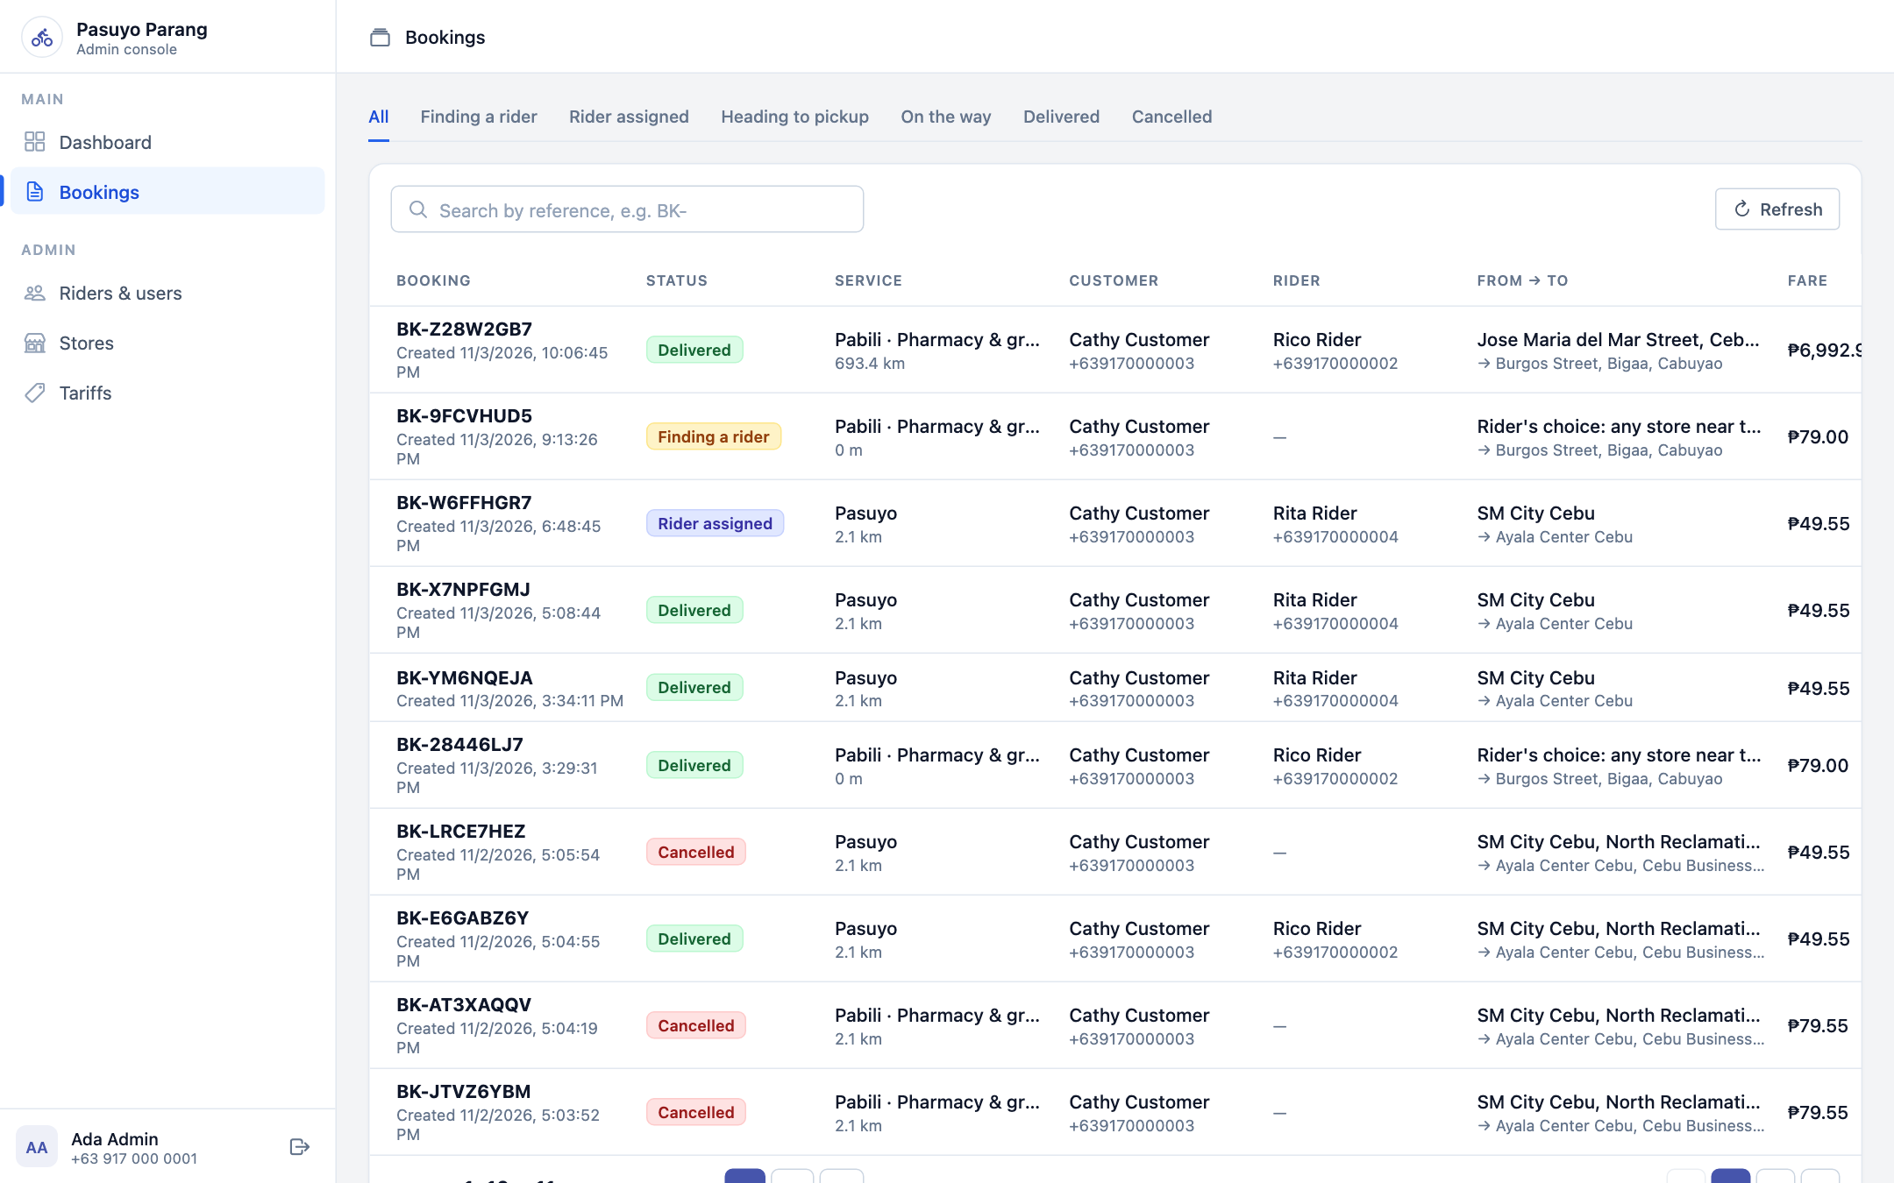




Bookings
Every booking in one table, newest first.
Filter by status
Tabs across the top: All, Finding a rider, Rider assigned, Heading to pickup and more.
Search
Type a booking reference, for example BK-, to find one fast.
Read a row
Status, service, customer, rider, from and to, and the fare.
Open a booking
Click a row to see its details, assign a rider or cancel it.

Slide 19
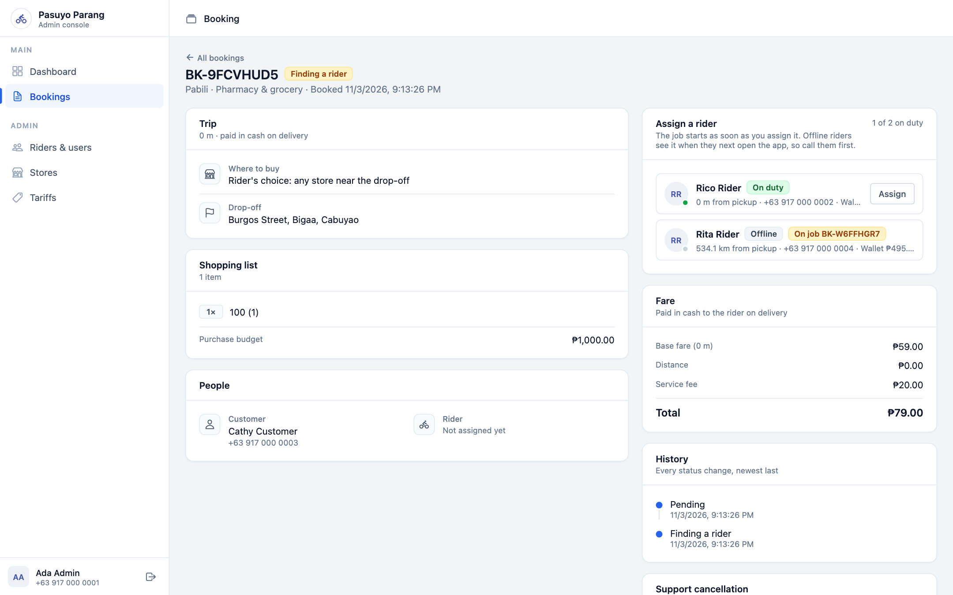



Assign a rider
Open a booking that is Finding a rider to dispatch it yourself.
Read the rider list
Available riders come first, then on duty before offline, then nearest to the pickup.
Check each rider
On duty or Offline, distance from pickup, and any job they are already on.
Click Assign
The job starts immediately and shows in that rider’s app.
Good to know Offline riders only see the job when they next open the app, so call them first.

Slide 20
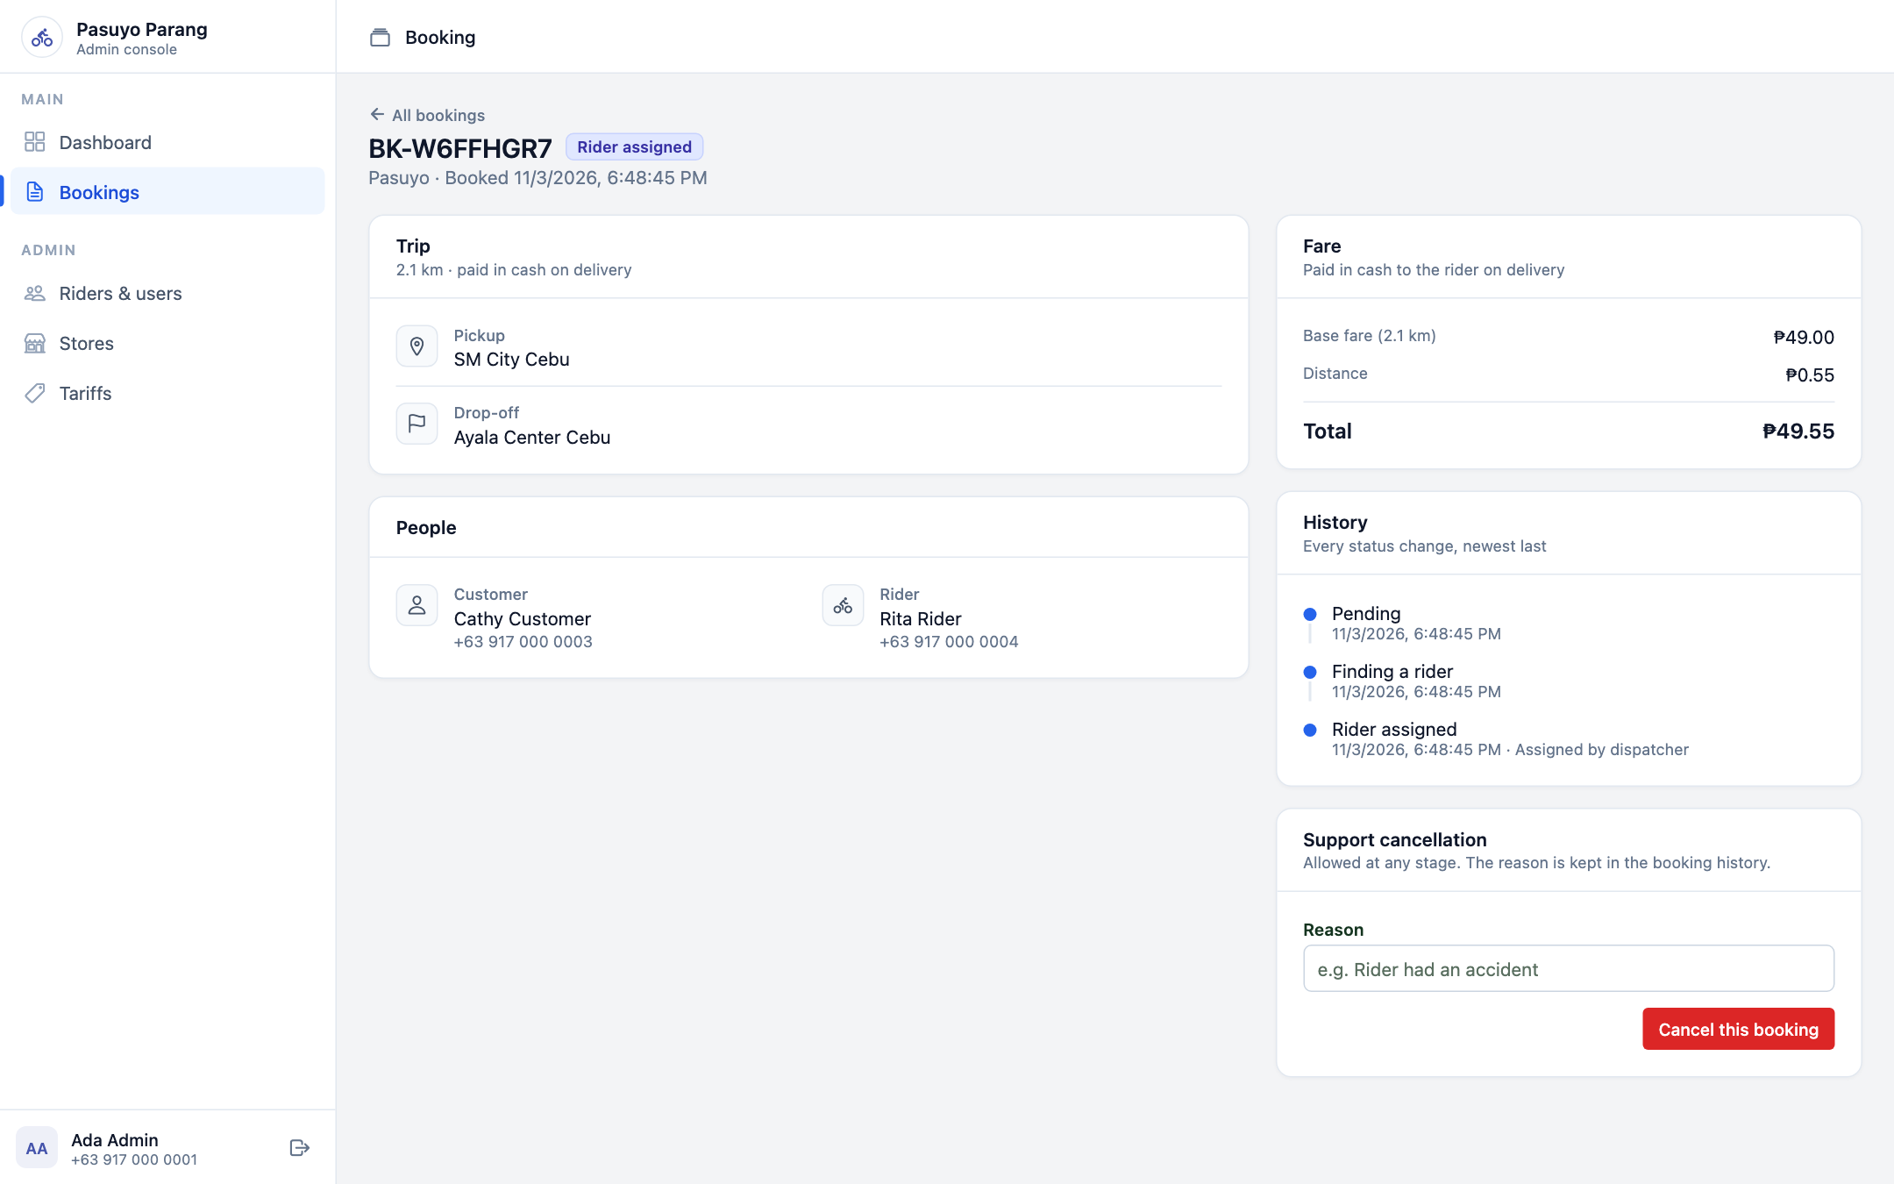


Booking details and cancelling
The full record of a booking, and the only place to cancel after pickup starts.
Trip, people and fare
Pickup, drop-off, customer and rider with phone numbers, and the fare breakdown.
History
Every status change with its time, newest last, including who assigned the rider.
Support cancellation
Type a reason, then click Cancel this booking. Allowed at any stage.
Tip The reason is saved in the booking history, so write what happened.

Slide 21
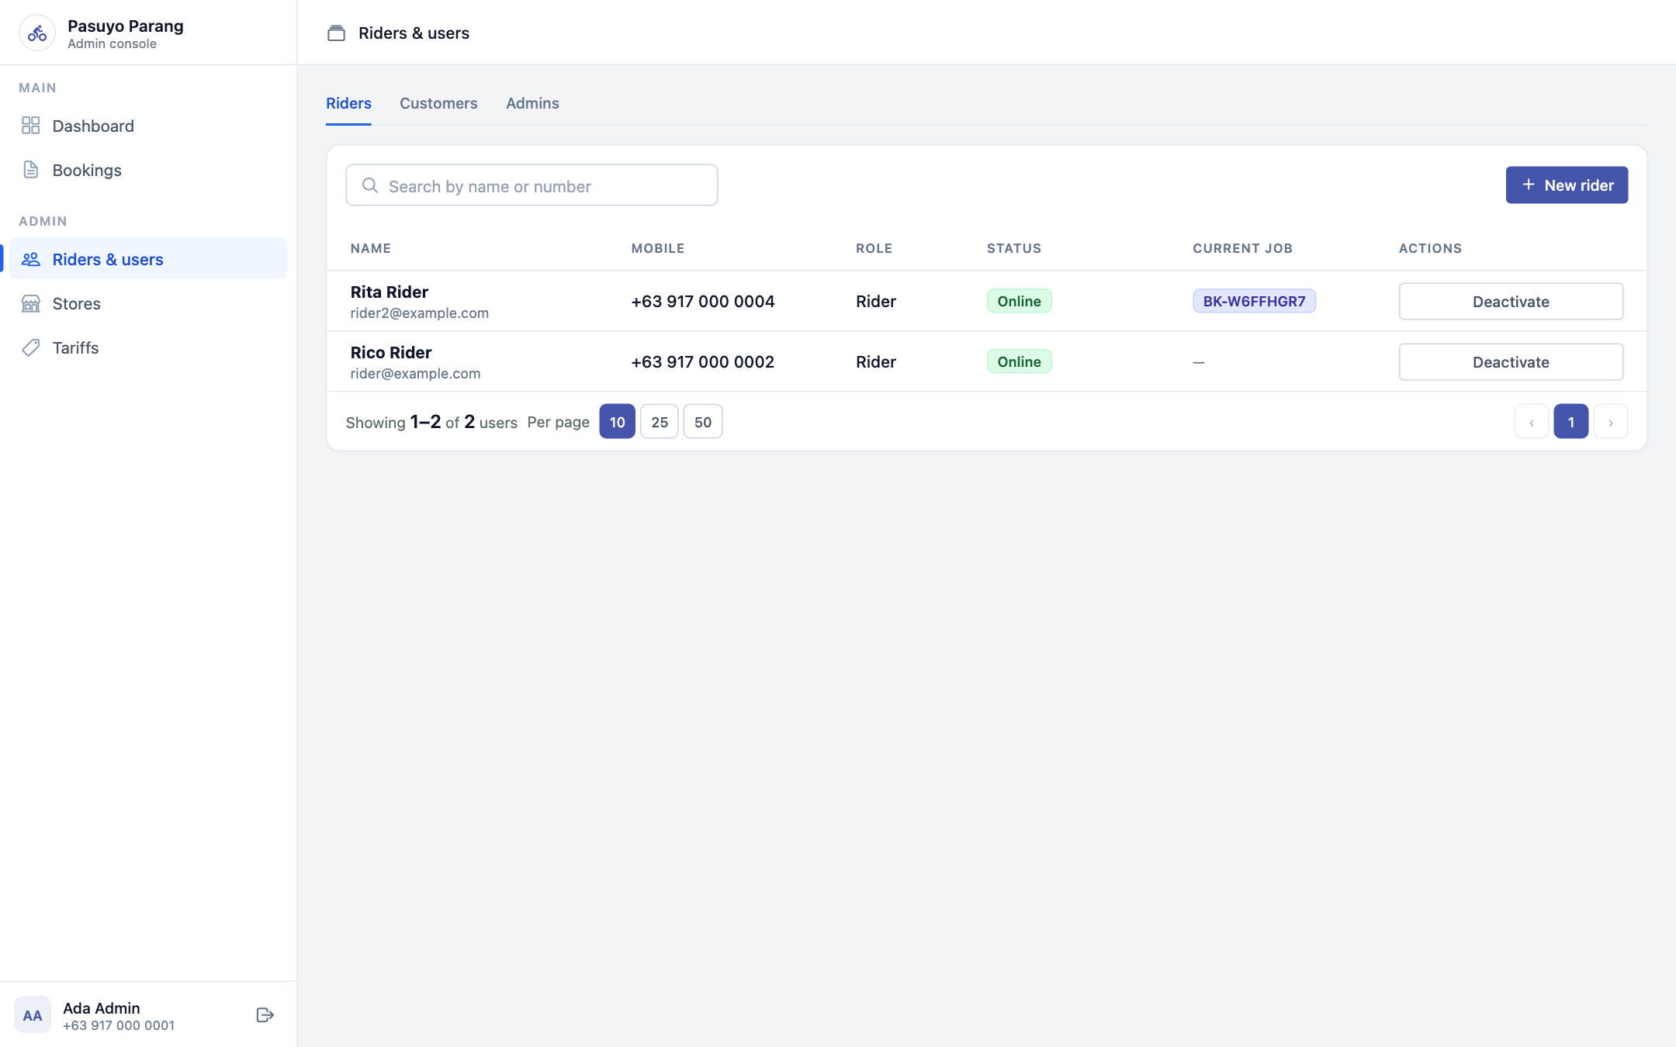

Riders and users
Add riders, look people up, and switch accounts off.
Pick a tab
Riders, Customers or Admins. Search by name or mobile number.
See who is working
Each rider shows Online or Offline and any current job.
Add a rider
Click New rider, then enter name, email, mobile and a first password. Give these to the rider.
Deactivate
Stops an account from signing in. Reactivate turns it back on.

Slide 22
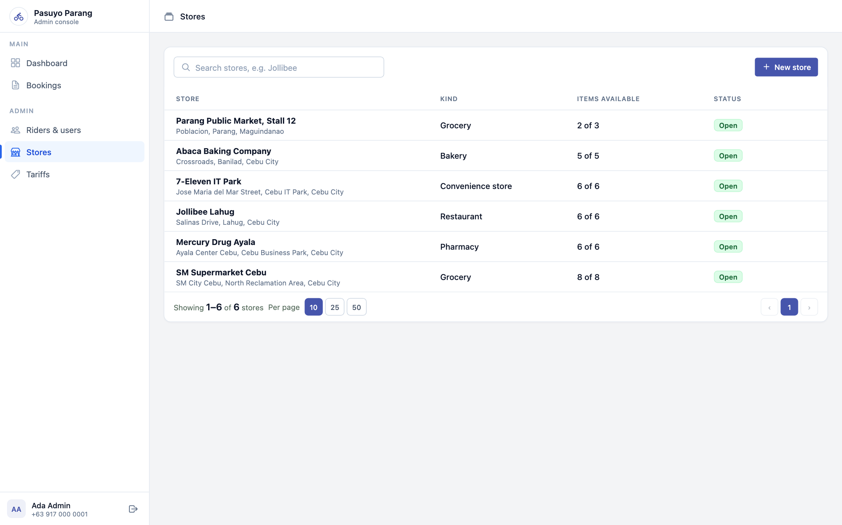
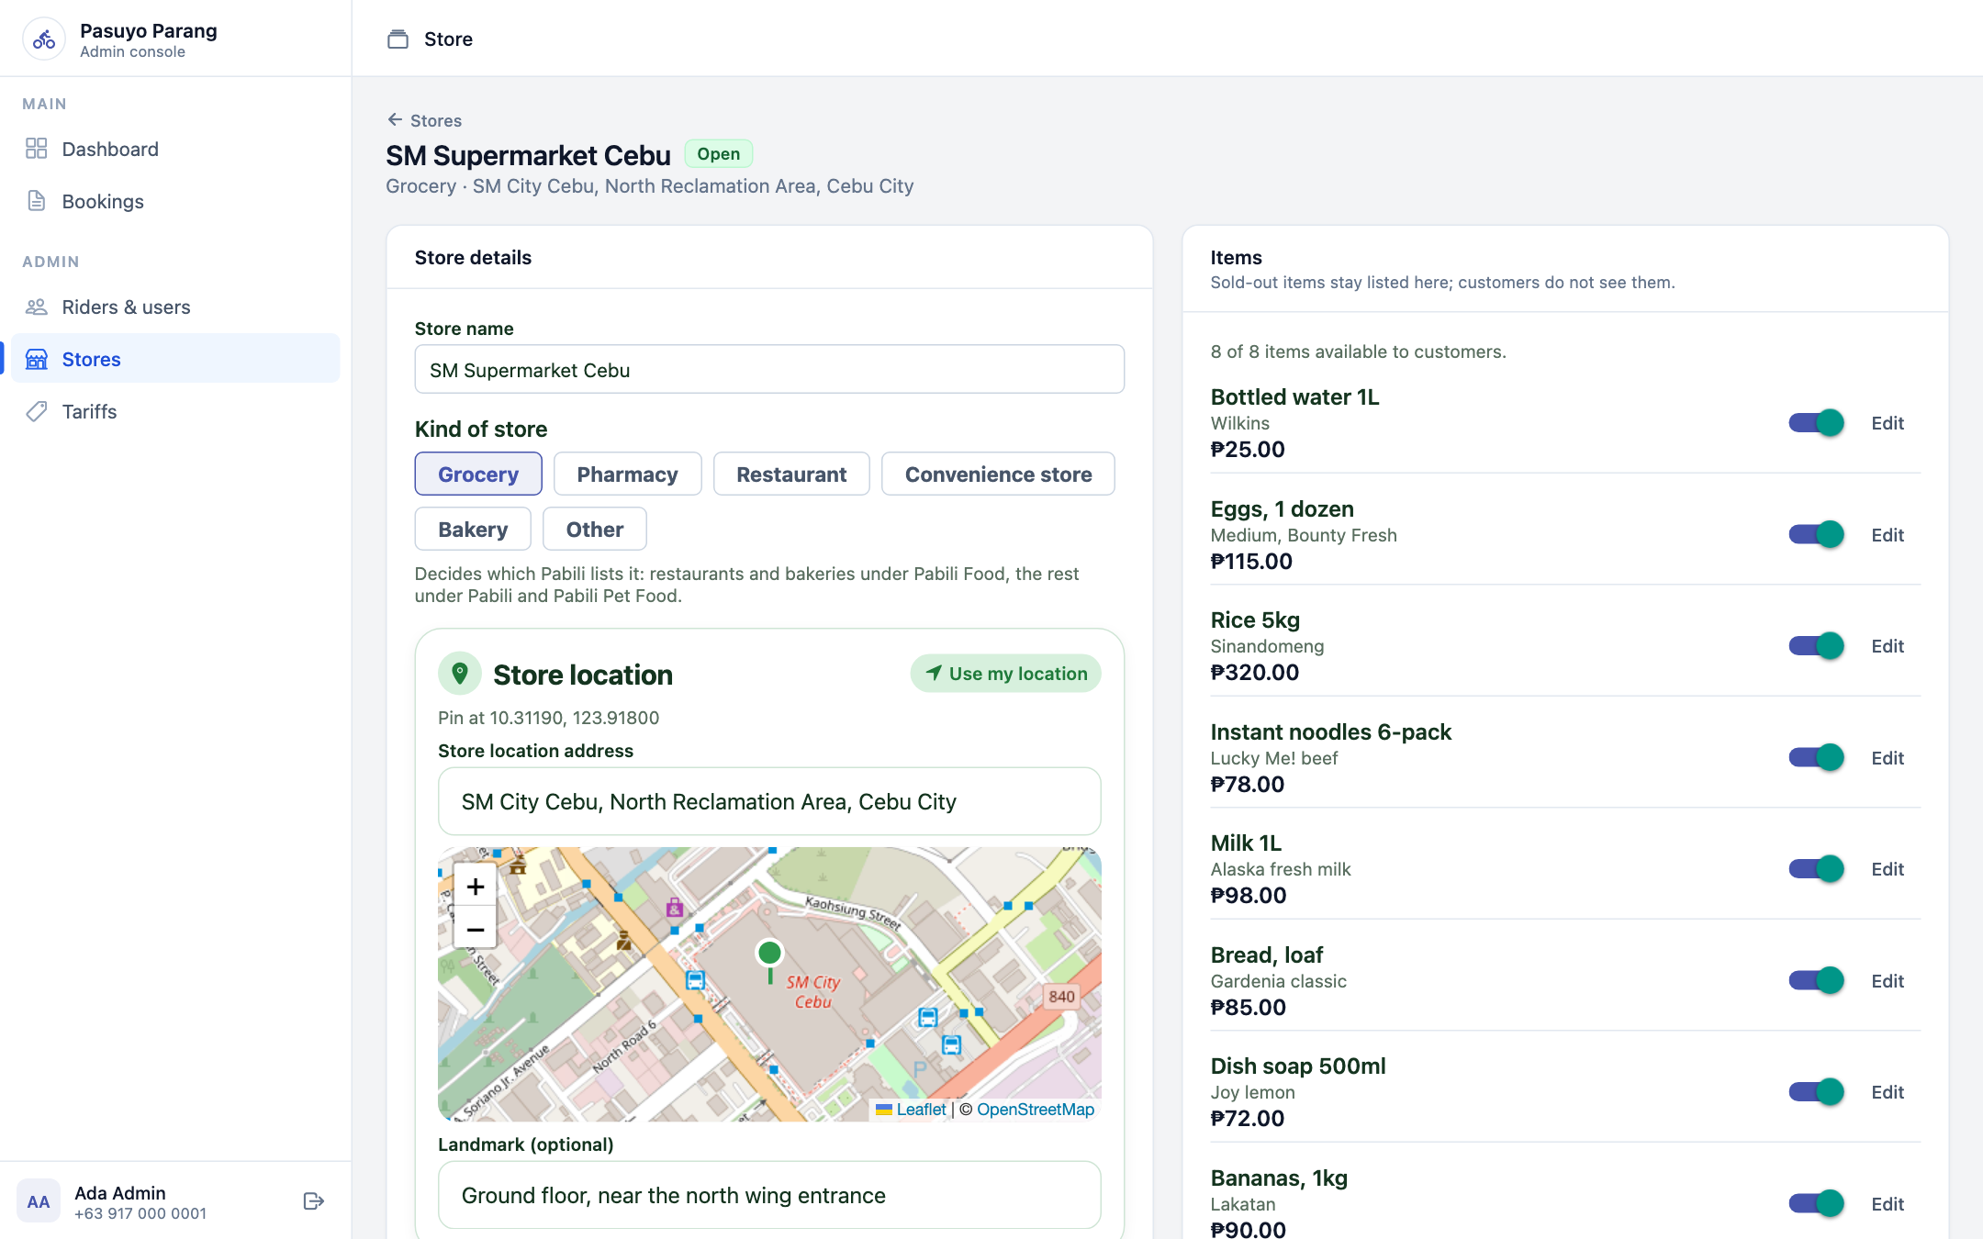
Stores and their items
Stores feed the Pabili store list that customers see.
1
Store list
Click New store to add one, or click a store to edit it.
2
Store details
Name, kind and map pin. The kind decides which Pabili list shows it.
3
Items
Add items and prices. Switch off sold-out items to hide them.

Slide 23
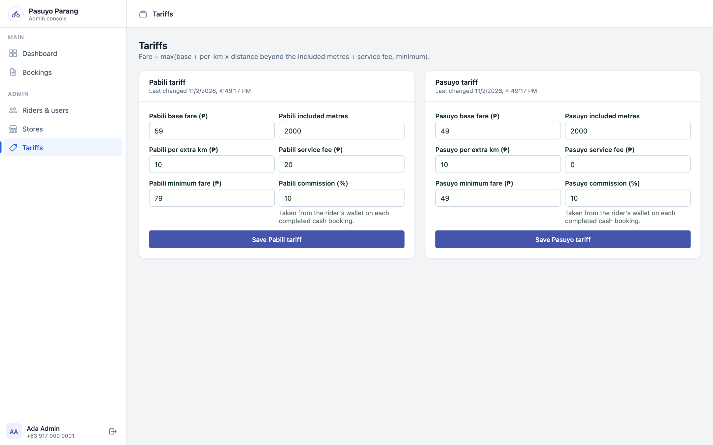

Tariffs
Fares are always worked out by the server from these settings.
One tariff per service
Pabili and Pasuyo each have their own card.
How the fare is built
Base fare, plus a per-km rate past the included metres, plus the service fee. Never below the minimum fare.
Save
Change a value, then click Save. New bookings use it; existing bookings keep their fare.
Good to know Commission is not charged while the rider wallet is switched off.

Slide 24
Quick fixes
The questions people ask most often.
?
Rider sees no jobs
Go online, share your location in Settings, and finish any job in progress.
?
Notifications say Blocked
Allow notifications for this site in the browser settings, then tap Turn on notifications.
?
Customer cannot cancel
The rider is already heading to pickup. An admin can cancel it with a reason.
?
No rider is taking a booking
An admin opens the booking and assigns a rider, calling offline riders first.
?
Signed in on the wrong page
Each role has its own page: /login, /rider/login and /admin/login.
?
A store item ran out
An admin switches the item off on the store page. Customers stop seeing it.

Slide 25
Salamat!
Where each person signs in
Customers /login
Riders /rider/login
Admins /admin/login

