Slide 1
Introduction to the GTIN
Global Trade Item Number
The globally unique identification key for trade items
GS1 Germany – Training Module 1

Slide 2
What is a GTIN?
Global Trade Item Number
Uniquely identifies every trade item worldwide
Assigned by GS1 Member Organisations
Used in: retail, logistics, healthcare, e-commerce
💡 A GTIN is not a price – it is an identity.

Slide 3
Structure of a GTIN-13
Component | Digits | Example
GS1 Company Prefix | 6–12 | 4012345
Item Reference | 0–6 | 77777
Check Digit | 1 | 5
Result: 402345777775

Slide 4
Where do we encounter the GTIN?
🛒Supermarket checkout – EAN-13 barcode on every product
📦Logistics – GTIN-14 on shipping cartons
🌐E-commerce – Product identification on Amazon, Google Shopping
🏥Healthcare – Unique identification of medical devices

Slide 5
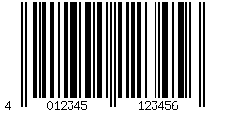
GTIN vs. Barcode
Note that a GTIN is the Identifier, not the Data Carrier.
Here you can see the GTIN encoded in an EAN-13 barcode:

Slide 6
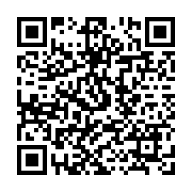
GTIN in QR Codes Powered by GS1
From 2028, the GTIN can be embedded in a web address – giving your customers direct access to product-related information.
Using the same GTIN as before: it now appears in what is called a
GS1 Digital Link URI and is encoded into a QR Code:
Encoded content:
https://id.gs1.de/01/04012345999969

Slide 7
Summary
✅ GTIN = globally unique trade item key
✅ Assigned via a GS1 Company Prefix
✅ Used across all industries and channels
✅ Foundation for barcodes, QR Codes and GS1 Digital Link

Slide 8
Next Module
Module 2: GS1 Digital Link – from barcode to URL
Questions? → streaming@example.example

