Slide 1
OpenMP
Umang Brahmakshatriya
ICSI 520
University At Albany

Slide 2
What is OpenMP
An Application Program Interface (API) that may be used to explicitly direct multi-threaded, shared memory parallelism
Comprised of three primary API components:
Compiler Directives
Runtime Library Routines
Environment Variables
An abbreviation for:
Short version: Open Multi-Processing
Long version: Open specifications for Multi-Processing via collaborative work between interested parties from the hardware and software industry, government and academia

Slide 3
OpenMP is NOT
Meant for distributed memory parallel systems (by itself)
Necessarily implemented identically by all vendors
Guaranteed to make the most efficient use of shared memory
Required to check for data dependencies, data conflicts, race conditions, or deadlocks
Meant to cover compiler-generated automatic parallelization and directives to the compiler to assist such parallelization
Designed to guarantee that input or output to the same file is synchronous when executed in parallel. The programmer is responsible for synchronizing input and output.

Slide 4
Goals of OpenMP
Standardization:
Provide a standard among a variety of shared memory architectures/platforms
Jointly defined and endorsed by a group of major computer hardware and software vendors
Lean and Mean:
Establish a simple and limited set of directives for programming shared memory machines.
Significant parallelism can be implemented by using just 3 or 4 directives.

Slide 5
Goals of OpenMP
Ease of Use:
Provide capability to incrementally parallelize a serial program, unlike message-passing libraries which typically require an all or nothing approach
Provide the capability to implement both coarse-grain and fine-grain parallelism
Portability:
The API is specified for C/C++ and Fortran
Public forum for API and membership
Most major platforms have been implemented including Unix/Linux platforms and Windows

Slide 6
References
OpenMP website: openmp.org
Wikipedia: en.wikipedia.org/wiki/OpenMP

Slide 7
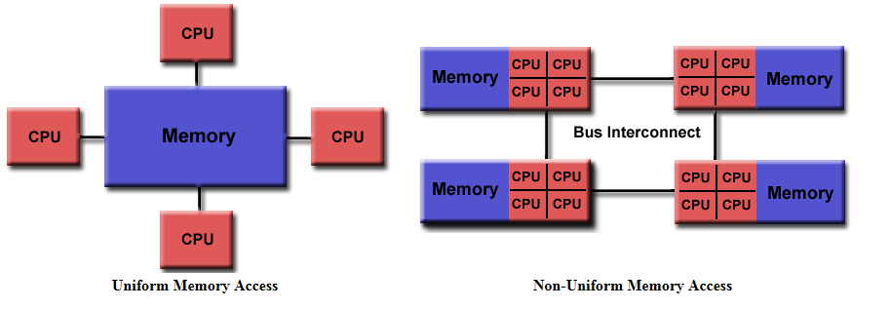
OpenMP programming model – Shared Memory
OpenMP is designed for multi-processor/core, shared memory machines. The underlying architecture can be shared memory (UMA or NUMA).
Notes:
http://en.wikipedia.org/wiki/Non-uniform_memory_access
Limiting the number of memory accesses provided the key to extracting high performance from a modern computer. For commodity processors, this meant installing an ever-increasing amount of high-speed cache memory and using increasingly sophisticated algorithms to avoid cache misses. But the dramatic increase in size of the operating systems and of the applications run on them has generally overwhelmed these cache-processing improvements. Multi-processor systems without NUMA make the problem considerably worse. Now a system can starve several processors at the same time, notably because only one processor can access the computer's memory at a time.[2]
NUMA attempts to address this problem by providing separate memory for each processor, avoiding the performance hit when several processors attempt to address the same memory. For problems involving spread data (common for servers and similar applications), NUMA can improve the performance over a single shared memory by a factor of roughly the number of processors (or separate memory banks).[3] Another approach to addressing this problem, utilized mainly by non-NUMA systems, is the multi-channel memory architecture; multiple memory channels are increasing the number of simultaneous memory accesses.

Slide 8
OpenMP programming model – Thread based parallelism
OpenMP programs accomplish parallelism exclusively through the use of threads.
A thread of execution is the smallest unit of processing that can be scheduled by an operating system. The idea of a subroutine that can be scheduled to run autonomously might help explain what a thread is.
Threads exist within the resources of a single process. Without the process, they cease to exist.
Typically, the number of threads match the number of machine processors/cores. However, the actual use of threads is up to the application.

Slide 9
OpenMP programming model – Explicit parallelism
OpenMP is an explicit (not automatic) programming model, offering the programmer full control over parallelization.
Parallelization can be as simple as taking a serial program and inserting compiler directives.
Or as complex as inserting subroutines to set multiple levels of parallelism, locks and even nested locks.

Slide 10
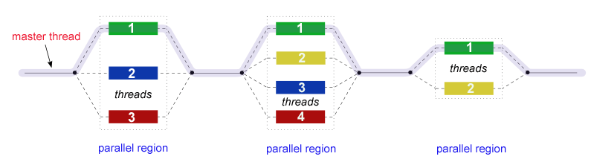
OpenMP programming model – Fork Join Model
OpenMP uses the fork-join model of parallel execution:

Slide 11
OpenMP programming model – Fork Join Model
All OpenMP programs begin as a single process: the master thread. The master thread executes sequentially until the first parallel region construct is encountered.
FORK: the master thread then creates a team of parallel threads.
The statements in the program that are enclosed by the parallel region construct are then executed in parallel among the various team threads.
JOIN: When the team threads complete the statements in the parallel region construct, they synchronize and terminate, leaving only the master thread.
The number of parallel regions and the threads that comprise them are arbitrary.

Slide 12
OpenMP programming model – Compiler Directive Based
Most OpenMP parallelism is specified through the use of compiler directives which are imbedded in C/C++ or Fortran source code

Slide 13
OpenMP programming model – Nested parallelism
The API provides for the placement of parallel regions inside other parallel regions.
Implementations may or may not support this feature.

Slide 14
OpenMP programming model – Dynamic Threads
The API provides for the runtime environment to dynamically alter the number of threads used to execute parallel regions. Intended to promote more efficient use of resources, if possible.
Implementations may or may not support this feature.

Slide 15
OpenMP programming model – I/O
OpenMP specifies nothing about parallel I/O. This is particularly important if multiple threads attempt to write/read from the same file.
If every thread conducts I/O to a different file, the issues are not as significant.
It is entirely up to the programmer to ensure that I/O is conducted correctly within the context of a multi-threaded program.

Slide 16
OpenMP programming model – Memory Model
OpenMP provides a "relaxed-consistency" and "temporary" view of thread memory (in their words). In other words, threads can "cache" their data and are not required to maintain exact consistency with real memory all of the time.
When it is critical that all threads view a shared variable identically, the programmer is responsible for insuring that the variable is FLUSHed by all threads as needed.
More later..

Slide 17
OpenMP API : Three components
Compiler Directives
Runtime Library Routines
Environment Variables
The application developer decides how to employ these components. In the simplest case, only a few of them are needed.

Slide 18
OpenMP : Compiler directives
Compiler directives appear as comments in your source code and are ignored by compilers unless you tell them otherwise - usually by specifying the appropriate compiler flag
OpenMP compiler directives are used for various purposes:
Spawning a parallel region
Dividing blocks of code among threads
Distributing loop iterations between threads
Serializing sections of code
Synchronization of work among threads

Slide 19
OpenMP : Compiler directives
Compiler directives have the following syntax:
sentinel directive-name [clause, ...]
Example
#pragma omp parallel default(shared) private(beta, pi)
We will talk more later

Slide 20
OpenMP: Library routines
The OpenMP API includes an ever-growing number of run-time library routines.
These routines are used for a variety of purposes:
Setting and querying the number of threads
Querying a thread's unique identifier (thread ID), a thread's ancestor's identifier, the thread team size
Setting and querying the dynamic threads feature
Querying if in a parallel region, and at what level
Setting and querying nested parallelism
Setting, initializing and terminating locks and nested locks
Querying wall clock time and resolution

Slide 21
OpenMP: Library routines
For C/C++, all of the run-time library routines are actual subroutines
Example:
#include <omp.h>
int omp_get_num_threads(void)
Note that for C/C++, you usually need to include the <omp.h> header file.

Slide 22
OpenMP: Environment Variables
OpenMP provides several environment variables for controlling the execution of parallel code at run-time.
These environment variables can be used to control such things as:
Setting the number of threads
Specifying how loop interactions are divided
Binding threads to processors
Enabling/disabling nested parallelism; setting the maximum levels of nested parallelism
Enabling/disabling dynamic threads
Setting thread stack size
Setting thread wait policy

Slide 23

OpenMP: Environment Variables
Setting OpenMP environment variables is done the same way you set any other environment variables, and depends upon which shell you use. For example:
More later..
Tip: Use unset command to remove the export in bash

Slide 24
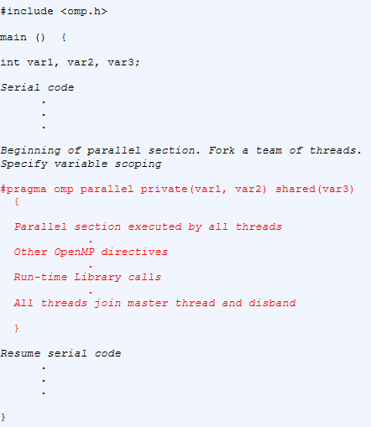
OpenMP Code structure
Declaring variables
Passing var1, var2 as private variables
Passing var3 as shared variable among
threads

Slide 25
Compiling OpenMP programs
We will use the following command for this class
gcc –g <filename>.c –o <output> -fopenmp
-g flag is optional but you should keep it for debugging

Slide 26
OpenMP Directives
Format
Example
#pragma omp parallel default(shared) private(beta, pi)

Slide 27
OpenMP directives: General rules
Case sensitive
Directives follow conventions of the C/C++ standards for compiler directives
Only one directive-name may be specified per directive
Each directive applies to at most one succeeding statement, which must be a structured block.
Long directive lines can be "continued" on succeeding lines by escaping the newline character with a backslash ("\") at the end of a directive line

Slide 28
OpenMP directives: Scoping
Static (Lexical) Extent
The code textually enclosed between the beginning and the end of a structured block following a directive.
The static extent of a directives does not span multiple routines or code files
Orphaned Directive
An OpenMP directive that appears independently from another enclosing directive is said to be an orphaned directive. It exists outside of another directive's static (lexical) extent.
Will span routines and possibly code files
Dynamic Extent
The dynamic extent of a directive includes both its static (lexical) extent and the extents of its orphaned directives.

Slide 29
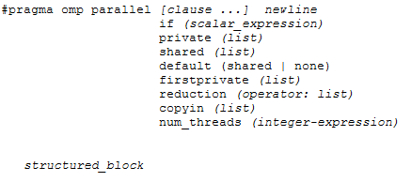
OpenMP directives: Parallel Region Construct
A parallel region is a block of code that will be executed by multiple threads. This is the fundamental OpenMP parallel construct.

Slide 30
OpenMP directives: Parallel Region Construct
When a thread reaches a PARALLEL directive, it creates a team of threads and becomes the master of the team. The master is a member of that team and has thread number 0 within that team.
Starting from the beginning of this parallel region, the code is duplicated and all threads will execute that code.
There is an implied barrier at the end of a parallel section. Only the master thread continues execution past this point.
If any thread terminates within a parallel region, all threads in the team will terminate, and the work done up until that point is undefined.

Slide 31
OpenMP directives: Parallel Region Construct
How many Threads?
The number of threads in a parallel region is determined by the following factors, in order of precedence:
Evaluation of the IF clause
Setting of the NUM_THREADS clause
Use of the omp_set_num_threads() library function
Setting of the OMP_NUM_THREADS environment variable
Implementation default - usually the number of CPUs on a node, though it could be dynamic
Threads are numbered from 0 (master thread) to N-1

Slide 32
OpenMP directives: Parallel Region Construct
Dynamic Threads (see #5 from previous slide)
Use the omp_get_dynamic() library function to determine if dynamic threads are enabled.
If supported, the two methods available for enabling dynamic threads are:
The omp_set_dynamic() library routine
Setting of the OMP_DYNAMIC environment variable to TRUE

Slide 33
OpenMP directives: Parallel Region Construct
Nested Parallel Regions
Use the omp_get_nested() library function to determine if nested parallel regions are enabled.
The two methods available for enabling nested parallel regions (if supported) are:
The omp_set_nested() library routine
Setting of the OMP_NESTED environment variable to TRUE
If not supported, a parallel region nested within another parallel region results in the creation of a new team, consisting of one thread, by default.

Slide 34
OpenMP directives: Parallel Region Construct
IF clause
IF clause: If present, it must evaluate to .TRUE. (Fortran) or non-zero (C/C++) in order for a team of threads to be created. Otherwise, the region is executed serially by the master thread.

Slide 35
OpenMP directives: Parallel Region Construct
Restrictions
A parallel region must be a structured block that does not span multiple routines or code files
It is illegal to branch (goto) into or out of a parallel region
Only a single IF clause is permitted
Only a single NUM_THREADS clause is permitted
A program must not depend upon the ordering of the clauses

Slide 36
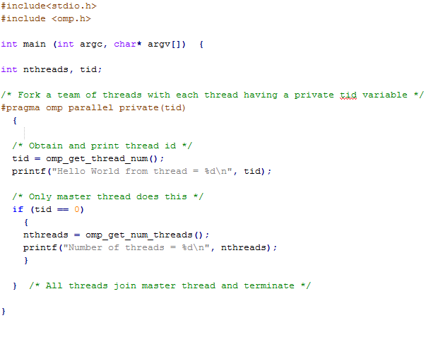
OpenMP example 1: Intro to Parallel Region

Slide 37
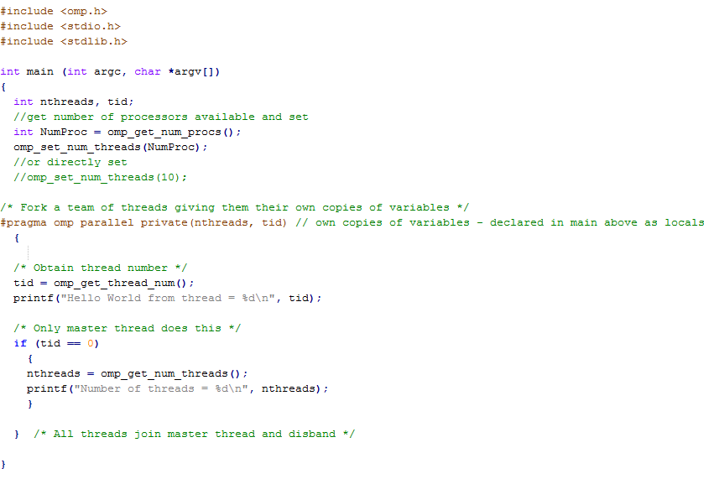
OpenMP example 2: Intro to Parallel Region

Slide 38
Lab 5
The goal of this lab is to run a few simple omp programs and understand how to write (one or more) parallel sections in the code
Implement and run the previous two examples
Change the number of threads programmatically (in at least one of the programs)
Change the number of threads through setting environment variable (slide 23) – You don’t need to submit this
Implement a third program where you have a second parallel section. You can use one of the previous two examples to start
The 2nd parallel block just prints out the sum – (tid + 10). tid is the thread id and is private to that section
Thus you submit the following for lab 5 (source and binary):
Previous two examples
A program where you create at least 2 parallel omp sections and one of the sections does what is described above

Slide 39
Homework
Implement a serial and a parallel implementation to calculate the value of PI as described in the following slides
For the parallel version you will create two binaries
Only using pthreads
Only using openMP

Slide 40
Monte carlo simulation of PI
Monte Carlo methods can be thought of as statistical simulation methods that utilize a sequences of random numbers to perform the simulation.
In a typical process one computes the number of points in a set A that lies inside box R.
The ratio of the number of points that fall inside A to the total number of points tried is equal to the ratio of the two areas.
The accuracy of the ratio p depends on the number of points used, with more points leading to a more accurate value.

Slide 41
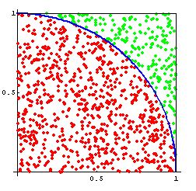
Monte carlo simulation of PI
Consider a circle inscribed in a unit square. Given that the circle and the square have a ratio of areas that is p = π/4, the value of π can be approximated using a Monte Carlo method
Draw a square on the ground, then inscribe a circle within it.
Uniformly scatter some objects of uniform size (grains of rice or sand) over the square.
Count the number of objects inside the circle and the total number of objects.
The ratio of the two counts is an estimate of the ratio of the two areas, which is π/4 or p. Multiply the result by 4 to estimate π.

Slide 42
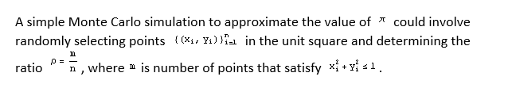
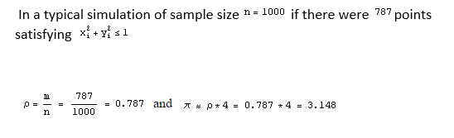
Monte carlo simulation of PI
m = number of points inside the circle
n = total points

Slide 43
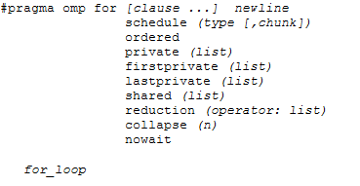
OpenMP directives : Work-sharing constructs – for directive
The for directive specifies that the iterations of the loop immediately following it must be executed in parallel by the team. This assumes a parallel region has already been initiated, otherwise it executes in serial on a single processor.
Format

Slide 44
OpenMP directives : Work-sharing constructs – for directive clauses
SCHEDULE: Describes how iterations of the loop are divided among the threads in the team. The default schedule is implementation dependent.
STATIC - Loop iterations are divided into pieces of size chunk and then statically assigned to threads. If chunk is not specified, the iterations are evenly (if possible) divided contiguously among the threads.
DYNAMIC - Use the internal work queue to give a chunk-sized block of loop iterations to each thread. When a thread is finished, it retrieves the next block of loop iterations from the top of the work queue. By default, the chunk size is 1. Be careful when using this scheduling type because of the extra overhead involved.
GUIDED - Similar to dynamic scheduling, but the chunk size starts off large and decreases to better handle load imbalance between iterations. The optional chunk parameter specifies them minimum size chunk to use. By default the chunk size is approximately loop_count/number_of_threads.
RUNTIME - The scheduling decision is deferred until runtime by the environment variable OMP_SCHEDULE.
AUTO - The programmer gives the compiler the freedom to choose any possible mapping of iterations to threads in the team.
Notes:
GUIDED
The size of the initial block is proportional to:
number_of_iterations / number_of_threads
Subsequent blocks are proportional to number_of_iterations_remaining / number_of_threads
The chunk parameter defines the minimum block size.
The default chunk size is 1.

Slide 45
OpenMP directives : Work-sharing constructs – for directive clauses
NO WAIT / nowait: If specified, then threads do not synchronize at the end of the parallel loop.
ORDERED: Specifies that the iterations of the loop must be executed as they would be in a serial program.
COLLAPSE: Specifies how many loops in a nested loop should be collapsed into one large iteration space and divided according to the schedule clause. The sequential execution of the iterations in all associated loops determines the order of the iterations in the collapsed iteration space.

Slide 46
OpenMP directives : Work-sharing constructs – for directive clauses
The FOR loop can not be a DO WHILE loop, or a loop without loop control. Also, the loop iteration variable must be an integer and the loop control parameters must be the same for all threads.
Program correctness must not depend upon which thread executes a particular iteration.
It is illegal to branch (goto) out of a loop associated with a for directive.
The chunk size must be specified as a loop invariant integer expression, as there is no synchronization during its evaluation by different threads.
ORDERED, COLLAPSE and SCHEDULE clauses may appear once each.

Slide 47
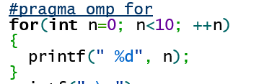
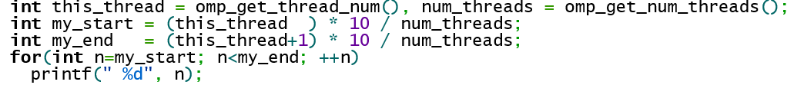
OpenMP directives : Work-sharing constructs – for directive clauses

Slide 48
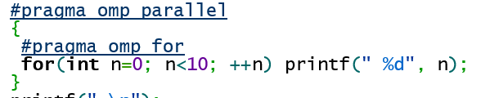

OpenMP directives : Work-sharing constructs – for directive clauses
OR

Slide 49
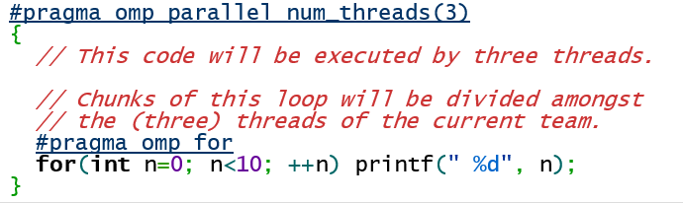
OpenMP directives : Work-sharing constructs – for directive clauses

Slide 50
OpenMP directives : Work-sharing constructs – for directive clauses
static is the default schedule as shown above.
Upon entering the loop, each thread independently decides which chunk of the loop they will process.

Slide 51
OpenMP directives : Work-sharing constructs – for directive clauses
In the dynamic schedule, there is no predictable order in which the loop items are assigned to different threads.
Each thread asks the OpenMP runtime library for an iteration number, then handles it, then asks for next, and so on.
This is most useful when used in conjunction with the ordered clause, or when the different iterations in the loop may take different time to execute.
In this example, each thread asks for an iteration number, executes 3 iterations of the loop, then asks for another, and so on. The last chunk may be smaller than 3, though.

Slide 52
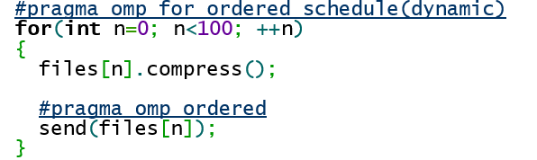
OpenMP directives : Work-sharing constructs
This loop "compresses" 100 files with some files being compressed in parallel, but ensures that the files are "sent" in a strictly sequential order.
If the thread assigned to compress file 7 is done but the file 6 has not yet been sent, the thread will wait before sending, and before starting to compress another file. The ordered clause in the loop guarantees that there always exists one thread that is handling the lowest-numbered unhandled task.
Each file is compressed and sent exactly once, but the compression may happen in parallel.
There may only be one ordered block per an ordered loop, no less and no more. In addition, the enclosing for directive must contain the ordered clause.

Slide 53
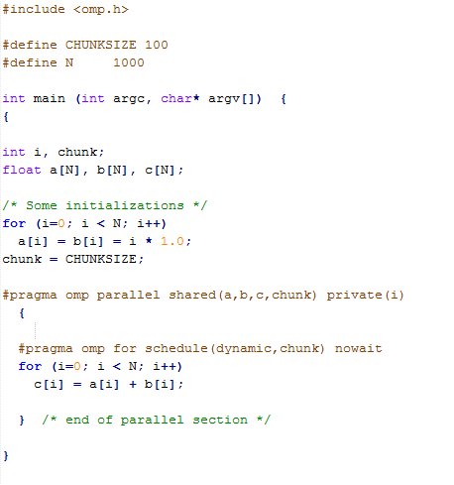
OpenMP directives : Work-sharing constructs – for directive. Example
Simple vector-add program
Arrays A, B, C, and variable N will be shared by all threads.
Variable I will be private to each thread; each thread will have its own unique copy.
The iterations of the loop will be distributed dynamically in CHUNK sized pieces.
Threads will not synchronize upon completing their individual pieces of work (NOWAIT).
Observe the For directive and chunk size

Slide 54
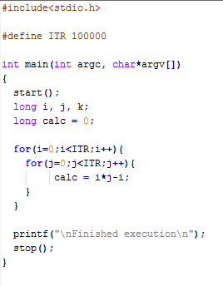
Lab 6
Given the serial implementation on the left, implement an openmp version which gives you a speedup
Submission:
Serial implementation (on the left)
Parallel implementation
Specify how much speedup you get and how many threads did you use
What type of parallel for did you use (guided/dynamic/etc), what chunk size was used?
Submit Binaries for each implementation
Speedup is calculated as
Serial execution time/ Parallel execution time

Slide 55
OpenMP directives : Work-sharing constructs – section directive
PURPOSE
The SECTIONS directive is a non-iterative work-sharing construct. It specifies that the enclosed section(s) of code are to be divided among the threads in the team.
Independent SECTION directives are nested within a SECTIONS directive. Each SECTION is executed once by a thread in the team. Different sections may be executed by different threads. It is possible for a thread to execute more than one section if it is quick enough and the implementation permits such.

Slide 56
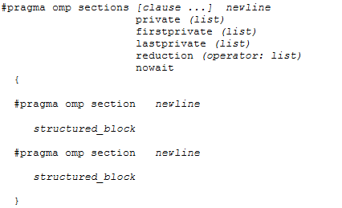
OpenMP directives : Work-sharing constructs – section directive
There is an implied barrier at the end of a SECTIONS directive, unless the NOWAIT/nowait clause is used.
What happens if the number of threads and the number of SECTIONs are different? More threads than SECTIONs? Less threads than SECTIONs?
Which thread executes which SECTION?
Notes:
If there are more threads than sections, some threads will not execute a section and some will. If there are more sections than threads, the implementation defines how the extra sections are executed.
It is up to the implementation to decide which threads will execute a section and which thread will not, it can vary from execution to execution.

Slide 57
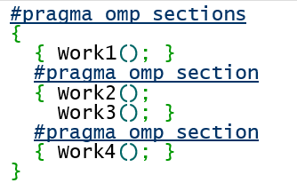
OpenMP directives : Work-sharing constructs – section directive
There is an implied barrier at the end of a SECTIONS directive, unless the NOWAIT/nowait clause is used.
This code indicates that any of the tasks Work1, Work2 + Work3 and Work4 may run in parallel, but that Work2 and Work3 must be run in sequence.
Each work is done exactly once.
If the compiler ignores the pragmas, the result is still a correctly running program.
Notes:
If there are more threads than sections, some threads will not execute a section and some will. If there are more sections than threads, the implementation defines how the extra sections are executed.
It is up to the implementation to decide which threads will execute a section and which thread will not, it can vary from execution to execution.

Slide 58
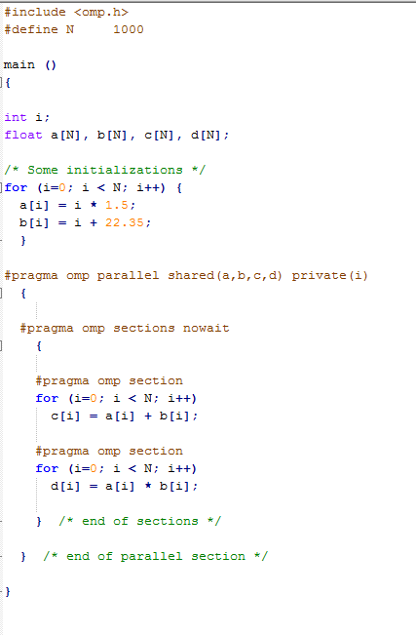
OpenMP directives : Work-sharing constructs – section directive
Executed by two different threads

Slide 59
Homework 5
Implement a serial matrix multiplication program.
Use the SAME code and make it parallel using OpenMP directives
You can use sections, parallel for
Measure timings and show speedup table

Slide 60
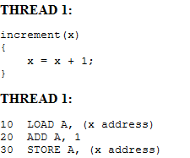
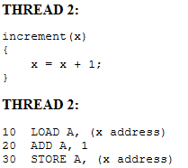
OpenMP synchronization constructs
One possible execution sequence:
Thread 1 loads the value of x into register A.
Thread 2 loads the value of x into register A.
Thread 1 adds 1 to register A
Thread 2 adds 1 to register A
Thread 1 stores register A at location x
Thread 2 stores register A at location x
The resultant value of x will be 1, not 2 as it should be.
To avoid a situation like this, the incrementing of x must be synchronized between the two threads to ensure that the correct result is produced.

Slide 61

OpenMP synchronization constructs – Master Directive
The MASTER directive specifies a region that is to be executed only by the master thread of the team. All other threads on the team skip this section of code
There is no implied barrier associated with this directive
It is illegal to branch into or out of MASTER block.

Slide 62

OpenMP synchronization constructs – Critical Directive
The CRITICAL directive specifies a region of code that must be executed by only one thread at a time.
If a thread is currently executing inside a CRITICAL region and another thread reaches that CRITICAL region and attempts to execute it, it will block until the first thread exits that CRITICAL region.
The optional name enables multiple different CRITICAL regions to exist:
Names act as global identifiers. Different CRITICAL regions with the same name are treated as the same region.
All CRITICAL sections which are unnamed, are treated as the same section.

Slide 63
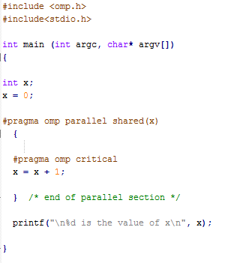
OpenMP synchronization constructs – Critical Directive
Change the number of threads and see what happens
export OMP_NUM_THREADS=10

Slide 64
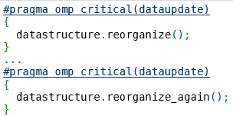
OpenMP synchronization constructs – Named Critical Directive

Slide 65

OpenMP synchronization constructs – Atomic Directive
The atomic keyword in OpenMP specifies that the denoted action happens atomically
Another thread cannot intervene during the execution of the event.
It is commonly used to update counters and other simple variables that are accessed by multiple threads simultaneously.
Unfortunately, the atomicity setting can only be specified to simple expressions that usually can be compiled into a single processor opcode, such as increments, decrements, xors and similar.
It cannot include function calls, array indexing, overloaded operators, or multiple statements.
Notes:
http://stackoverflow.com/questions/7798010/openmp-atomic-vs-critical

Slide 66
OpenMP synchronization constructs – Atomic Directive
Critical section:
Ensures serialization of blocks of code.
Can be extended to serialize groups of blocks with proper use of "name" tag.
Slower
Atomic operation:
Is much faster than critical sections
Can protect only a single assignment and you can use it only with specific operators.

Slide 67
OpenMP synchronization constructs – Barrier Directive
The BARRIER directive synchronizes all threads in the team.
When a BARRIER directive is reached, a thread will wait at that point until all other threads have reached that barrier. All threads then resume executing in parallel the code that follows the barrier.
Restrictions
All threads in a team (or none) must execute the BARRIER region.
The sequence of work-sharing regions and barrier regions encountered must be the same for every thread in a team.

Slide 68
OpenMP synchronization constructs – THREADPRIVATE Directive
The THREADPRIVATE directive is used to make global file scope variables local and persistent to a thread through the execution of multiple parallel regions.
The directive must appear after the declaration of listed variables. Each thread then gets its own copy of the variable, so data written by one thread is not visible to other threads.

Slide 69
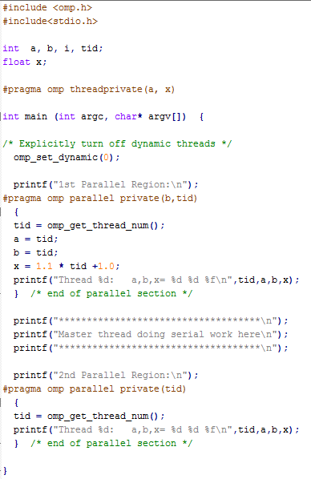
OpenMP synchronization constructs – THREADPRIVATE Directive
Variables a and x are now available as private variables to the threads (in the parallel section)
See the difference between private and threadprivate?

Slide 70
OpenMP synchronization constructs – Reduction clause
The REDUCTION clause performs a reduction on the variables that appear in its list.
A private copy for each list variable is created for each thread. At the end of the reduction, the reduction variable is applied to all private copies of the shared variable, and the final result is written to the global shared variable.
reduction (operator )

Slide 71
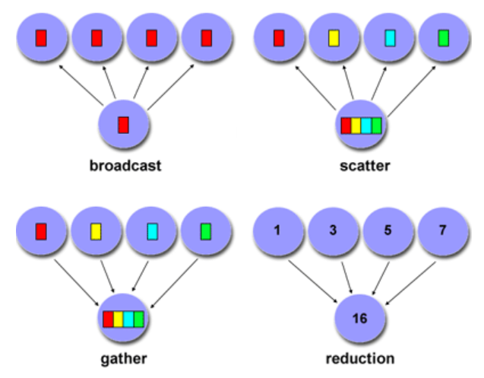
Designing Parallel Programs - Communications
Factors to Consider
Scope of communications

Slide 72
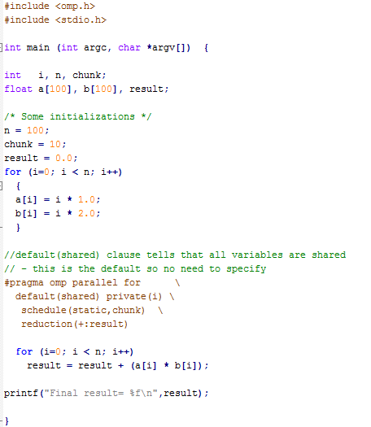
OpenMP synchronization constructs – Reduction clause
Iterations of the parallel loop will be distributed in equal sized blocks to each thread in the team (SCHEDULE STATIC)
At the end of the parallel loop construct, all threads will add their values of "result" to update the master thread's global copy.

Slide 73
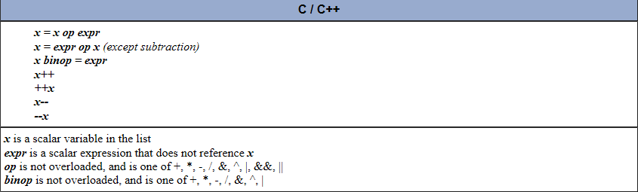
OpenMP synchronization constructs – Reduction clause
Variables in the list must be named scalar variables. They can not be array or structure type variables. They must also be declared SHARED in the enclosing context.
Reduction operations may not be associative for real numbers.
The REDUCTION clause is intended to be used on a region or work-sharing construct in which the reduction variable is used only in statements which have one of following forms:

Slide 74
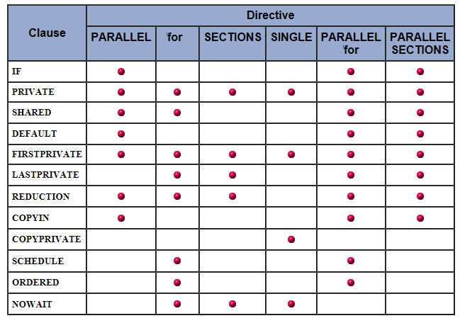
OpenMP directives summary
The table below summarizes which clauses are accepted by which OpenMP directives.
The following OpenMP directives do not accept clauses:
MASTER
CRITICAL
BARRIER
ATOMIC
ORDERED
THREADPRIVATE

Slide 75
OpenMP environment variables
OMP_SCHEDULE
The value of this variable determines how iterations of the loop are scheduled on processors. For example:
export OMP_SCHEDULE="guided, 4" export OMP_SCHEDULE="dynamic"
OMP_NUM_THREADS
Sets the maximum number of threads to use during execution. For example:
export OMP_NUM_THREADS=8
OMP_DYNAMIC
Enables or disables dynamic adjustment of the number of threads available for execution of parallel regions. Valid values are TRUE or FALSE. For example:
export OMP_DYNAMIC=TRUE
OMP_PROC_BIND
Enables or disables threads binding to processors. Valid values are TRUE or FALSE. For example
export OMP_PROC_BIND=TRUE
OMP_NESTED
Enables or disables nested parallelism. Valid values are TRUE or FALSE. For example:
export OMP_NESTED=TRUE

Slide 76
OpenMP environment variables
OMP_STACKSIZE
Controls the size of the stack for created (non-Master) threads. Examples:
export OMP_STACKSIZE=2000500B export OMP_STACKSIZE="3000 k " export OMP_STACKSIZE=10M export OMP_STACKSIZE=" 10 M " export OMP_STACKSIZE="20 m " export OMP_STACKSIZE=" 1G" export OMP_STACKSIZE=20000
OMP_WAIT_POLICY
Provides a hint to an OpenMP implementation about the desired behavior of waiting threads. A compliant OpenMP implementation may or may not abide by the setting of the environment variable. Valid values are ACTIVE and PASSIVE. ACTIVE specifies that waiting threads should mostly be active, i.e., consume processor cycles, while waiting. PASSIVE specifies that waiting threads should mostly be passive, i.e., not consume processor cycles, while waiting. The details of the ACTIVE and PASSIVE behaviors are implementation defined. Examples:
export OMP_WAIT_POLICY=ACTIVE export OMP_WAIT_POLICY=active export OMP_WAIT_POLICY=PASSIVE export OMP_WAIT_POLICY=passive

Slide 77
OpenMP environment variables
OMP_MAX_ACTIVE_LEVELS
Controls the maximum number of nested active parallel regions. The value of this environment variable must be a non-negative integer. The behavior of the program is implementation defined if the requested value of OMP_MAX_ACTIVE_LEVELS is greater than the maximum number of nested active parallel levels an implementation can support, or if the value is not a non-negative integer. Example:
Export OMP_MAX_ACTIVE_LEVELS=2
OMP_THREAD_LIMIT
Sets the number of OpenMP threads to use for the whole OpenMP program. The value of this environment variable must be a positive integer. The behavior of the program is implementation defined if the requested value of OMP_THREAD_LIMIT is greater than the number of threads an implementation can support, or if the value is not a positive integer. Example:
Export OMP_THREAD_LIMIT=10

