Slide 1

Ralph Donato Graduate Project Spring 2022
Distributed bitcoin pool miner

Slide 2
Distributed Bitcoin Miner
Bitcoin is a topic that is very much in the news. It isn’t the only crypto currency however It is probably the most well known.
If you look at the news it is easy to find an article concerning the role of crypto currency in current events.
A significant answer is the following link con concerning Russian Oligarchs hiding money in Crypto currency
Why Russian Oligarchs Can't Evade Sanctions Through Bitcoin | Markets Insider (businessinsider.com)

Slide 3
What is BITCOIN
BITCOIN is a crypto currency
01
Bitcoin is a blockchain
02
Blockchains are a type of distributed ledger
03

Slide 4
Distributed Ledger
Distributed Ledger is a peer-to-peer network where the peers each hold the same database.
Each peer has a copy of the database

Slide 5
Blockchain
Block chain is a type of Distributed Ledger. These terms are used interchangeably, however there are slight differences
The major difference is for Blockchain the database is immutable. It can’t change
It can only be added to. Blocks are added to it storing transactions. These blocks will contain a hash to the previous block.

Slide 6
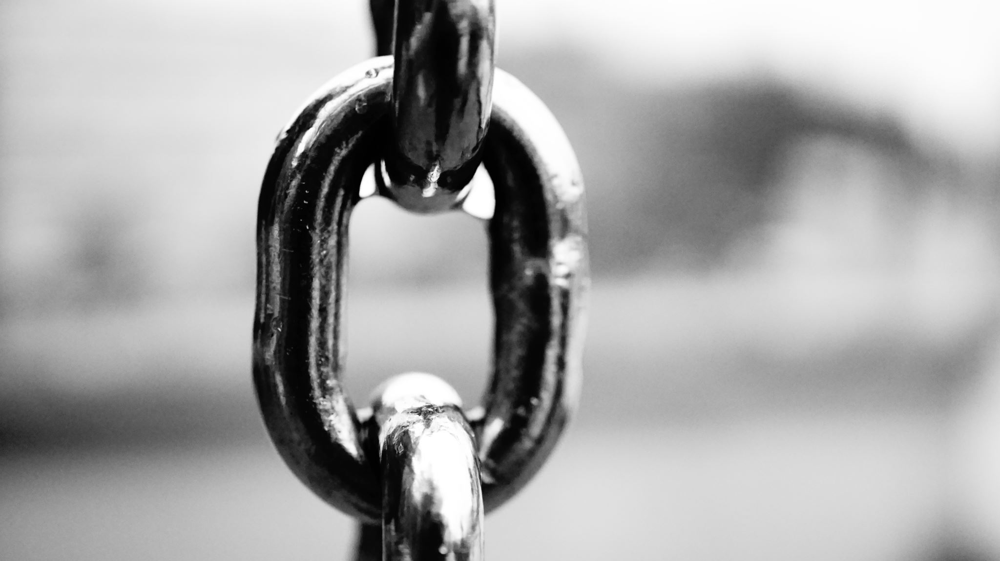
BLockCHain II
Block chain has much more uses outside of Cryptocurrency
NFTs are an example. This link 20 Real-World Uses for Blockchain Technology | The Motley Fool shows many interesting used of blockchain

Slide 7
Bitcoin
Bitcoin is a crypto currency. It is the first crypto currency.
Bitcoin first appeared in 2008. It is credited to Satoshi Nakamoto This is probably just a pseudonym. That is not important.
Bitcoin and crypto currency are news items today.
With rising inflation and less confidence in the dollar more people will consider it

Slide 8
Bitcoin
A search of the news can find many articles ranging from United States towns and states starting their own mining pools all the way to conversations about the Russian government trying to hide from sanctions by using crypto currency.

Slide 9
Bitcoin mining
Bitcoin mining is very processor intensive.
The proof of work algorithm is a simple algorithm that just keeps encrypting and adding a number until it is less than a target. This takes millions of tries.

Slide 10
Mining in a POOL
This goal of this project is to build a pool miner that uses distributed programming to split the job it receives from the pool to various PCs and other devices.

Slide 11
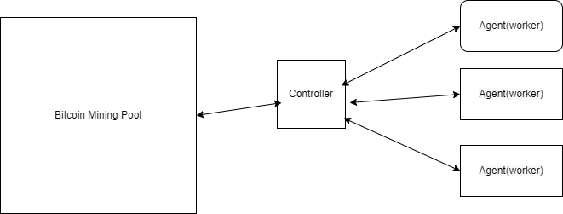
Components of the system

Slide 12
POOL
Pool is a bitcoin mining pool. Pooled mining is a way to share resources in order to increase the chances of successfully mining. Due to difficulty this is the only way to successfully mine without specialized equipment such as ASICs.
The pool I have used is Slushpool.

Slide 13
Controller
Controller does as the name states. This component connects to the Pool
It joins the pool then it gets jobs from the pool.
It distributes the job to the agents(workers)
It waits for agents to complete their part of the proof of work.
It sends these back to the POOL

Slide 14
Controller Pool communications
Communication is done over sockets. The protocol is tcp/ip
On top of that It uses the STRATUM V1 Protocol
Data is sent between the two systems as JSON via sockets

Slide 15
Communication Details Controller to Pool METHODS FOR communications
Controller sends the following methods
mining.subscribe This subscribes the user to the POOL
mining.authorize This handles the authoization
mining.submit this is the method for submitting a Nonce
Each of these items are serialized to json and sent to the POOL
These two are sent as separate packets using a socket.
At this point the controller waits for the following items to return

Slide 16
Communication Details POOL to CONTROLLER METHODS FOR communications
THE following are METHODS returned from the Controller
mining.set_difficulty This is important because it will contain a value for the difficulty. Difficulty will be used to create the Target Difficulty can change every 10 minutes
mining.notify is the actual job data mining.notify also contains a value to indicate whether the miner should forget all other items it is working on

Slide 17
Log of communication between controller and
Provide some examples of the data transfer between Controller and Pool
mining.set_difficulty This is the actual job data
This is the job that will be split and sent to the available agents
Put a sample in here
This contains a value for clearing all other jobs. It basically says to clear the queue and start with the Job in this message. If it is true all jobs are cleared.

Slide 18
Communication Responses
These are from Pool to Controller.
Every client method should get a response.
mining.subscribe Gets a response with the extranonce2
mining.authorize gets response indicating that the controller was authorized
mining.submit gets a response indicating success of the submit. True means the controller won.

Slide 19
Controller functionality
The Controller will handle the cryptographic tasks of creating the Merkle Root
It will create the coinbase
It will create the initial header

Slide 20
At this time go over the code for the controller

Slide 21

At this time go over code for agent

Slide 22

This ends the slide presentation the rest will be app demonstration

