Slide 1
Code Club
Week 2
Variables, Boolean and Conditions

Slide 2
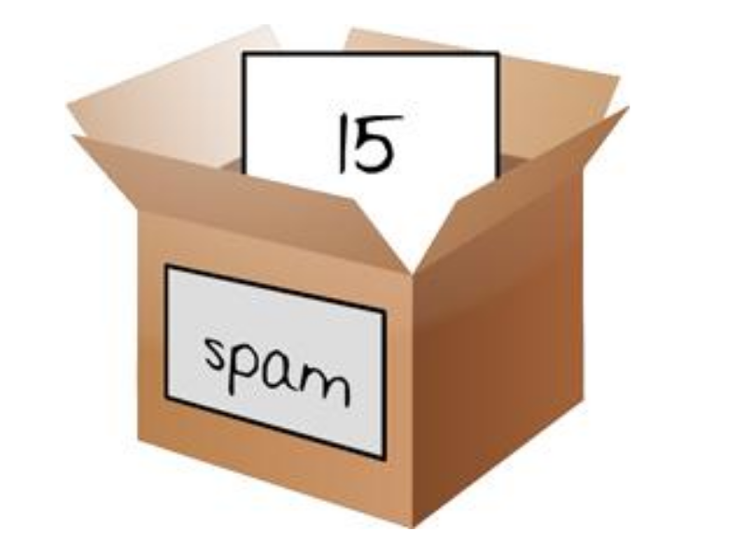
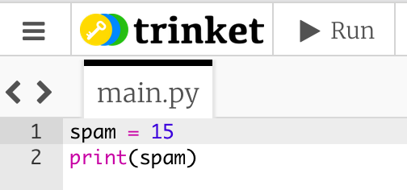
A little review on variables
When we program, we will often want to save values so we can use them later
We can store values in variables
Variables are like boxes that can hold values in them.

Slide 3

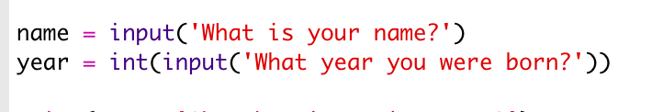
Variable types
Variables have Types of Data. They can store
For the moment we will work with only 2 types
Integers (or Int) and Strings
We can have many variables in a program

Slide 4
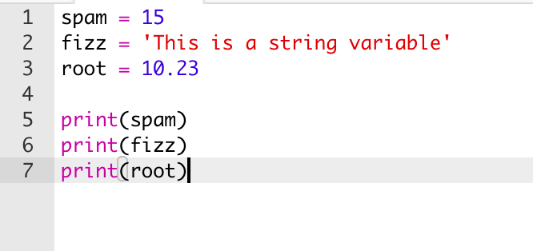
Can you guess the output of this program?

Slide 5
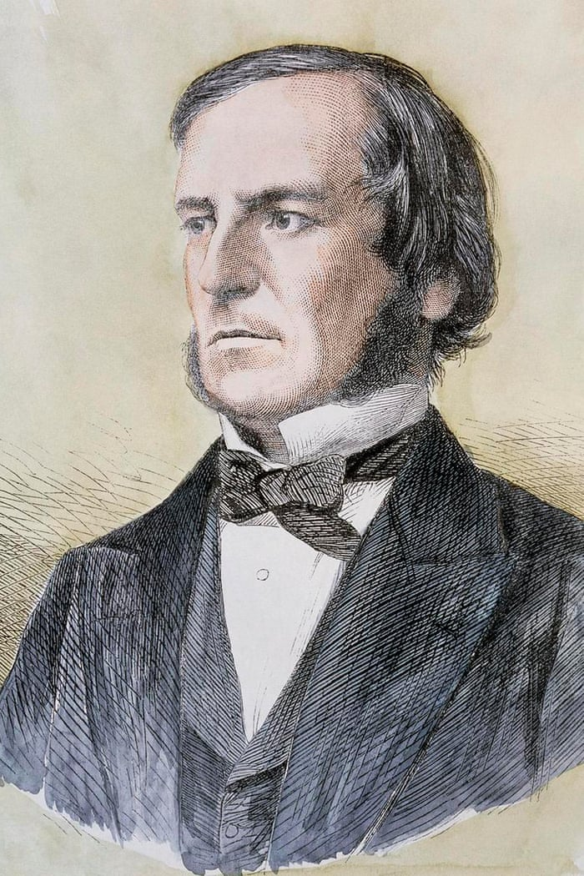
Charles Boole
English Mathematician (1815 – 1864)
Invented the Boolean Algebra
In Boolean only 2 values exists: true and false
We are going to use Boolean Values to understand conditions

Slide 6
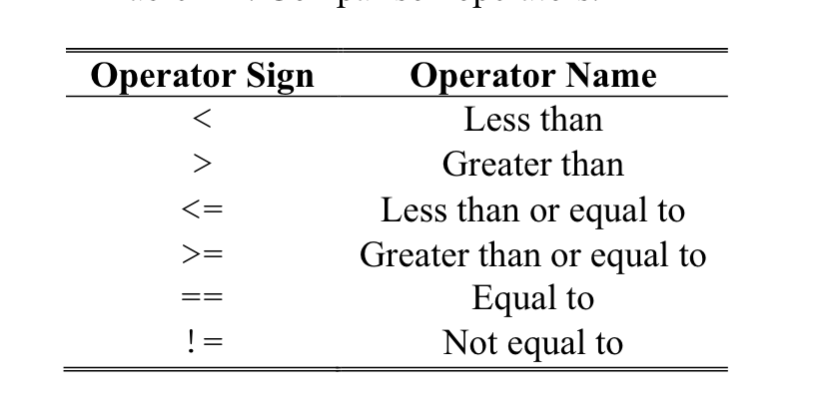
Conditions
Is an expression that combines two values with a comparison operator (such as < or >) and evaluates to a Boolean value
Is just another name for an expression that results in True or False

Slide 7
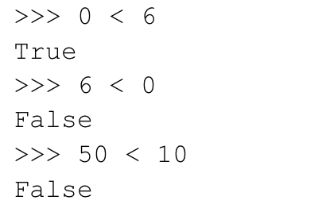
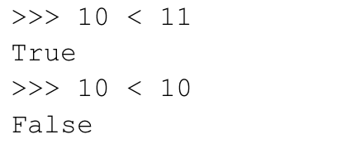
Conditions Examples
*10 is not less than 10. It’s Equal!

Slide 8
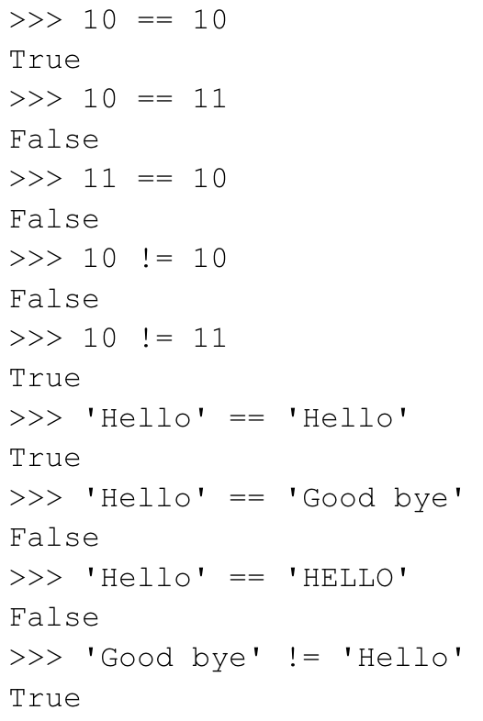

Slide 9
Let’s code in Python
Open your Internet Browser and go to
bit.ly/CCFULHAM
Click on the Week 2’s project steps

