Slide 1
Code Club
Week 1
Welcome

Slide 2
Welcome to our Code Club
My Name is Ralph
I am a programmer for +10 years
I will be your club leader and teach you to code! 👨🏻‍💻

Slide 3
Welcome to our Code Club
What is your name?
How old are you?
What do you know about computer programming?

Slide 4
Code Club Rules
Be kind with each other
Listen when the club leader explains
Use the equipment carefully

Slide 5
Code Club
Week 1
Computer Science Basics

Slide 6
Computers
Computers are very useful machines
Can you tell me examples of computers?
learning to program a computer is easy
If you can read a book, you can program a computer.

Slide 7
Computer Programs
A computer program is just a bunch of instructions run by a computer
Just like a storybook or a cook receipt is just a whole bunch of sentences read by the reader.
Instructions are like the turn by turn instructions you might get for walking to a friend’s
Turn left at the light, walk two blocks, keep walking
The computer follows each instruction that you give it in the order that you give it.

Slide 8
Programming Language
In order to tell a computer what you want it to do, you write a program in a language that the computer “understands”.
The programming language of the club is named Python
There are many others: Java, C, Pascal, JavaScript…
Python it's a serious programming language used by professional computer programmers but it is also easy to learn

Slide 9
Data Types
There are certain types of information that a computer can process.
Integers: 1, 2, 10, 9284
Whole numbers
floating point numbers: 5.0 12.54 4925.294
In mathematics, 5.0 is still considered an integer and the same as the number 5, but in computer programming the computer considers any number with a decimal point as not an integer
String: “This is a String”, “A”, “String is a text”
A string is a little chunk of text.

Slide 10
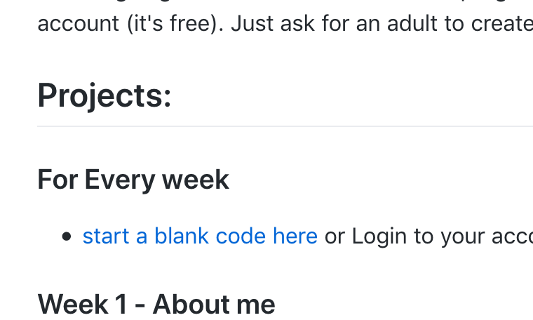
Let’s code in Python
Open your Internet Browser and go to
bit.ly/CCFULHAM

Slide 11
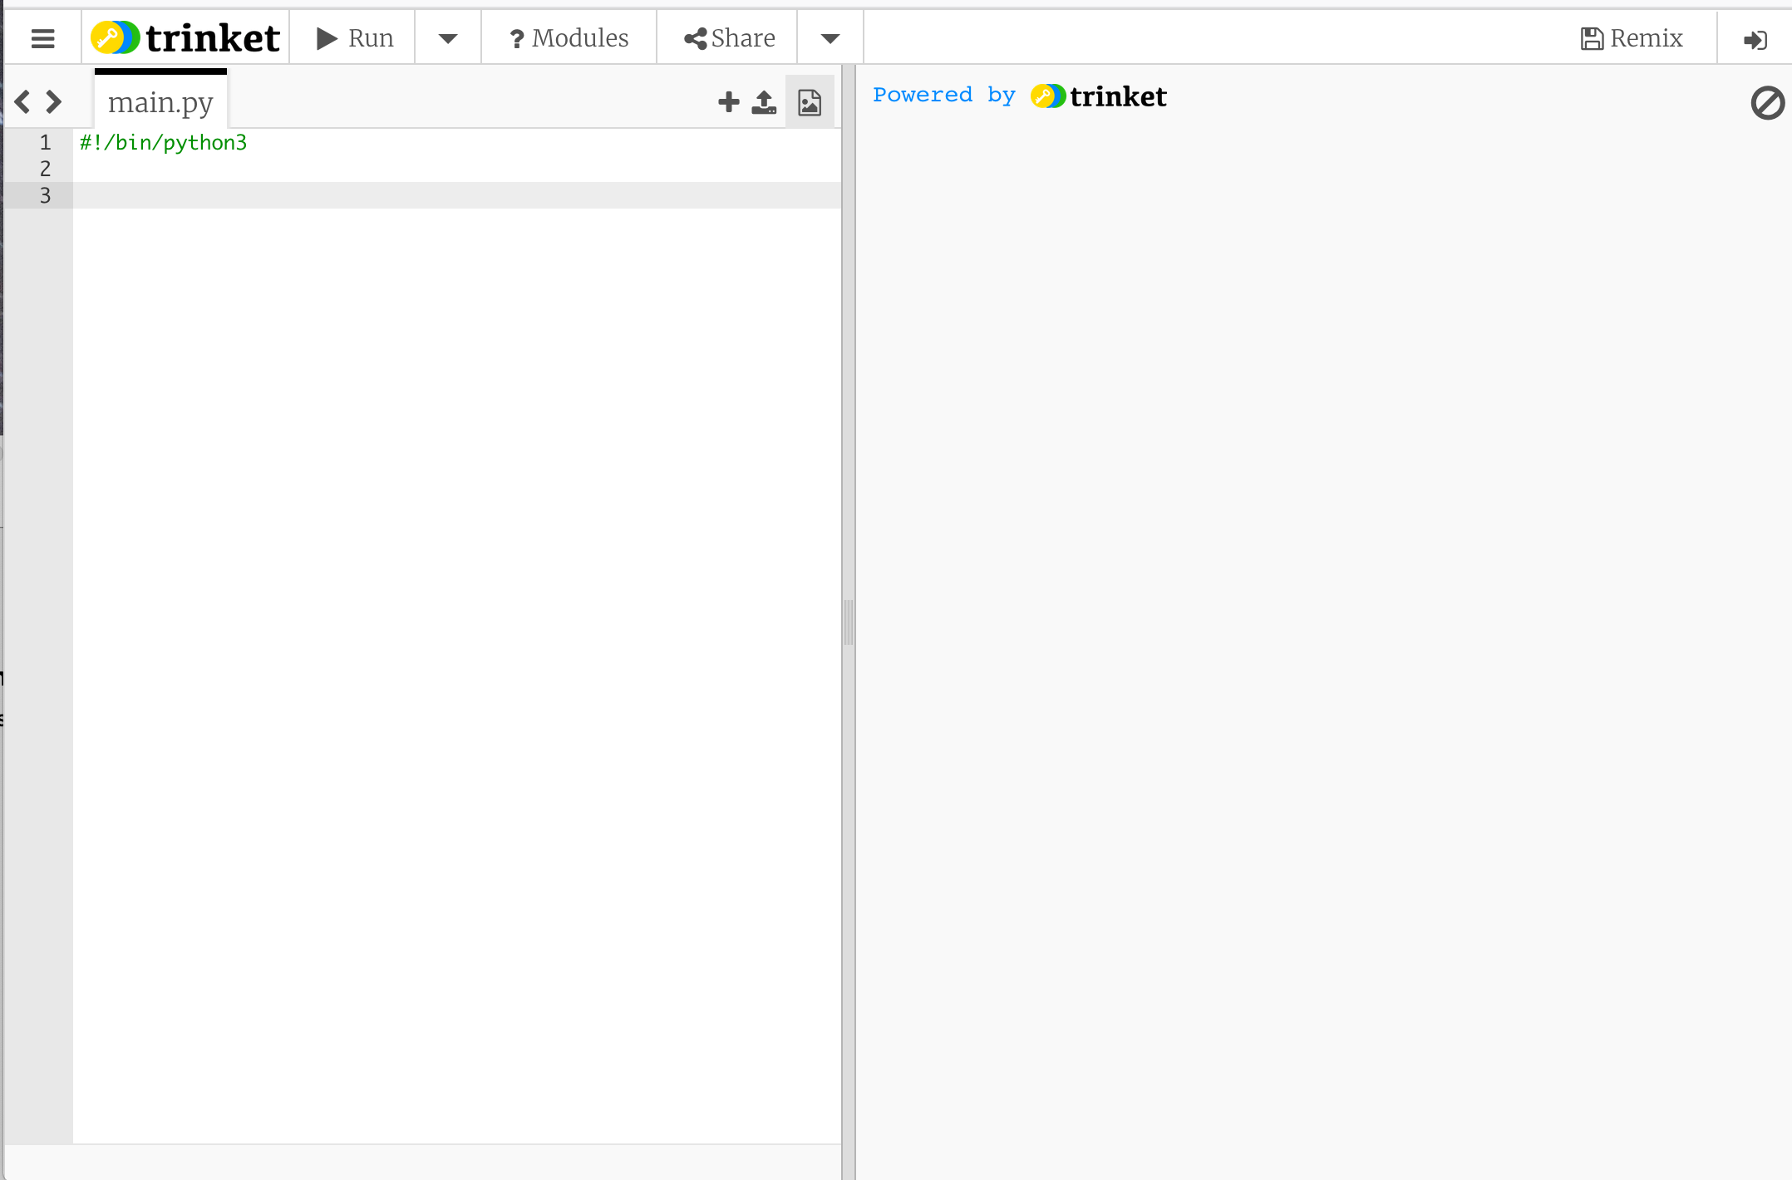
CODE EDITOR
CONSOLE OUTPUT
Where you write the instructions
Where you see the results

Slide 12
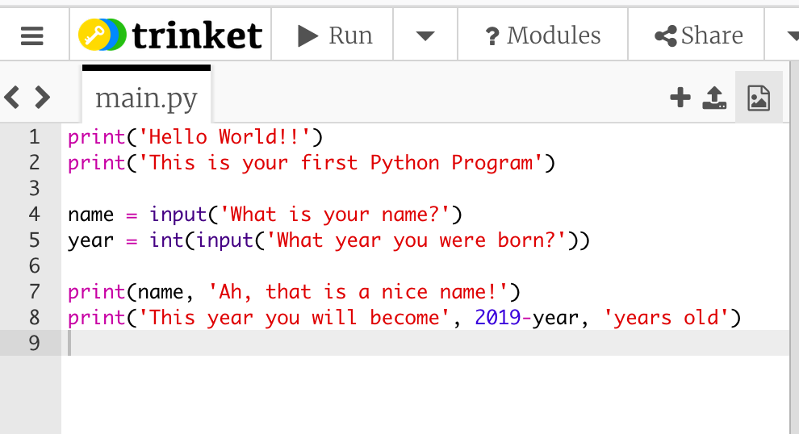
Hello world!
Write this program and when ready click on Run

Slide 13
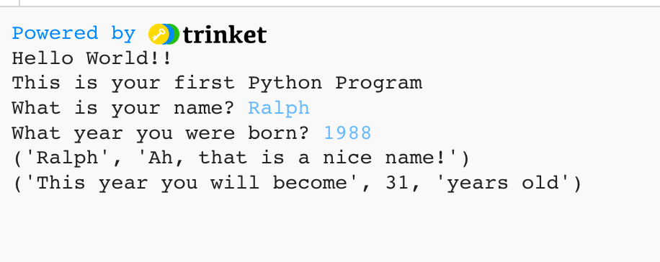

Slide 14





Important
Instruction to print the content to the console
A example of String
Instruction to the user type something in the keyboard
Math Operation
?

Slide 15
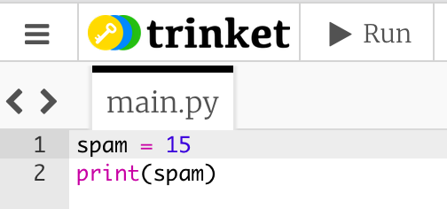
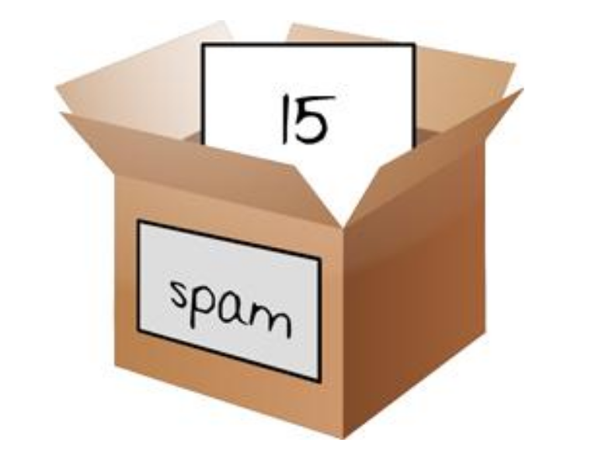
Variable
When we program, we will often want to save values so we can use them later
We can store values in variables
Variables are like boxes that can hold values in them.

Slide 16
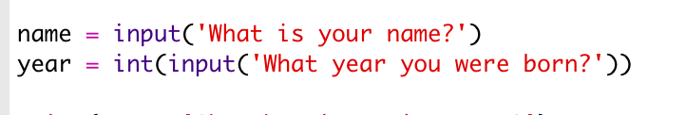
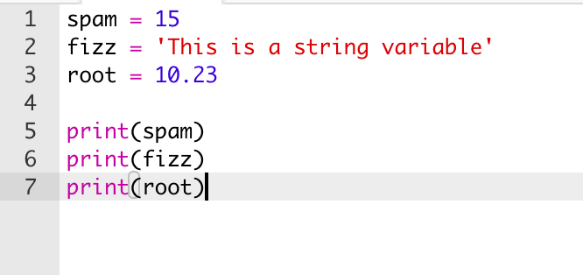
Variable
Variables have datatypes
We can have many variables in a program

Slide 17
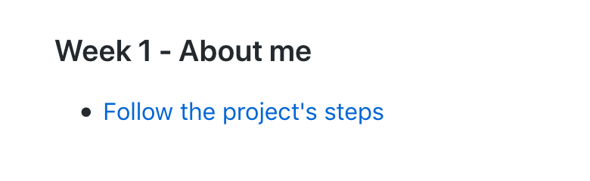
Let’s code in Python
Open your Internet Browser and go to
bit.ly/CCFULHAM

