Slide 1

IBM Applied Data Science Capstone Project
Opening up a Fast Food Restaurant in Chennai
By
Ram Anand
03-May-2020

Slide 2
Business Problem
The India online food delivery market attained a value of nearly USD 2,926 million in 2019
Rapid digitization and growth in both online buyer base and spending will help India's online food industry to become a $8 billion market by 2022
The objective of this capstone project is to analyze the neighborhood in Chennai and choose the best place for people who are looking to start up a Fast Food Restaurant through data analysis and clustering.

Slide 3
Data required for the analysis
List of neighborhoods in Chennai
Location data of List of neighborhoods in Chennai
Venues near the neighborhoods in Chennai
Source of data and methods to extract it
For the list of neighborhoods in Chennai, it can be extracted from Wikipedia from the link https://en.wikipedia.org/wiki/Areas_of_Chennai . The list of neighborhoods is extracted from the link through web scrapping package in python called BeautifulSoup.
For the location of the list of neighborhoods, it can be extracted with the help of geocoder library in python once the list of neighborhoods is converted into a data frame.
Venues near the neighborhoods in Chennai can be collected from Foursquare database through their API.

Slide 4
Methodology
Web scrapping the Wikipedia page using BeautifulSoup to obtain the list of neighborhoods in Chennai.
The data frame was then cleaned by removing the unnecessary data for further analysis
The latitude and longitude of the neighborhoods were obtained thorough the geocoder library available in the python.
The location data and name list data were combined for further analysis
Venues near the neighborhoods were obtained from Foursquare database was used through their API.
The data frame was grouped based on the neighborhoods taking the mean of the frequency of each venue category occurrence.
From this database, the Fast Foods Restaurant venue category was filtered along with its neighborhood.
K-means clustering was performed on the data frame and the neighborhood was split into 5 clusters based on frequency of occurrence of Fast Food Restaurants in the neighborhoods.
The clusters were then visualized on the map of Chennai.
The best option was chosen based on minimum number of occurrences of Fast Food Restaurant in the neighborhood for having less competition.

Slide 5
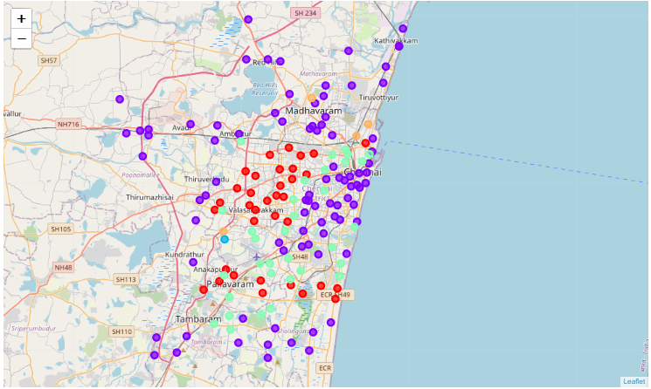
Result
Through K-means clustering the results were categorized into following 5 clusters based on frequency of occurrence of Fast Food Restaurants:
Cluster 1 (Red), Cluster 2 (Violet), Cluster4 (Green): The neighborhoods in this cluster have high number of Fast Food Restaurants.
Cluster 5 (Orange): The neighborhoods in this cluster have low to moderate number of Fast Food Restaurants.
Cluster 3 (Blue): The neighborhood in this cluster has the lowest number of Fast Food Restaurants.

Slide 6
Discussion
The neighborhoods in Cluster 1 (Red), Cluster 2 (Violet), Cluster4 (Green) have high number of Fast Food Restaurants. Hence it is challenging to open a Fast Food Restaurant in these neighborhoods unless its unique and has a great brand image.
The neighborhoods in Cluster 5 (Orange) have low to moderate number of Fast Food Restaurants. Hence it has less competition than the clusters 1,2 and 4. Opening up a restaurant in these neighborhoods might require some promotion.
The neighborhood in Cluster 3 (Blue) has the lowest number of Fast Food Restaurants. Hence, it is the best option to open up a Fast Food Restaurant as it has no competitors.

Slide 7
Recommendations
Based the analysis, for people who are planning to open a Fast Food Restaurant it is recommended to open in the neighborhood areas of cluster 3, which is the best option if they are willing to have no competition.
If they can invest in some brand promotion activities, they can open in the neighborhoods in cluster 5 as they have comparatively low competition than the clusters 1,2 and 4.

Slide 8
Conclusion
In this project, the business problem was identified based on the trends, required data was obtained, cleaned, analyzed and split into clusters and finally recommendations were given based on the obtained results.
The results of this project will be helpful for people who are looking forward to open a Fast Food Restaurant in Chennai.

Slide 9


