Slide 1
CS35L – F16
Slide set: | 1.1
Slide topics: | Linux basics
Assignment: | 1

Slide 2
What’s this class about?
“Fundamentals of commonly used software tools and environments, particularly open-source tools to be used in upper division computer science courses.”

Slide 3
What is open source software?
Source code is publicly available
Anyone is allowed to modify the source code
Examples
Firefox
Android
Apache

Slide 4
GNU/Linux
Open-source operating system
Kernel: core of operating system
Allocates time and memory to programs
Handles file system and communication between software and hardware
Shell: interface between user and kernel
Interprets commands user types in
Takes necessary action to cause commands to be carried out
Programs

Slide 5
Which Linux for this course?
Ubuntu Linux Distribution
Most popular
Frequently updated, fixed release cycle (6 months)
Simple installation and booting
Nice set of pre-installed packages
Seasnet servers:
Red Hat

Slide 6
Options
1) SEAS Server – best option, highly recommend
lnxsrv.seas.ucla.edu
Username: SEAS ID
Password: SEAS password
On windows: putty or cygwin
2) On your computer
Install or try Ubuntu
Run with Windows (https://wiki.ubuntu.com/WubiGuide)
Easy to remove Ubuntu from Windows via Control Panel, if you don’t need Ubuntu.

Slide 7
3) Virtual Machine
VMWare
Virtual Box
4) Live CDs on BH3760 Computers
Don’t install Ubuntu
Try Ubuntu

Slide 8
Connecting to SEAS from Windows
Putty
Recommended
Small and easy to use
Homepage: http://www.chiark.greenend.org.uk/~sgtatham/putty/download.html
Download: http://the.earth.li/~sgtatham/putty/latest/x86/putty.exe
Host name: lnxsrv.seas.ucla.edu
User name: your SEAS user name

Slide 9
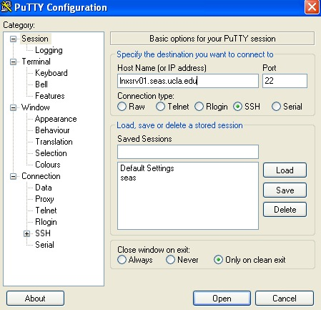
Putty

Slide 10
Connecting to SEAS from OS X or Linux
Terminal
$ ssh username@lnxsrv.seas.ucla.edu
Username = your SEAS user name

Slide 11
Command Line Interface vs. Graphical User Interface
CLI
GUI
Steep learning curve
Pure control (e.g., scripting)
Cumbersome multitasking
Convenient remote access
Intuitive
Limited control
Easy multitasking
Bulky remote access

Slide 12
The Basics: Shell
<up arrow>: previous command
<tab>: auto-complete
!!: replace with previous command
![str]: refer to previous command with str
^[str]: replace with command referred to as str

Slide 13
Files and Processes
Everything is either a process or a file:
Process: an executing program identified by PID
File: collection of data
A document
Text of program written in high-level language
Executable
Directory
Devices

Slide 14
Linux File System Layout
Tree structured hierarchy
/
root
bin
dev
home
usr
tmp
lakers
celtics
bulls
lib
README
music
doc
game1
game2
Notes:
Each file is under a directory.
A directory is also a file.
Only one root “/”.
Regular files can only be leaves.
e.g., documents, music, etc.

Slide 15
Absolute Path vs. Relative Path
/
root
bin
dev
home
usr
tmp
lakers
celtics
bulls
lib
README
music
doc
game1
game2
Current directory: home

Slide 16
The Basics: Moving Around
pwd: print working directory
cd: change directory
~ home directory
. current directory
/ root directory, or directory separator
.. parent directory

Slide 17
The Basics: Dealing with Files
mv: move/rename a file
cp: copy a file
rm: remove a file
r: remove directories and their contents recursively
mkdir: make a directory
rmdir: remove an empty directory
ls: list contents of a directory
d: list only directories
a: list all files including hidden ones
l: show long listing including permission info
s: show size of each file, in blocks

Slide 18
The Basics: Changing File Attributes
ln: create a link
Hard links: point to physical data
Soft links aka symbolic links (-s): point to a file
touch: update access & modification time to current time
touch filename
touch -t 201101311759.30 filename
Change filename’s access & modification time to (year 2011 January day 31 time 17:59:30)

Slide 20
Create two files
$ touch blah1 $ touch blah2
Fill contents into the files and print them
$ echo "Cat" > blah1 $ echo "Dog" > blah2
$cat blah1; cat blah2
Cat
Dog
Create links
$ ln blah1 blah1-hard $ ln -s blah2 blah2-soft $ ls –l
blah1 blah1-hard blah2 blah2-soft -> blah2
Change the original file
$ mv blah1 blah1-new $ cat blah1-hard
Cat
$ mv blah2 blah2-new $ cat blah2-soft
cat: blah2-soft: No such file or directory

Slide 21
Linux File Permissions

Slide 22
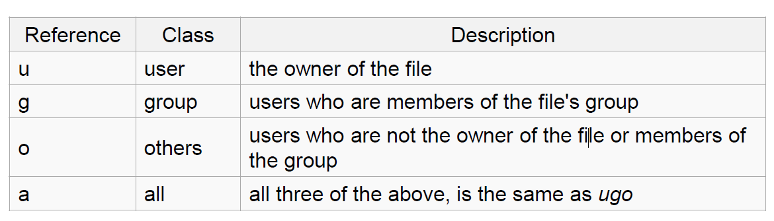
Linux File Permissions
chmod
read (r), write (w), executable (x)
User, group, others

Slide 23
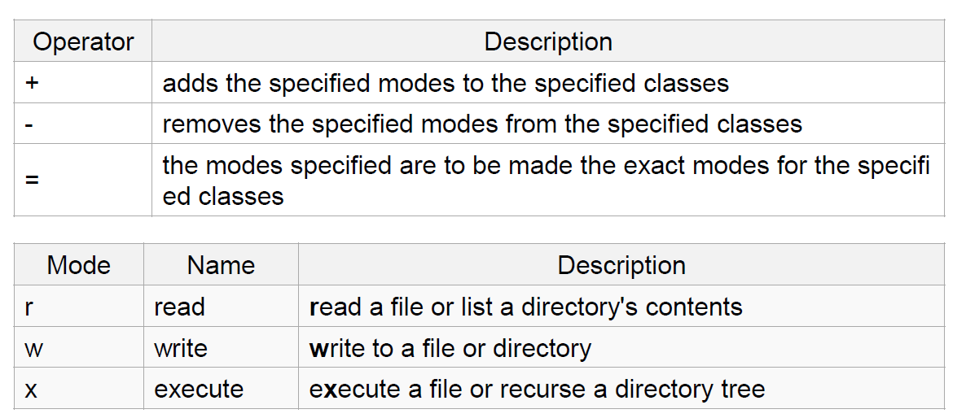
The Basics: chmod (symbolic)

Slide 24
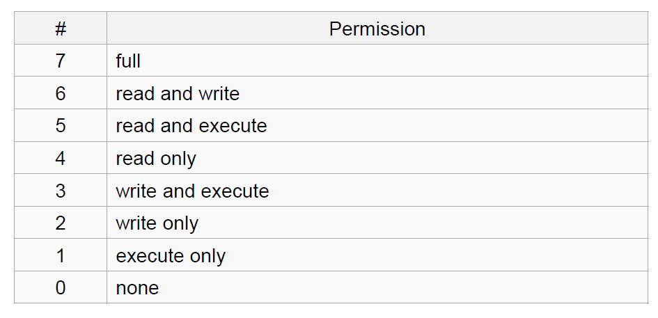
The Basics: chmod (numeric)
Usage
– chmod [''references''][''operator''][''modes''] ''file1'' ...
Example: chmod ug+rw mydir, chmod a-w myfile,
Example: chmod ug=rx mydir, chmod 664 myfile

Slide 25
The Basics: find
-type: type of a file (e.g: directory, symbolic link)
-perm: permission of a file
-name: name of a file
-user: owner of a file
-maxdepth: how many levels to search

Slide 26
File Name Matching
?: matches any single character in a filename
*: matches one or more characters in a filename
[]: matches any one of the characters between the brackets. Use ‘-’ to separate a range of consecutive characters.

Slide 27
find Examples
Examples
find . -name my*
find . -name my* -type f
find / -type f -name myfile –print

Slide 28
man
Extensive documentation that comes preinstalled with almost all substantial Unix and Unix-like operating systems
Usage
read a manual page for a Linux command
man <command_name>
man section command_name
1 User Commands 2 System Calls 3 C Library Functions 4 Devices and Special Files 5 File Formats and Conventions 6 Games et. al. 7 Miscellanea 8 System Administration tools and Daemons
Hit “q” to get out of man page

Slide 29
wh… Commands
whatis <command>: returns Name section of man page
whereis <command>: locates the binary, source, and manual page files for a command

Slide 30
Assignment 1
Hints for first 10 questions:
man man
which
find
readlink
man chmod
man find
find
whereis, man find
find, sort
localedef

Slide 31
Assignment 1 – Example ans1.txt
ans1.txt is specifically for LABORATORY section
1. Here is the answer to question 1
2. Here is the answer to question 2
3. Here is the answer to question 3
…..

Slide 32
Assignment 1 – Example key1.txt
key1.txt is specifically for HOMEWORK section
C-s H E L L O W O R L D
C-s H T M L
C-d
C-n
M-x goto-line Enter 1 2 3 Enter

