Slide 1
CS35L – F16
Slide set: | 1.2
Slide topics: | Linux basics
Assignment: | 1

Slide 2
Follow up – last lab
Hard link vs Soft link internal representation
Creation of groups in UNIX
groupadd – create new group
Useradd – add new user to group
usermod – add existing user to group

Slide 3
man Page Sections
man <command>
First Line: command (number)
Shows what section of the man page you are viewing
Man page sections are: (man man) (1) User Commands (2) System Calls (3) Library functions (4) Devices (5) File formats (6) Games and Amusements (7) Conventions and Miscellany (8) System Administration and Privileged Commands
Notes:
Read is both a command and a system call

Slide 4
Reading man Pages
Standard Headings
Name: name of the command followed by a short description of what the command does
usually one sentence or less
Synopsis: describes how the command is supposed to be used. Example: ls [Option]…[File]…
Description: gives a more detailed definition of the command and provides the OPTIONs available for the command.

Slide 5
Reading man Pages
Other Common Headings
AUTHORS: the people who created or assisted in the creation of the command.
BUGS: lists any known defects or shortcoming of the programs.
EXAMPLES or NOTES: An illustration of how to use the command including general notes.
REPORTING BUGS: where you should report problems you’re having with the command.
COPYRIGHT: The person or organization that holds the copyright to this information; usually a disclaimer that this is free software.
SEE ALSO: Other commands that are related to this command. This section also frequently mentions any other documentation related to this command.

Slide 6
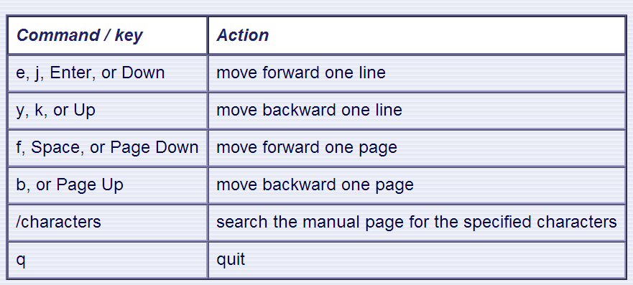
man – Moving Around
Use the following keys and commands to move around in the manual page:

Slide 7
Special Permissions
sticky bit (o+t)
On shared directories, it locks files within the directory from being modified/deleted by users other than the file creator, owner of the directory, or root, even if others have write permissions (Example: /tmp)
setuid, setgid (u+s, g+s)
“set user ID upon execution”
Run an executable with the permissions of the executable’s owner or group

Slide 8
Process: ps and kill
Process
An instance of a computer program in execution
ps
List processes that are currently running
kill
Terminate a certain process
Usage
kill PID

Slide 9
Daemon
A process that runs in the background
Example: cron
Enables users to schedule jobs to run periodically at certain times (cron jobs)
Usage: Full Backup every month

Slide 10
diff
A file comparison utility that outputs the differences between two files.
Shows the changes between one version of a file and a former version of the same file
Usage
diff original_file new_file
diff –u original_file new_file

Slide 11
wget
A computer program that retrieves content from web servers
Usage
wget <URL>

Slide 12
Emacs
“The customizable, extensible, self documenting, real-time display editor”
Customizable (no programming)
Users can customize font, colors, etc. in ~/.emacs
Extensible (programming required)
Run Lisp scripts to define new commands (dired)
Self-documenting
C-h r (manual) and C-h t (tutorial)
Real-time
Edits are displayed onscreen as they occur

Slide 13
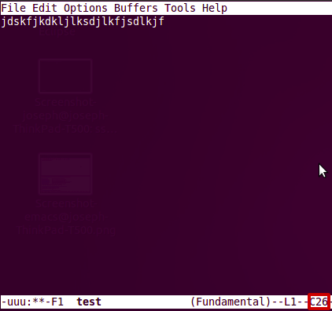
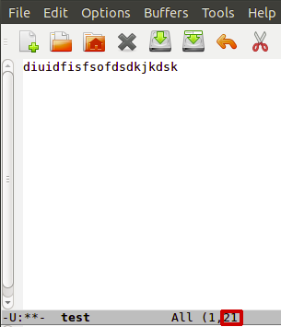
Getting Started
Install emacs
Should be installed already
Emacs has both GUI and CLI
All emacs commands start with “C” or “M”
“C” = ctrl; “M” = alt (Windows) / option(Mac)
Starting emacs
emacs <filename>
Exiting emacs
C-x C-c

Slide 14
Basic Editing
Insert text by simply typing it
Undo by typing C-x u
Save changes by typing C-x C-s
Copy, cut, paste
M-w (copy), C-w (kill), C-y (yank)
Command repetition
M-# <command> (M-2 C-n or M-5 C-f)

Slide 15
Directory edit (dired) (C-x d)
Creates an Emacs buffer containing list of dir
Allows you to operate on files
remove, rename, encrypt, decrypt, edit
Allows you to navigate filesystem
Switch to different directories and list content

Slide 16
Other Emacs Tricks…
Emacs as shell
Run shell commands
M-! <command>, M-x shell (interactive shell)
Emacs as IDE
Compile programs
M-x compile, then specify command to compile
Tip for homework: gcc hello.c –o hello
Run the executable by running the shell command
./hello

Slide 17
Submission Rules – Column Number Check
Emacs editor
M-x column-number-mode or
Options → Show/Hide → Check “Column Numbers”
The number inside the box is the Column Number.

Slide 18
80-Column Restriction in emacs
Add the following line to ~/.emacs
(setq-default fill-column 80)
Open your text file
Turn on AutoFill mode
“M-x auto-fill-mode” or
press “M-q” to auto wrap each paragraph

