Slide 1
CS35L – F16
Slide set: | 4.2
Slide topics: | Source control, Git
Assignment: | 4

Slide 2
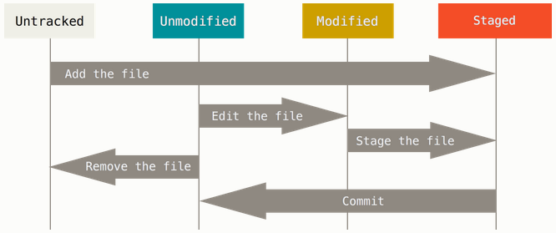
Git File Status Lifecycle
Tracked

Slide 3
Git Example
Project
games: pacman.c, pacman.h, README
Create repository to track new project
$ git init (creates .git dir w/ all necessary repo files)
Is the project tracked?
No, need to add files and do an initial commit
$ git add pacman.c pacman.h README
$ git commit –m “initial commit of my project”

Slide 4
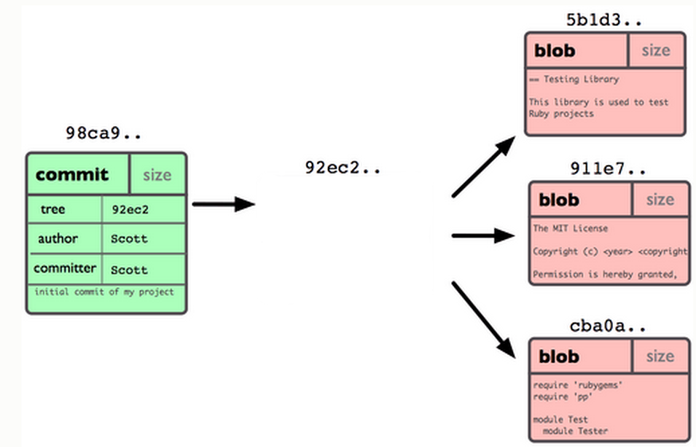
Git Repo Structure
Snapshot
tree |  | size
blob | 5b1d3 | README
blob | 911e7 | pacman.c
blob | cba0a | pacman.h

Slide 5
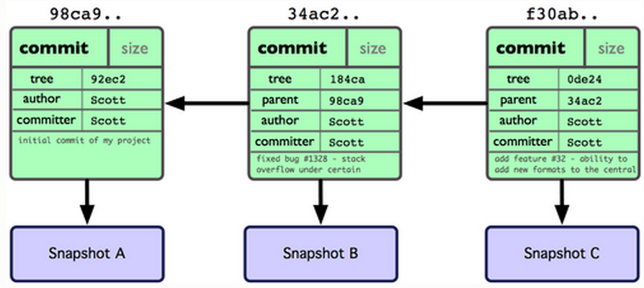
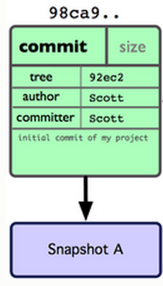
After 2 More Commits…

Slide 6
What Is a Branch?
A pointer to one of the commits in the repo (head) + all ancestor commits
When you first create a repo, are there any branches?
Default branch named ‘master’
The default master branch
points to last commit made
moves forward automatically, every time you commit

Slide 7
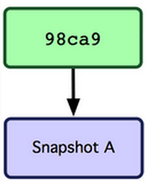
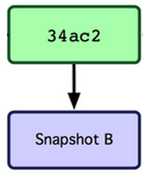
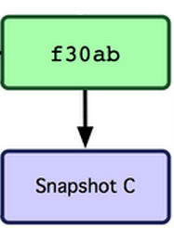
Where Is Master?
master
master

Slide 8
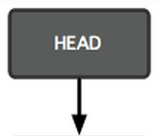
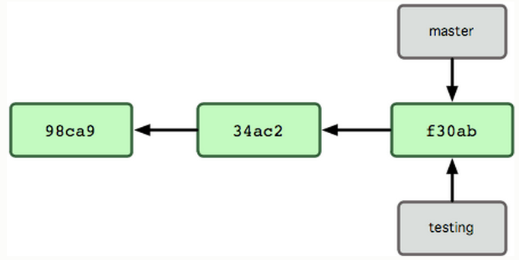
New Branch
Creating a new branch = creating new pointer
$ git branch testing
Where is new branch created?
Current commit
Where is current commit?
HEAD

Slide 9
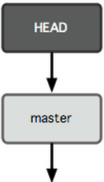
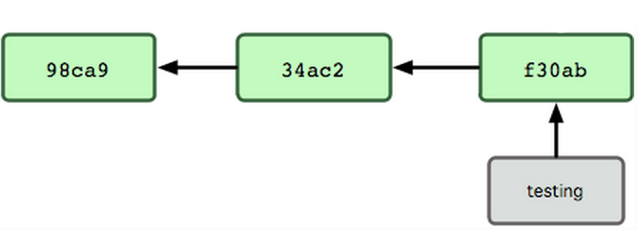
New Commit
What happens if we make another commit?
345f5

Slide 10
Switching to New Branch
Check out new branch
$ git checkout <branch_name>
$ git checkout testing

Slide 11
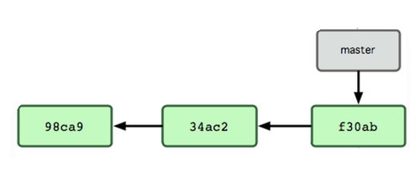

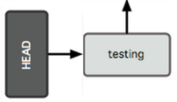
Commit After Switch

Slide 12
Why Branching?
Experiment with code without affecting main branch
Separate projects that once had a common code base
2 versions of the project

Slide 13
Homework 4
Publish patch you made in lab 4
Create a new branch “quote” of version 3.0
Branch command + checkout command (git branch quote v3.0; git checkout quote)
$ git checkout v3.0 -b quote
Use patch from lab 4 to modify this branch
Patch command
$ patch –pnum < quote-3.0-patch.txt
Modify ChangeLog-2008 file in diffutils directory
Add entry for your changes similar to entries in ChangeLog
Commit changes to the new branch
$ git add . $ git commit –F <Changelog file>
Generate a patch that other people can use to get your changes
$ git format-patch -[num] --stdout > formatted-patch.txt
Test your partner’s patch
Check out version 3.0 into a tmp branch
Apply patch with git am command: $ git am < formatted-patch.txt
Build and test with $ make check
Make sure partner’s name is in HW4.txt for #8

Slide 14
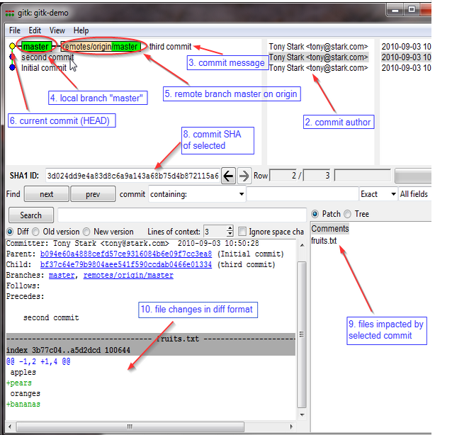
Gitk
A repository browser
Visualizes commit graphs
Used to understand the structure of the repo
Tutorial: http://lostechies.com/joshuaflanagan/2010/09/03/use-gitk-to-understand-git/

Slide 15
Gitk
SSH into the server with X11 enabled
ssh -X for OS with terminal (OS X, Linux)
Select “X11” option if using putty (Windows)
Run gitk in the ~eggert/src/gnu/emacs directory
Need to first update your PATH
$ export PATH=/usr/local/cs/bin:$PATH
Run X locally before running gitk
Xming on Windows

