Slide 1
Costco Inventory Management
Objective:
INV OH(inventory on hand) - is good or bad
Distribution For various product category:
Various category(segment)
Or depot
Or region
Inventory turns:
Understand which product ID causing low inventory turns, hence more inventory on hand.
Region where we have inventory
Geo map - drill down capabilities
Region to district
District to warehouse
Inv OH (Inventory on hand) distribution
Sales distribution
Loss of sales
Week of supply vs rate of sales
Top performer/ under performer in terms of product category
Buyers
GMM
AMM
Inventory specialist

Slide 2
Region hierarchy:
Region (10)--> Districts (35) --> Warehouse (675)
Regions:
Northwest, La region, Bay area, Southeast, Business centers, Business deliv-other, Mid west, Northwest, Sd region, Texas region
Product hierarchy:
Product Category (Major department-7)→ Product sub-category (Department in major department-87) → Product Segment (major category in department-634)→ Item (10,229)
Ex: Food→ Tobacco, candy.. → Smokeless Tobacco, Premium → Marlboro, Garrett scotch thrift Can
Note: Group category: 3116
Major Departments:
Food
Softlines
Hardlines
Fresh Food

Slide 3
Key Terms:
OH: on hand
WOS: Week of supply
LY: last Year
LP: Last period last month
TY: This Year
4 week supply:
4 week shipped:
Inline OH:
Online OH:
Buy-in-OH:
In-yard OH:
Avg-transit-week:

Slide 4
Buy in OH:
Buyin $ LP: Buyin $ LP = CALCULATE(SUM('Buy-in OH'[OH_$]),'Buy-in OH'[T_TYPE] = "LP")
Buyin $ LY: Buyin $ LY = CALCULATE(SUM('Buy-in OH'[OH_$]),'Buy-in OH'[T_TYPE] = "LY")
Buyin $ TY: Buyin $ TY = CALCULATE(SUM('Buy-in OH'[OH_$]),'Buy-in OH'[T_TYPE] = "TY")
Buyin Inc % Period: Buyin Inc % Period = (DIVIDE(DIVIDE (( 'Buy-in OH'[Buyin Qty TY] - 'Buy-in OH'[Buyin Qty LP] ),'Buy-in OH'[Buyin Qty LP],0), 100 ))
Buyin Inc % Year: Buyin Inc % Year = (DIVIDE(DIVIDE (( 'Buy-in OH'[Buyin Qty TY] - 'Buy-in OH'[Buyin Qty LY] ),'Buy-in OH'[Buyin Qty LY],0), 100 ))
Buyin Qty LP: Buyin Qty LP = CALCULATE(SUM('Buy-in OH'[OH_QTY]),'Buy-in OH'[T_TYPE] = "LP")
Buyin Qty LY: Buyin Qty LY = CALCULATE(SUM('Buy-in OH'[OH_QTY]),'Buy-in OH'[T_TYPE] = "LY")
Buyin Qty TY: Buyin Qty TY = CALCULATE(SUM('Buy-in OH'[OH_QTY]),'Buy-in OH'[T_TYPE] = "TY")

Slide 5
Inline OH
Inline-In-Transit $ LP: Inline In-Transit $ LP = CALCULATE(SUM('Inline OH'[In-Transit $]),'Inline OH'[T_TIME] = "LP")
Inline-In-Transit $ LY: Inline In-Transit $ LY = CALCULATE(SUM('Inline OH'[In-Transit $]),'Inline OH'[T_TIME] = "LY")
Inline-In-Transit $ TY: Inline In-Transit $ TY = CALCULATE(SUM('Inline OH'[In-Transit $]),'Inline OH'[T_TIME] = "TY")
Inline-In-Transit Qty LP: Inline In-Transit Qty LP = CALCULATE(SUM('Inline OH'[In-Transit Qty]),'Inline OH'[T_TIME] = "LP")
Inline-In-Transit Qty LY: Inline In-Transit Qty LY = CALCULATE(SUM('Inline OH'[In-Transit Qty]),'Inline OH'[T_TIME] = "LY")
Inline-In-Transit Qty TY: Inline In-Transit Qty TY = CALCULATE(SUM('Inline OH'[In-Transit Qty]),'Inline OH'[T_TIME] = "TY")
Inline Inc %: Inline Inc % = (DIVIDE(DIVIDE (( [Inline OH QTY TY] - [Inline OH QTY LY] ),[Inline OH QTY LY],0), 100 ))
Inline Inc % Period: Inline Inc % Period = (DIVIDE (DIVIDE(( [Inline OH QTY TY] - [Inline OH QTY LP] ),[Inline OH QTY LP], 0), 100 ))
Inline NSI $ LP : Inline NSI $ LP = CALCULATE(SUM('Inline OH'[NSI $]),'Inline OH'[T_TIME] = "LP")
Inline NSI $ LY : Inline NSI $ LY = CALCULATE(SUM('Inline OH'[NSI $]),'Inline OH'[T_TIME] = "LY")
Inline NSI $ TY: Inline NSI $ TY = CALCULATE(SUM('Inline OH'[NSI $]),'Inline OH'[T_TIME] = "TY")
Inline NSI Qty LP : Inline NSI Qty LP = CALCULATE(SUM('Inline OH'[NSI Qty]),'Inline OH'[T_TIME] = "LP")
Inline NSI Qty LY : Inline NSI Qty LY = CALCULATE(SUM('Inline OH'[NSI Qty]),'Inline OH'[T_TIME] = "LY")
Inline NSI Qty TY : Inline NSI Qty TY = CALCULATE(SUM('Inline OH'[NSI Qty]),'Inline OH'[T_TIME] = "TY")

Slide 6
Inline OH
Inline-OH $ LP: Inline OH $ LP = CALCULATE(SUM('Inline OH'[OH_Amt]), 'Inline OH'[T_TIME] = "LP")
Inline-OH $ LY: Inline OH $ LY = CALCULATE(SUM('Inline OH'[OH_Amt]), 'Inline OH'[T_TIME] = "LY")
Inline-OH $ TY: Inline OH $ TY = CALCULATE(SUM('Inline OH'[OH_Amt]),'Inline OH'[T_TIME] = "TY")
Inline-OH Qty LP: Inline OH QTY LP = CALCULATE(SUM('Inline OH'[OH_Qty]), 'Inline OH'[T_TIME] = "LP")
Inline-OH Qty LY: Inline OH QTY LY = CALCULATE(SUM('Inline OH'[OH_Qty]),'Inline OH'[T_TIME] = "LY")
Inline-OH Qty TY: Inline OH QTY TY = CALCULATE(SUM('Inline OH'[OH_Qty]),'Inline OH'[T_TIME] = "TY")
Inline WOS Inc % LP: Inline WOS Inc % LP = DIVIDE (DIVIDE(( [Inline WOS TY] - [Inline WOS LP] ),[Inline WOS LP]) , 100 )
Inline WOS Inc % LY: Inline WOS Inc % LY = DIVIDE (DIVIDE(( [Inline WOS TY] - [Inline WOS LY] ),[Inline WOS LY]) , 100 )
Inline WOS LP: Inline WOS LP = IF([Average Inline Sales 4Wk (Qty) LP] + 0 = 0 , "99.99",DIVIDE( [Inline OH QTY LP], [Average Inline Sales 4Wk (Qty) LP]))
Inline WOS LY: Inline WOS LY = IF([Average Inline Sales 4Wk (Qty) LY] + 0 = 0 , "99.99", DIVIDE([Inline OH QTY LY], [Average Inline Sales 4Wk (Qty) LY]))
Inline WOS TY: Inline WOS TY = IF([Average Inline Sales 4Wk (Qty)] + 0 = 0 , "99.99", Divide([Inline OH QTY TY],[Average Inline Sales 4Wk (Qty)]))
Out of Stock: Out Of Stock = IF([Total OH QTY] < 5,"Out Of Stock","In-Stock")
Total-In-Transit $ LP: Total In-Transit $ LP = [Inline In-Transit $ LP] + [Online In-Transit $ LP]
Total-In-Transit $ LY: Total In-Transit $ LY = [Inline In-Transit $ LY] + [Online In-Transit $ LY]
Total-In-Transit $ TY: Total In-Transit $ TY = [Inline In-Transit $ TY] + [Online In-Transit $ TY]

Slide 7
Inline OH
Total-In-Transit Qty LP: Total In-Transit Qty LP = [Inline In-Transit Qty LP] + [Online In-Transit Qty LP]
Total-In-Transit Qty LY: Total In-Transit Qty LY = [Inline In-Transit Qty LY] + [Online In-Transit Qty LY]
Total-In-Transit Qty TY: Total In-Transit Qty TY = [Inline In-Transit Qty TY] + [Online In-Transit Qty TY]
Total Inventory: Total Inventory = [Inline OH $ TY] + [Online OH $ TY] + [Buy In ($)] + [In-Yard OH $ TY]
Total LP: Total LP = Divide( DIVIDE (( [Inline OH QTY TY] + [Online OH QTY TY] ) - ( [Inline OH QTY LP] + [Online OH QTY LP] ) , ( [Inline OH QTY LP] + [Online OH QTY LP] )) , 100 )
Total LY: Total LY = DIVIDE( DIVIDE( ( [Inline OH QTY TY] + [Online OH QTY TY] ) - ( [Inline OH QTY LY] + [Online OH QTY LY] ) , ( [Inline OH QTY LY] + [Online OH QTY LY] ) ) , 100 )
Total OH $ LY: Total OH $ LY = [Inline OH $ LY] + [Online OH $ LY]
Total OH $ TY: Total OH $ TY = [Inline OH $ TY] + [Online OH $ TY]
Total OH QTY: Total OH QTY = [Inline OH QTY TY] + [Online OH QTY TY] iska naam change hona chahiye..last me TY aana chahiye
Total OH Qty LY: Total OH Qty LY = [Inline OH QTY LY] + [Online OH QTY LY]
Total WOS: Total WOS = DIVIDE ( [Inline OH QTY TY] + [Online OH QTY TY], (IF([Average Inline Sales 4Wk (Qty)] + 0 = 0 , "99.99",CALCULATE ([Average Inline Sales 4Wk (Qty)], 'Sales Inline'[T_YPE] = "TY")) + (IF([Average Online Sales 4Wk (Qty)] + 0 = 0 ,"99.99", CALCULATE ([Average Online Sales 4Wk (Qty)],'Sales Online'[T_TYPE] = "TY“ )))))
Total WOS + : Total WOS + = DIVIDE ([Inline OH QTY TY] + [Online OH QTY TY], (IF([Average Inline Sales 4Wk (Qty)] + 0 = 0 , "99.99", CALCULATE ([Average Inline Sales 4Wk (Qty)], 'Sales Inline'[T_YPE] = "TY“ )) + (IF([Average Online Sales 4Wk (Qty)] + 0 = 0 , "99.99", CALCULATE ([Average Online Sales 4Wk (Qty)], 'Sales Online'[T_TYPE] = "TY"))))) * -1
Total WOS LP: Total WOS LP = DIVIDE(([Inline WOS LP] + [Online WOS LP]), 100 )
Total WOS LY: Total Wos LY = DIVIDE(([Inline WOS LY] + [Online WOS LY]),100)
WOS Diff: WOS Diff = ([Total WOS])-('Inline OH'[Inline WOS LY]+'Online OH'[Online WOS LY])
WOS inline:
WOS Meause:

Slide 8
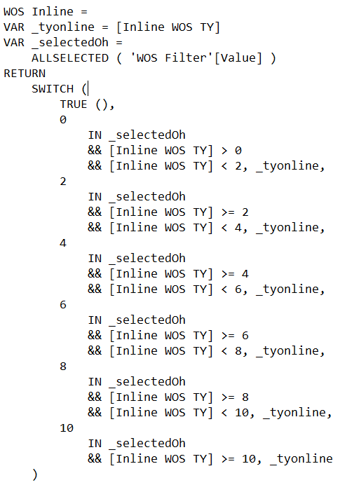
Inline OH
WOS inline:
WOS Meause:

Slide 9
Online OH
Online-In-Transit $ LP: Online In-Transit $ LP = CALCULATE(SUM('Online OH'[In-Transit $]),'Online OH'[T_TYPE] = "LP")
Online-In-Transit $ LY: Online In-Transit $ LY = CALCULATE(SUM('Online OH'[In-Transit $]),'Online OH'[T_TYPE] = "LY")
Online-In-Transit $ TY: Online In-Transit $ TY = CALCULATE(SUM('Online OH'[In-Transit $]),'Online OH'[T_TYPE] = "TY")
Online-In-Transit Qty LP: Online In-Transit Qty LP = CALCULATE(SUM('Online OH'[In-Transit Qty]),'Online OH'[T_TYPE] = "LP")
Online-In-Transit Qty LY: Online In-Transit Qty LY = CALCULATE(SUM('Online OH'[In-Transit Qty]),'Online OH'[T_TYPE] = "LY")
Online-In-Transit Qty TY: Online In-Transit Qty TY = CALCULATE(SUM('Online OH'[In-Transit Qty]),'Online OH'[T_TYPE] = "TY")
Online Inc %: Online Inc % = (DIVIDE (Divide(( [Online OH QTY TY] - [Online OH QTY LY] ),[Online OH QTY LY],0), 100 ))
Online Inc % LP: Online Inc % LP = DIVIDE (DIVIDE(( [Online OH QTY TY] - [Online OH QTY LP] ),[Online OH QTY LP],0) , 100 )
Online NSI $ LP: Online NSI $ LP = CALCULATE(SUM('Online OH'[NSI $] ),'Online OH'[T_TYPE] = "LP")
Online NSI $ LY: Online NSI $ LY = CALCULATE(SUM('Online OH'[NSI $] ),'Online OH'[T_TYPE] = "LY")
Online NSI $ TY: Online NSI $ TY = CALCULATE(SUM('Online OH'[NSI $] ),'Online OH'[T_TYPE] = "TY")
Online NSI Qty LP: Online NSI Qty LP = CALCULATE(SUM('Online OH'[NSI Qty]),'Online OH'[T_TYPE] = "LP")
Online NSI Qty LY: Online NSI Qty LY = CALCULATE(SUM('Online OH'[NSI Qty]),'Online OH'[T_TYPE] = "LY")
Online NSI Qty TY: Online NSI Qty TY = CALCULATE(SUM('Online OH'[NSI Qty]),'Online OH'[T_TYPE] = "TY")
Online OH $ LP: Online OH $ LP = CALCULATE(SUM('Online OH'[OH_Amt]),'Online OH'[T_TYPE] = "LP")
Online OH $ LY: Online OH $ LY = CALCULATE(SUM('Online OH'[OH_Amt]),'Online OH'[T_TYPE] = "LY")
Online OH $ TY: Online OH $ TY = CALCULATE(SUM('Online OH'[OH_Amt]),'Online OH'[T_TYPE] = "TY")

Slide 10
Online OH
Online OH QTY LP: Online OH QTY LP = CALCULATE(SUM('Online OH'[OH_Qty]),'Online OH'[T_TYPE] = "LP")
Online OH QTY LY: Online OH QTY LY = CALCULATE(SUM('Online OH'[OH_Qty]),'Online OH'[T_TYPE] = "LY")
Online OH QTY TY: Online OH QTY TY = CALCULATE(SUM('Online OH'[OH_Qty]),'Online OH'[T_TYPE] = "TY")
Online WOS Inc % LP: Online WOS Inc % LP = DIVIDE (DIVIDE(( [Online WOS TY] - [Online WOS LP] ),[Online WOS LP]) , 100)
Online WOS Inc % LY: Online WOS Inc % LY = DIVIDE (DIVIDE(( [Online WOS TY] - [Online WOS LY] ),[Online WOS LY]) , 100)
Online WOS LP: Online WOS LP = IF([Average online Sales 4Wk (Qty)] + 0 = 0 , "99.99",DIVIDE([Online OH QTY LP],[Average Online Sales 4Wk (Qty) LP],0))
Online WOS LY: Online WOS LY = IF([Average online Sales 4Wk (Qty)] + 0 = 0 , "99.99",DIVIDE([Online OH QTY LY],[Average Online Sales 4Wk (Qty) LY]))
Online WOS TY: Online WOS TY = IF([Average online Sales 4Wk (Qty)] + 0 = 0 , "99.99",DIVIDE([Online OH QTY TY],[Average Online Sales 4Wk (Qty)]))
Total NSI $ LP:Total NSI $ LP = [Inline NSI $ LP] + [Online NSI $ LP]
Total NSI $ LY: Total NSI $ LY = [Inline NSI $ LY] + [Online NSI $ LY]
Total NSI $ TY: Total NSI $ TY = [Inline NSI $ TY] + [Online NSI $ TY]
Total NSI Qty LP: Total NSI Qty LP = [Inline NSI Qty LP] + [Online NSI Qty LP]
Total NSI Qty LY: Total NSI Qty LY = [Inline NSI Qty LY] + [Online NSI Qty LY]
Total NSI Qty TY: Total NSI Qty TY = [Inline NSI Qty TY] + [Online NSI Qty TY]

Slide 11
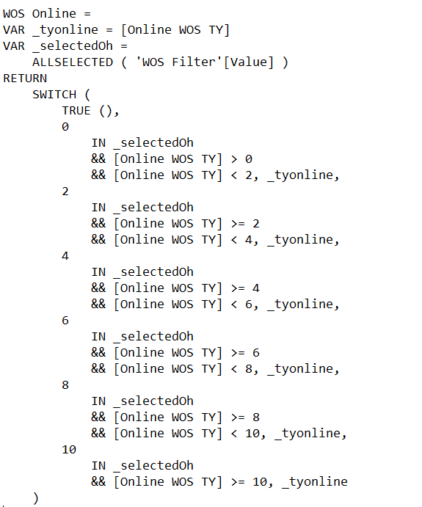
Online OH
WOS online:

Slide 12
Demo Table
Item Name:
Transit days:
WOS:
Potential out of stock = [Transit Days]-[WOS]
Fields Demo
Fields Demo
Fields Demo fields
Fields Demo Order

Slide 13
In Yard OH
In-Yard-Date:
In-Yard OH $:
In Yard OH $ TY: In-Yard OH $ TY = sum('In-Yard OH'[In-Yard OH $])
In Yard OH QTY TY: In-Yard OH QTY TY = sum('In-Yard OH'[In-Yard OH QTY])
On-hands Units
Item Dim
Department Hierarchy: Major Department → Department → Major Category → Item
Department Name(Department-2):
Dept Num:
Group Category:
Item Category:
Item Name (4):
Item Number:
Major Category(3):
Major Dept Long Desc (Major Department-1 ):

Slide 14
Location Dim
Location Id:
Location Number:
Region Code:
Region:
District Code:
District:
Location Long Name:
Location Name:
Company code:
Location Num:
Active Location Indicator:
Depot Indicator:
Location Sub Type:
Loc Latitude:
Loc Longitude

Slide 15
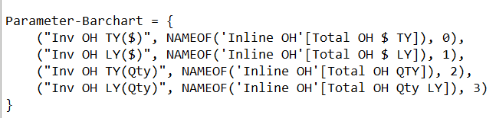
Matrix Dim
Matrix Dim:
Matrix Dim Fields:
Matrix Dim Order:
Matrix Dim = { ("Major Department", NAMEOF('Item Dim'[Major Dept Long Desc]), 0),
("Department Name", NAMEOF('Item Dim'[Department Name]), 1),
("Major Category", NAMEOF('Item Dim'[Major Category]), 2),
("Item Name", NAMEOF('Item Dim'[Item Name]), 3),
("Location", NAMEOF('Location Dim'[Location Name]), 4),
("Region", NAMEOF('Location Dim'[Region]), 5),
("District", NAMEOF('Location Dim'[District]), 6)
}
Parameter-Barchart:
Parameter-Barchart
Parameter-Barchart Fields
Parameter-Barchart order

Slide 16
Sales Inline:
Average Inline Sales 4Wk($): Average Inline Sales 4Wk ($) = SUMX (FILTER ( 'Sales Inline', 'Sales Inline'[T_YPE] = "TY" ),
DIVIDE(( 'Sales Inline'[WK1 Sales Amt] + 'Sales Inline'[WK2 Sales Amt] + 'Sales Inline'[WK3 Sales Amt] + 'Sales Inline'[WK4 Sales Amt] ) , 4))
Average Inline Sales 4Wk($) LP: Average Inline Sales 4Wk ($) LP = SUMX (FILTER ( 'Sales Inline', 'Sales Inline'[T_YPE] = "LP" ),
DIVIDE(( 'Sales Inline'[WK1 Sales Amt] + 'Sales Inline'[WK2 Sales Amt] + 'Sales Inline'[WK3 Sales Amt] + 'Sales Inline'[WK4 Sales Amt] ) , 4))
Average Inline Sales 4Wk($) LY: Average Inline Sales 4Wk ($) LY = SUMX (FILTER ( 'Sales Inline', 'Sales Inline'[T_YPE] = "LY" ), DIVIDE( ( 'Sales Inline'[WK1 Sales Amt] + 'Sales Inline'[WK2 Sales Amt] + 'Sales Inline'[WK3 Sales Amt] + 'Sales Inline'[WK4 Sales Amt] ) , 4))
Average Inline Sales 4Wk(Qty): Average Inline Sales 4Wk (Qty) = SUMX (FILTER ( 'Sales Inline', 'Sales Inline'[T_YPE] = "TY" ),DIVIDE( ( 'Sales Inline'[WK1 Sales] + 'Sales Inline'[WK2 Sales] + 'Sales Inline'[WK3 Sales] + 'Sales Inline'[WK4 Sales] ) , 4))
Average Inline Sales 4Wk(Qty) LP: Average Inline Sales 4Wk (Qty) LP = SUMX (FILTER ( 'Sales Inline', 'Sales Inline'[T_YPE] = "LP" ), DIVIDE( ( 'Sales Inline'[WK1 Sales] + 'Sales Inline'[WK2 Sales] + 'Sales Inline'[WK3 Sales] + 'Sales Inline'[WK4 Sales] ) , 4))
Average Inline Sales 4Wk(Qty) LY: Average Inline Sales 4Wk (Qty) LY = SUMX (FILTER ( 'Sales Inline', 'Sales Inline'[T_YPE] = "LY" ), DIVIDE(( 'Sales Inline'[WK1 Sales] + 'Sales Inline'[WK2 Sales] + 'Sales Inline'[WK3 Sales] + 'Sales Inline'[WK4 Sales] ) , 4))
D_TYPE
ITEM_ID: item id
Location_ID: Location ID
T_YPE: Time type(LP, LY, TY)

Slide 17
Sales Inline:
Total Avg Sales $ :
Total Avg Sales $ = CALCULATE ([Average Inline Sales 4Wk ($)], 'Sales Inline'[T_YPE] = "TY")
+ CALCULATE ([Average Online Sales 4Wk ($)],'Sales Online'[T_TYPE] = "TY")
Total Avg Sales $ LP: Total Avg Sales $ LP = CALCULATE ([Average Inline Sales 4Wk ($) LP],'Sales Inline'[T_YPE] = "LP")
+ CALCULATE ([Average Online Sales 4Wk ($) LP],'Sales Online'[T_TYPE] = "LP")
Total Avg Sales $ LY: Total Avg Sales $ LY = CALCULATE ([Average Inline Sales 4Wk ($) LY],'Sales Inline'[T_YPE] = "LY")
+ CALCULATE ([Average Online Sales 4Wk ($) LY],'Sales Online'[T_TYPE] = "LY")
Total Avg Sales Units: Total Avg Sales Units = CALCULATE ([Average Inline Sales 4Wk (Qty)],'Sales Inline'[T_YPE] = "TY")
+ CALCULATE ([Average Online Sales 4Wk (Qty)],'Sales Online'[T_TYPE] = "TY")
Total Avg Sales Units LP: Total Avg Sales Units LP = CALCULATE ([Average Inline Sales 4Wk (Qty) LP],'Sales Inline'[T_YPE] = "LP")
+ CALCULATE ([Average Online Sales 4Wk (Qty) LP], 'Sales Online'[T_TYPE] = "LP")
Total Avg Sales Units LY: Total Avg Sales Units LY = CALCULATE ([Average Inline Sales 4Wk (Qty) LY], 'Sales Inline'[T_YPE] = "LY")
+ CALCULATE ([Average Online Sales 4Wk (Qty) LY],'Sales Online'[T_TYPE] = "LY")
WK1 Sales: Sales in week 1 (units)
WK1 Sales Amt : Sales amount in week 1.

Slide 18
Sales Inline:
WK2 Sales: Sales in week 2 (units)
WK2 Sales Amt: Sales amount in week 2.
WK3 Sales: Sales in week 3 (units)
WK3 Sales Amt: Sales amount in week 3.
WK4 Sales: Sales in week 4 (units)
WK4 Sales Amt: Sales amount in week 4.
Sales Inline-YTD:
Avg Sales Amt:
Avg Sales Qty:
D_TYPE:
ITEM_ID:
LOCATION ID:

Slide 19
Sales Inline-YTD:
Sales $ LP % : Sales $ LP % = DIVIDE(DIVIDE( ( [Total Sales Summary $ YTD] - [Total Sales Summary $ LP] ) , ([Total Sales Summary $ LP] )) , 100 )
Sales $ LY %: Sales $ LY % = DIVIDE(DIVIDE(([Total Sales Summary $ YTD] - [Total Sales Summary $ LY]),([Total Sales Summary $ LY])),100)
Sales QTY LP %: Sales QTY LP % = DIVIDE( DIVIDE(( [Total Sales Summary QTY YTD] - [Total Sales Summary QTY LP] ) , ([Total Sales Summary QTY LP]) ) , 100)
Sales QTY LY %: Sales QTY LY % = DIVIDE(DIVIDE( ( [Total Sales Summary QTY YTD] - [Total Sales Summary QTY LY] ) , ([Total Sales Summary QTY LY] )) , 100 )
Sum Sales Amt:
Sum Sales Qty:
T_YPE:
Total Sales Summary $ LP: Total Sales Summary $ LP = CALCULATE (SUM ( 'Sales Inline - YTD'[Sum Sales Amt] ),'Sales Inline - YTD'[T_YPE] = "LP") + CALCULATE (SUM ( 'Sales Online - YTD'[Sum Sales Amt] ),'Sales Online - YTD'[T_TYPE] = "LP")
Total Sales Summary $ LY: Total Sales Summary $ LY = CALCULATE (SUM ( 'Sales Inline - YTD'[Sum Sales Amt] ), 'Sales Inline - YTD'[T_YPE] = "LY") + CALCULATE (SUM ( 'Sales Online - YTD'[Sum Sales Amt] ), 'Sales Online - YTD'[T_TYPE] = "LY")
Total Sales Summary $ YTD: CALCULATE (SUM ( 'Sales Inline - YTD'[Sum Sales Amt] ),'Sales Inline - YTD'[T_YPE] = "TY")
+ CALCULATE (SUM ( 'Sales Online - YTD'[Sum Sales Amt] ),'Sales Online - YTD'[T_TYPE] = "TY")

Slide 20
Sales Inline-YTD:
Total Sales Summary QTY LP: Total Sales Summary QTY LP = CALCULATE (SUM ( 'Sales Inline - YTD'[Sum Sales Qty] ), 'Sales Inline - YTD'[T_YPE] = "LP") + CALCULATE (SUM ( 'Sales Online - YTD'[Sum Sales Qty] ),'Sales Online - YTD'[T_TYPE] = "LP")
Total Sales Summary QTY LY: Total Sales Summary QTY LY = CALCULATE (SUM ( 'Sales Inline - YTD'[Sum Sales Qty] ),'Sales Inline - YTD'[T_YPE] = "LY")+ CALCULATE (SUM ( 'Sales Online - YTD'[Sum Sales Qty] ),'Sales Online - YTD'[T_TYPE] = "LY")
Total Sales Summary QTY YTD: Total Sales Summary QTY YTD = CALCULATE (SUM ( 'Sales Inline - YTD'[Sum Sales Qty] ), 'Sales Inline - YTD'[T_YPE] = "TY") + CALCULATE (SUM ( 'Sales Online - YTD'[Sum Sales Qty] ),'Sales Online - YTD'[T_TYPE] = "TY")
Sales Online:
Average Online Sales 4Wk ($): Average Online Sales 4Wk ($) = SUMX (FILTER ( 'Sales Online', 'Sales Online'[T_TYPE] = "TY" ), DIVIDE(( 'Sales Online'[WK1 Sales Amt] + 'Sales Online'[WK2 Sales Amt] + 'Sales Online'[WK3 Sales Amt] + 'Sales Online'[WK4 Sales Amt] ) , 4 ))
Average Online Sales 4Wk ($) LP: Average Online Sales 4Wk ($) LP = SUMX (FILTER ( 'Sales Online', 'Sales Online'[T_TYPE] = "LP" ),DIVIDE(( 'Sales Online'[WK1 Sales Amt] + 'Sales Online'[WK2 Sales Amt] + 'Sales Online'[WK3 Sales Amt] + 'Sales Online'[WK4 Sales Amt] ) , 4))
Average Online Sales 4Wk ($) LY: Average Online Sales 4Wk ($) LY = SUMX (FILTER ( 'Sales Online', 'Sales Online'[T_TYPE] = "LY" ), Divide( ( 'Sales Online'[WK1 Sales Amt] + 'Sales Online'[WK2 Sales Amt] + 'Sales Online'[WK3 Sales Amt] + 'Sales Online'[WK4 Sales Amt] ) , 4))
Average Online Sales 4Wk (Qty): Average Online Sales 4Wk (Qty) = SUMX (FILTER ( 'Sales Online', 'Sales Online'[T_TYPE] = "TY" ), DIVIDE(( 'Sales Online'[WK1 Sales] + 'Sales Online'[WK2 Sales] + 'Sales Online'[WK3 Sales] + 'Sales Online'[WK4 Sales] ) , 4))

Slide 21
Sales Online :
Average Online Sales 4Wk (Qty) LP: Average Online Sales 4Wk (Qty) LP = SUMX (FILTER ( 'Sales Online', 'Sales Online'[T_TYPE] = "LP" ), DIVIDE( ( 'Sales Online'[WK1 Sales] + 'Sales Online'[WK2 Sales] + 'Sales Online'[WK3 Sales] + 'Sales Online'[WK4 Sales] ) , 4 ))
Average Online Sales 4Wk (Qty) LY: Average Online Sales 4Wk (Qty) LY = SUMX (FILTER ( 'Sales Online', 'Sales Online'[T_TYPE] = "LY" ), DIVIDE(( 'Sales Online'[WK1 Sales] + 'Sales Online'[WK2 Sales] + 'Sales Online'[WK3 Sales] + 'Sales Online'[WK4 Sales] ) , 4))
D_TYPE:
FULFILMENT_LOCATION_ID:
ITEM_ID:
T_TYPE:
WK1 Sales: Sales in week 1 (units)
WK1 Sales Amt : Sales amount in week 1.
WK2 Sales: Sales in week 2 (units)
WK2 Sales Amt: Sales amount in week 2.
WK3 Sales: Sales in week 3 (units)
WK3 Sales Amt: Sales amount in week 3.
WK4 Sales: Sales in week 4 (units)
WK4 Sales Amt: Sales amount in week 4.

Slide 22
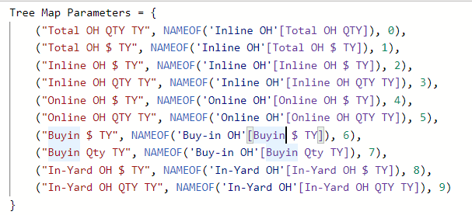
Sales Online-YTD :
Avg Sales Amt:
Avg Sales Qty:
D_TYPE:
FULFILMENT_LOCATION_ID:
ITEM_ID:
Sum Sales Amt:
Sum Sales Qty:
T_TYPE:
Tree Map Parameters
Tree Map Parameters
Tree Map Parameters Fields
Tree Map Parameters Order

Slide 23

TreeMap Dim:
Parameters
Parameters Fields
Parameters Order
WOS Filter:
Value: WOS Filter = GENERATESERIES(0,10,2)

Slide 24
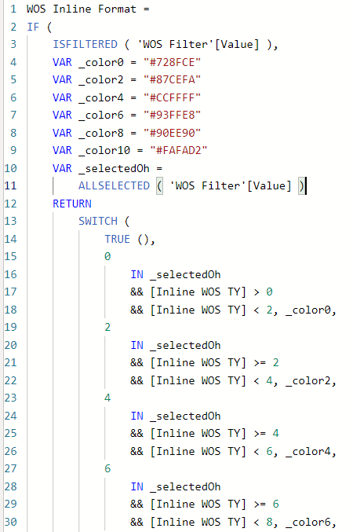
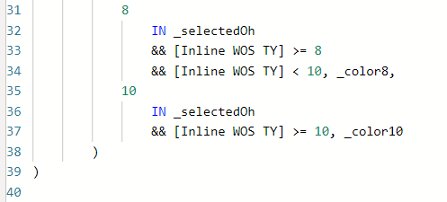
WOS Inline Format:

Slide 25
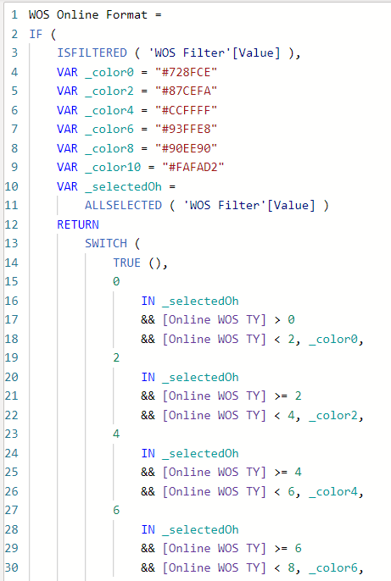
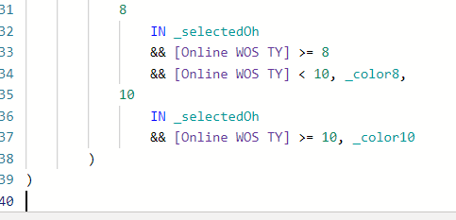
WOS Online Format:

Slide 26
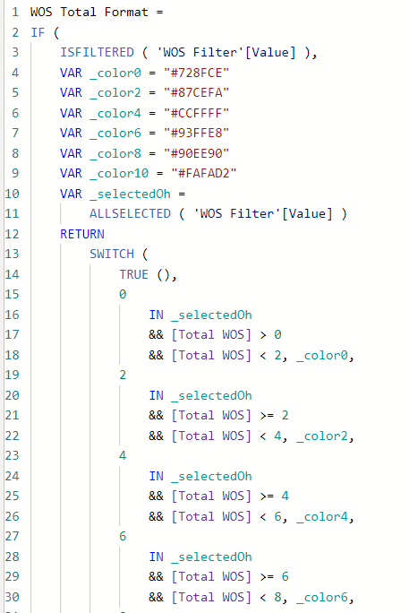
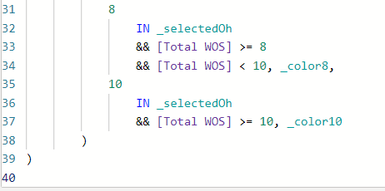
WOS Total Format:

Slide 27
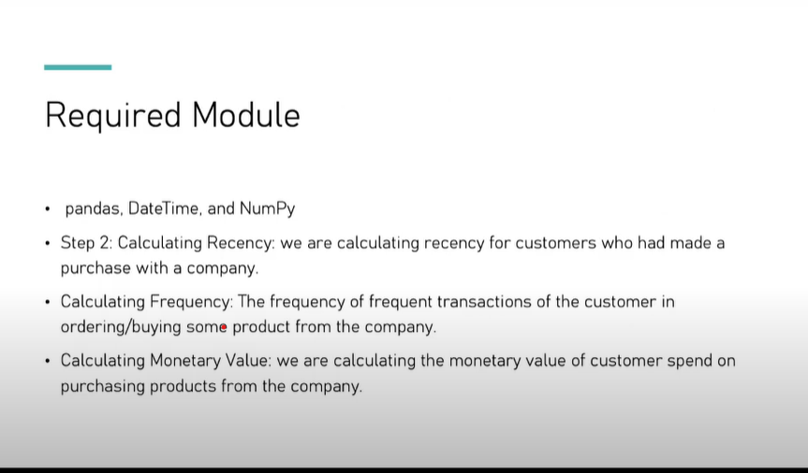

Slide 28
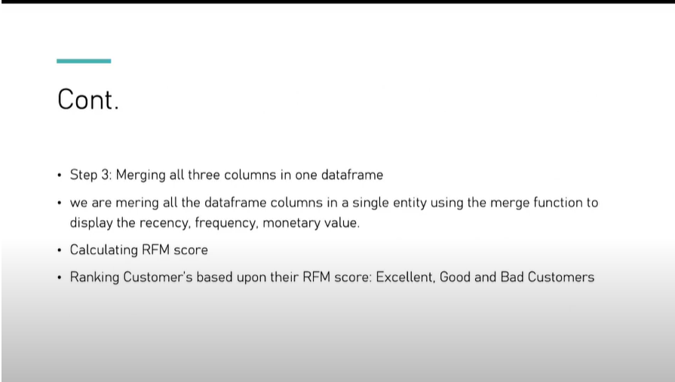

Slide 29
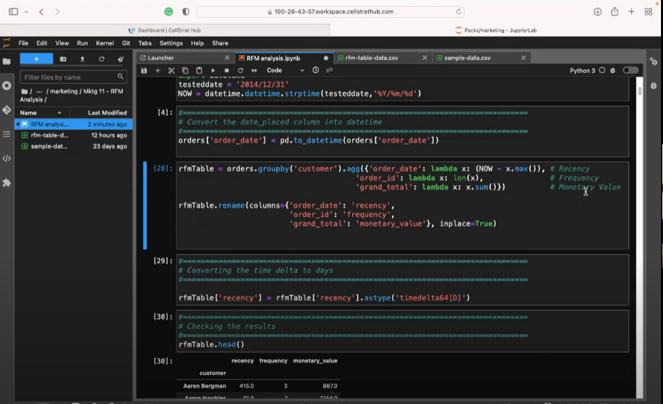

Slide 30
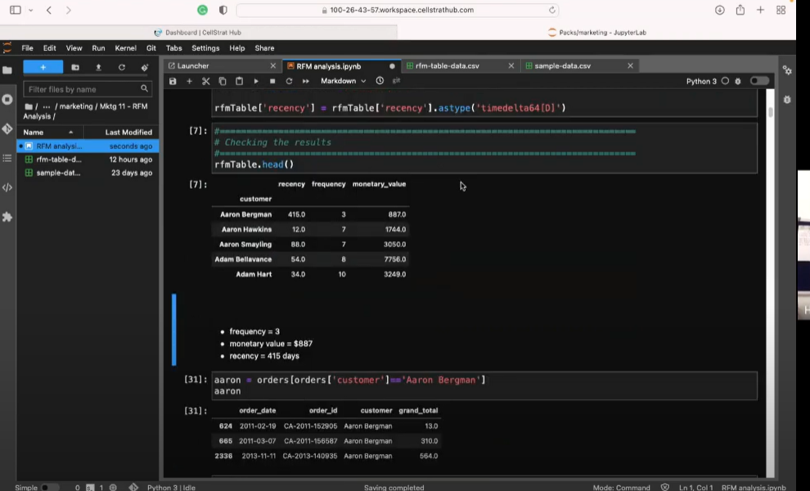

Slide 31
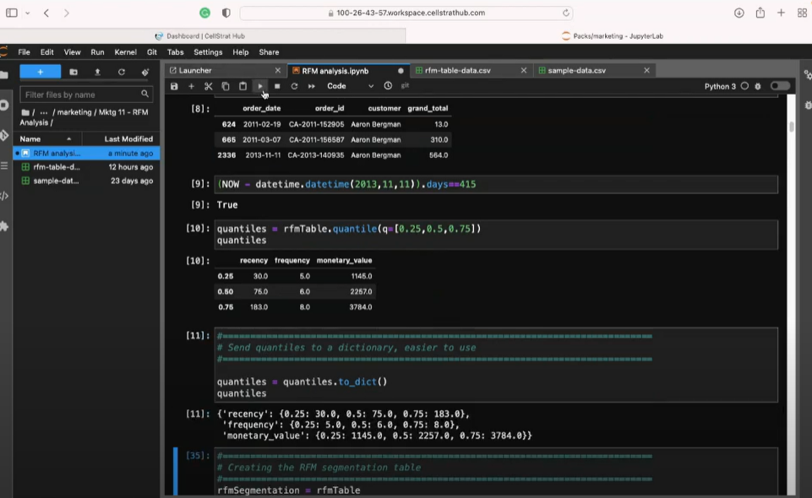
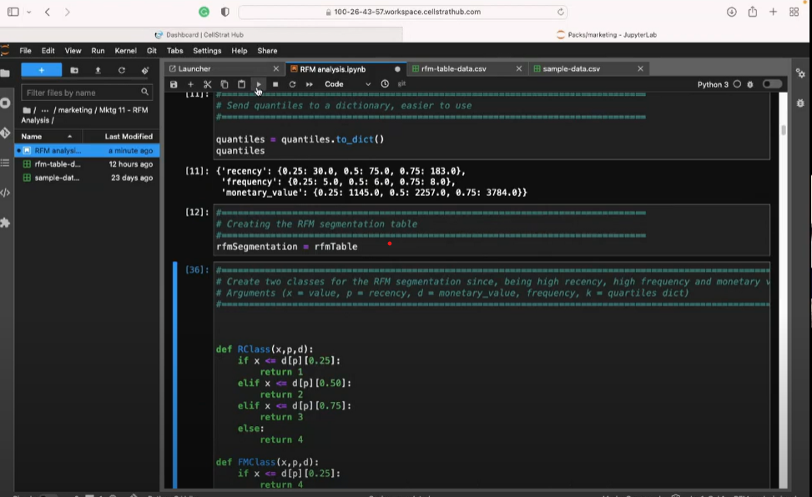

Slide 32
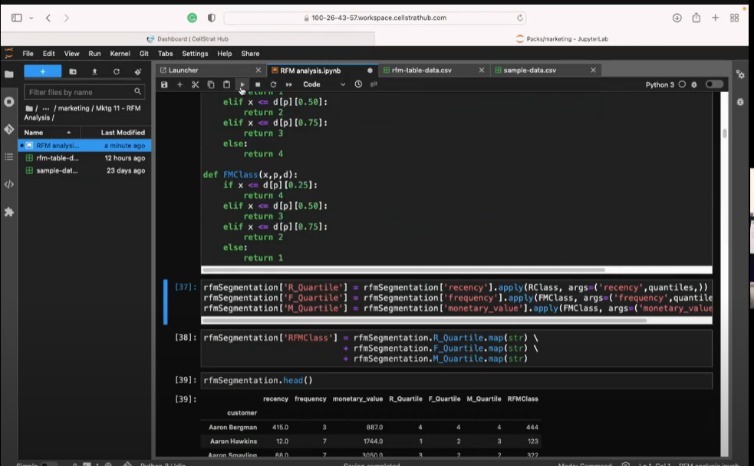
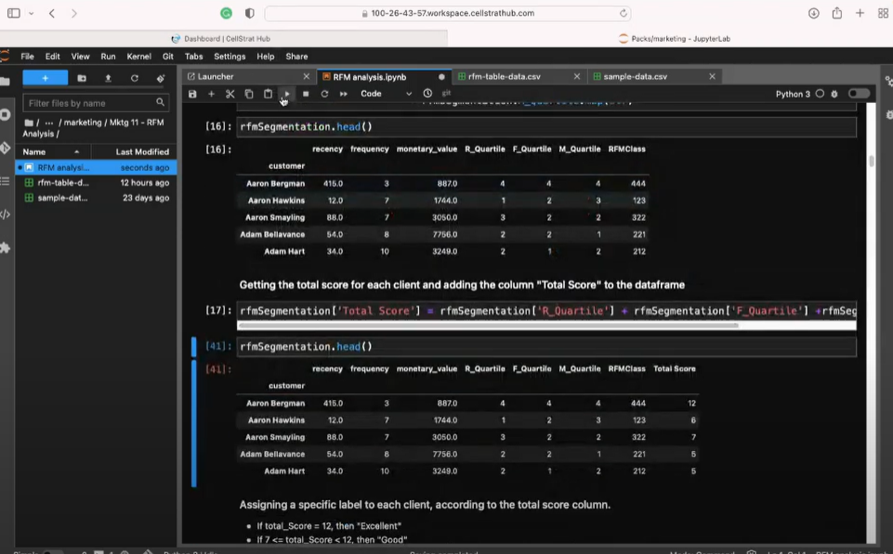

Slide 33
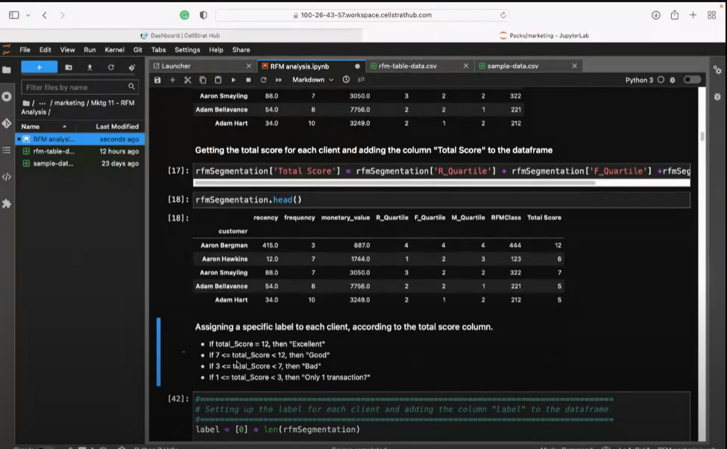
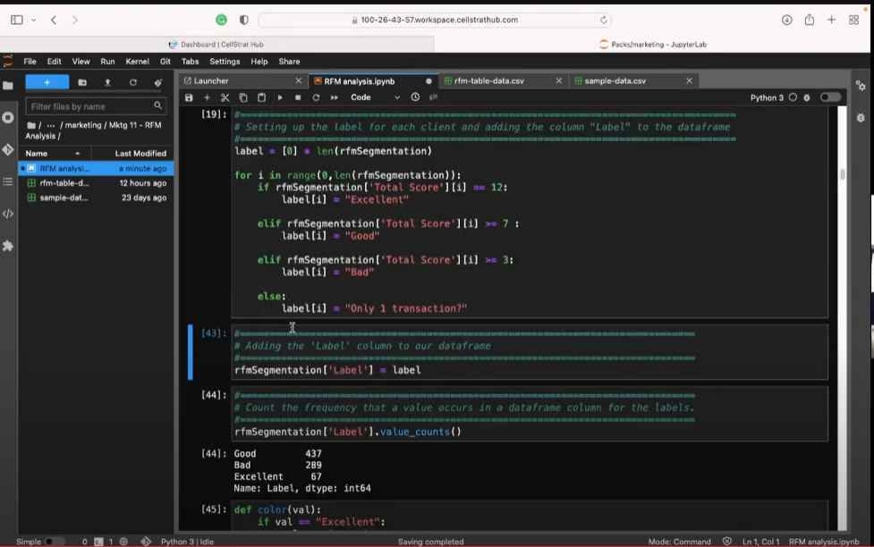

Slide 34
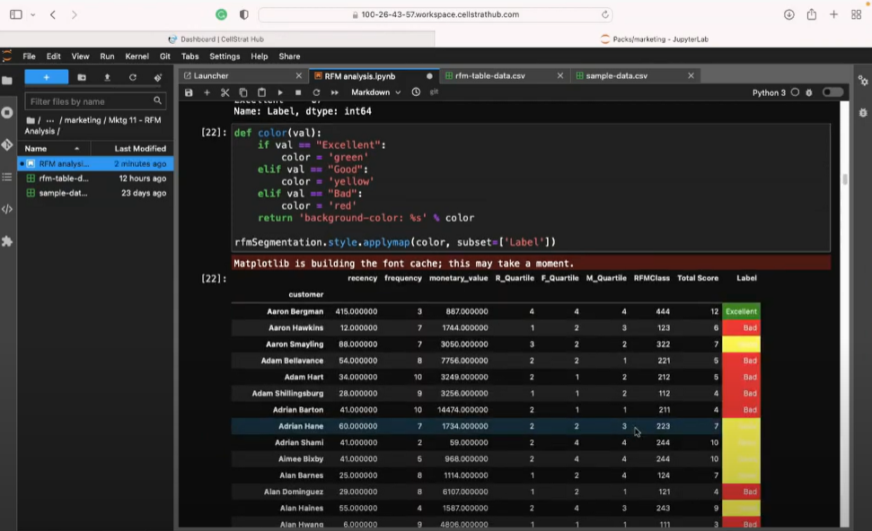

Slide 36
Costco Inventory
Problem Statement –
To improve the Costco shipment forecasts.
Forecast Costco SKUs on different levels at product & inventory level.​
Customer Segmentation to understand better marketing and promotion strategies.​
Note: We don’t have any information about customers, but we can do geographic segmentation, We have country, region, district and location names in data.
Solution / Action –
Structured analysis of the historical data to provide insight into forecasting.
Analyzing the historical data into (the underlying time series process and the promotion effect)
Methods – Xgboost, MLP, ARIMA, HWES to forecast the future demands.
RFM, K-Means, DBSCAN clustering for customer segmentations.
Transformation KPIS –
MAPE helps customer to plan the demand according to forecasted values
Overstocking rate helps to take decision on inventory management
Geographic segmentation allows to find most demanding/valuable locations.
Business Value –
Forecasting demand using promotional effects helps clients to increase their revenue and to continue uninterrupted distribution,
Customer segmentation helps to make more lucrative promotion for top locations to boost the sell

