Slide 1

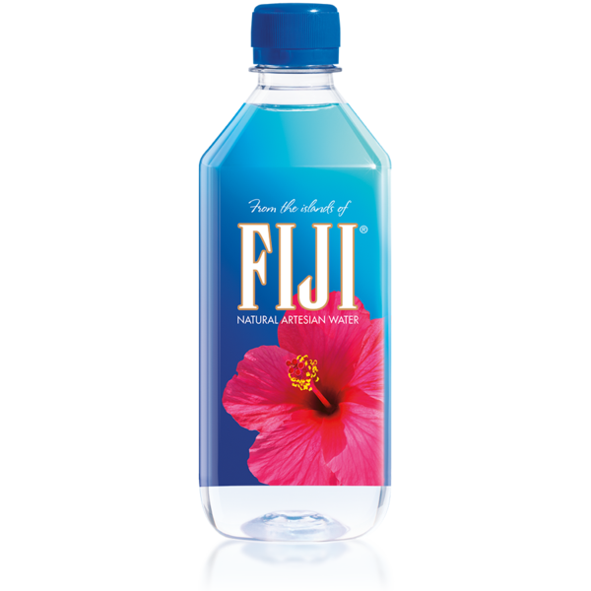
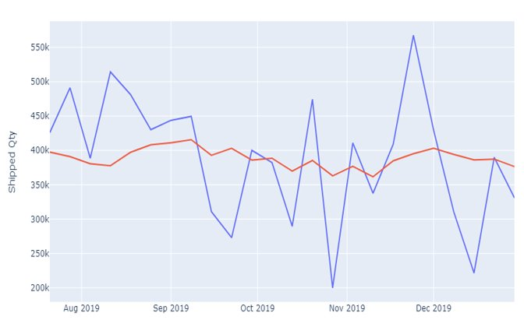

Forecasting & Customer Segmentation
Problem Statement –
To improve the Fiji Waters shipment forecasts
Forecast Fiji Water SKUs on different levels at product & inventory level.​
Customer Segmentation to understand better marketing and promotion strategies.​
Solution / Action –
Structured analysis of the historical data to provide insight into forecasting.
Analyzing the historical data into two parts (the underlying time series process and the promotion effect)
Methods – Xgboost, MLP, ARIMA, HWES to forecast the future demands.
RFM clustering for customer segmentations
Transformation KPIS –
MAPE helps customer to plan the demand according to forecasted values
Overstocking rate helps to take decision on inventory management
Customer segmentation allows to find most valuable buyers
Business Value –
Forecasting demand using promotional effects helps clients to increase their revenue and to continue uninterrupted distribution,
Customer segmentation helps to make more lucrative promotion for top buyers to boost the sell

Slide 2





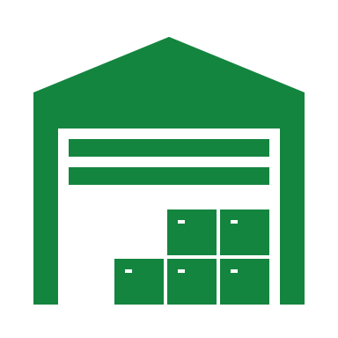


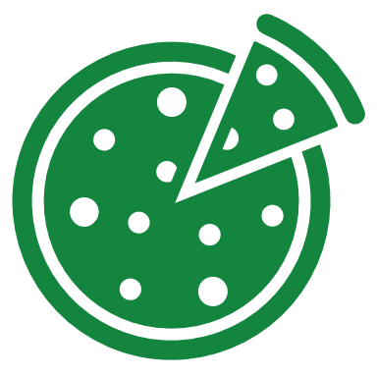

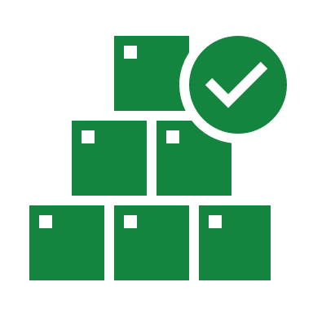

Data Driven Framework: Control Tower View
Efficient Promotional Planning
Plan Production
Sales Trend & Tracking
Optimize Inventory
TWC SME
Reduced
Transportation Costs
Monitor Key KPIs
Re-calibration
&
Monitoring
Re-Training
&
Updates
Customer
Segmentation
Demand
Forecasting
Volume & Monetary
Promotional lift
Regularity & Recency
SKUs
Promotions
Distributors
Market Response
Data Driven Predictive Framework

Slide 3

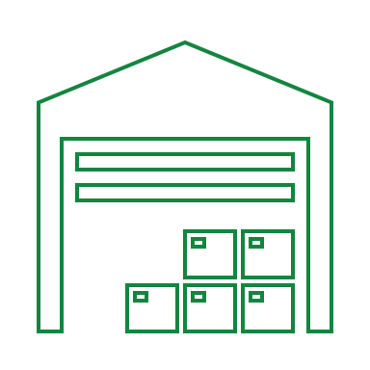


Benefits of using Promotion based forecasting @
Warehouse Level
Distributors (Suppliers)
Distributor Insights
Simulations & SME interactions
Price Strategy
Less understocking
Optimal Sell through rate during over stocking time segments
Reduced Inter-Warehouse Shipment
Best segments for initiating specific promotions
Customized Forecast Model
Trend and Regularity Insights
TWC
SME
Safety stock suggestions w.r.t
Churn possibilities and Idle customers at any given point of time
Promotional effectiveness
Ceiling recommendations in discounts based on price elasticity demand
Baseline discount threshold for maintaining trend
Data Driven
Simulations &
SME interactions
Data driven production planning
Stock Simulation using flexi parameters for SME
New acquisitions : Sales target
Forecasting simulations for different types of promotions
Price per quantity discount
Lumpsum discount
Coupons
Inventory
Management

