Slide 1

CAREER PILOT
GROUP
RACHANA GULLIPALLI
MAHIJA SHIVANI DADISETTY
MANASA AVULA
RAMU SIRUSANAGANDLA
SAHITHI PALADUGU
AVINASH KOYA

Slide 2
GO PARADIGMS
Go is an open-source language designed to create fast and efficient software
Go supports concurrency, allowing developers to perform multiple tasks without sacrificing performance.
Go's speed and power make it ideal for high performance applications.
Go is easy to use with simple syntax and library.
Go uses a garbage collector to ensure safe and reliable software.
Go's dependency management is rigorous and predictable to manage complex projects.
Go is adaptable and robust for handling unexpected errors

Slide 3

FEATURES
Simplicity and ease of use
Concurrency support
Garbage collection
Static typing
Fast compilation and execution
Cross-platform support
Standard library
Open-source community

Slide 4

LANGUAGE FOR PROGRAMMERS
Increased productivity
High performance
Cross-platform support
Built-in concurrency support
Strong typing and error checking
Large community and ecosystem

Slide 5
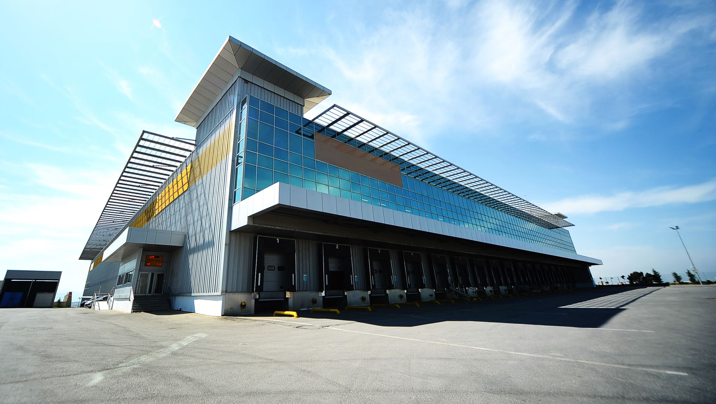
CAREER PILOT
Universities should have a website for job postings to make it easier for students to apply for jobs and recruiters to review applications.
The job portal has two sections: one for students and one for recruiters. Students can search for jobs and see the ones they've applied for, while recruiters can add new job roles and view student applications.
Our portal connects students and recruiters for job opportunities. Recruiters post jobs, students apply with their resumes, and recruiters can contact them directly. Students can also search for jobs.

Slide 6

TECHNOLOGY STACK
LANGUAGE:
GO Programming language
OTHER:
React JS
SQL
CSS
HTML
JWT
SOFTWARE CONFIGURATION:
Visual Studio Code 2022
My SQL Workbench 8.0 CE
Node JS

Slide 7

Introduction
New graduates face limited job opportunities that match their skills and interests, while recruiters struggle to find suitable candidates.
Traditional campus career fairs may not meet the needs of all students and recruiters.
A dedicated job portal for students could provide a more convenient and efficient platform for job seekers and recruiters to connect, allowing students to apply for jobs from anywhere and at any time, and recruiters to review resumes and applications in a more efficient manner.

Slide 8

PROBLEM STATEMENT
Lack of a dedicated job portal for students is a major issue facing universities today.
Campus career fairs are not accessible to all students and do not guarantee that their resumes will be directly given to recruiters.
This leads to frustration for both students and recruiters, wasting valuable time and resources in the recruitment process.

Slide 9
SOLUTION
Proposed solution: implementation of a dedicated job portal for students
Portal will have separate sections for students and recruiters
Common login and signup page for both students and recruiters
Students can browse and apply for jobs from anywhere and at any time
Recruiters can review resumes and applications more efficiently and reach wider pool of candidates

Slide 10
EXPERIMENTS
Our job portal aims to bridge the gap between job seekers and recruiters.
Both students and recruiters can sign up and use the portal to apply or recruit for job positions.
The student portal allows students to view available jobs, search for specific companies or roles, and keep track of their applied job positions.
The recruiter portal allows recruiters to add new job roles in their companies and view the details of students who have applied for a position.

Slide 11

FUTURE SCOPE
The dedicated job portal could be expanded to include more features such as video interviews, online assessments, and personalized job recommendations based on a student's skills and interests.
The portal could be used to facilitate internships and co-op programs, providing students with valuable work experience while still in school.
The portal could be expanded to include alumni, creating a more comprehensive network of job seekers and recruiters and offering new opportunities to alumni of the university.

Slide 12

CONCLUSION
The dedicated job portal solves the problem of limited access to job opportunities for graduating students.
The separate portals for students and recruiters, along with a common login page, offer a user-friendly experience.
The future scope of the portal is promising, with potential for further developments and expansion to include internships, co-op programs, and alumni.

Slide 13

Thank you

