Slide 1
Introduction to AC Circuits
Meet Soni
Assistant Professor
Electrical Engineering

Slide 2
Content
Introduction to AC circuit 1
Significance of AC Supply 2
Sinusoidal Voltage and Current 3
Mathematical Representation 4
Graphical Representation 5

Slide 3
Introduction to AC Circuit
An AC (Alternating Current) circuit is an electrical circuit powered by an alternating source, where the current changes its direction and magnitude periodically. Unlike DC circuits, AC circuits include reactance due to capacitors and inductors, which affect current flow.
Key characteristics of AC circuits:
Voltage and current vary sinusoidally.
Includes resistance (R), inductance (L), and capacitance (C).
Frequency and phase angle are essential parameters.

Slide 4
Significance of AC Supply
Alternating Current (AC) is the standard form of electricity delivered to homes and industries.
Highlighting Points:
Efficient Long-Distance Transmission
Transformers Can Easily Step Up or Down Voltage
Widely Available and Cost-Effective
Suitable for Motors, Appliances, and Lighting
Note: AC supply is preferred over DC for power distribution due to its ability to be transformed and transmitted over long distances with minimal losses.

Slide 5
Sinusoidal Voltages and Currents
In AC systems, sinusoidal waveforms are most commonly used because of their smooth, repetitive nature and ease of analysis.
A sinusoidal voltage or current can be described using amplitude, frequency, angular frequency, and phase angle.
Standard form:
Voltage:𝑣(𝑡)=𝑉𝑚sin⁡(𝜔𝑡+𝜙)
Current:𝑖(𝑡)=𝐼𝑚sin⁡(𝜔𝑡+𝜃)
Where:
𝑉𝑚,𝐼𝑚​ : Maximum (peak) values
ω: Angular frequency = 2𝜋𝑓
𝜙,𝜃: Phase angles in radians
𝑓: Frequency in Hz
𝑡: Time in seconds

Slide 6
Mathematical Representation
Sinusoidal voltage and current waveforms follow a predictable mathematical pattern:
Highlighting Points:
Instantaneous value: Value of voltage or current at any instant.
Peak value: Maximum amplitude of waveform.
RMS value:𝑉𝑟𝑚𝑠=𝑉𝑚/√2 ​ ,𝐼𝑟𝑚𝑠=𝐼𝑚/√2
​Time period (T):𝑇=1/𝑓
These parameters help in analyzing real-time behavior of AC signals in electrical circuits.

Slide 7
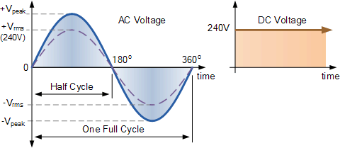
Graphical Representation
The sine wave is a graphical representation of alternating current and voltage.
Figure 1: Standard sinusoidal waveform of voltage

Slide 9
Sinusoidal Quantities and Phasor Representation
Meet Soni
Assistant Professor
Electrical Engineering

Slide 10
Content
Instantaneous Value 1
Peak (Maximum) Value 2
Average Value 3
R.M.S. Value 4
Frequency, Cycle, and Period 5
Peak Factor and Form Factor 6
Phase Difference 7
Lagging, Leading, and In-Phase Quantities 8
Phasor Representation 9

Slide 11
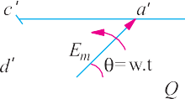
Instantaneous Value
The instantaneous value of a sinusoidal quantity refers to its magnitude at a particular instant of time.
Mathematical expression:𝑣(𝑡)=𝑉𝑚sin⁡(𝜔𝑡+𝜙)

Slide 12
Peak (Maximum) Value
The peak value is the maximum value (positive or negative) reached by a waveform during one cycle.
Highlighting Points:
Denoted by: 𝑉𝑚 or 𝐼𝑚
​Represents the amplitude of the wave
Occurs once every half cycle

Slide 13
Average Value
The average value of a pure sinusoidal wave over a full cycle is zero.
However, for practical calculations, average value is taken over one-half cycle.
Average Value Formula:
𝑉𝑎𝑣𝑔=2𝑉𝑚/𝜋
​𝐼𝑎𝑣𝑔=2𝐼𝑚/𝜋

Slide 14
R.M.S. Value
R.M.S. (Root Mean Square) value represents the effective or equivalent DC value of an AC quantity.
Formula:
𝑉𝑟𝑚𝑠=𝑉𝑚/√2
𝐼𝑟𝑚𝑠=𝐼𝑚/√ 2 ​
Highlighting Points:
Used in power calculations
Most commonly used value in AC analysis

Slide 15
Frequency, Cycle, and Period
Cycle : One complete set of positive and negative values of alternating quantity is known as cycle
Time Period: The time taken by an alternating quantity to complete one cycle is called its time period T. For example, a 50-Hz alternating current has a time period of 1/50 second.
Frequency : The number of cycles/second is called the frequency of the alternating quantity. Its unit is hertz (Hz).

Slide 16
Peak Factor and Form Factor
Peak Factor = Peak Value/RMS Value
=𝑉𝑚/𝑉𝑟𝑚𝑠≈1.414
Form Factor = RMS Value/Average Value
=𝑉𝑟𝑚𝑠/𝑉𝑎𝑣𝑔≈1.11
Highlighting Points:
Used in waveform comparison
Standard values for pure sine wave

Slide 17
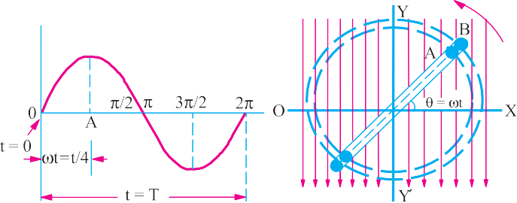
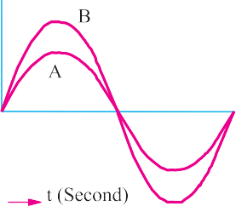
Phase Difference
Phase difference is the angular displacement between two sinusoidal waveforms of the same frequency.

Slide 18
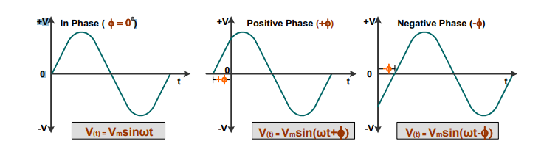
Phase Difference
Leading phase difference: A quantity which attains its zero or positive maximum value before the compared to the other quantity.
Lagging phase difference: A quantity which attains its zero or positive maximum value after the other quantity.
In-Phase: Voltage and current reach maxima/minima at the same time

Slide 19
Phasor Representation
A phasor is a rotating vector representing a sinusoidal function with constant amplitude and frequency.
Used to simplify the analysis of sinusoidal waveforms in AC circuits.
Phasor Notation:
𝑉=𝑉𝑚∠𝜙
𝐼=𝐼𝑚∠𝜃
Highlighting Points:
Easier to apply Ohm’s Law and KVL/KCL in AC
Visualizes phase relationships clearly

Slide 20
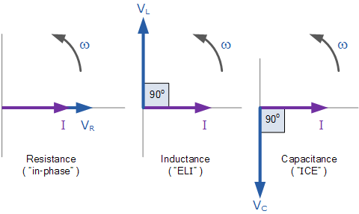
Phasor Representation

Slide 22
Rectangular and Polar Representation of Phasors, Examples Based on Theory
Meet Soni
Assistant Professor
Electrical Engineering

Slide 23
Content
Introduction to phasor representation 1
Rectangular form of phasor 2
Polar form of phasor 3
Conversion: Rectangular to Polar 4
Conversion: Polar to Rectangular 5
Example 1: Conversion of a Phasor 6
Example 2: AC Circuit Using Polar Representation 7
Graphical Representation of Phasors 8

Slide 24
Introduction to Phasor Representation
A phasor is a complex number representing a sinusoidal function of time in the frequency domain. It simplifies analysis of AC circuits by converting differential equations into algebraic equations.
Highlighting Points:
Phasors contain both magnitude and phase angle
Used in steady-state sinusoidal analysis

Slide 25
Rectangular Form of Phasor
In Rectangular form, a phasor is expressed as:
𝐴=𝑥+𝑗𝑦
Where:
𝑥: Real part (horizontal axis)
𝑦: Imaginary part (vertical axis)
𝑗=√−1
Highlighting Points:
Useful in phasor addition/subtraction
Represents phasors on the complex plane

Slide 26
Polar Form of Phasor
In Polar form, a phasor is represented as:𝐴=∣𝐴∣∠𝜃
Where:
∣𝐴∣: Magnitude of the phasor
𝜃: Phase angle (degrees or radians)
Highlighting Points:
Preferred for phasor multiplication/division
Provides clear view of phase relationship

Slide 27
Conversion: Rectangular to Polar
To convert 𝐴=𝑥+𝑗𝑦 to polar form:
Magnitude: ∣𝐴∣=√𝑥2+𝑦2 ​
Angle: 𝜃=tan⁡−1(𝑦/𝑥)
Highlighting Points:
Make sure to adjust angle according to quadrant

Slide 28
Conversion: Polar to Rectangular
To convert 𝐴=∣𝐴∣∠𝜃 to rectangular form:
Real part: 𝑥=∣𝐴∣cos⁡(𝜃)
Imaginary part: 𝑦=∣𝐴∣sin⁡(𝜃)
Highlighting Points:
Angle must be in radians if using a calculator
Helps in using phasors in matrix or loop equations

Slide 29
Example 1 – Conversion of a Phasor
Given: 𝐴=6+𝑗8
Magnitude: ∣𝐴∣=√ 36 + 64
=10
Angle: 𝜃=tan⁡−1(8/6)
=53.13∘
Polar Form: 𝐴=10∠53.13∘A
=10∠53.13 ∘
Highlighting Points:
Accurate angle is important in power factor analysis

Slide 31
Analysis with phasor diagram of Purely Resistive Load
Meet Soni
Assistant Professor
Electrical Engineering

Slide 32
Content
Introduction to AC and Resistive Loads ……………..3
Characteristics of Purely Resistive Load …………….4
Voltage and Current Relationship ……………………..5
Phasor Representation ……………………………………..6
Waveforms of Voltage and Current …………………..7
Power in Pure Resistive Load …………………………….8
Key Points / Summary ……………………………………….9

Slide 33
Introduction to AC and Resistive Load
Alternating Current (AC) is a type of electrical current that varies sinusoidally with time.
AC voltage:
V(t) = Vm × sin(ωt)
Where,
Vm = peak voltage, ω = angular frequency
A resistive load is an electrical component that resists the flow of current and converts electrical energy into heat.
Common examples of resistive loads: incandescent bulbs, electric heaters, resistors.

Slide 34
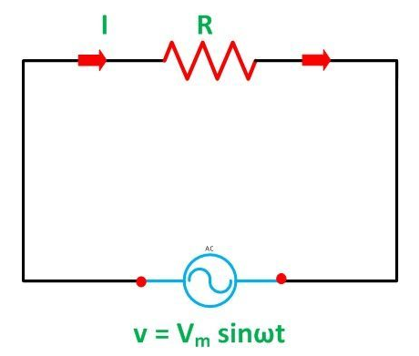
Characteristics of Purely Resistive Load
In a purely resistive circuit, the load contains only resistance (R); no inductance (L) or capacitance (C).
The voltage and current are in the same phase.
There is no phase difference (θ = 0°) between voltage and current.
Power is completely dissipated as heat in the resistor.
Figure 2.1 Purely Resistive Circuit

Slide 35
Voltage and Current Relationship
Ohm’s Law applies: V = I × R
If
V(t) = Vm × sin(ωt),
Then Current:
i(t) = Im × sin(ωt)
where,
Im = Vm / R
Both voltage and current have identical waveforms and peak at the same time.
No time lag or lead between voltage and current.

Slide 36
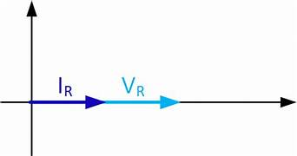
Phasor Representation
Phasors are rotating vectors used to represent sinusoidal quantities.
For a purely resistive load:
Voltage phasor (V) and current phasor (I) lie on the same axis.
Phase angle θ = 0°
No angular separation between phasors.
Figure 2.2 Phasor Diagram

Slide 37
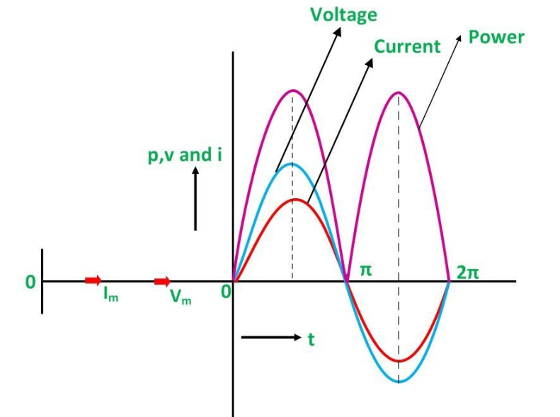
Waveforms of Voltage and Current
Figure 2.2 Waveform Diagram
Both waveforms are sinusoidal and superimpose in time.
Peak values of current and voltage occur simultaneously.

Slide 38
Power in Pure Resistive Load
Instantaneous Power:
p(t) = v(t) × i(t) = Vm × Im × sin²(ωt)
Since sin²(ωt) is always positive, power is always positive.
Average Power (P) over one cycle:
P = (Vm × Im) / 2 = Vrms × Irms
Power is continuously consumed in the resistor and converted to heat.
Key Formulas:
V(t) = Vm × sin(ωt)
I(t) = Im × sin(ωt)
P(t) = Vm × Im × sin²(ωt)
Pavg = (Vm × Im)/2 = Vrms × Irms

Slide 39
Summary
In a purely resistive AC circuit, voltage and current are in phase (θ = 0°).
No reactive components → no energy is stored or returned.
Phasors of V and I align, indicating phase alignment.
Power is always positive, indicating real power consumption.
Useful for understanding basic power dissipation in AC resistive loads.

Slide 41
Analysis with phasor diagram of Purely Inductive Load
Meet Soni
Assistant Professor
Electrical Engineering

Slide 42
Content
Introduction to Inductance and AC Circuits ……….. 3
Characteristics of Purely Inductive Load …………….. 4
Voltage and Current Relationship ………………………. 5
Phasor Representation ………………………………………. 6
Waveforms of Voltage and Current ……………………. 7
Power in Pure Inductive Load …………………………….. 8
Key Points / Summary ………………………………………… 9

Slide 43
Introduction to Inductance and AC Circuits
An inductor opposes changes in current and stores energy in a magnetic field.
In AC circuits, the current continuously changes direction, and inductors exhibit inductive reactance (XL).
The inductive reactance is given by: XL = 2πfL, where
f = frequency, L = inductance in henry (H)
A pure inductive load has only inductance, no resistance or capacitance.

Slide 44
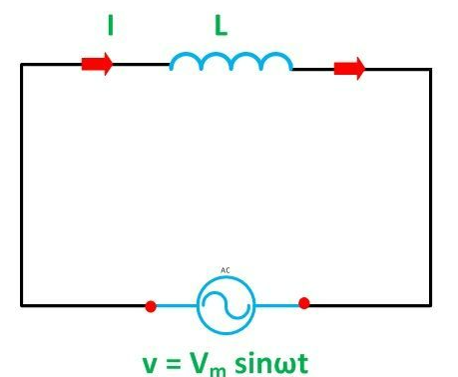
Characteristics of Purely Inductive Load
In a purely inductive circuit, current lags voltage by 90° (π/2 radians).
The energy is alternately stored and released by the inductor; no real power is consumed.
The circuit absorbs and returns power to the source each cycle.
The average power consumed over a full cycle is zero.
Figure 2.1 Purely Inductive Circuit

Slide 45
Voltage and Current Relationship
Applied voltage:
v(t) = Vm × sin(ωt)
Current through pure inductor:
i(t) = Im × sin(ωt − 90°) = Im × (−cos(ωt))
Current lags the voltage by 90° due to inductive nature.
Peak of current occurs after the peak of voltage.
Key Formula:
Im = Vm / XL,
where XL = 2πfL

Slide 46
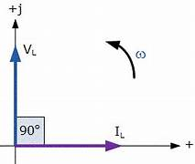
Phasor Representation
In phasor form:
Voltage phasor leads the current phasor by 90°
Alternatively, current lags the voltage phasor by 90°
This 90° phase shift represents purely inductive behavior.
Figure 2.2 Phasor Diagram

Slide 47
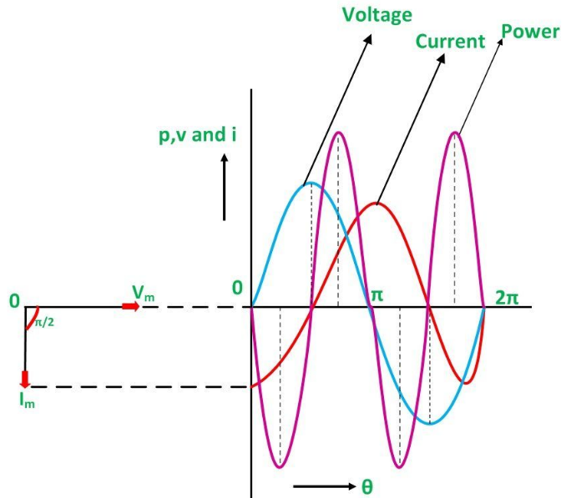
Waveforms of Voltage and Current
Voltage waveform: sinusoidal
Current waveform: sinusoidal and lags voltage by 90°
Zero crossing of current occurs after zero crossing of voltage.
Figure 2.2 Waveform Diagram

Slide 48
Power in Pure Inductive Load
Instantaneous Power:
p(t) = v(t) × i(t) = Vm × Im × sin(ωt) × sin(ωt − 90°)
p(t) = Vm × Im × sin(ωt) × (−cos(ωt))
p(t) = −Vm × Im × sin(ωt) × cos(ωt)
This results in alternating positive and negative power.
Average Power (P) = 0 (No net power consumed)
Important Observation:
Power oscillates between source and inductor.
Energy is stored and returned, not dissipated.

Slide 49
Summary
In a purely inductive AC circuit, current lags voltage by 90°.
Inductor stores energy in its magnetic field and returns it back.
Phasor diagram shows 90° lag of current behind voltage.
No real power is consumed; average power is zero.
Circuit is reactive, and power oscillates within the system.

Slide 51
Analysis with phasor diagram of Purely Capacitive Load
Meet Soni
Assistant Professor
Electrical Engineering

Slide 52
Content
Introduction to Capacitance and AC Circuits ……….. 3
Characteristics of Purely Capacitive Load …………….. 4
Voltage and Current Relationship ………………………. 5
Phasor Representation ………………………………………. 6
Waveforms of Voltage and Current ……………………. 7
Power in Pure Capacitive Load …………………………….. 8
Key Points / Summary ………………………………………… 9

Slide 53
Introduction to Capacitance and AC Circuits
A capacitor stores electrical energy in the form of an electric field between its plates.
In an AC circuit, capacitors exhibit capacitive reactance (XC) which opposes current flow.
Capacitive reactance is given by: XC = 1 / (2πfC)
where, f = frequency, C = capacitance in farads (F)
A purely capacitive circuit contains only capacitance, with no resistance or inductance.

Slide 54
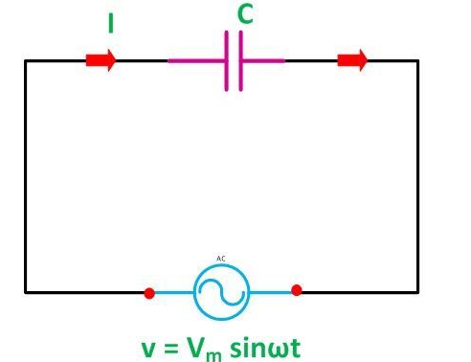
Characteristics of Purely Capacitive Load
In a purely capacitive AC circuit, current leads voltage by 90° (π/2 radians).
The capacitor charges and discharges every half-cycle.
No real power is consumed; energy is stored and then returned.
The average power over a full cycle is zero.
Figure 2.1 Purely Capacitive Circuit

Slide 55
Voltage and Current Relationship
Applied voltage:
v(t) = Vm × sin(ωt)
Current through pure capacitor:
i(t) = Im × sin(ωt + 90°) = Im × cos(ωt)
Current leads voltage by 90° in time domain.
Peak current occurs before the peak voltage.
Key Formula:
Im = Vm / XC, where XC = 1 / (2πfC)

Slide 56
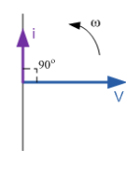
Phasor Representation
In phasor form:
Current phasor leads voltage phasor by 90°
This lead represents capacitive nature of the load
Voltage lags behind current in purely capacitive circuit
Figure 2.2 Phasor Diagram

Slide 57
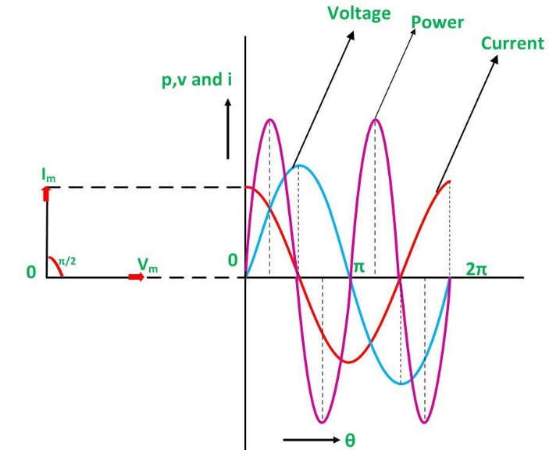
Waveforms of Voltage and Current
Voltage waveform is sinusoidal.
Current waveform is sinusoidal and leads the voltage by 90°.
Zero crossing of current occurs before that of voltage.
Figure 2.2 Waveform Diagram

Slide 58
Power in Pure Capacitive Load
Instantaneous Power:
p(t) = v(t) × i(t) = Vm × Im × sin(ωt) × sin(ωt + 90°)
p(t) = Vm × Im × sin(ωt) × cos(ωt)
p(t) = Vm × Im × 0.5 × sin(2ωt)
Power alternates between positive and negative values.
Average Power (P) = 0 over one full cycle.
Key Insight:
Energy is not dissipated but is stored and returned to the source cyclically.

Slide 59
Summary
In a purely capacitive circuit, current leads voltage by 90°.
The capacitor stores and returns energy every cycle.
Phasor diagram shows current ahead of voltage.
No real power is consumed; only reactive power is present.
Capacitors offer capacitive reactance (XC) which decreases with frequency.

Slide 61
Analysis with phasor diagram of RL Series Load
Meet Soni
Assistant Professor
Electrical Engineering

Slide 62
Content
Introduction to RL Series Circuit ……………………. 3
Impedance in RL Circuit ………………………………… 4
Voltage and Current Relationship ………………….. 5
Phasor Representation …………………………………. 6
Waveforms of Voltage and Current ………………. 7
Power in RL Circuit ……………………………………….. 8
Power Factor and Phase Angle ……………………… 9
Key Points / Summary …………………………………. 10

Slide 63
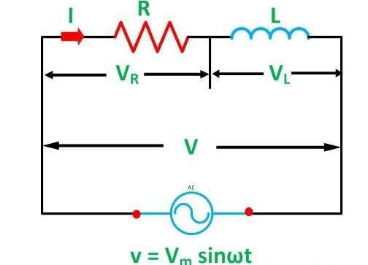
Introduction to RL Series Circuit
An RL series circuit contains a resistor (R) and an inductor (L) connected in series.
When supplied with an AC source, both elements influence the total behavior:
Resistor causes voltage drop in phase with current.
Inductor causes voltage drop leading the current by 90°.
The total current is common through both R and L.
Figure 2.1 RL Series Circuit

Slide 64
Impedance in RL Circuit
The total opposition offered to AC is called impedance (Z).
Impedance in an RL circuit is given by:
Z = √(R² + XL²)
Where, XL = 2πfL
The circuit behaves partly resistive and partly inductive.
Key Formula:
I = V / Z,
Where,
V = applied voltage,
Z = total impedance

Slide 65
Voltage and Current Relationship
Current in the RL circuit lags the applied voltage by a phase angle φ.
The phase angle is determined by the relative values of R and XL.
tan(φ) = XL / R
Current Equation:
i(t) = Im × sin(ωt − φ)
Im = Vm / Z

Slide 66
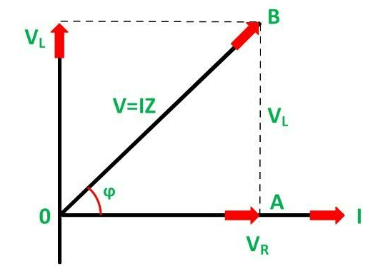
Phasor Representation
Figure 2.2 Phasor Diagram
The voltage drop across R (VR) is in phase with the current.
The voltage drop across L (VL) leads the current by 90°.
The total applied voltage (V) is the phasor sum of VR and VL.

Slide 67
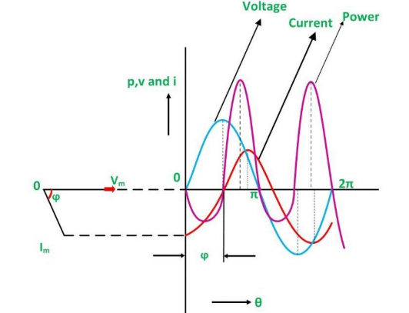
Waveforms of Voltage and Current
The current waveform lags behind the voltage waveform by angle φ.
Waveforms are sinusoidal but not in phase.
The degree of lag depends on the R to L ratio.
Figure 2.2 Waveform Diagram

Slide 68
Power in RL Circuit
Instantaneous Power:
p(t) = v(t) × i(t)
True (Active) Power:
P = VI × cos(φ) (Measured in watts)
Reactive Power (Q):
Q = VI × sin(φ) (Measured in VAR)
Apparent Power (S):
S = VI (Measured in VA)
Note:
Only the resistive part consumes real power.
Inductive part causes reactive power flow.

Slide 69
Power Factor and Phase Angle
Power Factor (PF) = cos(φ)
It indicates the efficiency of power usage.
φ is the phase angle between applied voltage and current.
If XL increases (i.e., more inductive), PF decreases.
Good to Know:
A low PF implies high reactive power, causing inefficiency.
Ideal PF = 1 (purely resistive)

Slide 70
Summary
RL series circuit contains both resistance and inductance.
Impedance (Z) is the vector sum of R and XL.
Current lags voltage by an angle φ.
Power factor depends on R to XL ratio.
Only resistive element consumes real power.
Phasor diagram and waveforms help in visualizing the phase relationship.

Slide 72
Analysis with phasor diagram of RC
Series Load
Meet Soni
Assistant Professor
Electrical Engineering

Slide 73
Content
Introduction to RC Series Circuit ……………………. 3
Impedance in RC Circuit ………………………………… 4
Voltage and Current Relationship ………………….. 5
Phasor Representation …………………………………. 6
Waveforms of Voltage and Current ………………. 7
Power in RC Circuit ……………………………………….. 8
Power Factor and Phase Angle ……………………… 9
Key Points / Summary …………………………………. 10

Slide 74
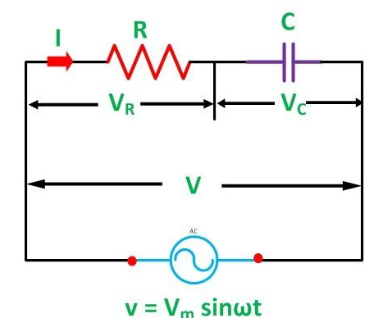
Introduction to RC Series Circuit
An RC series circuit contains a resistor (R) and a capacitor (C) connected in series.
When connected to an AC source:
Resistor causes voltage drop in phase with current.
Capacitor causes voltage drop that lags the current by 90°.
The total current flows through both R and C.
Figure 2.1 RC Series Circuit

Slide 75
Impedance in RC Circuit
The total opposition in an RC circuit is the impedance (Z).
Impedance is calculated using:
Z = √(R² + XC²)
Where, XC = 1 / (2πfC)
Capacitive reactance decreases with increasing frequency.
Key Formula:
I = V / Z

Slide 76
Voltage and Current Relationship
The current leads the applied voltage by a phase angle φ.
The phase angle depends on the relative values of R and XC.
tan(φ) = −XC / R
Current Equation:
I(t) = Im × sin(ωt + φ)
Im = Vm / Z

Slide 77
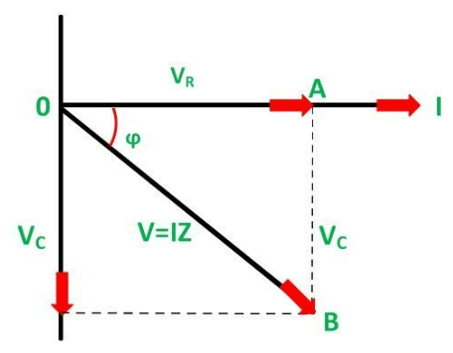
Phasor Representation
Figure 2.2 Phasor Diagram
Voltage across resistor (VR) is in phase with current.
Voltage across capacitor (VC) lags the current by 90°.
Total voltage is the phasor sum of VR and VC.

Slide 78
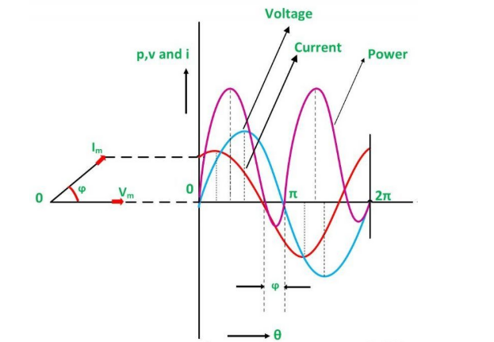
Waveforms of Voltage and Current
Voltage and current are sinusoidal but not in phase.
Current leads voltage by phase angle φ.
The lead depends on the ratio of R and XC.
Figure 2.2 Waveform Diagram

Slide 79
Power in RC Circuit
Instantaneous Power:
p(t) = v(t) × i(t)
True (Active) Power:
P = VI × cos(φ) (Measured in watts)
Reactive Power (Q):
Q = VI × sin(φ) (Measured in VAR)
Apparent Power (S):
S = VI (Measured in VA)
Note:
Only the resistive part consumes real power.
Capacitor only causes energy storage and return.

Slide 80
Power Factor and Phase Angle
Power Factor (PF) = cos(φ)
Measures the efficiency of power usage.
In an RC circuit, φ is negative, indicating leading current.
High XC → High phase angle → Low PF
Important:
A high-power factor means better energy efficiency.

Slide 81
Summary
RC series circuit consists of a resistor and a capacitor in series.
Impedance is calculated using vector addition of R and XC.
Current leads voltage by angle φ.
Only resistor consumes real power; capacitor causes reactive power.
Power factor depends on R and XC.
Phasor diagrams and waveforms clarify phase relationships.

Slide 83
Analysis with phasor diagram of RLC
Series Load
Meet Soni
Assistant Professor
Electrical Engineering

Slide 84
Content
Introduction to RLC Series Circuit ………….3
Impedance in RLC Circuit …………………….. 4
Voltage and Current Relationship ………… 5
Phasor Representation ………………………… 6
Waveforms of Voltage and Current ……… 7
Power in RLC Circuit ……………………………. 8
Resonance in RLC Circuit …………………….. 9
Power Factor and Phase Angle ………….. 10
Key Points / Summary ……………………….. 11

Slide 85
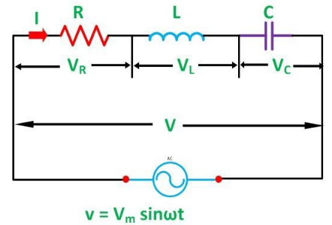
Introduction to RLC Series Circuit
An RLC series circuit contains a resistor (R), inductor (L), and capacitor (C) connected in series.
It combines the effects of resistance, inductance, and capacitance.
The behavior of the circuit depends on the relative values of L and C.
Figure 2.1 RLC Series Circuit

Slide 86
Impedance in RLC Circuit
Total impedance (Z) is given by:
Z = √[R² + (XL − XC)²]
where:
XL = 2πfL and XC = 1 / (2πfC)
Net reactance (X = XL − XC) can be:
  Positive → Inductive circuit
  Negative → Capacitive circuit
  Zero → Resonant circuit
Current Magnitude:
I = V / Z

Slide 87
Voltage and Current Relationship
Depending on net reactance, current either lags, leads, or is in phase with voltage.
tan(φ) = (XL − XC) / R
Current Equation:
i(t) = Im × sin(ωt ± φ)
(Sign depends on inductive or capacitive nature)

Slide 88
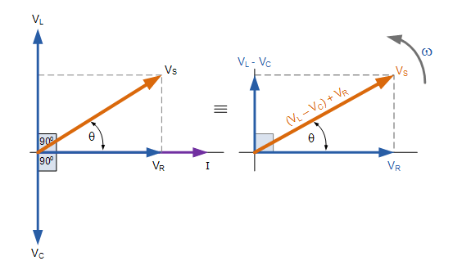
Phasor Representation
Figure 2.2 Phasor Diagram
VR is in phase with current.
VL leads the current by 90°.
VC lags the current by 90°.
Net reactive voltage = VL − VC

Slide 89
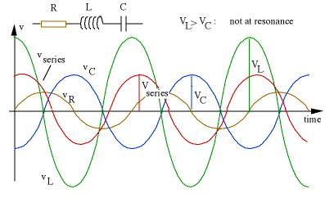
Waveforms of Voltage and Current
Figure 2.2 Waveform Diagram
Current waveform varies in phase with applied voltage depending on net reactance.
At resonance, current is in phase with voltage (purely resistive behavior).

Slide 90
Power in RLC Series Circuit
Instantaneous Power:
p(t) = v(t) × i(t)
True (Active) Power:
P = VI × cos(φ) (Measured in watts)
Reactive Power (Q):
Q = VI × sin(φ) (Measured in VAR)
Apparent Power (S):
S = VI (Measured in VA)
Note:
Power is dissipated only by the resistor.
Inductor and capacitor store and release energy without dissipation.

Slide 91
Resonance in RLC Circuit
Resonance occurs when XL = XC, making net reactance zero.
At resonance:
  Z = R (minimum)
  Current is maximum
  Power factor = 1
Resonant Frequency (fr):
fr = 1 / (2π√(LC))
Important:
Resonance improves circuit efficiency and is useful in tuning applications.

Slide 92
Power Factor and Phase Angle
Power Factor (PF) = cos(φ)
φ depends on (XL − XC) / R
PF = 1 at resonance
Inductive circuit → PF lagging
Capacitive circuit → PF leading
Key Insight:
Better power factor means better energy utilization and reduced losses.

Slide 93
Summary
RLC circuit combines R, L, and C in series.
Total impedance depends on R and net reactance (XL − XC).
Current can lead, lag, or be in phase with voltage.
Resonance occurs when XL = XC, resulting in maximum current and unity power factor.
Real power is consumed only by R; L and C exchange reactive power.
Applications include filters, oscillators, and tuning circuits.

Slide 95
Analysis with phasor diagram of RL
Parallel Load
Meet Soni
Assistant Professor
Electrical Engineering

Slide 96
Content
Introduction to RL Parallel Circuit …………………. 3
Behavior of RL Branches in Parallel ………………. 4
Current Distribution and Impedance ……………. 5
Phasor Representation ………………………………… 6
Waveforms of Current and Voltage ……………… 7
Power in RL Parallel Circuit ………………………….. 8
Power Factor and Phase Angle …………………….. 9
Key Points / Summary ………………………………… 10

Slide 97
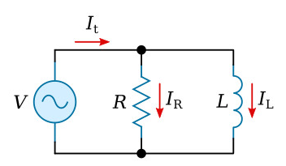
Introduction to RL Parallel Circuit
An RL parallel circuit has a resistor (R) and inductor (L) connected in parallel across an AC voltage source.
The voltage across both branches is the same.
The total current is the phasor sum of current through R and current through L.
Figure 2.1 RL parallel Circuit

Slide 98
Behavior of RL Branches in Parallel
Resistive branch current (IR) is in phase with voltage.
Inductive branch current (IL) lags behind voltage by 90°.
The resulting current is neither in phase nor 90° lagging, but has a phase angle φ.

Slide 99
Current Distribution and Impedance
Total current (IT) is calculated using phasor addition:
IT = √(IR² + IL²)
Branch currents:
IR = V / R
IL = V / XL, where XL = 2πfL
The total impedance (Z) is not just a scalar sum.
Admittance (Y) is used for easier analysis:
Y = √(G² + BL²),
Where,
G = 1 / R (conductance),
BL = 1 / XL (susceptive part)

Slide 100
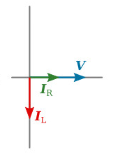
Phasor Representation
Voltage (V) is taken as reference (horizontal axis).
IR is in phase with V (horizontal phasor).
IL lags behind V by 90° (vertical downward phasor).
IT is the phasor sum of IR and IL.
Figure 2.2 Phasor Diagram

Slide 101
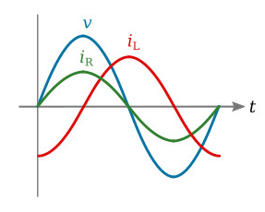
Waveforms of Voltage and Current
Voltage remains common and sinusoidal across both branches.
IR follows voltage waveform.
IL lags voltage waveform by 90°.
Figure 2.2 Waveform Diagram

Slide 102
Power in RL Parallel Circuit
Instantaneous Power:
p(t) = v(t) × i(t)
Real Power (P) is consumed only in resistive branch:
P = V × IR = V² / R
Reactive Power (Q) is associated with the inductor:
Q = V × IL = V² / XL
Apparent Power (S):
S = V × IT

Slide 103
Power Factor and Phase Angle
Power Factor (PF) = cos(φ), where φ is the angle between total current and voltage.
φ is positive (lagging) due to inductive effect.
Higher XL → higher phase lag → lower PF
Improving PF can reduce losses and increase efficiency.

Slide 104
Summary
RL parallel circuit shares common voltage, but branch currents differ in phase.
IR is in phase with V; IL lags behind by 90°.
Total current is phasor sum of IR and IL.
Only resistor consumes real power.
Power factor is lagging due to inductance.
Useful in analyzing filter circuits, tuning applications, and AC analysis.

Slide 106
Analysis with phasor diagram of RC
Parallel Load
Meet Soni
Assistant Professor
Electrical Engineering

Slide 107
Content
Introduction to RC Parallel Circuit ………………. 3
Behavior of RC Branches in Parallel ………………. 4
Current Distribution and Impedance ……………. 5
Phasor Representation ………………………………… 6
Waveforms of Current and Voltage ……………… 7
Power in RC Parallel Circuit ………………………….. 8
Power Factor and Phase Angle …………………….. 9
Key Points / Summary ………………………………… 10

Slide 108
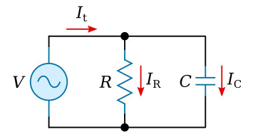
Introduction to RC Parallel Circuit
An RC parallel circuit has a resistor (R) and capacitor (C) connected in parallel across an AC supply.
The voltage is common to both branches.
The total current is the phasor sum of currents in R and C branches.
Figure 2.1 RC parallel Circuit

Slide 109
Behavior of RC Branches in Parallel
IR (Resistor current) is in phase with the voltage.
IC (Capacitor current) leads the voltage by 90°.
The resultant current leads the voltage by an angle φ depending on relative magnitudes of IR and IC.

Slide 110
Current Distribution and Impedance
Branch currents:
IR = V / R
IC = V / XC, where XC = 1 / (2πfC)
Total current (IT) is the phasor sum:
IT = √(IR² + IC²)
Admittance (Y):
Y = √(G² + BC²)
where:
G = 1 / R (conductance),
BC = 2πfC (capacitive susceptance)

Slide 111
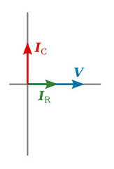
Phasor Representation
Voltage is the reference phasor (horizontal).
IR is in phase with V (horizontal).
IC leads V by 90° (vertical upward).
IT is the phasor resultant of IR and IC.
Figure 2.2 Phasor Diagram

Slide 112
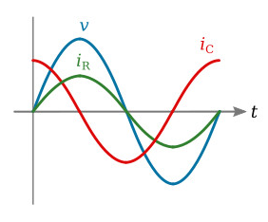
Waveforms of Voltage and Current
Voltage across both branches remains sinusoidal and common.
IR is in phase with voltage.
IC leads voltage by 90°.
Figure 2.2 Waveform Diagram

Slide 113
Power in RL Parallel Circuit
Instantaneous Power:
p(t) = v(t) × i(t)
Real Power (P) is consumed only in resistive branch:
P = V × IR = V² / R
Reactive Power (Q) is associated with the inductor:
Q = V × IC = V² / XC
Apparent Power (S):
S = V × IT

Slide 114
Power Factor and Phase Angle
Power Factor (PF) = cos(φ)
φ is the phase angle between total current and voltage.
PF is leading due to capacitive current.
High capacitance or frequency → higher IC → greater lead → lower PF

Slide 115
Summary
RC parallel circuit consists of R and C in parallel across an AC source.
Voltage remains common, but currents differ in phase.
IR is in phase; IC leads by 90°.
Total current leads voltage → leading power factor.
Power is dissipated only in resistor, not in capacitor.
Widely used in filtering, signal shaping, and tuning.

Slide 117
Analysis with phasor diagram of RLC
Parallel Load
Meet Soni
Assistant Professor
Electrical Engineering

Slide 118
Content
Introduction to RLC Parallel Circuit …………………... 3
Nature of Components and Current Flow …………. 4
Branch Currents and Admittance ……………………… 5
Phasor Representation …………………………………….. 6
Resonance in RLC Parallel Circuit ……………………… 7
Voltage and Current Waveforms ………………………. 8
Power and Power Factor ………………………………….. 9
Key Points / Summary …………………………………….. 10

Slide 119
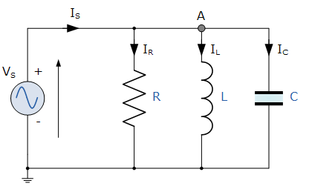
Introduction to RLC Parallel Circuit
An RLC parallel circuit has a resistor (R), inductor (L), and capacitor (C) connected in parallel across an AC voltage source.
All components share the same voltage.
The total current is the phasor sum of IR, IL, and IC.
Figure 2.1 RLC parallel Circuit

Slide 120
Nature of Components and Current Flow
IR is in phase with voltage.
IL lags voltage by 90°.
IC leads voltage by 90°.
Net reactive current: IX = IC - IL
Total current IT = IR + IX (phasor sum)

Slide 121
Branch Currents and Admittance
Individual branch currents:
IR = V / R
IL = V / XL, where XL = 2πfL
IC = V / XC, where XC = 1 / (2πfC)
Use Admittance (Y) for calculation:
Y = √(G² + (BC - BL)²)
where:
G = 1 / R
BC = 2πfC,
BL = 1 / (2πfL)

Slide 122
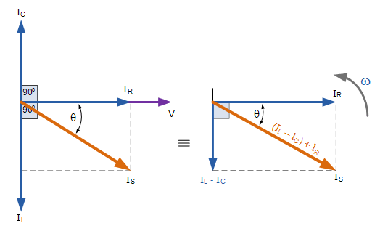
Phasor Representation
Figure 2.2 Phasor Diagram
V is taken as reference phasor.
IR is in phase with V (horizontal).
IL lags V by 90° (downward).
IC leads V by 90° (upward).
Net reactive current = IC - IL
IT is resultant phasor of IR and IX.

Slide 123
Resonance in RLC Parallel Circuit
Resonance occurs when inductive reactance = capacitive reactance
i.e., XL = XC
At resonance:
IC = IL → IX = 0, so IT = IR
Power factor becomes unity (purely resistive).
Minimum line current at resonance.

Slide 124
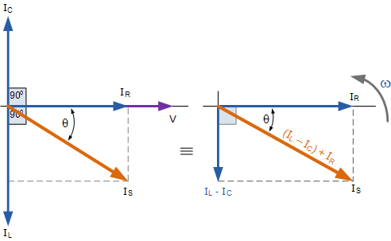
Voltage and Current Waveforms
Figure 2.3 Waveform Diagram
Voltage remains sinusoidal and same across all elements.
IR follows V(t), IL lags V(t) by 90°, IC leads V(t) by 90°.

Slide 125
Power and Power Factor
Real Power (P):
P = V² / R
Reactive Power (Q):
Q = V² × (1 / XL - 1 / XC)
Apparent Power (S):
S = V × IT
Power Factor (PF):
PF = cos(φ)
Leading, lagging, or unity based on net reactance.

Slide 126
Summary
RLC parallel circuit has R, L, and C in parallel with AC source.
All components share common voltage, but branch currents differ in phase.
Total current is phasor sum of IR, IL, and IC.
Resonance occurs when XL = XC, and current is minimized.
Power factor depends on whether circuit is capacitive, inductive, or resistive.
Useful in parallel resonance applications, filters, and tuned circuits.

Slide 128
Concept of Impedance, Admittance, Conductance, and Susceptance
Meet Soni
Assistant Professor
Electrical Engineering

Slide 129
Content
Introduction ……………………………………………………. 3
Impedance (Z) …………………………………………………. 4
Admittance (Y) ………………………………………………… 5
Conductance (G) ……………………………………………… 6
Susceptance (B) ………………………………………………. 7
Mathematical Relationships ……………………………. 8
Phasor Domain View ………………………………………. 9
Key Points / Summary …………………………………… 10

Slide 130
Introduction
These four terms are essential for analyzing AC circuits, especially involving complex quantities.
Impedance (Z) and Admittance (Y) are vector quantities, while Conductance (G) and Susceptance (B) are scalar.
They represent opposition or ease to current flow in AC systems.

Slide 131
Impedance (Z)
Impedance is the total opposition to current in an AC circuit.
It includes both resistance (R) and reactance (X):
Z = R + jX
R: Resistive component
X: Reactance (can be inductive or capacitive)
j: Imaginary unit (√–1)
Magnitude:
|Z| = √(R² + X²)
Unit: Ohm (Ω)

Slide 132
Admittance (Y)
Admittance is the reciprocal of impedance:
Y = 1 / Z
It indicates how easily current can flow.
Expressed as:
Y = G + jB
G: Conductance
B: Susceptance
Magnitude:
|Y| = √(G² + B²)
Unit: Siemens (S)

Slide 133
Conductance (G)
Conductance is the real part of admittance.
Represents the part of current that is in phase with voltage.
G = R / (R² + X²)
Unit: Siemens (S)
In a purely resistive circuit:
G = 1 / R

Slide 134
Susceptance (B)
Susceptance is the imaginary part of admittance.
Represents the reactive component of current:
B = –X / (R² + X²)
Positive B → Capacitive
Negative B → Inductive
In purely reactive circuits:
For inductors: B = –1 / XL
For capacitors: B = +1 / XC

Slide 135
Mathematical Relationships
Z = R + jX
Y = 1 / Z = G + jB
G = Re(Y), B = Im(Y)
|Z| = 1 / |Y|
Ohm’s Law in AC form:
V = IZ
I = VY

Slide 136
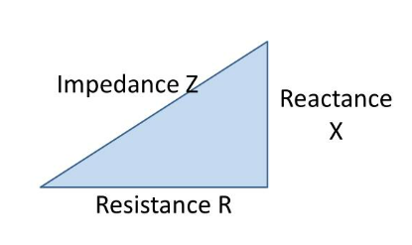
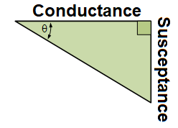
Phasor Domain View
Figure 2.1 Impedance Triangle
Figure 2.2 Admittance Triangle

Slide 137
Summary
Impedance (Z): Opposition to AC, includes resistance and reactance.
Admittance (Y): Ease of AC flow, reciprocal of Z.
Conductance (G): Real part of admittance, represents resistive behavior.
Susceptance (B): Imaginary part of admittance, represents reactive behavior.
These terms are essential for solving and analyzing AC networks, especially in parallel circuits and phasor analysis.

Slide 139
Concept of Active Power, Reactive Power, Apparent Power and Power Factor
Meet Soni
Assistant Professor
Electrical Engineering

Slide 140
Content
Introduction ……………………………………………………. 3
Active Power (P) ……………………………………………… 4
Reactive Power (Q) …………………………………………. 5
Apparent Power (S) ………………………………………… 6
Power Triangle ……………………………………………….. 7
Power Factor (PF) …………………………………………… 8
Significance of Power Factor …………………………… 9
Key Points / Summary ……………………………………. 10

Slide 141
Introduction
In AC circuits, power is not just a product of voltage and current.
Due to phase difference, different types of power are defined:
Active Power (P)
Reactive Power (Q)
Apparent Power (S)
These quantities help understand how efficiently power is utilized.

Slide 142
Active Power (P)
Also known as real or true power.
Represents the actual power consumed by resistive components.
Formula:
P = V × I × cos(φ)
V: RMS Voltage
I: RMS Current
φ: Phase angle between V and I
Unit: Watt (W)
It performs useful work: lighting, heating, rotating machines.

Slide 143
Reactive Power (Q)
Power that oscillates between source and reactive components (L and C).
Does not perform any net work.
Formula:
Q = V × I × sin(φ)
Unit: VAR (Volt-Ampere Reactive)
It supports the magnetic and electric fields in inductors and capacitors.

Slide 144
Apparent Power (S)
The product of RMS voltage and current, regardless of phase angle.
Formula:
S = V × I
Unit: VA (Volt-Ampere)
Represents the total power delivered to the circuit.
Relationship:
S² = P² + Q²

Slide 145
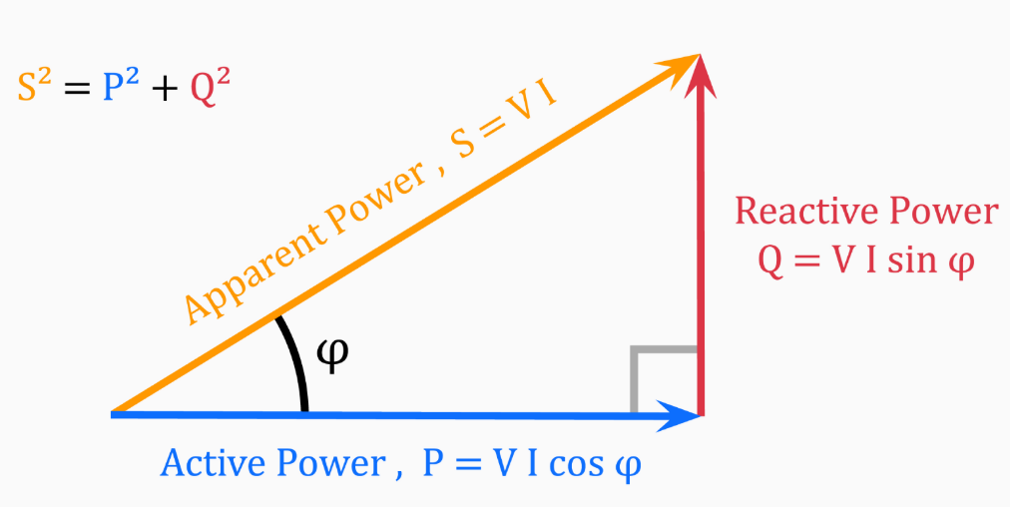
Power Triangle
A right-angled triangle representing:
Active power (P) – Base
Reactive power (Q) – Height
Apparent power (S) – Hypotenuse
Figure 2.1 Power Triangle

Slide 146
Power Factor (PF)
Indicates how effectively electrical power is converted into useful work.
Formula:
Power Factor (PF) = cos(φ) = P / S
PF ranges from 0 to 1
  PF = 1 → purely resistive (ideal)
  PF < 1 → reactive power is present
Can be leading (capacitive) or lagging (inductive)

Slide 147
Significance of Power Factor
Higher PF means better efficiency and reduced power losses.
Low PF results in:
Increased current
Larger conductor sizes
Higher losses
Voltage drops
Industries are penalized for low PF – hence power factor correction is common using capacitor banks or synchronous condensers.

Slide 148
Summary
Active Power (P): Useful power consumed (W).
Reactive Power (Q): Oscillating power (VAR).
Apparent Power (S): Total supplied power (VA).
Power Factor (PF): Efficiency ratio (cos(φ)).
Power Triangle helps visualize the relationship among P, Q, and S.
Efficient systems aim for high power factor to reduce losses and improve performance.

Slide 150
Concept of three phase supply and phase sequence
Meet Soni
Assistant Professor
Electrical Engineering

Slide 151
Content
Introduction to Three-Phase System …………… 3
Advantages of Three-Phase Supply …………….. 4
Construction and Generation ……………………… 5
Phase Sequence …………………………………………. 6
Types of Connections …………………………………. 7
Significance of Phase Sequence ………………….. 8
Applications ……………………………………………….. 9
Key Points / Summary ……………………………….. 10

Slide 152
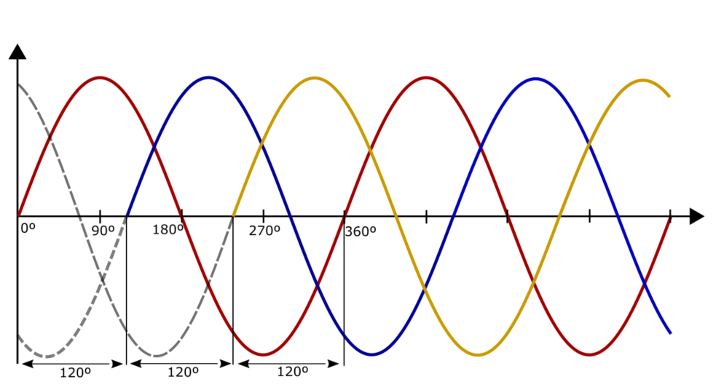
Introduction to Three-Phase System
Figure 2.1 Three Phase AC supply waveform
A three-phase system consists of three alternating voltages of the same frequency, 120° phase difference apart.
Generated using a three-phase alternator with three windings 120° apart.
Commonly used in industrial and power systems for efficient energy transfer.

Slide 153
Advantages of Three-Phase Supply
More power delivered for the same current than single-phase.
Constant power output – unlike pulsating power in single-phase.
Requires less conductor material for transmission.
Motors run more smoothly and efficiently.

Slide 154
Construction and Generation
Generated by rotating a magnetic field inside a stator with three windings placed 120° apart.
The output voltages are:
  Balanced: Equal magnitude, 120° apart.
  Unbalanced: Unequal magnitudes or angle deviations (not preferred).
Voltage Equations (Balanced):
VR(t) = Vm × sin(ωt)
VY(t) = Vm × sin(ωt − 120°)
VB(t) = Vm × sin(ωt − 240°)

Slide 155
Phase Sequence
Phase sequence refers to the order in which the voltages attain their maximum positive values.
In a standard system, it is either:
R → Y → B (Clockwise)
R → B → Y (Counterclockwise)
Phase sequence is crucial in rotating machinery (e.g., motors) as it determines rotation direction.

Slide 156
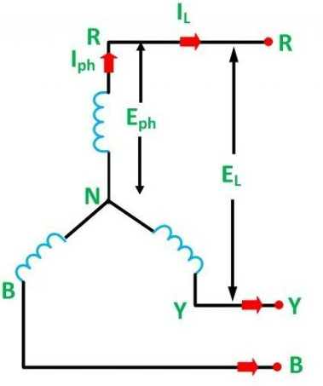
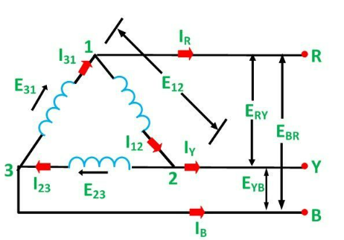
Types of Connections
Star (Y) Connection:
3 phase wires + 1 neutral
Line voltage = √3 × Phase voltage
Delta (Δ) Connection:
3 phase wires only
Line voltage = Phase voltage

Slide 157
Significance of Phase Sequence
Incorrect phase sequence can:
Reverse motor direction
Damage sensitive equipment
Critical in:
Synchronizing alternators
Phase-sensitive devices
Control circuits and automation

Slide 158
Applications
Power distribution systems
Three-phase motors and generators
Heavy industrial loads
HVAC systems
Electric trains and escalators

Slide 159
Summary
Three-phase supply uses 3 sinusoidal voltages 120° apart.
Delivers more power efficiently and continuously.
Phase sequence determines the direction of rotation in motors.
Star and Delta are two main connection types.
Understanding sequence is vital for system protection and synchronization.

