Slide 1
DIODE AND TRANSISTORS
Dr. Shubhrajyoti Kundu
Assistant Professor
Electrical Engineering

Slide 2
Content
Diode 1
Introduction to Ideal Diode 2
Effect of temperature on Ideal Diode 3
Unbiased diode 4
Forward and Reverse Bias 5

Slide 3
DIODE
A nonlinear device
The graph of current vs. voltage is not a straight line
The diode voltage must exceed the barrier voltage to conduct

Slide 4
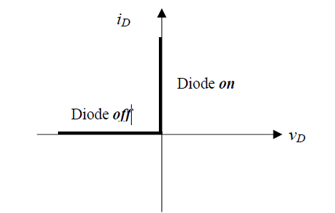
Introduction to Ideal Diode
The ideal diode acts as a short circuit for forward currents and as an open circuit with reverse voltage applied.

Slide 5
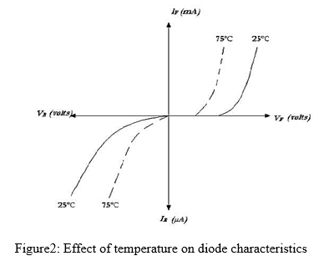
Effect of Temperature on Ideal Diode
The current that a PN junction diode can conduct at a given voltage is dependent upon the operating temperature.
An Increased temperature will result in a large number of broken covalent bonds increasing the large number of majority and minority carriers.
Diode current larger than its previous diode current.

Slide 6
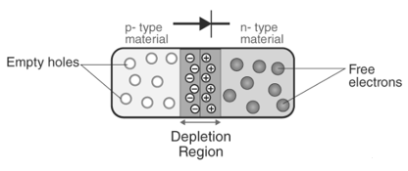
UNBIASED DIODE

Slide 7
Forward bias
The carriers move toward the junction
and collapse the depletion layer.
P
N
If the applied voltage is greater than
the barrier potential, the diode conducts.

Slide 8
Reverse bias
The carriers move away from the junction.
P
N
The depletion layer is reestablished
and the diode is off.

Slide 10
DIODE AND TRANSISTORS
Dr. Shubhrajyoti Kundu
Assistant Professor
Electrical Engineering

Slide 11
Content
Peak Inverse Voltage 1
Forward Surge Current 2
Diode as Uncontrolled Switch 3
Rectifier 5
4.1 Half Wave Rectifier

Slide 12
Peak Inverse Voltage (PIV)
Peak Inverse Voltage (PIV) or Peak Reverse Voltage (PRV) refer to the maximum voltage a diode or other device can withstand in the reverse-biased direction before breakdown. Also may be called Reverse Breakdown Voltage.

Slide 13
Forward surge current
Forward surge current is one of the maximum ratings and represents the instantaneous current in the forward direction.
The non-repeating maximum permissible peak current is the value that allows one cycle of 50 Hz sinusoidal waveform (conduction angle 180 degrees) to flow in the forward direction at the specified junction temperature.

Slide 14
DIODE AS UNCONTROLLED SWITCH
A semiconductor switch with no control input.
The diode turns off and acts as an open switch.
Device switching depends on supply voltage.
Hence, the diodes operate as an uncontrollable switch.

Slide 15
RECTIFIER
A rectifier is an electrical device that converts alternating current (AC), which periodically reverses direction, to direct current (DC), which is in only one direction, a process known as rectification.

Slide 16
TYPES OF RECTIFIERS
HALF WAVE RECTIFIER
FULL WAVE RECTIFIER
BRIDGE RECTIFIER

Slide 17
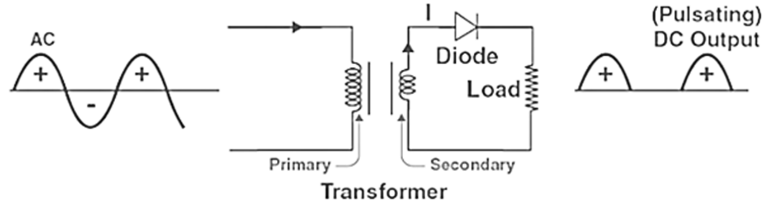
HALF WAVE RECTIFIER

Slide 19
DIODE AND TRANSISTORS
Dr. Shubhrajyoti Kundu
Assistant Professor
Electrical Engineering

Slide 20
Content
Full Wave Rectifier 3
Bridge Rectifier 7

Slide 21
FULL WAVE RECTIFIER
What Is Full Wave Rectifier?
Electric circuits that convert AC to DC are known as rectifiers. Rectifiers are classified into two types as Half Wave Rectifiers and Full Wave Rectifiers. Significant power is lost while using a half-wave rectifier and is not feasible for applications that need a smooth and steady supply. For a more smooth and steady supply, we use the full wave rectifiers. In this article, we will be looking into the working and characteristics of a full wave rectifier.
A full wave rectifier is defined as a rectifier that converts the complete cycle of alternating current into pulsating DC.
Unlike halfwave rectifiers that utilize only the halfwave of the input AC cycle, full wave rectifiers utilize the full cycle. The lower efficiency of the half wave rectifier can be overcome by the full wave rectifier.

Slide 22
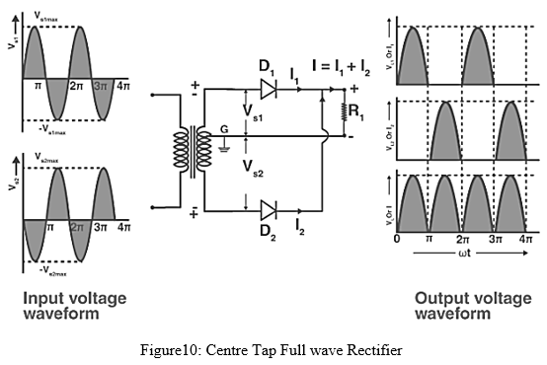
FULL WAVE RECTIFIER CIRCUIT

Slide 23
Working Principle
During the positive half cycle, diode D1 is forward biased as it is connected to the top of the secondary winding while diode D2 is reverse biased as it is connected to the bottom of the secondary winding. Due to this, diode D1 will conduct acting as a short circuit and D2 will not conduct acting as an open circuit
During the negative half cycle, the diode D1 is reverse biased and the diode D2 is forward biased because the top half of the secondary circuit becomes negative and the bottom half of the circuit becomes positive. Thus in a full wave rectifiers, DC voltage is obtained for both positive and negative half cycle.

Slide 24
BRIDGE RECTIFIER
Many electronic circuits require a rectified DC power supply to power various electronic basic components from the available AC mains supply. Rectifiers are used to convert an AC power to a DC power. Among the rectifiers, the bridge rectifier is the most efficient rectifier circuit. We can define bridge rectifiers as a type of full-wave rectifier that uses four or more diodes in a bridge circuit configuration to efficiently convert alternating (AC) current to a direct (DC) current. In the next few sections, let us learn more about its construction, working, and more.

Slide 25
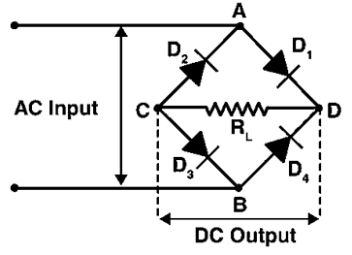
BRIDGE RECTIFIER CIRCUIT

Slide 26
WORKING PRINCIPLE
When an AC signal is applied across the bridge rectifier, terminal A becomes positive during the positive half cycle while terminal B becomes negative. This results in diodes D1 and D3 becoming forward biased while D2 and D4 becoming reverse biased.
During the negative half-cycle, terminal B becomes positive while terminal A becomes negative. This causes diodes D2 and D4 to become forward biased and diode D1 and D3 to be reverse biased.

Slide 27
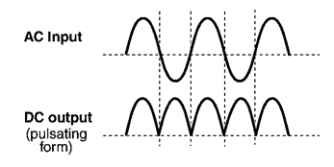
BRIDGE RECTIFIER OUTPUT WAVEFORM

Slide 29
DIODE AND TRANSISTORS
Dr. Shubhrajyoti Kundu
Assistant Professor
Electrical Engineering

Slide 30
Content
Filter Circuit 6
1.1 Choke Filter
1.2 Capacitor Input Filter
2. Clipper Circuit 7

Slide 31
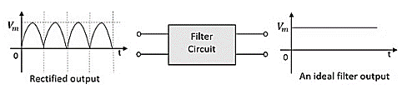
FILTER CIRCUIT
The ripple in the signal denotes the presence of some AC component. This ac component has to be completely removed in order to get pure dc output. So, we need a circuit that smoothens the rectified output into a pure dc signal.
The following figure shows the functionality of a filter circuit.

Slide 32
CHOKE FILTER
Definition: Choke filter consists of an inductor connected in series with rectifier output circuit and a capacitor connected in parallel with the load resistor. It is also called L-section filter because the inductor and capacitor are connected in the shape of inverted L. The output pulsating DC voltage from a rectifier circuit passes through the inductor or choke coil.
The inductor has low DC resistance and extremely high AC reactance. Thus, ripples get filtered through choke coil. Some of the residual ripples if present in filtered signal from inductor coil will get bypassed through the capacitor. The reason behind this is that capacitor allow AC and block DC.

Slide 33
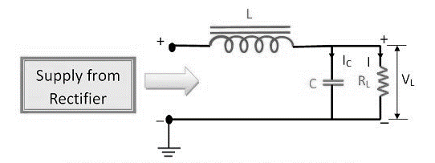
WORKING OF CHOKE FILTER OR L-SECTION FILTER
When the pulsating DC signal from the output of the rectifier circuit is feed into choke filter, the AC ripples present in the output DC voltage gets filtered by choke coil. The inductor has the property to block AC and pass DC. This is because DC resistance of an inductor is low and AC impedance of inductor coil is high. Thus, the AC ripples get blocked by inductor coil.

Slide 34
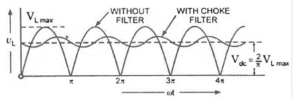
WAVEFORM OF CHOKE FILTER OR L-SECTION FILTER

Slide 35
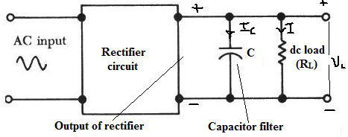
CAPACITOR INPUT FILTER OR SHUNT CAPACITOR FILTER

Slide 36
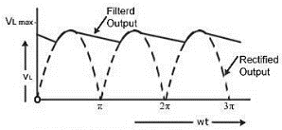
CAPACITOR INPUT FILTER OR SHUNT CAPACITOR FILTER

Slide 37
CLIPPER CIRCUITS
A clipper is a device which limits, remove or prevents some portion of the wave form (input signal voltage) above or below a certain level In other words the circuit which limits positive or negative amplitude ,or both is called chipping circuit. The clipper circuits are of the following types.
Series positive clipper
Series negative clipper
Shunt or parallel positive clipper
Shunt or parallel negative clipper
Dual (combination)Diode clipper

Slide 39
DIODE AND TRANSISTORS
Dr. Shubhrajyoti Kundu
Assistant Professor
Electrical Engineering

Slide 40
Content
Clipper Circuits 5
1.1 Series Positive Clipper
1.2 Series Positive Clipper with Bias
1.3 Series Negative Clipper
1.4 Series Negative Clipper with Bias

Slide 41
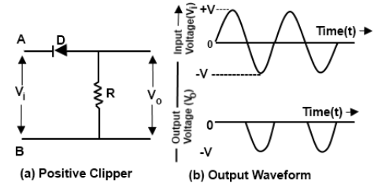
CLIPPER CIRCUITS
SERIES POSITIVE CLIPPER

Slide 42
CLIPPER CIRCUITS
SERIES POSITIVE CLIPPER
During the positive half of the input voltage, the terminal A is positive with respect to B. This reverse biases the diode and it acts as an open switch Therefore all the applied voltage drops across the diode and none across the resistor As a result of this there is no output voltage during the positive half cycle of the input voltage.
During the negative half cycle of the input voltage the terminal B is positive with respect to A. Therefore it forward biases the diode and it acts as a closed switch. Thus there is on voltage drop across diode during the negative half cycle of the input voltage.

Slide 43
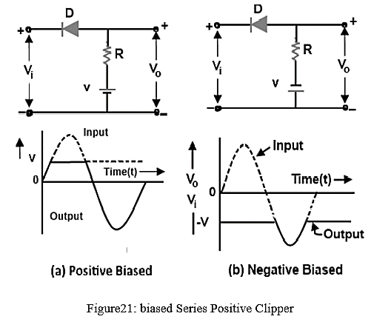
CLIPPER CIRCUITS
SERIES POSITIVE CLIPPER

Slide 44
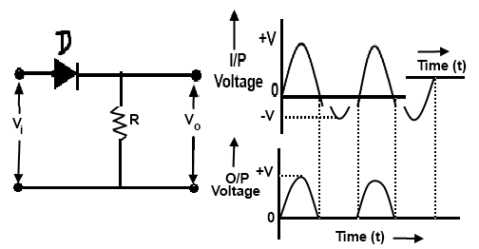
CLIPPER CIRCUITS
SERIES NEGATIVE CLIPPER

Slide 45
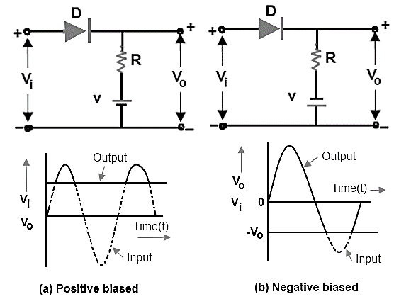
CLIPPER CIRCUITS
SERIES NEGATIVE CLIPPER WITH BIAS

Slide 47
DIODE AND TRANSISTORS
Dr. Shubhrajyoti Kundu
Assistant Professor
Electrical Engineering

Slide 48
Content
Clipper Circuits 3
1.1 Shunt or Parallel Positive Clipper
1.2 Shunt or Parallel Positive Clipper with bias
1.3 Shunt or Parallel Negative Clipper

Slide 49
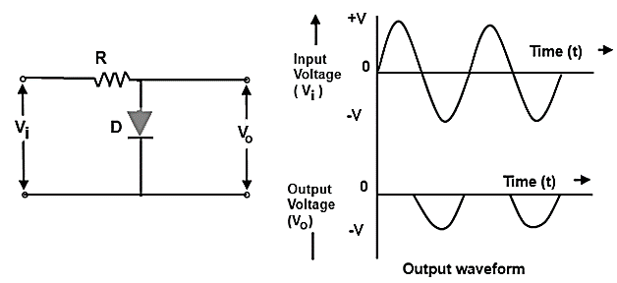
CLIPPER CIRCUITS
SHUNT OR PARALLEL POSITIVE CLIPPER

Slide 50
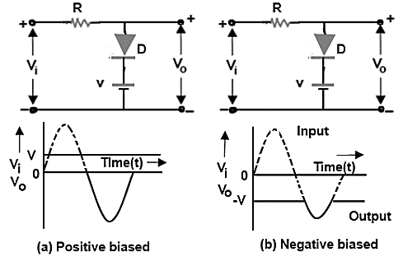
CLIPPER CIRCUITS
SHUNT OR PARALLEL POSITIVE CLIPPER WITH BIAS

Slide 51
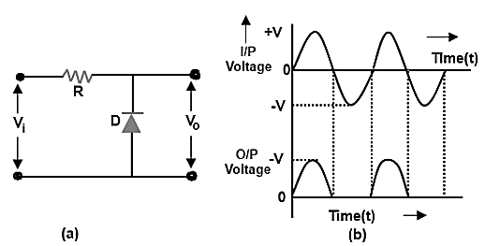
CLIPPER CIRCUITS
SHUNT OR PARALLEL NEGATIVE CLIPPER

Slide 53
DIODE AND TRANSISTORS
Dr. Shubhrajyoti Kundu
Assistant Professor
Electrical Engineering

Slide 54
Content
Clipper Circuits 2
1.1 Shunt or Parallel Negative Clipper with Bias
1.2 Dual Diode Clipper
Clamping Circuits 8
2.1 Positive Clamper
2.2 Positive Clamper with Bias
2.3 Negative Clamper
2.4 Negative Clamper with Bias

Slide 55
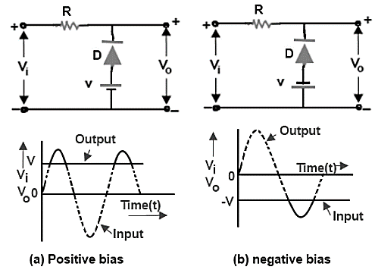
CLIPPER CIRCUITS
SHUNT OR PARALLEL NEGATIVE CLIPPER WITH BIAS

Slide 56
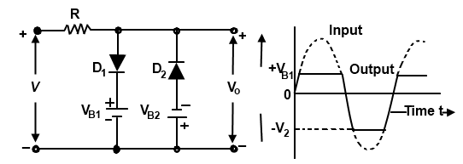
DUAL (COMBINATION) DIODE CLIPPER

Slide 57
CLAMPING CIRCUITS
A circuit that places either the positive or negative peak of a signal at a desired D.C level is known as a clamping circuit. A clamping circuit introduces (or restores) a D.C level to an A.C signal. Thus a clamping circuit is also known as D.C restorer, or D.C reinserted or a baseline stabilizer.
Positive clamping occurs when negative peaks raised or clamped to ground or on the zero level In other words, it pushes the signal upwards so that negative peaks fall on the zero level.
Negative clamping occurs when positive peaks raised or clamped to ground or on the zero level In other words, it pushes the signal downwards so that the positive peaks fall on the zero level.

Slide 58
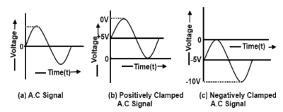
CLAMPING CIRCUITS

Slide 59
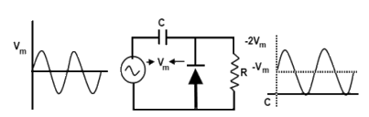
DIODE CLAMPERS
POSITIVE CLAMPER

Slide 60
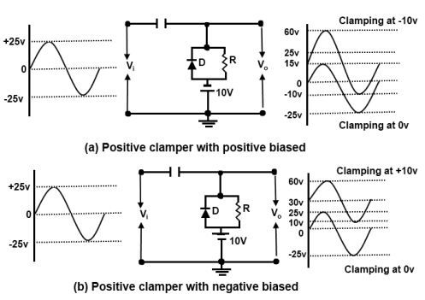
POSITIVE CLAMPER WITH BIAS

Slide 61
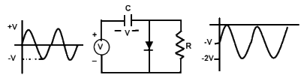
NEGATIVE CLAMPER

Slide 62
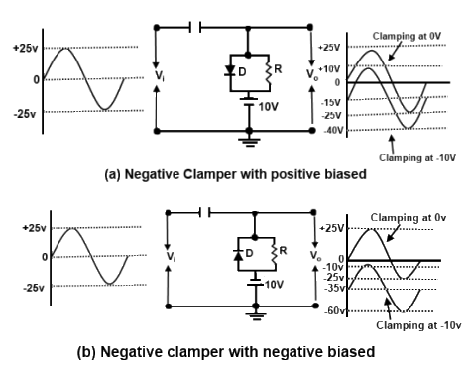
NEGATIVE CLAMPER WITH BIAS

Slide 64
DIODE AND TRANSISTORS
Dr. Shubhrajyoti Kundu
Assistant Professor
Electrical Engineering

Slide 65
Content
Voltage Multiplier 3
Construction of BJT and its Working 8

Slide 66
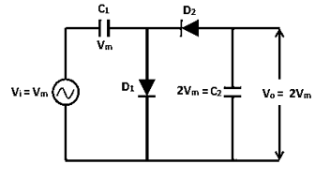
VOLTAGE MULTIPLIERS
The voltage if doubled, such a circuit is called as a Voltage Doubler. This can be extended to make a Voltage Tripler or a Voltage Quadrupler or so on to obtain high DC voltages.

Slide 67
WORKING PRINCIPLE
During the first positive half cycle − When the input signal is applied, the capacitor C₁ is charged and the diode D₁ is forward biased. While the diode D₂ is reverse biased and the capacitor C₂ doesn’t get any charge. This makes the output V₀ to be V_{m}. This can be understood from the following figure.
During the negative half cycle − After that, when the negative half cycle arrives, the diode D₁ gets reverse biased and the diode D₂ gets forward biased. The diode D₂ gets the charge through the capacitor C₂ which gets charged during this process. The current then flows through the capacitor C₁ which discharges.

Slide 68
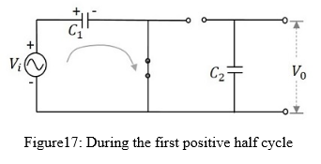
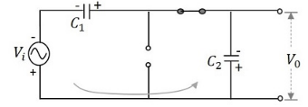
WORKING PRINCIPLE
During the first positive half cycle
During the first negative half cycle

Slide 69
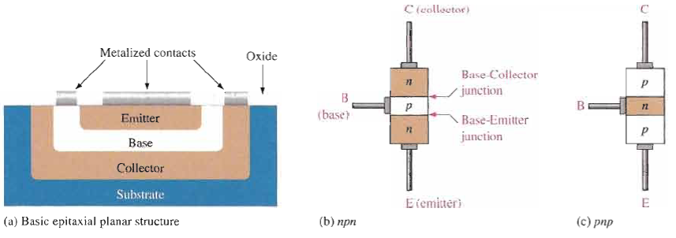
Construction of BJT and its Working

Slide 70
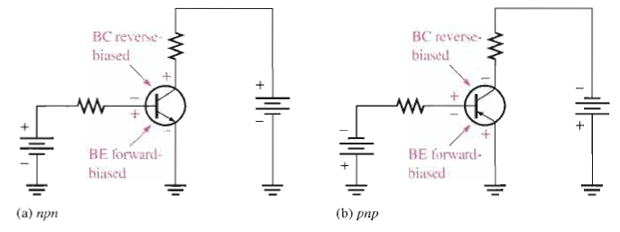
BJT Operation
In normal operation, the base-emitter is forward-biased and the base-collector is reverse-biased.
For the npn type shown, the collector is more positive than the base, which is more positive than the emitter.
For the pnp type, the voltages are reversed to maintain the forward-reverse bias.

Slide 71
DC Beta (β_{DC}) and DC Alpha (α_{DC})
The dc current gain of a transistor is the ratio of the dc collector current (I_{C}) to the dc base current (I_{B}) and is designated dc beta (β_{DC}).
β_{DC}= I_{C}/I_{B}
Typical values of β_{DC} range from less than 20 to 200 or higher.

Slide 72
The ratio of the dc collector current (IC) to the dc emitter current (IE) is the dc alpha (αDC).
α_{DC} =I_{C}/I_{E}
Typically, values of α_{DC} range from 0.95 to 0.99 or greater, but α_{DC} is always less than 1.
The alpha is a less-used parameter than beta in transistor circuits.

Slide 73
Relation between α_{DC} and β_{DC} :
We know that α_{DC} =I_{C}/I_{E} But I_{E} = I_{C} + I_{B}
α_{DC} =I_{C}/I_{C} + I_{B}
Divide numerator and denominator by I_{B} to get,
α_{DC} =(I_{C}/I_{B} ) /(1+ (I_{C}/I_{B}))
But I_{C}/I_{B} = β_{DC}
α_{DC} =β_{DC}/1 + β_{DC}
Similarly we can obtain the expression for β_{DC} :
β_{DC}=α_{DC}/1 - α_{DC}

Slide 75
DIODE AND TRANSISTORS
Dr. Shubhrajyoti Kundu
Assistant Professor
Electrical Engineering

Slide 76
Content
BJT Characteristics 2
Biased and Unbiased BJT 5
2.1 Fixed Base Biasing a Transistor
2.2 Emitter Feedback Bias
3. Transistor Configurations 15
3.1 Common Emitter
3.2 Common Base
3.3 Common Collector

Slide 77
Characteristics and Specifications of BJT
The collector characteristic curves show the relationship of the three transistor currents.
The curve shown is for a fixed based current. The first region is the saturation region.
As V_{CE} is increased, I_{C} increases until B. Then it flattens in region between points B and C, which is the active region.
Breakdown region
Active region
Saturation region
After C, is the breakdown region.

Slide 78
The collector characteristic curves illustrate the relationship of the three transistor currents.
By setting up other values of base current, a family of collector curves is developed.
β_{DC} is the ratio of collector current to base current.
It can be read from the curves. The value of β_{DC} is nearly the same wherever it is read.

Slide 79
Biased and Unbiased BJT
Transistor Biasing is the process of setting a transistors DC operating voltage or current conditions to the correct level so that any AC input signal can be amplified correctly by the transistor.
An "unbiased BJT" refers to a bipolar junction transistor (BJT) with its base, emitter, and collector terminals left open or unconnected, meaning no external voltage or current is applied to the transistor's terminals.

Slide 80
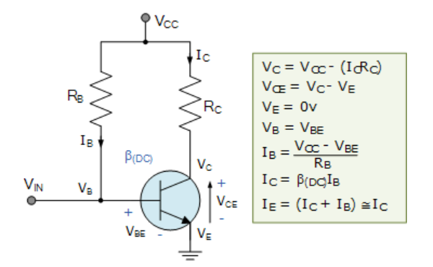
Fixed Base Biasing a Transistor

Slide 81
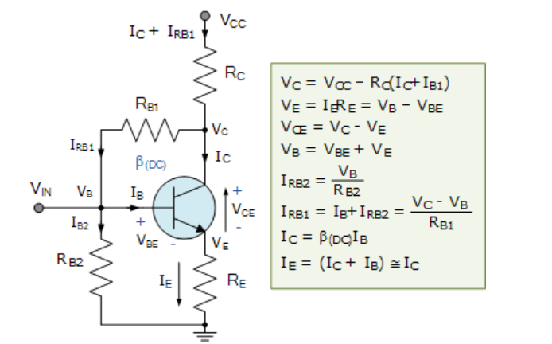
Emitter Feedback Bias

Slide 82
Transistor Configuration
Common Emitter Configuration
Common Base Configuration
Common Collector Configuration

Slide 83
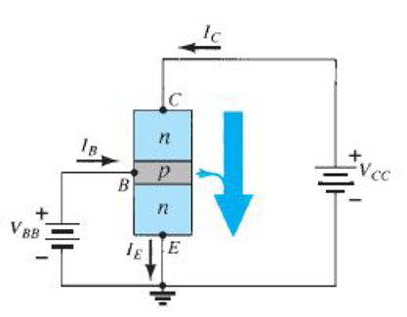
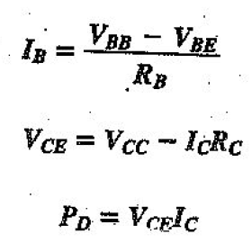
Common Emitter Configuration
collector characteristic curves can be generated that show how the collector current, IC, varies with the collector-to-emitter voltage, VCE, for specified values of base current, IB.

Slide 84
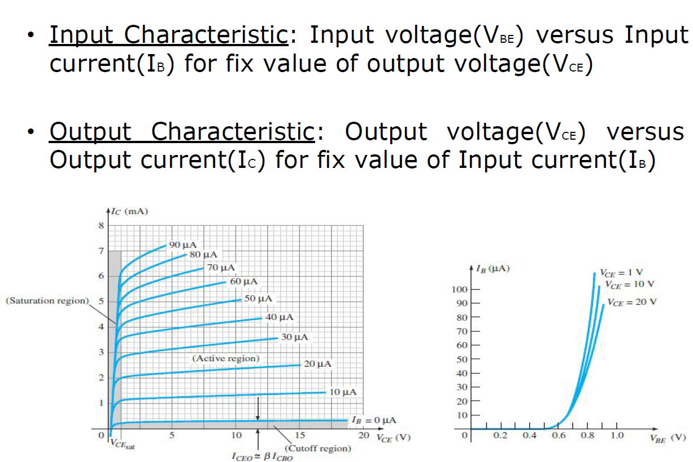
Common Emitter Configuration
Output Characteristic: Three operating regions.
Active region: As, I_{B} I_{C} , also as V_{CE} , I_{C} means I_{C} curves are not constant. As V_{CE} = V_{CB} + V_{BE}, Reverse bias across C and B increase, so effective base width , so recombination rate in the base will , so most of the electrons get collected at the collector terminal, so I_{C .} BJT is used as amplifier in active region.
Saturation region: C-B and B-E both junctions are forward biased.
Cut off region: IB = 0, but IC is not zero and it is relative large as the reverse saturation current or leakage current is more.

Slide 85
Common Emitter Configuration
V_{CE} = V_{CB} + V_{BE}, Reverse bias across C and B increase, so effective base width , so recombination rate in the base will , so most of the electrons get collected at the collector terminal and so I_{B}

Slide 86
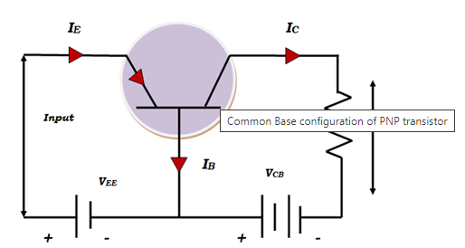
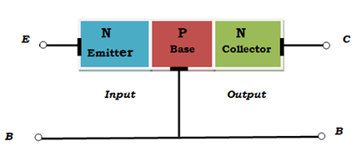
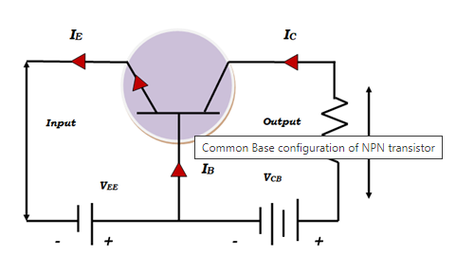
Common Base Configuration

Slide 87
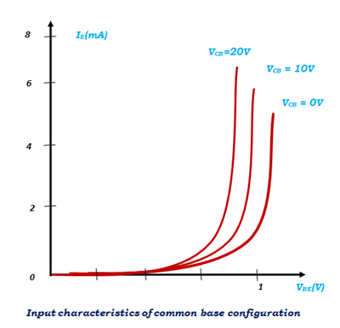
Common Base Configuration
Input characteristics are the relationship between the input current and input voltage with constant output voltage. In common base configuration input current is emitter current I_{E} and the input voltage is base emitter voltage V_{BE}. The curve is plotted between I_{E} and V_{BE} keeping V_{CB} as constant.

Slide 88
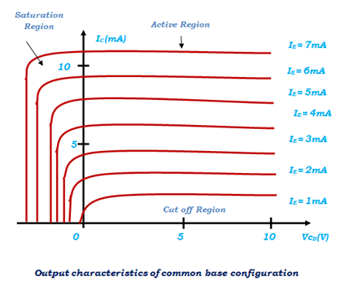
Common Base Configuration
Output characteristics are the relationship between output current I_{C} and output voltage V_{CB} keeping input current I_{E} constant. When the input current I_{E} is zero it is in cut off region. In saturation region both emitter base junction and collector base junction are forward biased.

Slide 89
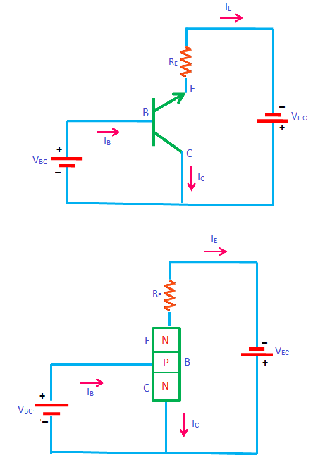
Common Collector Configuration
In this configuration the input is applied between the base and the collector and the output is taken from the collector and the emitter. Here the collector is common to both the input and the output circuits as shown in fig.
In common collector configuration the input current is the base current I_{B} and the output current is the emitter current I_{E}. The ratio of change in emitter current to the change in the base current is called current amplification factor.

Slide 90
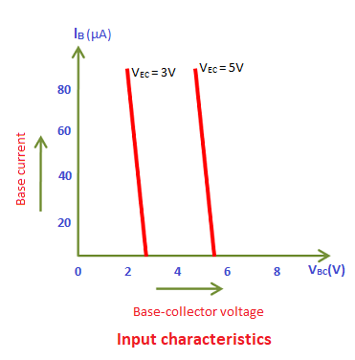
Common Collector Configuration
Input characteristic
It is a curve which shows the relationship between the base current, I_{B} and the collector base voltage V_{CB} at constant V_{CE} This method of determining the characteristic is as follows.
First, a suitable voltage is applied between the emitter and the collector. Next the input voltage V_{CB} is increased in a number of steps and corresponding values of I_{B} are noted.
Fig. shows the family of the input characteristic at different collector- emitter voltages.

Slide 91
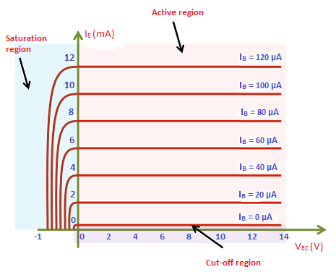
Common Collector Configuration
Output characteristic
It is a curve which shows the relationship between the emitter current l_{E} and collector-emitter voltage V_{CE}, the method of determining the output characteristic is as follows.
First, by adjusting the input a suitable current I_{B} is maintained. Next V_{CE} increased in a number of steps from zero and corresponding values of I_{E} are noted.
The above whole procedure is repeated for different values of I_{B}.
Fig. shows the family of output characteristics at different base current values.
Output characteristics of CC configuration

Slide 93
DIODE AND TRANSISTORS
Dr. Shubhrajyoti Kundu
Assistant Professor
Electrical Engineering

Slide 94
Content
Operation of BJT 1
BJT as a Switch 2
Transistor as an amplifier 3

Slide 95
Operation of BJT in various regions

Slide 96
BJT Switches
A BJT can be used as a switching device in logic circuits to turn on or off current to a load. As a switch, the transistor is normally in either cutoff (load is OFF) or saturation (load is ON).
In cutoff, the transistor looks like an open switch.
In saturation, the transistor looks like a closed switch.

Slide 97
Transistor as an Amplifier
A BJT amplifies AC signals by converting some of the DC power from the power supplies to AC signal power. An ac signal at the input is superimposed in the dc bias by the capacitive coupling. The output ac signal is inverted and rides on a dc level of V_{CE}.

Slide 99
DIODE AND TRANSISTORS
Dr. Shubhrajyoti Kundu
Assistant Professor
Electrical Engineering

Slide 100
Content
Voltage divider bias 5
VDB analysis 6
VDB load line and Q point 7

Slide 101
Voltage divider bias
Base circuit contains a voltage divider
Most widely used
Known as VDB

Slide 102
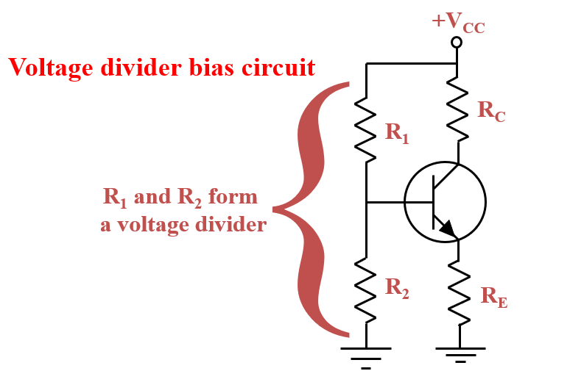
Voltage divider bias

Slide 103
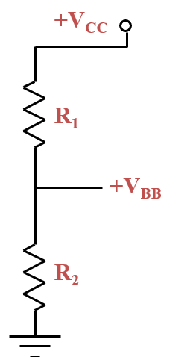
Voltage divider bias
Divider analysis:
R₂
V_{BB} =
V_{CC}
R₁ + R₂
ASSUMPTION: The base
current is normally much
smaller than the divider current.

Slide 104
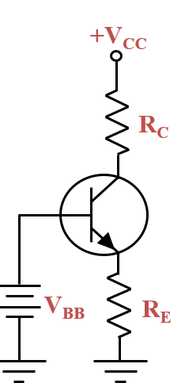
Voltage divider bias
Now the circuit can be viewed this way:
To complete the analysis:
V_{BB} - V_{BE}
I_{E} =
R_{E}
I_{C} ≅ I_{E}
V_{C} = V_{CC} - I_{C}R_{C}
V_{CE} = V_{C} - V_{E}

Slide 105
Voltage divider bias
The six-step process
1. Calculate the base voltage using the voltage divider equation.
2. Subtract 0.7 V to get the emitter voltage.
3. Divide by emitter resistance to get the emitter current.
4. Determine the drop across the collector resistor.
5. Calculate the collector voltage by subtracting the voltage across the collector resistor from V_{CC}.
6. Calculate the collector-emitter voltage by subtracting the emitter voltage from the collector voltage.

Slide 106
VDB analysis
The base current must be much smaller than current through the divider.
With the base voltage constant, the circuit produces a stable Q point under varying operational conditions

Slide 107
VDB load line and Q point
VDB is derived from emitter bias
The Q point is immune to changes in current gain
The Q point is moved by varying the emitter resistor

