Slide 1
Introduction of IC voltage regulator
Meet Soni
Faculty (PIT)
Electrical Engineering

Slide 2
Content
1. DC Power Supply Requirements in Electronic Circuits
2. Unregulated DC Power Supply
3. Drawbacks of Unregulated Power Supply

Slide 3
DC Power Supply Requirements in Electronic Circuits
Electronic circuits need a stable d.c. supply for components like transistors and vacuum tubes.
In transistor circuits, specific bias voltages are applied to emitter and collector for proper functioning.
Batteries can provide d.c. power but are expensive, short-lived, and require frequent replacement.
A common method is converting a.c. mains into d.c. using a rectifier-filter circuit.
Rectifier converts a.c. to pulsating d.c., filter smooths it.
Voltage regulators are added to ensure a constant d.c. output for sensitive electronics.

Slide 4
Working Principle of Series Voltage Regulator
Input voltage is unregulated DC.
Zener diode provides a stable reference.
Feedback from output is compared to reference.
Transistor adjusts conduction to regulate output.

Slide 5
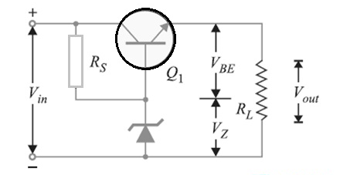
Basic Series Voltage Regulator Circuit

Slide 6
Circuit Components
Series Pass Transistor(Q1) : Main regulating element.
Zenner Diode : Provides constant reference voltage.
Voltage Divider(R1, R2) : Samples a fraction of output of feedback.
Error Detector(Op-Amp or transistor base-emitter junction) : Compares and controls base current of the series transistor.

Slide 7
Mathematical Analysis
Vout = Vz + Vbe
Where :
        Vz = Zener voltage
        Vbe = Base-Emitter voltage(~0.7V for silicon)

Slide 8
Advantages
Excellent line and lead regulation
Low output ripple
Simple design and easy to implement
Fast transient response
Can be made using discrete components

Slide 9
Disadvantages
Inefficient : Excess energy is dissipated as heat.
Requires heatsink for high currents.
Dropout voltage limits low input-output differential.
Not suitable for high power applications.

Slide 10
Applications
Power supplies for analog and digital circuits.
Voltage regulation in audio systems.
Battery chargers.
Voltage regulators in embedded systems.
Laboratory power supplies.

Slide 11
Practical Example
Given :
  Vin = 12V
  Zener = 5.6V
  Vbe = 0.7V
Then :
  Vout = 5.6V + 0.7V = 6.3V
  If the load changes, the transistor dynamically adjusts to maintain ~6.3V output.

Slide 12
Comparison with Shunt Regulator
Feature | Series Regulator | Shunt Regulator
Configuration | In series with load | In parallel with load
Efficiency | Higher | Lower
Load Regulation | Better | Poorer
Power Dissipation | Less(at low load current) | More
Usage | Precision application | Simple, low-power circuits

Slide 13
Thermal Considerations
Transistor dissipates Power = (Vin – Vout ) x lload
Requires a heatsink to prevent thermal runaway.
Use of thermal shutdown or current limiting is recommended for safety.

Slide 14
Key Takeaways
Series voltage regulators provide stable and precise output voltage.
They are widely used due to their simplicity and reliability.
However, they suffer from low efficiency, especially at high currents.
Design must consider thermal management and protection features.
Ideal for medium-power linear regulation where energy efficiency is not the primary concern.

Slide 15
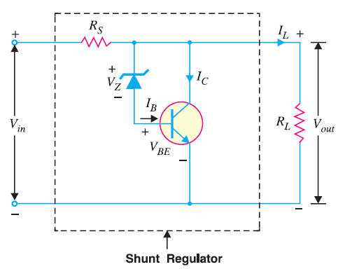
Introduction to Shunt Voltage Regulator
A Shunt Voltage Regulator is an electronic circuit that regulates the voltage across a load by shunting excess current to ground. It works parallel with the load and maintains a constant output voltage regardless of changes in input voltage or load current.

Slide 16
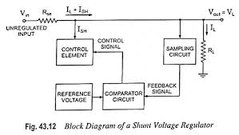
Working Principle
When input voltage increases : The regulator diverts more current away from the load to ground, keeping the output voltage constant.
When input voltage decreases : It diverts less current, allowing more to flow through the load, maintaining voltage.

Slide 17
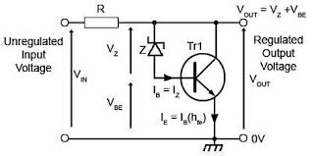
Operation
The series resistor R limits the current through the circuit.
When the input voltage exceeds the Zener breakdown voltage, the Zener diode conducts and shunts current to ground, there by maintaining a constant Vout = Vz (Zener voltage).
Shunt Regulator with Transistor.

Slide 18
Application
Voltage reference circuits
Protection circuits(against overvoltage)
Low-current power supplies
Analog signal conditioning
Sensor biasing

Slide 19
Advantages
Simple and inexpensive
Fewer components required
Instant response to voltage changes
No complex feedback loop

Slide 20
Disadvantages
Not suitable for high load currents (inefficient at high power)
Poor efficiency due to continuous power dissipation in the shunt element
Heat dissipation can be significant
Not ideal for variable loads
Requires large series resistor for higher voltages

Slide 21
Efficiency Considerations
The regulating element continuously draws current
A part of the input power is always dissipated as heat efficiency can be improved
Using low current application only
Minimizing series resistance
Ensuring optimal Zener current

Slide 22
Key Takeaways
Shunt regulators are parallel voltage circuits.
They work by shunting excess current to maintain a constant output voltage.
Zener diode is the core components in most basic shunt regulators.
Efficient for low-power, steady-load applications.
Not ideal for high-current or dynamic-load systems due to energy inefficiency.

Slide 24
Basic series and shunt voltage regulator
Meet Soni
Faculty (PIT)
Electrical Engineering

Slide 25
Content
Series Voltage Regulator 1
Shunt Voltage Regulator 2

Slide 26
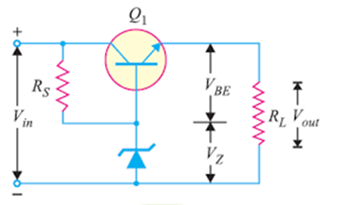
Introduction to Series Voltage Regulator
A Series Voltage Regulator maintains constant output by controlling a series pass element (typically a transistor). It operates with a closed-loop feedback system to adjust voltage dynamically.

Slide 27
Working Principle of Series Voltage Regulator
Input voltage is unregulated DC.
Zener diode provides a stable reference.
Feedback from output is compared to reference.
Transistor adjusts conduction to regulate output.

Slide 28
Basic Series Voltage Regulator Circuit

Slide 29
Circuit Components
Series Pass Transistor(Q1) : Main regulating element.
Zenner Diode : Provides constant reference voltage.
Voltage Divider(R1, R2) : Samples a fraction of output of feedback.
Error Detector(Op-Amp or transistor base-emitter junction) : Compares and controls base current of the series transistor.

Slide 30
Mathematical Analysis
Vout = Vz + Vbe
Where :
        Vz = Zener voltage
        Vbe = Base-Emitter voltage(~0.7V for silicon)

Slide 31
Advantages
Excellent line and lead regulation
Low output ripple
Simple design and easy to implement
Fast transient response
Can be made using discrete components

Slide 32
Disadvantages
Inefficient : Excess energy is dissipated as heat.
Requires heatsink for high currents.
Dropout voltage limits low input-output differential.
Not suitable for high power applications.

Slide 33
Applications
Power supplies for analog and digital circuits.
Voltage regulation in audio systems.
Battery chargers.
Voltage regulators in embedded systems.
Laboratory power supplies.

Slide 34
Practical Example
Given :
  Vin = 12V
  Zener = 5.6V
  Vbe = 0.7V
Then :
  Vout = 5.6V + 0.7V = 6.3V
  If the load changes, the transistor dynamically adjusts to maintain ~6.3V output.

Slide 35
Comparison with Shunt Regulator
Feature | Series Regulator | Shunt Regulator
Configuration | In series with load | In parallel with load
Efficiency | Higher | Lower
Load Regulation | Better | Poorer
Power Dissipation | Less(at low load current) | More
Usage | Precision application | Simple, low-power circuits

Slide 36
Thermal Considerations
Transistor dissipates Power = (Vin – Vout ) x lload
Requires a heatsink to prevent thermal runaway.
Use of thermal shutdown or current limiting is recommended for safety.

Slide 37
Key Takeaways
Series voltage regulators provide stable and precise output voltage.
They are widely used due to their simplicity and reliability.
However, they suffer from low efficiency, especially at high currents.
Design must consider thermal management and protection features.
Ideal for medium-power linear regulation where energy efficiency is not the primary concern.

Slide 38
Introduction to Shunt Voltage Regulator
A Shunt Voltage Regulator is an electronic circuit that regulates the voltage across a load by shunting excess current to ground. It works parallel with the load and maintains a constant output voltage regardless of changes in input voltage or load current.

Slide 39
Working Principle
When input voltage increases : The regulator diverts more current away from the load to ground, keeping the output voltage constant.
When input voltage decreases : It diverts less current, allowing more to flow through the load, maintaining voltage.

Slide 40
Operation
The series resistor R limits the current through the circuit.
When the input voltage exceeds the Zener breakdown voltage, the Zener diode conducts and shunts current to ground, there by maintaining a constant Vout = Vz (Zener voltage).
Shunt Regulator with Transistor.

Slide 41
Application
Voltage reference circuits
Protection circuits(against overvoltage)
Low-current power supplies
Analog signal conditioning
Sensor biasing

Slide 42
Advantages
Simple and inexpensive
Fewer components required
Instant response to voltage changes
No complex feedback loop

Slide 43
Disadvantages
Not suitable for high load currents (inefficient at high power)
Poor efficiency due to continuous power dissipation in the shunt element
Heat dissipation can be significant
Not ideal for variable loads
Requires large series resistor for higher voltages

Slide 44
Efficiency Considerations
The regulating element continuously draws current
A part of the input power is always dissipated as heat efficiency can be improved
Using low current application only
Minimizing series resistance
Ensuring optimal Zener current

Slide 45
Key Takeaways
Shunt regulators are parallel voltage circuits.
They work by shunting excess current to maintain a constant output voltage.
Zener diode is the core components in most basic shunt regulators.
Efficient for low-power, steady-load applications.
Not ideal for high-current or dynamic-load systems due to energy inefficiency.

Slide 47
Fixed voltage regulator & linear adjustable voltage regulator
Meet Soni
Faculty (PIT)
Electrical Engineering

Slide 48
Content
1. Fixed Linear Voltage Regulators
2. Adjustable Linear Voltage Regulators
3. Positive vs. Negative Voltage Regulators

Slide 49
Fixed Linear Voltage Regulators
Fixed voltage regulators provide consistent output under varying conditions
Common in low-noise, low-power applications such as analog or embedded systems
They operate in linear mode, dissipating excess voltage as heat
Ideal when simplicity and reliability are more important than efficiency
Widely used in power supplies of radios, sensors, and consumer electronics

Slide 50
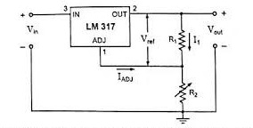
Fixed Linear Voltage Regulators

Slide 51
Working & Characteristics
Requires an input voltage higher than the desired output by at least the dropout margin
Maintains voltage using internal reference, pass transistor, and feedback loop
Dropout voltage typically ranges between 1.5V to 2.5V
Thermal dissipation occurs when input-output difference is high under load
Capacitors at input and output improve voltage stability and noise rejection

Slide 52
Fixed Regulator – Pros, Cons, and Use Cases
Advantages include simple circuitry, minimal external components, and clean output
Excellent for noise-sensitive applications such as amplifiers or precision instruments
Disadvantages include poor efficiency under high input-output voltage differences
Heat management becomes critical at higher currents
Not suitable for variable-voltage or high-power applications without major derating

Slide 53
Common ICs – 78XX & 79XX
78XX series provides fixed positive voltages, commonly used in 5V, 12V, and 15V designs
Used in digital electronics, sensor interfaces, and microcontroller systems
79XX series provides negative voltages, essential in dual rail and analog systems
Each IC has built-in thermal and short-circuit protection for safety
Input voltage must be sufficiently higher (usually 2V or more) than output for regulation

Slide 54
Circuit Components
Series Pass Transistor(Q1) : Main regulating element.
Zenner Diode : Provides constant reference voltage.
Voltage Divider(R1, R2) : Samples a fraction of output of feedback.
Error Detector(Op-Amp or transistor base-emitter junction) : Compares and controls base current of the series transistor.

Slide 55
Advantages
Excellent line and lead regulation
Low output ripple
Simple design and easy to implement
Fast transient response
Can be made using discrete components

Slide 56
Disadvantages
Inefficient : Excess energy is dissipated as heat.
Requires heatsink for high currents.
Dropout voltage limits low input-output differential.
Not suitable for high power applications.

Slide 57
Positive vs. Negative Voltage Regulators
Positive (78XX) vs Negative (79XX) series differ in polarity and internal layout
Pin mapping is different and must be carefully followed when integrating
Negative rails are common in audio, analog, and op-amp based designs
Both series include built-in current limiting, thermal protection, and noise suppression.

Slide 58
Positive vs. Negative Voltage Regulators
Positive voltage regulators like 78XX deliver output above ground potential
Negative voltage regulators like 79XX provide output below ground reference
Correct pin configuration is essential for preventing reverse connections
Both types are needed in dual-supply op-amp and analog environments
Selection depends on circuit topology and voltage rail requirements

Slide 59
Practical Example
Given :
  Vin = 12V
  Zener = 5.6V
  Vbe = 0.7V
Then :
  Vout = 5.6V + 0.7V = 6.3V
  If the load changes, the transistor dynamically adjusts to maintain ~6.3V output.

Slide 60
Adjustable Linear Voltage Regulators
Output voltage is set using external resistors across adjust pin and ground
Popular ICs include LM317 (positive) and LM337 (negative) with wide voltage range
Ideal for circuits needing non-standard voltages like 2.2V, 6.8V, or 9V
Supports dynamic power configurations in lab setups and multi-voltage boards
Can replace several fixed regulators with a single adjustable unit

Slide 61
Key Takeaways
Series voltage regulators provide stable and precise output voltage.
They are widely used due to their simplicity and reliability.
However, they suffer from low efficiency, especially at high currents.
Design must consider thermal management and protection features.
Ideal for medium-power linear regulation where energy efficiency is not the primary concern.

Slide 62
Application
Voltage reference circuits
Protection circuits(against overvoltage)
Low-current power supplies
Analog signal conditioning
Sensor biasing

Slide 63
Advantages
Simple and inexpensive
Fewer components required
Instant response to voltage changes
No complex feedback loop

Slide 64
Key Takeaways
Fixed regulators are ideal for consistent voltage needs with standard output values
Adjustable regulators offer flexibility using resistor networks
78XX and 79XX series are widely used in academic, industrial, and commercial electronics
Negative regulators are vital for analog and bipolar systems
Voltage regulators ensure performance, safety, and longevity of circuits

Slide 66
IC 78xx and IC 79xx
Meet Soni
Faculty (PIT)
Electrical Engineering

Slide 67
Content
1. 78XX Series Positive Voltage Regulators
2. 79XX Series Negative Voltage Regulators
3. Application Circuit and Features

Slide 68
78XX Series – Introduction & IC Overview
Fixed voltage regulators provide consistent output under varying conditions
Common in low-noise, low-power applications such as analog or embedded systems
They operate in linear mode, dissipating excess voltage as heat
Ideal when simplicity and reliability are more important than efficiency
Widely used in power supplies of radios, sensors, and consumer electronics

Slide 69
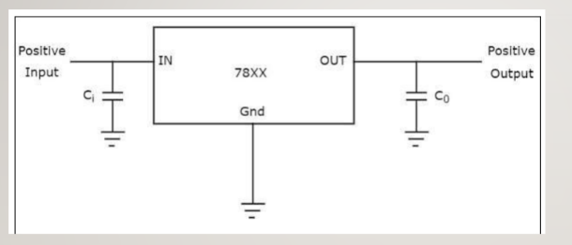
78XX Series – Introduction & IC Overview

Slide 70
78XX Series – ICs, Pins & Operation
Common ICs: 7805, 7806, 7809, 7812, 7815, 7824
Input voltage must always exceed output voltage by at least 2V
Pin 1 is Input, Pin 2 is Ground, Pin 3 is Output
Optional diode at the output can raise voltage by approx. 0.7V
Output = Vreg + Vdiode if a diode is placed in series

Slide 71
78XX Series – Features, Pros & Limitations
Provides regulated positive voltage with minimal external parts
Features include short-circuit protection, thermal shutdown, and overload handling
Advantages include ease of use, low cost, and stable voltage output
Limitations include poor efficiency at high current, and fixed output range
Best suited for low-noise and moderate power applications

Slide 72
79XX Series – Introduction & IC Overview
79XX series offers fixed negative voltage outputs
Used in dual-rail systems where both +V and −V are needed
Similar in function to 78XX but for negative voltage rails
Examples: 7905 (–5V), 7912 (–12V), 7924 (–24V)
Essential in op-amp and analog circuit designs

Slide 73
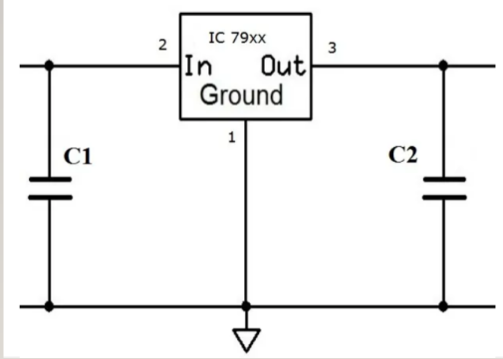
79XX Series – Introduction & IC Overview

Slide 74
79XX Series – Pins, Range & Formula
Pin configuration: Pin 1 is Ground, Pin 2 is Output, Pin 3 is Input
Input must be more negative than output by at least 2V
Vout = –XXV (fixed)
With a diode in series, Vout can be shifted: Vout = –Vreg – Vdiode
Same protection features as 78XX for reliability and safety

Slide 75
79XX Series – Features, Uses, Pros & Limitations
Designed for stable negative rail supply in analog systems
Applications include audio amplifiers, instrumentation, signal processing
Advantages include built-in protection and simple design
Limitations include low efficiency and lack of voltage flexibility
Must be paired with capacitors for ripple filtering and stable operation

Slide 76
Application Circuit & Component Guidelines
Input capacitor C1 = 0.33µF to 10µF for voltage stability
Output capacitor C2 = 0.1µF to 100µF for transient response
Protection diodes D1 and D2 prevent reverse polarity or back current
Capacitors help reduce noise and improve dynamic response
Applicable for both 78XX and 79XX series designs

Slide 77
Comparison of 78XX vs. 79XX
Series Pass Transistor(Q1) : Main regulating element.
Zenner Diode : Provides constant reference voltage.
Voltage Divider(R1, R2) : Samples a fraction of output of feedback.
Error Detector(Op-Amp or transistor base-emitter junction) : Compares and controls base current of the series transistor.

Slide 78
Key Takeaways
78XX series delivers fixed positive voltage, ideal for standard supply needs
79XX series provides fixed negative voltage, necessary for dual-rail systems
Both are simple, cost-effective, and widely available
Use capacitors and diodes to enhance reliability and stability
Not suitable for high-current or high-efficiency requirements

Slide 80
DC Regulated Power Supply Concepts and Implementation
Meet Soni
Faculty (PIT)
Electrical Engineering

Slide 81
Content
Introduction and Functional Blocks of DC Power Supply
Working Principle and Voltage Regulation Techniques
Design Considerations and Thermal Management
Practical Applications and Implementation Examples

Slide 82
Introduction to DC Regulated Power Supply
DC regulated power supplies convert AC mains into stable DC output
Provide safe, consistent voltage to circuits like microcontrollers and sensors
Protect sensitive electronic components from input voltage fluctuations
Critical for maintaining accuracy, performance, and safety over time

Slide 83
Functional Blocks of DC Power Supply
Transformer steps down or steps up AC voltage and isolates the circuit
Rectifier converts AC to pulsating DC, commonly using bridge rectifiers
Filter reduces ripple content using capacitors or inductors
Voltage regulator maintains constant output voltage despite load variations
Each block improves signal quality and protects downstream electronics

Slide 84
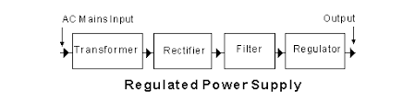
Functional Blocks of DC Power Supply

Slide 85
Fixed Linear Voltage Regulators
Fixed voltage regulators provide consistent output under varying conditions
Common in low-noise, low-power applications such as analog or embedded systems
They operate in linear mode, dissipating excess voltage as heat
Ideal when simplicity and reliability are more important than efficiency
Widely used in power supplies of radios, sensors, and consumer electronics

Slide 86
Transformer, Rectifier and Filter Stages
Transformer adjusts voltage level and provides safety isolation
Rectifiers like bridge circuits provide full-wave DC conversion
Filters smooth DC output using capacitors and LC combinations
Minimizing ripple improves stability of final DC supply
Critical for analog, digital, and communication circuits

Slide 87
Voltage Regulator Stage
Final stage ensures constant output regardless of input or load changes
Linear regulators (like 78XX) use resistive control to stabilize voltage
Switching regulators use energy storage and high-frequency switching
Feedback systems dynamically adjust regulator output
Ensures circuit functionality even under fluctuating conditions

Slide 88
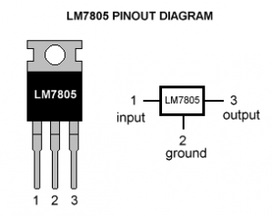
Voltage Regulator Stage

Slide 89
Working Principle of Regulated Power Supply
AC input is stepped down and isolated via transformer
Rectifier converts AC to unsteady DC
Filter smooths waveform to reduce ripple
Voltage regulator locks output to desired constant value
Ensures reliable and noise-free DC power for electronics

Slide 90
Voltage Regulation Techniques
Linear Regulation
Simple design, low ripple output, but inefficient due to heat loss
Ideal for low-noise sensitive applications
Switching Regulation
Efficient power conversion with reduced heat generation
More complex circuitry, additional filtering needed
Used in battery-operated, high-efficiency systems

Slide 91
Design Considerations and Thermal Management
Heat sinks must be attached to linear regulators for safe operation
Power dissipation = (Vin – Vout) × Iload
Ventilation and thermal shutdown circuits improve longevity
Proper capacitor placement improves stability and transient response
Component protection is vital against overload, short circuits, and reverse polarity

Slide 92
Practical Applications and Examples
Example: 7805 circuit provides stable +5V from 9V–12V input
Input capacitor 0.33µF suppresses noise, output capacitor 0.1µF stabilizes output
Applications include microcontroller boards, sensor circuits, and industrial controllers
Regulated supplies power oscilloscopes, PLCs, and communication equipment
Essential for ensuring precise voltage in test instruments and embedded devices

Slide 93
Key Takeaways
DC regulated power supply provides safe and reliable DC output
Key stages include transformer, rectifier, filter, and regulator
Linear regulators are simple but inefficient at high currents
Switching regulators are efficient but complex
Design must focus on heat management, ripple reduction, and voltage stability
Applications span from consumer electronics to industrial automation

Slide 95
Introduction to Transducers Basics and Definitions
Meet Soni
Faculty (PIT)
Electrical Engineering

Slide 96
Content
Fundamentals of Transducers
Core Characteristics and Functions
Types and Classification Overview

Slide 97
Fundamentals of Transducers
A transducer converts one form of energy into another form
Mainly converts physical quantities like temperature, pressure, light into electrical signals
Examples include thermocouples, microphones, strain gauges, and photodiodes
Transducers bridge the gap between the physical environment and digital processing systems
Widely used in automation, medical devices, robotics, and industrial controls

Slide 98
Basic Elements of a Transducer System
Sensing Element directly interacts with the physical quantity
Examples include strain gauges, thermistors, or photodiodes
Transduction Element converts sensed change into an electrical signal
Examples include resistance change, voltage output, or capacitance variation
Combined operation ensures accurate detection and reliable signal output

Slide 99
Characteristics of a Good Transducer
Sensitivity: Large output for small input change improves measurement precision
Linearity: Input-output relation should ideally be directly proportional
Accuracy: Output must match actual physical quantity as close as possible
Response Time: Fast response is critical for dynamic system performance
Stability: Maintains accuracy and performance over time and environmental changes

Slide 100
Classification Based on Energy Conversion and Output
Active Transducers generate output without external energy (e.g., thermocouples)
Passive Transducers need external power to operate (e.g., strain gauges)
Analog Transducers provide continuous signals (e.g., temperature sensors)
Digital Transducers provide discrete signals (e.g., optical encoders)
Classification helps in selecting the right transducer for an application

Slide 101
Classification Based on Physical Quantity
Temperature: Thermocouples, Thermistors
Pressure: Strain gauges, Piezoelectric sensors
Light Intensity: Photodiodes, LDRs
Displacement: LVDTs, Potentiometers
Sound: Microphones, Piezo buzzers
Each category specializes in detecting a specific kind of physical event

Slide 102
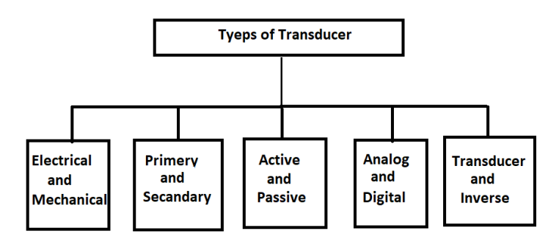
Classification Based on Physical Quantity

Slide 103
Types of Transducers – Overview
Resistive Transducers: Measure change in resistance due to input (e.g., potentiometers)
Inductive Transducers: Detect change in inductance (e.g., LVDTs)
Capacitive Transducers: Sense variations in capacitance (e.g., humidity sensors)
Piezoelectric Transducers: Generate voltage when mechanically stressed
Optical Transducers: Convert light intensity into measurable electrical signals

Slide 104
Advantages of Using Transducers
High sensitivity allows detection of minute physical changes
Fast response time enables real-time monitoring and control
Compact size allows easy integration into embedded electronics
Simple interfacing with microcontrollers and data acquisition systems
Crucial for building intelligent, automated, and responsive devices

Slide 105
Limitations and Challenges
Non-linearity in some transducers affects measurement accuracy
Environmental factors like temperature and humidity may affect performance
Periodic calibration is needed to maintain precision over time
Signal conditioning like amplification and filtering is often necessary
Proper packaging is needed for hostile or industrial environments

Slide 106
Key Takeaways
Shunt regulators are parallel voltage circuits.
They work by shunting excess current to maintain a constant output voltage.
Zener diode is the core components in most basic shunt regulators.
Efficient for low-power, steady-load applications.
Not ideal for high-current or dynamic-load systems due to energy inefficiency.

Slide 107
Practical Applications and Real-Life Example
Medical: ECG, blood pressure monitors, digital thermometers
Industrial: Load cells, pressure sensors, position encoders
Consumer Electronics: Proximity sensors in smartphones, microphones
Environmental Monitoring: Weather sensors for temperature, humidity, air quality
Real-life Example: Thermocouple converts temperature difference into voltage using Seebeck effect

Slide 108
Key Takeaways
Transducers convert physical phenomena into electrical signals and vice versa
They are classified by energy conversion type, signal output, and measured quantity
Core characteristics like sensitivity, linearity, and accuracy define their performance
Widely used across medical, industrial, aerospace, and consumer sectors

Slide 110
Classification and Types of Transducers
Meet Soni
Faculty (PIT)
Electrical Engineering

Slide 111
Content
Classification by Function and Energy
Classification by Measured Quantity
Classification by Transduction Mechanism
Selection and Examples

Slide 112
Introduction to Classifications
Transducers connect real-world physical events to digital systems
Classified based on energy conversion, signal type, measurement quantity, and mechanism
Correct classification improves design accuracy and system efficiency
Used extensively in instrumentation, control, robotics, and automation
Understanding classifications helps in targeted engineering applications

Slide 113
Classification by Energy Conversion
Active Transducers generate output signal without external power
Examples include thermocouples, piezoelectric sensors, photovoltaic cells
Advantages are simple construction and no need for excitation voltage
Passive Transducers require external excitation for operation
Examples include strain gauges, RTDs, and LVDTs
Provide high sensitivity but need signal conditioning for use

Slide 114
Classification by Output Signal Type
Analog Transducers produce continuous output signals
Examples include thermistors, potentiometers, and LVDTs
Used for continuous monitoring and real-time control applications
Digital Transducers produce discrete binary or pulse signals
Examples include optical encoders, proximity switches, Hall effect sensors
Suitable for microcontroller interfacing and digital automation systems

Slide 115
Classification by Measured Quantity
Transducers are classified by the physical quantity they measure
Temperature: Thermocouples, RTDs, Thermistors
Pressure: Strain gauges, Piezo sensors
Light Intensity: Photodiodes, LDRs
Sound: Microphones, Ultrasonic sensors
Displacement: LVDTs, Potentiometers
Humidity: Hygrometers, Capacitive sensors
Acceleration: Accelerometers using piezoelectric or capacitive effects

Slide 116
Classification by Transduction Mechanism – I
Resistive Transducers vary resistance with input
Examples are strain gauges, thermistors, potentiometers
Inductive Transducers vary inductance with displacement or motion
Examples include LVDTs and variable inductance sensors
Capacitive Transducers vary capacitance with distance or dielectric change
Examples include proximity and humidity sensors

Slide 117
Classification by Transduction Mechanism – II
Piezoelectric Transducers generate voltage under mechanical stress
Examples include vibration detectors, microphones, ultrasonic sensors
Optical Transducers generate current or voltage proportional to light intensity
Examples include photodiodes, LDRs, phototransistors
Choice of mechanism depends on application sensitivity and environment

Slide 118
Classification Based on Application Function
Input Transducers convert physical phenomena into electrical signals
Examples are microphones, load cells, accelerometers
Output Transducers convert electrical signals into physical action
Examples are loudspeakers, relays, actuators
Signal Conditioning Transducers modify signal for next processing stage
Examples include amplifier-integrated sensors, ADC interfaced systems

Slide 119
Selection Criteria for Transducers
Range: Transducer must cover the measurable range accurately
Sensitivity: High sensitivity improves measurement precision
Linearity: Essential for direct input-output relationship
Frequency Response: Must match dynamic nature of application
Environmental Resistance: Temperature, humidity, and vibration tolerance
Output Compatibility: Should match acquisition and processing system standards

Slide 120
Real-Life Example: LVDT
LVDT measures linear displacement with high accuracy
Consists of primary coil, two secondary coils, and movable magnetic core
As core moves, differential voltage output varies proportionally
Applications include CNC machines, robotics, aircraft control surfaces
Advantages include frictionless operation, high resolution, and robustness

Slide 121
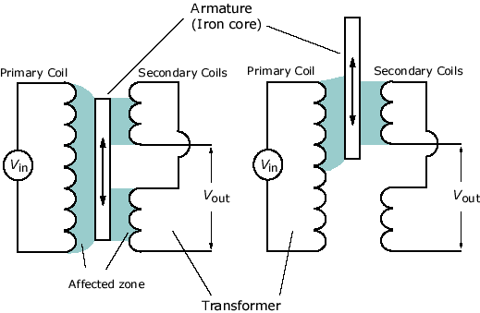
Real-Life Example: LVDT

Slide 122
Key Takeaways
Transducers classified based on energy conversion, output type, quantity measured, and mechanism
Active transducers generate their own signal, passive need external power
Analog transducers offer continuous signals; digital ones offer discrete outputs
Selection depends on sensitivity, range, frequency response, and environment

Slide 124
Working Principles of Transducers
Meet Soni
Faculty (PIT)
Electrical Engineering

Slide 125
Content
Introduction to Transduction Principles
Detailed Working of Core Transducer Types
Signal Conditioning and Practical Use

Slide 126
Introduction to Transduction Principles
Transducers convert physical parameters into electrical signals
Physical quantities include temperature, pressure, displacement, and light
Based on changes in resistance, inductance, capacitance, voltage, or light response
Core to instrumentation, automation, control, and sensing systems
Each type exploits a specific physical effect to perform the conversion

Slide 127
Overview of Transduction Mechanisms
Resistive: Change in resistance with deformation or temperature
Inductive: Change in inductance due to magnetic field or coil movement
Capacitive: Change in capacitance with geometry or dielectric shift
Piezoelectric: Voltage generation from mechanical pressure
Electromagnetic: Voltage induced by conductor in magnetic field
Photovoltaic: Light energy converted into voltage

Slide 128
Working Principle – Resistive Transducers
Resistance changes as physical dimension or material property varies
Equation: R = ρL/A
Strain gauges detect pressure or force via material elongation
Thermistors and RTDs respond to temperature with resistance shift
LDRs reduce resistance as light intensity increases
Used in force sensors, temperature monitors, and light detectors

Slide 129
Working Principle – Inductive Transducers
Inductance changes with movement of magnetic core or coil spacing
Equation: L = (N²μA)/l
LVDT uses a movable magnetic core to vary secondary coil voltage
Highly accurate for linear displacement measurement
Used in CNC systems, automation, and industrial position feedback

Slide 130
Working Principle – Capacitive Transducers
Capacitance changes with plate distance, area, or dielectric property
Equation: C = (εA)/d
Proximity sensors detect objects by measuring gap distance
Humidity sensors detect moisture by changing dielectric constant
Used in pressure systems, tank level monitoring, and humidity control

Slide 131
Working Principle – Piezoelectric Transducers
Mechanical stress produces voltage across piezo crystal
Equation: V = d × F
Used in microphones, vibration detectors, and force sensors
Highly sensitive and fast response devices
Common in sound systems, impact sensors, and industrial alerts

Slide 132
Working Principle – Photonic & Thermoelectric
Photonic Transducers: Light alters current or resistance
Photodiodes and LDRs convert light into electrical response
Used in solar panels, light meters, and optical switches
Thermoelectric Transducers: Seebeck effect generates voltage from heat
Equation: V = S × ΔT
Thermocouples used in high-temperature monitoring and engine control

Slide 133
Signal Conditioning Requirements
Raw transducer signals are often weak or noisy
Signal conditioning makes them suitable for ADC and controllers
Includes amplification using op-amps to boost signal levels
Filtering removes unwanted noise or high-frequency interference
Conversion to digital is needed for microcontroller integration
Isolation ensures system safety and signal protection

Slide 134
Practical Example – Piezoelectric Microphone
Quartz crystal placed between metal electrodes
When sound waves hit, the crystal compresses and generates voltage
Voltage is amplified and transmitted to audio processing circuits
Used in telecommunication, voice recording, and acoustic sensors
Demonstrates direct mechanical-to-electrical signal conversion

Slide 135
Key Takeaways
Transducers convert physical input to electrical signals via specific mechanisms
Working principles include resistive, inductive, capacitive, piezoelectric, and others
Each mechanism has suited applications depending on sensitivity and use case
Signal conditioning is essential for reliable interfacing and accuracy

Slide 137
Characteristics and Specifications of Transducers
Meet Soni
Faculty (PIT)
Electrical Engineering

Slide 138
Content
Static and Dynamic Characteristics
Electrical and Mechanical Parameters
Environmental and Calibration Aspects

Slide 139
Introduction to Transducer Specifications
A transducer's behavior is defined by both its principle and performance characteristics
Proper understanding ensures reliable system design and accurate measurements
Static and dynamic characteristics are critical in automation, medical, and control systems
Helps engineers avoid errors, drift, and system failures

Slide 140
Static Characteristics – Part I
Accuracy: Closeness of measured value to true value
Expressed as percentage of full-scale output
Precision (Repeatability): Consistency of output for repeated identical input
High precision doesn't guarantee high accuracy
Critical in stable control and measurement applications

Slide 141
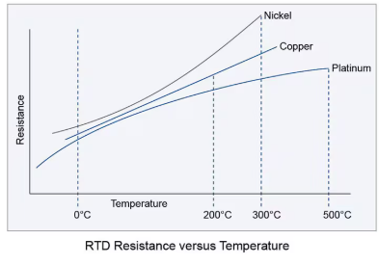
Static Characteristics – Part I

Slide 142
Static Characteristics – Part II
Sensitivity = Change in output / Change in input
Used to detect small variations in physical parameters
Linearity: Degree to which output follows input proportionally
Ideal linear systems provide straight-line I/O relationship
Resolution: Smallest input change that produces a detectable output shift
Higher resolution enables finer measurement detail

Slide 143
Dynamic Characteristics
Response Time: Time to reach defined percentage of final value after input
Time Constant (τ): Time to reach 63.2% of final value in step input
Lower τ indicates faster system response
Rise Time: Time to go from 10% to 90% of final value
Settling Time: Time to stabilize within error band of final value
Bandwidth: Range of input frequencies that can be accurately sensed

Slide 144
Electrical Characteristics
Input Impedance: Resistance offered to source input
High input impedance prevents loading effects
Output Impedance: Resistance at transducer output
Should be compatible with load or next signal stage
Signal Types: Analog (voltage, current), Digital (binary, pulse)
Some outputs may require amplification or conditioning

Slide 145
Mechanical Characteristics
Range: Input span over which the transducer functions accurately
Hysteresis: Output difference for same input during increasing vs decreasing conditions
Must be minimized for precision control
Drift: Slow, unintentional change in output over time
Caused by aging, temperature, and wear; minimized through regular calibration

Slide 146
Environmental Specifications
Operating Temperature: Safe temperature range for functional operation
Humidity Tolerance: Prevents corrosion or short-circuits in moist environments
Shock and Vibration Resistance: Important in mobile, automotive, aerospace systems
EMI/EMC Resistance: Immunity to electromagnetic noise ensures stable output

Slide 147
Calibration Essentials
Calibration aligns transducer output with known reference values
Corrects for deviations across the measurement range
Performed using standard inputs and adjustment procedures
Maintains measurement integrity across operating life
Periodic recalibration ensures long-term accuracy

Slide 148
Real-Life Example – RTD (Pt100)
RTD uses platinum wire whose resistance varies with temperature
Accuracy: ±0.1°C is typical in precision-grade RTDs
Sensitivity: 0.385 Ω/°C
Linearity is excellent across operational range
Low drift, fast response, and high stability
Widely used in medical, HVAC, and industrial process control

Slide 149
Key Takeaways
Transducer performance depends on static, dynamic, electrical, and environmental factors
Key terms include accuracy, precision, sensitivity, linearity, resolution, and response
Impedance matching, calibration, and drift control are essential
Mechanical limits like range and hysteresis define usability
Understanding specifications ensures reliability and safety in engineering systems

Slide 151
Industrial and Engineering Applications of Transducers
Meet Soni
Faculty (PIT)
Electrical Engineering

Slide 152
Content
General Role and Importance
Application Domains
Case Study and Examples

Slide 153
Introduction and General Role
Transducers convert physical phenomena into electrical signals
Bridge the gap between real-world conditions and electronic control systems
Enable measurement, monitoring, automation, and feedback
Critical in improving operational efficiency, safety, and reliability
Used in industries like manufacturing, aerospace, healthcare, and energy

Slide 154
Role of Transducers in Industry
Measurement: Detect and quantify physical variables accurately
Monitoring: Track operational parameters in real-time
Control: Enable dynamic adjustments through feedback systems
Safety: Trigger alerts and shutdowns under abnormal conditions
Vital for automation, quality control, and system optimization

Slide 155
Applications in Manufacturing and Automation
Displacement and Position Sensing
LVDTs, potentiometers, encoders used in CNC, robotics, conveyors
Pressure and Force Measurement
Strain gauges and piezo sensors used in hydraulic presses, injection molding
Temperature Monitoring
Thermocouples, RTDs used in soldering, furnace control, food processing

Slide 156
Applications in Energy and Power Systems
Power System Monitoring
Voltage and current sensors for grid, substation, and smart metering
Renewable Energy Systems
Light sensors monitor solar panels, anemometers monitor wind turbines
Strain gauges monitor structural integrity of renewable energy systems

Slide 157
Applications in Automotive Systems
Engine and Exhaust Monitoring
Pressure sensors, oxygen sensors, and thermocouples optimize combustion
Safety and Stability Systems
Accelerometers, gyroscopes, and ultrasonic sensors used in ABS and airbags
Transducers ensure efficiency, emission control, and passenger safety

Slide 158
Applications in Aerospace and Defense
Flight Control and Navigation
Gyroscopes, LVDTs, barometric sensors guide autopilot and spacecraft
Structural Health Monitoring
Strain gauges and piezo sensors monitor aircraft wings and spacecraft structures
Reliability of transducers is crucial for mission-critical aerospace operations

Slide 159
Applications in Biomedical Engineering
Vital Sign Monitoring
Temperature sensors, pressure sensors, ECG electrodes for patient health
Prosthetics and Rehabilitation
Force sensors and motion sensors empower smart prosthetics and physiotherapy tools
Enable real-time monitoring, diagnostics, and personalized treatments

Slide 160
Applications in Consumer Electronics and Smart Homes
User Interaction Devices
Microphones, touch sensors, accelerometers in smartphones, gaming devices
Home Automation
Light sensors, motion detectors, and thermostats manage smart homes
Transducers enhance user experience, convenience, and energy efficiency

Slide 161
Applications in Environmental and Agricultural
Weather and Climate Monitoring
Humidity sensors, rain gauges, temperature sensors in weather stations
Smart Farming
Soil moisture sensors, pH sensors optimize irrigation and crop health
Support sustainable agriculture and environmental conservation efforts

Slide 162
Case Study – Automated Packaging Line
Proximity Sensors detect package arrival
Load Cells ensure correct package weight
Temperature Sensors maintain sealing machine quality
Optical Encoders verify labeling accuracy
Transducers automate quality control, reduce errors, and enhance productivity

Slide 163
Key Takeaways
Transducers are essential across industry, aerospace, biomedical, and consumer fields
Enable precise measurement, real-time monitoring, control, and automation
Selection of appropriate transducer improves system reliability and efficiency
Transducers are foundational in Industry 4.0 and smart technological evolution

