Slide 1


Programming for Problem Solving (PPS)
Chapter-1
Introduction to ‘C’ Programming:

Slide 2
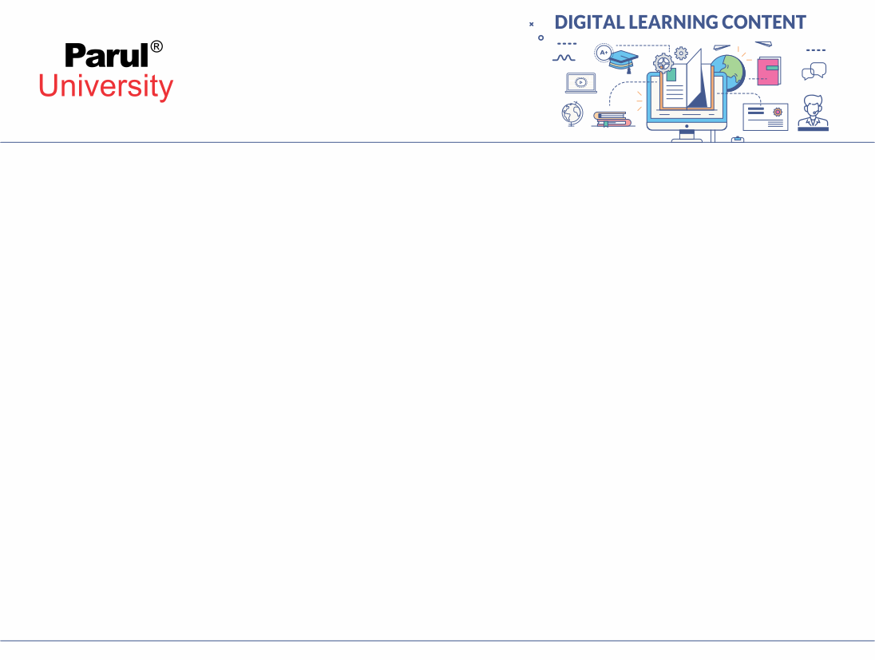

What is a Program?
Program is a collection of instructions that performs a specific task when executed by a computer.
What are Programming Languages?
A programming language is a set of commands, instructions and other syntax use to create a software
program. Programming languages are used in computer programming to implement algorithms.

Slide 3
Introduction to C Programming Language
C is a general-purpose, high-level programming language, which means it can be used to write a wide range of programs—from operating systems to games.
High-level: Easier for humans to read and write than machine code.
General-purpose: Not limited to specific applications.
Low-level features: Allows direct memory access using pointers.
Procedural: Follows a step-by-step approach using functions.
Compiled: Code is converted into machine language before execution.
Structured: Code is divided into blocks (functions), making it easier to manage.
Common Usage: Operating systems, embedded systems, and compilers.

Slide 4
1. High Level Language
Meaning:
A high-level language provides abstraction from the hardware. This means you don’t need to worry about managing memory locations, CPU registers, or writing binary code.
Why it matters:
You can write commands like printf(“Hello”) instead of complicated machine-level instructions.
It uses English-like keywords (e.g., if, while, for, return).
Easier to learn and debug than assembly or machine code.

Slide 5
2. General-Purpose
Meaning:
C is not restricted to solving a specific type of problem or limited to one domain. You can use it for a wide variety of applications.
Where it can be used:
System software (OS, drivers)
Embedded systems (firmware)
Application software (compilers, databases)
Scientific computing
Games and graphics engines
Why it matters:
You learn one language and can apply it almost anywhere.

Slide 6
3. Low-Level Features
Meaning:
Even though C is a high-level language, it gives access to low-level operations like memory manipulation through pointers.
What this lets you do:
Access and modify memory directly using addresses.
Write efficient and fast code.
Communicate with hardware-level resources.
Why it matters:
Critical for writing OS kernels, drivers, and performance-critical code.

Slide 7
4. Procedural
Meaning:
C follows the procedure-oriented approach. The program is divided into functions or procedures that run step-by-step.
Characteristics:
Executes instructions in the order they are written.
Uses main() as the starting point.
Functions are used to divide tasks (e.g., input(), process(), output()).
Why it matters:
Easier to write, understand, and maintain code.
Encourages logical thinking and problem-solving through small steps.

Slide 8
5. Compiled
Meaning:
C is a compiled language, meaning the program you write (source code) is first converted into machine code by a compiler before it can be executed.
Steps:
Write code in .c file.
Compile it using a compiler like GCC.
The compiler converts it into .exe (Windows) or a.out (Linux).
Run the executable.
Why it matters:
Faster execution than interpreted languages.
Errors are caught during compilation.
No need for the compiler to run the program again.

Slide 9
6. Structured
Meaning:
C supports structured programming, which means organizing code into blocks, mainly using functions, loops, conditionals, etc.
Benefits:
Increases readability and reusability.
Reduces errors and complexity.
Makes debugging easier.
Why it matters:
Students learn to break problems into smaller tasks (modular design).
Helps in managing large codebases.

Slide 10
History of C Language
Developed in 1972 by Dennis Ritchie at Bell Labs.
Evolved from:
                -BCPL → Basic Combined Programming Language
                -B (developed by Ken Thompson)
                -C (a successor to B)
                UNIX OS was originally written in assembly, then rewritten in C (1973), making it portable.
                Standardization:
                -ANSI C (1989) – American National Standards Institute version
                -ISO C – International Standardization, later versions like C99, C11, C18.

Slide 11
Application Areas of C
C is used in various fields due to its performance and control over hardware:
System Programming: Operating systems like UNIX, Linux kernels.
Embedded Systems: Microcontrollers, firmware for smart devices.
Game Development: Core engines and performance-critical parts.
Compilers/Interpreters: GCC and others are written in C.
GUI Applications: Though rare today, some interfaces still use C.
Database Systems: MySQL is developed in C.
Network Programming: Socket programming, protocol implementations.
Scientific & Engineering: Simulations and numerical analysis.

Slide 12
1. System Programming
Used for: Operating Systems, Kernels, Drivers, File Systems
C was originally developed to write UNIX, and even today, parts of Linux, Windows, and macOS kernels are written in C.
It gives access to low-level operations like memory and I/O ports.
System programs need fast execution, direct hardware access, and reliability, all of which C provides.

Slide 13
2. Embedded Systems
Used for: Microcontrollers, IoT devices, Smart appliances
In embedded systems, memory and processing power are limited. C is ideal because it creates compact and fast executables.
C can communicate directly with hardware registers and sensors via memory addresses.
Used in automobiles, washing machines, smart TVs, thermostats, medical devices, etc.
Example:
Firmware of a microwave oven or heartbeat monitor uses C to control its operations.

Slide 14
3. Game Development
Used for: Game engines, Physics calculations, Graphics rendering
C (and C++) powers the core engine of many games because it's extremely fast.
Games need real-time performance, especially in physics engines and rendering pipelines.
C is often used to build custom graphics engines, AI algorithms, or low-level optimizations.
Example:
The Unreal Engine (originally) and early versions of games like Doom and Quake used C.

Slide 15
4. Compilers and Interpreters
Used for: Building programming tools, language compilers
Many popular compilers like GCC (GNU Compiler Collection) are written in C.
C helps in building the compiler's lexer, parser, optimizer, and code generator.
Interpreters for other languages also often rely on a C-written runtime.
Example:
Python’s interpreter(CPython) is written in C.

Slide 16
5. GUI Applications
Used for: Creating desktop applications with graphical interfaces
C was widely used for GUI-based applications in early Windows and Linux.
Even though high-level languages (like Java, C#, Python) are used today, C libraries like GTK and WinAPI are still written in C.
Developers may use C for the backend logic and then connect to a GUI frontend.
Example:
The GIMP image editor uses C and the GTK+ toolkit.

Slide 17
6. Database Systems
Used for: Core development of relational databases
C provides fine control over memory and file systems, which is essential for database engines.
Since databases need high-speed processing for large data sets, C is an ideal choice.
It also allows efficient indexing, query parsing, and memory pooling.
Example:
MySQL, one of the most widely used relational databases, is written in C and C++.

Slide 18
7. Network Programming
Used for: Protocol implementation, server/client architecture
Network programs often deal with sockets, ports, and protocols (like TCP/IP).
C provides low-level socket access and the ability to work closely with the OS's networking stack.
Many web servers, proxies, and firewalls are built using C.
Example:
Nginx, a powerful web server used by millions of websites, is written in C.

Slide 19
8. Scientific & Engineering Applications
Used for: Simulations, modeling, numerical computation
These applications require high performance, precision, and custom data handling.
C supports integration with mathematical libraries like BLAS, LAPACK, etc.
Used in climate modeling, molecular simulation, signal processing, and more.
Example:
NASA’s scientific computing applications have used C for performance-sensitive simulations.

Slide 20
Features of C language
Simplicity: Few keywords and clean syntax.
Efficiency: Closer to hardware, thus fast.
Portability: Write on one machine, run on another with minor changes.
Modularity: Code is organized in functions.
Rich Library: Standard libraries support I/O, math, etc.
Pointer Support: Direct access to memory.
Structured Programming: Encourages code reuse and readability.

Slide 21
1. Simplicity: Few Keywords and Clean Syntax
What it means:
C has a small set of 32 keywords (like if, while, for, int, return) which are easy to learn.
Its syntax is straightforward, and programs follow a logical structure with minimal special symbols or confusing rules.
Why it matters:
Beginners can focus more on problem-solving and logic than memorizing syntax.
Helps in writing concise and clean code.

Slide 22
2. Closer to Hardware, Thus Fast
What it means:
C gives you low-level access to memory and hardware through pointers, bitwise operators, and direct register access (via inline assembly).
There is no overhead like in languages with garbage collection or runtime interpreters.
Why it matters:
C programs run faster than those written in high-level languages like Python or Java.
Ideal for performance-critical systems like OS kernels, games, or embedded software.

Slide 23
3. Portability: Write Once, Compile Anywhere
What it means:
C code can be compiled and run on any hardware platform with a C compiler.
You may need to make minor changes (like header files or hardware-specific code), but the logic remains the same.
Why it matters:
C is used to develop cross-platform applications.
The same C program can run on Windows, Linux, or even embedded systems like Raspberry Pi or microcontrollers.

Slide 24
4. Modularity: Code is Organized in Functions
What it means:
C encourages breaking a large program into smaller units called functions.
Each function handles a specific task, like input, processing, or output.
Why it matters:
Makes code easier to debug, read, and reuse.
Promotes divide and conquer approach in programming.

Slide 25
5. Rich Library: Standard Libraries Support I/O, Math, etc.
What it means:
C provides built-in libraries for input/output, string handling, memory allocation, math, etc.
These are available through header files like stdio.h, math.h, stdlib.h.
Why it matters:
Saves time for the programmer—you don’t need to write everything from scratch.
Increases productivity and functionality

Slide 26
6. Pointer Support: Direct Access to Memory
What it means:
C allows you to create pointers, which are variables that store memory addresses.
This gives you fine-grained control over how data is accessed and stored.
Why it matters:
Crucial for building dynamic data structures (linked lists, trees).
Enables efficient memory management.
Needed in system-level programming (e.g., memory-mapped I/O, device drivers).

Slide 27
7. Structured Programming: Encourages Code Reuse and Readability
What it means:
C follows a structured, top-down design approach.
It uses control structures (if, for, while, switch) and functions to create logical blocks of code.
Why it matters:
Encourages students to write clean, readable, and maintainable code.
Easy to follow the program flow from start to finish.
Supports code reuse through functions and modular design.

Slide 28
C Editor
Syntax Highlighting:
Different elements of the C language (keywords, comments, strings) are displayed in distinct colors for improved readability.
Code Completion/IntelliSense:
Suggestions for variable names, function calls, and library functions appear as the user types, accelerating coding and reducing errors.
Error Highlighting:
Potential syntax errors or warnings are flagged directly within the editor, often with squiggly underlines or specific icons.
Code Formatting:
Tools to automatically indent code, align elements, and apply consistent styling.
Integrated Terminal/Output Window:
Allows for direct compilation and execution of C programs and viewing of program output.
Project Management:
Features to organize multiple source files, header files, and other project components.

Slide 29
C Debugger
Breakpoints:
Setting specific points in the code where program execution will pause, allowing inspection of variables and program state.
Step-by-Step Execution:
Executing the program line by line to observe the flow of control and variable changes. This includes:Step Over: Executes a function call as a single step without entering the function's code.
Step Into: Enters the function's code when a function call is encountered.
Step Out: Executes the remainder of the current function and stops at the line after the function call.
Watchpoints:
Setting conditions on variables or memory locations that will cause the program to pause when the condition is met (e.g., a variable's value changes).
Variable Inspection:
Viewing the current values of variables, arrays, and data structures during program execution.
Call Stack:
Examining the sequence of function calls that led to the current point of execution.

Slide 30
C Compiler
Preprocessing: Handles preprocessor directives (e.g., #include, #define), expanding macros and including header files.
Compilation (Translation): Converts the preprocessed source code into assembly language.
Assembly: Translates the assembly code into machine code (object code).
Linking: Combines the object code with necessary library functions and other object files to create a single executable program.

Slide 31
Key Aspects of C Compilation
Error Detection:
Compilers identify syntax errors, type mismatches, and other issues during the compilation phases.
Optimization:
Compilers can apply various optimizations to the generated code to improve performance and efficiency.
Portability:
C compilers allow source code to be compiled for different platforms, enabling the same C code to run on various operating systems and architectures.

Slide 32
Structure of C Program
#include <stdio.h> // Preprocessor directive
int main() { // Main function
printf("Hello World"); // Statement
return 0; // Exit status
}

Slide 33
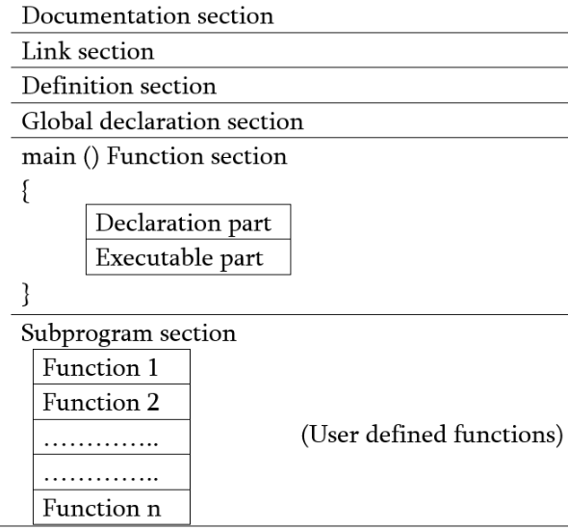
Structure of C Program
Documentation – comments about program
Link- instructions to compiler
Definition- defines all symbolic constants
Global declaration - variable that is frequently used
Main()-
Declaration: all variables
Execution: programming
Subprogram- user defined functions

Slide 34
Parts of C Program
#include <stdio.h> → Includes standard I/O functions.
Main() function → Entry point of every C program.
Printf() function → Outputs data to the console.
Return 0; → Exits the program, returning 0 to the OS.
Other parts in programs:
Variable Declarations
Statements & Expressions
Comments (// or /* */)

Slide 35
Execution Flow of a C program
Writing: Code is written in a (.c) file extension.
Preprocessing: Preprocessor handles (#include), macros, etc..
Compilation: Code is translated into assembly code.
Assembly: Translates assembly into machine-level object code.
Linking: Links code with libraries, creates executable.
Execution: Executable is run on the system.

Slide 36
  Algorithm
Programs=algorithms+data
An algorithm is a part of computer program; an algorithm is an effective procedure for solving a problem in a finite number of steps.
It is a complete step by step representation of the solution to a problem.

Slide 37
How to Design an Algorithm
Step-1: Investigation
Identify process
Identify major decisions
Identify loops
Identify variables
Step-2: Preliminary algorithm
Devise high level algorithm
Walk-through algorithm. If any problem occurs then correct it.
Step-3: Refining the algorithm
Incorporate any refinements from step 2
Group process
Group variables
Teat algorithm again

Slide 38
Example: Find sum of two numbers
Read value of a
Read value of b
Add a and b
Display the summation

Slide 39
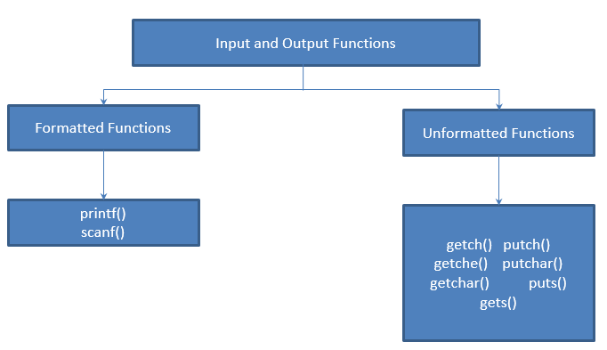
Managing Input and Output Operations

Slide 40
Managing Input and Output Operations
Formatted Functions
It read and write all types of data values.
Require format string to produce formatted result
Returns value after execution
Unformatted Functions
Works only with character data type
Do not require format conversion for formatting data type

Slide 41
Formatted function: scanf() function
scanf() function reads all the types of data values.
It is used for runtime assignment of variables.
The scanf() statement also requires conversion symbol to identify the data to be read during the execution of the program.
The scanf() stops functioning when some input entered does not match format string.

Slide 42
Formatted function: scanf() function
Syntax :
scanf(“%d %f %c”, &a, &b, &c);
Scanf statement requires ‘&’ operator called address operator
The address operator prints the memory location of the variable
scanf() statement the role of ‘&’ operator is to indicate the memory location of the variable, so that the value read would be placed at that location.
The scanf() function statement also return values. The return value is exactly equal to the number of values correctly read.
If the read value is convertible to the given format, conversion is made.

Slide 43
Formatted Input
Taking input with formatting (e.g., numbers, text):
int a;
scanf("%d", &a); // Reads formatted data (int here)
scanf() reads user input.
%d tells the compiler to expect an integer.
&a means we’re giving the address of variable a to store the input.

Slide 44
Examples
void main()
{
int a;
clrscr();
printf(“Enter value of ‘A’ : “);
scanf(“%c”, &a);
printf(“A : %c”,a);
}
OUTPUT
Enter value of ‘A’ : 8
A : 8

Slide 45
Examples
void main()
{
char a;
clrscr();
printf(“Enter value of ‘A’ : “);
scanf(“%d”, &a);
printf(“A : %d”,a);
}
OUTPUT
Enter value of ‘A’ : 255
A : 255
Enter value of ‘A’ : 256
A : 256

Slide 46
Formatted function: printf() function
1
2
3
4
5
This function displays output with specified format
It requires format conversion symbol or format string and variables names to the print the data
The list of variables are specified in the printf() statement
The values of the variables are printed as the sequence mentioned in printf()
The format string symbol and variable name should be the same in number and type

Slide 47
Formatted Output
Displaying values with text:
int a = 10;
printf("Value of a: %d", a); // Prints formatted output
printf() shows the value of ‘a’ along with text.
%d will be replaced by the value of ‘a’ in the output.

Slide 48
Examples
void main()
{
int NumInt = 2;
float NumFloat=2.2;
char LetterCh = ‘C’;
printf(“%d %f %c”, NumInt, NumFloat, LetterCh);
}
Output :
2 2.2000 C

Slide 49
Examples
void main()
{
int NumInt = 65;
clrscr();
printf(“%c %d”, NumInt, NumInt);
}
Output :
A 65

Slide 50
Examples
void main()
{
int NumInt = 7;
clrscr();
printf(“%f”, NumInt);
}
Output :
Error Message : “Floating points formats not linked”

Slide 51
Format Specifiers
All the format specification starts with % and a format specification letter after this symbol.
It indicates the type of data and its format.
If the format string does not match with the corresponding variable, the result will not be correct.
Along with format specification use
  Flags
  Width
  Precision

Slide 52
Flag and Width
Flag
It is used for output justification, numeric signs, decimal points, trailing zeros.
The flag (-) justifies the result. If it is not given the default result is right justification.
Width
It sets the minimum field width for an output value.
Width can be specified through a decimal point or using an asterisk ‘*’.

Slide 53
Common Format Specifier
%d → Integer
%f → Float
%c → Character
%s → String

Slide 54
Examples
void main()
{
float g=123.456789;
clrscr();
printf(“\n %.1f”, g);
printf(“\n %.2f”, g);
printf(“\n %.3f”, g);
printf(“\n %.4f”, g);
}
OUTPUT
123.5
123.46
123.457
123.4568

Slide 55
Format Specifier - Tables
Sr. No1 | Format | Meaning | Explanation
1 | %wd | Format for integer output | w is width in integer and d is conversion specification
2 | %w.cf | Format for float numbers | w is width in integer, c specifies the number of digits after decimal point and f specifies the conversion specification
3 | %w.cs | Format for string output | w is width for total characters, c are used displaying leading blanks and s specifies conversion specification

Slide 56
Format Specifier - Tables
Data Type |  | Format string
Integer | Short Integer | %d or %i
 | Short unsigned | %u
 | Long signed | %ld
 | Long unsigned | %lu
 | Unsigned hexadecimal | %u
 | Unsigned octal | %o
Real | Floating | %f or %g
 | Double Floating | %lf
Character | Signed Character | %c
 | Unsigned Character | %c
 | String | %s
Octal number |  | %o
Displays Hexa decimal number in lowercase |  | %hx
Displays Hexa decimal number in lowercase |  | %p
Aborts program with error |  | %n

Slide 57
Escape sequence
printf() and scanf() statement follows the combination of characters called escape sequence
Escape sequence are special characters starting with ‘\’
Escape Sequence | Use | ASCII value
\n | New Line | 10
\b | Backspace | 8
\f | Form feed | 12
\’ | Single quote | 39
\\ | Backslash | 92
\0 | Null | 0
\t | Horizontal Tab | 9
\r | Carriage Return | 13
\a | Alert | 7
\” | Double Quote | 34
\v | Variable tab | 11
\? | Question mark | 63

Slide 58
Examples
#include <stdio.h>
#include <conio.h>
void main()
{
int a = 1, b = a + 1, c = b + 1, d = c + 1;
//clrscr();
printf("\tA = %d\nB = %d 'C = %d'", a, b, c);
printf("\n\b*** D = %d **", d);
printf("\n*************");
printf("\nrA = %d B = %d", a, b);
getch();
}
OUTPUT
A = 1
B = 2 ‘C = 3’
*** D = 4 **
**************
A = 1 B = 2**

Slide 59
Unformatted functions
C has three types of I/O functions
  Character I/O
  String I/O
  File I/O

Slide 60
getchar()
This function reads a character type data from standard input.
It reads one character at a time till the user presses the enter key.
Syntax
  VariableName = getchar();
Example
  char c;
  c = getchar();

Slide 61
putchar()
This function prints one character on the screen at a time, read by the standard input.
Syntax
  putchar(variableName)
Example
  char c = ‘C’;
  putchar(c);

Slide 62
getch() and getche()
These functions read any alphanumeric character from the standard input device.
The character entered is not displayed by the getch() function.
The character entered is displayed by the getche() function.
Exampe
  ch = getch();
  ch = getche();

Slide 63
gets()
This function is used for accepting any string through stdin keyword until enter key is pressed.
The header file stdio.h is needed for implementing the above function.
Syntax
  char str[length of string in number];
  gets(str);
void main()
{
char ch[30];
clrscr();
printf(“Enter the string : “);
gets();
printf(“\n Entered string : %s”, ch);
}

Slide 64
puts()
This function prints the string or character array.
It is opposite to gets()
char str[length of string in number];
gets(str);
puts(str);

Slide 65
Reading a Character
char ch;
ch = getchar(); // Reads a single character from user input
getchar() waits for the user to press a key and stores it in ch.
Useful for reading individual characters or key presses.

Slide 66
Writing a Charater
char ch = 'A’;
putchar(ch); // Outputs a single character
putchar() prints a single character.
Simple and fast way to output characters.

Slide 67


www.paruluniversity.ac.in

